Slide 1
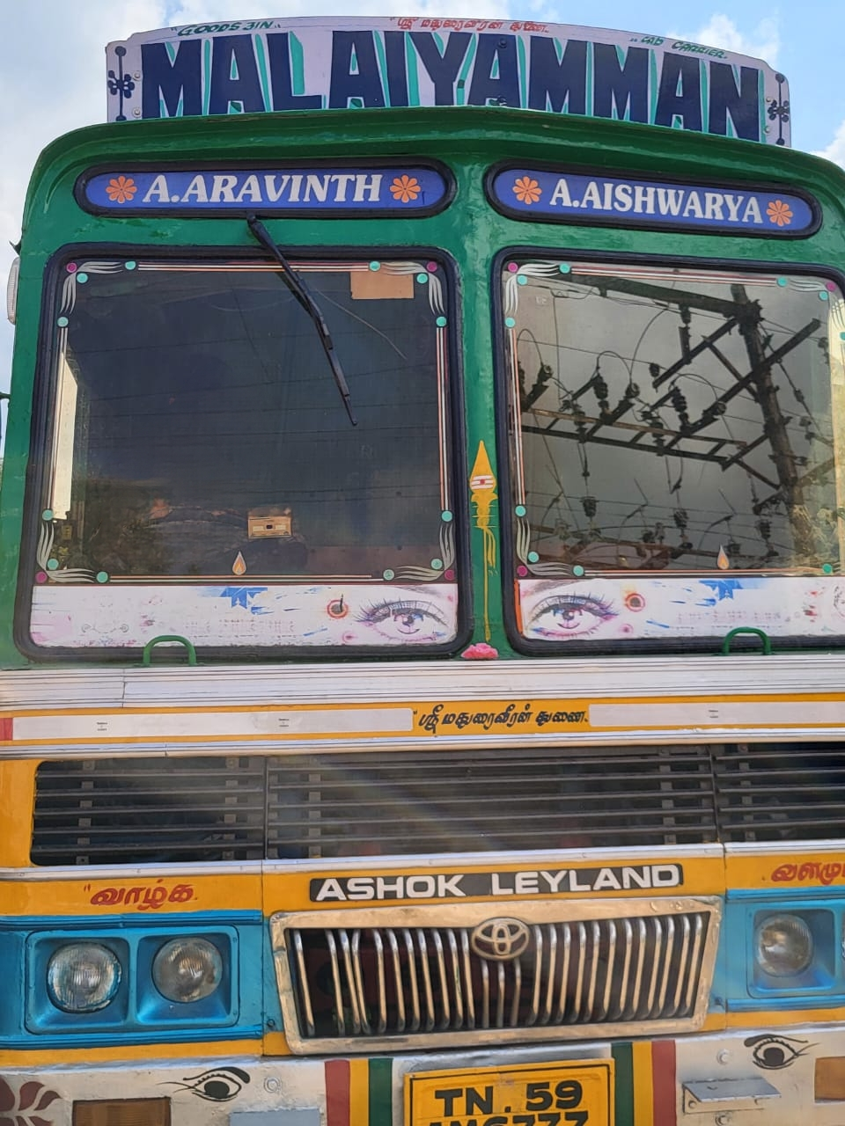
Malaiyamman Lorry Service:
A Professional Approach to Logistics and Supply Chain Management
BY
22-UCO-11
ARUL SAM S

Slide 2
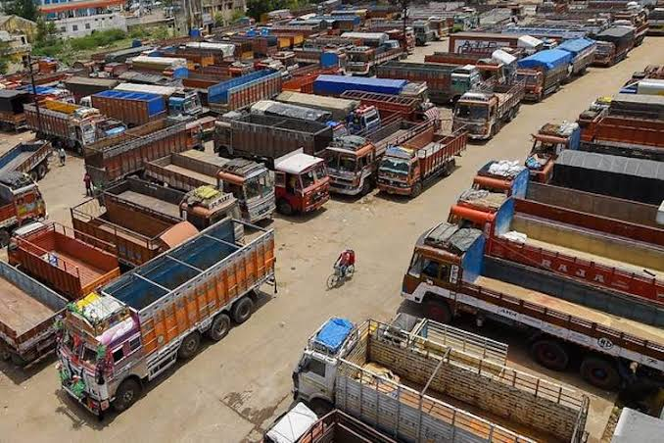
Malaiyamman Lorry Transport
Malaiyamman Lorry Transport is a reliable and trusted logistics provider located in Mannargudi, Tamil Nadu. They offer comprehensive transportation services and focus on efficiency and great customer service.
Company Overview
Fleet and Workforce Management
Types of Loads and Routes
Maintenance and Safety Protocols
Logistics Processes
Cost Management
Challenges and Opportunities

Slide 3
Company Overview
Fleet
Employees
Location
Our fleet consists of 5 lorries and 2 Taurus vehicles, ensuring we can handle a wide range of cargo and transport requirements.
We have a team of 7 regular employees, supported by 7 additional trained personnel with verified licenses, all dedicated to providing efficient and safe transportation services.
Our base is located in Mannargudi, Thiruvarur District, allowing us to serve a large area across South Tamil Nadu and beyond.

Slide 4

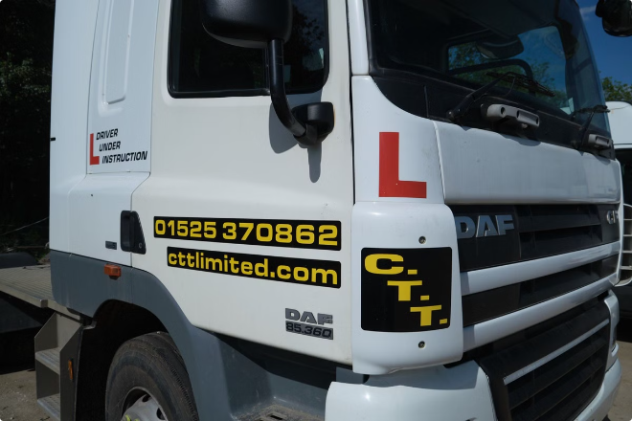
Fleet and Workforce Management
1
Fleet Maintenance
Regular maintenance is crucial, including weekly checks for oil, air, battery, joints, radiator cooling, battery acid, and steering.
2
Employee Verification
All our drivers undergo a rigorous selection process, requiring essential licenses and a mandatory one-week training program to ensure proficiency and safety.
3
Compensation System
Our wages are structured based on kilometers driven, with double pay for return loads and a fixed rate for government loads, rewarding efficiency and effort.

Slide 5
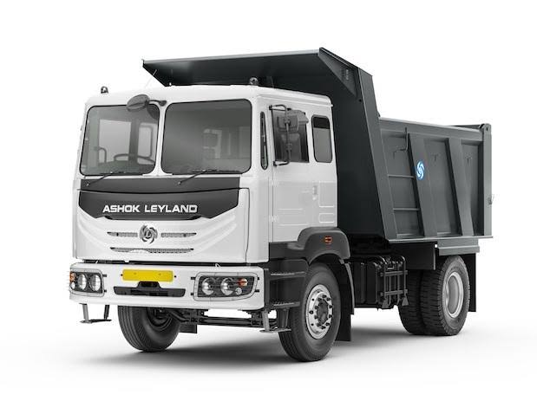
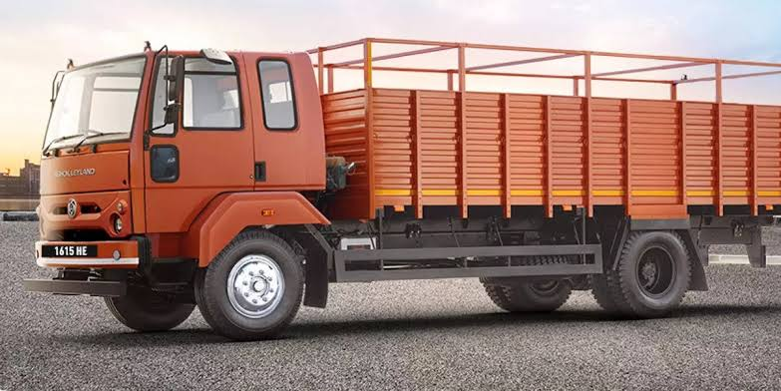
Types of Loads and Routes
Government Loads
We handle essential agricultural commodities like paddy and rice, as well as sack loads for the Thiruvarur District Cooperative (TNCC).
Private Loads
Our services extend to private clients, transporting building materials like bricks, crushed stones, river sand, and iron rods to various locations in South Tamil Nadu, up to Karur.
Routes
Mannargudi serves as our primary pickup point, with delivery destinations varying depending on client requirements.

Slide 6
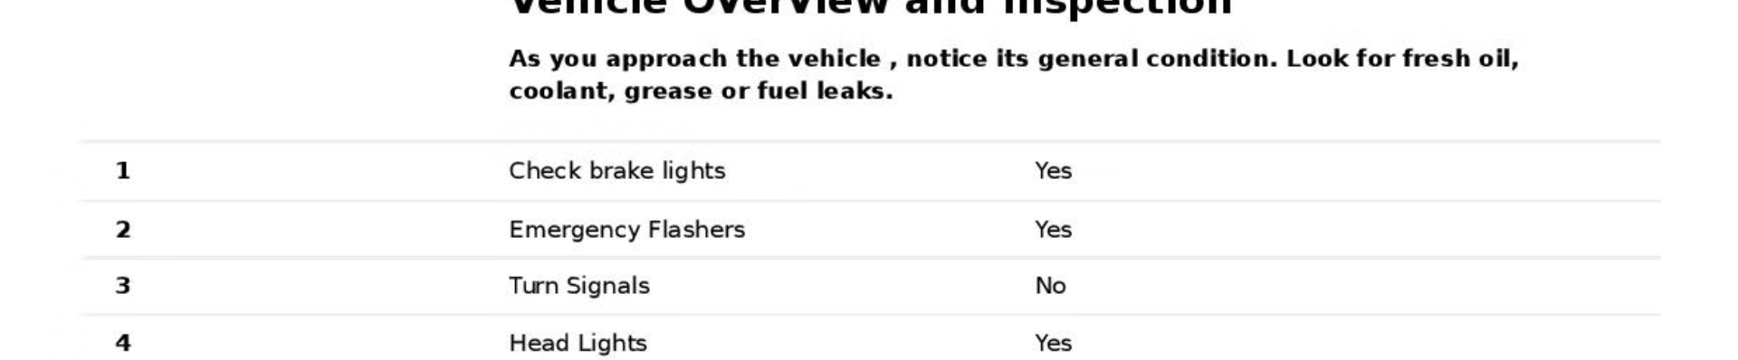
Maintenance and Safety Protocols
1
Regular Maintenance
2
Safety Measures
To ensure optimal performance and safety, our vehicles undergo weekly maintenance checks, including oil, air, battery, joint grease, radiator cooling, battery acid, and steering checks.
Safety is paramount. We adhere to strict protocols, including mandatory police reporting in case of accidents and using tarpaulin sheets and ropes to secure goods during transport.

Slide 7
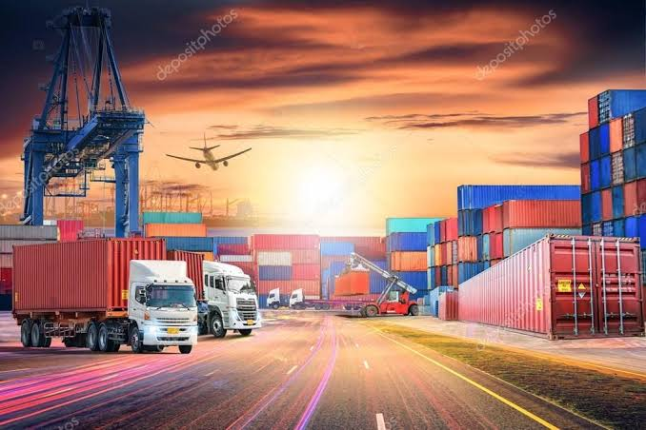



Logistics Processes
Loading and Unloading
Loading and unloading times vary based on the specific requirements of each client and load, ensuring efficient handling.
Weight Checks
We perform meticulous weight checks for both empty and loaded vehicles, ensuring accurate load measurements and fair payment for our services.
GPS Tracking
All vehicles are equipped with GPS tracking systems, allowing for real-time monitoring of their location and ensuring timely delivery.

Slide 8

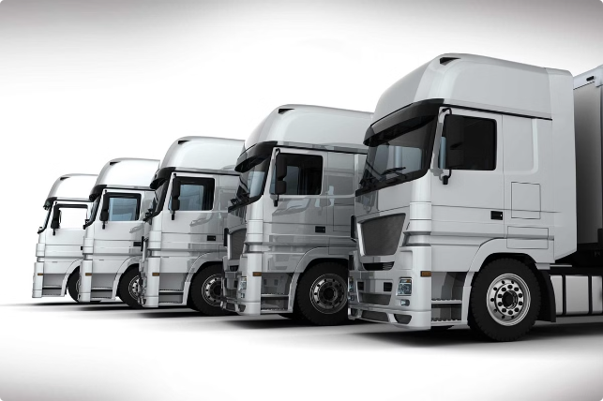
Cost Management
Operating Expenses
Docking Charges
Diesel
Tolls
Wages
Accidents
Annual Expenses
Insurance
FC
Painting
Green Tax
Speedometer Renewal
Road Tax
Pollution Certificate

Slide 9


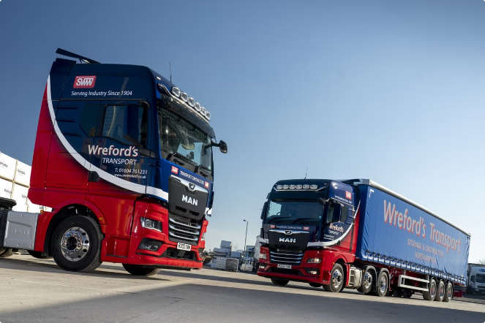


Challenges and Opportunities
Challenges
Our industry faces challenges like high toll prices, increased fines, and seasonal profit loss during monsoon season (August to November).
Opportunities
We capitalize on opportunities by providing efficient services, building strong customer relationships, and leveraging shortcuts to optimize diesel consumption.
Parking
We have dedicated parking spaces for our vehicles, including our owned land and designated areas near roads, ensuring secure and organized parking, especially for TNCC loads.

Slide 10
T H A N K Y O U

