Slide 1
CH20 – Air Quality Insight
DS Sprint 2026 – Skill-Based Assessment 2
Objective: understand station and time patterns in measured air quality and communicate evidence-based actions.

Slide 2
Datasets and compatibility
Air quality: 108,035 timestamped records, 110 stations, 2015-01-01–2020-07-01.
Stations provides station metadata; calendar provides date attributes.
Weather and traffic are 2022–2024 and do not overlap air quality dates (2015–2020); no unsupported merge was made.

Slide 3
Methodology and data quality
Exact duplicate rows: none in the five supplied files.
AQI is present for 87,025 of 108,035 air-quality rows.
Dates were parsed safely; station IDs were trimmed and uppercased. Cleaned copies are saved in processed/.
Weather contains categorical conditions only; wind/rainfall measurements are unavailable.

Slide 4
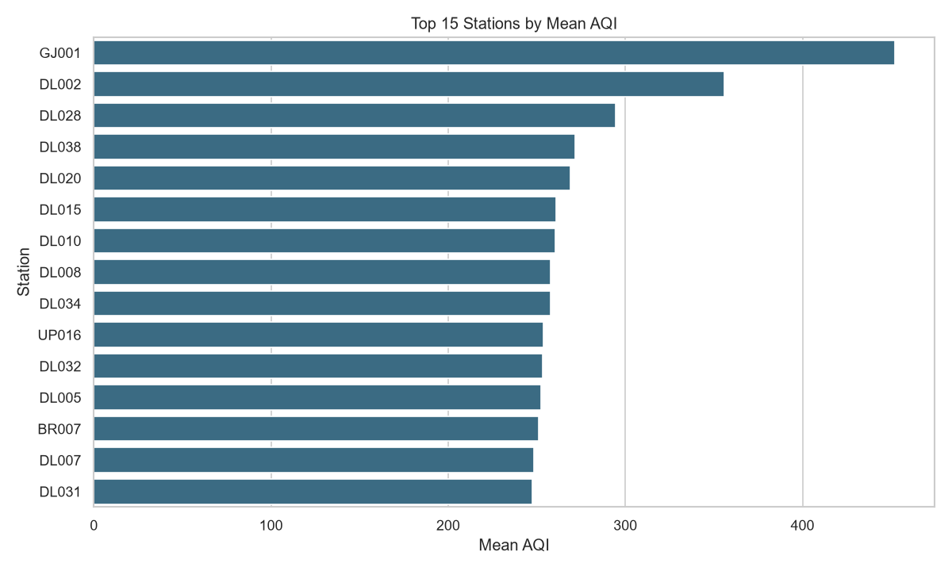
Evidence from EDA
3. [Supported by data] Derived seasonal pattern: Winter has the highest mean AQI (243.48) and Summer the lowest (117.39); seasons are derived from timestamp month, not weather observations.
4. [Suggestive, not causal] Strongest absolute pollutant correlation with AQI in these records is PM10 (Pearson r=0.885). Correlation is not causation.
5. [Not assessable with supplied data] Wind, rainfall, temperature and humidity analyses were not performed because the weather file contains only categorical weather_condition and does not overlap the air-quality date range.
6. [Not assessable with supplied data] Traffic volume versus AQI was not performed because traffic has no AQI/station key and its dates (2022–2024) do not overlap air quality (2015–2020).

Slide 5
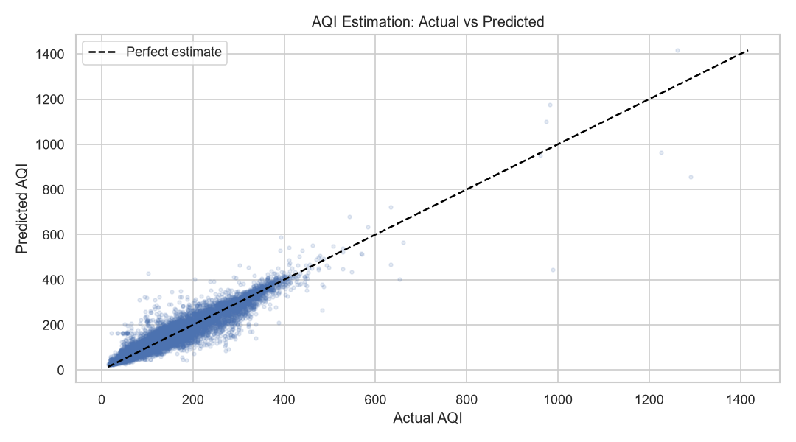
Machine-learning result
Random Forest estimation: MAE=17.46, RMSE=26.97, R²=0.902.
Training-mean baseline: MAE=93.95, RMSE=105.32, R²=-0.492.
This is same-record AQI estimation from pollutant readings, not a future forecast.

Slide 6
Recommendations
Prioritize monitoring and investigation at stations with persistently higher mean AQI.
Use the seasonal and monthly patterns to plan intensified monitoring and public advisories.
Collect weather measurements and station-linked traffic data in the same time window before claiming causal effects.

Slide 7
Conclusion and limitations
The strongest defensible results come from station and time analysis within the air-quality dataset.
Traffic and weather relationships remain untested because the supplied datasets are temporally and structurally incompatible.
Interpret pollutant/AQI relationships as associations; AQI is derived from pollutant measurements.

