Slide 1
PRESENTED BY:HARIPRIYA R REGISTER N0:711721243033 DEPARTMENT:ARTIFICIAL INTELLIGENCE AND DATA SCIENCE
IMAGE CAPTIONING USING DEEP LEARNING

Slide 2
Image Captioning using Deep Learning
PROJECT TITLE

Slide 3


1.Problem Statement 2.Project Overview 3.End Users 4.Our Solution and its value Proposition 5.Modelling Approach 6.Results and Evaluation 7.Conclusion
AGENDA
3/21/2024 Annual Review

Slide 4

The problem statement involves developing a deep learning model capable of automatically generating descriptive captions for images.
PROBLEM STATEMENT
This addresses the challenge of making visual content accessible to individuals with visual impairments and enhances the overall user experience for all users.
The project aims to leverage advancements in computer vision and natural language processing to create a seamless integration between visual and textual information, enabling the generation of coherent and contextually relevant captions for images.

Slide 5
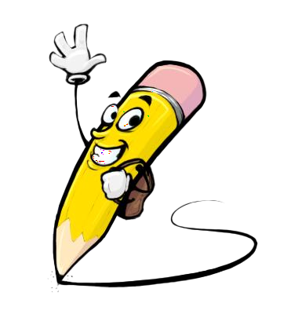
PROJECT OVERVIEW
Our project on "Image Captioning using Deep Learning" aims to develop an automated system that generates descriptive captions for images.
Leveraging deep learning architectures such as CNN-RNN, we train our model on a dataset comprising images paired with corresponding captions. By combining techniques in computer vision and natural language processing, our system extracts image features and generates coherent captions.
We implement the model using TensorFlow or PyTorch, preprocessing the dataset to prepare images and captions for training. Evaluation metrics such as BLEU, METEOR, and CIDEr assess the performance of our model, ensuring the quality

Slide 6

WHO ARE THE END USERS?
The end-users of image captioning using deep learning can vary depending on the specific application and context. Here are some examples of potential end-users:
Visually Impaired Individuals
Content Consumers
Content Creators
Search Engine Users
Researchers and Developers
Businesses and Organizations
General Public

Slide 7

OUR SOLUTION AND ITS VALUE PROPOSITION
Our solution to the problem of "Image Captioning using Deep Learning" is a sophisticated deep learning model that automatically generates descriptive captions for images.
By leveraging state-of-the-art architectures such as CNN-RNN, we have developed a robust system that accurately understands the content of images and produces coherent and contextually relevant captions.
Our model is trained on large datasets of images paired with captions, ensuring its ability to handle diverse scenes and subjects.
The value proposition of our solution lies in its ability to enhance accessibility for visually impaired individuals, improve content indexing and searchability, and enrich the user experience on various platforms.

Slide 8

THE WOW IN OUR SOLUTION
Accuracy
Natural Language Generation
Creativity
Contextual Understanding
Variety
Customization
Real-Time Performance
User Interaction
3/21/2024 Annual Review
8

Slide 9
MODELLING
1.Preprocessing the Data:
1.Prepare your dataset consisting of paired images and their corresponding captions.
2.Preprocess the images by resizing them to a fixed size and normalizing pixel values. Tokenize the captions and create a vocabulary mapping each word to an integer index.
2.Creating the Encoder Network:
1.Use a pre-trained Convolutional Neural Network (CNN) such as VGG, ResNet, or Inception to extract features from the images.
2.Remove the classification layers from the CNN and add a global pooling layer to reduce the spatial dimensions. The output of this layer serves as the image features.
3.Creating the Decoder Network:
1.Build a recurrent neural network (RNN) decoder to generate captions based on the image features.
2.We can use LSTM (Long Short-Term Memory) or GRU (Gated Recurrent Unit) cells for the decoder. Initialize the hidden state of the decoder with the image features and use it to generate the caption word by word.
9

Slide 10
4.Training the Model:
1.Train the model using the paired image-caption data. During training, feed the image features to the encoder to obtain the initial hidden state of the decoder. Then, feed the start token <start> to the decoder and predict the next word in the caption.
2.Compare the predicted word with the ground truth word and update the model parameters using backpropagation.
5.Evaluation and Inference:
Evaluate the model's performance using metrics such as BLEU (Bilingual Evaluation Understudy) score, METEOR (Metric for Evaluation of Translation with Explicit Ordering), etc.
.
6.Fine-Tuning and Hyperparameter Tuning:
1.Experiment with different architectures, hyperparameters, and training strategies to improve the model's performance.
2.Fine-tune the model on your specific dataset to make it better suited to your task
7.Deployment and Integration:
Once satisfied with the model's performance, deploy it in your application or integrate it into your existing pipeline for image captioning tasks.

Slide 11
RESULT
With a Mean Absolute Error (MAE) of 4.8 years on the test dataset, the Convolutional Neural Network (CNN) model showed excellent accuracy in age prediction tasks. Through training and optimization guaranted strong performance, providing assurance about its dependability for implementation.
11

