Slide 1
AgriData Explorer
Understanding Indian Agriculture with EDA
Python
SQL
Power BI
Agricultural Data
Domain: Agricultural Crop Production Statistics | 1966 – 2017

Slide 2
Problem Statement
India's agricultural data is complex and fragmented across states and districts
Farmers, policymakers, and researchers lack easy access to actionable insights
No unified platform to analyze crop trends, yields, and regional productivity gaps
GOAL: Build a data visualization platform integrating state & district level crop data to drive smarter agricultural decisions.

Slide 3
Project Workflow
01
02
03
04
05
Data Collection
Data Cleaning
EDA Analysis
MySQL Database
Power BI
ICRISAT CSV
1966–2017
Python / Pandas
Nulls, Columns
Charts, Trends
Correlations
Import & SQL
10 Queries
Dashboard
10 Charts
4 Key Stages: Collection → Cleaning → Analysis → Visualization

Slide 4
Dataset Overview
Source: ICRISAT District-Level Agricultural Dataset
30+
500+
50
20+
States
Districts
Years
(1966–2017)
Crops
Crops Covered:
Rice • Wheat • Maize • Cotton • Groundnut • Oilseeds • Sugarcane • Sorghum • Pearl Millet • Finger Millet • Barley • Chickpea • Pigeonpea • + more
Key Fields: State | District | Year | Crop Area (1000 ha) | Production (1000 tons) | Yield (Kg/ha)

Slide 5
Step 1: Data Cleaning (Python)
1
Load Raw CSV
4
Standardize Columns
Loaded ICRISAT dataset using Pandas read_csv()
Renamed columns, removed spaces & special chars
2
Remove Duplicates
5
Convert Units
Identified and dropped all duplicate rows
Validated hectares, tons, kg/ha units
3
Handle Nulls
6
Export Clean CSV
Detected and handled missing/null values
Saved as Cleaned_Agri_new.csv for SQL import

Slide 6
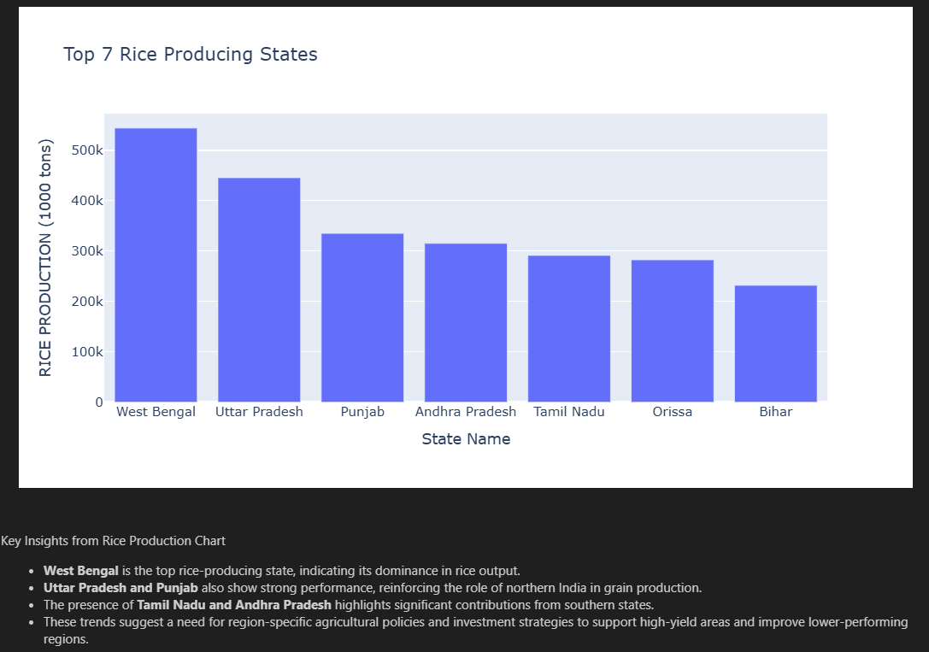
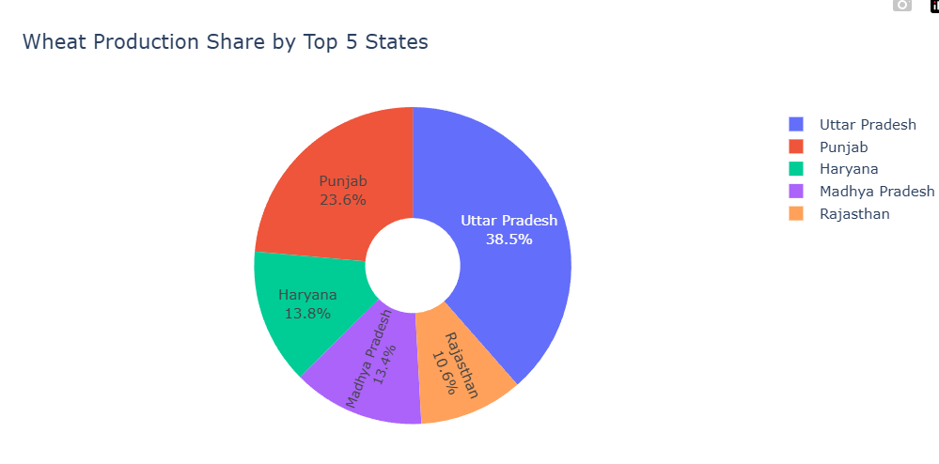
Step 2: Exploratory Data Analysis (EDA)
Tools: Python | Matplotlib | Seaborn | Plotly
1. Top 7 Rice Production States (Bar Chart)
[ Add EDA Screenshot 1 here ]
2. Top 5 Wheat Producing States (Pie + Bar)
3. India's Sugarcane Production — 50 Years
4. Rice vs Wheat Production Comparison
[ Add EDA Screenshot 2 here ]
5. Oilseed Production by Top 5 States
6. Area vs Production Correlation
Goal: Identify trends, patterns, and outliers before SQL analysis

Slide 7
Step 3: Loading Data into MySQL
Database Details
Import Steps
Database:
agriculture_dataset
1
Fixed unnamed index column from CSV
Table:
cleaned_agri
2
Renamed columns (spaces → underscores)
Total Rows:
16,146 records
3
Created database & table in Workbench
Total Columns:
80 columns
4
Used Table Data Import Wizard
Year Range:
1966 – 2017
States:
30+ states

Slide 8
Step 4: SQL Analysis — 10 Business Questions
Q1
Year-wise Rice Production Trend (Top 3 States)
Q6
Top Groundnut Districts (2017)
Q2
Top 5 Districts by Wheat Yield Increase
Q7
Average Maize Yield by State
Q3
States with Highest Oilseed Growth
Q8
Total Oilseed Area by State
Q4
Area vs Production Correlation
Q9
Districts with Highest Rice Yield
Q5
Cotton Production Growth — Top 5 States
Q10
Wheat vs Rice — Top 5 States (10 Years)
SQL Features: GROUP BY | CTEs (WITH clause) | Pearson Correlation | LIMIT | BETWEEN | Aggregate Functions

Slide 9
Step 5: Connecting MySQL to Power BI
1
Install MySQL Connector/NET 8.0.32
Download from MySQL Archives and install with Complete option
2
Open Power BI → Get Data
Search for MySQL Database in the data sources list
3
Enter Connection Details
Server: localhost | Database: agriculture_dataset
4
Enter Credentials
Username: root | Enter your MySQL password
5
Select Table & Load
Select cleaned_agri → Click Load → Data imported!

Slide 10
Step 6: Power BI Dashboard — Charts Used
Question | Chart Type
Q1 — Rice Production Trend | Line Chart
Q2 — Wheat Yield by District | Horizontal Bar Chart
Q3 — Oilseed Growth by State | Column Chart
Q4 — Area vs Production Correlation | 3 Horizontal Bar Charts
Q5 — Cotton Production Growth | Line Chart
Q6 — Top Groundnut Districts | Horizontal Bar Chart
Q7 — Average Maize Yield | Horizontal Bar Chart
Q8 — Oilseed Area by State | Treemap
Q9 — Districts with Highest Rice Yield | Horizontal Bar Chart
Q10 — Wheat vs Rice Comparison | Clustered Bar Chart

Slide 11
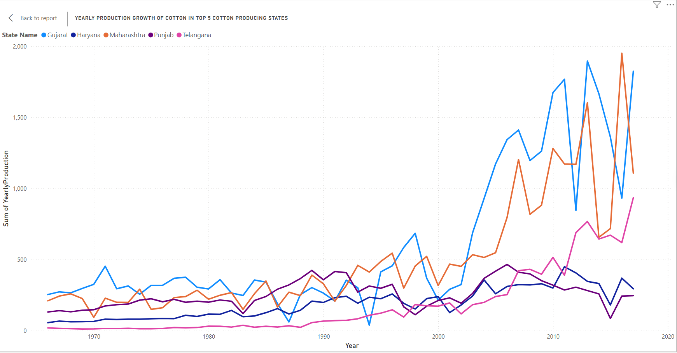
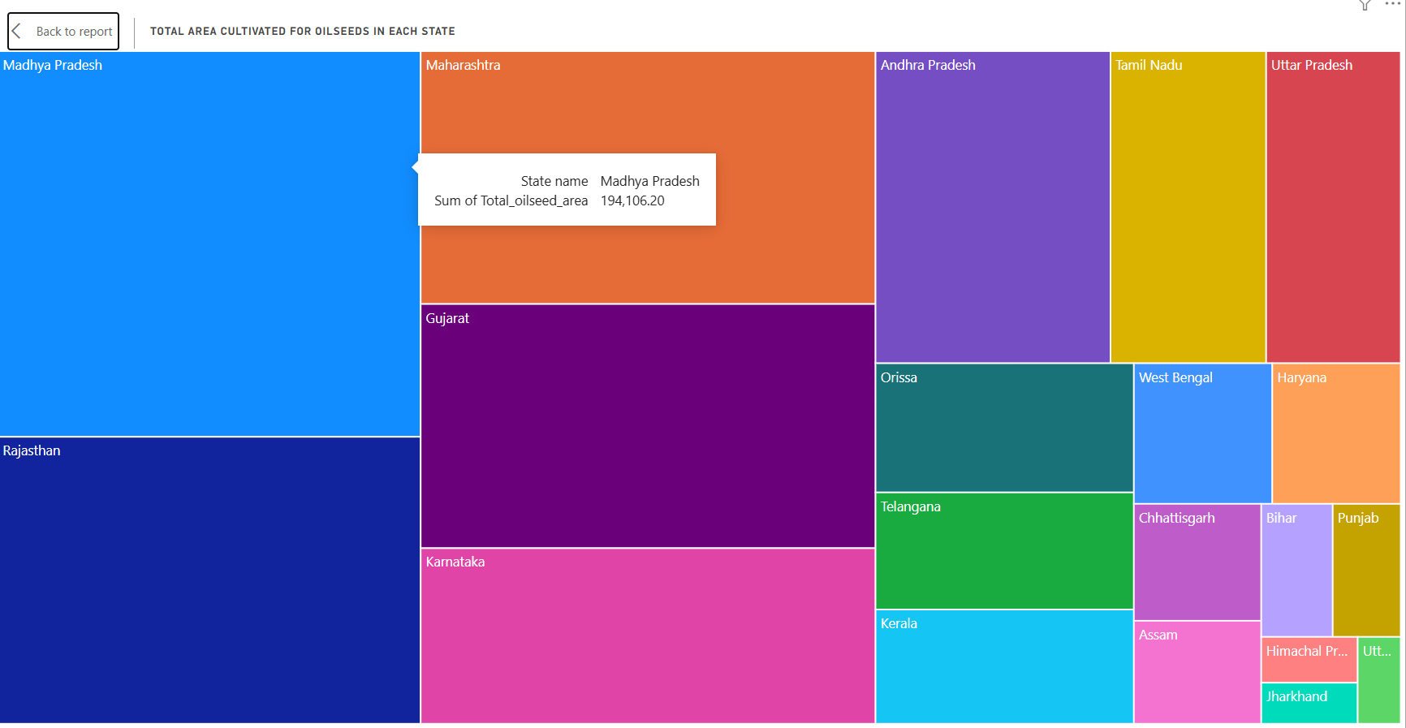
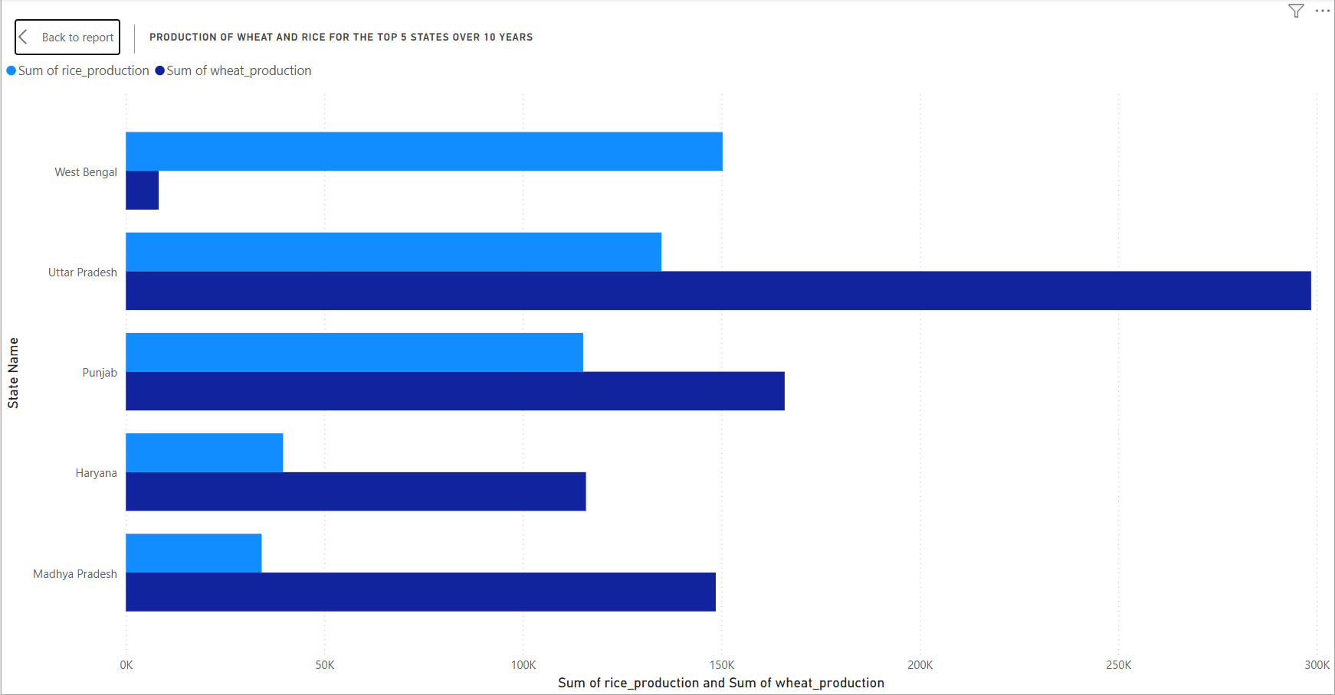
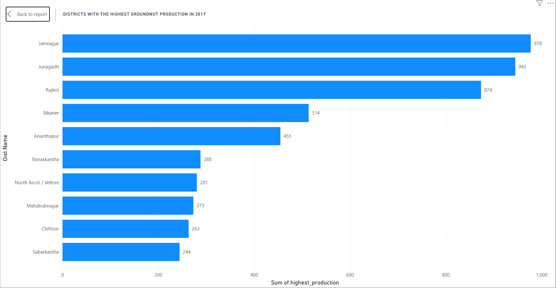
Step 7: Power BI screenshots

Slide 12
Key Insights from Dashboard
Rice Leaders
Fastest Grower
Punjab & Tamil Nadu lead in rice yield at district level
Madhya Pradesh showed strongest growth — rice 4x, wheat 3x in 10 years
Wheat Giant
Gujarat Dominates
Uttar Pradesh is India's wheat giant — 2.98 lakh thousand tons in 10 years
Gujarat dominates cotton and groundnut production across all years
Pure Rice State
Biggest Opportunity
West Bengal is a pure rice state — barely grows wheat
Eastern states have large farmland but lowest yields — highest growth potential

Slide 13
Business Use Cases
Farmers
Identify best crops for their region based on historical yield data
Recommendation: Crop recommendations based on 50-year district-level yield data to maximize productivity
Policymakers
Find low-productivity districts needing subsidies and support
Recommendation: Data-driven budget allocation to underperforming regions with large farming areas
Researchers
Analyze 50-year trends in crop area, production, and yield
Recommendation: Longitudinal analysis of crop shifts, climate impact, and regional productivity evolution

Slide 14
Project Deliverables
✓
EDA.ipynb
EDA notebook with 15+ visualizations
✓
agriculture_dataset
MySQL database with cleaned data (16,146 rows)
✓
sql_agri.sql
SQL queries for all 10 analysis questions
✓
AgriData_Dashboard.pbix
Power BI interactive dashboard with 10 chart pages

Slide 15
Thank You
"Data-driven agriculture is the key to India's food security"
Tech Stack Used:
Python
Pandas
Matplotlib
MySQL
Power BI

