Slide 1
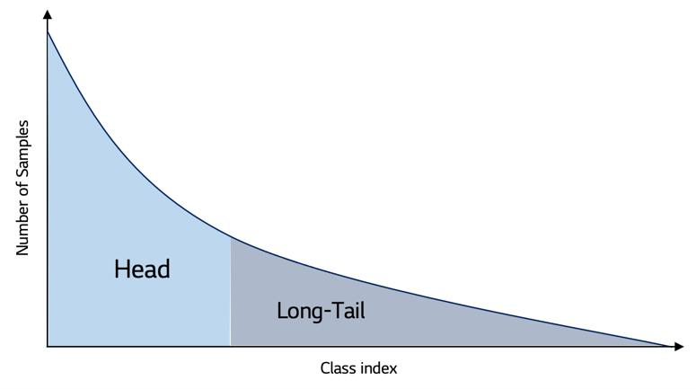
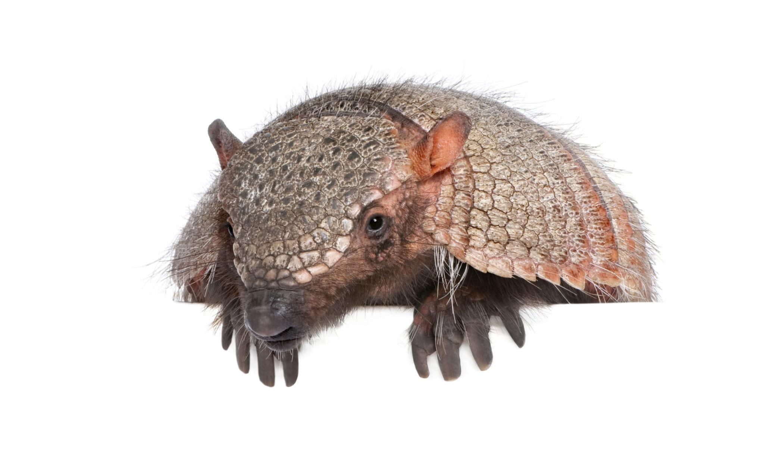


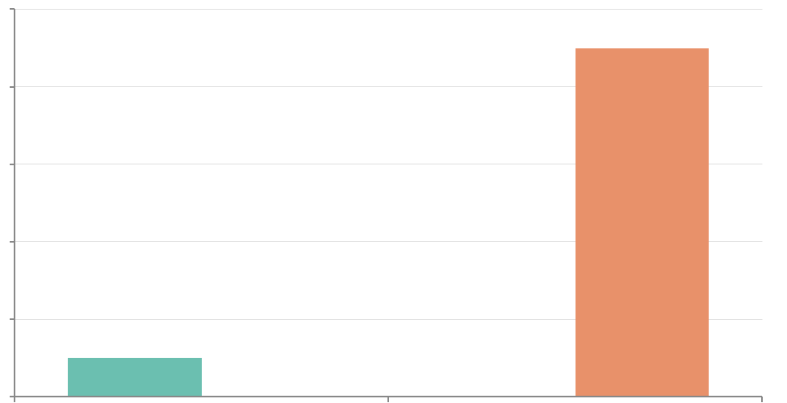

1
2
3
4
5
PROBLEM
SEMANTIC PROMPT EVIDENCE
OWL-ViT Object Detection Framework
Semantic Evidence Fusion and Risk Analysis
Evaluation & Safe Findings
Object category e.g., 'armadillo'
OWL-ViT zero-shot detector
(owlvit-base-patch32)
Fusion strategies
LVIS + COCO evaluation
⟐
Max / Mean / Weighted
LVIS long-tail category imbalance
🚌
🐕
🚲
Image
encoder
Text prompt
encoder
🚗
Adaptive + Prior-aware
airplane
primary
Primary-prompt OVD misses semantic variants
Image–prompt evidence
Frequency-aware reweighting
Σ
Entropy + conflict analysis
aircraft
synonym
p1
p2
aeroplane
hypernym
Fused evidence score
Multi-prompt evidence raises false positives
p3
Prompt-level aggregation
Rare
Common
Frequent
vehicle
attribute
pn
score
Final safe claim
Long-tail distribution
Semantic evidence improves recall, but FP risk must be modelled
1000
800
visible airplane
Frequency
Detection evidence
600
400
image evidence
Box + class score analysis
1000
🐘
🐦
🪑
0
0
Class
1
AP50-proxy and recall metrics
Need uncertainty, conflict and prior analysis
a photo of airplane
description
🎯
Higher image-level category recall
🛡
Uncertainty explains FP risk
Prompt sources show redundancy + complementarity
Information Fusion view of OVD evidence
MEASURED IMPACT
🗄
💡
📈

Slide 2
1
2
3
4
5
PROBLEM
METHOD
FUSION CORE
RESULTS
SAFE CONTRIBUTIONS
Semantic Prompt Generation
Semantic Fusion Strategies
Key Quantitative Results
Research Question Findings
Long-tail Object Detection
WordNet
Templates
Category recall
Max Fusion
Recall improves on both datasets
WordNet semantic variants and related terms
attributes · contexts · descriptions
Highest prompt evidence score
mean score: 0.3292
RQ1
RQ2
Semantic evidence gives strongest recall coverage.
Max Fusion has highest mean score; Adaptive is more selective.
Prompt pool per class
Adaptive Fusion
AP50-proxy gains
airplane
aircraft
confidence-aware aggregation
LVIS: 0.2343 → 0.2687 COCO: 0.3687 → 0.4379
vehicle
mean score: 0.2184
LVIS rare classes are under-represented
visible airplane
photo of airplane
Semantic prompts help, but add FP risk
OWL-ViT Encoding
Weighted Fusion
RQ3
RQ4
False positives
High uncertainty/conflict bins show higher FP risk.
Descriptions provide the strongest complementary evidence among evaluated prompt sources.
Evaluation subsets
Image encoder
Text prompts
Mean score: 0.1436
Semantic prompts increase FP counts
4132 GT image-category pairs LVIS
1000
3,217 COCO GT pairs
Mean Fusion
1000
LVIS images
COCO images
Zero-shot object detection → boxes, labels, scores
Mean score: 0.1420
RQ5
RQ6
COCO evaluation
LVIS recall: 0.8486 → 0.9143
Prior-aware fusion improves LVIS adaptive-threshold recall for rare categories.
Semantic Evidence achieves the strongest overall recall coverage across evaluated frameworks.
3,217 GT pairs
IoU AP50-proxy
Preprocessing
Evidence modules
COCO recall: 0.8901 → 0.9387
Baseline limitation
Images resized/normalized for OWL-ViT
Multi-prompt evidence coverage
+0.0238
✕ single primary prompt has limited coverage
Ground-truth category annotations parsed
No extra training data; diagnostic fusion analysis for OVD
Entropy and semantic conflict modelling
LVIS rare AP50-proxy gain
✕ semantic evidence increases false positives
✕ prior-aware fusion is not best overall; it helps LVIS long-tail thresholding
LVIS + COCO evaluated with recall and AP50-proxy
LVIS frequency-aware rescaling
Uncertainty bins show higher FP-rate in high-risk cases
Motivation: recall gain with FP control

Slide 3















1
2
3
4
5
6
Dataset Acquisition
Data Preprocessing
Semantic Prompt Generation
LVIS frequency-prior score recalibration
Experimental Evaluation
Result & Impact
LVIS
LVIS semantic evidence recall: 0.9131
1000 images · 4,132 GT image-category pairs
Image Resize
& Normalise
Evaluation Metrics
WordNet prompts
Semantic evidence vs. primary-prompt baseline
Image Stream
Text Stream
1000 images · 3,217 GT image-category pairs
OWL-ViT image processor
WordNet semantic variants and related terms
semantic variants
OWL-ViT visual encoder
OWL-ViT text encoder
Image-level recall · pair recall · AP50-proxy
Visual features
for detection
Prompt embeddings
per class
Semantic evidence
COCO
Annotation Parsing
image evidence
Image–text matching
Ablation Studies
Primary prompt
Template prompts
Long-tail/frequency analysis
Ground-truth annotations used for evaluation
Fusion strategy comparison
Prompt-source removal
Prior-aware effect
Recall/AP50-proxy comparison
Common/Freq.
attributes · contexts
descriptions
Semantic Fusion Strategies
Rare
Uncertainty-risk bins
Mean
Max
Weighted
Adaptive
Evaluation protocol setup
airplane
visible
airplane
Entropy/conflict risk estimation
Frequency-aware LVIS reweighting
Framework evolution analysis Primary → semantic → adaptive → prior-aware
Frequency-aware prior only for LVIS
aeroplane
vehicle
Redundancy–complementarity analysis (RQ3–RQ4)
Example semantic scores
aircraft
photo of
airplane
Rare
Common
Frequent
Dataset evaluation subsets
Semantic Fusion Framework
prompt variants per category
Image-level and pair-level semantic evidence scoring
Matched against GT categories and IoU AP50-proxy where available
airplane 0.90
Findings support safe, bounded claims
aircraft 0.84
Complementary + redundant semantic sources
vehicle 0.61

Slide 4
1
5
7
LVIS Evaluation Subset
2
4
Preprocessing
Prompt Generation
Semantic Fusion + Aggregation
COCO Evaluation Subset
🖼️ Image Processing
🌳 WordNet
Mean
WordNet semantic variants and related terms
1000
4,623
4,132
1000
3,217 GT image-category pairs
OWL-ViT processor resize/normalise
images evaluated
Max
images evaluated
GT boxes
GT image-category pairs
🧩 Prompt templates
LVIS frequency groups in evaluated subset:
COCO evaluated as a balanced dataset subset
attributes · contexts · descriptions
Weighted
Balanced comparison subset
Rare / Common / Frequent LVIS groups used for long-tail analysis
🏷️ Parse Annotations
Prompt Pool
Adaptive Fusion
Prior-Aware Fusion
No LVIS-style prior
category labels + boxes
airplane
aircraft
aeroplane
neutral prior
for COCO
Prompt evidence aggregation
vehicle
visible airplane
photo of airplane
multi-prompt evidence per category
class scores and detection evidence
8
3
✂️ Select Evaluation Subsets
6
OWL-ViT Detection
Evaluation
Example Prompt Construction Category-level Semantic Evidence
1000 LVIS + 1000 COCO images
fixed evaluation protocol
Category
Primary
Semantic evidence
Example
aircraft
👁 Image pathway
Image recall
airplane
airplane
WordNet semantic variants and related terms, attributes, contexts and descriptions are generated for each class
zero-shot detection features
Prompt type examples:
Pair recall
aircraft
vehicle
🔒 Long-tail Groups
📝 Text pathway
Long-tail challenge
per-prompt text evidence
AP50-proxy
Frequency group used only for LVIS prior-aware analysis
Frequent classes:
higher recall
Rare classes:
lower recall
LVIS rare/common/frequent metadata
Prompt–image matching → scores
FP-risk bins

Slide 5
1
2
3
4
5
6
7
8
Semantic Fusion Module
Category scoring
Detected categories with bounding-box localization and confidence scores
Pretrained OWL-ViT Visual Encoder
Visual object evidence
Prompt Generator
Detection scoring
8
Output
Input Image
OWL-ViT
text
Image embedding
Visual representation for zero-shot detection
N prompts
scores
OWL-ViT
visual features
Semantic prompt generation
per category
Image–text
matching
boxes
labels
scores
Mean
arithmetic prompt average
5
Image-category scoring
using aggregated prompt evidence
Frequency-aware adjustment
applied only for LVIS
Max
highest prompt evidence
Input
image
RGB
Template prompts
a photo of airplane...
Weighted
score-weighted fusion
Prior-aware
LVIS frequency prior
WordNet semantic variants and related terms
Adaptive
confidence-aware selectivity
Image Feature Extraction
OWL-ViT image features
Framework Evaluation
Primary vs Semantic Evidence Image-level Category Recall Pair Recall AP50-proxy Evaluation
No detector training in this pipeline
Prompt Pool
primary · synonym
hypernym · attribute
context · description
Image-text matching, category scores, and detection evidence
Fusion Module
uncertainty + conflict + prior analysis
Category-Level Evidence Scoring
aggregated prompt evidence
category confidence scores

Slide 6
FRAMEWORK EVOLUTION ON LVIS AND COCO
1
2
3
4
5
6
7
Primary Prompt
Object Detection
Primary Evidence
Prior-Aware Fusion
Primary
Prompt
Baseline
Semantic Evidence
Adaptive Fusion
LVIS recall 0.8412 COCO recall 0.8231
detections
boxes + scores
one prompt per category
LVIS recall 0.8538 COCO recall 0.8816
multi-prompt semantic evidence recall
LVIS recall 0.9131 COCO recall 0.9270
more selective aggregation
LVIS recall 0.8015 COCO recall 0.8231
8
Final Evaluation
Metrics used: image-level category recall pair-level recall AP50-proxy diagnostic metric
RQ1 Results:
LVIS AP50-proxy gain +0.0344
OWL-ViT base-patch32
RQ1 Results:
COCO AP50-proxy gain +0.0692
FALSE-POSITIVE AND UNCERTAINTY ANALYSIS PATHWAY
RQ1 Results:
Rare-category AP50 gain +0.0238
1
2
3
4
5
6
7
Semantic
Multi-Prompt
Evidence
Prompt Evidence
Prompt Sources
Uncertainty Risk
High-risk Bin
Improved recall should be interpreted jointly with uncertainty and conflict analysis.
Semantic Evidence
Main finding: Multi-prompt semantic evidence improves recall, while uncertainty and conflict analysis help characterize false-positive behaviour.
prompt-level
evidence
primary · synonym
hypernym · attribute
context · description
entropy · conflict
variation · reliability
FP-risk proxy
High uncertainty and conflict are associated with increased false-positive risk
OWL-ViT evidence extraction

