Slide 1

ABALONE USING POWERBI AND REGRESSION.
Project Supervisor: Dr.M.Kanipriya M.E., Ph.D
Name of the Student: HARIPRIYANKA DAVULURU
Register Number: 39110374

Slide 2
Presentation Outline
Course Certificate
Introduction
Objectives
System Architecture / Ideation Map
Required libraries
Project Implementation
Module Implementation
Application Snapshots
Results and Discussions
Conclusion
References

Slide 3
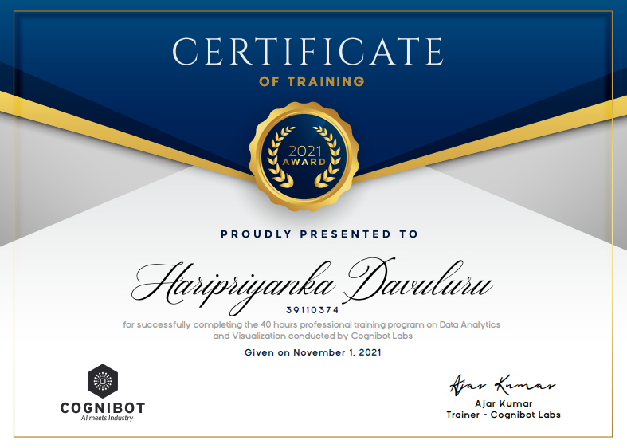
Course Certificate

Slide 4
Introduction
ABALONE:
Abalone are shellfish, a genus of gastropods.
The meat (foot muscle) of abalone is used for food, and the shells of abalone are used as decorative items and as a source of mother of pearl for jewelry, buttons, buckles, and inlay.
POWER BI:
Power BI is a collection of software/tools that works in synchronisation to turn unrelated sources of data into meaningful and interactive insights. Power BI support 100’s of data sources including the most common one’s like Excel spreadsheets, Text/CSV, SQL, Oracle etc.

Slide 5
Continuation
Logistic regression:
Logistic regression is a statistical analysis method used to predict a data value based on prior observations of a data set. ... A logistic regression model predicts a dependent data variable by analyzing the relationship between one or more existing independent variable.

Slide 6
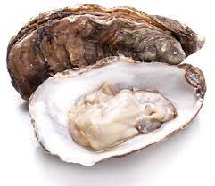

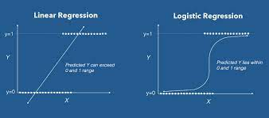
DIAGRAM REPRESENTATION

Slide 7
PROBLEM STATEMENT
There is a large amount of data available about abalone and its features.But there has been little analysis and visualization done to understand features of the abalone to find its rings(ages). This research focuses on how to analyze and how the other features of abalone effects on the rings.
This dataset can be visualize using leveraged Power BI framework to filter the data in a simple and digestible format which can assist to formulate conclusions on the effects that these features may have on the rings(ages).

Slide 8
Continuation
After visualizing the data via Power BI, the framework obtains logistic regressions to determine the relationships.
The results indicate that the Power BI framework can effectively and innovatively provide analysis on the abalone features.
Through the reformulated data for an individual abalone, we can analyze and predict the rings of an abalone.

Slide 9
Objectives
POWER BI:
The given dataset is used to analyze and visualize the features of an abalone.
REGRESSION:
The given dataset is used to analyze and to predict the rings(ages)of an abalone.
The main objective is to predict the rings(ages).

Slide 10
Cont…
SCOPE:
Regression:
From the dataset we are able to find the values of rings (ages) with the concept of regression using python.
POWERBI:
From the dataset we are visualizing the features and values of an abalone dataset.

Slide 11
CONT..(describe)
Regression:
From the dataset we are able to find the values of rings (ages) with the concept of regression using python.
Using python, we are predicting the age of an abalone with concept of logistic regression.
POWERBI:
From the dataset we are visualizing the features and values of an abalone dataset.
Using the PowerBI tools we are visualizing the data present in the dataset

Slide 12
System Architecture / Ideation Map
Dataset
Visualization
Analytics
CSV
Visual representation
Pandas
Visual Graphs
Regression
Accuracy Score

Slide 13
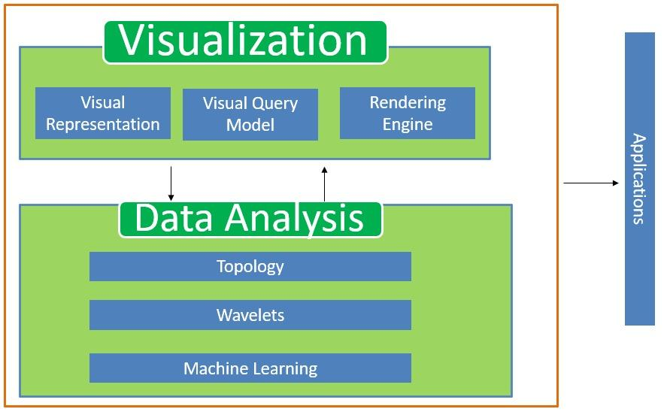
Cont..

Slide 14
Required libraries:
Import Matplot.lib
Import Pandas as pd
Import Seaborn and sns
Import numPy as np
Import sklearn
From sklearn.preprocessing import MinMaxScaler
From sklearn.neural_network import MLPClassifier
From sklearn.metrics import accuracy_score
From sklearn.preprocessing import LabelEncoder
From sklearn.model_selection import train_test_split
From sklearn.datasets import make_blobs
From sklearn.linear_model import LogisticRegression.

Slide 15
Project Implementation
POWERBI:
*Getting the dataset
*checking and analyzing the dataset
*Designing the different visualization.
*Implementing the designed visualization
*Checking the visualization with the dataset.
Regression:
*Getting the dataset.
*Checking the values present in the dataset.
*Implementing the logistic regression using pandas.
*Testing the predict model with the original values
*Checking the accuracy of the model.

Slide 16
Hardware and Software Requirements.
.NET Framework 4.8
Hard Disk minimum of 1 GB
Memory Minimum: 1 GB
Operating system windows 10

Slide 17
MODULES
IMPORTING THE DATASET
ANALYZING AND FILTERING THE DATASET
VISUALIZING THE DATA
BUILDING THE MODEL TO PREDICT THE RINGS.
CHECKING THE ACCURANCY SCOPE.

Slide 18
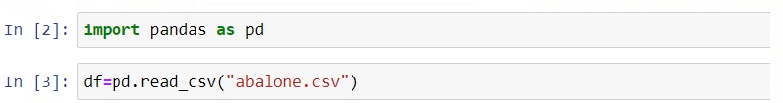
MODULE 1
IMPORTING THE DATASET:
*downloading the dataset
*importing the data into the pandas.
*checking if any null values present in the dataset.
Path:
POWERBI:
Get data->excel workbook->choose file ->open
REGRESSION:

Slide 19
MODULE 2
ANALYZING AND FILTERING THE DATASET:
*Import the dataset into the powerbi.
*transforming the dataset into the powerbi.
*filtering the data in query editor.
*Then apply the filtered values and save and close window.

Slide 20
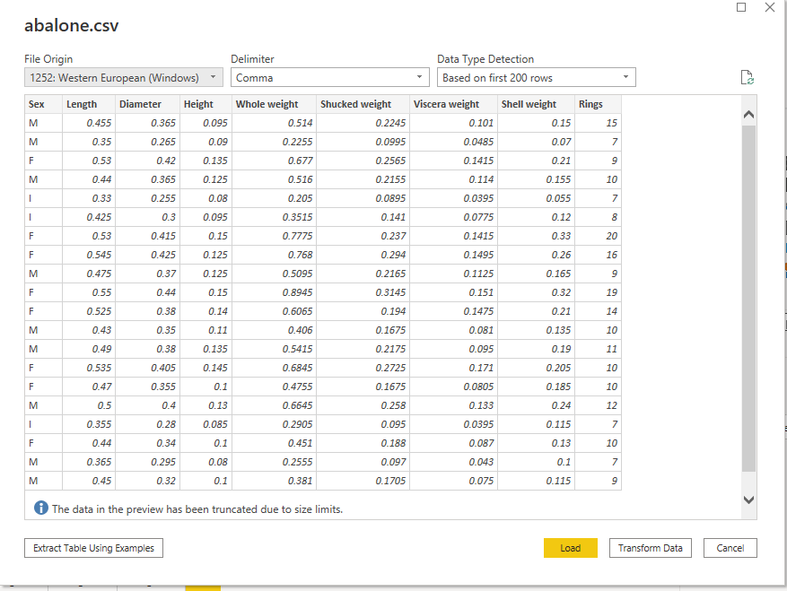
LOADING THE DATA SET

Slide 21
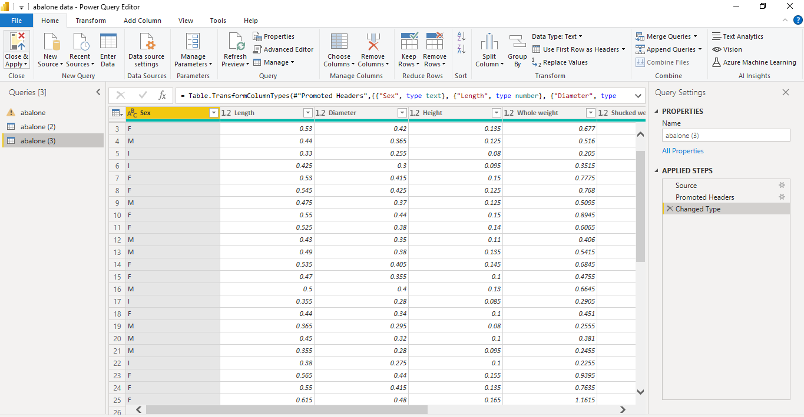
POWER QUERY EDITOR.

Slide 22
MODULE 3
VISUALIZING THE DATA:
*From the visualization panel we will select any one chart and we assign data set values the fields.
*Changing the values according to the given dataset.
Example:
sum ,average ,count,max,mean,min,sd etc….

Slide 23
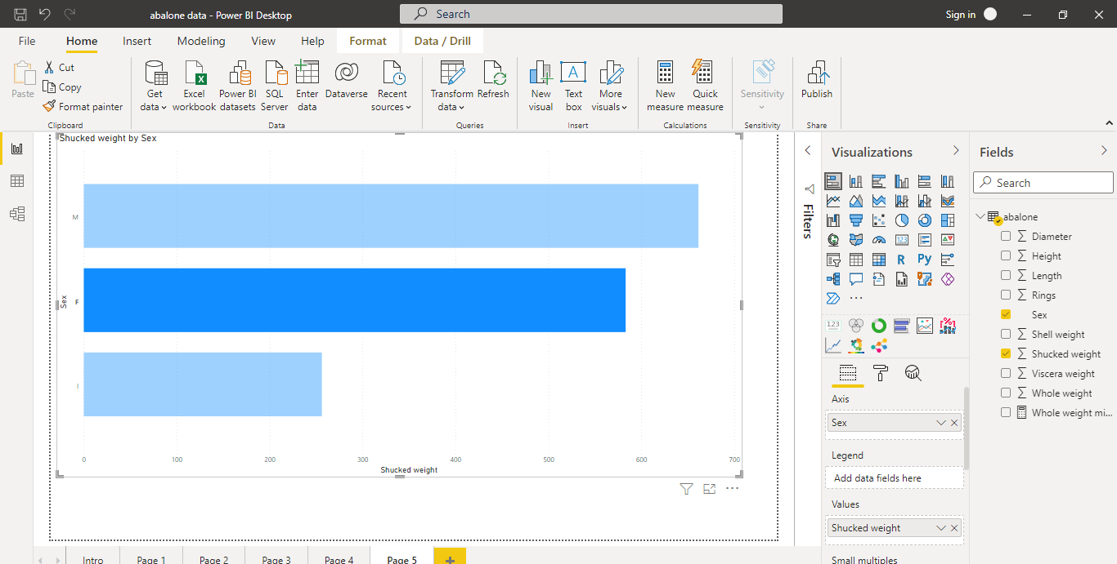
Visualization

Slide 24
MODULE 4
BUILDING THE MODEL TO PREDICT THE RINGS:
*Import the data into the juypter notebook.
*Checking the null values:
->if the null values present then drop the values.
->if the null values are not present continue.
*Changing the categorical columns into numeric columns using label encoder function.
*To predict the values, we need to train your model.
*Except the target feature(rings) the remaining columns are the training the data.
*After training the model we need to check predicted values by model with the original testing values.
*In case we are have built two models :
1.Logistic regression
2.Neural networks

Slide 25
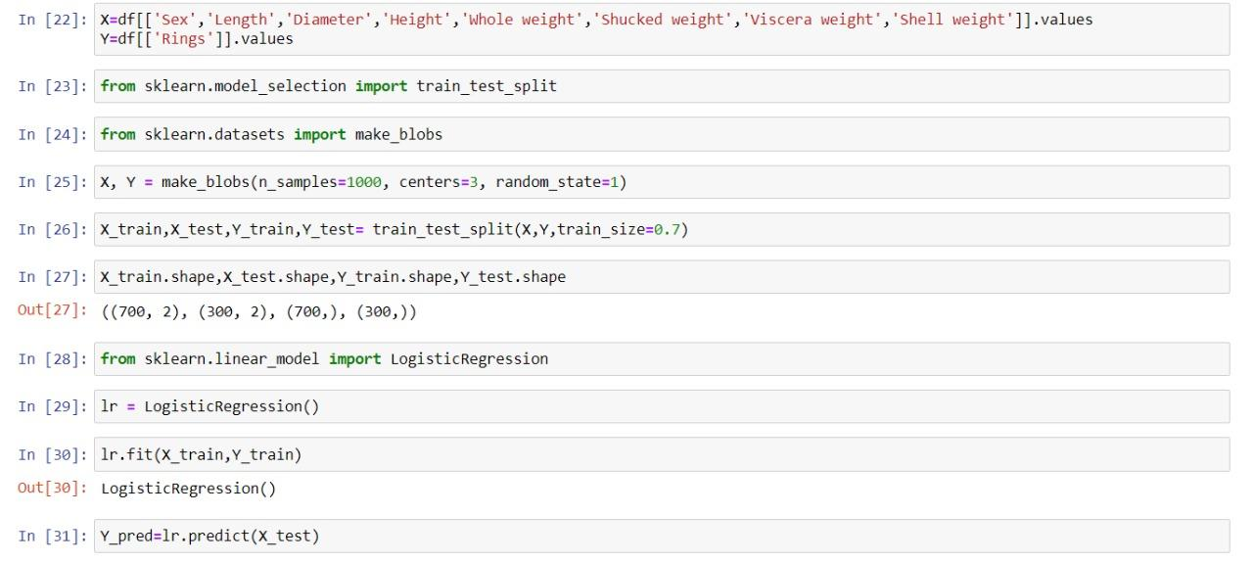
Model

Slide 26
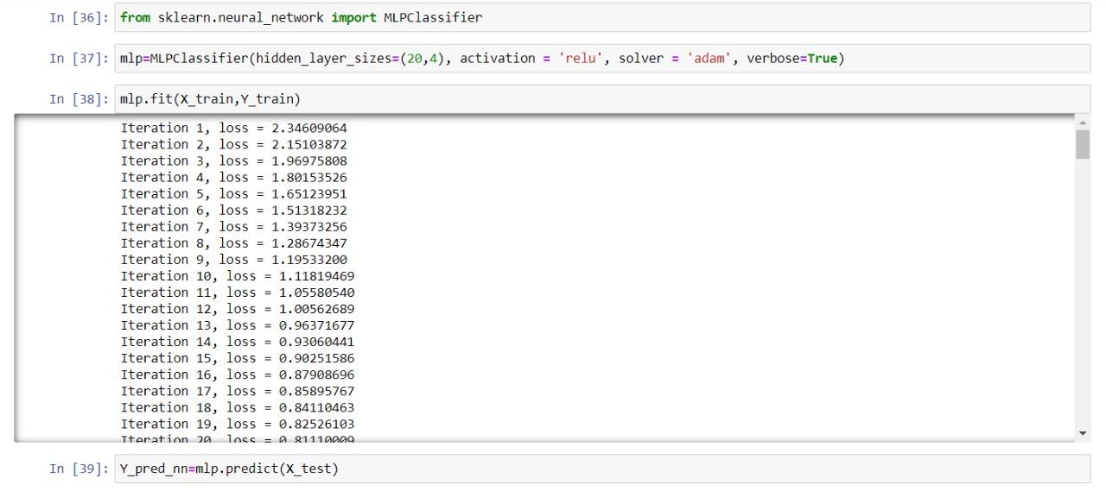

Slide 27
MODULE 5
CHECKING THE ACCURACY SCORE:
*After testing the predicted and test value we import functions from Sklearn.lib
*We imported accuracy_score function from the lib.
*Testing the accuracy score.
->The original values with the predict values by the neural network model.
->->The original values with the predict values by the Logistic regression model.

Slide 28
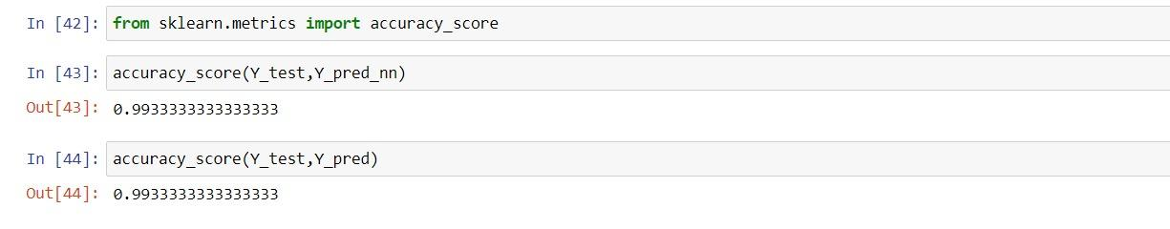
Accuracy SCORE

Slide 29
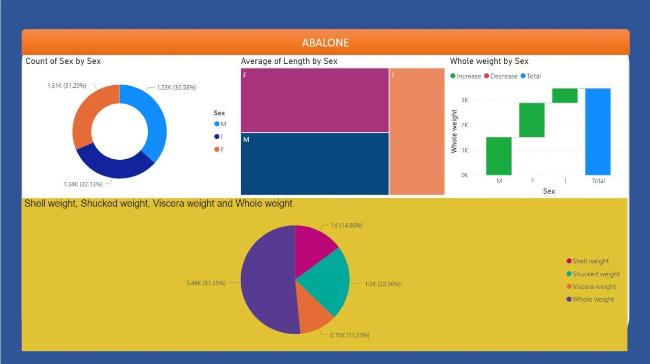
Application Snapshots
ABALONE

Slide 30
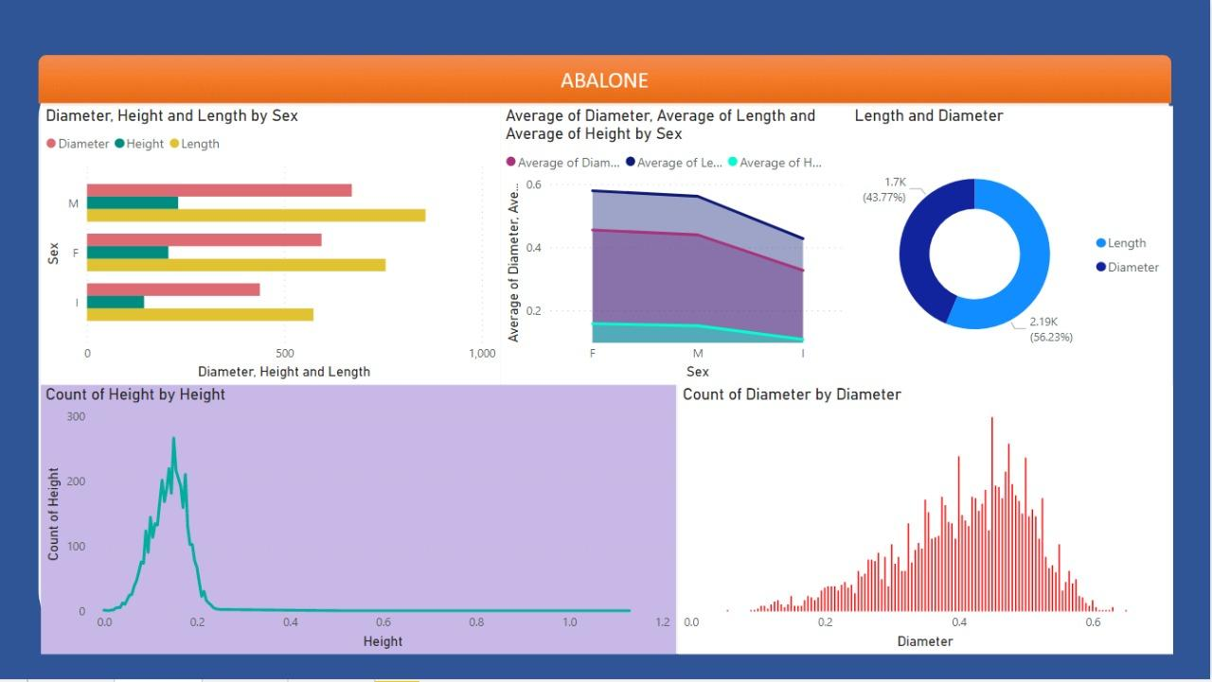
DIAMETER, HEIGHT AND LENGTH

Slide 31
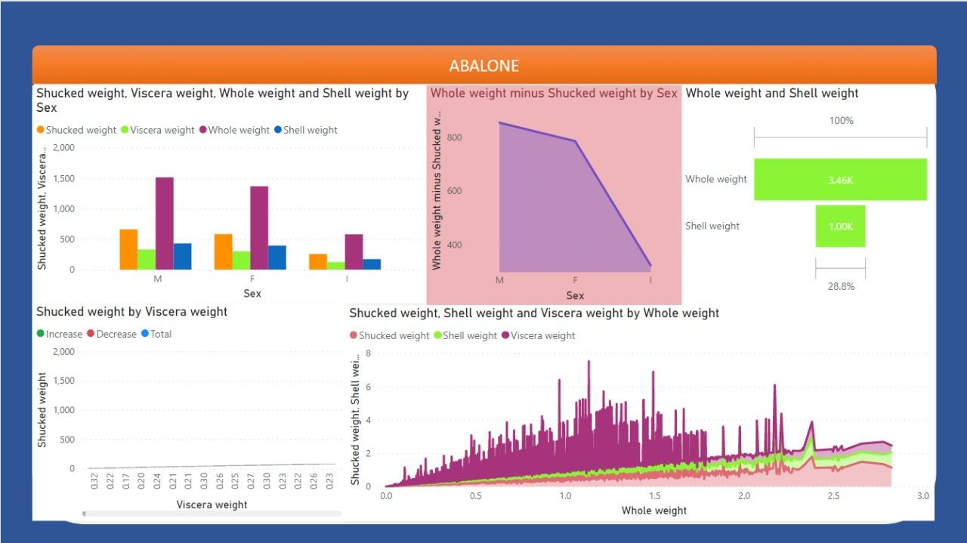
WEIGHTS

Slide 32
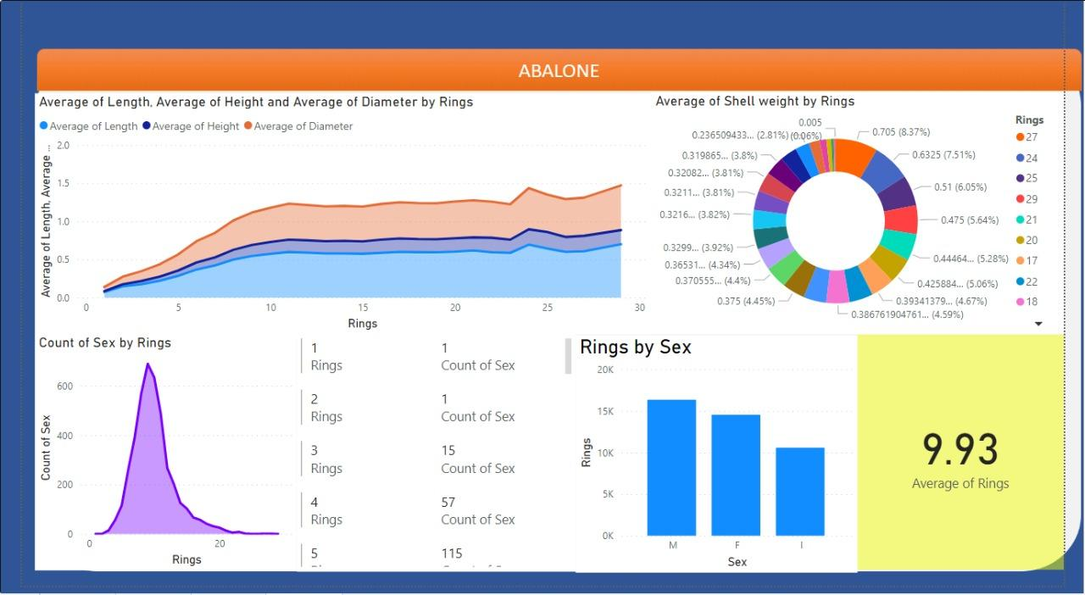
RINGS:(Ages)

Slide 33
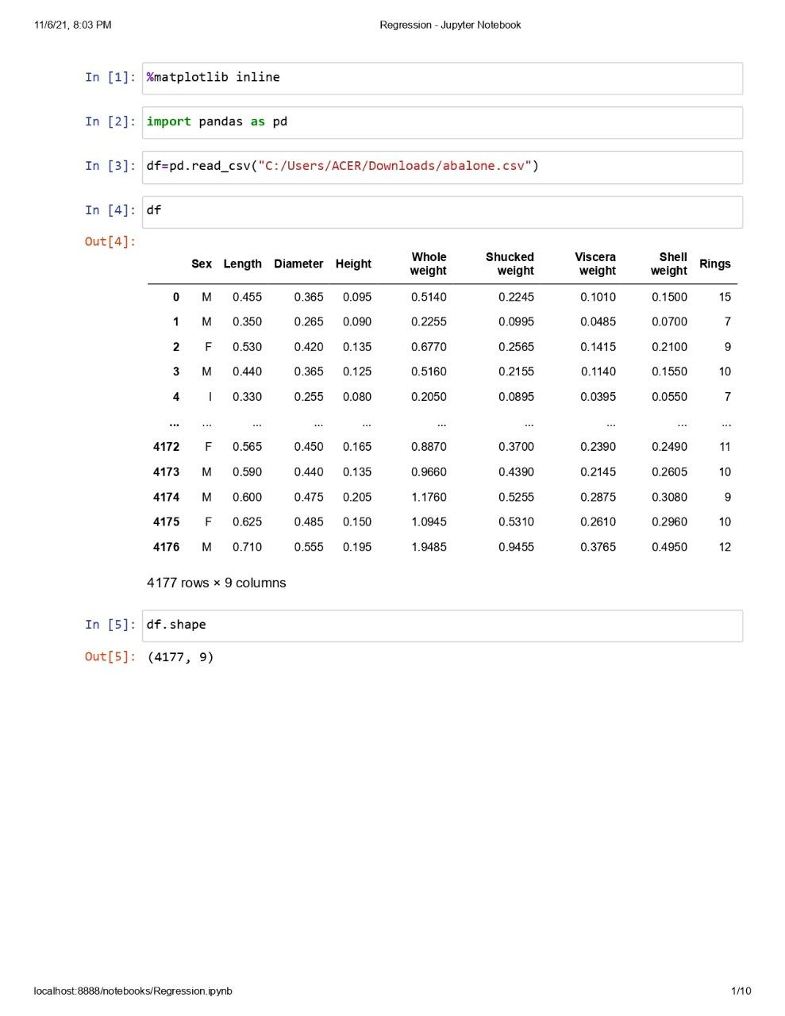
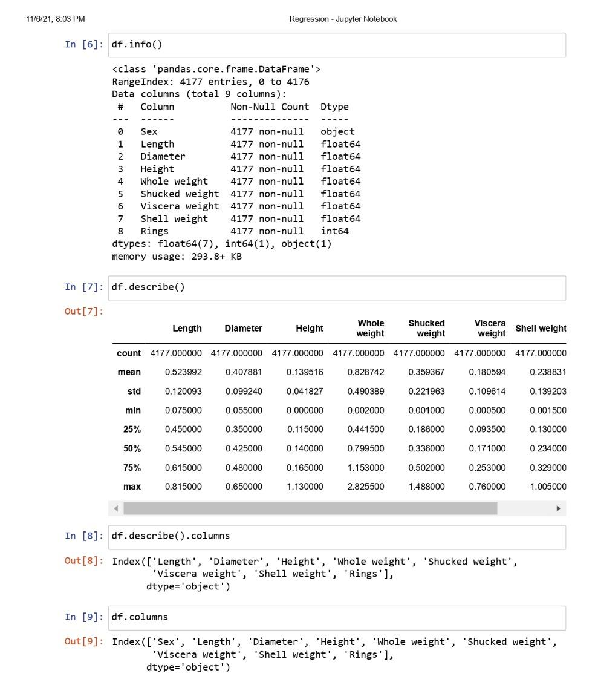
REGRESSION:

Slide 34
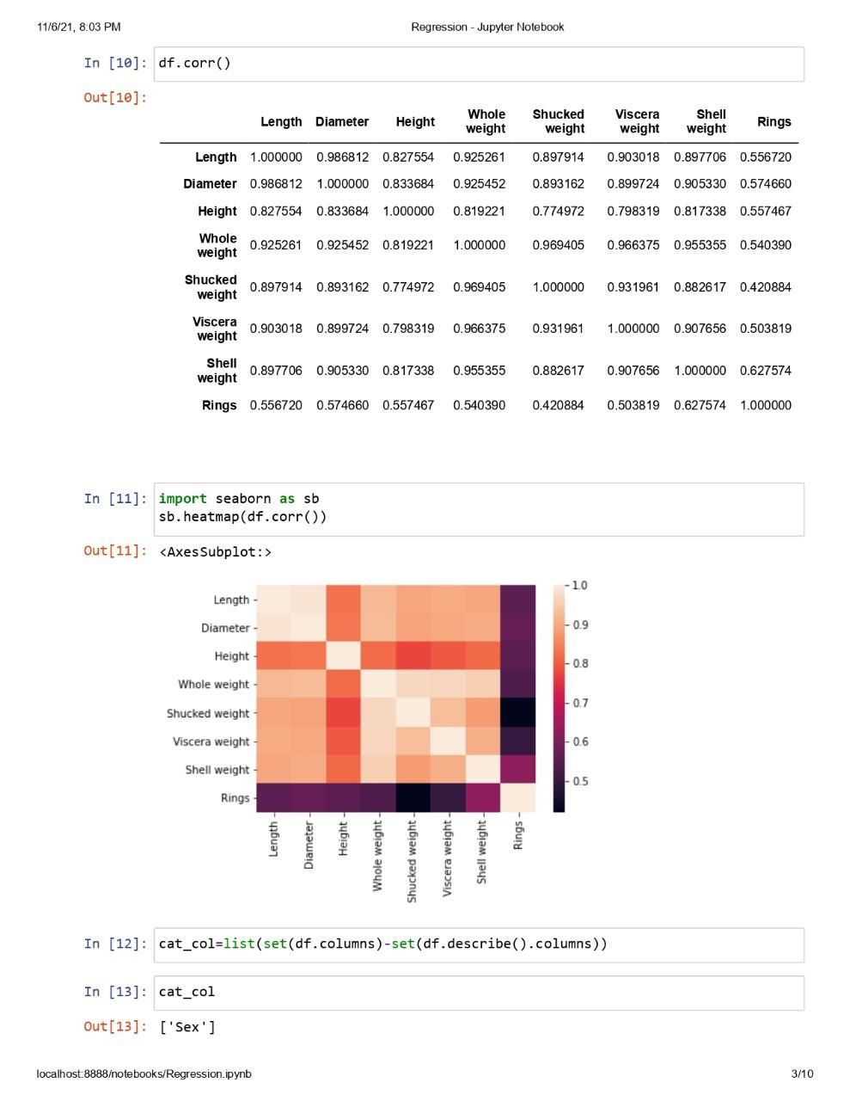
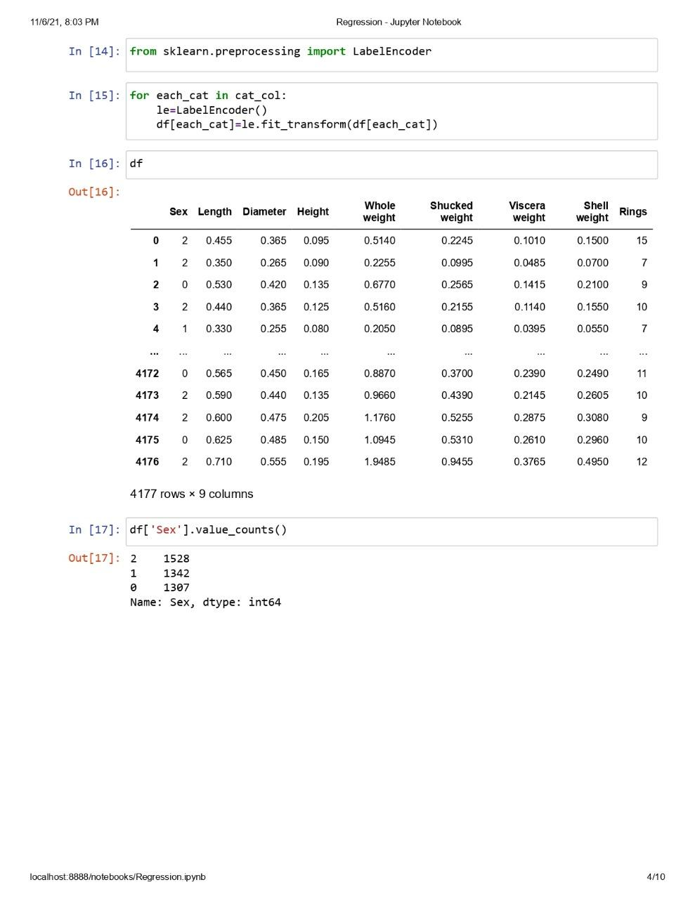

Slide 35
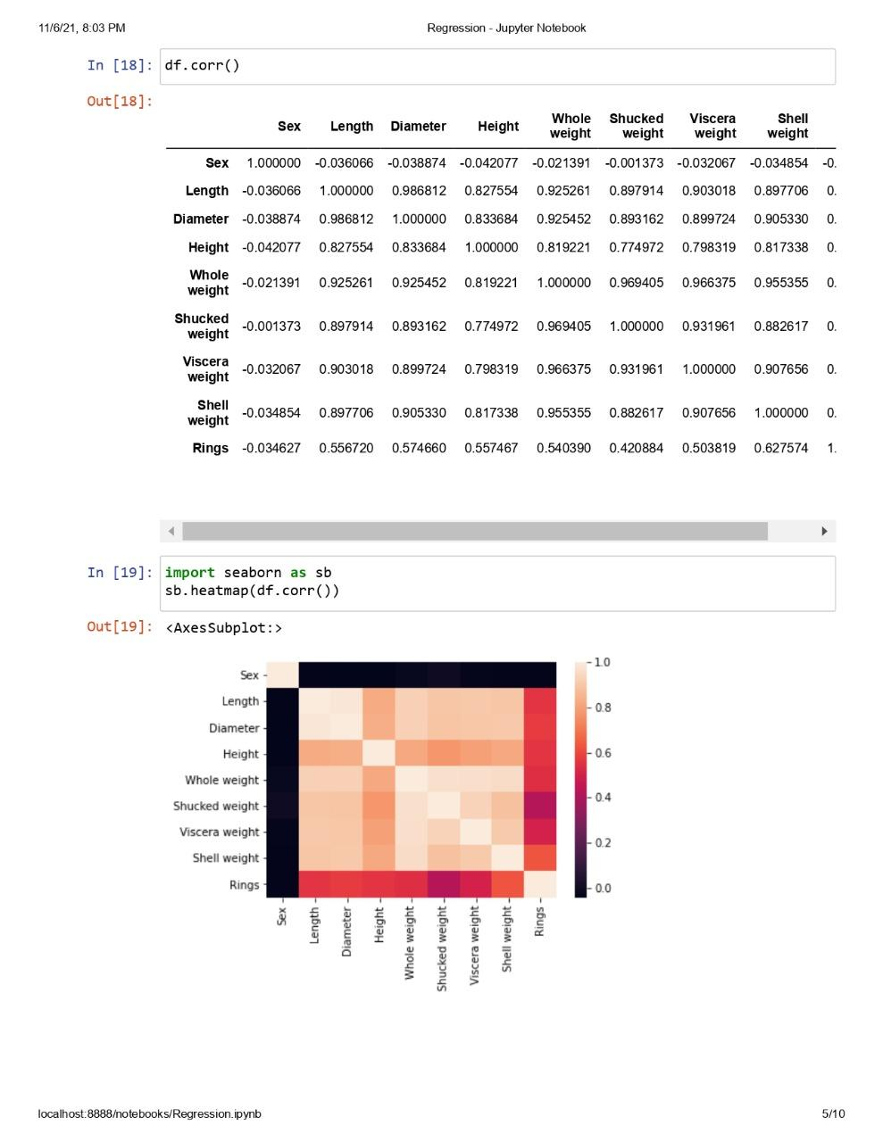
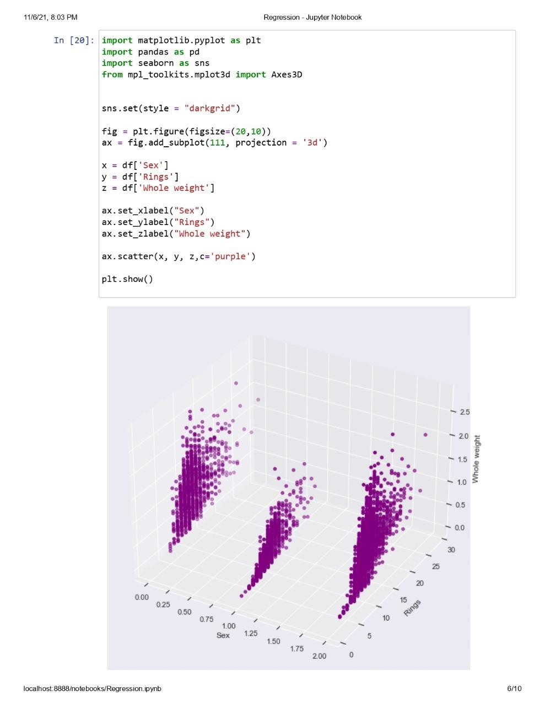

Slide 36
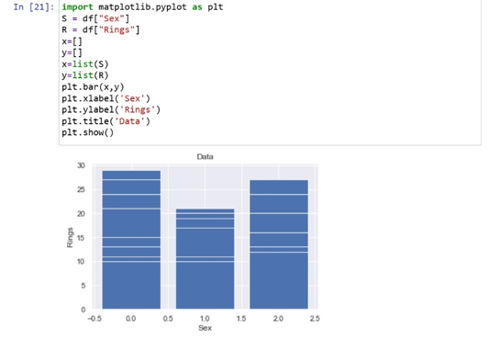
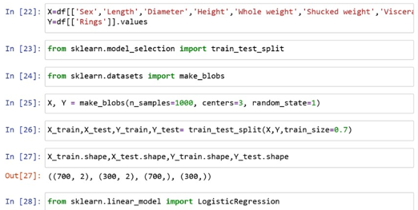

Slide 37
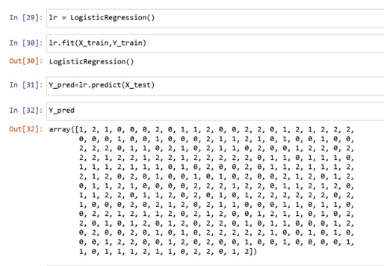
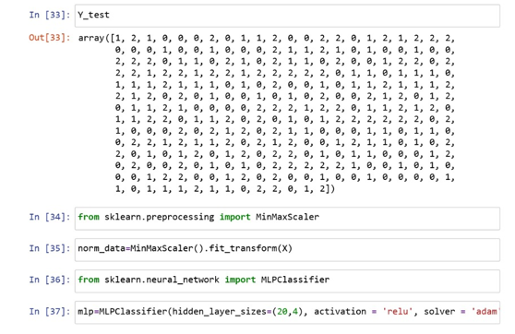

Slide 38
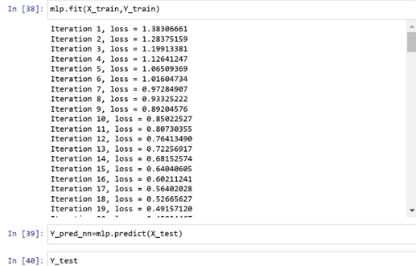
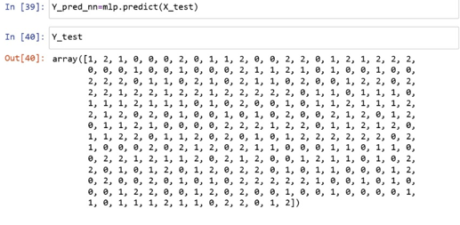

Slide 39
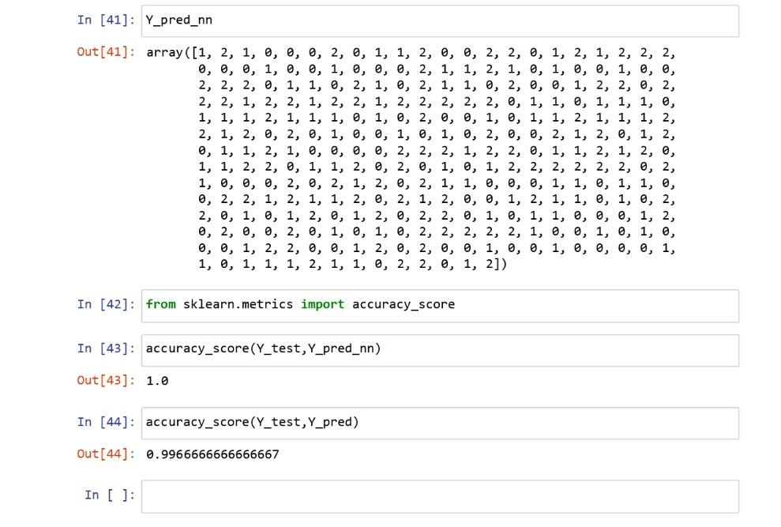

Slide 40
Results and Discussion
From this project we were able to find out the Rings(age) of the abalone and we found out from the given dataset that most of the abalone rings were on an average of 9.93 as we can see in the previous figure(19).
From the dataset we also found out that most of the abalone/seashells are Male around 1528 then next females around 1307 and last the infants are 1342.
From this we can say that the dataset contained more of Males when compared with other two sex’s. The female and the infants are almost same.

Slide 41
Continuation
Most of the abalone present in the dataset had height of 0.15 which were around 267, and most of the seashells had diameter ranged between 0.4 to 0.6.
On top we found out that the average length for Male were around 0.56, for females it was around 0.58 and for infant’s it is around 0.43.
We also found out that the weights of the abalone of different sex were almost same except for the infants. The Sum weight for Males were around 1514, females it’s 1,367 and for the infants its 578.

Slide 42
Continuation
We also found that the male abalone(seashells) had more shucked weight(meat) when compared to females and infants. The male had average of 853(0.991), female 784(1.04) and for infants it was 322(0.43).
As we have shown in fig.14, we have selected a value i.e 2.38 which is used to get the graph for the shucked weight by viscera weight to find the perfect weight of the abalone meat.
In the dataset the greatest number of the abalones(seashell) were younger …… at the Rings(age) of 9 the total abalones were 689 then followed by 8 at 568,10 at 634 and 11 at 487. And the older abalone from age 24 to 29 were very less when compared.
The average rings(age) for males was 11.3 females 10.71 and infants 7.89.

Slide 43
Regression
For the project we used the Python's pandas concept of regression to find/prediction out the values for rings(age). We used logistics regression to find the values and we train the model and then test the trained predicted model with the original model, and we find the accuracy for the model we have to check if its correct.

Slide 44
Conclusion
This project is about to Analyzing and Visualizing the given data set. The given data set is about the Abalone. The dataset is used to find out/ predict the values for Rings(age).
In this project we use the software called Power Bi to do the visualization of the data set and we use python- panda’s regression to predict/find the age for the abalone.
Importing the dataset to the power bi the data needs to be visualized and then the data present in the file which are the Length, height, diameter, Rings(age) and all the different weights of the abalones and

Slide 45
Continuation
the data can be represented in different forms of graphs which were Bar, pie and also using the python with the concept of pandas and regression to predict the values for the rings(age).
And then checked withed the original value to make sure that the predicted values were perfect for the data set.
Form this project we were able to find out the Length, height, diameter, Rings(age) and all the different weights of the abalones with help of power bi visualization and pandas regression to find/ predict the rings(age) of the abalones.

Slide 46
References
 | https://archive.ics.uci.edu/ml/datasets/abalone https://www.kaggle.com/rodolfomendes/abalone-dataset https://data.world/uci/abalone http://rexa.info/paper/351e173bc2176dbf14635cc5471660c911f8e79c https://www.researchgate.net/publication/337146276_Machine_Learning_Project_-_Predict_the_Age_of_Abalone https://ieeexplore.ieee.org/abstract/document/8970983

