Slide 1





Introduction to Robotic Process Automation
Build a news Robot
Your Register No: 220701086
Name: Haripriya P
Guide Name: Mrs. J. Jinu Sophia
Designation and Department: Assistant Professor (SG)

Slide 2
Abstract
The "Build a News Robot" project utilizes Robotic Process Automation (RPA) to automate news gathering and email dissemination, streamlining the process of staying updated on specific topics. The robot accepts a topic and recipient email as inputs, performs a web search, and scrapes relevant data such as article titles, URLs, and publishing times from news websites. Using intelligent filtering logic to identify the latest updates, it organizes the data and sends an automated email with the curated news to the specified recipient. This project demonstrates the power of RPA in automating repetitive tasks, enhancing efficiency, and delivering timely information with minimal effort..

Slide 3
Need for the Proposed System
The proposed system automates the time-consuming task of searching for and sharing news updates on specific topics. It eliminates the need for manual browsing across multiple sources by scraping relevant data and delivering curated news via email.
This ensures timely and accurate updates, enhancing efficiency for users who need to stay informed. Ideal for professionals and businesses, the system saves time, reduces effort, and ensures personalized, real-time news delivery, making it a valuable tool for efficient information management.

Slide 4
Advantages of the Proposed System
Time Efficiency: Automates news gathering and delivery, saving significant time for users.
Real-Time Updates: Provides the latest news promptly with intelligent filtering for relevance.
Accuracy: Reduces human errors in searching and selecting news articles.
Convenience: Delivers curated news directly to the user’s email, eliminating manual effort.
Customization: Users can specify topics of interest and tailor their news feed.
Productivity Boost: Frees users from repetitive tasks, allowing focus on core activities.
Cost-Effective: Reduces the need for manual labor, making it a resource-efficient solution.

Slide 5
Literature Survey
Paper 1 : “Web Scraping and Automation using RPA”
Advantages: automates the process of data collection and dissemination, enabling faster and more accurate reporting compared to manual efforts.
Disadvantages: depends heavily on the stability of the web page structure; any changes could cause the scraping logic to fail.
Paper 2 : “Intelligent Automation in Robotic Process Automation for Education”
Advantages:implifies repetitive workflows like scheduling or information dissemination, making processes highly efficient.
Disadvantages:Limited ability to process and understand unstructured or complex data, reducing its applicability in dynamic environments.

Slide 6
Main Objective
The “Build a News Robot” project's primary objective is to automate the process of collecting, filtering, and disseminating relevant news on a specified topic. Users provide a topic of interest and an email address, and the bot performs web scraping to gather the latest news, including the title, URL, and timestamp. It processes the collected data, stores it in a structured format, and automates the delivery of the most recent and relevant news via email. This enhances efficiency by saving time and eliminating the need for manual news searching and sharing, ensuring users stay informed in real time.

Slide 7
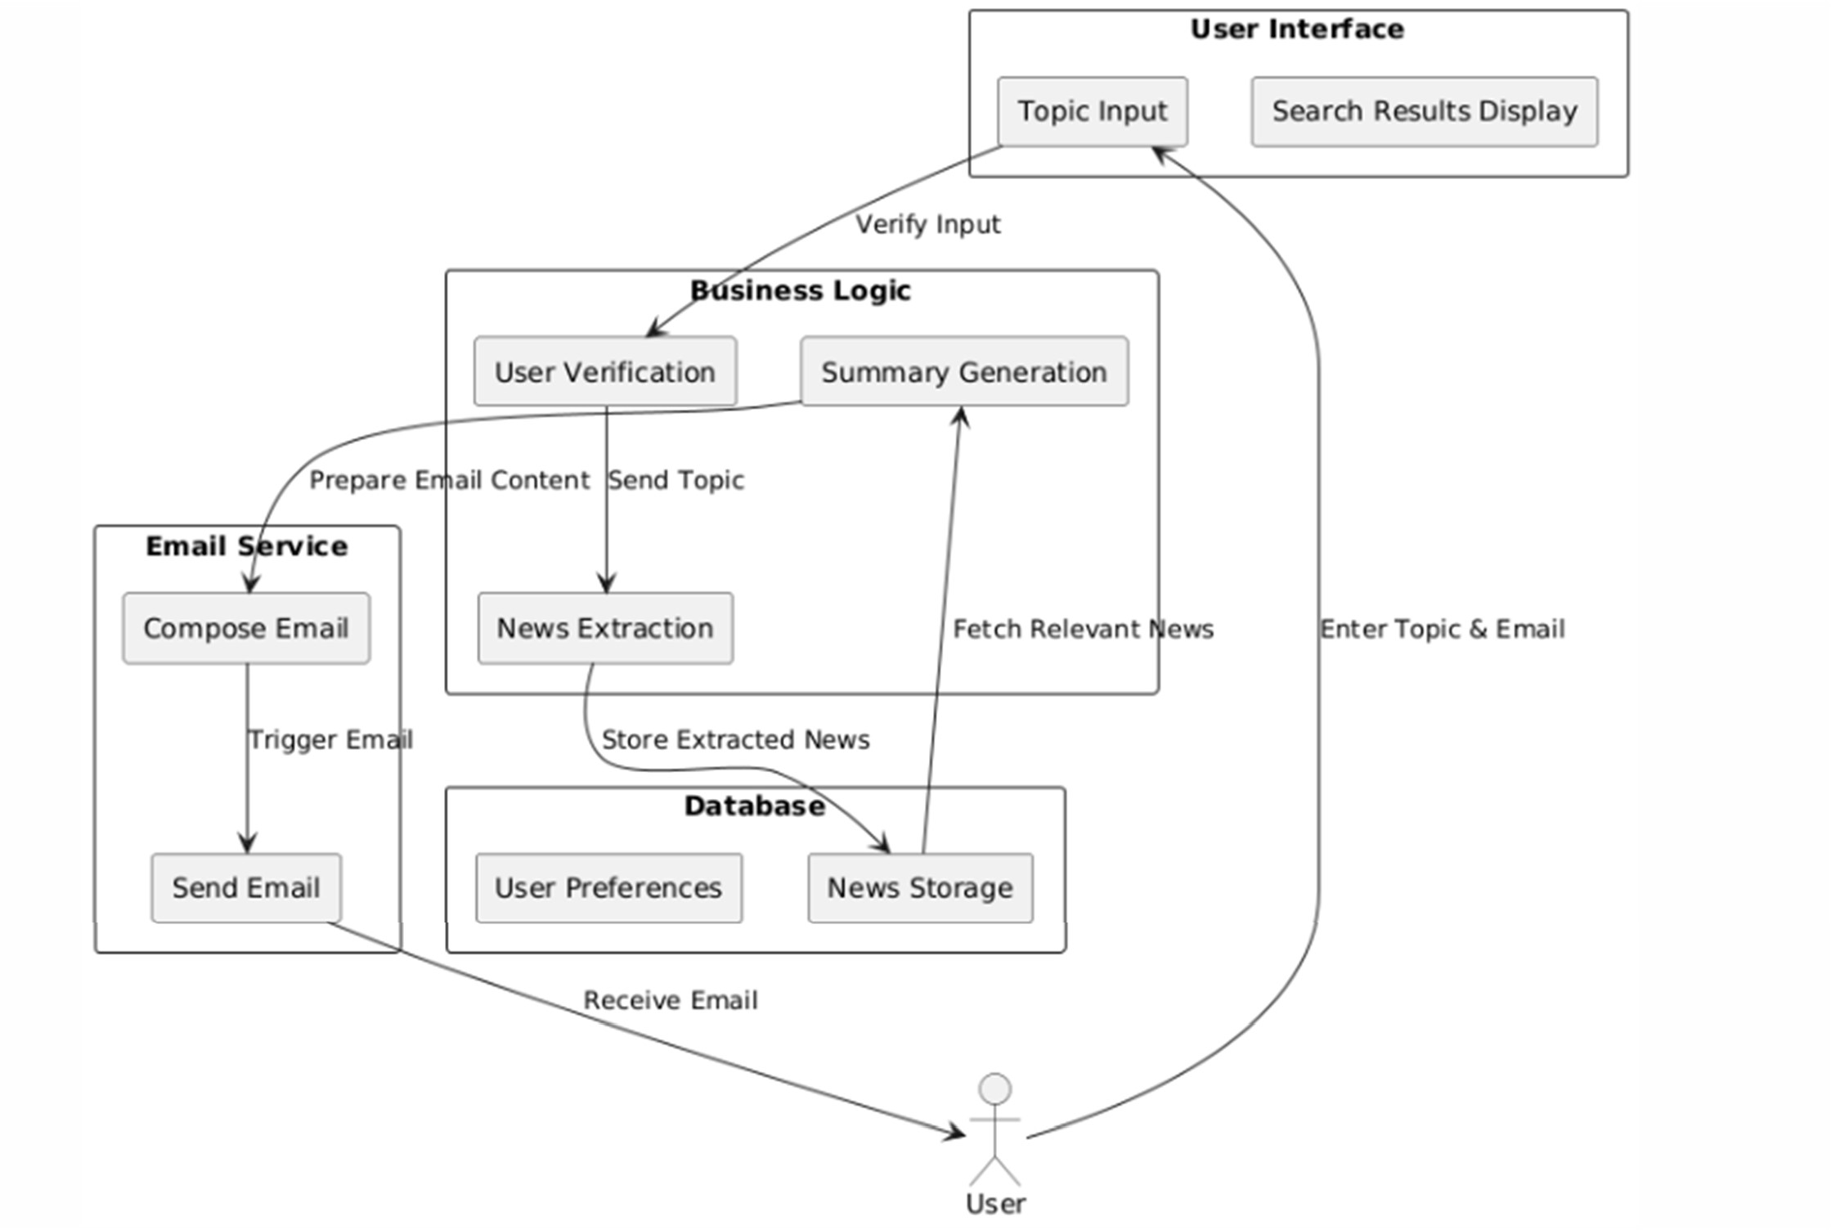
Architecture

Slide 8
System Requirements
Software Requirements:
UiPath Studio: For building and automating the workflows for data scraping and email automation.
Email Automation Tools: SMTP or Gmail API for email integration.
Web Browser: Google Chrome or Microsoft Edge for web scraping and searches.
.NET Framework: Required for running UiPath Studio.
Hardware Requirements:
Processor: Intel i3 or higher for smooth execution of workflows.
RAM: Minimum 4GB (8GB recommended for multitasking).
Storage: At least 2GB of free disk space for software, bot files, and cached data.
Internet Connection: A stable connection for real-time web scraping and email delivery.

Slide 9
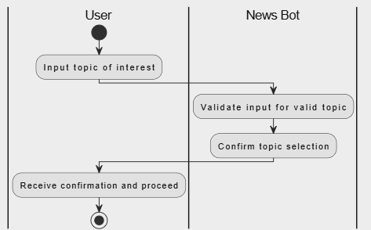
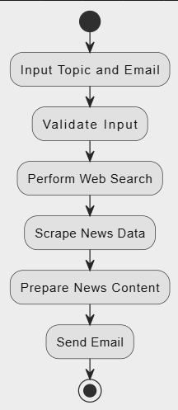
Functional Description
Name of the Module 1: Asking topic for the latest news
Short description: This module prompts the user to input their preferred topic for news, which is then used to search for the latest relevant articles.
DFD / Activity Diagram:
Name of the Module 2: data extraction and web scraping
Short description: Automates the process of extracting data and sending the latest news through email based on a topic.
DFD / Activity Diagram:

Slide 10
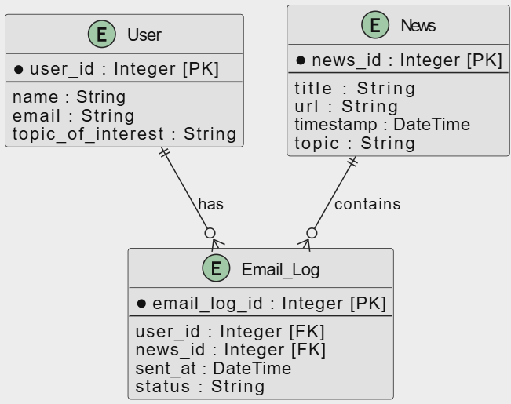
Table Design

Slide 11
Process Design
Main Process:
User inputs topic and email: The user provides a topic and email to receive news updates.
Bot searches and scrapes news: It automatically searches for news articles and extracts relevant details.
News email sent: The bot sends the latest articles to the provided email.
Sub-Processes:
Collect user input: Accept topic and email address.
Search and scrape news: Search for articles and extract key information (title, URL, time).
Format and store data: Organize the scraped data for easy presentation.
Send email: Dispatch the formatted news to the user’s email.

Slide 12
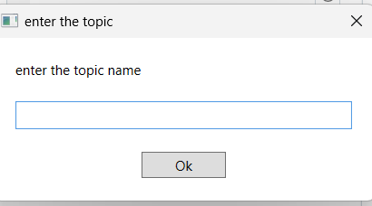
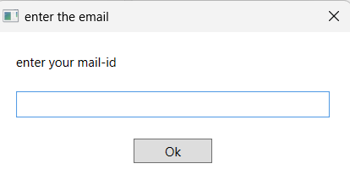
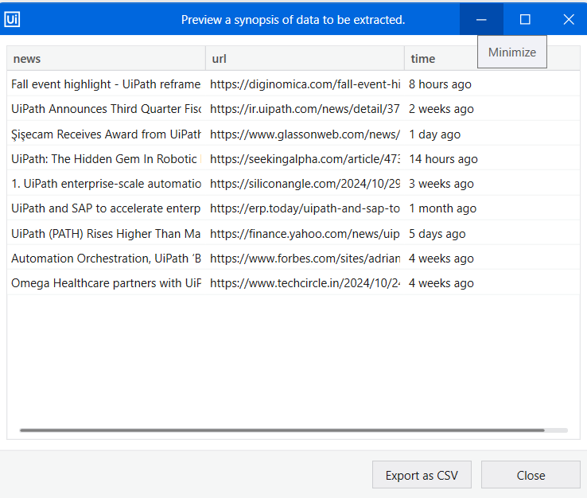
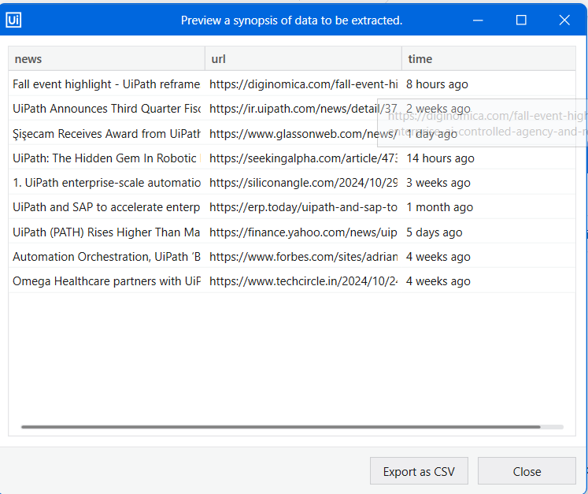
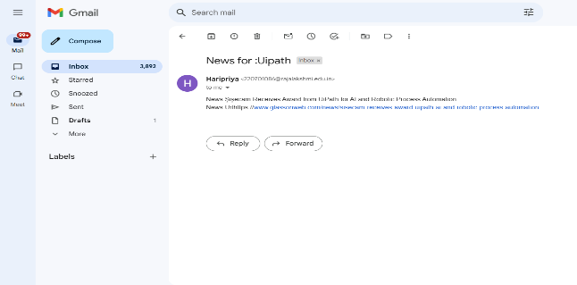
Implementation
Module 1: User Input Collection
Captures user inputs for name, mail-id using prompts.
Screen shots
Module 2: News Search & Validation
Automates searching for the specified contact on WhatsApp to validate its existence before scheduling the message.
Screen shots

Slide 13
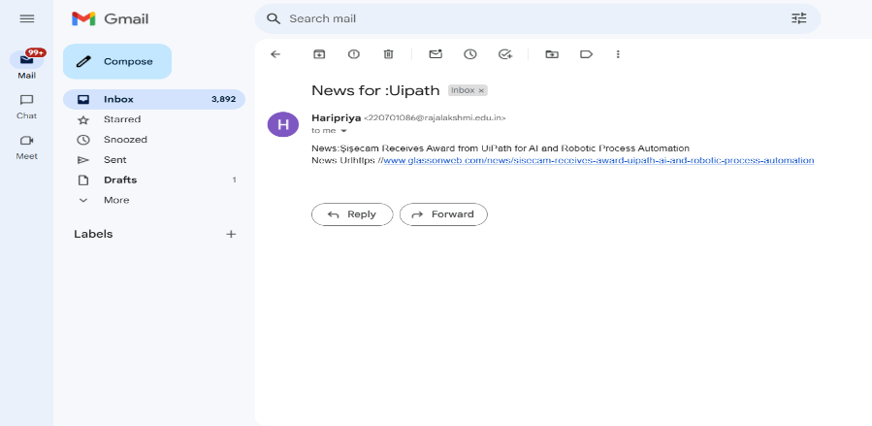
Testing
Description:
Screen shots:
Test User Input: Ensure valid topic and email input.
Test News Scraping: Verify correct data extraction (title, URL, time).
Test Email Delivery: Confirm the formatted news is sent successfully.

Slide 14
Conclusions
In conclusion, this project demonstrates the power of Robotic Process Automation (RPA) using UiPath to automate the process of collecting, summarizing, and delivering news. By applying RPA principles, the news bot effectively retrieves data from multiple sources, processes it using natural language processing, and delivers relevant summaries to users through automated channels. The integration of UiPath Orchestrator ensures efficient scheduling and monitoring, making the system scalable and reliable. This approach not only streamlines repetitive tasks but also enhances productivity and user engagement by providing timely, personalized news updates.

Slide 15
Future Enhancement
Sentiment Analysis: Integrating AI-based sentiment analysis would enable the system to evaluate the tone of news articles (positive, neutral, or negative), providing users with a deeper understanding of the content beyond just the facts.
Push Notifications: Adding push notifications would allow the system to instantly alert users about breaking news or updates on their chosen topics, ensuring timely delivery of relevant information directly to their devices.

Slide 16
IEEE Paper
For your "Build a News Robot" RPA project, I found a relevant IEEE paper titled "Data Analysis using Robotic Process Automation: Study on Web Scraping using UI Path Studio" by authors from IEEE. The paper provides insights into web scraping with RPA technologies, specifically using UiPath Studio, which aligns with the automation and data scraping aspects of your project​.
Additionally, another paper titled "Towards a Process Analysis Approach to Adopt Robotic Process Automation" discusses the general adoption of RPA for automating business processes, which could offer useful theoretical insights for your email automation feature​.

Slide 17
References
Towards a Process Analysis Approach to Adopt Robotic Process Automation
https://ieeexplore.ieee.org/document/8592629
Data Analysis using Robot Process Automation Study on Web Scraping using UI Path Studio
https://ieeexplore.ieee.org/document/10074502

Slide 18
Queries

Slide 19
Demonstration

Slide 20
Thank You

