Slide 1

MYCHENNAI
BY
HARIPRIYA.D
ARCHANA.A
BHAVASHRI.B

Slide 2
MYCHENNAI
My chennai App is one touch window to all the information about chennai city.
Mychennai app helps you to become a smart citizen of the chennai city.

Slide 3
FEATURES
Major features:
One touch helpline
NearBy locations
Location Based advertisements
Citizens basic needs

Slide 4
REQUIREMENTS
SOFTWARE:
PLATFORM: IOS
LANGUAGE: OBJECTIVE-C
HARDWARE:
MAC OS X MAVERICKS(10.9.1)
IOS SDK-7.1(XCODE)
HARDDISK(500 GB)

Slide 5
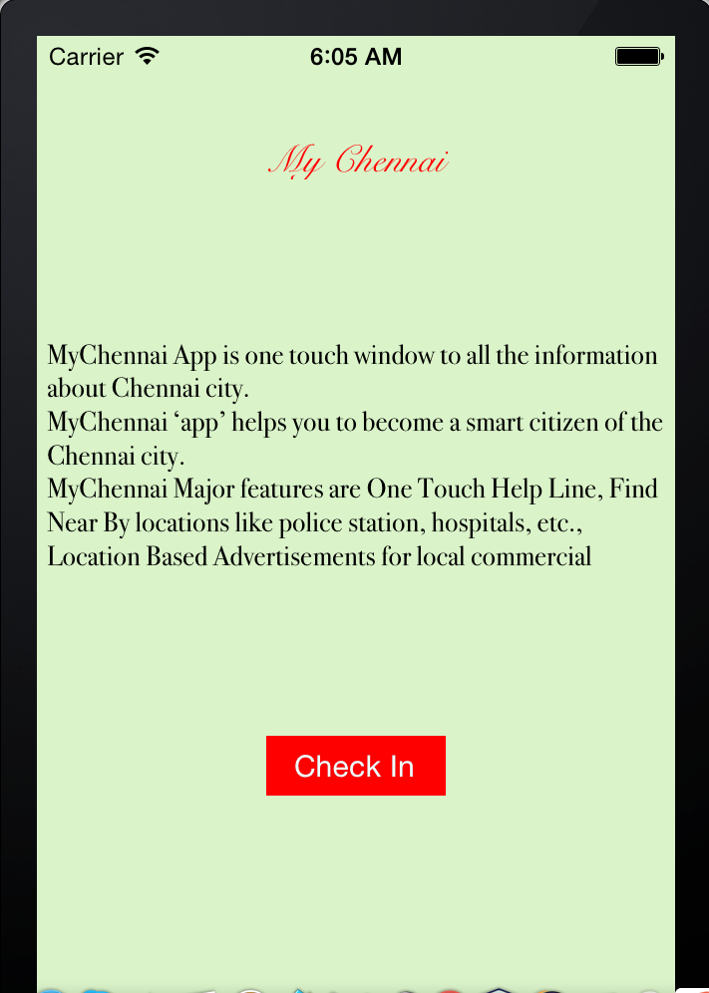
FIRST PAGE
This is the first page which introduces about the app
When we click “checkin” it takes next page.

Slide 6
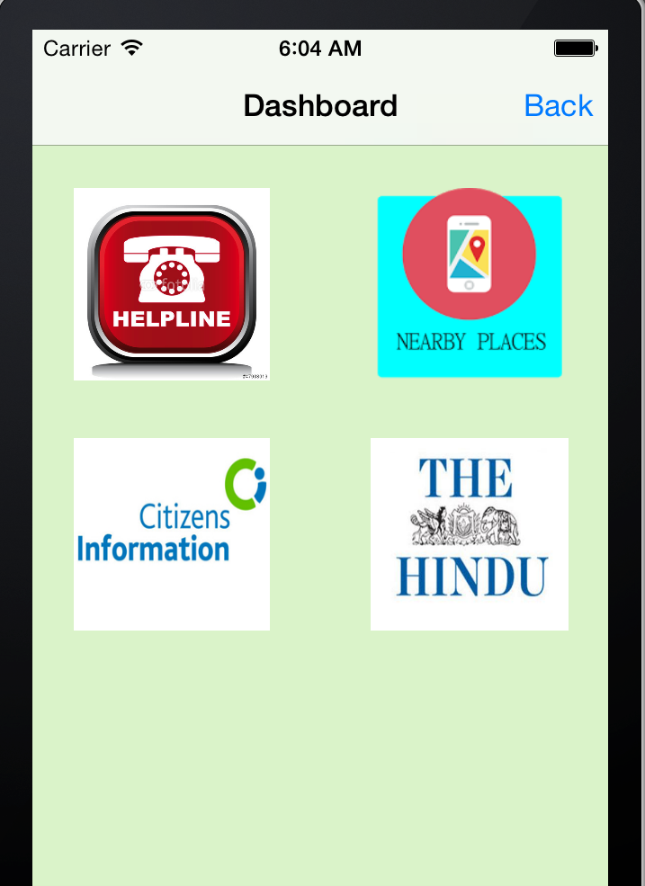
Dashboard
This has collectively 4 menus

Slide 7
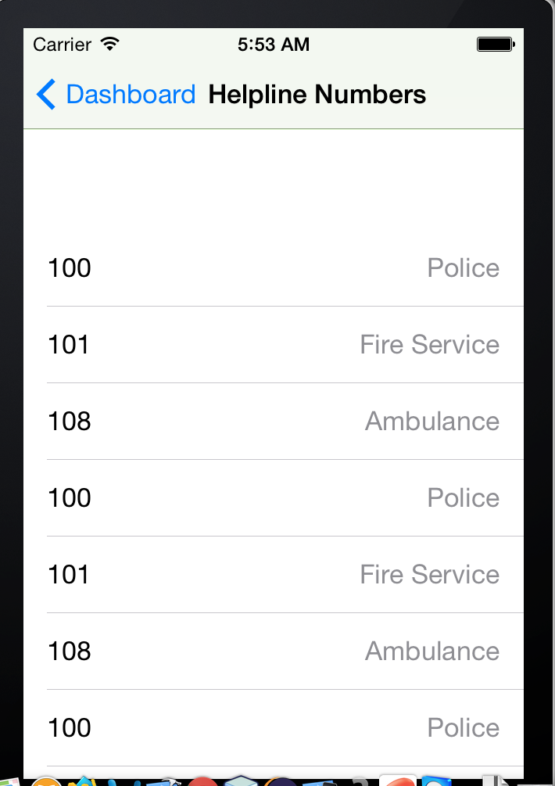
HELPLINE

Slide 8
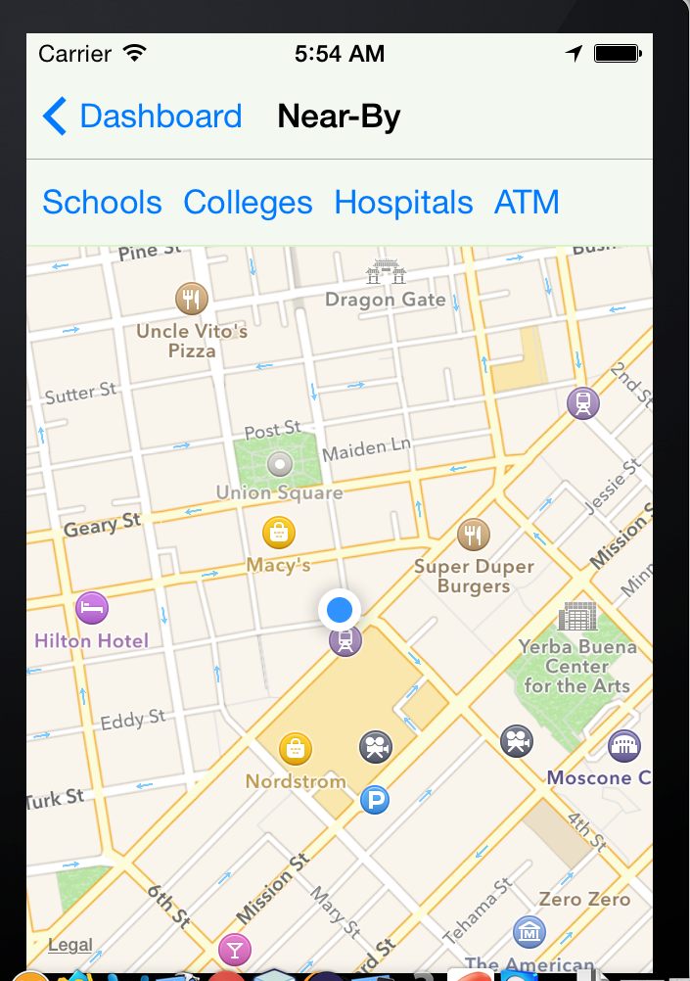
NEAR-BY

Slide 9
NEAR-BY

Slide 10
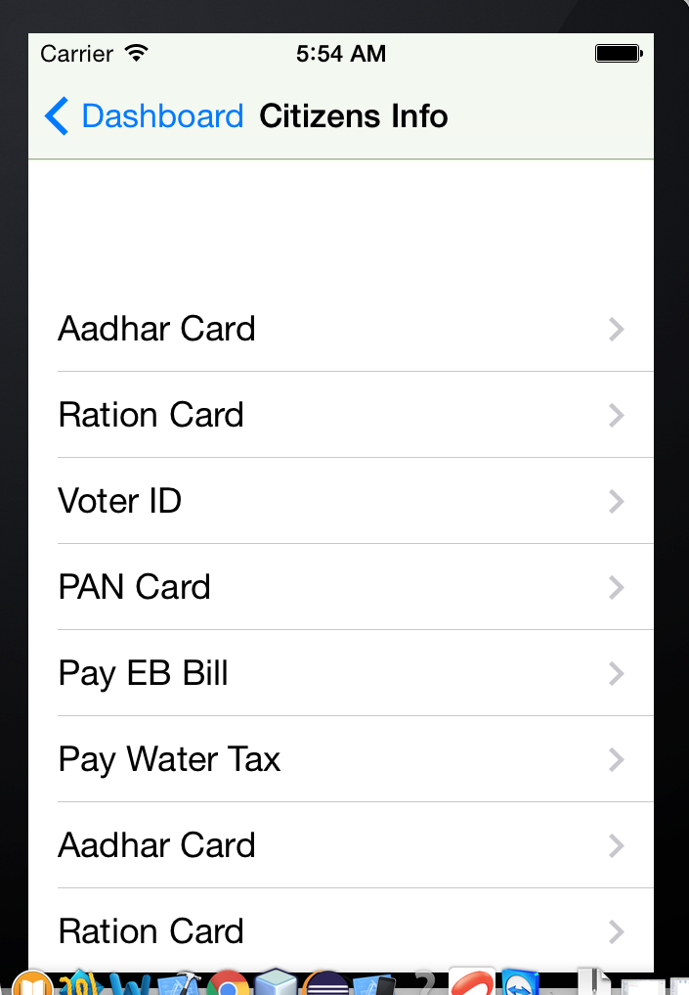
CITIZENS-INFO

Slide 11
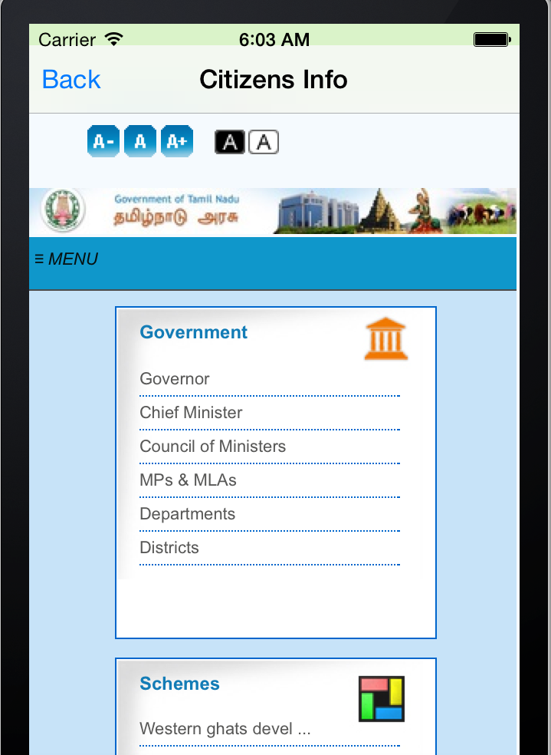
CITIZENS-INFO

Slide 12
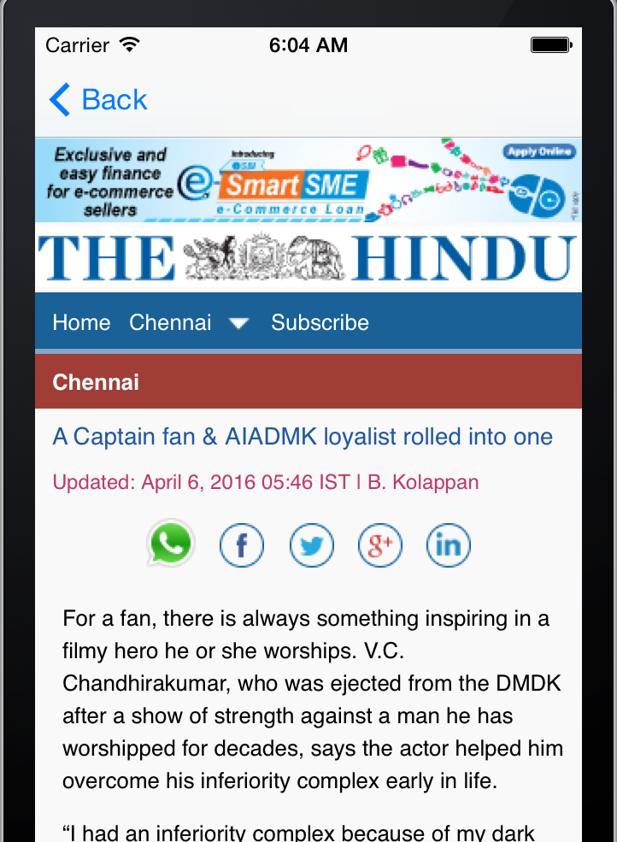
DAILY NEWS

Slide 13
FUTURE ENHANCEMENTS
Since this only made for our city…with the help of GPS all the city informations are updated with the help of database.

