Slide 1


Slide 2
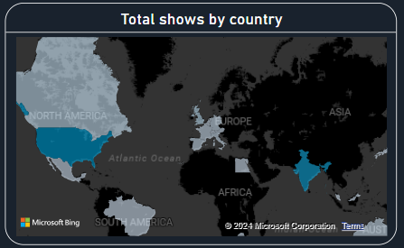
Total shows by country
To begin, this slide shows the total number of movies and TV shows produced by different countries. As we can see from the data, the leading content producers globally are [Country 1, Country 2, etc.]. This reflects the cultural influence and global reach these countries have, especially in entertainment. It’s interesting to note that countries like [Country X] are quickly emerging as notable players in the film and television industry

Slide 3
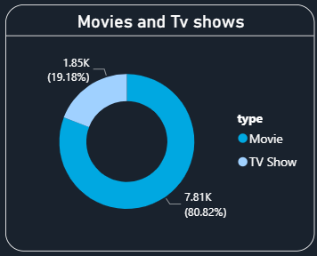
Movies and Tv shows

Slide 4
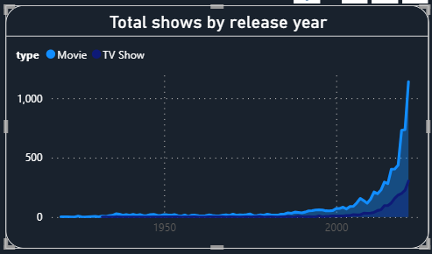
Total shows by release year
Next, let’s take a look at the total number of shows released over the years. This visual highlights key trends in content production, with significant growth in certain periods, possibly linked to the rise of streaming services. The data also suggests [periods of decline or rise] that could be attributed to factors like global events or technological advancements in the entertainment industry.

Slide 5
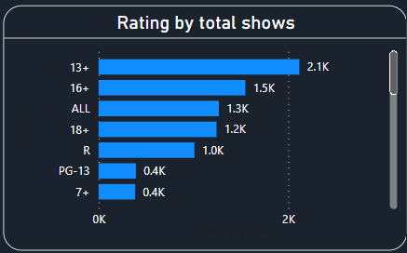
Rating by total shows
Moving on to ratings, this slide presents a comparison of show ratings and their distribution across different platforms. We see that the majority of shows fall under [rating category], indicating that audience preferences are heavily skewed towards [family-friendly, mature, etc.] content. This information is crucial for production companies as it helps in targeting content towards the most engaging rating categories.

Slide 6
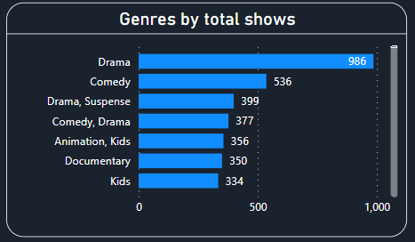
Genres by total shows
This next visual shows the most popular genres based on the total number of shows. The genre analysis reveals that [Genre X] dominates the content space, while other genres like [Genre Y and Z] have a more niche audience. Understanding genre trends allows content creators and producers to adapt to changing audience preferences and invest in genres that are trending.

Slide 7
Different cards
Conclusion:
"In conclusion, this analysis provides a comprehensive view of the global TV and movie industry. We explored how content is distributed across countries, genres, and ratings, and what trends we can expect in the coming years. Data like this helps industry stakeholders make informed decisions to cater to audiences more effectively. Thank you for your time, and I look forward to any questions you may have."

Slide 8
