Slide 1
UI design for
data collection
Guided image and metadata collection
SHUM Ho Yin
Student ID 56317378
EE4080 Final Year Project
3 November 2026
HLL-04
01
Notes:
Target: 40 seconds. Main talk target 770 seconds (12 minutes 50 seconds).
Good morning. My name is Shum Ho Yin, and the project is UI design for data collection. The project asks how a guided interface can help someone keep an image and its description together, review the record, and export it reliably. I will explain the workflow and the dated engineering evidence, including a new remote-study test on AWS. This presentation contains no human comparison results. The current evidence supports the implementation and its functional behavior. It leaves the question of user benefit open.
Sources
21 October 2026 repaired source and execution evidence: docs/repair-20261021/; browser-results.json; independent-export-verification.json; eval/PROTOCOL.md
docs/verification-2026-10-26.md (summary of the 26 October remote walkthrough)
26 Oct evidence: fyp-aws-submission-verification.json; independent-zip-verification.json
remote-study/PROTOCOL.md
remote-study/frontend/README.md
remote-study/backend/README.md

Slide 2
The data collection problem
A usable record needs an image
and the right context
Separate files
Incomplete context
Unnoticed mistakes
Photos and spreadsheet rows must keep the same identity.
Missing fields leave uncertainty about what a record describes.
An allowed value can still describe the image incorrectly.
Illustrative workflow risks. Their frequency in an industrial setting has not been measured here.
HLL-04
02
Notes:
Target: 45 seconds. Main talk target 770 seconds (12 minutes 50 seconds).
Consider a basic workflow where a person copies photos into a folder and types descriptions into a spreadsheet. Each row must continue to refer to the intended image. Missing fields, mistaken filenames and plausible but incorrect descriptions are different failure modes. These are illustrative risks; I have not measured their frequency in a company. The proposed interface brings image import, metadata entry, review and export together. That can make certain mistakes easier to prevent or recover from, but it also introduces a cost: more structure may take longer or feel restrictive. The project must evaluate both the data and the work needed to produce it.
Sources
21 October 2026 repaired source and execution evidence: docs/repair-20261021/; browser-results.json; independent-export-verification.json; eval/PROTOCOL.md

Slide 3
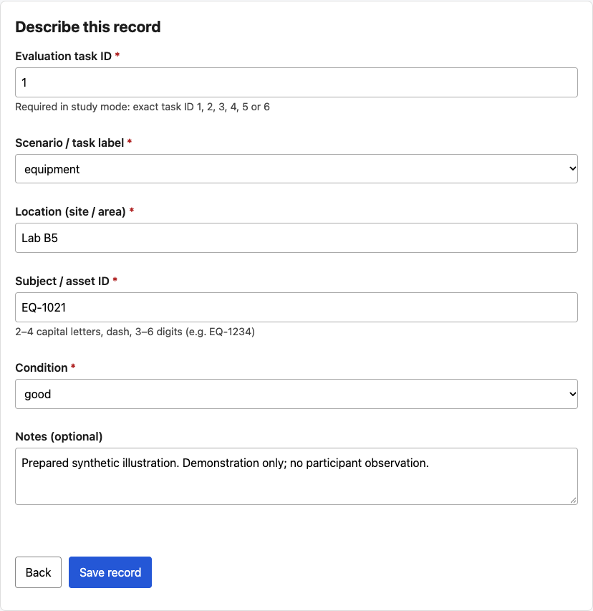
Project objective and scope
Can a guided workflow reduce
missing or incorrect metadata?
What does it cost in completion time?
Current scope
Prepared images and metadata
Primary: remote Guided + Table
Historical: frozen desktop v2
Study payloads omit image bytes
Working scope: image and metadata collection. The human comparison uses remote v3.
HLL-04
03
Notes:
Target: 55 seconds. Main talk target 770 seconds (12 minutes 50 seconds).
The implementation uses prepared images and four required metadata fields. The working direction is image and metadata collection, and the primary comparison is remote-table-v3: guided collection versus a basic browser table. Frozen desktop v2 provides a historical or alternate folder-and-spreadsheet protocol and the standalone feature demonstration. The new remote wrapper uses invitation entry, separate practice, timed blocks and metadata submission to AWS. It retains ZIP generation and isolated browser storage. The research revision changes initial validation timing for new remote sessions and preserves legacy behavior for existing sessions. Image bytes remain in the browser and local exports. AWS receives agreed study metadata and image hashes. These changes affect the baseline, device setting and timing endpoint, so results from the two instruments must remain separate. Company-specific requirements and acceptance criteria still need confirmation.
Sources
21 October 2026 repaired source and execution evidence: docs/repair-20261021/; browser-results.json; independent-export-verification.json; eval/PROTOCOL.md
AWS Amplify Hosting user guide: https://docs.aws.amazon.com/amplify/latest/userguide/welcome.html (accessed 21 October 2026; source preserved in docs/report-evidence/aws-amplify.txt)
AWS manual deployments: https://docs.aws.amazon.com/amplify/latest/userguide/manual-deploys.html (accessed 21 October 2026; source preserved in docs/report-evidence/aws-manual.txt)
work/aws-deploy-20261021/OPERATIONS.md
work/aws-deploy-20261021/VERIFICATION-SUMMARY.json
docs/verification-2026-10-26.md (summary of the 26 October remote walkthrough)
26 Oct evidence: fyp-aws-submission-verification.json; independent-zip-verification.json
remote-study/PROTOCOL.md
remote-study/frontend/README.md
remote-study/backend/README.md

Slide 4
Design foundations
Open Data Kit [1]
Web form design [3]
Established mobile collection architecture and multiple data types.
Clear labels, required fields, explicit formats and useful error feedback.
Project contribution
An integrated image workflow, failure recovery,
and reproducible checks of the exported records
Human studies inform the design choices. This prototype’s comparative benefit still needs evaluation.
HLL-04
04
Notes:
Target: 45 seconds. Main talk target 770 seconds (12 minutes 50 seconds).
The design builds on established work. Hartung and colleagues describe Open Data Kit as a modular collection architecture. Bargas-Avila and colleagues give guidance on clear labels, required fields and error handling. The empirical studies on the next slide test related choices with people. They support the rationale for the design and identify limits to generalization. Frozen desktop v2 used blur feedback followed by a final save gate. The remote research revision changes the initial feedback timing while keeping that historical instrument intact. This project contributes a scoped image and metadata workflow, recovery behavior and reproducible export checks. Its own comparative human evidence is still pending.
Sources
[1] https://homes.cs.washington.edu/~anderson/papers/ICTD/ICTD2010.pdf
[3] https://doi.org/10.5772/9500
[8] https://doi.org/10.1145/2556288.2557265
[13] https://doi.org/10.1016/j.intcom.2007.01.003

Slide 5
Human evidence behind the design
Form improvements [8]
Format guidance [9]
Error location [10]
65 participants
Fewer submission attempts
Two forms completed faster
166 participants
Advance rules reduced errors
and submission attempts
303 participants
Feedback beside fields
outperformed top or bottom
messages
Supports a combined set
of form improvements
Keep explicit rules visible
before entry
Keep corrections beside
the affected field
External studies. [8] full text checked. [9–10] abstracts checked. Results depend on the tested tasks and designs.
HLL-04
05
Notes:
Target: 60 seconds. Main talk target 770 seconds (12 minutes 50 seconds).
Three human studies support related design choices. A study with 65 participants tested bundled form improvements and found fewer submission attempts. Two of three forms also showed significantly shorter completion times. Another study with 166 participants found that explicit format rules before entry reduced errors and attempts. A study with 303 participants found better performance when errors appeared beside the affected field. These findings support clear rules and local feedback in the guided interface. They concern other tasks and implementations, so the project's own comparison must establish whether the benefits transfer.
Additional panel answers
These are results from other researchers' human studies. Seckler and colleagues tested bundled web-form improvements with 65 participants in two groups. For two of three reconstructed registration forms, mean completion time fell from 113 to 85 seconds and from 105 to 70 seconds, with significant differences. The third time difference was not significant. Submission attempts decreased for all three forms. This supports testing the combined design rather than assigning the gains to a single control.
The 2011 format study involved 166 participants. Advance format specifications reduced errors and submission attempts. Explicit rules were the most efficient approach, and adding an example did not provide a further benefit. The 2012 location study involved 303 participants and six error-message positions. Messages near the erroneous field performed better than messages at the top or bottom. The right side was most satisfying and intuitive. Location evidence does not establish when a message should appear. I use these findings to justify visible asset-ID rules and feedback close to the relevant field.
Additional supporting evidence needs careful interpretation. Zeleke and colleagues compared electronic and paper collection through 12 interviewers and 1,246 questionnaires per method. Overall item error rates were 0.60% electronically and 1.67% on paper. Structured inputs and several checks changed together, and the paper comparator differs from this project's browser table. Nakamura and colleagues' 2026 abstract reports 20 therapists in a randomized crossover comparison. Their tested wizard had shorter entry times, fewer errors and lower workload. Navigation and input methods also differed, and the authors reject a universal wizard advantage. None of these papers directly proves better image–metadata matching in this application.
Sources and access limits
[8] Seckler, Heinz, Bargas-Avila, Opwis and Tuch (2014). Designing usable web forms: empirical evaluation of web form improvement guidelines. CHI, 1275–1284. https://doi.org/10.1145/2556288.2557265. Full-text methods/results checked using https://research.google.com/pubs/archive/42513.pdf. N=65, original n=32 and improved n=33. Improvements were bundled. Satisfaction effects varied.
[9] Bargas-Avila, Orsini, Piosczyk, Urwyler and Opwis (2011). Enhancing online forms: Use format specifications for fields with format restrictions to help respondents. Interacting with Computers 23(1), 33–39. https://doi.org/10.1016/j.intcom.2010.08.001. University abstract checked: https://edoc.unibas.ch/entities/publication/902d717d-b335-4297-a357-bd254f1834cf. No effect-size claim.
[10] Seckler, Tuch, Opwis and Bargas-Avila (2012). User-friendly locations of error messages in web forms: Put them on the right side of the erroneous input field. Interacting with Computers 24(3), 107–118. https://doi.org/10.1016/j.intcom.2012.03.002. University abstract checked: https://edoc.unibas.ch/entities/publication/be021efa-b63d-4451-a5e2-3cf9da3f0555. Location and timing are separate questions.
[11] Zeleke et al. (2019). Evaluation of Electronic and Paper-Pen Data Capturing Tools for Data Quality in a Public Health Survey in a Health and Demographic Surveillance Site, Ethiopia: Randomized Controlled Crossover Health Care Information Technology Evaluation. JMIR mHealth and uHealth 7(2), e10995. https://doi.org/10.2196/10995. Full text checked: https://mhealth.jmir.org/2019/2/e10995/. The number of questionnaires is not the number of interface users. Clinical and paper-comparison evidence is indirect here.
[12] Nakamura, Kasahara, Miura, Kinoshita and Asao (2026). Usability of Two Clinical Registry Data-Entry Interfaces: A Randomized Crossover Study. Informatics 13(10), 171. https://doi.org/10.3390/informatics13100171. Publisher abstract checked: https://www.mdpi.com/2227-9709/13/10/171. Published 14 October 2026. Complete methods/results not verified. No effect magnitude or general wizard-superiority claim.
Reference IDs match the report. External participant evidence remains separate from this project's synthetic engineering checks.

Slide 6
Validation revision and hypotheses
Remote UI revision
Planned human comparison
First errors appear on Save
Explicit rules remain visible
Corrections stay beside fields
Expect fewer missing or format errors
Measure accuracy, time and SUS
Image–metadata matching stays open
Timing evidence is mixed [13]
Save-time feedback is a testable design choice
research-20261026-r1. Legacy sessions keep their original behavior. Human results remain pending.
HLL-04
06
Notes:
Target: 60 seconds. Main talk target 770 seconds (12 minutes 50 seconds).
The remote revision delays initial metadata errors until Save while keeping the rules visible and corrective feedback beside each field. A 2007 study found fewer repeated errors with submission-time feedback than with blur feedback, but its artificial tasks limit generalization. This is therefore a design choice to test. The strongest expectations are fewer missing values and format errors. Accuracy, completion time and SUS remain empirical questions. New sessions carry a fixed UI revision, and existing sessions keep their original behavior. The study analyzes these revisions separately. Frozen desktop v2 retains its historical blur behavior.
Additional panel answers
The remote revision responds to mixed evidence on validation timing. Bargas-Avila and colleagues' 2007 paper reports two studies with 77 and 90 participants. In the second study, mean repeated errors were 3.48 with all errors at submission, 3.17 with one error at a time after submission, and 7.25 with onBlur feedback. The overall difference was significant at p<.03, while completion-time differences were not significant. The artificial tasks used undisclosed formatting obstacles, so this is a reason to test less interruptive initial feedback rather than a universal rule.
The implemented remote revision delays first metadata validation until Save. It retains visible explicit rules, required markers, nearby corrective feedback, review and recovery. A Save attempt can therefore identify problems without interrupting the first pass through the fields. No radio-control conversion is part of this revision. Frozen desktop v2 retains its original blur behavior.
The protocol name remains HLL04-remote-table-v3. New sessions carry the immutable ui_revision value research-20261026-r1. An existing session without a value belongs to legacy-v3 and keeps the old behavior. Exported revision provenance and analysis selection keep these groups separate. Local verification supports the implemented revision behavior. The revision was deployed on 26 October as Amplify job 6; detailed hosted verification is recorded in docs/research-ui-change-notes.md.
The primary expectations are higher completeness and fewer format errors than the browser-table condition. Factual accuracy and image–metadata matching need separate checks because a valid value can still be wrong. Completion time and SUS may improve or worsen, and the study must report both possibilities. The combined comparison cannot isolate a causal effect of validation timing. Literature supplies rationale and hypotheses, while project-specific human results remain unavailable.
Sources
[9] https://doi.org/10.1016/j.intcom.2010.08.001. Abstract checked.
[10] https://doi.org/10.1016/j.intcom.2012.03.002. Abstract checked. Location evidence only.
[13] Bargas-Avila, Oberholzer, Schmutz, de Vito and Opwis (2007). Usable error message presentation in the World Wide Web: Do not show errors right away. Interacting with Computers 19(3), 330–341. https://doi.org/10.1016/j.intcom.2007.01.003. Full text checked: https://interruptions.net/private/misc/Bargas-Avila-IntCom07.pdf.
remote-study/PROTOCOL.md
remote-study/frontend/README.md
remote-study/backend/README.md
docs/research-ui-change-notes.md

Slide 7
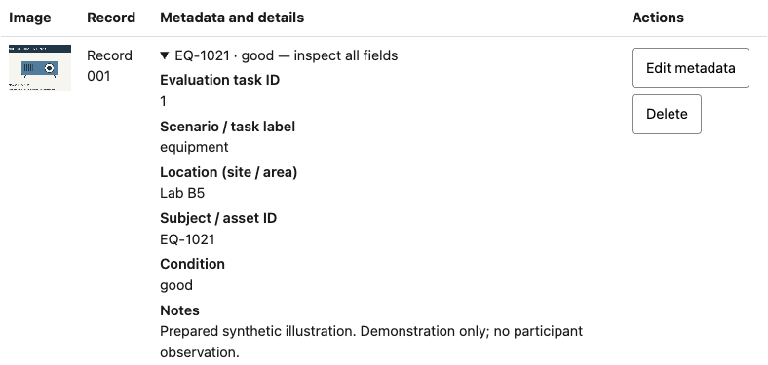
The collection workflow
1 Session
2 Import image
3 Enter metadata
4 Inspect, edit and export
Open remote study
Frozen v2 review screen, 21 Oct. Remote v3 retains this review and export workflow.
HLL-04
07
Notes:
Target: 60 seconds. Main talk target 770 seconds (12 minutes 50 seconds).
The guided interface has four stages: start a session, select an image, enter metadata, then inspect or edit the result before export. Review exposes every field, including task identity and notes. An edit preserves the record ID and image. This screenshot comes from the frozen v2 test on 21 October. The optional 90-second feature demonstration uses frozen desktop v2 and its historical blur feedback. The primary human comparison uses remote v3 with versioned validation timing inside the study wrapper. It supplies the participant code and requires an explicit choice from the prepared fictional images. The wrapper hides camera and arbitrary image import, so this study does not assess physical capture. The landing-page link opens the remote study, which requires a private invitation. I use recorded screens for the main talk. Any live demonstration needs my own rehearsal on synthetic data.
Use the screenshot for the main talk. Point to task ID, exposed metadata and Edit metadata. The hyperlink is optional; do not depend on venue internet. Rehearse any live demonstration on synthetic data first.
Sources
21 October 2026 repaired source and execution evidence: docs/repair-20261021/; browser-results.json; independent-export-verification.json; eval/PROTOCOL.md
work/aws-deploy-20261021/VERIFICATION-SUMMARY.json
work/aws-deploy-20261021/mac-live-regression/browser-results.json
work/aws-deploy-20261021/mac-live-smoke-v2/hosted-smoke-results.json
work/aws-deploy-20261021/linux-first-run/linux-20261021T085639Z/regression/browser-results.json
work/aws-deploy-20261021/linux-smoke-v2/linux-smoke-v2-20261021T090308Z/hosted-smoke/hosted-smoke-results.json
docs/verification-2026-10-26.md (summary of the 26 October remote walkthrough)
26 Oct evidence: fyp-aws-submission-verification.json; independent-zip-verification.json
remote-study/PROTOCOL.md
remote-study/frontend/README.md
remote-study/backend/README.md

Slide 8
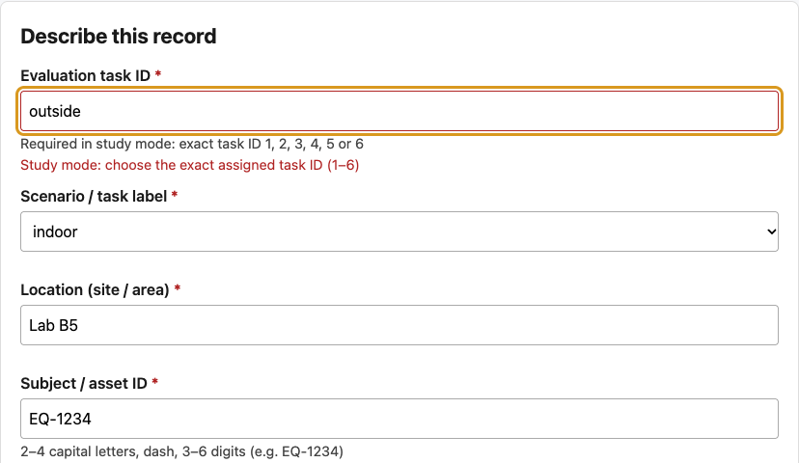
Validation and data accuracy
Task identity
Unknown and duplicate IDs block saving
Invalid inputs
Reject malformed values, corrupt images and duplicate task IDs
Allowed values still need
a truth check
Validation checks (v2), 21 Oct. Remote v3 also blocked empty guided metadata on 26 Oct.
HLL-04
08
Notes:
Target: 55 seconds. Main talk target 770 seconds (12 minutes 50 seconds).
The original guided validation checks presence, format and allowed values. In study mode it also requires an assigned task ID and rejects duplicate IDs. The frozen v2 checks covered corrupt images, a failed replacement and an old asynchronous import. The 26 October remote walkthrough also tried empty guided metadata and observed five field-specific problems before saving could proceed. The measured guided block accepted six records and disabled the seventh-record control. The table deliberately preserves raw answers, including errors and blank cells, because it is the comparison condition. Validation still cannot establish truth. A value can be permitted by the schema and incorrect for a task. Accuracy therefore needs a separate check against the declared task labels.
Point to the inline messages and blocked-save summary.
Sources
21 October 2026 repaired source and execution evidence: docs/repair-20261021/; browser-results.json; independent-export-verification.json; eval/PROTOCOL.md
docs/verification-2026-10-26.md (summary of the 26 October remote walkthrough)
26 Oct evidence: fyp-aws-submission-verification.json; independent-zip-verification.json
remote-study/PROTOCOL.md
remote-study/frontend/README.md
remote-study/backend/README.md

Slide 9
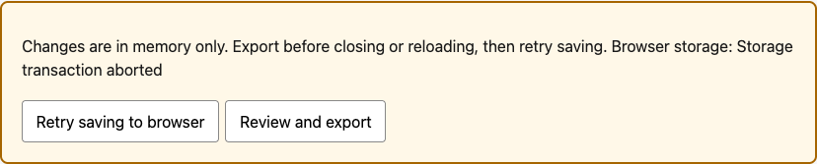
Recovery from a storage failure
1 record persisted
2 records + 1 draft
in working memory
Recovery ZIP kept both
and the separate draft
Retry and reload
restored the work
The previous commit stays intact
Records and the unfinished draft
remain separately recoverable
Recovery check (v2), 21 Oct: induced transaction abort. Natural quota failure remains untested.
HLL-04
09
Notes:
Target: 65 seconds. Main talk target 770 seconds (12 minutes 50 seconds).
The storage-recovery evidence on this slide belongs to frozen v2 on 21 October. The earlier design stored image data in localStorage and could not support the selected workload. The repair uses a transactional IndexedDB snapshot and acknowledges a save after transaction completion. In a deliberately induced abort, one record remained in durable storage while the page held two accepted records and a separate unfinished draft. The recovery ZIP retained that work separately. Retry and reload then restored it. A separate quota override did not produce a failure, so this does not prove natural quota recovery. In remote v3, the new walkthrough retained guided work and table images through refresh, but its task-reference panel reset. Preserving data and preserving the visible context are different requirements.
Point to the warning first. Explain that working memory and persistent storage differ.
Sources
21 October 2026 repaired source and execution evidence: docs/repair-20261021/; browser-results.json; independent-export-verification.json; eval/PROTOCOL.md
docs/verification-2026-10-26.md (summary of the 26 October remote walkthrough)
26 Oct evidence: fyp-aws-submission-verification.json; independent-zip-verification.json
remote-study/PROTOCOL.md
remote-study/frontend/README.md
remote-study/backend/README.md

Slide 10
Traceable export
ZIP contents | Purpose
Image files | Retain the collected data
CSV | Spreadsheet text protection; declared policy
JSON manifest | Raw metadata, IDs, hashes and update history
6 of 6 image hashes matched in both checkpoints
v2 ZIP checks, 21 Oct. Remote v3 Chrome ZIP audits also passed on 26 Oct. Hashes do not establish scene truth.
HLL-04
10
Notes:
Target: 55 seconds. Main talk target 770 seconds (12 minutes 50 seconds).
The ZIP contains images, a CSV and a raw JSON manifest. Image hashes connect the metadata to particular prepared bytes. The frozen v2 test independently checked archive members, image hashes and agreement between the CSV and manifest at two checkpoints. The new remote test added actual desktop Chrome downloads for both measured conditions. Each archive contained six task metadata sets and six matching prepared images. An external reader checked CRC integrity, safe and unique paths, image hashes and CSV-to-manifest agreement. Editing a location after export cleared both file-check confirmations and marked the export stale. Restoring the value and exporting again allowed completion. These checks establish the content and consistency of the downloaded files. They do not establish scene truth or participant usability.
Sources
21 October 2026 repaired source and execution evidence: docs/repair-20261021/; browser-results.json; independent-export-verification.json; eval/PROTOCOL.md
docs/verification-2026-10-26.md (summary of the 26 October remote walkthrough)
26 Oct evidence: fyp-aws-submission-verification.json; independent-zip-verification.json
remote-study/PROTOCOL.md
remote-study/frontend/README.md
remote-study/backend/README.md

Slide 11
Engineering evaluation
Dated engineering evidence from two separate instruments
Evidence | Observed | Scope
Frozen v2, 21 Oct | 82/82 + 42/42 | Each Mac/Linux suite. Node: 47/47
Remote v3, 26 Oct | 6 + 6 records | Chrome ZIPs opened and audited
AWS readback | S005, seq. 43 | 15:35:13 HKT. Synthetic, no image bytes
S005 completed both conditions. Both questionnaires were skipped
Agent-run checks only. No human results, SUS score or interface-speed comparison.
HLL-04
11
Notes:
Target: 75 seconds. Main talk target 770 seconds (12 minutes 50 seconds).
This slide separates the evidence by date and instrument. On 21 October, frozen v2 passed the 82-check regression and 42-check hosting suites on each of Mac and Linux Chrome. Linux also passed 47 Node tests, and 26 frozen kit files matched. On 26 October, an agent completed the remote v3 flow in desktop Chrome using synthetic session S005. Both measured conditions finished with six records, and both ZIPs were downloaded, opened and independently audited. The interface showed a receipt at 15:35:13 Hong Kong time. Independent AWS readback confirmed accepted sequence 43, synthetic exclusion, both completed blocks, both skipped questionnaires and no image bytes in the payload. The walkthrough also found a reset of reference context after refresh and several scrolling areas. The public build lacked a local queue safeguard, although a live slow-network failure was not reproduced. This remains engineering evidence. Agent execution time includes inspection and tool interruptions, so it cannot compare interface speed. This test supplies no human SUS result.
Separate 21 October v2 from 26 October v3. Say “synthetic session” before the S005 outcome. Do not compare agent timings or infer a SUS score.
Additional panel answers
Frozen v2 counts are historical and are not the remote-v3 test count. The original Linux hosting v1 result was 39 checks passed and 1 failed because the camera-denial precondition did not establish a camera. The corrected v2 harness supplied a synthetic device before actual browser permission denial. No physical camera is implied. The 26 October report says S004 retained six guided records and an incomplete-finish checkpoint, with its table unstarted and no final submission. A second tab could not edit or submit S004. In-app-browser export/control limits were environment-specific. Desktop Chrome subsequently produced and opened both measured exports for S005. Both SUS responses were skipped with labelled agent-test comments. S005 is excluded from human analysis. A server receipt and AWS readback support acknowledged storage, not research validity.
Sources
21 October 2026 repaired source and execution evidence: docs/repair-20261021/; browser-results.json; independent-export-verification.json; eval/PROTOCOL.md
work/aws-deploy-20261021/VERIFICATION-SUMMARY.json
work/aws-deploy-20261021/mac-live-regression/browser-results.json
work/aws-deploy-20261021/mac-live-smoke-v2/hosted-smoke-results.json
work/aws-deploy-20261021/linux-first-run/linux-20261021T085639Z/regression/browser-results.json
work/aws-deploy-20261021/linux-smoke-v2/linux-smoke-v2-20261021T090308Z/hosted-smoke/hosted-smoke-results.json
work/aws-deploy-20261021/test-harness-correction.txt
work/aws-deploy-20261021/linux-first-run/linux-20261021T085639Z/hosted-smoke/hosted-smoke-results.json
docs/verification-2026-10-26.md (summary of the 26 October remote walkthrough)
26 Oct evidence: fyp-aws-submission-verification.json; independent-zip-verification.json
remote-study/PROTOCOL.md
remote-study/frontend/README.md
remote-study/backend/README.md

Slide 12
Complete metadata can still be wrong
6 tasks × 4 required fields = 24 metadata cells
Checkpoint in one guided run | Complete | Correct
Initial export | 24 / 24 | 23 / 24
After direct metadata edit | 24 / 24 | 24 / 24
An allowed but wrong condition passed validation
One synthetic run, 21 October. The script knew the error; the edit retained the record ID and image.
HLL-04
12
Notes:
Target: 45 seconds. Main talk target 770 seconds (12 minutes 50 seconds).
This earlier example belongs to one synthetic guided v2 run on 21 October. Six tasks and four required fields give twenty-four scored cells. The script deliberately chose an allowed but wrong condition for task two. The initial export was complete in twenty-four cells but correct in twenty-three. Direct editing corrected that known value. A second export was complete and correct in all twenty-four, while retaining the same record ID and image. The automation already knew the mistake. These are before-and-after checkpoints within one scripted workflow. They demonstrate why format validation and factual accuracy need separate measures. They do not show that a person made fewer errors or that guided collection outperformed the baseline.
Pause on 23/24. This is a deliberately wrong value known by the script.
Sources
21 October 2026 repaired source and execution evidence: docs/repair-20261021/; browser-results.json; independent-export-verification.json; eval/PROTOCOL.md

Slide 13
Remote workflow comparison (v3)
Browser Table
Guided workflow
Six rows with raw text cells
Explicit prepared-image selection
Versioned validation, review and ZIP
Same task cards and image choices
Six tasks each. Alternating order. Two-minute practice per condition
Planned human measures: quality, block time and SUS [4]
Analyze one UI revision at a time. The frozen v2 folder/spreadsheet protocol remains separate.
HLL-04
13
Notes:
Target: 65 seconds. Main talk target 770 seconds (12 minutes 50 seconds).
The remote human method is a new browser-table comparison. Each permitted adult volunteer uses both conditions in the same sitting on their own desktop Chrome. The server alternates starting order across assignments. Each condition starts with a separate two-minute practice and then six assigned tasks, with a fifteen-minute maximum. Both conditions show the same task cards and image choices, and require explicit image selection. The table uses raw text cells. The guided condition retains validation and review, with the immutable UI revision determining when initial errors appear. Legacy and revised sessions are analyzed separately. Block time includes checking, correction, export and self-reported file inspection, but excludes questionnaire and final-upload time. Normal completion requires a current export and file confirmations. People can also finish incomplete, reach the cap or skip. Missing tasks remain in the twenty-four-cell denominators. The exploratory target is six to eight permitted adults, subject to the required arrangements. No human observations are available for this report. Frozen v2 retains its different folder-and-spreadsheet protocol.
Additional panel answers
Remote v3 changes the baseline from a folder/spreadsheet to an in-browser table, allows different participants to use different computers, and uses self-reported local file checks. It therefore cannot be silently pooled with v2. The server submission status is separate from analysis eligibility. Quality, completed timing and valid SUS each need their own eligibility and paired sample size. The synthetic S004/S005 runs cannot enter participant results. Consent screens do not imply institutional approval.
Sources
21 October 2026 repaired source and execution evidence: docs/repair-20261021/; browser-results.json; independent-export-verification.json; eval/PROTOCOL.md
[4] https://digital.ahrq.gov/sites/default/files/docs/survey/systemusabilityscale%2528sus%2529_comp%255B1%255D.pdf
docs/verification-2026-10-26.md (summary of the 26 October remote walkthrough)
26 Oct evidence: fyp-aws-submission-verification.json; independent-zip-verification.json
remote-study/PROTOCOL.md
remote-study/frontend/README.md
remote-study/backend/README.md

Slide 14
Current contribution and remaining work
Implemented
Guided collection and local ZIP export,
plus a separate remote study instrument
Demonstrated
Dated synthetic checks, Chrome ZIP audits
and an acknowledged AWS submission
Still to establish
Human usability, device behaviour
and fit with the industry workflow
Questions
HLL-04
14
Notes:
Target: 45 seconds. Main talk target 770 seconds (12 minutes 50 seconds).
The current contribution is a guided collection prototype with validation, review, recoverable drafts and checked local exports. A separate remote instrument adds structured practice, a browser-table comparison and acknowledged metadata collection on AWS. The evidence now includes dated frozen-v2 tests and a synthetic remote Chrome run, audited ZIPs and direct AWS readback. 26 October follow-up repair: Job 5 restores reference context and strengthens checkpoint, private receipt resume and withdrawal safeguards. Guided nested scrolling remains a protocol review item. The next research step is a permitted human comparison with the exact protocol and build documented. Physical-device behavior and fit with the intended industry workflow remain open. I can defend the implemented behavior and its evidence limits. Human usability and any comparative benefit still need data. Thank you.
End the main talk here. Slides 15–19 are backup slides for questions.
Sources
21 October 2026 repaired source and execution evidence: docs/repair-20261021/; browser-results.json; independent-export-verification.json; eval/PROTOCOL.md
work/aws-deploy-20261021/VERIFICATION-SUMMARY.json
docs/verification-2026-10-26.md (summary of the 26 October remote walkthrough)
26 Oct evidence: fyp-aws-submission-verification.json; independent-zip-verification.json
remote-study/PROTOCOL.md
remote-study/frontend/README.md
remote-study/backend/README.md
docs/maintenance-2026-10-26/code-review-verification.json
docs/maintenance-2026-10-26/aws-deployment-verification.json
docs/maintenance-2026-10-26/deployed-files.json
docs/maintenance-2026-10-26/hosted-six-record-results.json
docs/maintenance-2026-10-26/hosted-aws-submission-verification.json
docs/maintenance-2026-10-26/hosted-zip-verification.json
docs/maintenance-2026-10-26/hosted-slow-network-results.json
docs/maintenance-2026-10-26/hosted-recovery-initial-results.json
docs/maintenance-2026-10-26/hosted-receipt-diagnostic.json
docs/maintenance-2026-10-26/hosted-recovery-verification.json
docs/maintenance-2026-10-26/hosted-receipt-corrected-results.json

Slide 15
Evaluation measures
Measure | Definition
Completeness | Filled required cells / all required cells
Accuracy | Correct required cells / all required cells
Completion time | Whole six-task block, including recovery
SUS [4] | Ten-item questionnaire, 0–100 composite
Count missing tasks. Match explicit task IDs rather than row position. Human timing and SUS are pending.
HLL-04 / Backup
15
Notes:
Backup slide for questions, outside the main talk.
Completeness is the fraction of all assigned required cells that are nonempty. Accuracy uses the same denominator and checks the declared truth. Six tasks give twenty-four cells per condition. Missing tasks remain missing. Task identity and selected-image hash matches are assessed separately. For remote v3, block time includes export generation and self-reported file checks, then stops before final upload. That differs from researcher-verified file inspection in v2. SUS is a ten-item zero-to-one-hundred composite. An absent answer is not imputed, and valid SUS pairs can differ from valid timing or quality pairs. Both questionnaires in synthetic session S005 were skipped, so that run has no SUS score. Human outcome data are unavailable for this report.
Sources
21 October 2026 repaired source and execution evidence: docs/repair-20261021/; browser-results.json; independent-export-verification.json; eval/PROTOCOL.md
[4] https://digital.ahrq.gov/sites/default/files/docs/survey/systemusabilityscale%2528sus%2529_comp%255B1%255D.pdf
docs/verification-2026-10-26.md (summary of the 26 October remote walkthrough)
26 Oct evidence: fyp-aws-submission-verification.json; independent-zip-verification.json
remote-study/PROTOCOL.md
remote-study/frontend/README.md
remote-study/backend/README.md

Slide 16
Limitations and AI assistance
Current limits
AI assistance
26 Oct: synthetic desktop Chrome run
Both SUS questionnaires skipped
No human or physical-camera results
Code, tests and synthetic fixtures
Analysis, report and presentation
Disclosed contribution to this work
The current build needs my personal rehearsal
Student responsibility: explain the design, verify the evidence,
and distinguish personal work from assisted work
HLL-04 / Backup
16
Notes:
Backup slide for questions, outside the main talk.
AI assistance contributed to code, tests, fixtures, analysis, writing, deployment and presentation preparation. I remain responsible for understanding and explaining the work and personally rehearsing the current build. The 26 October test was an agent-run synthetic walkthrough. It used fictional illustrations in desktop Chrome, skipped both SUS questionnaires and supplied no human ratings. The earlier Mac and Linux v2 checks remain separate. The walkthrough found a reference-context reset and nested scrolling. It also identified a public-versus-local queue difference without proving a live slow-network failure. In-app-browser export and control problems were environment-specific, while desktop Chrome downloaded both exports successfully. Cross-browser receipt recovery, withdrawal/deletion, offline and slow-network recovery, a complete set of numeric SUS answers, mobile use, accessibility conformance and hostile-input security were outside this walkthrough. No physical photographs, camera capture, human usability or industrial acceptance result is claimed.
Sources
21 October 2026 repaired source and execution evidence: docs/repair-20261021/; browser-results.json; independent-export-verification.json; eval/PROTOCOL.md
work/aws-deploy-20261021/VERIFICATION-SUMMARY.json
docs/verification-2026-10-26.md (summary of the 26 October remote walkthrough)
26 Oct evidence: fyp-aws-submission-verification.json; independent-zip-verification.json
remote-study/PROTOCOL.md
remote-study/frontend/README.md
remote-study/backend/README.md

Slide 17
Selected references
[1] Hartung et al. (2010)
Open Data Kit: Tools to Build Information Services
for Developing Regions. ICTD.
[3] Bargas-Avila et al. (2010)
Simple but Crucial User Interfaces in the World Wide Web:
Introducing 20 Guidelines for Usable Web Form Design. DOI 10.5772/9500.
[4] Brooke
SUS: A quick and dirty usability scale.
Chapter reproduction hosted by AHRQ.
Empirical sources [8–13]: full citations and access limits in the research slide notes and report.
HLL-04 / Backup
17
Notes:
Backup slide for questions, outside the main talk.
The references establish prior work and the intended measurement method. Hartung and colleagues describe Open Data Kit's collection architecture. Bargas-Avila and colleagues discuss usable web forms, including required fields and feedback timing. Brooke's System Usability Scale supplies the questionnaire and scoring approach for the proposed comparison. The report also retains the official ODK form-logic source. None of these sources establishes that this prototype is better; that would require the project's own comparison.
Sources
[1] https://homes.cs.washington.edu/~anderson/papers/ICTD/ICTD2010.pdf
[3] https://doi.org/10.5772/9500
[4] https://digital.ahrq.gov/sites/default/files/docs/survey/systemusabilityscale%2528sus%2529_comp%255B1%255D.pdf
Empirical research: [8] https://doi.org/10.1145/2556288.2557265; [9] https://doi.org/10.1016/j.intcom.2010.08.001; [10] https://doi.org/10.1016/j.intcom.2012.03.002; [11] https://doi.org/10.2196/10995; [12] https://doi.org/10.3390/informatics13100171; [13] https://doi.org/10.1016/j.intcom.2007.01.003. Full citations and source-access limits accompany slides 5 and 6. Reference IDs match the report.

Slide 18
Recovery safeguards
Browser recovery
Server checkpoint
26 Oct report: reference context reset
Follow-up: restored context verified
Serial requests and acknowledged snapshots
Receipt follows a server response
Local recovery and server receipt answer different questions
Job 5 deploys the reviewed safeguards, 26 Oct.
Guided nested scrolling remains a protocol review item.
Hosted synthetic checks include controlled browser faults. Frozen v2 and the comparison protocol remain unchanged.
HLL-04 / Backup
18
Notes:
Backup slide for questions, outside the main talk.
Recovery has a local-browser part and a server-checkpoint part. The original guided prototype keeps records, images and drafts in isolated IndexedDB storage, with transaction completion and one writer tab. The remote wrapper preserves its own progress and serializes exact idempotent requests. A server receipt follows acknowledgement. The walkthrough retained saved records and drafts after refresh, but the selected outer task-reference card reset, so the visible context could disagree with the recovered draft or table. Several scrolling areas were also a navigation observation, not a measured human effect. Public deployment job 4 matched the report’s recorded source hash and lacked the local checkpoint-busy/coalescing safeguard. Existing requests were serialized. Redundant checkpoints might delay final actions under slow responses, but the walkthrough did not reproduce that failure. The follow-up checks address reference and queue safeguards. Guided layout changes still need protocol review.
26 October follow-up repair: Job 5 restores reference context and strengthens checkpoint, private receipt resume and withdrawal safeguards. Amplify job 5 succeeded at 16:05:05 HKT on 26 October. All 21 served files matched the reviewed release. The backend template and frozen desktop v2 stayed unchanged. A new synthetic session, S006, completed both six-record blocks, produced two independently audited ZIPs and reached accepted AWS submission sequence 5. Its numeric questionnaire answers were synthetic fixtures for the collection path, with no human SUS interpretation. Hosted slow-network checks held a real checkpoint acknowledgement and verified subsequent submission and withdrawal. The initial hosted recovery run passed nine scenarios and timed out on cross-browser receipt restoration. The retained diagnostic showed that the test had waited for an older acknowledgement. Once the latest task metadata was actually acknowledged, the same deployed application restored it correctly in a fresh browser. The corrected focused receipt test then passed with one synthetic session creation, after checking the actual sequence-3 task-row acknowledgement. Together with the original nine passing scenarios, this verifies all ten targeted behaviors across separate runs. The original complete run remains nine of ten, and no full ten-of-ten rerun is claimed. The application stayed unchanged after job 5. Hosted recovery also used controlled browser faults, including injected expiry and network responses. It does not establish real four-hour expiry, ninety-day retention behavior or every AWS deletion race. Guided nested scrolling remains a protocol review item.
Additional panel answers
A private resume receipt restores acknowledged metadata only. Guided images and original instrument state still need the original browser’s namespaced storage. The frontend refuses to silently begin a new timed attempt if that state is missing. A metadata response backup omits the private credential. The receipt is private and must never appear in a public repository or slide. The 26 October walkthrough did not test cross-browser receipt recovery, withdrawal or slow-network behavior.
Follow-up evidence: docs/maintenance-2026-10-26/code-review-verification.json; docs/maintenance-2026-10-26/aws-deployment-verification.json; docs/maintenance-2026-10-26/deployed-files.json; docs/maintenance-2026-10-26/hosted-six-record-results.json; docs/maintenance-2026-10-26/hosted-aws-submission-verification.json; docs/maintenance-2026-10-26/hosted-zip-verification.json; docs/maintenance-2026-10-26/hosted-slow-network-results.json; docs/maintenance-2026-10-26/hosted-recovery-initial-results.json; docs/maintenance-2026-10-26/hosted-receipt-diagnostic.json; docs/maintenance-2026-10-26/hosted-recovery-verification.json; docs/maintenance-2026-10-26/hosted-receipt-corrected-results.json
Sources
21 October 2026 repaired source and execution evidence: docs/repair-20261021/; browser-results.json; independent-export-verification.json; eval/PROTOCOL.md
work/aws-deploy-20261021/VERIFICATION-SUMMARY.json
work/aws-deploy-20261021/OPERATIONS.md
docs/verification-2026-10-26.md (summary of the 26 October remote walkthrough)
26 Oct evidence: fyp-aws-submission-verification.json; independent-zip-verification.json
remote-study/PROTOCOL.md
remote-study/frontend/README.md
remote-study/backend/README.md
docs/maintenance-2026-10-26/code-review-verification.json
docs/maintenance-2026-10-26/aws-deployment-verification.json
docs/maintenance-2026-10-26/deployed-files.json
docs/maintenance-2026-10-26/hosted-six-record-results.json
docs/maintenance-2026-10-26/hosted-aws-submission-verification.json
docs/maintenance-2026-10-26/hosted-zip-verification.json
docs/maintenance-2026-10-26/hosted-slow-network-results.json
docs/maintenance-2026-10-26/hosted-recovery-initial-results.json
docs/maintenance-2026-10-26/hosted-receipt-diagnostic.json
docs/maintenance-2026-10-26/hosted-recovery-verification.json
docs/maintenance-2026-10-26/hosted-receipt-corrected-results.json

Slide 19
Remote v3 on AWS
Component | Role in the remote study
Amplify Hosting | Desktop Chrome study pages and prepared assets
This browser | Images and drafts, local ZIP export, private resume receipt
Lambda + private store | API, DynamoDB receipts and S3 metadata snapshots
Study uploads omit image bytes. Local ZIPs retain the images
https://main.d3g93doyp3ywja.amplifyapp.com/
Invitation required. S005 readback confirmed synthetic exclusion and both skipped questionnaires.
HLL-04 / Backup
19
Notes:
Backup slide for questions, outside the main talk.
This slide describes remote-table-v3, separate from the original static v2 deployment. Amplify serves the study pages and prepared fictional assets over HTTPS. Lambda handles invitation and private session authorization. DynamoDB tracks assignments and accepted receipts, while a private S3 bucket holds metadata snapshots. The browser retains image bytes and produces local ZIP exports. Submitted study payloads include agreed task metadata, selected-image hashes, progress, timing observations and questionnaire responses, but no image contents. The S005 readback confirmed this boundary for the tested final payload. The API has private authorization and bounded small-study safeguards, but this is not a security or scale audit. The public landing page needs a private invitation. The separate human and synthetic invitations and resume credentials must remain private.
Give the short explanation first. Use the additional defence answers only for the panel’s specific questions.
Additional panel answers
The backend documents a four-hour collection window and a ninety-day retention policy. TTL and S3 lifecycle processing are asynchronous, so they do not guarantee deletion at an exact time. Withdrawal can be pending and must not be described as completed until cleanup is acknowledged. The 26 October walkthrough did not test withdrawal. The original static v2 host and its earlier EC2 test runner are separate infrastructure. Do not describe the remote metadata collector as browser-only storage or as a store of uploaded photographs. No new EC2 application server is used.
Sources
AWS Amplify Hosting user guide: https://docs.aws.amazon.com/amplify/latest/userguide/welcome.html (accessed 21 October 2026; source preserved in docs/report-evidence/aws-amplify.txt)
AWS manual deployments: https://docs.aws.amazon.com/amplify/latest/userguide/manual-deploys.html (accessed 21 October 2026; source preserved in docs/report-evidence/aws-manual.txt)
work/aws-deploy-20261021/VERIFICATION-SUMMARY.json
work/aws-deploy-20261021/mac-live-regression/browser-results.json
work/aws-deploy-20261021/mac-live-smoke-v2/hosted-smoke-results.json
work/aws-deploy-20261021/linux-first-run/linux-20261021T085639Z/regression/browser-results.json
work/aws-deploy-20261021/linux-smoke-v2/linux-smoke-v2-20261021T090308Z/hosted-smoke/hosted-smoke-results.json
work/aws-deploy-20261021/test-harness-correction.txt
work/aws-deploy-20261021/OPERATIONS.md
work/aws-deploy-20261021/live-after-runner-stopped.json
work/aws-deploy-20261021/infrastructure-verification.json
work/aws-deploy-20261021/http-and-exposure-checks.json
docs/verification-2026-10-26.md (summary of the 26 October remote walkthrough)
26 Oct evidence: fyp-aws-submission-verification.json; independent-zip-verification.json
remote-study/PROTOCOL.md
remote-study/frontend/README.md
remote-study/backend/README.md

