Slide 1

AI for Bharat
UBID Unified Business Identifier & Active Business Intelligence
One identifier. Every business. Full clarity.
Team Members
Nikhil
K Harinadha Reddy
"You can't govern what you can't identify."

Slide 2
PROBLEM STATEMENT
The Problem with Karnataka's Business Data Today
The Core Flaw: Karnataka has 40+ government department systems Shop Establishment, Factories, Labour, KSPCB, BESCOM and more. Every single one was built in isolation with no shared ID for businesses.
The same business exists as completely different records in different databases. There is no way to connect them.
PAN and GSTIN exist in some systems but are only partially filled — so even the federal anchors can't be used reliably.
The Cascading Failure
No Join Key: Karnataka C&I cannot link a business's records across even two departments.
No Activity View: Inspections, renewals, compliance events all trapped inside individual department silos.
No Answer: "How many factories in Bengaluru had no inspection in 18 months?" impossible to answer today.
No Migration Option: A big-bang migration like the GST rollout caused months of chaos. That approach cannot be repeated here.
The Consequence: Compliance tracking, audits, and policy decisions are all based on incomplete, disconnected data.
40+
0
12+
~100%
Simple questions Karnataka cannot answer today
Months it took to recover from GST data issues
Businesses that exist under different names across departments
Government departments with no shared business ID

Slide 3
Proposed Solution
UBID: One ID for Every Business, Across Every Department
"UBID doesn't touch any existing system. It just connects them and finally lets Karnataka see the full picture."
Link
Classify
Explain
Every business across all 40+ departments gets one single permanent ID called a UBID. No existing system is changed or replaced. UBID just reads from them and connects the dots.
Once linked, UBID tracks activity inspections, renewals, filings, electricity usage and automatically labels each business as: Active, Dormant, or Closed.
Every decision the system makes comes with a simple, plain explanation of why it decided that. No black boxes. Every decision can be reversed and asked for in simple query
Matches records using business name, address, PAN and GSTIN
Confident matches are linked automatically
Uncertain matches go to a human reviewer
Every link is logged and can be undone
Active → business has recent filings, inspections or licence renewals.
Dormant → no activity for an extended period
Closed → closure notice or zero signals detected
Shows exactly which events drove the classification decision
Reviewer can see a field-by-field breakdown of why two records were linked
Every decision has a confidence score
No engineering needed to override any officer can correct it directly
The classification updates automatically as new activity events come in.
No manual engineering required.

Slide 4
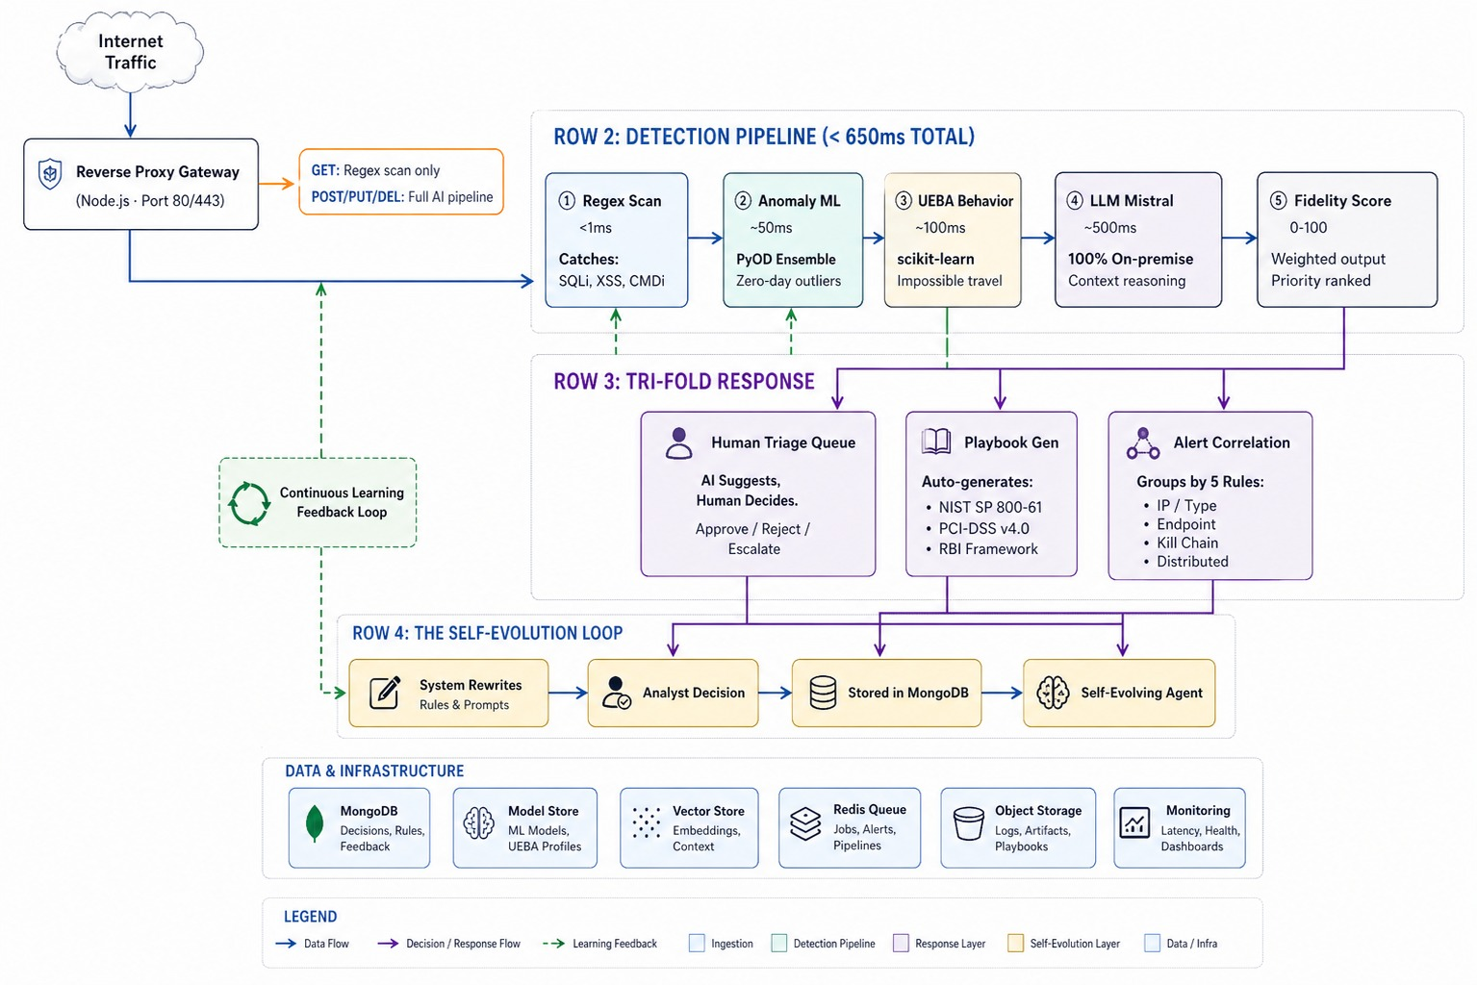
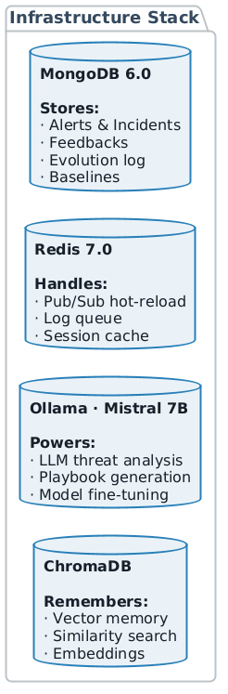
SYSTEM ARCHITECTURE

Slide 5

TECHNICAL METHODOLOGY: DETECTION PIPELINE
ENTITY RESOLUTION PIPELINE
UBID matches business records across departments using a 4-step pipeline - from cleaning raw data to assigning a final ID.
MATCHING LAYERS
Layer | Method | Technology | What it Matches | Speed
Exact ID Match | PAN / GSTIN exact lookup | PostgreSQL index | Same business with a federal ID | < 1 ms
Name Similarity | Fuzzy match on cleaned names | RapidFuzz (token sort ratio) | Same business with name spelling variations | ~ 20 ms
Address Match | PIN code + locality comparison | Custom normaliser | Same business at the same location | ~ 30 ms
ML Scoring | XGBoost binary classifier | XGBoost + SHAP | Ambiguous records with partial or missing data | ~ 50 ms
CONFIDENCE SCORE DISTRIBUTION
MATCH DECISION RULES
PAN / GSTIN Match
35%
Rule | Trigger Condition | Meaning
PAN Anchor | Exact PAN found in 2+ systems | Instant link — confidence 1.0
GSTIN Anchor | Same GSTIN root across systems | Auto linked, flagged if PAN absent
Name Conflict | Same name, different address | Sent to review queue
Duplicate within Dept | Same business registered twice in one dept | Merged before cross-dept linking
Escalation | Reviewer flags as complex | Routed to senior officer
Name Similarity
25%
Address Match
20%
Phone / Email
10%
ML Classifier
10%
CONFIDENCE BANDS
90 – 100
AUTO LINK
Instantly linked
70 – 89
HIGH
Auto link with log
55 – 69
REVIEW
Sent to human officer
0 – 54
REJECT
Kept as separate businesses

Slide 6
TECHNICAL METHODOLOGY: SELF-EVOLUTION ENGINE
Rule Refinement
Validation & Rollback
Trigger: A new type of business name mismatch is confirmed by reviewer.
Process:
•System analyses the failed match pattern
· Generates a new normalisation rule automatically
· Tested on existing records before deployment
· Logged in the audit trail
Result: New name variations get matched correctly without manual rule writing.
Applied to:All system improvements.
Process:
• Runs in shadow mode first — old and new run together
· Compares old vs new accuracy on real records
· Deploys only if the new version performs better
· Instant rollback available if anything breaks
Result: System improves safely — nothing breaks during updates.
SELF-EVOLVING AGENT
Continuously learns from reviewer decisions and automatically improves matching accuracy, confidence thresholds, and the AI model.
Threshold Tuning
Model Retraining
Trigger: Too many correct matches going to review queue unnecessarily.
Process:
· Raises auto-link threshold if reviewers keep approving
· Lowers it if reviewers keep rejecting · Keeps total decision accuracy = 100%
Result: Confidence bands automatically adjust to real-world data over time.
Trigger: 500+ new reviewer decisions accumulated.
Process:
• Uses confirmed matches as positive training data · Uses rejected matches as negative training data · Retrains XGBoost classifier on updated dataset · Deploys only if accuracy improves by 2%+
Result: AI learns directly from real Karnataka business data..
Weight Adjustment
Trigger: One matching signal is consistently wrong.
Process:
•Measures accuracy of each signal PAN, name, address, phone
• Increases weight of signals that are reliable
• Total matching weight always sums to 100%
Result: Matching gets smarter with every reviewer decision made.
"Unlike a static database, UBID automatically gets more accurate over time learning from every decision a reviewer makes."

Slide 7
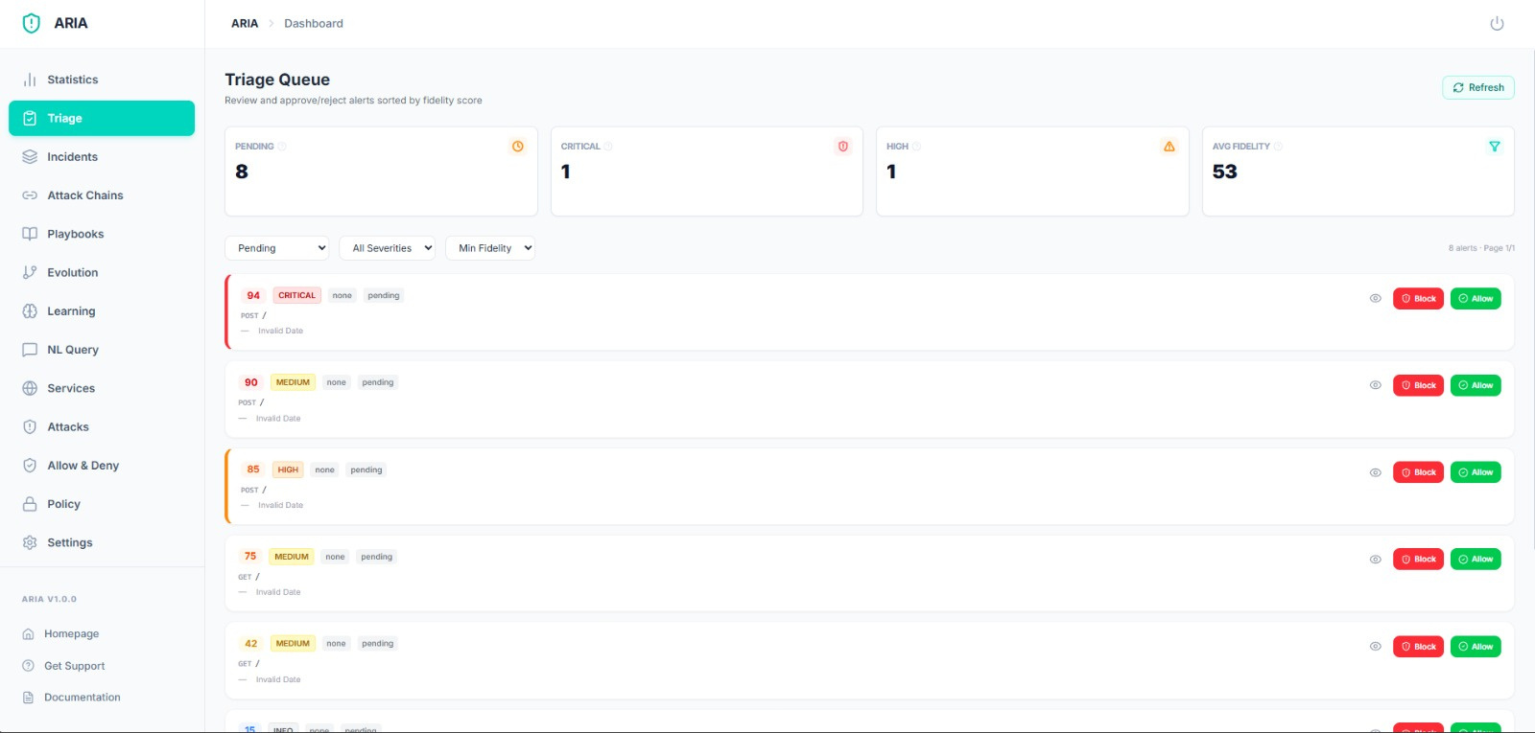
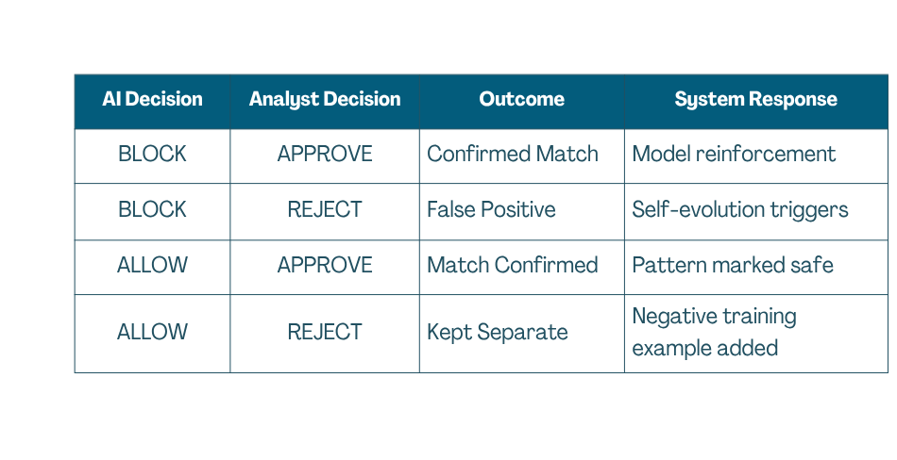
HUMAN TRIAGE + FEEDBACK LOOP
4 Possible Decision Outcomes
Core Philosophy
· AI suggests matches, humans make the final call
· Prevents wrong business records from being silently merged
· Every reviewer decision becomes a training example
· System continuously gets more accurate over time
· No match is ever permanent — any decision can be reversed
Human expertise + AI automation
working together for safer security decision.

Slide 8
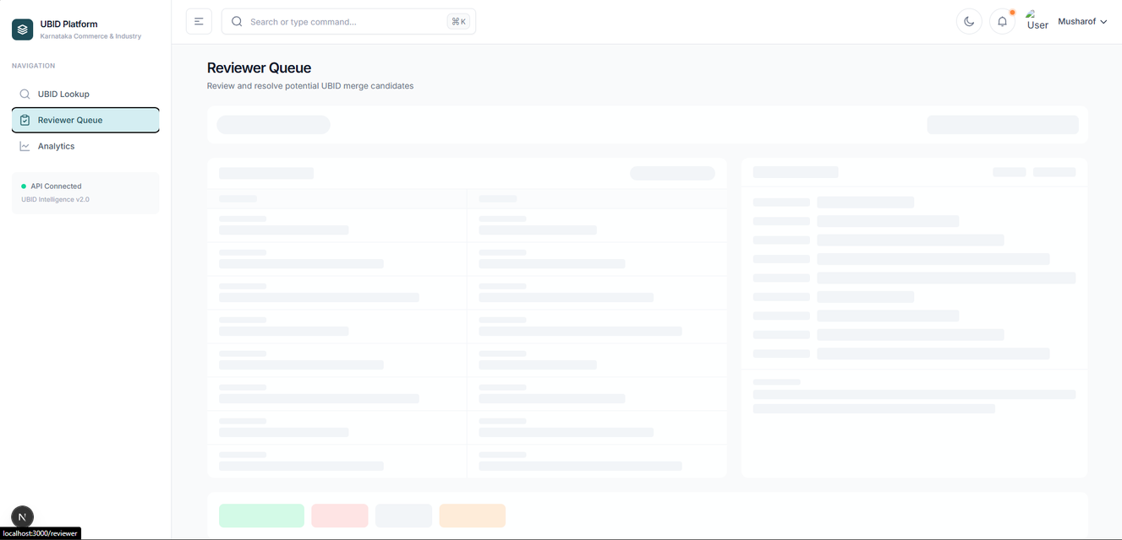

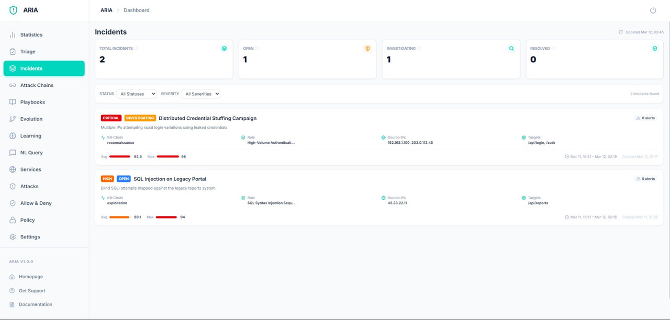
Dashboard
Triage & Monitoring
Real-time monitoring and geographic analysis
Management Dashboard
Correlated incidents with scoring
GitHub Repository
LIVE WEBSITE
GIT HUB
DEPLOYED LINK

Slide 9
DATA ARCHITECTURE
PostgreSQL TABLES
VECTOR / INDEX COLLECTIONS
Table | Stored Data | Used By
Businesses | Raw records from all departments, canonical schema, ingest timestamp | Resolution Engine
UBID Registry | Final UBID, linked records, confidence score, anchor type | All Layers
Review Queue | Pending matches, confidence band, reviewer ID, decision, timestamp | Reviewer Dashboard
Audit Log | Every link, rejection, override, and model update with full history | Compliance & Officers
Events | Activity events — inspections, renewals, filings, electricity readings | Activity Classifier
Classifications | Active / Dormant / Closed label, confidence score, SHAP explanation | Business Intelligence
Collection | Purpose
Business Names | Finds similar business names during fuzzy matching
Address Tokens | Matches addresses with spelling variations
Reviewer Decisions | Finds similar past cases to assist reviewers
Learned Patterns | Prevents duplicate normalisation rules from being generated
SHAP Explanations | Retrieves similar explanations for classification decisions
REDIS ROLES
MATCH DISTRIBUTION
Auto Linked (PAN / GSTIN)
35%
CACHE
QUEUE
PUB/SUB
Auto Linked (High Confidence)
30%
Cache
Queue
Pub/Sub
Stores blocking keys and candidate pairs during resolution runs for fast lookup without hitting PostgreSQL.
Buffers incoming activity events before writing to the database — prevents overload during high traffic.
Instantly notifies the reviewer dashboard when a new case lands in the review queue — no page refresh needed.
Sent for Human Review
25%
Kept Separate (Low Confidence)
10%
Total Records Processed: Across 40+ departments
Human review ensures no wrong merges are silently committed.

Slide 10

EXPECTED IMPACT
Metric | Without UBID | With UBID | Measurable Impact
Business Identification | Manual search across 40+ systems | One UBID lookup — instant | From days to milliseconds
Cross-Department View | Impossible — no shared ID | Full activity history in one place | 40+ systems connected
Match Accuracy | 0% — no matching exists today | Auto-linked + reviewer verified | Continuously improving
Wrong Merges | N/A — no linking attempted | Reviewer catches all edge cases | Zero silent wrong links
Activity Classification | Manual, outdated, unreliable | Auto-classified daily — Active / Dormant / Closed | Real-time business status
Compliance Queries | Weeks of manual data pulling | Answered in seconds from dashboard | From weeks to seconds
GOVERNMENT COMPLIANCE
SCALE FOR KARNATAKA
100% On-Premise:
The Problem:
All data stays inside Karnataka's own servers. Nothing goes to any external cloud or third party.
40+ departments generate thousands of fragmented records with no way to connect them today.
Read-Only by Design:
The UBID Solution:
No source system is ever modified. Existing department data is fully protected.
Smart blocking filters millions of record pairs down to only the most likely matches — reviewers only see genuinely unclear cases, not everything.
Full Audit Trail:
Horizontal Scalability:
Every link, rejection, and classification is logged with timestamp and reviewer ID. Any decision can be traced and reversed.
New departments are added by plugging in one new adapter. No changes needed to the core system.
The Advantage:
The Result:
The only business registry system deployable across Karnataka's departments without replacing a single existing system.
Karnataka can answer district-level, sector-level, and compliance-level questions it has never been able to answer before.

Slide 11
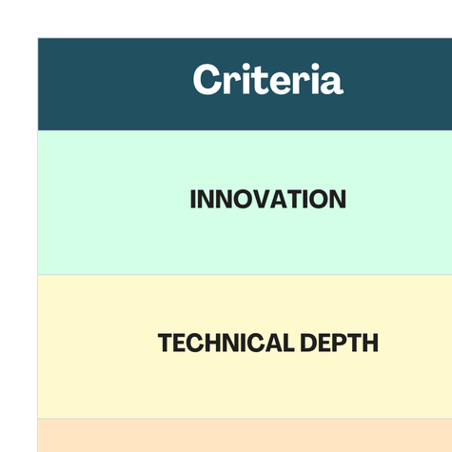
CLOSING SUMMARY

