Slide 1


PSB Hackathon Series 2026
IntelliCredit Subtitle: AI-Powered Alternate Credit Scoring for the Unbanked
Problem 1: AI driven Credit for borrower with no credit history
Team Members
Team Name : Diet Code
Registration ID: HACK-1D598347
  Nikhil
  K Harinadha Reddy

Slide 2
PROBLEM STATEMENT
The Credit Gap No One Talks About
190 million Indians are "credit invisible" - they have no credit history. Banks reject them not because they are financially irresponsible, but because the system has no way to see them. Traditional credit scores only work for people who already have loans. Everyone else is locked out permanently.
The Cascading Failure
  The Gap - 190 million adults have no formal credit score and cannot access any institutional loan
  The Bias - Existing models reject first-time borrowers, gig workers, and rural users by default - not by evidence
  The Risk - Lenders either reject good borrowers or approve bad ones without better data. Both outcomes cause loss
  The Legal Block - AI scoring tools risk violating India's DPDP Act 2023 without explicit per-source consent
90M+
₹3.5L Cr
90%
30 Sec
Potential lending market left untapped
Loan rejections among first-time borrowers
Credit-invisible adults in India
Time IntelliCredit takes to score a user

Slide 3
Proposed Solution
IntelliCredit: A Credit Score Built From How You Live
IntelliCredit doesn't ask if you've taken loans before. It looks at how you pay your phone bill, how stable your address is, and how you answer 30 simple questions and builds a fair, explainable score in 30 seconds.
Collects
Scores
Explains
Every consented data source - UPI transactions, telecom payments, shopping patterns, location stability, questionnaire answers, and merchant activity - is fetched simultaneously by 6 parallel workers in 30 seconds.
A two-tier ML engine (XGBoost + LightGBM) blends all signals into a score from 0 to 850. Users with zero financial history still get a fair score using the Tier 1 model built on 3 alternate signals.
SHAP (Shapley values) breaks down exactly why you got your score - which signals helped, which hurt, and by how many points. The RAG Advisor answers any question in plain language, grounded in RBI guidelines.

Slide 4
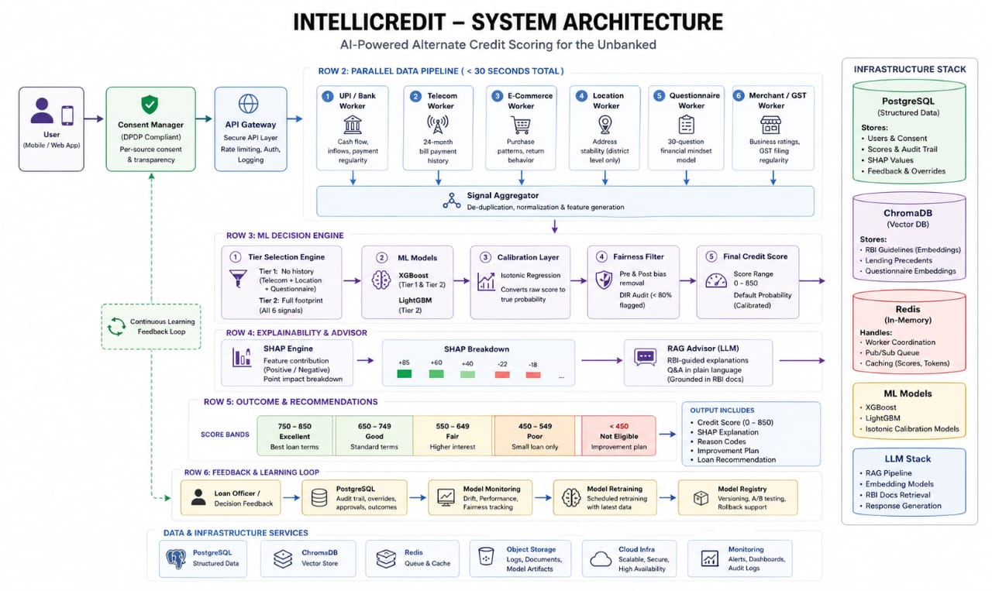

Slide 5

DATA PIPELINE
ID | Source | Key Signal | Weight
D1 | Bank / UPI | Transaction inflows, payment regularity | 25%
D2 | Telecom | 24-month bill payment history | 20%
D3 | E-Commerce | Purchase patterns, return rate | 15%
D4 | Location | Address stability (district-level only) | 15%
D5 | Questionnaire | 30-question financial mindset model | 15%
D6 | Merchant / GST | Business ratings, filing regularity | 10%
Score Bands
750–850
Best loan terms
Excellent
650–749
Standard terms
Good
550–649
Higher interest
Fair
450–549
Small loan only
Signal Conflict Flags
Poor
⚑ Stable UPI income + high e-commerce return rate → Consolidator flags contradiction
⚑ Unstable location + high questionnaire responsibility score → Tier 1 adjusts weight
< 450
Improvement plan
⚑ RBI wilful defaulter → score hard-capped at 200, no override
Not Eligible

Slide 6
ML Engine
Every Score Is Auditable. Every Rejection Has a Reason.
Tier 1 — Zero History
Tier 2 — Digital Footprint
Isotonic Calibration
  Trigger: No bank/UPI data
  Uses Telecom + Location + Questionnaire
  Simpler XGBoost, capped ceiling
  First-time borrowers still scored fairly
  Trigger: UPI/bank/merchant data available
  All 6 workers feed the engine
  XGBoost + LightGBM run independently
  Weighted blend for max accuracy
  Converts raw output to true probability
  70% default risk = 70% historically
  Prevents over/underconfident predictions
  Score is trustworthy, not just a ranking
Fairness Filter
Validation & Rollback
  Remove gender, religion, caste pre-model
  Balanced training across demographics
  Post-score DIR audit: <80% → red flag
  Score reflects behavior, not identity
  Every model version tested on held-out data
  Deployed only if accuracy improves
  Previous version restored instantly if worse
  Model improves safely over time

Slide 7
SHAP + Fairness Loop
Every decision is auditable, explainable, and RBI-compliant
Core Philosophy
4 Score Outcomes
750–850
Loan approved, best terms shown
SHAP Transparency
Excellent
Every signal's contribution is shown in plain language — positive and negative.
RBI Fair Practices
650–749
Standard loan offer presented
Every rejection legally requires a reason. We show exactly what to improve.
Good
RAG Advisor
550–649
Smaller loan, higher interest explained
Natural language Q&A grounded in real RBI guidelines. No hallucinations.
Fair
3-Layer Fairness
Pre-processing, in-processing, and post-processing bias controls enforce equity.
< 550
SHAP breakdown + 6-month improvement plan
Poor / Not Eligible
Human-readable explanations + AI accuracy — working together for fair credit decisions.

Slide 8
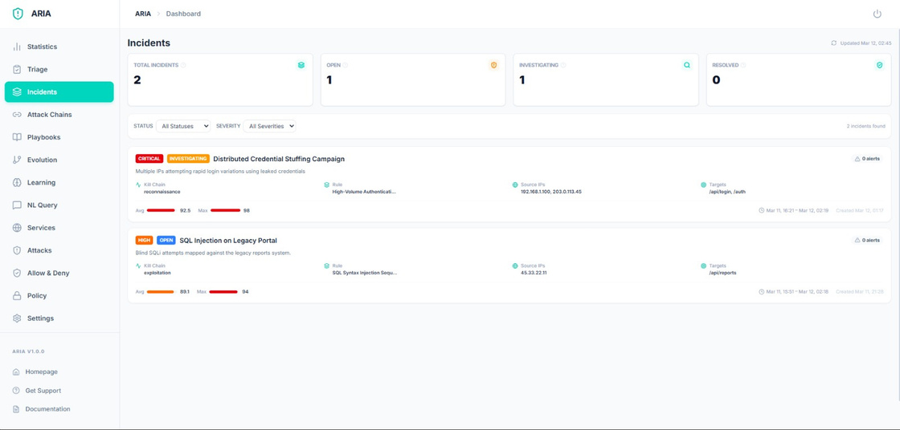
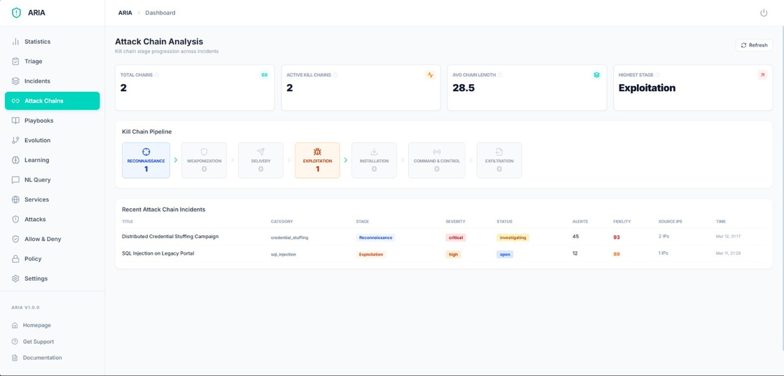
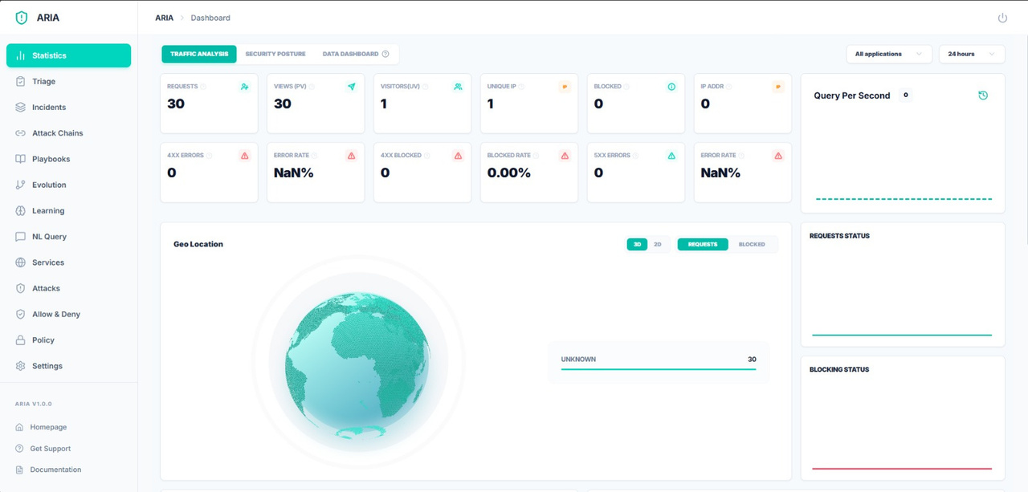
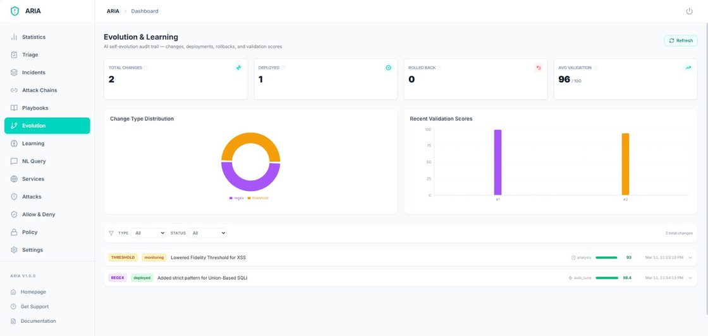
Dashboard

Slide 9
SHAP Breakdown + RAG Advisor
Transparency at the individual level
SHAP Score Breakdown
RAG Advisor — Ask Anything
Score: 720 — GOOD ✅
ChromaDB Vector Search
200+ RBI policy documents indexed as embeddings
✅ Phone bill payments — 23/24 on time
+89 pts
Retrieval-Grounded
✅ UPI inflow — steady 12-month growth
+67 pts
Every answer is retrieved, not generated — zero hallucinations
Lending Precedents
✅ Questionnaire — strong responsibility
+45 pts
Historical case embeddings inform contextual advice
⚠️ E-commerce return rate — above avg
−23 pts
Plain Language
Complex regulatory guidance translated for first-time borrowers

Slide 10
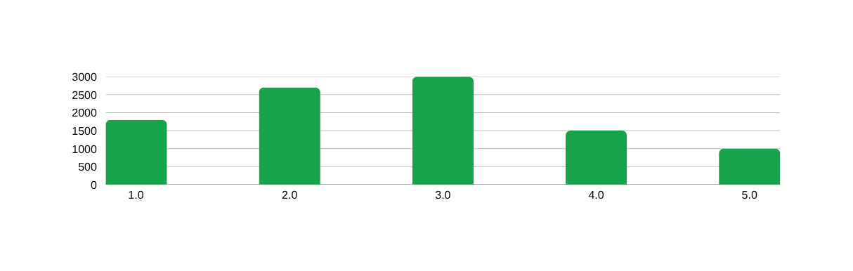
Data Architecture
10,000+ applicants processed (simulated) — Score distribution optimised for loan officer focus
PostgreSQL
Structured Decisions
ChromaDB
Vector Intelligence
Structured Decisions
Redis
Worker Coordination
  users - consent records, basic profile
  scores - full audit trail per applicant with timestamp
  shap values - per-feature point breakdown stored per decision
  feedback - loan officer decisions and override logs
  rbi_guidelines - 200+ RBI policy documents indexed as embeddings
  lending_precedents - historical case embeddings for RAG retrieval
  questionnaire_embeddings - user financial mindset vectors for similarity search
  Pub/Sub: Signals completion of all 6 workers to the Consolidator
  Queue: Buffers incoming scoring requests during peak load
  Cache: Stores session state, partial scores, and dashboard data
Score Distribution (Simulated — 10,000 applicants)
18%
27%
30%
15%
10%
Excellent
Good
Fair
Poor
Not Eligible

Slide 11
Compliance + Expected Impact
DPDP ACT COMPLIANCE
PS1 COMPLIANCE CHECKLIST
Consent-First by Design
Requirement | Implementation
✓ Phone bill payment consistency | D2 Telecom Worker
✓ E-commerce purchase behavior | D3 E-Commerce Worker
✓ Geolocation stability | D4 Worker (district-level only)
✓ Questionnaire-based risk | D5 Psychometric Worker
✓ Merchant ratings | D6 Worker
✓ Bank account cash flow | D1 UPI/Bank Worker
✓ Psychometric & behavioral models | XGBoost + LightGBM blend
✓ Consent-based data flow | DPDP-compliant per-source consent
✓ Privacy & encryption compliance | No PII stored, derived scores only
✓ Responsible lending practices | Hard blocks + DIR audit + SHAP
Every data source requires explicit per-source opt-in before access
DPDP Act 2023
Data minimization & purpose limitation enforced. No PII stored — derived scores only
RBI Fair Practices Code
SHAP explanation mandatory on every rejection. Full audit trail in PostgreSQL
IT Act 2000
All processing on-premise. Data residency compliant
RBI KYC Guidelines
District-level location only. No GPS. Geolocation capped at 5% feature weight

Slide 12
FUTURE SCOPE
Federated Learning
Account Aggregator Integration
Loan Marketplace API
Train the ML model across multiple banks without any raw user data leaving the institution. Privacy-preserving improvement at scale.
Pull consented financial data via RBI's official AA framework for real-time, verified bank feed data in production.
Connect approved users directly to NBFC and bank partners. Instant loan offers with pre-filled applications based on ICA score.
01
02
03
Continuous Score Updates
Voice-Based Questionnaire
Multilingual RAG Advisor
Re-score users monthly as new UPI and telecom data flows in. Score improves in real time as the borrower builds positive behavior.
Replace the text form with voice input in Hindi and regional languages built for low-literacy rural borrowers.
Answer user questions in Hindi, Marathi, Tamil, Telugu, and 8 other regional languages. Same RBI-grounded answers, any language.
04
05
06

