Slide 1


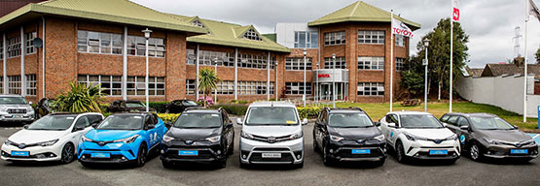
CAR SALES OF UKRAINE IN 2016
By
Gujju Hari Kesava Sree Venkata Ramana Reddy

Slide 2
Project Introduction
Dataset used : Car Sales data set from Insaid Github (https://github.com/insaid2018/term-1/tree/master/Data/Projects).
01
Goal : Based on Cars, how can Car sales can be increased in developing country like Ukraine near future?
02
There are total 10 columns and 9576 records available

Slide 3
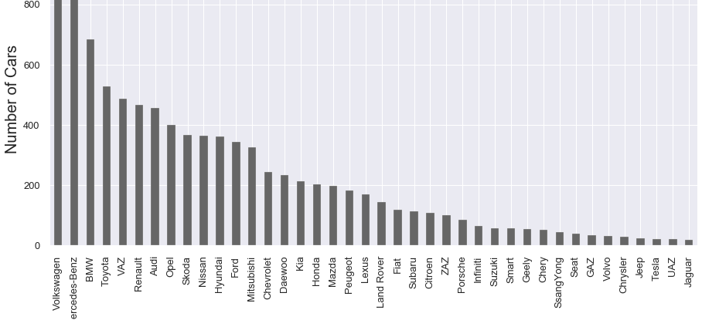
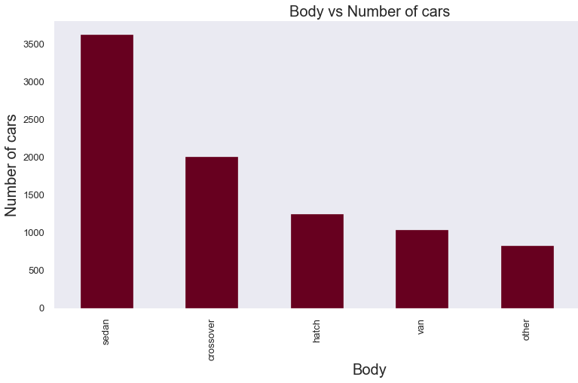
Car Sales from Each Manufacture Brand
Volkswagen , Mercedes-benz, BMW, Toyota, VAZ are having more sales in Ukraine till 2016
Sedan cars are most used cars

Slide 4

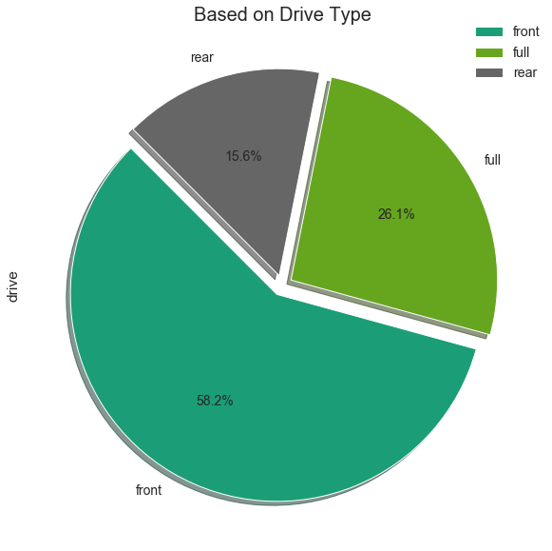
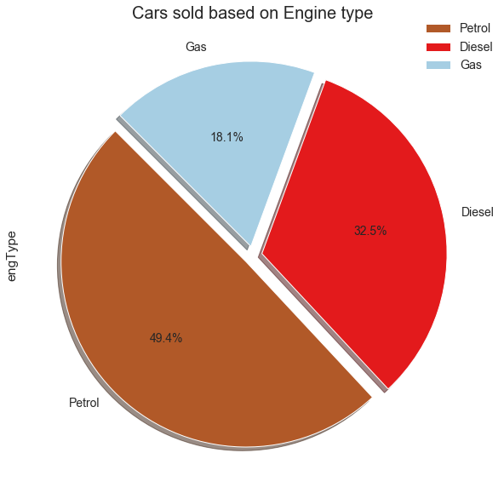


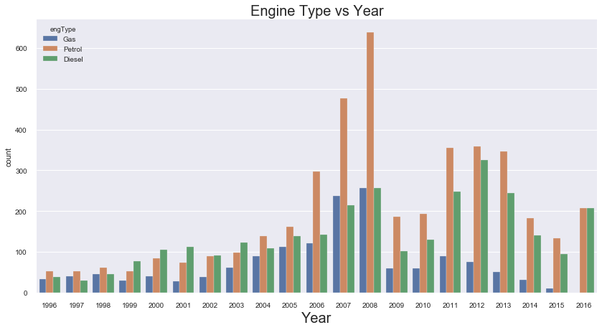

2008 highest number of cars are been sold
2008 there are more petrol cars but in 2016 petrol and diesel cars are equal
Petrol engines are more chosen
40% are petrol cars and 32% are diesel cars
58% of cars are front drive

Slide 5
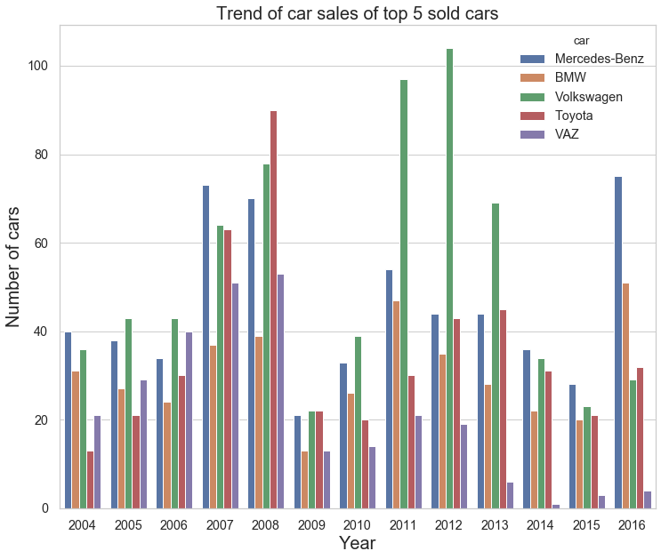
Trend of car sales of top 5 sold cars
Mercedes have decent sales and it has sales in 2014,2015,2016
Volkswagen sales are high in year 2011,2012 and there is a drop in sales in last three years
BMW sales are fluctuating but in 2016 it has highest sales over last 12 years
After 2008 VAZ sales are decreasing and in 2014 it has lowest record of lowest sales
Toyato has highest sale in 2016 and lowest in 2004.

Slide 6
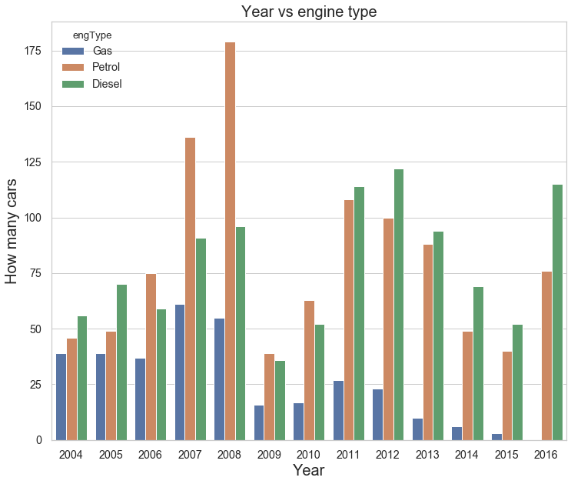
Till 2009 Petrol cars has more sales , later on Diesel cars over crossed Petrol car sales but in 2010 Both Diesel and Petrol cars have same number of sales in TOP cars sold.

Slide 7
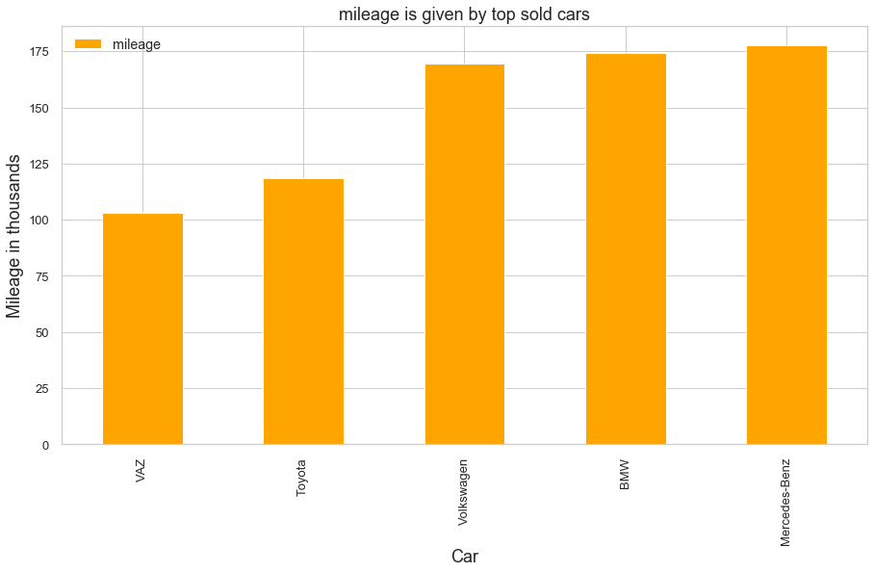
Mercedes gives more mileage in all four and BMW , Volkswagen are very near to Mercedes

Slide 8
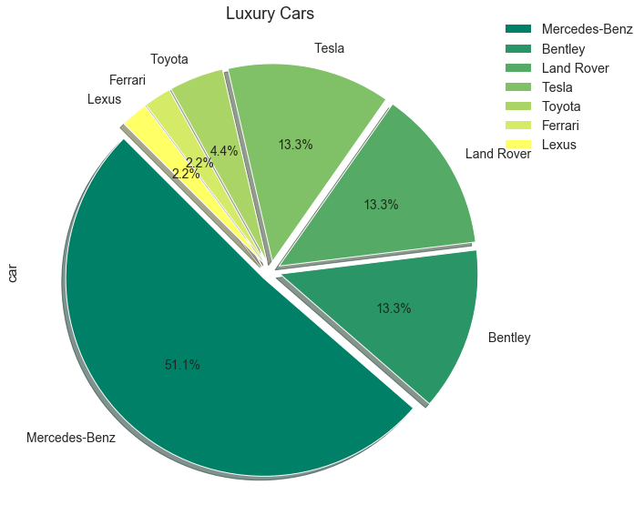
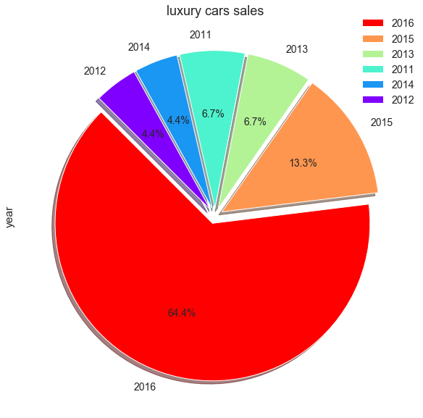
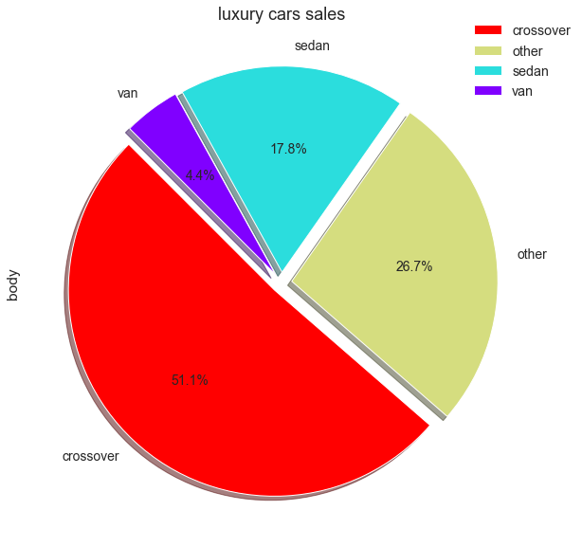
Luxury cars
Sales of luxury cars started in the year 2011. In 2016 sales are very high , More than 50% sales of luxury cars are in 2016
Crossover are more sold in year 2016
50% of luxury are manufactured by Mercedes

Slide 9
Conclusion
Volkswagen , Mercedes-Benz, BMW, Toyota, VAZ are most sold cars in Ukraine
Taxi is most commonly used transport in Ukraine asper the statistics (https://mtu.gov.ua/en/content/statistichni-dani-po-galuzi-avtomobilnogo-transportu.html), Sedan cars are most used.
2008 is most successfully year for car sales , which is highest record from past 60 years, there has been increase from 2006 but 2008 remains highest.
2016 is the year where 50% of the luxury cars sold and out of it 50% is Mercedes-Benz, one of the reason would be due to mileage, and it is same for sales increase of BMW cars as well.
People are opts to buy more SUV's , as most of the luxury cars are SUV's
Diesel cars are having more sales in Top 5 sold cars overall it petrol

Slide 10
INSIGHTS
Mercedes-Benz, BMW can increase their sales by keeping more stores
Car manufactures can concentrate in producing more SUV's and Sedan cars to increase sales
People are using more Diesel cars in last four years

