Slide 1



Customer Success Team
View in Power BI
Developed by:
Haris Shanmugam – Software Engineer
Hexaware Technologies
Microsoft Certified Data Analyst Associate
Last data refresh:
3/6/2022 12:50:50 PM UTC
Downloaded at:
3/6/2022 2:46:29 PM UTC

Slide 2
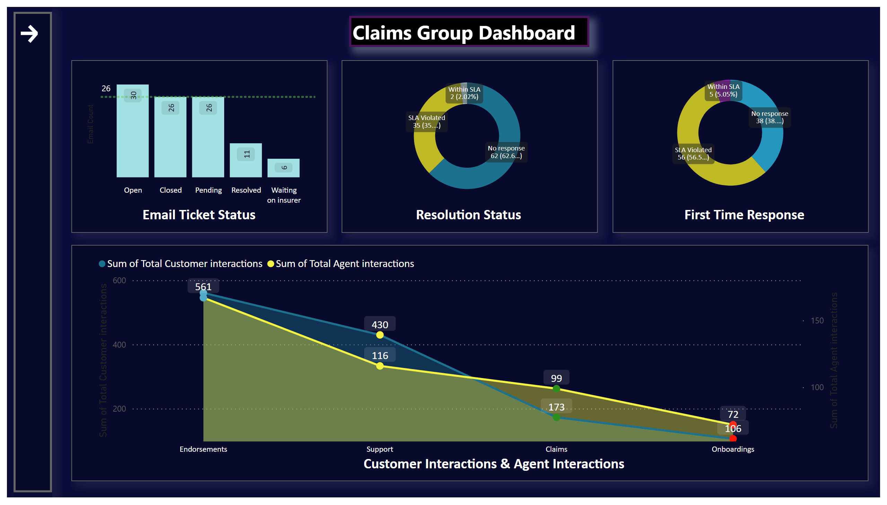
Claims
Notes:
nav_open_1
No alt text provided
nav_1
No alt text provided
actionButton
No alt text provided
basicShape
No alt text provided
actionButton
No alt text provided
actionButton
No alt text provided
actionButton
No alt text provided
actionButton
No alt text provided
actionButton
No alt text provided
actionButton
No alt text provided
actionButton
No alt text provided
actionButton
No alt text provided
textbox
No alt text provided
clusteredColumnChart
No alt text provided
actionButton
No alt text provided
donutChart
No alt text provided
textbox
No alt text provided
actionButton
No alt text provided
textbox
No alt text provided
donutChart
No alt text provided
actionButton
No alt text provided
actionButton
No alt text provided
areaChart
No alt text provided
textbox
No alt text provided

Slide 3
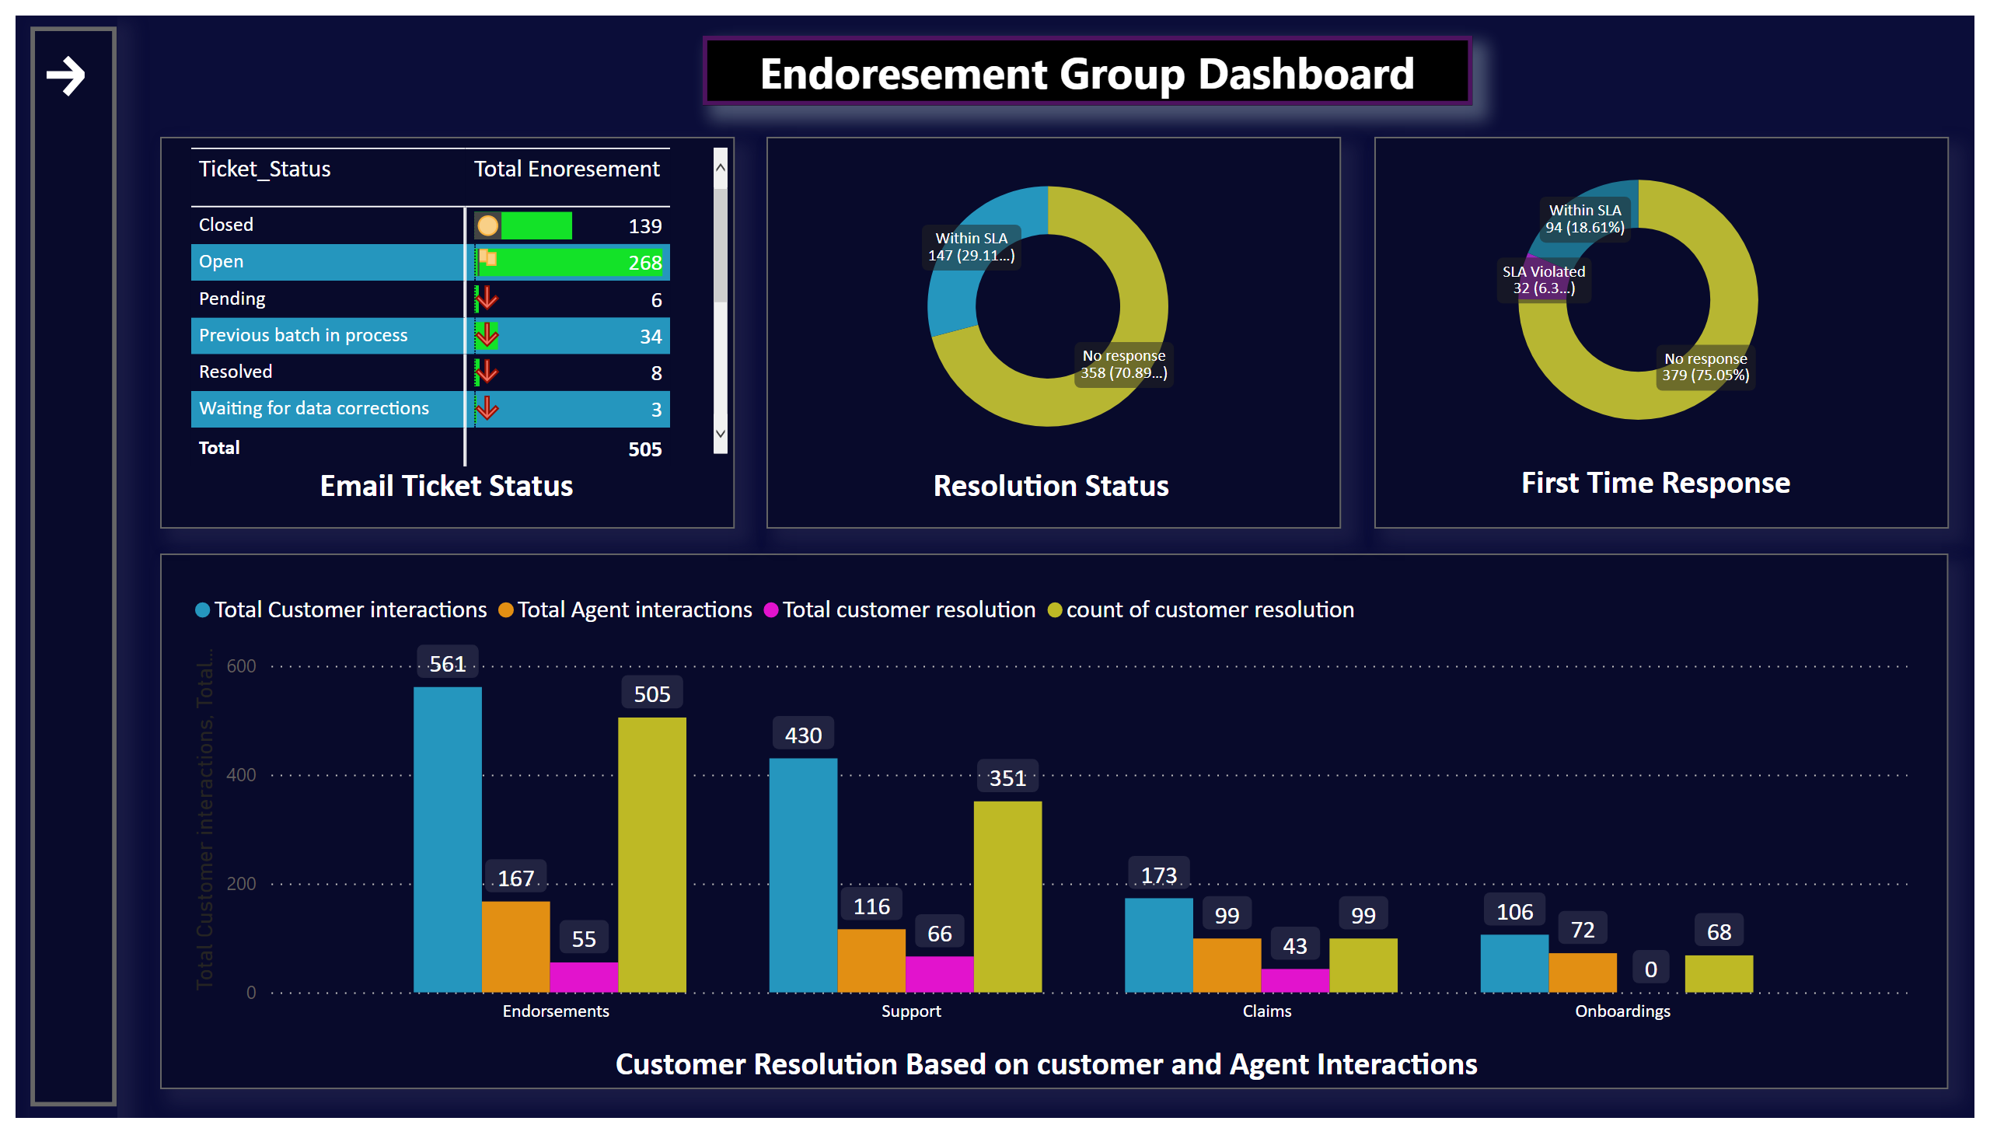
Endoresement
Notes:
nav_open_1
No alt text provided
nav_1
No alt text provided
actionButton
No alt text provided
basicShape
No alt text provided
actionButton
No alt text provided
actionButton
No alt text provided
actionButton
No alt text provided
actionButton
No alt text provided
actionButton
No alt text provided
actionButton
No alt text provided
actionButton
No alt text provided
actionButton
No alt text provided
textbox
No alt text provided
pivotTable
No alt text provided
actionButton
No alt text provided
donutChart
No alt text provided
textbox
No alt text provided
actionButton
No alt text provided
textbox
No alt text provided
donutChart
No alt text provided
actionButton
No alt text provided
Button
No alt text provided
Total Customer interactions, Total Agent interactions, Total customer resolution and count of customer resolution by Group_name
No alt text provided
textbox
No alt text provided

Slide 4
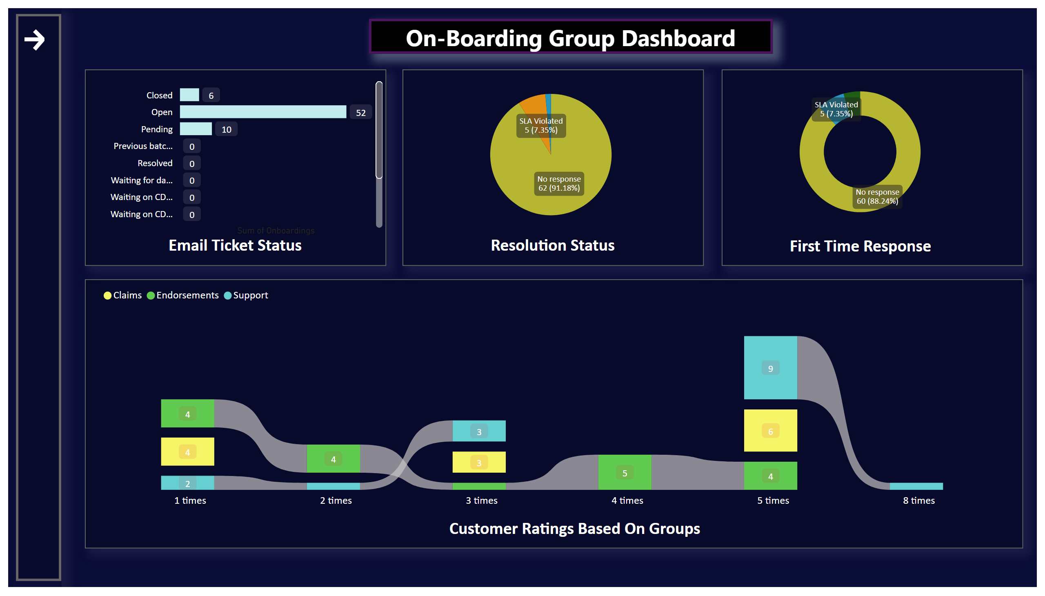
On-Boardings
Notes:
nav_open_1
No alt text provided
nav_1
No alt text provided
actionButton
No alt text provided
basicShape
No alt text provided
actionButton
No alt text provided
actionButton
No alt text provided
actionButton
No alt text provided
actionButton
No alt text provided
actionButton
No alt text provided
actionButton
No alt text provided
actionButton
No alt text provided
actionButton
No alt text provided
actionButton
No alt text provided
textbox
No alt text provided
barChart
No alt text provided
actionButton
No alt text provided
pieChart
No alt text provided
textbox
No alt text provided
actionButton
No alt text provided
textbox
No alt text provided
donutChart
No alt text provided
actionButton
No alt text provided
ribbonChart
No alt text provided
textbox
No alt text provided

Slide 5
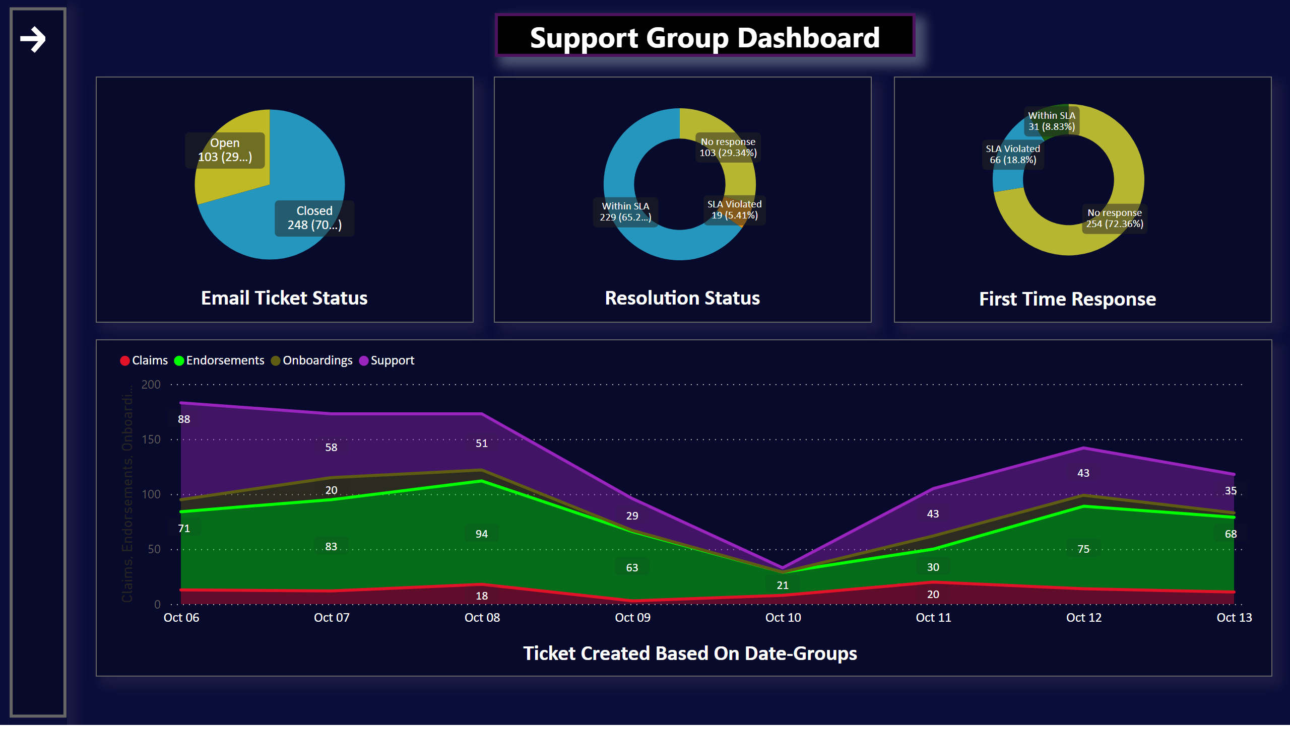
Support
Notes:
nav_open_1
No alt text provided
nav_1
No alt text provided
actionButton
No alt text provided
basicShape
No alt text provided
actionButton
No alt text provided
actionButton
No alt text provided
actionButton
No alt text provided
actionButton
No alt text provided
actionButton
No alt text provided
actionButton
No alt text provided
actionButton
No alt text provided
actionButton
No alt text provided
textbox
No alt text provided
pieChart
No alt text provided
actionButton
No alt text provided
donutChart
No alt text provided
textbox
No alt text provided
actionButton
No alt text provided
textbox
No alt text provided
donutChart
No alt text provided
actionButton
No alt text provided
stackedAreaChart
No alt text provided
textbox
No alt text provided
actionButton
No alt text provided

Slide 6
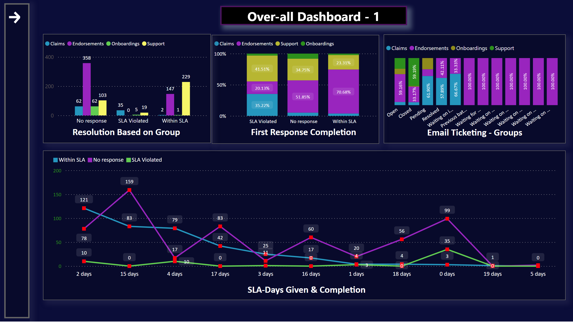
Overall_dash_1
Notes:
nav_open_1
No alt text provided
nav_1
No alt text provided
actionButton
No alt text provided
basicShape
No alt text provided
actionButton
No alt text provided
actionButton
No alt text provided
actionButton
No alt text provided
actionButton
No alt text provided
actionButton
No alt text provided
actionButton
No alt text provided
actionButton
No alt text provided
actionButton
No alt text provided
textbox
No alt text provided
clusteredColumnChart
No alt text provided
actionButton
No alt text provided
hundredPercentStackedColumnChart
No alt text provided
textbox
No alt text provided
actionButton
No alt text provided
textbox
No alt text provided
hundredPercentStackedColumnChart
No alt text provided
actionButton
No alt text provided
lineChart
No alt text provided
textbox
No alt text provided
actionButton
No alt text provided

Slide 7
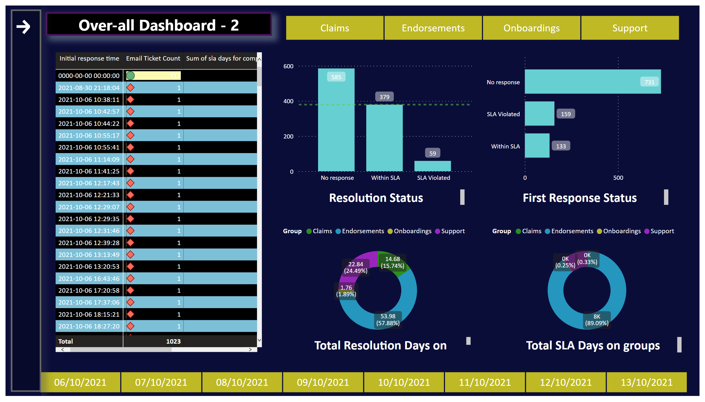
Overall_dash_2
Notes:
nav_open_1
No alt text provided
nav_1
No alt text provided
actionButton
No alt text provided
basicShape
No alt text provided
actionButton
No alt text provided
actionButton
No alt text provided
actionButton
No alt text provided
actionButton
No alt text provided
actionButton
No alt text provided
actionButton
No alt text provided
actionButton
No alt text provided
textbox
No alt text provided
textbox
No alt text provided
textbox
No alt text provided
textbox
No alt text provided
actionButton
No alt text provided
donutChart
No alt text provided
clusteredColumnChart
No alt text provided
donutChart
No alt text provided
slicer
No alt text provided
pivotTable
No alt text provided
slicer
No alt text provided
barChart
No alt text provided

