Slide 1
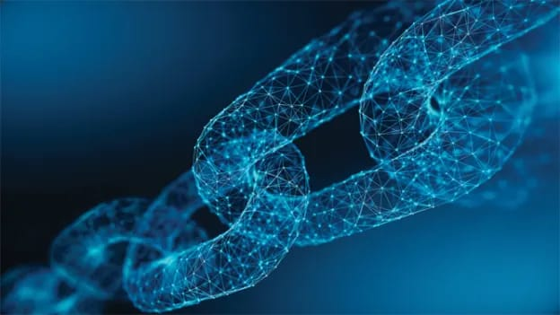
BLOCKCHAIN TECNOLOGY
PRESENTED BY HARIS AND USMAN SOHAIL
This Photo by Unknown author is licensed under CC BY-SA-NC.

Slide 2
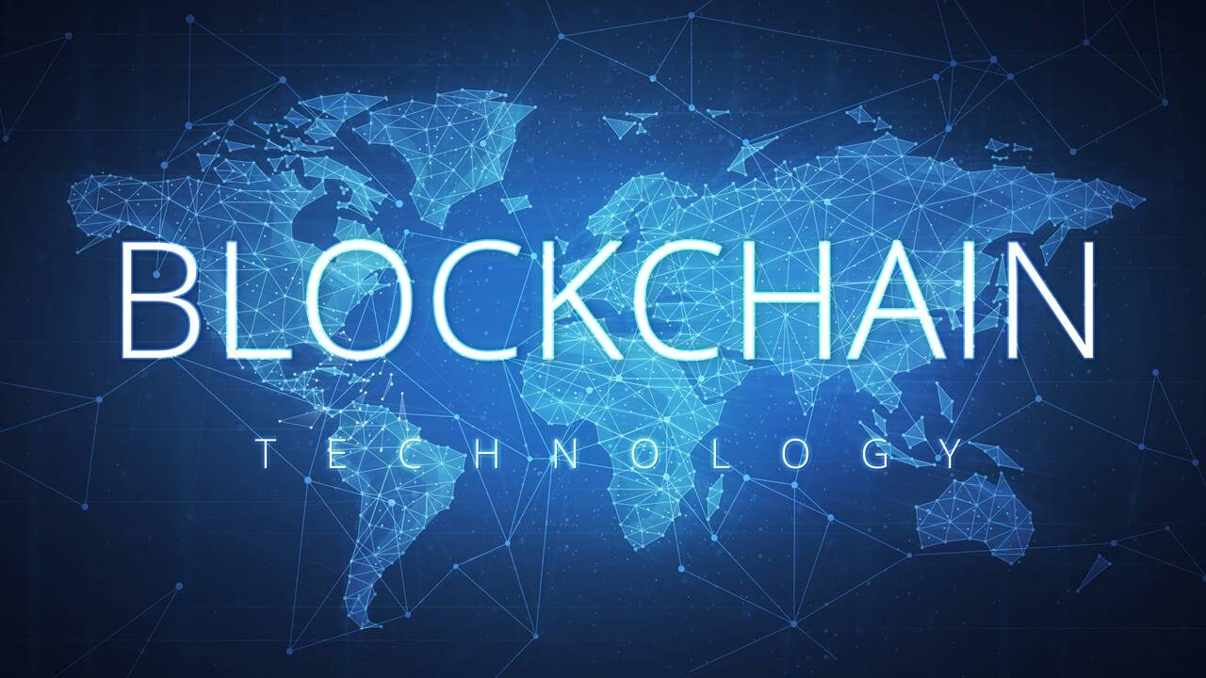
WHAT IS BLOCKCHAIN TECNOLOGY?
Blockchain is a shared, immutable ledger that facilitates the process of recording transactions and tracking assets in a business network.
It is a database use to store data and information or transaction.
A blockchain is a distributed ledger with growing lists of records (blocks) that are securely linked together via cryptographic hashes.
This Photo by Unknown author is licensed under CC BY-NC-ND.

Slide 3
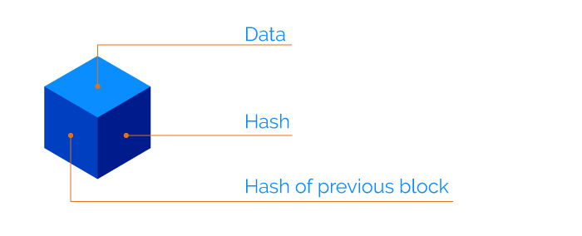
WHAT IS A BLOCK?
BLOCK IS USED TO STORE INFORMATION
BLOCK NUMBER
NONCE
DATA OR INFORMATION
PREVIOUS HASH

Slide 4
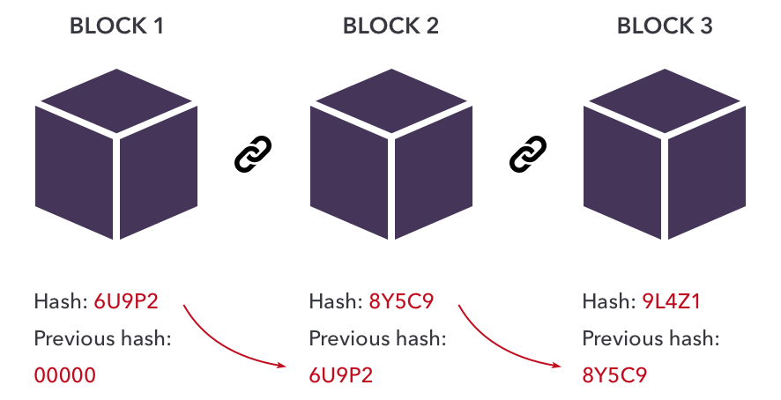
BLOCKCHAIN
A CHAIN IS A COLLECTION OF BLOCKS CONNECTED THROUGH HASHES

Slide 5
WORKING MECHANISM OF BLOCKCHAIN TECNOLOGY
TRANSACTION INITIATION
DATA IS ADDED IN A BLOCK
ADDITION OF NEW BLOCK THROUGH MINING
CONSENSUS MECHANISM
MEMORY POOL AND CANDIDATE POOL
BLOCK HEADER AND PREVIOUS HASH
MERKLE TREE
HASHING(SHA 256)
VERIFICATION
A NEW BLOCK IS ADDED

Slide 6
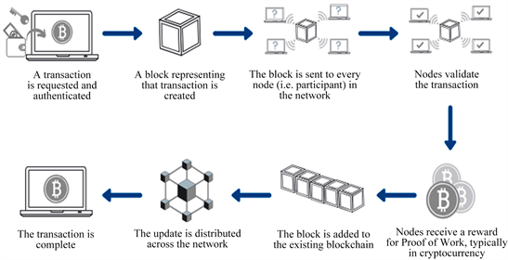

Slide 7
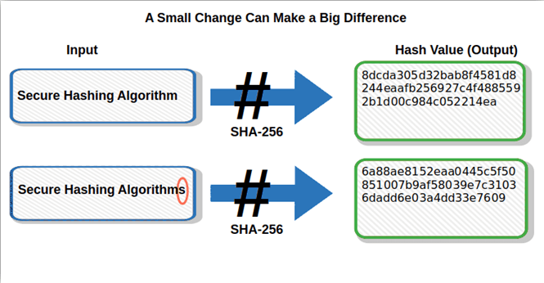

Slide 8
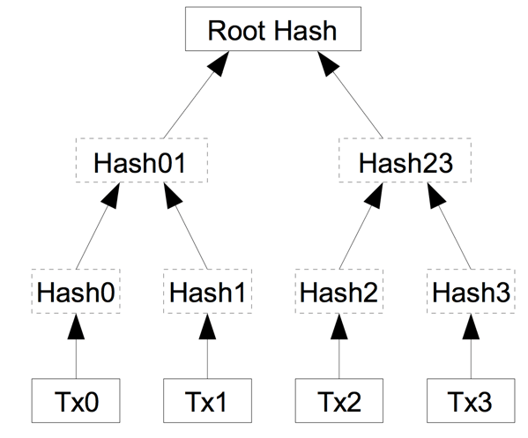
MERKLE TREE
IT COMPRESSES THE TRANSACTION
THROUGH ROOT HASH WE CAN HAVE ACCESS TO ALL DATA IN BLOCKS

Slide 9
USES OF BLOCK CHAIN TECHNOLOGY
CRYPTO CURRENCY(BITCOIN,ETHERUM)
HEALTHCARE
REAL ESTATE
SUPPLY CHAIN MANAGEMNET
FOOD SAFTEY
IDENTITY MANAGEMENT

Slide 10
FUTURE TRENDS
SCALIBILITY SOLUTIONS
INTEGRATION WITH OTHER TECHNOLOGIES
PRIVACY

Slide 11
CONCLUSION
In summary, blockchain technology offers a ground-breaking method for ensuring security, trust, and transparency.
Its decentralized and impervious to tampering nature has the power to revolutionize a number of sectors, including healthcare and finance.
Blockchain has the potential to promote creativity, effectiveness, and inclusivity in our digital future as it develops further.

Slide 12
THANKS FOR YOUR ATTENTION Q&A

