Slide 1

Social Science
By:
Gowshik vel. C.M
Harish.c
Jayesh. L
Kartheeshwaran. R

Slide 2
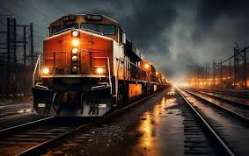
Railways
>> Railways are the principal mode od transportation for freight and passengers in India.
>> Railways also make it possible for people to conduct multifarious activities like business, sightseeing, pilgrimage along with transportation of goods over longer distances.
>> Apart from and important means of transport, the Indian Railways have been a great integrating force for more than 150 years.

Slide 3

>> Railways in India bind the economic life of the country as well as accelerate the development of the industry and agriculture.

Slide 4
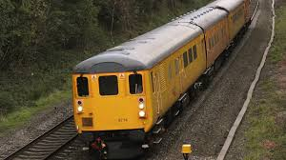

Slide 5

>> As cotton industries developed in England, industrial groups began worrying about imports from other countries.
>> They pressurised the government to impose import duties on cotton textiles so that Manchester goods could sell in Britain without facing an competition from outside.
>> At the same time industrialists persuaded the East India Company to sell British manufactures in Indian market as well.

Slide 6
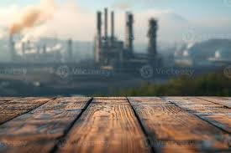

Slide 7
>> Exports of British cotton goods increase dramatically in the early nineteenth century.
>> At the end of the eighteenth century, there had been virtually no import of cotton piece-goods into India.
>> But by 1850, cotton piece-goods constituted over 31% of the value of Indian imports and by the 1870s, this figure was over 50%.

Slide 8

Marketing
>> One way in which new customers are created is by advertisements.
>> As we know, advertisements make products appear desirable and necessary.
>> They try to shape the minds of people and create new needs.
>> They appear in newspapers, magazines, hoardings, street walls, television screens.

Slide 9

Pace Of Industrial Change

Slide 10
First:
>> The most dynamic industries in Britain were clearly cotton and metals.
>> Growing at a rapid pace, cotton was the leading sector in the first phase of industrialisation up to the 1840s.
>> After that the iron and steel industry led the way. With the expansion of railways, in England from the 1840s and in the colonies from the 1860s, the demand for iron and steel increased rapidly.
>> By the 1873, Britain was exporting iron and steel worth about 77 million of their currency, double the value of its cotton export.

Slide 11
Second:
>> The new industries could not easily displace traditional industries.
>> Even at the end of the nineteenth century, less than 20% of the total workforce was employed in technologically advanced industrial sectors.
>> Textiles was a dynamic sector, but a large portion of the output was produces not within factories but outside, within domestic units.

Slide 12
Third:
>> The pace of change in the ‘traditional’ industries was not set by steam-powered cotton or metal industries, but they did not remain entirely stagnant either.
>> Seemingly ordinary and small innovations were the basis of growth in many non-mechanised. >> EG: Food processing, building, pottery, glass work, tanning, furniture making, and production of implements.

Slide 13
Fourth:
>> Technological changes occurred slowly.
They did not spread dramatically across the industrial landscape.
>> New technology was expensive and merchants and industrialists were cautious about using it.
>> The machines often broke down and repair was costly.
>> They were not as effective as their inventors and manufactures claimed.

Slide 14
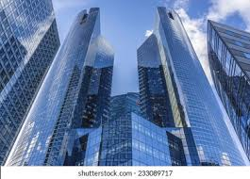
>> The result of greater foreign investment and greater foreign trade has been greater integration of production and markets across countries.
>> Globalisation is this process of rapid integration or interconnection between countries.
>> MNCs are playing a major role in the globalisation process.
>> More and more goods and services, investments and technology are moving between countries.

Slide 15


Slide 16
>> Even more remarkable have been the developments in information and communication technology.
>> In recent times, technology in the areas of telecommunications, computers, internet has been changing rapidly.
>> Telecommunication facilities are used to contact one another around the world, to access information instantly and to communicate from remote areas.

Slide 17
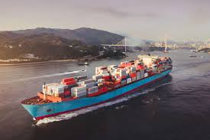
>> The commodities imported to India include petroleum crude and products, gems and jewellery, chemicals and related products, base metals, electronic items, machinery, agriculture and allied products.
>> India has emerged a software giant at the international level and it is earning large foreign exchange through the export of information technology.

Slide 18
>> India has trade relations with all the major trading blocks and all geographical regions of the world.
>> The commodities exported from India to other countries include gems and jewellery, chemicals and related products, agriculture and allied products,etc.

Slide 19
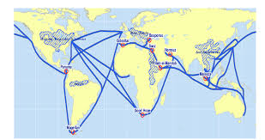
Sea Routes

Slide 20
>> Coarser cottons were produced in many countries, but the finer varieties often came from India.
>> Armenian and Persian merchants took the goods from Punjab to Afghanistan, Eastern Persia and Central Asia.
>> Bales of fine textiles were carried on camel back via the north-west frontier, through mountain passes and across deserts.

Slide 21
>> A vibrant sea trade operated through the main pre-colonial ports.
>> Surat on the Gujarat coast connected India to the Gulf and Red Sea Ports.
>> Masulipatam on the Coromandal coast and Hoogly in Bengal had trade links with Southeast Asian ports
>> A variety of Indian merchants and bankers were involved in this network of export trade- financing production, carrying goods and supplying exporters.

Slide 22
>> Supply merchants linked the port towns to the inland regions.
>> They gave advances to weavers, procured the woven cloth from weaving villages, and carried the supply to the ports.
>> At the port, the big shippers and export merchants had brokers who negotiated the price and bought goods from the supply merchants operating inland.

Slide 23
India in Tele Network
>> India has one of the largest telecom networks in Asia.
>> Excluding urban places more than two-thirds of the villages in India have already been covered with subscriber Trunk Dialling (STD) telephone facility.
>> In order to strengthen the flow of information from the grassroot to the higher level, the government has made special provision to extend twenty-four hours STD facility to every village in the country.

Slide 24

>> There is a uniform rate of STD facilities all over India. It has been made possible by integrating the development in space technology with communication technology.

Slide 25


Thank You

