Slide 1
IoT BASED ONLINE BILLING AND GENERATING ALARM SYSTEM
PRESENTED BY:
Haris KHALID (SP17-BSSE-0046)
ZAUFISHAN HASSAN (FA16-BSSE-0028)
M.ABDULLAH WASEEM (SP17-BSSE-0060)

Slide 2
WHAT IS THE BIGGEST PROBLEM IN PAKISTAN?
According to sources, the national gird faced a shortage of around 2,360MW amid which K-Electric failed to manage the load, marring lives of millions of consumers who could not continue their businesses goings-on and perform every day tasks with ease.
A resident of Liaqatabad, Amir said it appeared as if the power cuts were a “new year surprise” from the government to the people.
There should be a system, such as an SMS alert, through which consumers are informed about load-shedding. It is necessary to save the people from all the inconvenience. I could not work for a single hour at my office due to power failures and fluctuations.

Slide 3
WHAT problem we face in electricity issue?
CIRCUIT BREAKER TRIPPING FREQUENTLY
High electrical bill
Electrical shocks
Circuit overload
Light bulbs burning out too often
Recessed light ‘goes out’ and comes back on
Notes:
Circuit Breaker Tripping Frequently:
High wattage items like microwaves and hairdryers can trip circuit breakers, particularly when other power consuming items are used on the same source. A circuit breaker is designed to protect you and your home, so when it does trip, that’s a sign it’s doing its job.
Look at what you were using when it tripped. If it was a hair dryer, try using the low setting. Alternatively, limit the electrical usage on a single circuit while high watt devices are in use.
High electrical bill :
3

Slide 4
BILLING SYSTEM IN PAKISTAN
Today employee of the company visits each and every house take the photo of the meter or note down the readings of the meter due to which time required to take snapshot increases. This snapshot is submitted by the employee to the company databases. Now from the submitted snapshot bill is generated. Due to lot of human interventions accuracy in the bill generation is not achieved. Error rate is very high.
Usually the bill is calculated on average of two three months. Many times wrong snapshot is taken on wrong people name, this is also the major issue. This requires large number of man power and also long working time to compute the bill. Sometime meter is also located at the remote location where it is not possible to reach in first visit; the employee has to revisit the site. Sometimes the printed bill gets misplaced or it is not delivered to the appropriate address. The country like Pakistan which has huge population requires long hours to generate the bill.
Notes:
4

Slide 5
Benefits of our application
The software “IOT Based Automatic Electricity Bill & Maintenance Alarm Generation System”, is used for multiple purposes, It provides services to both, the employees of the Organization using it; Here its electricity company and the end users who are the staff of organization or consumers as well.
Where we are monitoring the electric meter continuously and generate the bill based on consumption of electricity. Also this will require no additional time to generate the bill. Moreover bill will be more accurate and will be given to the appropriate customer.

Slide 6
K-ELECTRIC OFFICIALS
The employees of Electricity Company are benefited in a way that, from the office if someone has not paid the bill, they can terminate their electricity.
In case of a meter breakdown, instead of the user notifying them about the problem, they can automatically detect the problem and its location as an alarm will start buzzing in that mobile and the location will be traced easily, so they can send a maintenance man ASAP.
They can get notified of the faulty meter.
They can keep close eyes on electricity thefts.
They can monitor the usage of individuals or whole power feeders.

Slide 7
For Consumers
For the consumers, they can pay the bills without having to go to the bank.
They can monitor their electricity consumption and can register complaint whether it is about excessive bill amount or electricity shortfall.
They can track the status of their complain. Whether their complain is in processing or they still have to wait for their turn. Or how much time would it take to resolve the issue. By secure login consumer has no need to worry about privacy

Slide 8
Solutions
Register Complain
Check Status
Paybill
Generate Maintenance Alarm
Track complain status

Slide 9
targeted audience
This software targets all the audience, especially those with the facility of the internet.
Consumers, power house station staff
Management staff of organization who owns this software.

Slide 10
List of deliverables
The system consist of two parts, one is mobile application other is web portal.
The device will be installed to the meter of the user which works as a bridge between company and the user.
The device is directly controlled by the K-Electric also the user can easily access it through mobile application.
The device provides 24hr meter details to the K-Electric as well as the User.

Slide 11
project constrains
Mobile application can face application malfunctions depending on their mobile type, since app requires internet and it may not be available every time.
Web users can also face same problem. Internet downfall can cause my progress to slack.
Not all systems are well built; some are of new technology while same our still old, the old systems have slow response time.

Slide 12
Functional requirements
Enable the user/customer to check the consumption of electricity of his/her home online.
Facilitate the user to pay bill online rather than going to a physical location (Bank) to pay.
In an event of an electricity outbreak or shortfall, the consumer will be immediately notified.
Providing the user, the facility to call maintenance in an event of a meter malfunction.
In an event of a meter malfunction, notify the maintenance man immediately.
To check how much electricity is consumed at residential and industrial level.
To check if anyone is tampering with the meter.
Notify if someone has paid or not paid the bill.
To prevent the stealing of electricity.
Rather than manually going to a grid station to shut down electricity, the person can cut down power from the department.

Slide 13
Non-functional requirements
Accounting Requirement
Usability Requirement
Security Requirement
External Requirement
Performance Requirement
Organizational Requirement
Operational Requirement
Development Requirement
Notes:
Accounting Requirements
Update the ones who have paid the electricity bills, bills should not be paid after 2359. Fine will be
imposed.
Usability Requirements
Both the consumers and the employees can use this system to monitor but an employee cannot make
changes after work time.
Security Requirements
Login and password of the user is required. The data of consumer is visible only to the user and not to
anyone else, in case of data being delivered to an unauthorized user, the consumer will be notified.
External Requirements
Those who have signed in to the system will receive details, any outsider will not be permitted to access the
system.
Performance Requirements
System updates every 30 minutes, so any changes or status can be updated efficiently.
Organizational Requirements
The system should follow all of the organizational norms, any functionality other than organizations norm
should not be included in the system. The system should authorize specific users with limited access as it
will be against organization culture to give access to personal records of employee and customers.
Operational Requirements
System is capable of handling 1000 requests at a time means at one time the system is capable to perform
either data entries or retrievals. Requests more than one thousand will be placed in queue so that as soon
as one user closes its operation other can continue with his own.
Development Requirements
System and sub systems should be developed using specific development tools and methods. Development
methods other than specified one’s cannot be used.
13

Slide 14
Availability: The system shall be available 97% in a year and will be shut down for at least 4 hours on Sunday morning from 6 am to 9 am twice a year.
Installibility: The system shall be taken minimum 3 minutes on installation while the time is totally dependent on how fast the device will work. The maximum time taken would be 5 minutes for any amateur user
Integrity: The bridge of information between the k-electric, users and the device which is planted on user’s meter is totally based on encryption so that no other person can over write then.

Slide 15
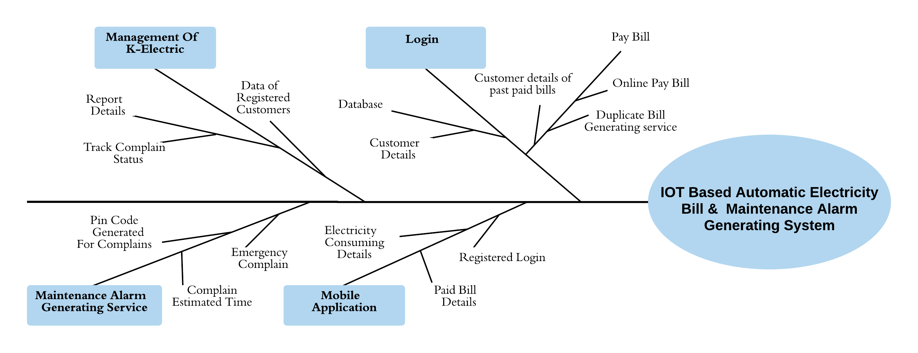
FEATURE TREE

Slide 16
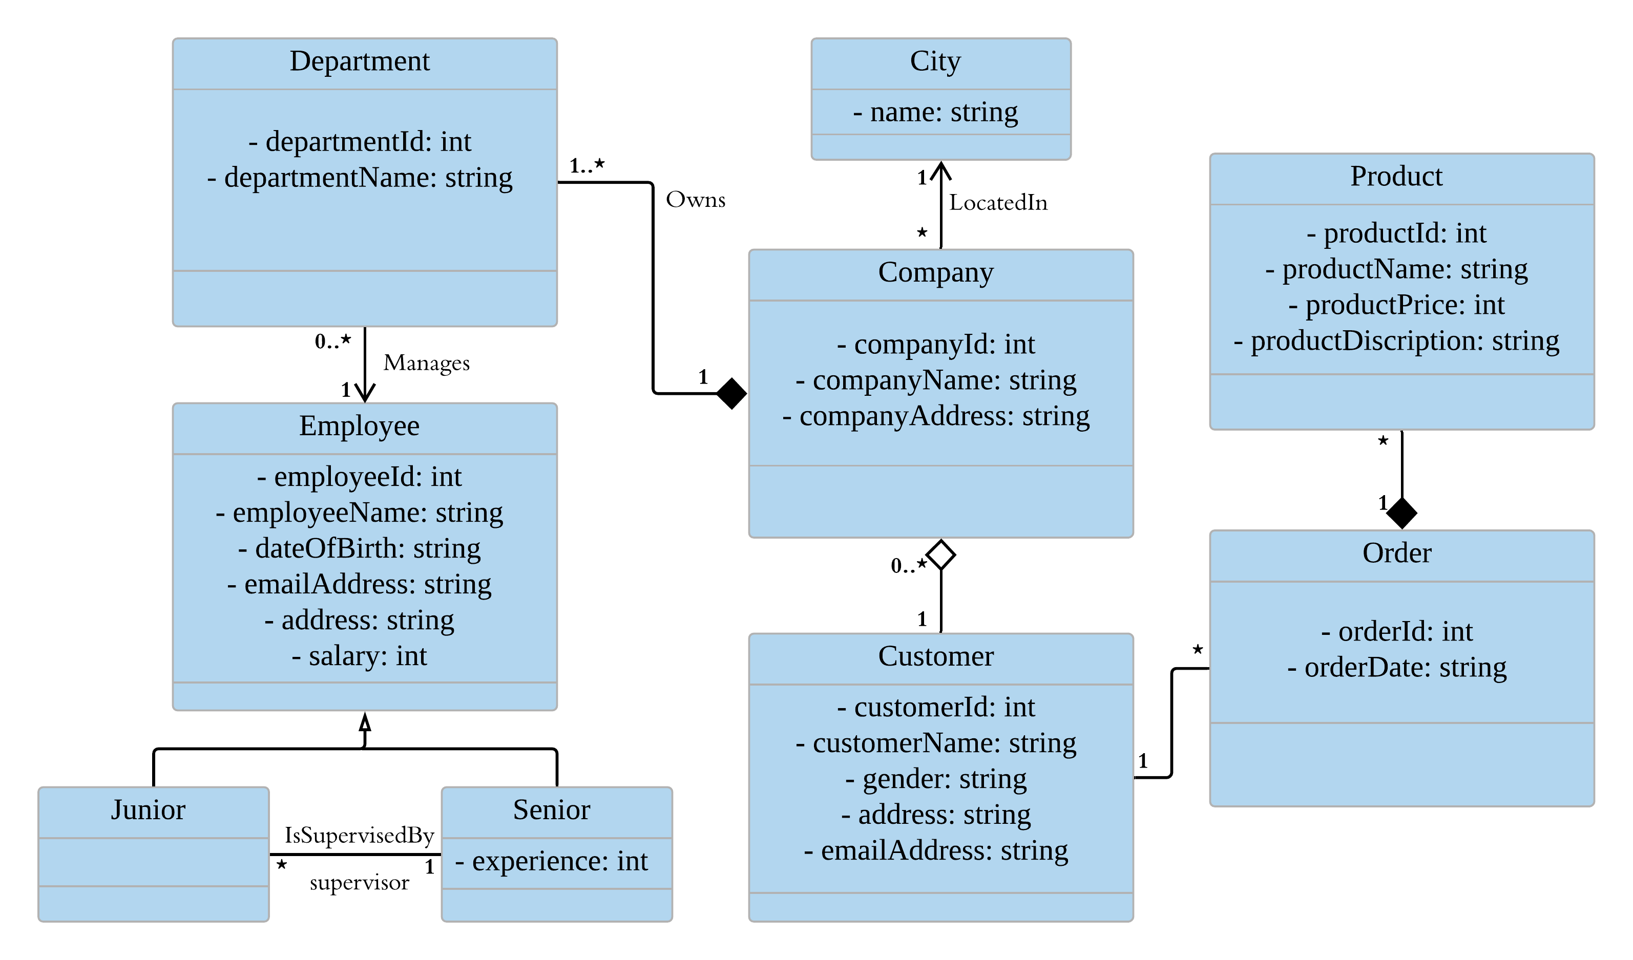
UML CLASS DIAGRAM

Slide 17
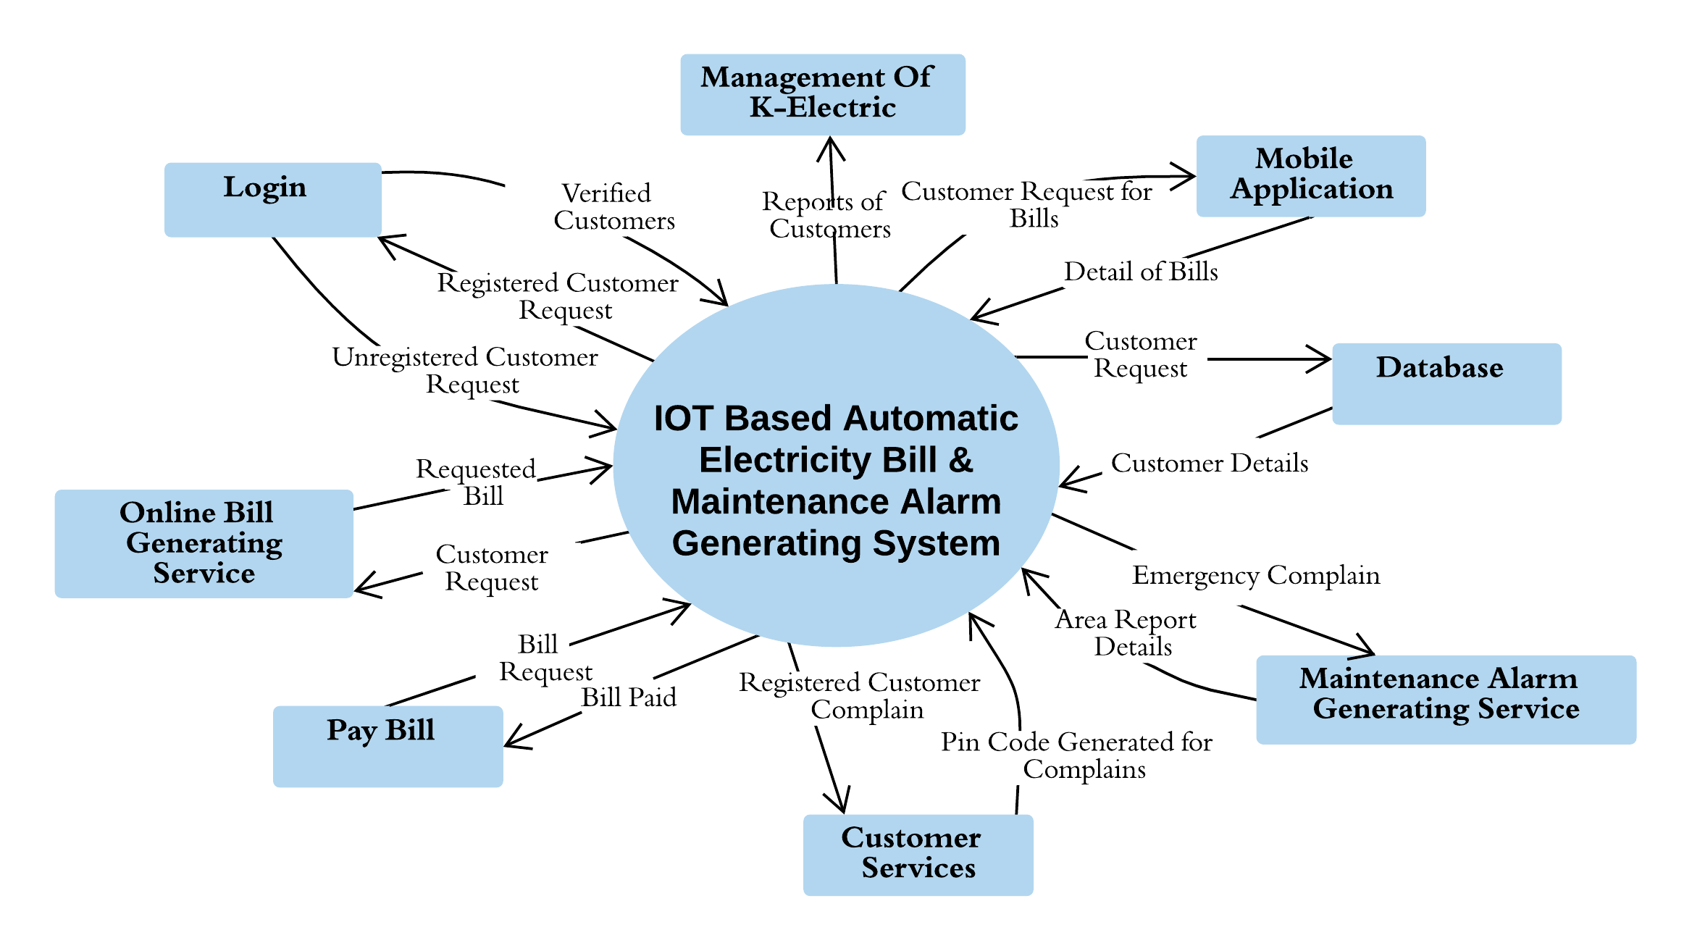
CONTEXT DIAGRAM

Slide 18
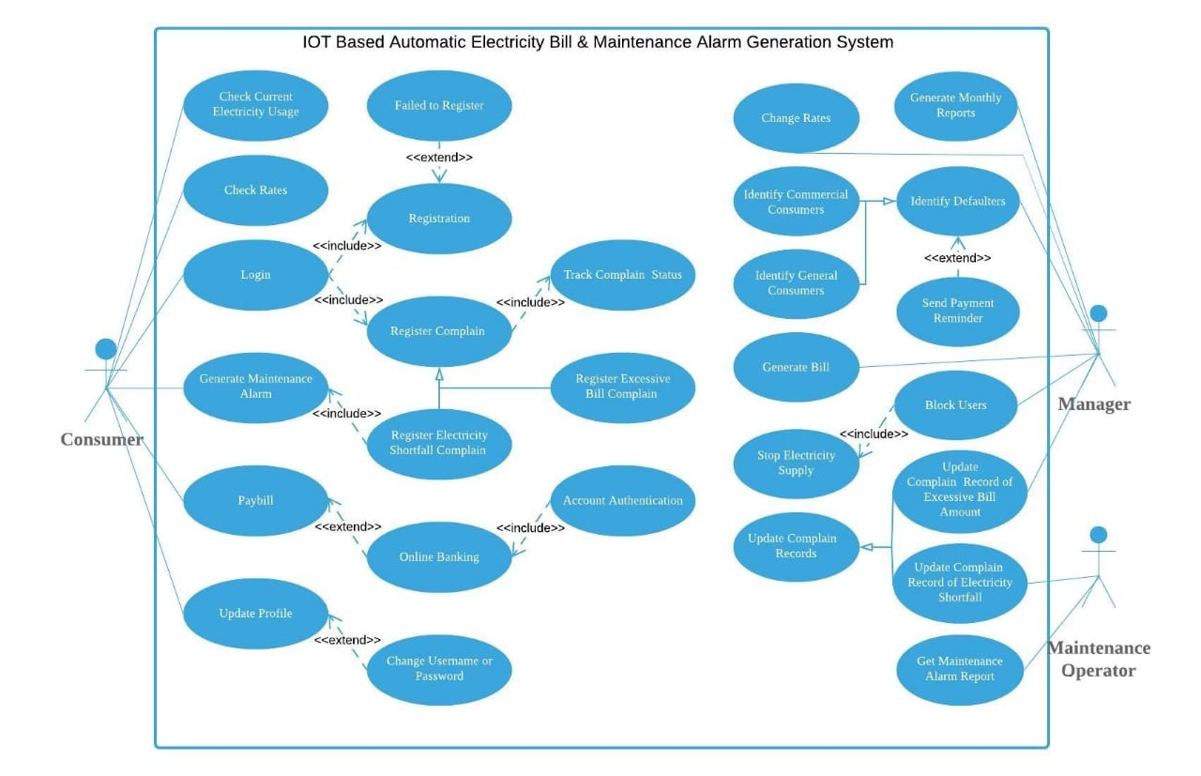
USE CASE

Slide 19
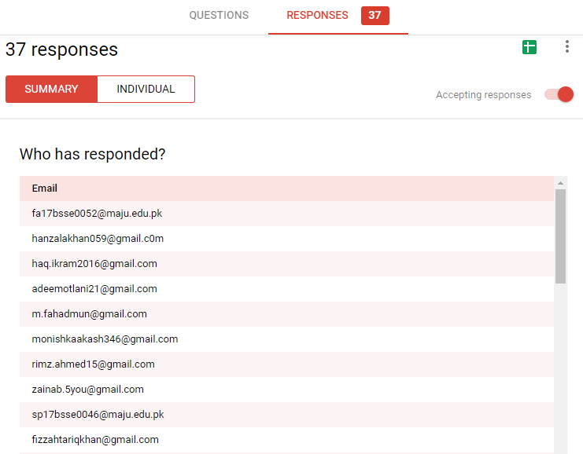
QUESTIONNAIRE

Slide 20
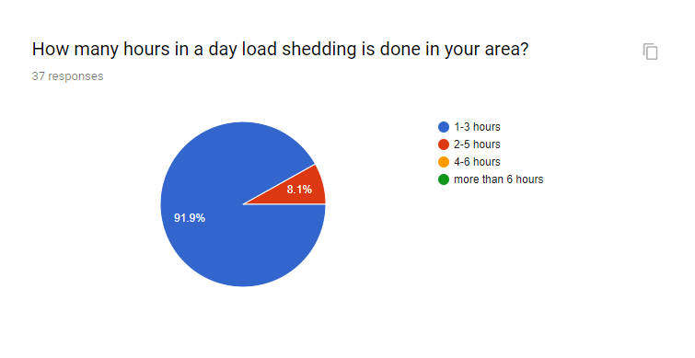
CONTINUED...

Slide 21
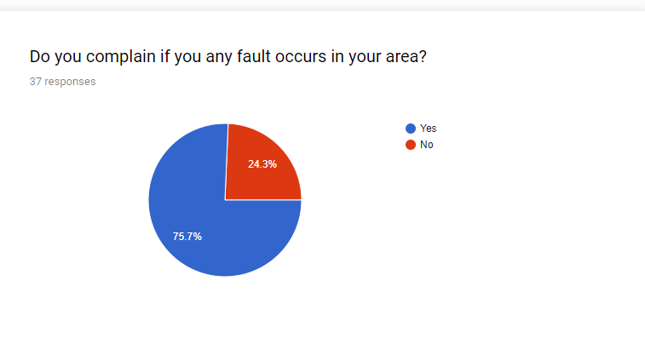
CONTINUED...

Slide 22
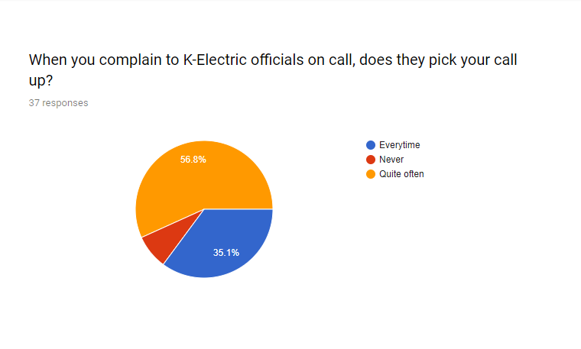
CONTINUED...

Slide 23
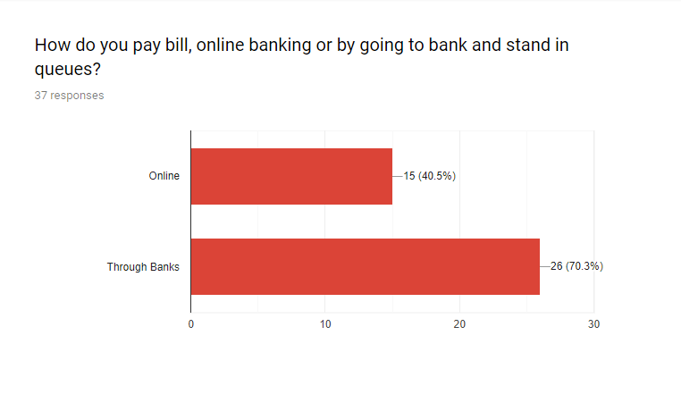
CONTINUED...

Slide 24
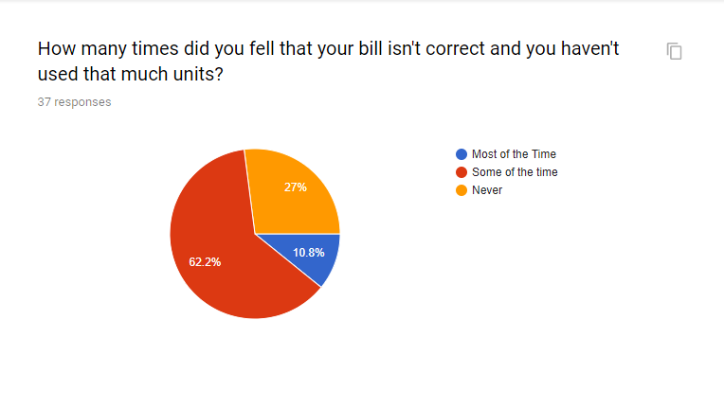
CONTINUED...

Slide 25
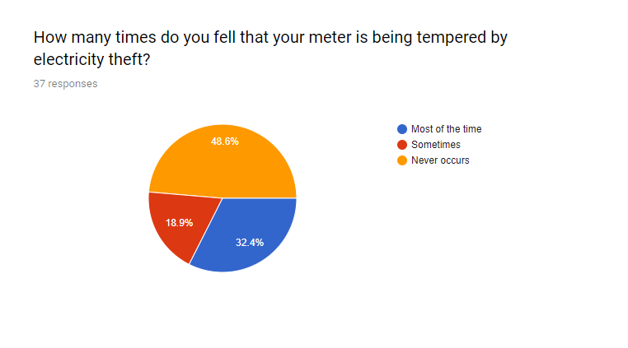
CONTINUED...

Slide 26
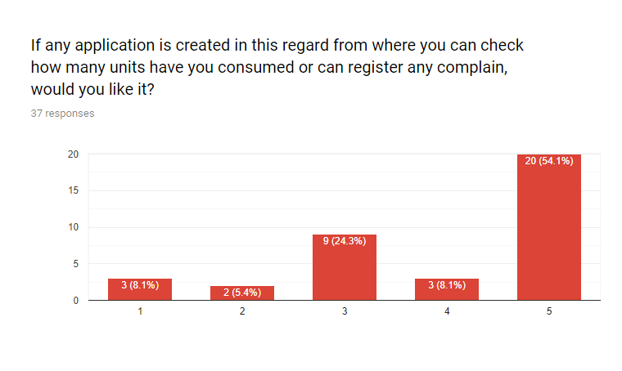
CONTINUED...

