Slide 1
Plan Eve
PRESENTED BY:
Danish ali (fa16-bscs-0038)
Haris KHALID (SP17-BSSE-0046)
ZAUFISHAN HASSAN (FA16-BSSE-0028)
M.ABDULLAH WASEEM (SP17-BSSE-0060)

Slide 2
THE main PROBLEM IN Planning events?
Arranging a corporate event becomes a massive task these days
Planning an event requires a lot of energy, time, and money
Choosing the right venue
Uncooperative Weather
Running out of time
Too many guests

Slide 3
WHAT problem we face in
Planning an event in Pakistan?
Consistency in messaging
Communication across venues
Juggling the volume of events
Staying organized when you manage events at multiple venues
Overspending of money
Not confirming the exact date with vendor can be a huge mistake
Event Schedule is not looked properly

Slide 4
Benefits of our application
Auto-synced event details
A software with time-saving automation
Keep event info in one easy-to-access place
Document templates that’ll show clients your professionalism
Budget will be well defined and fixed
Energy and effort will be saved

Slide 5
Product scope
This project “Plan Eve” introduces that by sitting at home User can see the details, user can reserve a venue and other services related to an Event, user can give feedback, user can communicate with provider. User gathered all appropriate information about best venues all over the Pakistan according to your budget and all your needs like Banquet halls and Lawns in Karachi, Lahore, Quetta and other cities in Pakistan. Service provider have their own account in which they can update the details of its services like images, video, price etc. In this project there a referral system in it there are two categories in this system one is top rating those service provider who have top rating will shown on the top of the list and second is promotion category those service provider who will pay us for advertisement will be shown on the top.

Slide 6
System Features
Client enter the details
Client can see the details
Registration
Login
client can reserve a venue
client can reserve other services
Expert system opinion
Service provider can update the details
Feedback
logout

Slide 7
Pact Analysis
People Analysis: Service provider, Client, Management team
Activity Analysis:
Context Analysis:
Technology Analysis: react js, firebase, html,css,bootstrap

Slide 8
Contextual enquiry
Performance Requirement
Stakeholders
Proposed system
Existing system
User profile
Strength and weakness of the existing system
Requirement gathering through question and answer
Notes:
Accounting Requirements
Update the ones who have paid the electricity bills, bills should not be paid after 2359. Fine will be
imposed.
Usability Requirements
Both the consumers and the employees can use this system to monitor but an employee cannot make
changes after work time.
Security Requirements
Login and password of the user is required. The data of consumer is visible only to the user and not to
anyone else, in case of data being delivered to an unauthorized user, the consumer will be notified.
External Requirements
Those who have signed in to the system will receive details, any outsider will not be permitted to access the
system.
Performance Requirements
System updates every 30 minutes, so any changes or status can be updated efficiently.
Organizational Requirements
The system should follow all of the organizational norms, any functionality other than organizations norm
should not be included in the system. The system should authorize specific users with limited access as it
will be against organization culture to give access to personal records of employee and customers.
Operational Requirements
System is capable of handling 1000 requests at a time means at one time the system is capable to perform
either data entries or retrievals. Requests more than one thousand will be placed in queue so that as soon
as one user closes its operation other can continue with his own.
Development Requirements
System and sub systems should be developed using specific development tools and methods. Development
methods other than specified one’s cannot be used.
8

Slide 9
USER PROFLE
Expert, Intermediate, Novice
Age: 15 and above
Rich/Poor: Both can use this application
Frequent and intermittent both can use it
Male and female both
Able
Skilled, Un skilled both
Interested
Educated
Native and foreign both
Heterogenous
Notes:
Accounting Requirements
Update the ones who have paid the electricity bills, bills should not be paid after 2359. Fine will be
imposed.
Usability Requirements
Both the consumers and the employees can use this system to monitor but an employee cannot make
changes after work time.
Security Requirements
Login and password of the user is required. The data of consumer is visible only to the user and not to
anyone else, in case of data being delivered to an unauthorized user, the consumer will be notified.
External Requirements
Those who have signed in to the system will receive details, any outsider will not be permitted to access the
system.
Performance Requirements
System updates every 30 minutes, so any changes or status can be updated efficiently.
Organizational Requirements
The system should follow all of the organizational norms, any functionality other than organizations norm
should not be included in the system. The system should authorize specific users with limited access as it
will be against organization culture to give access to personal records of employee and customers.
Operational Requirements
System is capable of handling 1000 requests at a time means at one time the system is capable to perform
either data entries or retrievals. Requests more than one thousand will be placed in queue so that as soon
as one user closes its operation other can continue with his own.
Development Requirements
System and sub systems should be developed using specific development tools and methods. Development
methods other than specified one’s cannot be used.
9

Slide 10
Functional requirements
To provide secure venue, preventing any disruption from external entity.
To check the amount related to the venue or other services.
Expert system will guide the client.
Client can see the availability of the venue.
Send the request to the expert system for the reservation.
Expert system will communicate with the service provider for the approval.
Admin manage the position of service provider in referral system.
Enable the client to enter the information regarding the venue or other services.
Client can see the details according to its requirements rather than going to the physical location.
The client can login the system if he is registered in the system.

Slide 11
Non-functional requirements
Performance Requirement
Security Requirement
Safety Requirement
Organizational Requirement
Operational Requirement
Development Requirement
Notes:
Accounting Requirements
Update the ones who have paid the electricity bills, bills should not be paid after 2359. Fine will be
imposed.
Usability Requirements
Both the consumers and the employees can use this system to monitor but an employee cannot make
changes after work time.
Security Requirements
Login and password of the user is required. The data of consumer is visible only to the user and not to
anyone else, in case of data being delivered to an unauthorized user, the consumer will be notified.
External Requirements
Those who have signed in to the system will receive details, any outsider will not be permitted to access the
system.
Performance Requirements
System updates every 30 minutes, so any changes or status can be updated efficiently.
Organizational Requirements
The system should follow all of the organizational norms, any functionality other than organizations norm
should not be included in the system. The system should authorize specific users with limited access as it
will be against organization culture to give access to personal records of employee and customers.
Operational Requirements
System is capable of handling 1000 requests at a time means at one time the system is capable to perform
either data entries or retrievals. Requests more than one thousand will be placed in queue so that as soon
as one user closes its operation other can continue with his own.
Development Requirements
System and sub systems should be developed using specific development tools and methods. Development
methods other than specified one’s cannot be used.
11

Slide 12
Software quality attributes
Availability
Usability
Testability
Adaptability
Flexibility
Maintainability
Portability
Reliability
Notes:
Accounting Requirements
Update the ones who have paid the electricity bills, bills should not be paid after 2359. Fine will be
imposed.
Usability Requirements
Both the consumers and the employees can use this system to monitor but an employee cannot make
changes after work time.
Security Requirements
Login and password of the user is required. The data of consumer is visible only to the user and not to
anyone else, in case of data being delivered to an unauthorized user, the consumer will be notified.
External Requirements
Those who have signed in to the system will receive details, any outsider will not be permitted to access the
system.
Performance Requirements
System updates every 30 minutes, so any changes or status can be updated efficiently.
Organizational Requirements
The system should follow all of the organizational norms, any functionality other than organizations norm
should not be included in the system. The system should authorize specific users with limited access as it
will be against organization culture to give access to personal records of employee and customers.
Operational Requirements
System is capable of handling 1000 requests at a time means at one time the system is capable to perform
either data entries or retrievals. Requests more than one thousand will be placed in queue so that as soon
as one user closes its operation other can continue with his own.
Development Requirements
System and sub systems should be developed using specific development tools and methods. Development
methods other than specified one’s cannot be used.
12

Slide 13
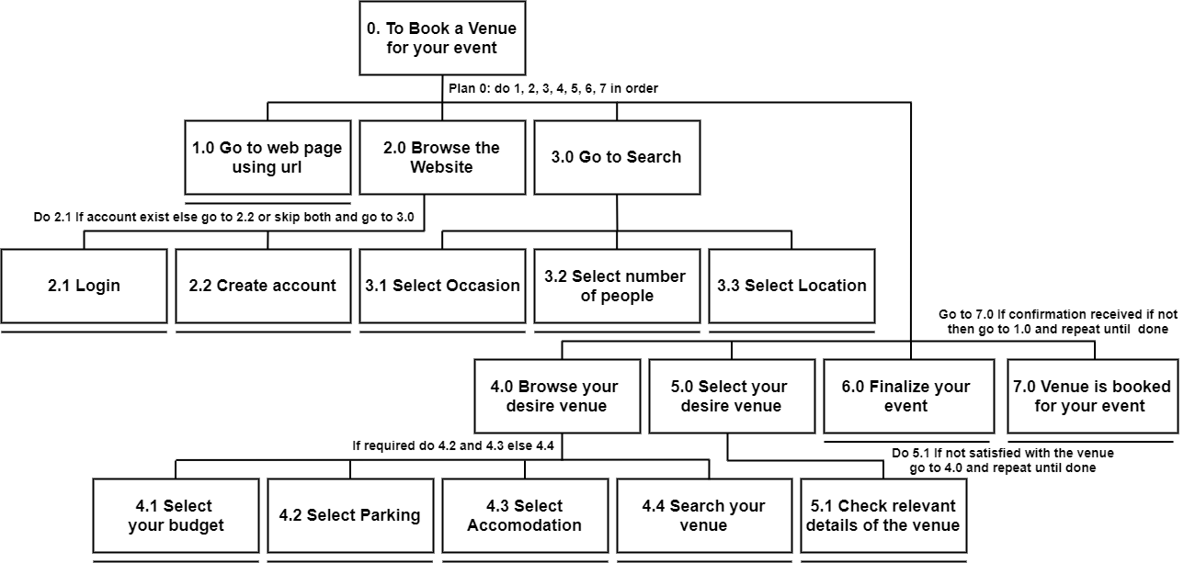
HTA (Hierarchical Task Analysis)

