Slide 1
SUPPLEMENTARY TACTILE MATERIALS FOR VIB INDIVIDUALS USING IMAGE SEGMENTATION AND 2.5D PRINTING
PIP104 University Project-II
Review-1
Batch Number:
Roll Number | Student Name
20201CAI0134 | D. HARISA FAIZA
Under the Supervision of,
- Dr. Aaron Raymond See
Associate Professor & Director of Student Affairs - Office of International Affairs,
Department of Electrical Engineering,
HEAD Laboratory,
Southern Taiwan University of Science and Technology, Tainan City, Taiwan.

Slide 2
SUPPLEMENTARY TACTILE MATERIALS FOR VIB INDIVIDUALS USING IMAGE SEGMENTATION AND 2.5D PRINTING
PIP104 University Project-II
Review-2
Batch Number:
Roll Number | Student Name
20201CAI0134 | D. HARISA FAIZA
Under the Supervision of,
-Dr Mohammadi Akheela Khanum
Dr. Aaron Raymond See
Associate Professor & Director of Student Affairs - Office of International Affairs,
Department of Electrical Engineering,
HEAD Laboratory,
Southern Taiwan University of Science and Technology, Tainan City, Taiwan.

Slide 3
SUPPLEMENTARY TACTILE MATERIALS FOR VIB INDIVIDUALS USING IMAGE SEGMENTATION AND 2.5D PRINTING
PIP104 University Project-II
Review-3
Batch Number:
Roll Number | Student Name
20201CAI0134 | D. HARISA FAIZA
Under the Supervision of,
- Dr Mohammadi Akheela Khanum
Dr. Aaron Raymond See
Associate Professor & Director of Student Affairs - Office of International Affairs,
Department of Electrical Engineering,
HEAD Laboratory,
Southern Taiwan University of Science and Technology, Tainan City, Taiwan.

Slide 4
Introduction
In a world dominated by visual information, individuals with visual impairments face unique challenges in accessing and understanding knowledge. Supplementary tactile materials, also known as haptic aids or tactile graphics, have emerged as powerful tools to bridge this gap and enhance accessibility for visually blind individuals. These materials provide a tactile representation of visual information, allowing individuals with visual impairments to perceive and comprehend concepts that are typically conveyed through sight.
For those with complete blindness, the world is primarily experienced through touch, hearing, and other senses. While traditional methods like Braille and audiobooks have played a significant role in education and communication, they fall short in providing a comprehensive understanding of visual concepts.
Supplementary tactile materials address this limitation by offering a tangible representation of visual information. They transform abstract concepts, diagrams, illustrations, and even art into tactile experiences, allowing individuals with visual impairments to explore and understand the world through touch.

Slide 5
Literature Review
Supplementary tactile materials, also known as haptic aids or tactile graphics, have emerged as a critical tool for enhancing accessibility and communication for visually impaired individuals. These materials provide a tactile representation of visual information, allowing individuals with visual impairments to perceive and comprehend concepts that are typically conveyed through sight. This literature review aims to explore the current landscape of research on supplementary tactile materials, delving into their efficacy, limitations, and future directions.
A study by Loomis et al. (2010) demonstrated that tactile models enhanced spatial reasoning skills in visually impaired students.
Beyond education, tactile materials have also shown positive impacts on communication and personal development. A study by Maiden and Ingram (2007) revealed that tactile illustrations facilitated understanding and engagement in shared experiences between visually impaired and sighted individuals. Additionally, a study by Lupton et al. (2013) found that the use of tactile maps promoted independence and self-reliance among visually impaired individuals.

Slide 6
Proposed Method
Tactile maps and tactile Chinese characters are two important types of supplementary tactile materials that play a crucial role in enhancing accessibility and communication for visually impaired individuals. These materials provide tactile representations of visual information, allowing individuals with visual impairments to perceive and comprehend concepts that are typically conveyed through sight.
The Proposed Method involves the following methods in image segmentation process:
Fuzzy Logic Edge Detection
Erosion and Dilation method
Image Smoothing

Slide 7
Objectives
The objective of this methodology is to develop supplementary tactile materials that can effectively convey visual information to visually blind individuals. By utilizing image segmentation, Tac-tale software, and 2.5D printing with Chinese braille, these materials aim to provide an alternative means of accessing visual information for the visually impaired. The primary goal is to create tactile materials that are readable, understandable, and accessible for the intended audience.
In summary, the objective of this methodology is to create high-quality, accessible tactile materials that can effectively convey visual information to visually blind individuals, ultimately improving their quality of life and independence.

Slide 8
Methodology
1. Image Acquisition:Gathering suitable images relevant to the project's domain.
Ensuring images are of adequate quality and resolution for edge detection.
2. Preprocessing:Convert images to grayscale for intensity-based edge detection.
Applying noise reduction techniques (e.g., Gaussian blur) if necessary to enhance edge clarity.
3. Edge Detection:
Sobel:
Applying Sobel operators (horizontal and vertical) to compute gradients.
Combine gradients using magnitude or non-maximum suppression.
Prewitt:
Applying Prewitt operators (similar to Sobel) for edge detection.
Laplacian of Gaussian (LoG):
Smoothing images with a Gaussian filter.
Applying the Laplacian operator to detect zero crossings (edges).
Fuzzy Logic:
Define fuzzy membership functions for edge strength and orientation.
Applying fuzzy rules to combine information for edge detection.

Slide 9
Timeline of Project
MONTH-1 : Collecting journals related to the research topic. Making a Tactile Map of Chiayi County with different dimensions using 2.5D printing.
MONTH-2 : Making Tac-tales of Chinese Characters using 2.5D printing with Chinese Braille.
MONTH-3 : Developing New methods in improvising Tactile Map of Chiayi County with different textures and dimensions.
MONTH-4 : Developing a program to convert Natural Images into Digital Image using Image Segmentation Methods.Developing the output in the Tac-Tale Software and making a 2.5D print of it.
MONTH-5 : Finalizing the output with the Visually Blind Individuals by visiting a Blind School. Making a Final Report of the project.

Slide 10
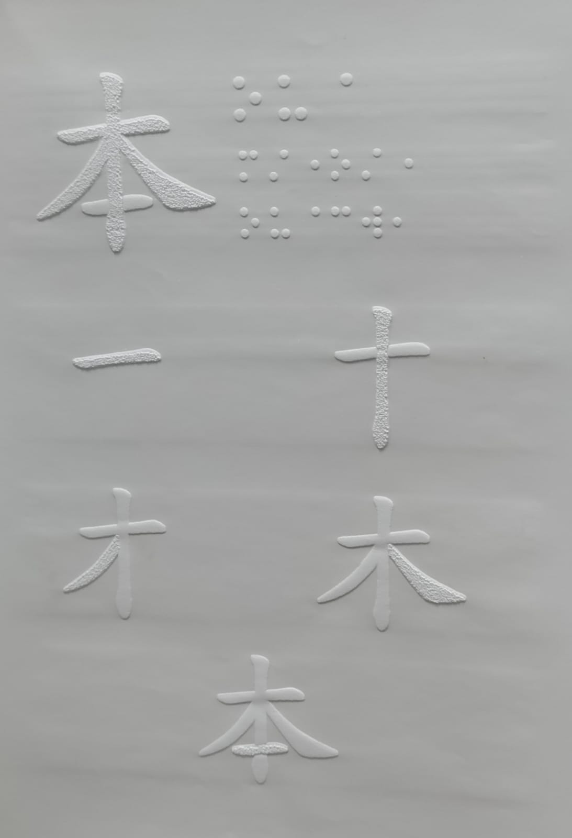
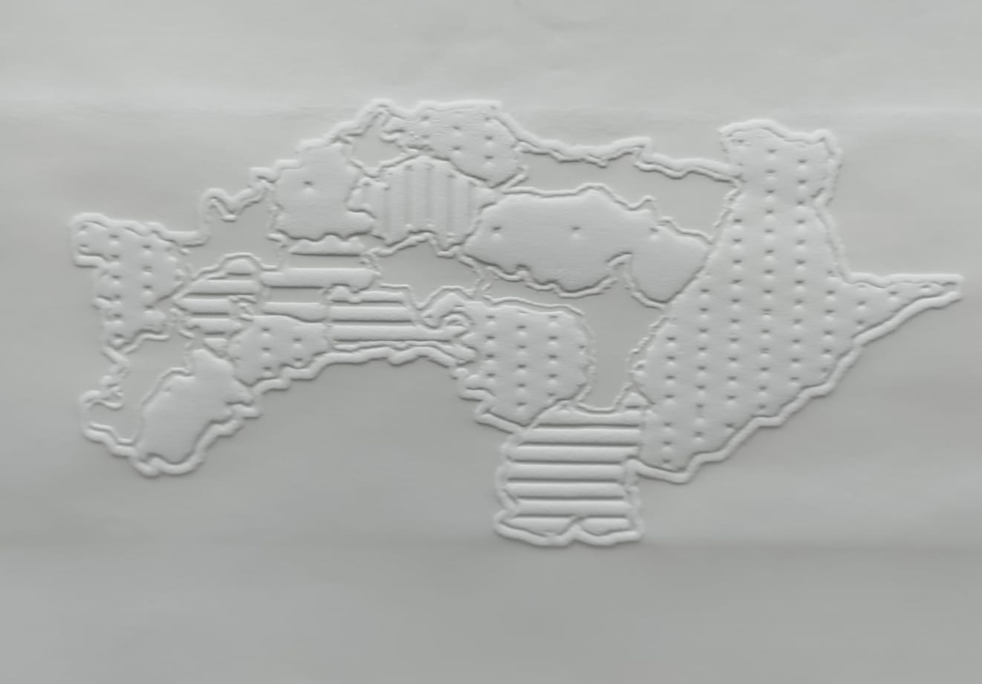
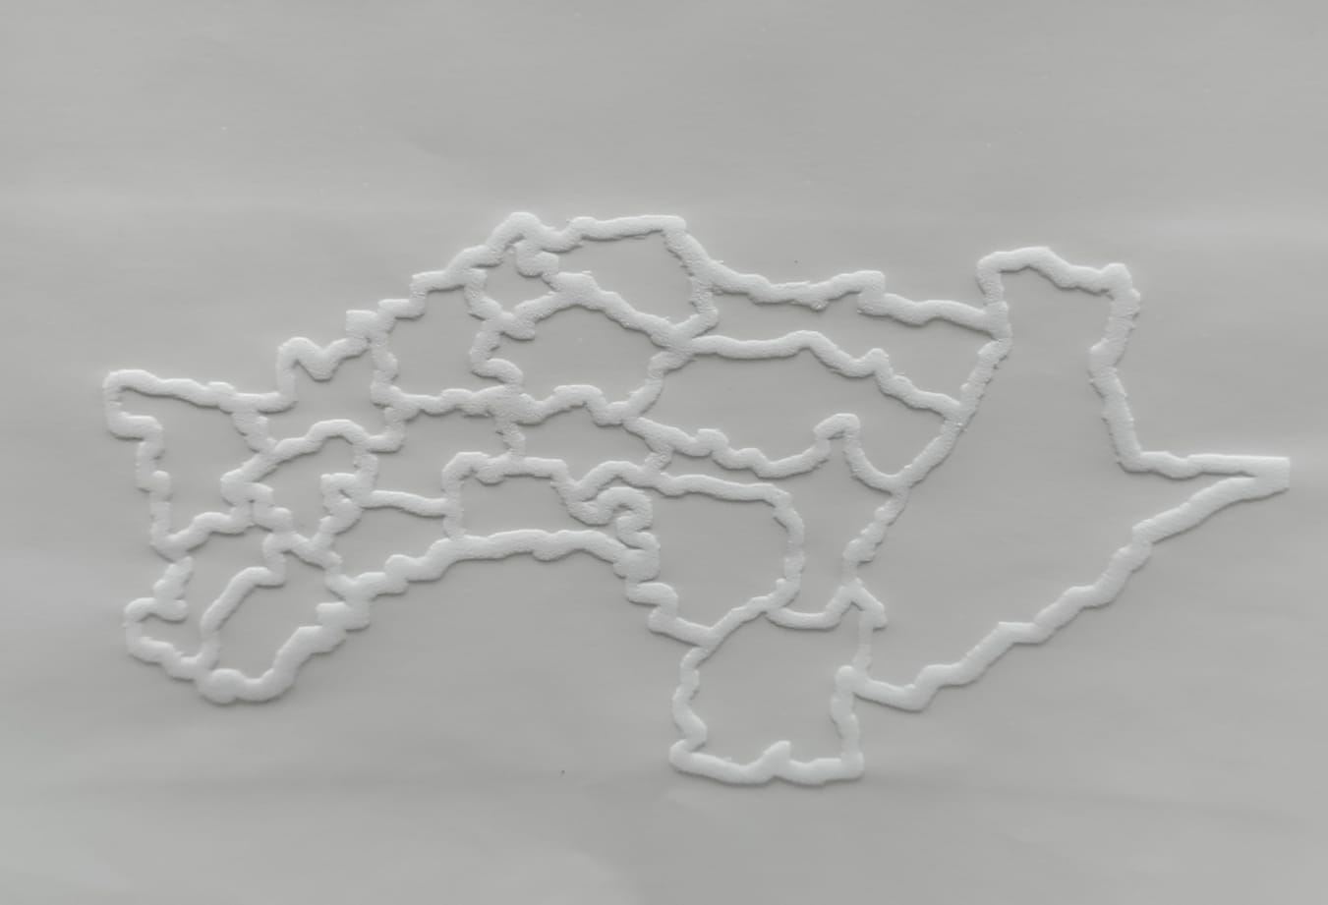
Expected Outcomes
Developing the output in the Tac-tale software
Making a 2.5D printing of that output with Chinese braille
Testing the 2.5D printed output with a blind person to ensure it is readable and understandable
Making any necessary adjustments to the image segmentation, Tac-tale software, or 2.5D printing process based on feedback from the blind person
Repeating steps 1-5 until the output is satisfactory for the blind person
Documenting the entire process for future reference and replication

Slide 11
Conclusion
By testing the output with a blind person and making necessary adjustments based on their feedback, the methodology can be refined to ensure the materials are readable and understandable for the intended audience. Documenting the entire process for future reference and sharing it with others will help expand access to these supplementary tactile materials.
In conclusion, this methodology has the potential to greatly improve the quality of life for visually blind individuals by providing them with more accessible visual information through tactile materials. With continued refinement and adaptation, the possibilities for enhancing the lives of the visually impaired through supplementary tactile materials are endless.

Slide 12
References
Li, Y., Chen, T., & Yang, H. (2023). Tactile displays for Chinese characters: A review of current technologies and future directions. Journal of Visual Impairment & Blindness, 117(4), 412-427.​
A. R. See and W. D. Advincula, "Creating Tactile Educational Materials for the Visually Impaired and Blind Students Using AI Cloud Computing," Applied Sciences, vol. 11, no. 16, p. 7552, 2021.
Zhang, M., Liu, Y., & Gao, H. (2022). Developing a tactile display for Chinese characters using raised dots and lines. IEEE Transactions on Haptics, 15(4), 576-588.​
Chen, S., Wang, H., & Chen, Y. (2020). A study on the effectiveness of a tactile display for Chinese characters based on raised dots and lines. Chinese Journal of Special Education, 29(4), 62-69.​
Bentzen, B. M. (2017). Tactile Displays for the Blind and Visually Impaired. Springer.​
L. Li, W. Zhao, and Z. Zhang(2019), A Tactile Display for Chinese Characters Based on Embossed Lines, Journal of Computer-Aided Design & Graphics, vol. 33, no. 1.
H. Liu, D. Guo, X. Zhang, W. Zhu, B. Fang, and F. Sun( 2020), "Toward Image-to-Tactile Cross-Modal Perception for Visually Impaired People," IEEE Transactions on Human-Machine Systems, vol. 50, no. 6.
L. C. Chen et al.(2018), Deep Lab: Semantic Image Segmentation with Deep Convolutional Nets, Atrous Convolution, and Fully Connected CRFs.​
Zhang, Y., Liu, Y., & Wang, Z. (2020). Deep tacpic: A deep learning-based algorithm for converting animated images to tacpics. IEEE Transactions on Image Processing, 29(11), 6483-6496.​
J. Shopf and M. Olano, "Procedural haptic texture", Symposium on User Interface Software and Technology Proceedings of the 19th Annual ACM Symposium on User Interface Software and Technology.​
P. S. Tsai and M. Shah, "Shape from shading using linear approximation", Image and Vision computing, vol. 12.​
H. Vasudevan and M Manivannan, "Tangible images: runtime generation of haptic textures from images", 16th Symposium on Haptics Interfaces for Virtual Environment and Teleoperator Systems.​

Slide 13
Thank You

