Slide 1
Using Subversion
James Brucker

Slide 2
What is version control?
manage documents over time
keep a history of all changes - multiple versions of every file
coordinate work of multiple authors
avoid conflicts ...and help resolve them
permissions: authenticate and control access to files
show differences between versions of a file
document changes -- reason for change

Slide 3
CMMI Level 2 : Managed
At CMMI maturity level 2, requirements, processes, work products, and services are managed.
The status of the work products and the delivery of services are visible to management at defined points (for example, at major milestones and at the completion of major tasks).

Slide 4
CMMI Level 2 - Key Process Areas
Question:
What is a Process Area?
Question:
What are the CMMI Level 2 Key Process Areas?

Slide 5
CMMI Level 2 - Key Process Areas
CMMI suggests ("requires") a company implement practices in these process areas:
CM - Configuration Management
MA - Measurement and Analysis
PMC - Project Monitoring and Control
PP - Project Planning
PPQA - Process and Product Quality Assurance
REQM - Requirements Management
SAM - Supplier Agreement Management

Slide 6


How to Use Version Control
client
server
checkout (first time)
send current revision ( n )
(do some work, test)
check status
any changes since revision n?
update
update your local copy with any changes in the repo.
(resolve conflicts)
commit
save your changes and log entry
(do more work, test)

Slide 7






Subversion Repository Layout
One repository, many projects
One project per repository
Root
Repository parent dir
Project 1
Project 1
trunk
trunk
tags
tags
branches
branches
Project 2
Project 2
trunk
trunk
tags
tags
branches
branches

Slide 8
Subversion "repository"
Typically one "repository" per project.
Server can have an unlimited number of "repositories".
"KUClock" Project Repository
/var/svn/kuclock
revision 3:
content diffs
author
date
reason for change (comment)
revision 4
revision 3
revision 2
revision 1
(initial repo structure)
revision 2:
initial project check-in
...etc...

Slide 9



Revision numbers
0 1 2 3
Revision number is increased for every transaction that changes the repository.
Notes:
Subversion
Revision numbers are global across the whole repository
Identify how the entire repository looks at that instant in time
A commit creates a snapshot of the entire tree in the repository at that revision number
Allows users to say, “Hey so-and-so, go get revision 1432 of XYZ and try to compile it.”
Before an update, both bar.c and foo.c are at revision 25
Modify bar.c and commit
Then update the working copy
Now bar.c and foo.c are at revision 26, except that foo.c in revision 25 and 26 are identical
No additional space in repository required, i.e. a cheap copy or a symbolic link is made

Slide 10
Properties of a Repository
History of all changes to files and directories.
  you can recover any previous version of a file
  remembers "moved" and "deleted" files
Access Control
  Read / write permission for users and groups
  Permissions can apply to repo, directory, or file
Logging
  author of the change
  date of the change
  reason for the change

Slide 11
Typical Work Cycle
client
server
checkout (first time)
send current revision ( n )
(do some work, test)
status
any changes since revision n?
update
get all revised files
(resolve conflicts)
commit
save my changes and log entry
(do more work, test)

Slide 12









The Work Cycle
Create a local copy
Submit your changes
svn commit
svn checkout
svn update
Subversion
Repository
106
100
Resolve conflicts
(Merge your changes)
Make changes
svn diff
svn resolved
svn add
svn move
svn delete
105
See what was changed
in the repository in the meantime
Update your local copy
svn update
svn status -u

Slide 13
Logging a Revision
Content what has changed?
Date when did it change?
Author who changed it?
Reason why has it changed?
SVN does this
you enter this

Slide 14
URLs and Protocols
http://myhost.com:port/path/to/repository
optional port number
Protocol:
svn
svn+ssh
http
https
file
Host name or IP address
127.0.0.1
localhost
host:8443
Repository
relative path

Slide 15
How to Contact a Subversion Server
checkout (first time)
client
server
1. You need the URL of repository.
http://se.cpe.ku.ac.th/svn/demo
2. (optional) may need a username and password.

Slide 16
URL on se.cpe.ku.ac.th
http://se.cpe.ku.ac.th/svn/demo
port not needed
protocol
we use http and https
Host name
Repository
/svn/project_name

Slide 17
(1) Check Out -- first time
List files in the repository:
> svn list http://se.cpe.ku.ac.th/svn/demo
branches/
tags/
trunk/
Change to a suitable directory
> cd d:\workspace
check out the "trunk" to a directory named "demo"
> svn checkout http://se/svn/demo/trunk demo
name of local directory

Slide 18
Check-out: Advice
Don't check-out the entire repository!
Only check out the part that you need.
  For developers, this is usually "/repo/trunk"
  For documenters, maybe "/repo/doc"
  Multi-project repo: //se.../jim/hibernate-demo/trunk/

Slide 19
Check Out - results
/home/faculty/jim> cd workspace/
faculty/jim/workspace> svn co http://se.cpe.ku.ac.th/svn/demo/trunk demo
A demo/test
A demo/src
A demo/src/firstgen
A demo/src/firstgen/pos
A demo/src/firstgen/pos/POSInterface.java
A demo/src/firstgen/pos/RegisterUI.java
A demo/src/firstgen/pos/Register.java
A demo/src/firstgen/Main.java
A demo/src/firstgen/domain
A demo/src/firstgen/domain/Customer.java
A demo/src/firstgen/domain/ProductDescription.java
A demo/src/firstgen/domain/Sale.java
A demo/src/firstgen/domain/LineItem.java
A demo/README
Checked out revision 4.
faculty/jim/workspace>

Slide 20
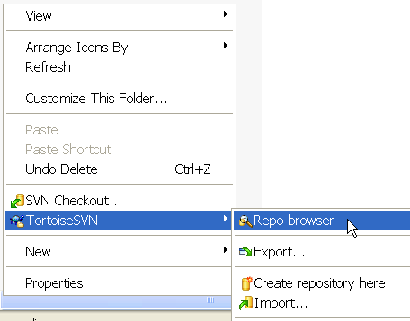
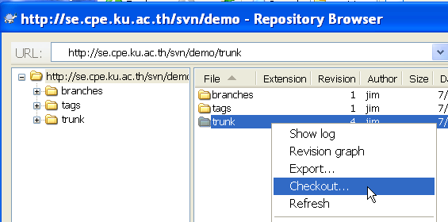
(1) Check Out using TortoiseSVN
Using Windows Explorer, right-click in a directory.
If not sure of path to check-out then use Repo-browser first.
In Repo-browser, right-click on folder or file you want to check-out.

Slide 21
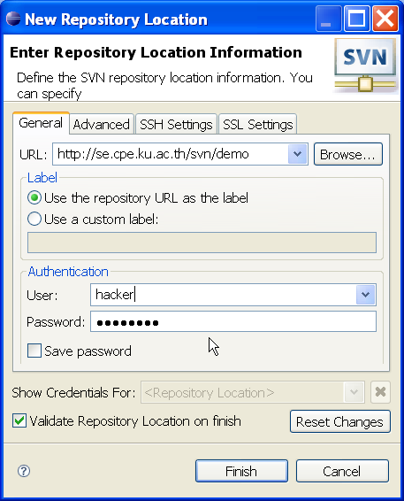
(1) Check out using Eclipse
Many ways to do it. Here is a simple way:
1. Switch to "SVN Repository Exploring Mode".
2. Right click and choose
New => Repository Location
3. Enter URL and (optional)
authentication info.

Slide 22
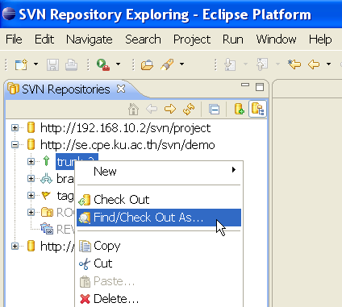
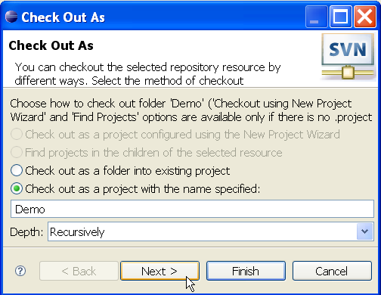
(1) Check out using Eclipse
Now you can browse the repository.
Choose the part you want to check-out (usually "trunk")
Right click and choose "Check Out as..."
("Check Out as..." gives you a chance to change local project name if you want.)

Slide 23


Check Out and the "Working Copy"
The client machine
Repository Server
Check out a "working copy"

Slide 24
(2) Work Cycle: Edit Files
1. Edit files using anything you like.
2. Test Your Work.
  Don't commit buggy code to the repository.
Then go to next step...

Slide 25
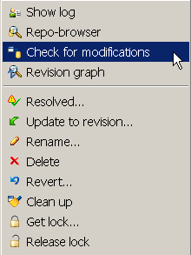
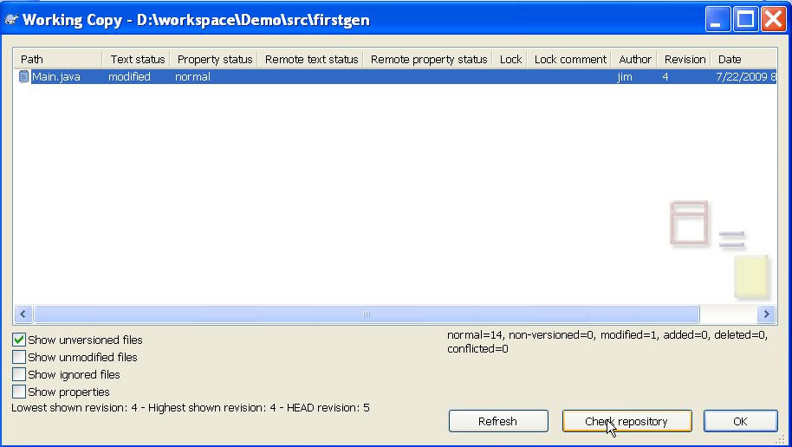
(3) Check for Updates
Before "committing" your work, check for updates in the repository.
Something might have changed while you were working.
Subversion requires you to synchronize before commit.

Slide 26
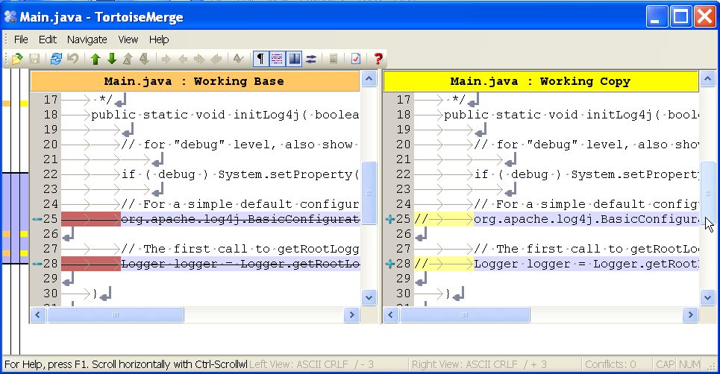
View Differences
You can compare your version and the base or repo version.
Select file, right-click => Compare with base

Slide 27
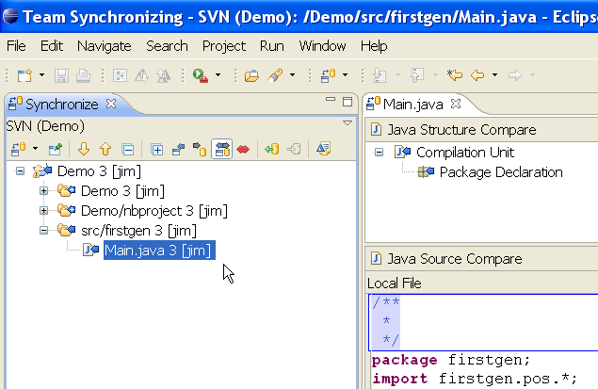
(3) Check for Updates using IDE
Eclipse:
right click on project
Team -> Synchronize with Repository (Ctrl+Alt+S)
NetBeans:
Team menu -> Show changes
Demo: Eclipse and NetBeans show changes graphically. You can compare differences in files and resolve conflicts.

Slide 28
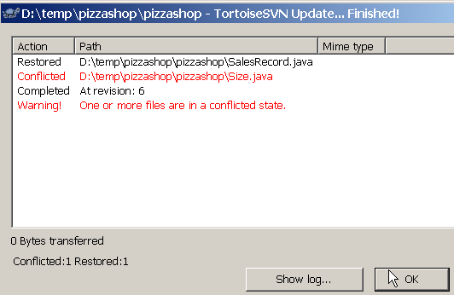
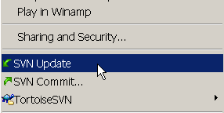
(4) Work Cycle: Update working copy
If there are any changes on the server,
then you should "update" your working copy before "commit"-ing your changes.

Slide 29
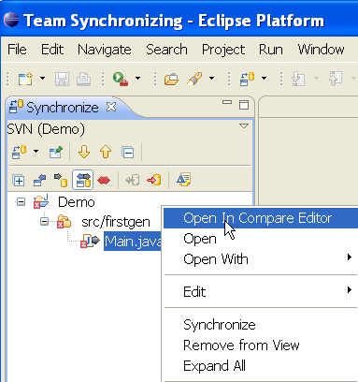
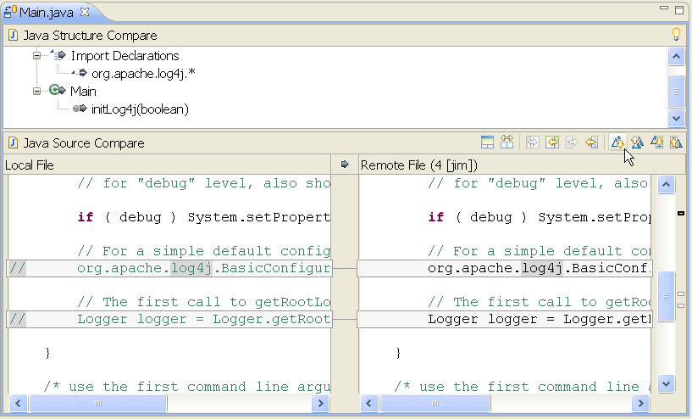
(4) Updating in Eclipse
Right-click => Team => Synchronize with Repository
Eclipse switches to "Team Synchronize" perspective.
Use "Compare Editor" to compare modified files.

Slide 30
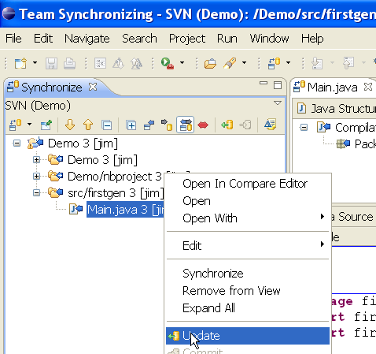
(4) Updating in Eclipse
You can use "Compare Editor" to download changes.
or, right-click => "Update" on file or project.

Slide 31
(5) Resolve Conflicts
"Conflict" means you have made changes to a file, and the version in the repository has been changed, too.
So there is a "conflict" between your work and work already in the repository.

Slide 32
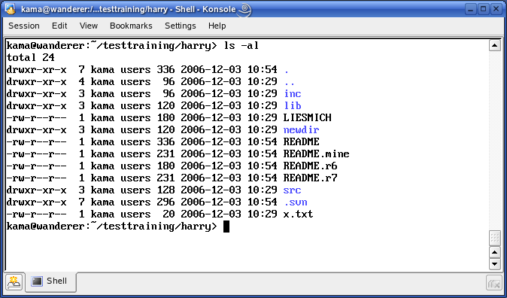
Conflict Support Files
Subversion client creates 4 files when a conflict exists.

Slide 33
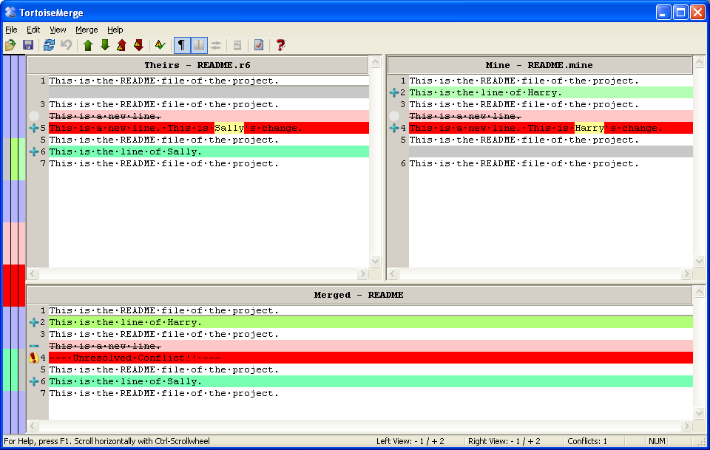
Resolving Conflicts with TortoiseSVN
Edit-Conflict tool of TortoiseSVN

Slide 34
Resolving Conflicts
The choices are:
(1) merge local & remote changes into one file.
(2) accept remote, discard your local changes.
(3) override remote, use your local changes.
After resolving all conflicts, mark the file as "resolved".
Subversion will delete the extra 3 copies.

Slide 35
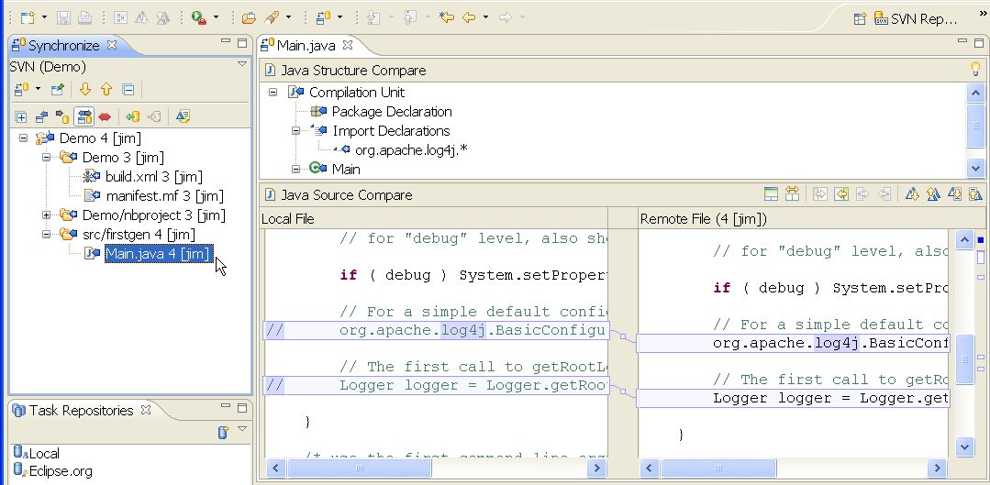
Resolving Conflicts in Eclipse
Use "Compare Editor" in Synchronize perspective.
Accept or reject changes one-by-one or all at once.

Slide 36
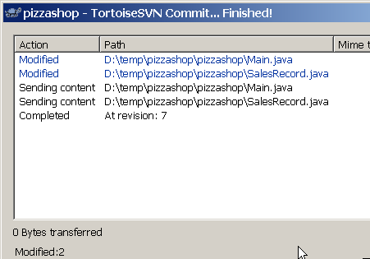
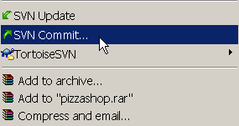
(6) Work Cycle: Commit
After "update" and resolving conflicts, commit your work.
Command line:
svn commit -m "description of your changes"
TortoiseSVN:

Slide 37
(6) Commit in IDE
Eclipse:
right click on file or project => Commit
NetBeans:
Team menu => Commit...

Slide 38
Move, Rename, Delete
Use:
svn copy oldfile newfile
svn move oldfile newfile
svn rename oldname newname
svn delete filename
Don't use Windows (or other OS) move, rename cmd
You must use svn move, svn rename, or svn delete, so that Subversion will know that you want these changes applied to repository.

Slide 39
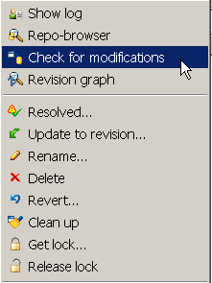
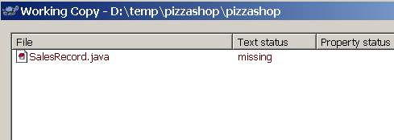
Exercise: Delete File use Explorer
Check-out a project from the repository.
In Windows Explorer, delete a file... or many files!
TortoiseSVN "Check for modifications" or "svn status"
What is the result?

Slide 40
Exercise: Delete a File
What happens when you "update" your working copy?

Slide 41
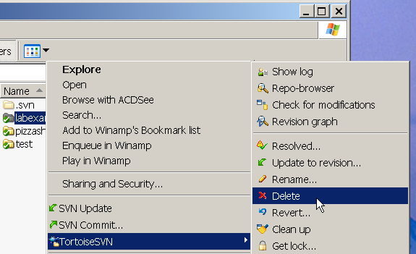
Move, Rename, Delete via TortoiseSVN
TortoiseSVN integrates into Windows Explorer.
Right click on file to open menu.

Slide 42
Move, Rename, Delete in Eclipse/Netbeans
The IDE will mark file for rename or deletion from SVN.

Slide 43
Useful Tools

Slide 44
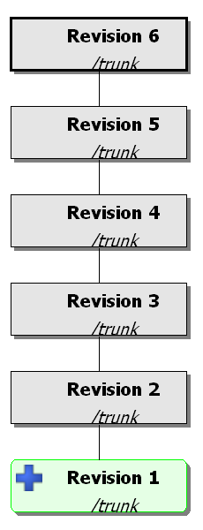
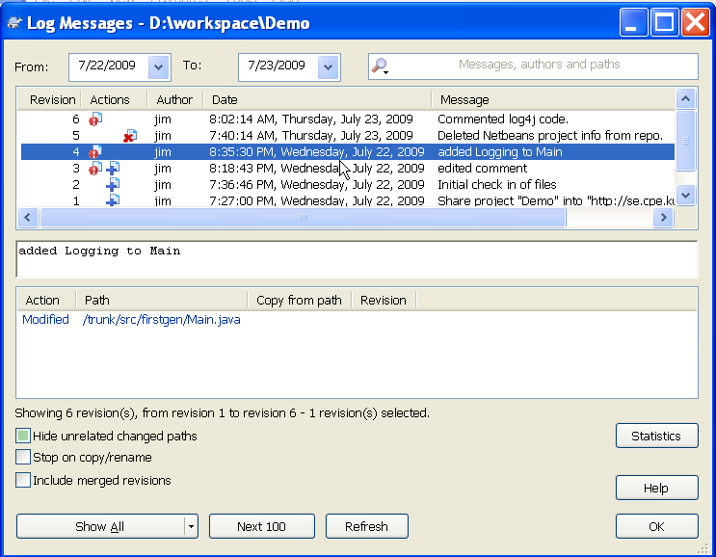
SVN Log Viewer and Revision Graph
Eclipse and Netbeans have similar tools.

Slide 45
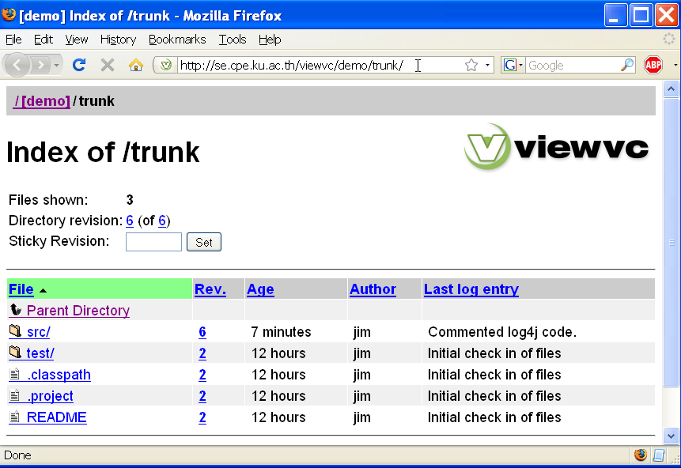
ViewVC - show SVN in web browser
http://se.cpe.ku.ac.th/viewvc/demo

Slide 46
"Importing" a Project
The initial check-in of code into subversion

Slide 47
Plan Before You Import
1. Choose a directory layout for project, and organize your local copy.
src/ Source code
org/
myproject/
domain/
ui/
service/
test/ Test code
org/
myproject/
dist/ Distributables
lib/ Libraries needed

Slide 48
The Maven Project Layout
For a Maven Project, preferrably use Maven's standard directory layout.
src/ Source code
main/
java/
org/
myproject/
resources/
test/ Test code
java/
...
target/ Build output, don't
classes/ check-in to subversion
site/

Slide 49
Plan Before You Import
2. Decide what not to import. Examples:
  compiler output (*.class, *.obj, *.exe)
  large image files, video, other "data"
  3rd party libraries you can get from Internet,
  e.g. log4j.jar, mysql-connector-5.1.jar, ...
  if you need an online copy of 3rd party libraries, put them in a separate project and link it as an "external" in your project

Slide 50
.svnignore
In the project root directory create a file named .svnignore
Put any file patterns (including "*" wildcard) and names of directories that you don't want to import into subversion
*.obj
*.class
*.bak
.classpath
bin
build
dist
nbproject

Slide 51
.svnignore
Eclipse and other IDE automatically ignore most of these (bin, dist, build).

Slide 52
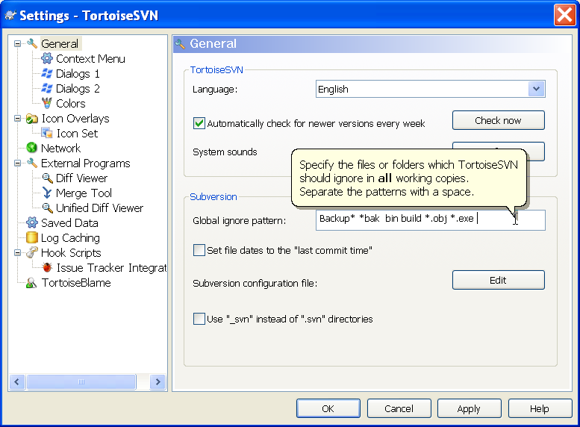
Global svnignores in TortoiseSVN

Slide 53
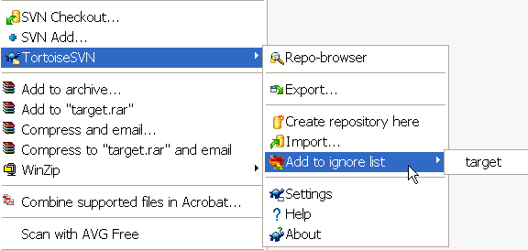
Adding "ignores" to a project
TortoiseSVN:
1. Right click on file or folder
2. Choose TortoiseSVN => Add to Ignore List
3. TortoiseSVN changes folder icon to indicate ignored
NOTE: You must "ignore" a folder or file before the folder is checked in SVN.

Slide 54
Adding "ignores" to a project
Eclipse:
1. Right click on file or folder
2. Choose Team => Add to svn:ignore
3. Eclipse changes folder icon to indicate ignored

Slide 55
Benefit of project "ignores"
When team members check-out project, they will get the svn "ignores" for the project, too.
Prevents team from accidentally checking in files you don't want in repository.

Slide 56
Import using Command Line
Import your project directory into a "trunk" directory inside repository:
cmd> cd myproject
cmd> svn import . http://svnserver/svn/myrepo/trunk \
--username jim
Create the tags and branches directories
cmd> svn mkdir -m "create branches dir" \
http://svnserver/svn/myrepo/branches
cmd> svn mkdir -m "create tags dir" \
http://svnserver/svn/myrepo/tags

Slide 57
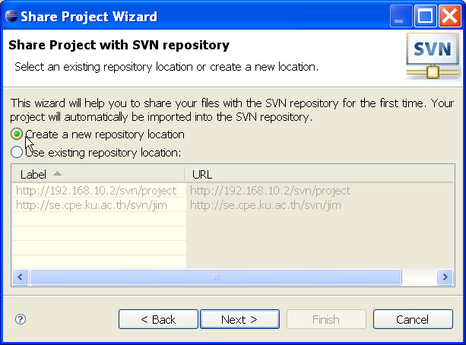
Import using Eclipse
Open the project and right click on it.
Choose Team -> Share Project...
Choose "SVN" and click "Next"
Choose "Create a new repository
location" or use existing.
This only creates location in
Eclipse, not on the server
click Next

Slide 58
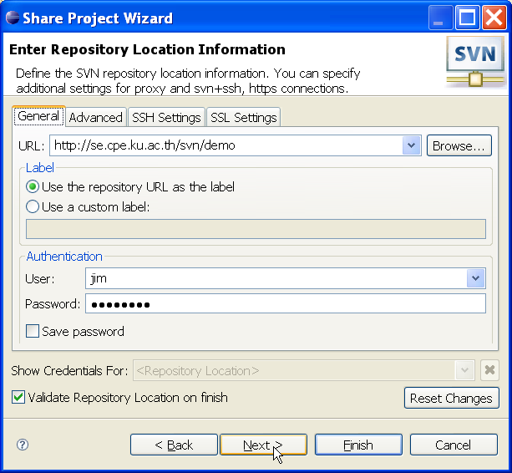
Import Using Eclipse (new repo)
If creating a new repo location in Eclipse, enter authentication information.

Slide 59
Import using Eclipse (2): Layout
Choose layout of folders in the SVN repository:
1. choose name in repository:
project name - useful for repo with several projects
empty name - convenient for repo with only one project
2. choose repository layout.
3. you should use "trunk", "branches", "tags"
For single project, path should look like one of these:
  http://servername/svn/myproject/trunk
  http://servername/svn/myrepo/myproject/trunk

Slide 60
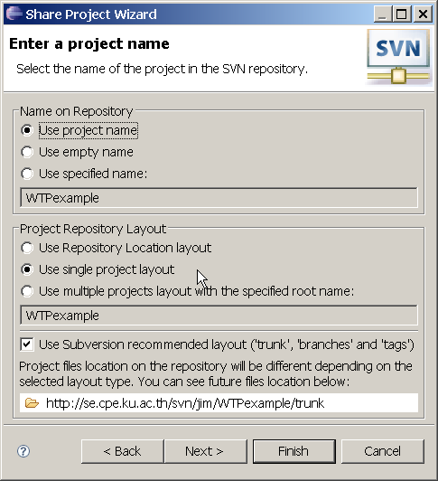
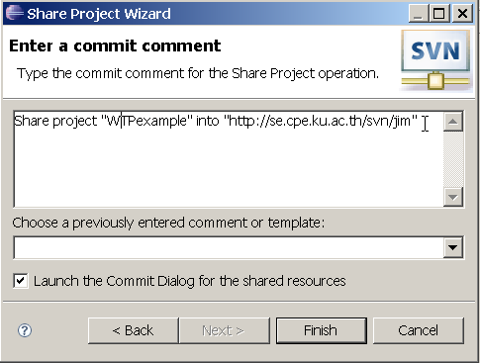
Import using Eclipse (2): Layout
any of these is OK
Launch commit dialog

Slide 61
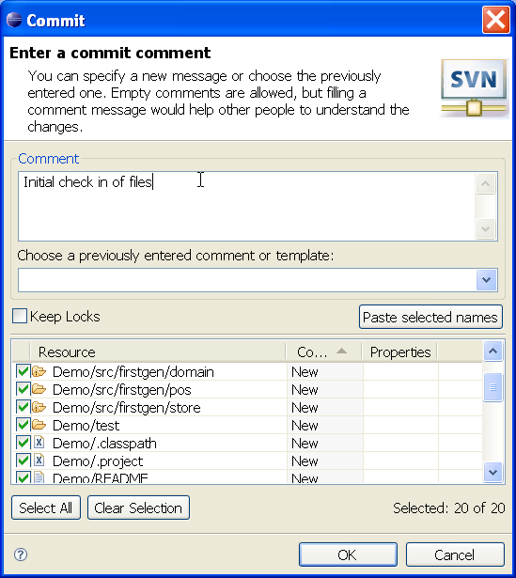
Import using Eclipse (3): Choose files
Enter a commit comment.
Carefully review the files that will be committed.
Subversion never really deletes a file from the repository -- even if you delete it later.
Once you commit a file, it stays in the repository forever.
Choose your files and layout carefully.

Slide 62
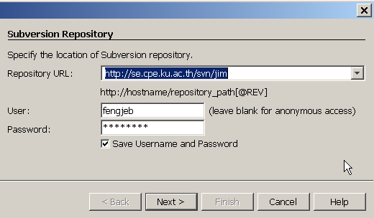
Import Using NetBeans (1)
Right click on project and choose
Versioning -> Import into Subversion Repository...
Enter repository URL and login credentials
Click Next

Slide 63
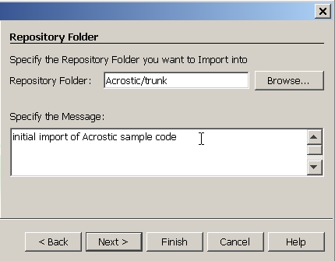
Import Using NetBeans (2)
Enter base directory in repository for the project trunk
You have to type the "trunk" yourself.
Enter import message
Click Next

Slide 64
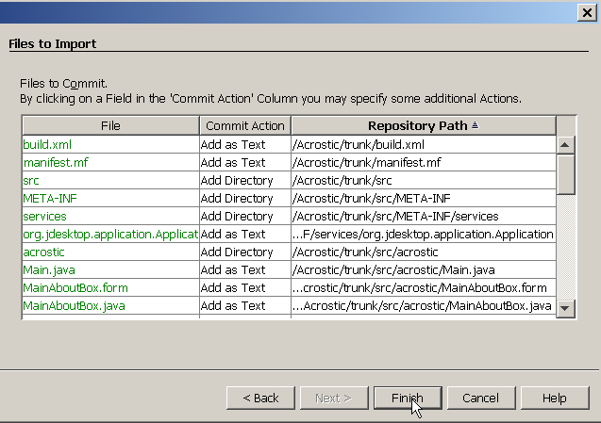
Import Using NetBeans (3)
NetBeans shows files it will import and waits for you to press Finish

Slide 65
Branches & Tags in NetBeans (4)
NetBeans doesn't create "tags" and "branches" for you.
You can copy to any folder, but you should follow the Subversion convention
MyProject/trunk
MyProject/branches
MyProject/tags
You can create branches and tags folders when you do Subversion -> Copy to ...

Slide 66
Subversion Server and Protocols
To help understand how things work

Slide 67




Subversion Architecture
Client Interface
Repository Interface
FSFS
Apache
GUI clients
Access
Protocol
mod_dav
mod_dav_svn
DAV
Client
Library
Intranetwork
svnserve
Cmd line
clients
SVN
sshd
SSH
Subversion
Repository
Working Copy Management
Library
Local
"file" protocol
Berkley DB
Notes:
Two locations of SVN repositories
On a local filesystem
Typically used for a single developer
Accessed via direct file read/write access
Requires that users have local accounts
Uses filesystem and user/group security
On a remote system
Accessed via a HTTP or HTTPS connection
Does not require that users have accounts on the server
Use Apache style authentication

Slide 68
URLs and Protocols
http://myhost.com:port/path/to/repository
optional port number
Protocol:
svn
svn+ssh
http
https
file
Host name or IP address
127.0.0.1
localhost
host:8443
Repository
relative path

Slide 69
Tags and Branches

Slide 70
Tags
Why do we need tags?
  Mark a release version of a product.
  Mark a snapshot of the current development.
Typical Release names:
  Release-1.0.0
  REL-0.3.0RC1
A Tag name must be unique.
Contents of a "tag" should not be changed.
...but Subversion won't stop you from changing them!

Slide 71



Tagging by Copy
Root
Project 1
trunk
To create a release tag just copy …
... subversion doesn't really copy the files; it just creates a name ("Release-1") for the revision number
tags
Release-1

Slide 72
Tagging by Copy: command line
You can create a tag using the following command:
svn copy source destination -m "comment"
The Subversion “copy” command.
The source of the operation (this can be the current
working copy or an explicit referenced part in the
repository).
The destination of the operation. This means the
name of the tag.
Description of this tag.

Slide 73
Tagging by Copy: CLI
Example:
  svn copy
  http://svnserver/calc/trunk
  http://svnserver/calc/tags/RELEASE-1.0.0
  -m ”Create Release Tag for Release 1.0.0”
  If path contains space or special characters, use quotes: 'rel 1.0'
  Don't use spaces in release names.

Slide 74
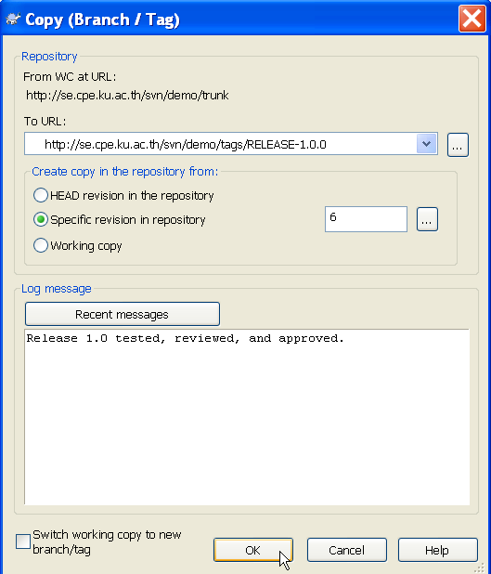
Tagging by Copy using TortoiseSVN
Create a tag for the trunk development via TortoiseSVN:
Right click on your working copy.
TortoiseSVN... => Branch/Tags

Slide 75
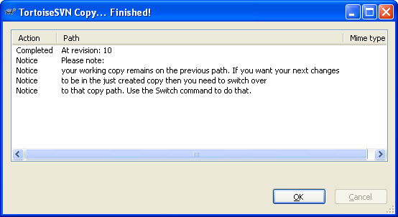
Tagging by Copy using TortoiseSVN
After clicking on OK:

Slide 76
Branching
Why Branching
Creating Branches
Using Branches

Slide 77
Why Branching?
This could happen to you:
  You create a great product and it has been delivered to your customers.
  Before you delivered the product you create a svn tag, named it REL-1.0.0
  Your development team is modifying the trunk version with new features.
And now Murphy‘s Law strikes!
  Customer reports that he found a major bug in your software!

Slide 78

Why Branching?
The development has continued after the release of REL-1.0.0
You want to fix the bug
to satisfy your customer!
In your current development
you have enhanced many of
the product’s functions
but you don‘t want to deliver
a product with more
features and you haven‘t
finished testing yet.
How to solve this situation?
tag: REL-1.0.0
Main line of development

Slide 79

Why Branching?
Based on the tag you‘ve created during the delivery you can check out the exact state of the delivery.
You create a Branch to
fix the bug in the software.
After you have fixed the bug
you can tag the Branch and
deliver another version to the
customer.
Your customer is satisfied
that you fixed the bug
so fast.
You haven‘t disturbed the
current development.
RELEASE 1.0.0
BUGFIX_BRANCH
RELEASE 1.0.1

Slide 80
Creating Branches
You can create a branch using the following command:
  svn copy source destination
  The Subversion “copy”-command.
  The source of the operation: local working copy or svn URL.
  The name of the branch to create.

Slide 81
Creating Branches
Example:
  svn copy
  http://svnserver/calc/trunk
  http://svnserver/calc/branches/my-branch
  -m”- Create the branch”
  You can replace this with a "." for your working copy.
  The branch name.
  Log Message.

Slide 82

Creating Branches
Root
Calc
trunk
branches
my-calc branch
Paint
trunk
branches

Slide 83
Using Branches
Based on your company’s policy you may have subdirectories under the branches directory in the repository:
  branches/release-candidates
  branches/sub-projects
  branches/user-branches
  This differs much from company to company.

Slide 84
Using Branches
You would like to work on the branch to fix the bug.
You can do it in two ways:
  Check out a complete new
  working copy from the
  branch.
  Or switch your current
  working copy to the
  particular branch.
RELEASE 1.0.0
BUGFIX_BRANCH
RELEASE 1.0.1

Slide 85
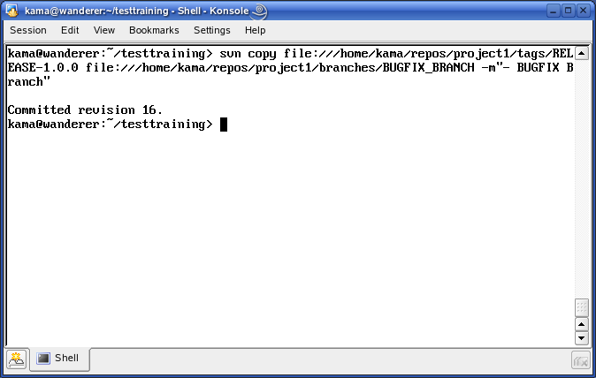
Using Branches
Create a branch from a release tag via CLI:

Slide 86
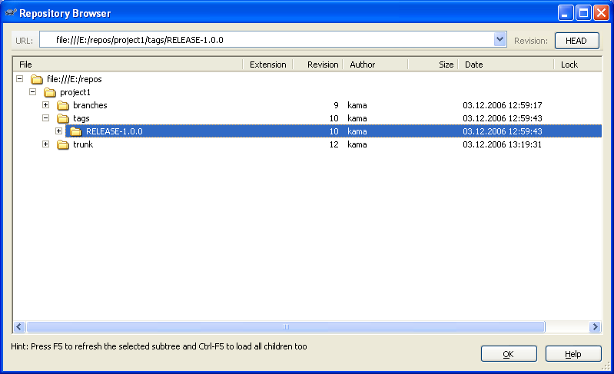
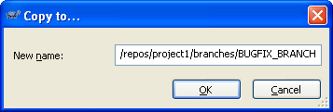
Using Branches
Create a branch from a release tag via TortoiseSVN:
  Context Menu -> Copy to…

Slide 87
Using Branches
You can switch your current working copy to a branch with the following command:
  svn switch destination
  The Subversion “switch”-command.
  The name of the branch to use.

Slide 88
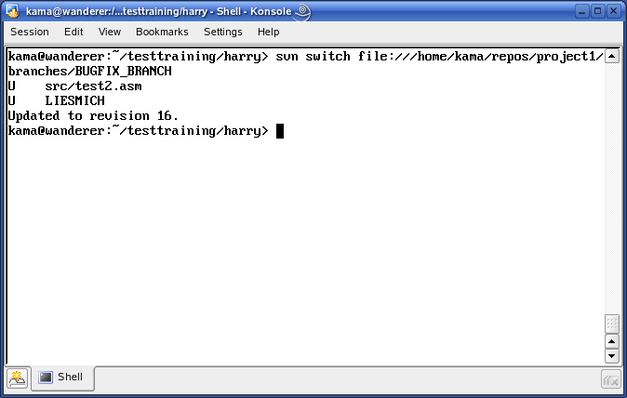
Using Branches

Slide 89
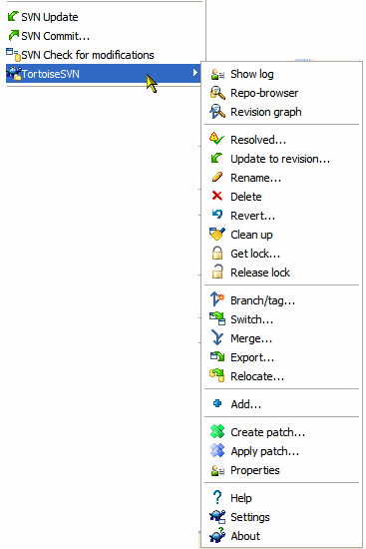
Using Branches

Slide 90
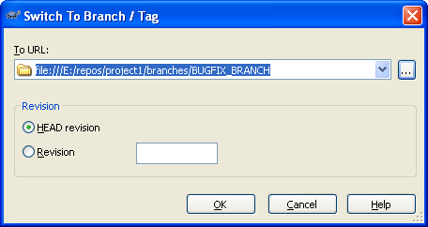
Using Branches

Slide 91
Using Branches
Fix the bug through doing the necessary modifications and finally commit the changes to the branch.
After having fixed the bug on the branch create a tag to mark the new release which can be delivered to the customer.
Create the new Release Tag:
svn copy
file:///home/kama/repos/project1/branches/BUGFIX_BRANCH
file:///home/kama/repos/project1/tags/RELEASE-1.0.1
-m”Fixed Release 1.0.1”

Slide 92
Merging
Merging from a Branch
Merge Tracking
Best Practices

Slide 93

Merging From a Branch
What’s with the bug you've fixed on the bug-fix-branch?
What about your current development?
You have to merge the
changes made in the branch
back to the main line.
RELEASE 1.0.0
BUGFIX_BRANCH
267
RELEASE 1.0.1
Merge back

Slide 94
Merge From a Branch via CLI
You can merge the changes from the branch into your current working copy with the following command:
  svn merge -r 267:HEAD branchname
  The Subversion “merge”-command.
  The revision in which we created the branch (267) and HEAD
  for the complete branch.
  The branch-name you like to merge into your current
  working copy.

Slide 95
Merge From a Branch via CLI
You can find the revision number when the branch was created using the command:
  svn log --verbose --stop-on-copy branchname
  The Subversion “log”-command.
  Print out much information (verbose).
  Stop the log-output at the revision the branch was copied.
  The branch-name you like to merge into your current
  working copy.

Slide 96
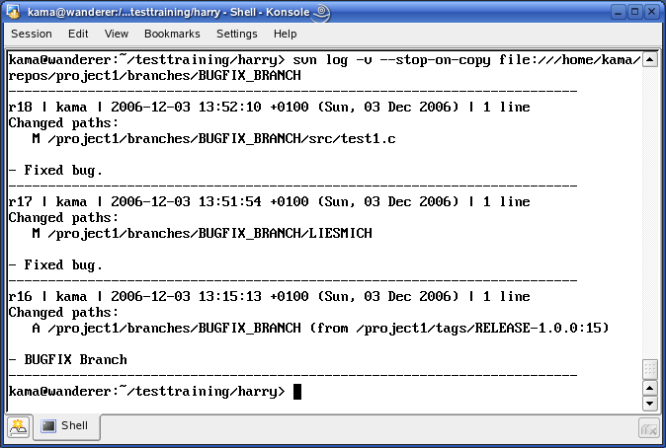
Merge From a Branch via CLI
Extract the start point of the branch via CLI:

Slide 97
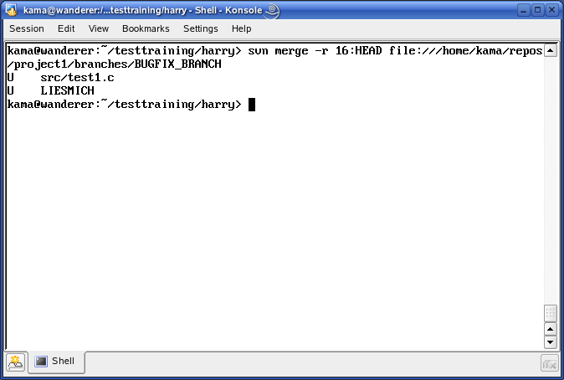
Merge From a Branch via CLI
Merging of a branch via CLI:

Slide 98
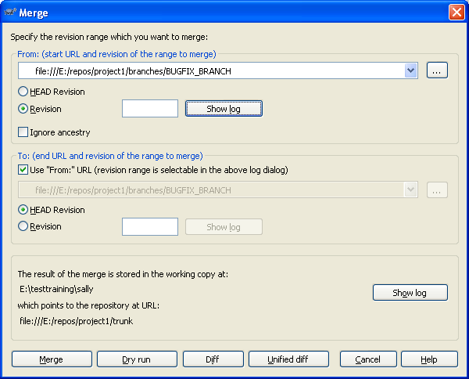
Merge From a Branch via TortoiseSVN
Merging of a branch via TortoiseSVN:

Slide 99
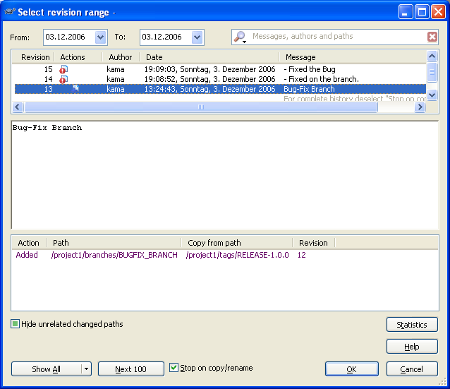
Merge From a Branch via TortoiseSVN
Merging of a branch via TortoiseSVN:

Slide 100
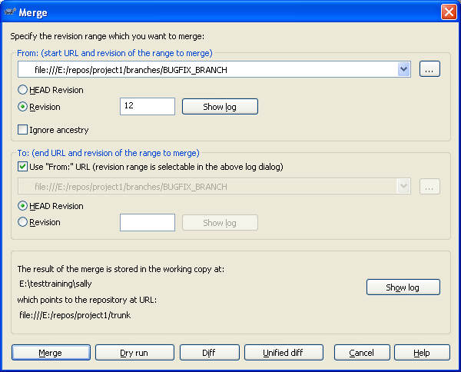
Merge From a Branch via TortoiseSVN
Merging of a branch via TortoiseSVN:

Slide 101
Merge Tracking
Merge tracking:
Subversion does not have any function to track merges that have already been done,
i.e., to prevent you to merge a branch a second time.
You have to do it yourself!
  Example: after merging, create a README-merged file in the branch stating that it was merged into trunk revision r99.

Slide 102
Merge Tracking
Best Practices:
If you need to create a branch, you should do it from a completely committed working copy. This prevents you from becoming confused.
If you merge check out a clean copy into another directory.
  Otherwise you can't go back using “svn revert”.
  After you've merged commit the changes and provide a log message with information on which revision/branch you have merged (merge tracking).
  You can first test the merge using the --dry-run flag of the merge command.

Slide 103

Merge Warning
From the technical view branch and tag are the same.
BUT:
  The intention of a tag is that it should be used as read-only area whereas a branch is used to continue development (interim code, bug-fixing, release candidate etc.).
  Technically you can use a tag to continue development and check in etc. but you shouldn’t do it.
  So in other words the difference between a tag and a branch is just an agreement.

Slide 104
Version Control Best Practices

Slide 105
1. Configuration Plan Before Checkin
Plan the directory structure
Decide what work products to put in version control
Decide what to exclude
Big decision: repository layout
  one "project" per repo?
  many projects per repo?
  Example:
  separate Eclipse projects for "core", "web", and "web services" components of your software

Slide 106
2. Test Your Work Before Commiting
Don't check-in buggy code

Slide 107
3. Single "commit" for related files
Commit all files related to the same task as one commit.
This makes comments more meaningful.

Slide 108
4. Use Tags and Branches
Create a tag for each milestone and each release.
Create branches for experimental work and bug fixes.
Avoid too many branches.

Slide 109
Team Work II
Developer Branches
Feature Branches

Slide 110


Developer Branches
Separation of team members can be realized with branches.
One branch per team member or several members on a branch - the decision is based on the size of the teams.
Main line
Member 1
Member 2

Slide 111
Developer Branches
Advantages using branches for team work:
    No changes during development on the main line needed => Code stability.
    Every team member can work in its own environment.
Disadvantages:
    Sometimes the mainline and the branch will diverge if the branch lives too long.

Slide 112
Feature Branches
Separation by features (one branch each).
Main line
Feature 1
Feature 2

