Slide 1
NATURAL LANGUAGE PROCESSING
DEPARTMENT OF CSE-AIML (CSM) – III-II Sem
NATURAL LANGUAGE PROCESSING

Slide 2
NATURAL LANGUAGE PROCESSING
DEPARTMENT OF CSE-AIML (CSM) – III-II Sem
NATURAL LANGUAGE PROCESSING
UNIT-II
SYNTATIC ANALYSIS
SEMANTIC ANALYSIS

Slide 3
This Session Learning Objectives I Syntactic Parsing: 1. Grammar formalisms. 2.Tree banks, 3. Efficient parsing for Context Free grammars (CFG). 4.Statistical Context Free Grammars 5.Probabilistic Context Free Grammars (PCFG) 6. Lexicalized PCFGs. .II Semantic Parsing: 7. Lexical semantics. 8. word-sense disambiguation. 9.Computational semantics, 10.semantic Role, 11. labelling and semantic Parsing.
DEPARTMENT OF CSE-AIML (CSM) – III-II Sem
NATURAL LANGUAGE PROCESSING
Syntactic Analysis:

Slide 4
This Session Learning Objectives 1. Introduction 2.Motivations 3.NLP? 4.Roadmap for NLP 5. NLP Components 6.NLP Issues 7. NLP Techniques 8.NLP Applications. 9. The role of Deep Learning in Natural Language Processing 10. Backpropagations, recurrent neural networks, Transformers. .
DEPARTMENT OF CSE-AIML (CSM) – III-II Sem
NATURAL LANGUAGE PROCESSING
Introduction to NLP:
NLP would be to program computers for analyzing and processing huge amount of natural language data.
It is a challenge for us to develop NLP applications because computers need structured data, but human speech is unstructured and often ambiguous in nature.
Study of Human Languages, Language is a crucial component for human lives and also the most fundamental aspect of our behavior.
Written and Spoken.

Slide 5
DEPARTMENT OF CSE-AIML (CSM) – III-II Sem
NATURAL LANGUAGE PROCESSING
NLP - Motivation :
The goal is to show you what is possible with current NLP techniques.
It inspire you to use some of these applications for your own.
Automatic text summarization : https://www.summarizebot.com/text_api_demo.html
2. Question answering : https://twitter.com/paraschopra/status/1284801028676653060?ref_src=twsrc%5Etfw%7Ctwcamp%5Etweetembed%7Ctwterm%5E1284801028676653060%7Ctwgr%5E89ef6d98baf71853523d6979e82ddbbc35d094f2%7Ctwcon%5Es1_&ref_url=https%3A%2F%2Fcdn.iframe.ly%2FyFGbULo%3Fapp%3D1
This Session Learning Objectives 1. Introduction 2.Motivations 3.NLP? 4.Roadmap for NLP 5. NLP Components 6.NLP Issues 7. NLP Techniques 8.NLP Applications. 9. The role of Deep Learning in Natural Language Processing 10. Backpropagations, recurrent neural networks, Transformers. .

Slide 6
DEPARTMENT OF CSE-AIML (CSM) – III-II Sem
NATURAL LANGUAGE PROCESSING
NLP - Motivation :
The goal is to show you what is possible with current NLP techniques.
It inspire you to use some of these applications for your own.
3. Information extraction
https://demos.explosion.ai/displacy-ent
4. Text classification --
https://dandelion.eu/semantic-text/entity-extraction-demo/?text=The+Mona+Lisa+is+a+sixteenth+century+oil+painting+created+by+Leonardo.+It%27s+held+at+the+Louvre+in+Paris.&lang=en&min_confidence=0.6&exec=true#results
This Session Learning Objectives 1. Introduction 2.Motivations 3.NLP? 4.Roadmap for NLP 5. NLP Components 6.NLP Issues 7. NLP Techniques 8.NLP Applications. 9. The role of Deep Learning in Natural Language Processing 10. Backpropagations, recurrent neural networks, Transformers. .

Slide 7
DEPARTMENT OF CSE-AIML (CSM) – III-II Sem
NATURAL LANGUAGE PROCESSING
NLP - Motivation :
The goal is to show you what is possible with current NLP techniques.
It inspire you to use some of these applications for your own.
5. Machine Translation --
https://pbs.twimg.com/media/EdcIrZyXkAADjcG?format=png&name=large
6. Write Code using natural language
ex: https://twitter.com/i/status/1282676454690451457
This Session Learning Objectives 1. Introduction 2.Motivations 3.NLP? 4.Roadmap for NLP 5. NLP Components 6.NLP Issues 7. NLP Techniques 8.NLP Applications. 9. The role of Deep Learning in Natural Language Processing 10. Backpropagations, recurrent neural networks, Transformers. .

Slide 8
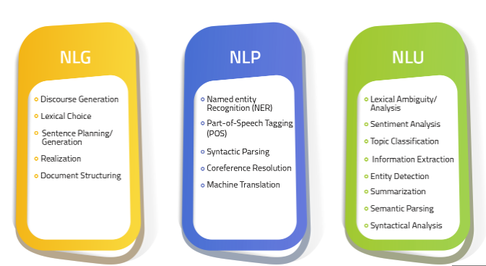
DEPARTMENT OF CSE-AIML (CSM) – III-II Sem
NATURAL LANGUAGE PROCESSING
NLP Components:
NLP=NLU+NLG
NLP identifies and processes the most significant data and structures it into text, numbers, or computer language
· NLU understands the human language and converts it into data
· NLG uses the structured data and generates meaningful narratives out of it
This Session Learning Objectives 1. Introduction 2.Motivations 3.NLP? 4.Roadmap for NLP 5. NLP Components 6.NLP Issues 7. NLP Techniques 8.NLP Applications. 9. The role of Deep Learning in Natural Language Processing 10. Backpropagations, recurrent neural networks, Transformers. .

Slide 9
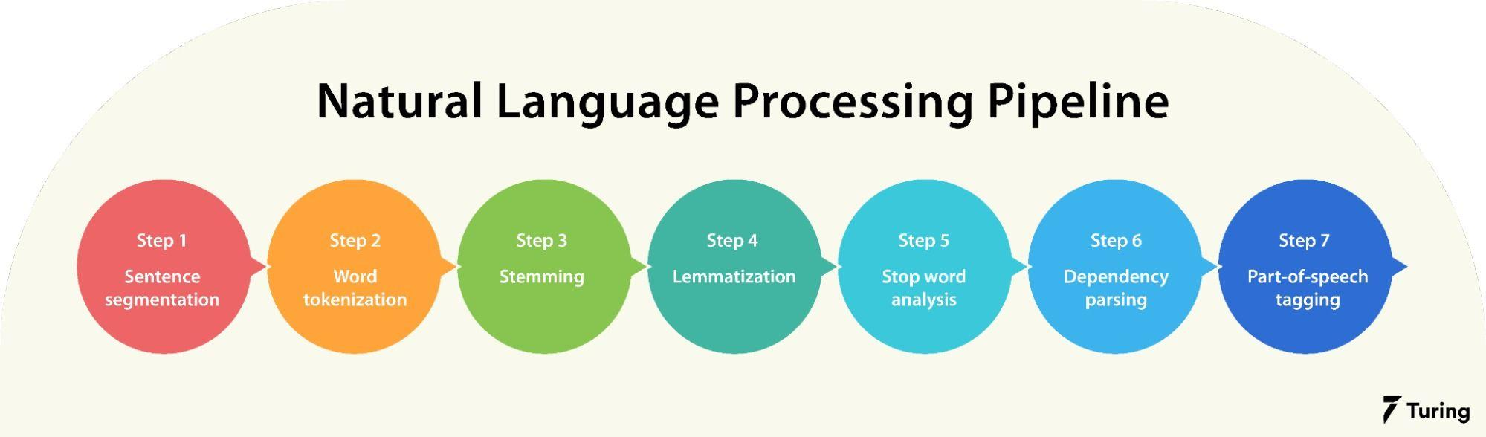
DEPARTMENT OF CSE-AIML (CSM) – III-II Sem
NATURAL LANGUAGE PROCESSING
Road Map:
This Session Learning Objectives 1. Introduction 2.Motivations 3.NLP? 4.Roadmap for NLP 5. NLP Components 6.NLP Issues 7. NLP Techniques 8.NLP Applications. 9. The role of Deep Learning in Natural Language Processing 10. Backpropagations, recurrent neural networks, Transformers. .

Slide 10
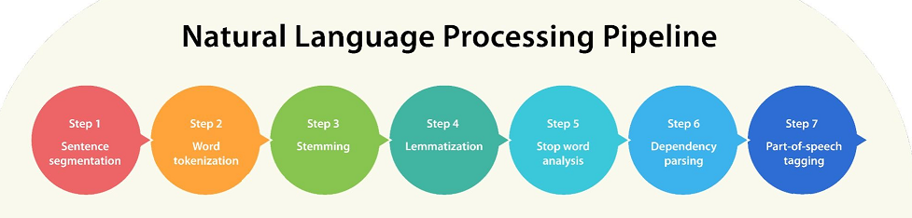
DEPARTMENT OF CSE-AIML (CSM) – III-II Sem
NATURAL LANGUAGE PROCESSING
NLP Pipeline:
This Session Learning Objectives 1. Introduction 2.Motivations 3.NLP? 4.Roadmap for NLP 5. NLP Components 6.NLP Issues 7. NLP Techniques 8.NLP Applications. 9. The role of Deep Learning in Natural Language Processing 10. Backpropagations, recurrent neural networks, Transformers. .

Slide 11
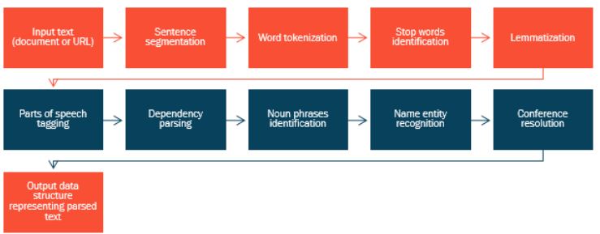
DEPARTMENT OF CSE-AIML (CSM) – III-II Sem
NATURAL LANGUAGE PROCESSING
NLP Pipeline:
This Session Learning Objectives 1. Introduction 2.Motivations 3.NLP? 4.Roadmap for NLP 5. NLP Components 6.NLP Issues 7. NLP Techniques 8.NLP Applications. 9. The role of Deep Learning in Natural Language Processing 10. Backpropagations, recurrent neural networks, Transformers. .

Slide 12
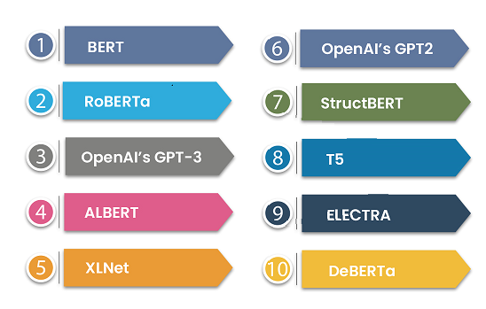
DEPARTMENT OF CSE-AIML (CSM) – III-II Sem
NATURAL LANGUAGE PROCESSING
NLP Applications:
Automatic text summarization
Question answering
Information extraction
Text classification
Machine Translation
Write Code using natural language
This Session Learning Objectives 1. Introduction 2.Motivations 3.NLP? 4.Roadmap for NLP 5. NLP Components 6.NLP Issues 7. NLP Techniques 8.NLP Applications. 9. The role of Deep Learning in Natural Language Processing 10. Backpropagations, recurrent neural networks, Transformers. .

Slide 13
DEPARTMENT OF CSE-AIML (CSM) – III-II Sem
NATURAL LANGUAGE PROCESSING
Deep Learning Role:
Deep learning model can learn word meaning and perform language tasks, evading the need for performing complex language tasks.
A variety of deep learning models have been applied to natural language processing (NLP) to:
Improve,
Accelerate,
Automate the Text Analytics functions and
Other NLP features.
Deep learning methods are being applied in the field of natural language processing,
achieving state-of-the-art results for most language problems.
DL based Applications:
Tokenization and Text Classification
Generating Captions for Images
Speech Recognition
Machine Translation
Question Answering (QA)
Document Summarization
This Session Learning Objectives 1. Introduction 2.Motivations 3.NLP? 4.Roadmap for NLP 5. NLP Components 6.NLP Issues 7. NLP Techniques 8.NLP Applications. 9. The role of Deep Learning in Natural Language Processing 10. Backpropagations, recurrent neural networks, Transformers. .

Slide 14
DEPARTMENT OF CSE-AIML (CSM) – III-II Sem
NATURAL LANGUAGE PROCESSING
Deep Learning Role:
Deep learning model can learn word meaning and perform language tasks, evading the need for performing complex language tasks.
A variety of deep learning models have been applied to natural language processing (NLP) to:
Improve,
Accelerate,
Automate the Text Analytics functions and
Other NLP features.
Deep learning methods are being applied in the field of natural language processing,
achieving state-of-the-art results for most language problems.
DL based Applications:
Tokenization and Text Classification
Generating Captions for Images
Speech Recognition
Machine Translation
Question Answering (QA)
Document Summarization
This Session Learning Objectives 1. Introduction 2.Motivations 3.NLP? 4.Roadmap for NLP 5. NLP Components 6.NLP Issues 7. NLP Techniques 8.NLP Applications. 9. The role of Deep Learning in Natural Language Processing 10. Backpropagations, recurrent neural networks, Transformers. .

Slide 15
DEPARTMENT OF CSE-AIML (CSM) – III-II Sem
NATURAL LANGUAGE PROCESSING
UNIT-II
This Session Learning Objectives a) . Syntactic Analysis
1 Grammars, Formalisms
2. CFG,PCFG
b) .Semantic Analysis? 3. Lexical Semantic
4.Word-Sense Disambuigity 5.Compositional semantics
6.Semantic Role Labeling
7.Semantic Parsing .

Slide 16
DEPARTMENT OF CSE-AIML (CSM) – III-II Sem
NATURAL LANGUAGE PROCESSING
SEMANTIC ANALYSIS
Helps to Understanding the Natural Language
Draw exact meaning and context of the text
Inform the logical meaning of certain given sentences or Parts of these semantics
Used to Understand the meaning and interpretation of words, signs and
Sentence structure
Identifying relationships between individual words in particular context
Example : Ram is Great. (Person , Lord , H/W)
This Session Learning Objectives a) . Syntactic Analysis
1 Grammars, Formalisms
2. CFG,PCFG
b) .Semantic Analysis? 3. Lexical Semantic
4.Word-Sense Disambuigity 5.Compositional semantics
6.Semantic Role Labeling
7.Semantic Parsing .

Slide 17
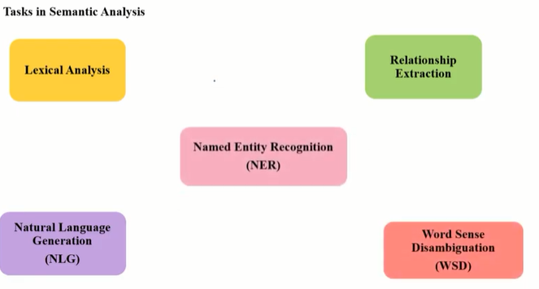
DEPARTMENT OF CSE-AIML (CSM) – III-II Sem
NATURAL LANGUAGE PROCESSING
This Session Learning Objectives a) . Syntactic Analysis
1 Grammars, Formalisms
2. CFG,PCFG
b) .Semantic Analysis? 3. Lexical Semantic
4.Word-Sense Disambuigity 5.Compositional semantics
6.Semantic Role Labeling
7.Semantic Parsing .

Slide 18
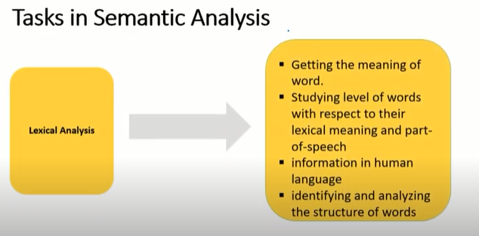
DEPARTMENT OF CSE-AIML (CSM) – III-II Sem
NATURAL LANGUAGE PROCESSING
This Session Learning Objectives a) . Syntactic Analysis
1 Grammars, Formalisms
2. CFG,PCFG
b) .Semantic Analysis? 3. Lexical Semantic
4.Word-Sense Disambuigity 5.Compositional semantics
6.Semantic Role Labeling
7.Semantic Parsing .

Slide 19
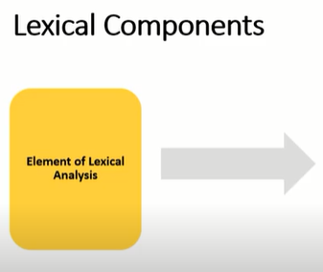

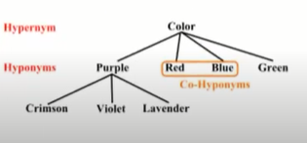
DEPARTMENT OF CSE-AIML (CSM) – III-II Sem
NATURAL LANGUAGE PROCESSING
This Session Learning Objectives a) . Syntactic Analysis
1 Grammars, Formalisms
2. CFG,PCFG
b) .Semantic Analysis? 3. Lexical Semantic
4.Word-Sense Disambuigity 5.Compositional semantics
6.Semantic Role Labeling
7.Semantic Parsing .

Slide 20
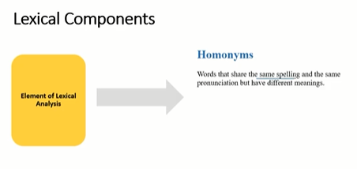
DEPARTMENT OF CSE-AIML (CSM) – III-II Sem
NATURAL LANGUAGE PROCESSING
This Session Learning Objectives 1. Introduction 2.Motivations 3.NLP? 4.Roadmap for NLP 5. NLP Components 6.NLP Issues 7. NLP Techniques 8.NLP Applications. 9. The role of Deep Learning in Natural Language Processing 10. Backpropagations, recurrent neural networks, Transformers. .

Slide 21
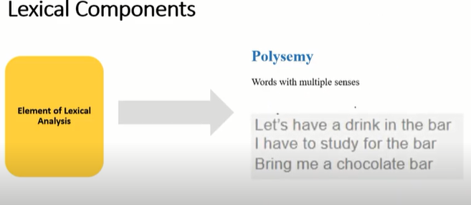
DEPARTMENT OF CSE-AIML (CSM) – III-II Sem
NATURAL LANGUAGE PROCESSING
This Session Learning Objectives a) . Syntactic Analysis
1 Grammars, Formalisms
2. CFG,PCFG
b) .Semantic Analysis? 3. Lexical Semantic
4.Word-Sense Disambuigity 5.Compositional semantics
6.Semantic Role Labeling
7.Semantic Parsing .

Slide 22
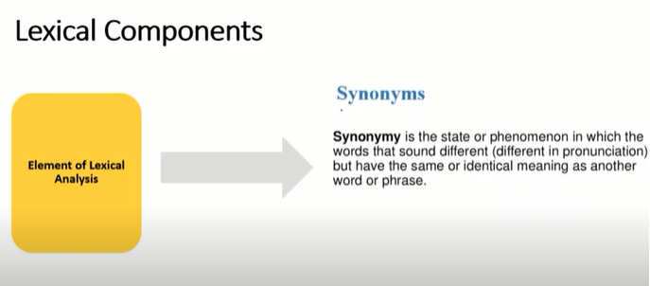
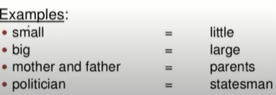
DEPARTMENT OF CSE-AIML (CSM) – III-II Sem
NATURAL LANGUAGE PROCESSING
This Session Learning Objectives a) . Syntactic Analysis
1 Grammars, Formalisms
2. CFG,PCFG
b) .Semantic Analysis? 3. Lexical Semantic
4.Word-Sense Disambuigity 5.Compositional semantics
6.Semantic Role Labeling
7.Semantic Parsing .

Slide 23
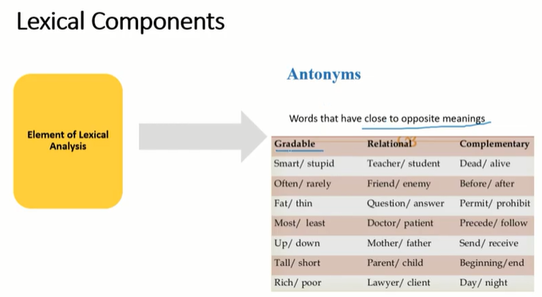
DEPARTMENT OF CSE-AIML (CSM) – III-II Sem
NATURAL LANGUAGE PROCESSING
This Session Learning Objectives a) . Syntactic Analysis
1 Grammars, Formalisms
2. CFG,PCFG
b) .Semantic Analysis? 3. Lexical Semantic
4.Word-Sense Disambuigity 5.Compositional semantics
6.Semantic Role Labeling
7.Semantic Parsing .

Slide 24
DEPARTMENT OF CSE-AIML (CSM) – III-II Sem
NATURAL LANGUAGE PROCESSING
Word-sense disambiguation (WSD) is the process of identifying which sense of a word is meant in a sentence or other segment of context.
Many techniques have been researched, including dictionary-based methods that use the knowledge encoded in lexical resources,
In supervised machine learning methods in which a classifier is trained for each distinct word on a corpus of manually sense-annotated examples.
In English, accuracy at the coarse-grained (homograph) level is routinely above 90% (as of 2009), with some methods on particular homographs achieving over 96%
This Session Learning Objectives a) . Syntactic Analysis
1 Grammars, Formalisms
2. CFG,PCFG
b) .Semantic Analysis? 3. Lexical Semantic
4.Word-Sense Disambuigity 5.Compositional semantics
6.Semantic Role Labeling
7.Semantic Parsing .

Slide 25
DEPARTMENT OF CSE-AIML (CSM) – III-II Sem
NATURAL LANGUAGE PROCESSING
Semantic role labeling
In natural language processing, semantic role labeling is the process that assigns labels to words or phrases in a sentence that indicates their semantic role in the sentence, such as that of an agent, goal, or result.
It serves to find the meaning of the sentence.
It detects the arguments associated with the predicate or verb of a sentence and how they are classified into their specific roles
Ex: “ Mary sold the book to John.“
The agent is "Mary,"
the predicate is "sold" (or rather, "to sell,")
the theme is "the book," and
the recipient is "John."
This Session Learning Objectives a) . Syntactic Analysis
1 Grammars, Formalisms
2. CFG,PCFG
b) .Semantic Analysis? 3. Lexical Semantic
4.Word-Sense Disambuigity 5.Compositional semantics
6.Semantic Role Labeling
7.Semantic Parsing .

Slide 26
DEPARTMENT OF CSE-AIML (CSM) – III-II Sem
NATURAL LANGUAGE PROCESSING
Labeling Uses :
Semantic role labeling is mostly used for machines to understand the roles of words within sentences.
A better understanding of semantic role labeling could lead to advancements in
question answering, information extraction,
automatic text summarization, text data mining, and speech recognition
This Session Learning Objectives a) . Syntactic Analysis
1 Grammars, Formalisms
2. CFG,PCFG
b) .Semantic Analysis? 3. Lexical Semantic
4.Word-Sense Disambuigity 5.Compositional semantics
6.Semantic Role Labeling
7.Semantic Parsing .

Slide 27
DEPARTMENT OF CSE-AIML (CSM) – III-II Sem
NATURAL LANGUAGE PROCESSING
Word-sense disambiguation (WSD) Difficulties :
Differences between dictionaries -- having different dictionaries and thesauruses
Different algorithms for different applications – different algorithms used for different applications of NLP
Word-sense discreteness ---Another difficulty in WSD is that words cannot be easily divided into discrete sub meanings.
Inter-judge variance : it is often impossible for individuals to memorize all of the senses a word can take.
This Session Learning Objectives a) . Syntactic Analysis
1 Grammars, Formalisms
2. CFG,PCFG
b) .Semantic Analysis? 3. Lexical Semantic
4.Word-Sense Disambuigity 5.Compositional semantics
6.Semantic Role Labeling
7.Semantic Parsing .

Slide 28
DEPARTMENT OF CSE-AIML (CSM) – III-II Sem
NATURAL LANGUAGE PROCESSING
Semantic parsing is the task of converting a natural language utterance to a logical form.
Logical Form in the sense : a machine-understandable representation of its meaning.
Semantic parsing can thus be understood as extracting the precise meaning of an utterance.
The Applications of semantic parsing include
machine translation,
question answering,
ontology induction,[
automated reasoning, and
code generation.
The phrase was first used in the 1970s by Yorick Wilks as the basis for machine translation programs working with only semantic representations.
This Session Learning Objectives a) . Syntactic Analysis
1 Grammars, Formalisms
2. CFG,PCFG
b) .Semantic Analysis? 3. Lexical Semantic
4.Word-Sense Disambuigity 5.Compositional semantics
6.Semantic Role Labeling
7.Semantic Parsing .

Slide 29
DEPARTMENT OF CSE-AIML (CSM) – III-II Sem
NATURAL LANGUAGE PROCESSING
Types Semantic parsing :
Shallow Semantic Parsing
Deep Semantic Parsing
Shallow :
Shallow semantic parsing is concerned with identifying entities in an utterance and labelling them with the roles they play.
Shallow semantic parsing is sometimes known as slot-filling or frame semantic parsing.
since its theoretical basis comes from frame semantics, wherein a word evokes a frame of related concepts and roles.
Slot-filling systems are widely used in virtual assistants in conjunction with intent classifiers, which can be seen as mechanisms for identifying the frame evoked by an utterance.
Popular architectures for slot-filling are largely variants of an encoder-decoder model, wherein two recurrent neural networks (RNNs) are trained jointly to encode an utterance into a vector and to decode that vector into a sequence of slot labels
This Session Learning Objectives a) . Syntactic Analysis
1 Grammars, Formalisms
2. CFG,PCFG
b) .Semantic Analysis? 3. Lexical Semantic
4.Word-Sense Disambuigity 5.Compositional semantics
6.Semantic Role Labeling
7.Semantic Parsing .

Slide 30
DEPARTMENT OF CSE-AIML (CSM) – III-II Sem
NATURAL LANGUAGE PROCESSING
Shallow Type Semantic Parsing :
Real time application using this Semantic Parsing Technique :
Amazon Alexa spoken language understanding system.
Ex: Shallow semantic parsers can parse utterances like
"show me flights from Boston to Dallas"
-- by classifying the intent as "list flights", and filling slots "source" and "destination"
with "Boston" and "Dallas",
respectively
This Session Learning Objectives a) . Syntactic Analysis
1 Grammars, Formalisms
2. CFG,PCFG
b) .Semantic Analysis? 3. Lexical Semantic
4.Word-Sense Disambuigity 5.Compositional semantics
6.Semantic Role Labeling
7.Semantic Parsing .

Slide 31
DEPARTMENT OF CSE-AIML (CSM) – III-II Sem
NATURAL LANGUAGE PROCESSING
Deep :
Deep semantic parsing, also known as compositional semantic parsing
Which is concerned with producing precise meaning representations of utterances that can
contain significant compositionality.
Ex: Shallow semantic parsing cannot parse arbitrary compositional utterances, like
"show me flights from Boston to anywhere that has flights to Juneau“
Deep semantic parsing attempts to parse such utterances, typically by converting them to a
formal meaning representation language
This Session Learning Objectives a) . Syntactic Analysis
1 Grammars, Formalisms
2. CFG,PCFG
b) .Semantic Analysis? 3. Lexical Semantic
4.Word-Sense Disambuigity 5.Compositional semantics
6.Semantic Role Labeling
7.Semantic Parsing .

Slide 32
DEPARTMENT OF CSE-AIML (CSM) – III-II Sem
NATURAL LANGUAGE PROCESSING
Natural Language Discourse Processing
The most difficult problem of AI is to process the natural language by computers or in other words natural language processing is the most difficult problem of artificial intelligence.
One of the major problems in NLP is discourse processing , which is one of the major problems in NLP is discourse processing − building theories and models of how utterances stick together to form coherent discourse.
The language always consists of collocated, structured and coherent groups of sentences rather than isolated and unrelated sentences.
These coherent groups of sentences are referred to as discourse.
Coherence and discourse structure are interconnected in many ways,
This Session Learning Objectives a) . Syntactic Analysis
1 Grammars, Formalisms
2. CFG,PCFG
b) .Semantic Analysis? 3. Lexical Semantic
4.Word-Sense Disambuigity 5.Compositional semantics
6.Semantic Role Labeling
7.Semantic Parsing .

Slide 33
DEPARTMENT OF CSE-AIML (CSM) – III-II Sem
NATURAL LANGUAGE PROCESSING
Natural Language Discourse Processing
The coherent discourse must possess the following properties −
Coherence relation between utterances –meaningful connection between utterances
Relationship between entities -- there must be a certain kind of relationship with the entities
Discourse structure:
It Depends upon the segmentation we applied on discourse,
-- this may be defined as determining the types of structures for large discourse.
This Session Learning Objectives a) . Syntactic Analysis
1 Grammars, Formalisms
2. CFG,PCFG
b) .Semantic Analysis? 3. Lexical Semantic
4.Word-Sense Disambuigity 5.Compositional semantics
6.Semantic Role Labeling
7.Semantic Parsing .

Slide 34
DEPARTMENT OF CSE-AIML (CSM) – III-II Sem
NATURAL LANGUAGE PROCESSING
Algorithms for Discourse Segmentation:
Unsupervised Discourse Segmentation:-
Often represented as linear segmentation
The text into multi-paragraph units; the units represent the passage of the original text.
Use of certain linguistic devices to tie the textual units together.
Supervised Discourse Segmentation:-
needs to have boundary-labeled training data
discourse marker or cue words play an important role
is a word or phrase that functions to signal discourse structure.
These discourse markers are domain-specific.
This Session Learning Objectives a) . Syntactic Analysis
1 Grammars, Formalisms
2. CFG,PCFG
b) .Semantic Analysis? 3. Lexical Semantic
4.Word-Sense Disambuigity 5.Compositional semantics
6.Semantic Role Labeling
7.Semantic Parsing .

Slide 35
DEPARTMENT OF CSE-AIML (CSM) – III-II Sem
NATURAL LANGUAGE PROCESSING
Text Coherence
Lexical repetition is a way to find the structure in a discourse,
But it does not satisfy the requirement of being coherent discourse
To achieve the coherent discourse, we must focus on coherence relations in specific.
Coherence properties :
Result
We are taking two terms S₀ and S₁ to represent the meaning of the two related sentences −
Ex : Ram was caught in the fire. His skin burned.
Parllel
It infers p(a1,a2,…) from assertion of S₀ and p(b1,b2,…) from assertion S₁. Here ai and bi are similar for all i. For example, two statements are parallel −
ex :Ram wanted car. Shyam wanted money.
This Session Learning Objectives a) . Syntactic Analysis
1 Grammars, Formalisms
2. CFG,PCFG
b) .Semantic Analysis? 3. Lexical Semantic
4.Word-Sense Disambuigity 5.Compositional semantics
6.Semantic Role Labeling
7.Semantic Parsing .

Slide 36
DEPARTMENT OF CSE-AIML (CSM) – III-II Sem
NATURAL LANGUAGE PROCESSING
Text Coherence
Coherence properties :
Elaboration
It infers the same proposition P from both the assertions − S₀ and S₁ For example, two statements show the relation elaboration:
Ram was from Chandigarh. Shyam was from Kerala.
Occasion
It happens when a change of state can be inferred from the assertion of S₀, final state of which can be inferred from S₁ and vice-versa.
For example, the two statements show the relation occasion:
Ram picked up the book. He gave it to Shyam.
This Session Learning Objectives a) . Syntactic Analysis
1 Grammars, Formalisms
2. CFG,PCFG
b) .Semantic Analysis? 3. Lexical Semantic
4.Word-Sense Disambuigity 5.Compositional semantics
6.Semantic Role Labeling
7.Semantic Parsing .

Slide 37
DEPARTMENT OF CSE-AIML (CSM) – III-II Sem
NATURAL LANGUAGE PROCESSING
Text Coherence
Building Hierarchical Discourse Structure:
The coherence of entire discourse can also be considered by hierarchical structure between coherence relations.
For example, the following passage can be represented as hierarchical structure −
S₁ − Ram went to the bank to deposit money.
S₂ − He then took a train to Shyam’s cloth shop.
S₃ − He wanted to buy some clothes.
S₄ − He do not have new clothes for party.
S₅ − He also wanted to talk to Shyam regarding his health
This Session Learning Objectives a) . Syntactic Analysis
1 Grammars, Formalisms
2. CFG,PCFG
b) .Semantic Analysis? 3. Lexical Semantic
4.Word-Sense Disambuigity 5.Compositional semantics
6.Semantic Role Labeling
7.Semantic Parsing .

Slide 38
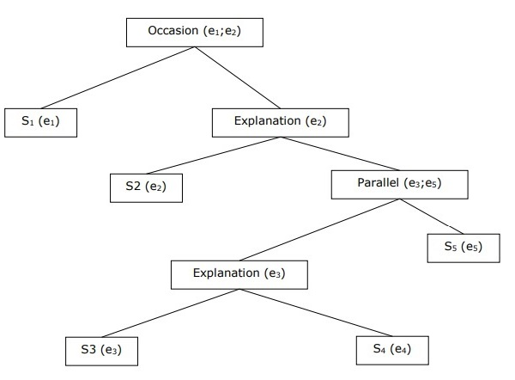
DEPARTMENT OF CSE-AIML (CSM) – III-II Sem
NATURAL LANGUAGE PROCESSING
Text Coherence
For example, the following passage can be represented as hierarchical structure −
S₁ − Ram went to the bank to deposit money.
S₂ − He then took a train to Shyam’s cloth shop.
S₃ − He wanted to buy some clothes.
S₄ − He do not have new clothes for party.
S₅ − He also wanted to talk to Shyam regarding his health
This Session Learning Objectives a) . Syntactic Analysis
1 Grammars, Formalisms
2. CFG,PCFG
b) .Semantic Analysis? 3. Lexical Semantic
4.Word-Sense Disambuigity 5.Compositional semantics
6.Semantic Role Labeling
7.Semantic Parsing .

Slide 39
DEPARTMENT OF CSE-AIML (CSM) – III-II Sem
NATURAL LANGUAGE PROCESSING
Reference Resolution
Interpretation of the sentences from any discourse is another important task and to achieve this we need to know who or what entity is being talked about.
For Ex: “Ram, the manager of ABC bank, saw his friend Shyam at a shop. He went to meet him”, the linguistic expressions like Ram, His, He are reference.
Reference resolution may be defined as the task of determining what entities are referred to by which linguistic expression.
Terminology Used in Reference Resolution
Referring expression − The natural language expression that is used to perform reference is called a referring expression.
Referent − It is the entity that is referred. Ex: in the last given example Ram is a referent.
Corefer − used to refer to the same entity, they are called corefers. Ex: Ram and he are corefers.
Antecedent − The term has the license to use another term. Ex: Ram is the antecedent of the reference he.
Anaphora & Anaphoric − The reference to an entity that has been previously introduced into the sentence.
This Session Learning Objectives a) . Syntactic Analysis
1 Grammars, Formalisms
2. CFG,PCFG
b) .Semantic Analysis? 3. Lexical Semantic
4.Word-Sense Disambuigity 5.Compositional semantics
6.Semantic Role Labeling
7.Semantic Parsing .

Slide 40
DEPARTMENT OF CSE-AIML (CSM) – III-II Sem
NATURAL LANGUAGE PROCESSING
Types of Referring Expression:
Indefinite Noun Phrases:
The reference represents the entities that are new to the hearer into the discourse context
Ex: Ram had gone around one day to bring him some food.
Definite Noun Phrases
Reference represents the entities that are not new or identifiable to the hearer into the discourse context.
Ex: I read Times of India , or The Hindhu or NewYorkTimes.
Pronouns : It is a form of definite reference
Ex: Ram laughed as loud as he could
Demonstratives : These demonstrate and behave differently than simple definite pronouns.
Ex:-This and that are demonstrative pronouns
Names: It is the simplest type of referring expression
Ex: Ram is the name-refereeing expression.
This Session Learning Objectives a) . Syntactic Analysis
1 Grammars, Formalisms
2. CFG,PCFG
b) .Semantic Analysis? 3. Lexical Semantic
4.Word-Sense Disambuigity 5.Compositional semantics
6.Semantic Role Labeling
7.Semantic Parsing .

Slide 41
DEPARTMENT OF CSE-AIML (CSM) – III-II Sem
NATURAL LANGUAGE PROCESSING
Reference Resolution Tasks:
Coreference Resolution --- finding referring expressions in a text that refer to the same entity.
A set of coreferring expressions are called coreference chain.
For example - He, Chief Manager and His …..
Constraint on Coreference Resolution-
It can refer much like he and she
The pronoun it also refers to the things that do not refer to specific things.
It’s raining. It is really good.
Pronominal Anaphora Resolution:-
pronominal anaphora resolution may be defined as the task of finding the antecedent for a single pronoun.
The pronoun is his and the task of pronominal anaphora resolution is to find the word Ram because Ram is the antecedent.
This Session Learning Objectives a) . Syntactic Analysis
1 Grammars, Formalisms
2. CFG,PCFG
b) .Semantic Analysis? 3. Lexical Semantic
4.Word-Sense Disambuigity 5.Compositional semantics
6.Semantic Role Labeling
7.Semantic Parsing .

Slide 42
DEPARTMENT OF CSE-AIML (CSM) – III-II Sem
NATURAL LANGUAGE PROCESSING
This Session Learning Objectives a) . Syntactic Analysis
1 Grammars, Formalisms
2. CFG,PCFG
b) .Semantic Analysis? 3. Lexical Semantic
4.Word-Sense Disambuigity 5.Compositional semantics
6.Semantic Role Labeling
7.Semantic Parsing .

