Slide 1
API DEVELOPMENT TOOLS
UNIT - 5

Slide 2
TOPICS TO BE COVERED
Setting up cloud environment
Cloud access from sensors
Data Analytics for IoT
Case studies
Open Source e-Health sensor platform
Be Close Elderly monitoring
Other recent projects
Agriculture
Smart Home

Slide 3
SET UP CLOUD ENVIRONMENT
Cloud Computing can be defined as delivering computing power( CPU, RAM, Network Speeds, Storage OS software) as a service over a network (usually on the internet) rather than physically having the computing resources at the customer location.
Example: AWS, Azure, Google Cloud, ThingSpeak
Cloud computing comprises of two components front end and back end.
Front end consist client part of cloud computing system. It comprise of interfaces and applications that are required to access the cloud computing platform.
Back end refers to the cloud itself. It comprises of the resources that are required for cloud computing services. It consists of virtual machines, servers, data storage, security mechanism etc. It is under providers control.

Slide 4
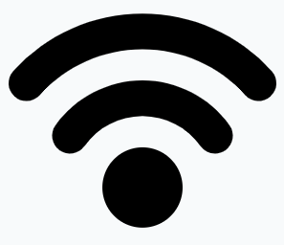
SETTING THINGSPEAK CLOUD ENVIRONMENT
2
THINGSPEAK
SERVER
3
1
4
PROCESS
Begin
Connect the device to a Wi-Fi Access point.
Connect to ThingSpeak server using a http port.
Establish a TCP connection between the ThingSpeak and device.
Create a URL that encapsulates the sensor data and sent it over the TCP link.
Repeat 4 periodically
Sensor - 1
IoT device with Sensors
Sensor - 1
Sensor - 1

Slide 5
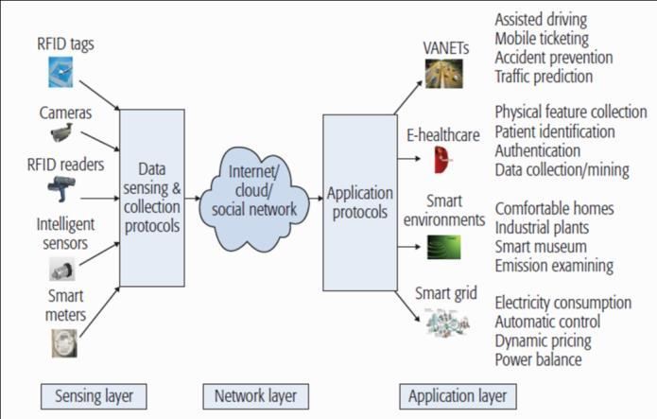
CLOUD ACCESS FROM SENSORS

Slide 6
DATA ANALYTICS FOR IoT
IoT provides platform for smart sensing and continuously monitoring various targets.
Data generated by Things
Data generated by monitoring devices, machines such as energy meters, elevators, air plane engines, bridges etc.
This data can be used for predictive analytics to repair or replace these items before they break.
Data about Things
To monitor about natural phenomena such as meteorological pattern, under ground pressure during oil extraction, patient body monitoring during recovery from a medical procedure.
Sensor IoT data is one of the major data resources and IoT data analytics has become a paradigm in the big data era.
There are four major characteristics of this big data, represented as 4V’s.

Slide 7
DATA ANALYTICS FOR IoT The 4V’s of Big Data
Volume
Vast number of sensors collecting data from different sources continuously.
Velocity
Data coming in minutes, seconds and even microseconds.
Variety
Nominal/Numerical
Text
Multimedia
Image
Audio
Video
Veracity
High Noise, inconsistency, and incompleteness

Slide 8
CHALLENGES IN DATA ANALYTICS FOR IoT
Limitation on Computational Power
Cannot run complicated computations
Limitation on End Device Memory Space
Cannot keep large volumes of data on end devices
Sustainability
Try to avoid unnecessary computations and data transmissions
Noise
Will have significant impact on sensor data
Application Specific nature
Different applications need different scenarios for computing and analysis.

Slide 9
DATA ANALYTICS FRAMEWORK FOR IoT
Centralized frameworks are not feasible for IoT because of the large scale deployment of IoT devices. Distributed and hierarchical frameworks are more feasible.
With such a distributed model, the front end devices will only do minimal process that depends on the type of application. The complicated job is done in the cloud.
Nodes need to keep only small amount of representative data. This model requires a set of algorithms to deal with different types of data.

Slide 10
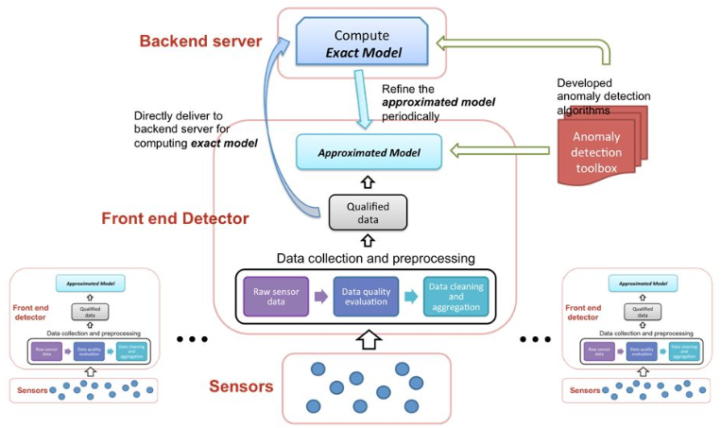
DATA ANALYTICS FRAMEWORK FOR IoT

Slide 11
CASE STUDIES

Slide 12
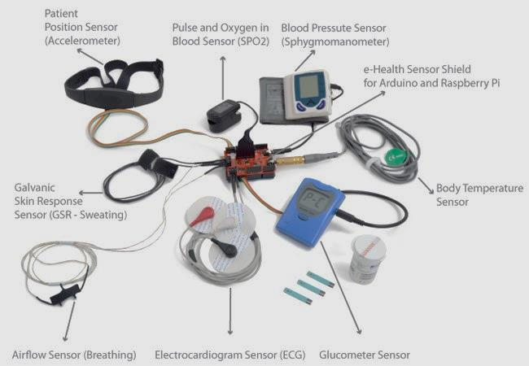
OPEN SOURCE E-HEALTH SENSOR PLATFORM

Slide 13
OPEN SOURCE E-HEALTH SENSOR PLATFORM
With the kit and associated documentation they hope to give researchers, developers and artists an easy way to measure biometric sensor data for their projects and inspire a new era of open source medical products for everyone.
Nine different biometric parameters sensors are offered including; pulse, blood pressure, oxygen in blood (SPO2), electrocardiogram (EKG), airflow, glucometer, galvanic skin response (GSR), patient position and body temperature.
This platform provides a cheap, open alternative compared to the proprietary and price-prohibitive medical market solutions available, to inspire makers to develop new applications that help people thrive.
Such information can be used to monitor a patient’s state or to collect sensitive data to be analyzed for medical diagnosis. Using different wireless protocols—such as Wi-Fi, 3G and Bluetooth—the information can be sent to a laptop computer, a smartphone or directly to the Cloud for subsequent analysis.
Mobile apps for the iPhone and Android have been created to help users visualize the data in real-time

Slide 14
BECLOSE ELDERLY MONITORING
BeClose remote monitoring system, which is currently owned by Alarm.com is designed to keep elderly in close contact with their family and caregivers.
The system uses discrete wireless sensors placed at different locations in the home to track the daily activities of the elderly.
The caregivers or family members of the elderly can also monitor his/her activities using a private and secure webpage.
The system can notify the caregivers by phone calls, e-mails or text messages in case of any emergency.
The system is unobtrusive, easy to install, and does not require the home to have an internet or wireless service plan.
Data gathered by the sensors can show caregivers whether a senior is having trouble sleeping, forgetting to take medication, or maintaining a normal and healthy routine.
Family members receive real-time alerts if something out of the ordinary occurs. BeClose does not use cameras, so seniors can maintain their privacy.

Slide 15
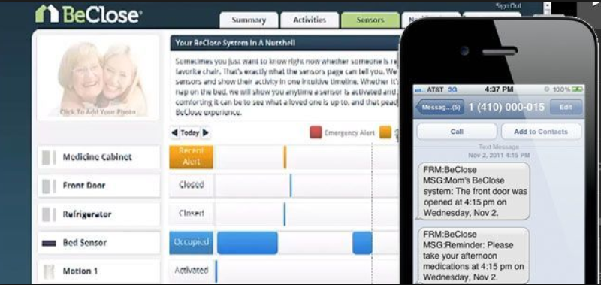
BECLOSE ELDERLY MONITORING

Slide 16
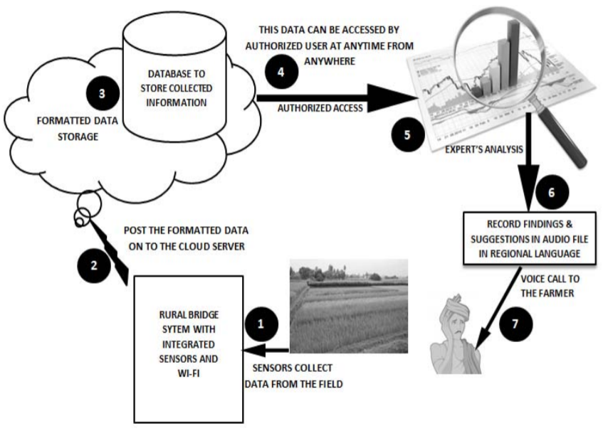
SMART AGRICULTURE

Slide 17
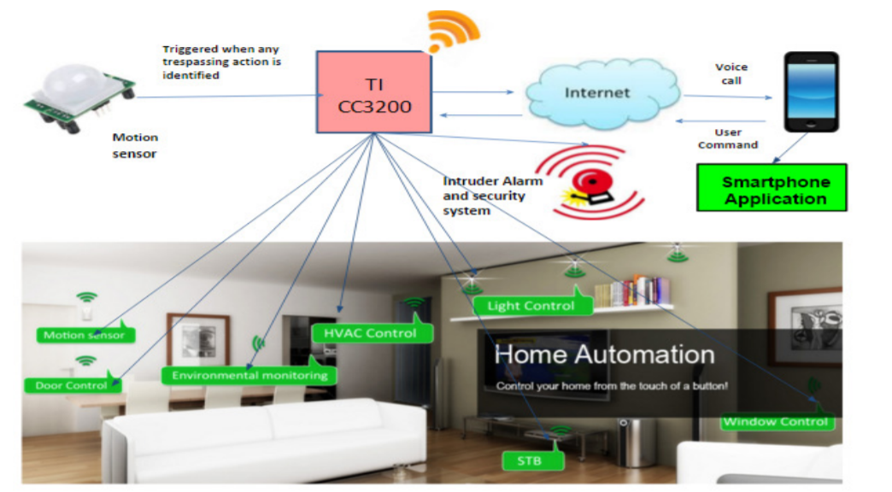
SMART HOME

Slide 18
END OF UNIT - 5

