Slide 1
DEPARTMENT OF CSE-AIML (CSM) – III-II Sem
NATURAL LANGUAGE PROCESSING –UNIT -III
UNIT-III: POS Tagging and N-Gram Models
Parts of Speech POS:
Tagging is a kind of classification that may be defined as the automatic assignment of description to the tokens.
Here the descriptor is called tag, which may represent one of the part-of-speech, semantic information and so on.
Part-of-Speech (PoS) the process of assigning one of the parts of speech to the given word.
POS tagging is a task of labelling each word in a sentence with its appropriate part of speech.
Parts of speech include nouns, verb, adverbs, adjectives, pronouns, conjunction and their sub-categories.
Parts of Speech Tagging:
POS Sequence Labeling
POS Lexical syntax,
Hidden Markov Models
Viterbi Algol
EM Trainings

Slide 2
DEPARTMENT OF CSE-AIML (CSM) – III-II Sem
NATURAL LANGUAGE PROCESSING –UNIT -III
Parts of Speech (POS) Tagging:
Most of the POS tagging Approaches are
Rule Base POS tagging,
Stochastic POS tagging and
Transformation based tagging
Rule-based POS Tagging:
. Rule-based taggers use dictionary or lexicon for getting possible tags for tagging each word. . If the word has more than one possible tag, then rule-based taggers use hand-written rules to identify the correct tag.
For example, suppose if the preceding word of a word is article then word must be a noun.
Rule-based POS tagging is coded in the form of rules. These rules may be either −
Context-pattern rules
Regular expression compiled into finite-state automata, intersected with lexically ambiguous sentence representation.
Parts of Speech Tagging:
POS Sequence Labeling
POS Lexical syntax,
Hidden Markov Models
Viterbi Algol
EM Trainings

Slide 3
DEPARTMENT OF CSE-AIML (CSM) – III-II Sem
NATURAL LANGUAGE PROCESSING –UNIT -III
Parts of Speech (POS) Tagging:
Properties of Rule-Based POS Tagging:
Rule-based POS taggers possess the following properties −
These taggers are knowledge-driven taggers.
The rules in Rule-based POS tagging are built manually.
The information is coded in the form of rules.
We have some limited number of rules approximately around 1000.
Smoothing and language modeling is defined explicitly in rule-based taggers
.
Parts of Speech Tagging:
POS Sequence Labeling
POS Lexical syntax,
Hidden Markov Models
Viterbi Algol
EM Trainings

Slide 4
DEPARTMENT OF CSE-AIML (CSM) – III-II Sem
NATURAL LANGUAGE PROCESSING –UNIT -III
Parts of Speech (POS) Tagging:
Stochastic POS Tagging:
The model that includes frequency or probability (statistics) can be called stochastic
Any number of different approaches to the problem of part-of-speech tagging can be referred to as stochastic tagger.
The simplest stochastic tagger applies the following approaches for POS tagging −
Word Frequency Approach
Tag Sequence Probabilities.
Word Frequency Approach
The tag encountered most frequently with the word in the training set is the one assigned to an ambiguous instance of that word.
Tag Sequence Probabilities.
It is another approach of stochastic tagging, where the tagger calculates the probability of a given sequence of tags occurring
Parts of Speech Tagging:
POS Sequence Labeling
POS Lexical syntax,
Hidden Markov Models
Viterbi Algol
EM Trainings

Slide 5
DEPARTMENT OF CSE-AIML (CSM) – III-II Sem
NATURAL LANGUAGE PROCESSING –UNIT -III
Parts of Speech (POS) Tagging:
Properties of Stochastic POST Tagging
Stochastic POS taggers possess the following properties −
This POS tagging is based on the probability of tag occurring.
It requires training corpus
There would be no probability for the words that do not exist in the corpus.
It uses different testing corpus (other than training corpus).
It is the simplest POS tagging because it chooses most frequent tags associated with a word in training corpus.
Parts of Speech Tagging:
POS Sequence Labeling
POS Lexical syntax,
Hidden Markov Models
Viterbi Algol
EM Trainings

Slide 6
DEPARTMENT OF CSE-AIML (CSM) – III-II Sem
NATURAL LANGUAGE PROCESSING –UNIT -III
Parts of Speech (POS) Tagging:
Transformation-based Tagging
Transformation based tagging is also called Brill tagging.
It is an instance of the transformation-based learning (TBL), which is a rule-based algorithm for automatic tagging of POS to the given text.
TBL, allows us to have linguistic knowledge in a readable form, transforms one state to another state by using transformation rules.
It draws the inspiration from both rule-based and stochastic tagging.
Working of Transformation Based Learning(TBL) :
The working of transformation-based learning. Consider the following steps to understand the working of TBL −
Start with the solution − The TBL usually starts with some solution to the problem and works in cycles.
Most beneficial transformation chosen − In each cycle, TBL will choose the most beneficial transformation.
Apply to the problem − The transformation chosen in the last step will be applied to the problem.
Parts of Speech Tagging:
POS Sequence Labeling
POS Lexical syntax,
Hidden Markov Models
Viterbi Algol
EM Trainings

Slide 7
DEPARTMENT OF CSE-AIML (CSM) – III-II Sem
NATURAL LANGUAGE PROCESSING –UNIT -III
Parts of Speech (POS) Tagging:
Transformation-based Tagging
Advantages of Transformation-based Learning (TBL):
The advantages of TBL are as follows −
We learn small set of simple rules and these rules are enough for tagging.
Development as well as debugging is very easy in TBL because the learned rules are easy to understand.
Complexity in tagging is reduced because in TBL there is interlacing of machine learned and human-generated rules.
Transformation-based tagger is much faster than Markov-model tagger.
Disadvantages of Transformation-based Learning (TBL)
The disadvantages of TBL are as follows −
Transformation-based learning (TBL) does not provide tag probabilities.
In TBL, the training time is very long especially on large corpora.
.
Parts of Speech Tagging:
POS Sequence Labeling
POS Lexical syntax,
Hidden Markov Models
Viterbi Algol
EM Trainings

Slide 8

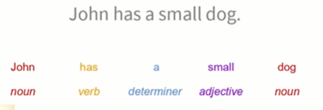
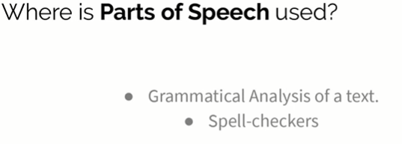
DEPARTMENT OF CSE-AIML (CSM) – III-II Sem
NATURAL LANGUAGE PROCESSING –UNIT -III
Parts of Speech (POS) Tagging:
Hidden Markov Model (HMM)
Parts of Speech Tagging:
POS Sequence Labeling
POS Lexical syntax,
Hidden Markov Models
Viterbi Algol
EM Trainings

Slide 9

DEPARTMENT OF CSE-AIML (CSM) – III-II Sem
NATURAL LANGUAGE PROCESSING –UNIT -III
Parts of Speech (POS) Tagging:
Hidden Markov Model (HMM)
Parts of Speech Tagging:
POS Sequence Labeling
POS Lexical syntax,
Hidden Markov Models
Viterbi Algol
EM Trainings

Slide 10

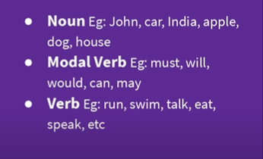

DEPARTMENT OF CSE-AIML (CSM) – III-II Sem
NATURAL LANGUAGE PROCESSING –UNIT -III
Parts of Speech (POS) Tagging:
Hidden Markov Model (HMM)
Parts of Speech Tagging:
POS Sequence Labeling
POS Lexical syntax,
Hidden Markov Models
Viterbi Algol
EM Trainings

Slide 11
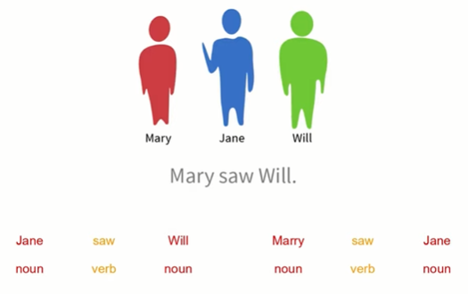
DEPARTMENT OF CSE-AIML (CSM) – III-II Sem
NATURAL LANGUAGE PROCESSING –UNIT -III
Parts of Speech (POS) Tagging:
Hidden Markov Model (HMM)
Parts of Speech Tagging:
POS Sequence Labeling
POS Lexical syntax,
Hidden Markov Models
Viterbi Algol
EM Trainings

Slide 12
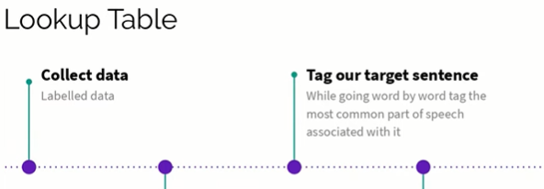
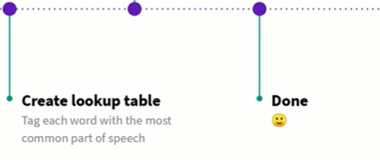
DEPARTMENT OF CSE-AIML (CSM) – III-II Sem
NATURAL LANGUAGE PROCESSING –UNIT -III
Parts of Speech (POS) Tagging:
Hidden Markov Model (HMM)
Parts of Speech Tagging:
POS Sequence Labeling
POS Lexical syntax,
Hidden Markov Models
Viterbi Algol
EM Trainings

Slide 13
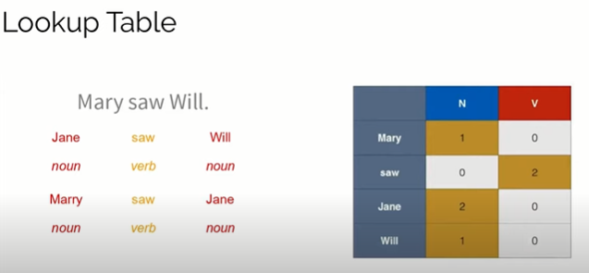
DEPARTMENT OF CSE-AIML (CSM) – III-II Sem
NATURAL LANGUAGE PROCESSING –UNIT -III
Parts of Speech (POS) Tagging:
Hidden Markov Model (HMM)
Parts of Speech Tagging:
POS Sequence Labeling
POS Lexical syntax,
Hidden Markov Models
Viterbi Algol
EM Trainings

Slide 14
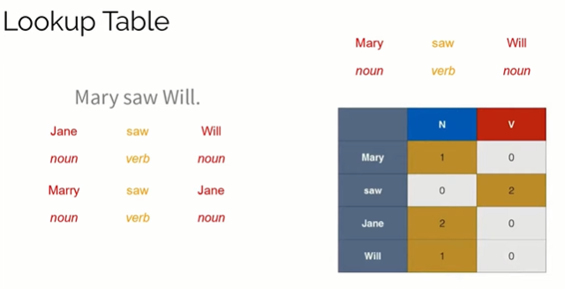
DEPARTMENT OF CSE-AIML (CSM) – III-II Sem
NATURAL LANGUAGE PROCESSING –UNIT -III
Parts of Speech (POS) Tagging:
Hidden Markov Model (HMM)
Parts of Speech Tagging:
POS Sequence Labeling
POS Lexical syntax,
Hidden Markov Models
Viterbi Algol
EM Trainings

Slide 15
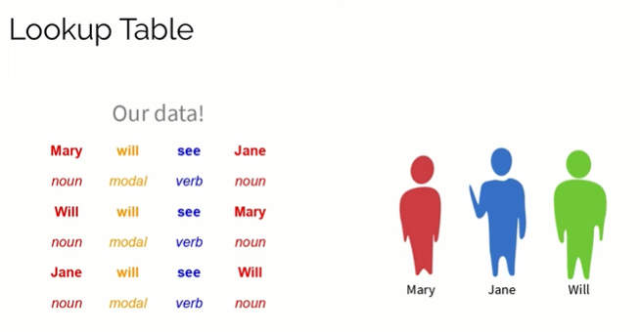
DEPARTMENT OF CSE-AIML (CSM) – III-II Sem
NATURAL LANGUAGE PROCESSING –UNIT -III
Parts of Speech (POS) Tagging:
Hidden Markov Model (HMM)
Parts of Speech Tagging:
POS Sequence Labeling
POS Lexical syntax,
Hidden Markov Models
Viterbi Algol
EM Trainings

Slide 16
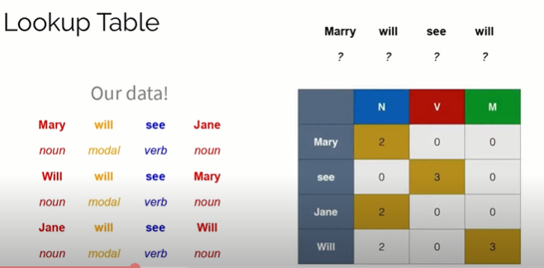
DEPARTMENT OF CSE-AIML (CSM) – III-II Sem
NATURAL LANGUAGE PROCESSING –UNIT -III
Parts of Speech (POS) Tagging:
Hidden Markov Model (HMM)
Parts of Speech Tagging:
POS Sequence Labeling
POS Lexical syntax,
Hidden Markov Models
Viterbi Algol
EM Trainings

Slide 17
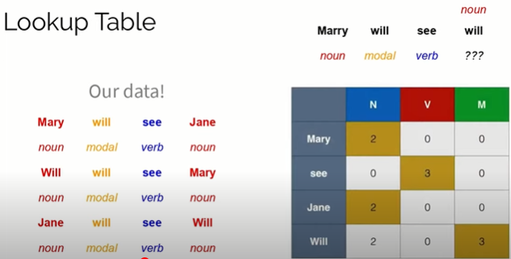
DEPARTMENT OF CSE-AIML (CSM) – III-II Sem
NATURAL LANGUAGE PROCESSING –UNIT -III
Parts of Speech (POS) Tagging:
Hidden Markov Model (HMM)
Parts of Speech Tagging:
POS Sequence Labeling
POS Lexical syntax,
Hidden Markov Models
Viterbi Algol
EM Trainings

Slide 18

DEPARTMENT OF CSE-AIML (CSM) – III-II Sem
NATURAL LANGUAGE PROCESSING –UNIT -III
Parts of Speech (POS) Tagging:
Hidden Markov Model (HMM)
Parts of Speech Tagging:
POS Sequence Labeling
POS Lexical syntax,
Hidden Markov Models
Viterbi Algol
EM Trainings

Slide 19
DEPARTMENT OF CSE-AIML (CSM) – III-II Sem
NATURAL LANGUAGE PROCESSING –UNIT -III
Parts of Speech (POS) Tagging:
Hidden Markov Model (HMM)
Parts of Speech Tagging:
POS Sequence Labeling
POS Lexical syntax,
Hidden Markov Models
Viterbi Algol
EM Trainings

Slide 20
DEPARTMENT OF CSE-AIML (CSM) – III-II Sem
NATURAL LANGUAGE PROCESSING –UNIT -III
Parts of Speech (POS) Tagging:
Hidden Markov Model (HMM)
Parts of Speech Tagging:
POS Sequence Labeling
POS Lexical syntax,
Hidden Markov Models
Viterbi Algol
EM Trainings

Slide 21
DEPARTMENT OF CSE-AIML (CSM) – III-II Sem
NATURAL LANGUAGE PROCESSING –UNIT -III
Parts of Speech (POS) Tagging:
Hidden Markov Model (HMM)
Parts of Speech Tagging:
POS Sequence Labeling
POS Lexical syntax,
Hidden Markov Models
Viterbi Algol
EM Trainings

Slide 22
DEPARTMENT OF CSE-AIML (CSM) – III-II Sem
NATURAL LANGUAGE PROCESSING –UNIT -III
Parts of Speech (POS) Tagging:
Hidden Markov Model (HMM)
Parts of Speech Tagging:
POS Sequence Labeling
POS Lexical syntax,
Hidden Markov Models
Viterbi Algol
EM Trainings

Slide 23
DEPARTMENT OF CSE-AIML (CSM) – III-II Sem
NATURAL LANGUAGE PROCESSING –UNIT -III
Parts of Speech (POS) Tagging:
Hidden Markov Model (HMM)
Parts of Speech Tagging:
POS Sequence Labeling
POS Lexical syntax,
Hidden Markov Models
Viterbi Algol
EM Trainings

Slide 24
DEPARTMENT OF CSE-AIML (CSM) – III-II Sem
NATURAL LANGUAGE PROCESSING –UNIT -III
Parts of Speech (POS) Tagging:
Hidden Markov Model (HMM)
Parts of Speech Tagging:
POS Sequence Labeling
POS Lexical syntax,
Hidden Markov Models
Viterbi Algol
EM Trainings

