Slide 1
Impact of Weather Variables and Roles of Human Population in Vector Borne Diseases
Case Study Lab

Slide 2
TABLE OF CONTENTS
01
02
03
04
Motivation
Abstract
The Need for the research.
Domain, concept and goals.
Dataset
Features
Malaria & Weather Dataset
ML & Frontend

Slide 3
01
MOTIVATION
Cheat sheet for doctors & prevention of life threatening Diseases.

Slide 4

Need for research ?
Since the beginning of human civilization,mankind has lived in a competitive relationship with nature.
The relentless pursuit of progress, comfort and security has resulted in increased stress on environment, particularly since the industrial revolution.
Consequently, the life sustaining environment has been forced to transform more rapidly than ever before.
Presently Climate change is one the biggest threats that we face.
Notes:
Alaknanda and Dhauliganga rivers
precarious pile of debris and buried ice,

Slide 5
Combined daily values of temperature, rainfall and humidity were found to influence the mosquito load and the risk of malaria incidence.
40%
2 minutes
Risk
Children under 5
3 billion people are at risk of contracting malaria.
Malaria - Leading causes of death

Slide 6
02
Abstract
How would the research benefit in betterment of the world ?

Slide 7
“Extreme weather, increased temperature, and air quality poses direct risk to human vector borne disease. Air quality affects the survival rates of pathogens, while the temperature influences the life cycle of mosquitoes and transmitters. Further warmer temperature and humidity favours the breeding of insects”

Slide 8


Attributes and variable to consider
Air
Quality
Extreme
weather
Human
population
Increased Temperature

Slide 9
Diseases ↑ Population ↑
Touch
Pollution
In-proper Sanitization
Cough

Slide 10
Despite the global implications of this problem, the research is very limited in this domain.
Towards the end, this research aims to show whether a single or combined weather variable has any significant association with the observed disease prevalence.
Kids and elderly mainly !

Slide 11
03
DATA SET
Enter a subtitle here if you need it

Slide 12
Data Sets
Climate
Vector borne diseases
The data set might include temperature, precipitation, air quality, year and month or depend on multiple data sets.
Our main focus will be on malaria and dengue data sets which will be used to bring in a relation and compare it with climate data set.

Slide 13
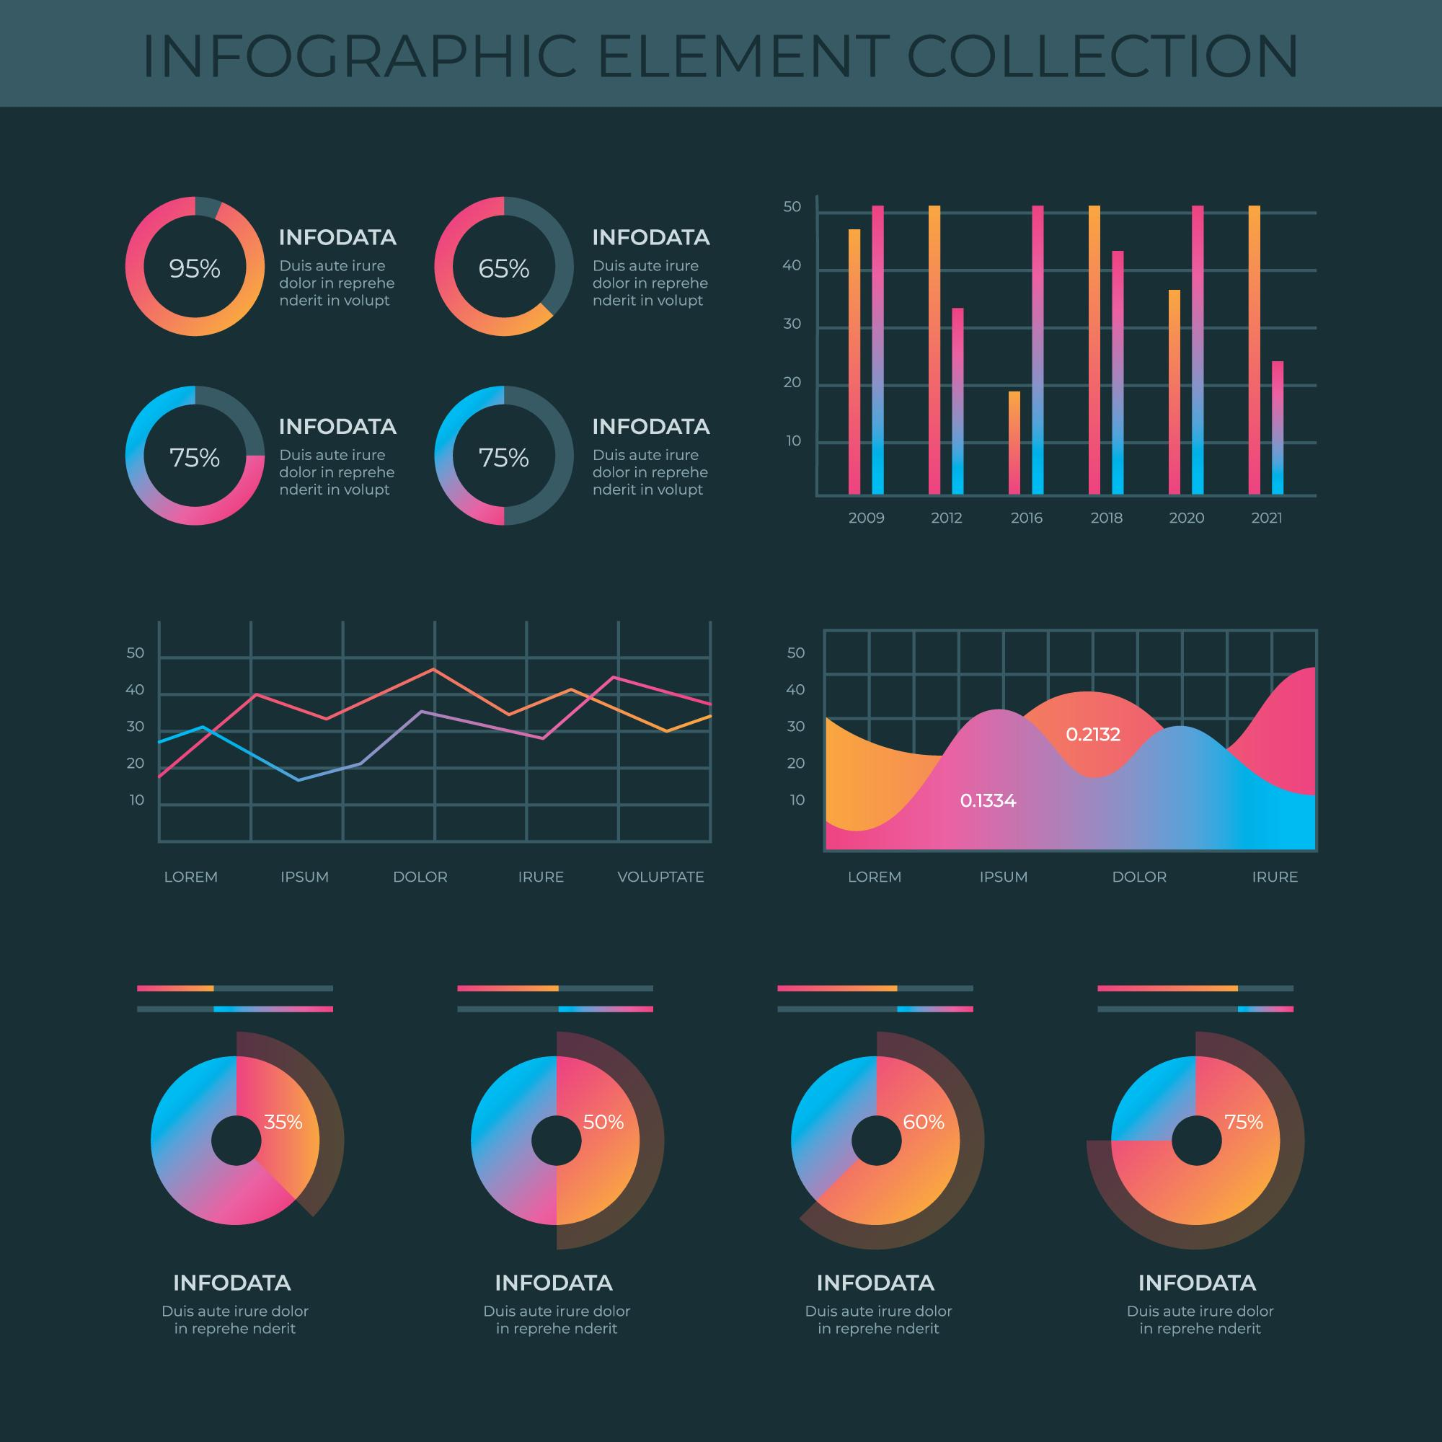
Web Support
Using React and other visualization libraries graphs would be designed to provide further useful information.
Download option would be provided

Slide 14
A web page will be developed using React js which will show a detailed view about the graphs.
Graphs will developed using js or python chart libraries.
users or doctors will be given an option to download the worked out data visualization graphs and documents.

Slide 15
04
FEATURES
You can enter a subtitle here if you need it

Slide 16
Project works
Machine Learning Models
Web
Framework
Data visualization

Slide 17


Project Timeline
Testing dataset with different models
Dataset search
Full stack devs
Paper publish
Domain discussion
To come up significant observations
1
3
4
..
01
02
2
Developing model
Web support with data visualization
Narrowing the area
Success

Slide 18
2,000,000
Vector­ borne disease

Slide 19
References
The Impact of Climate Change on PublicHealth in India:Future Research Directions
Kathleen F. Bush,1,2 Howard Frumkin,3 S. Rani Kotha
Development and Application of Spatially Disaggregated Exposure
Series in Time-series Analyses of Air Pollution-related Health Effects in
Chennai, India
Santu Ghosh, Priscilla Johnson
The impacts of climate change on human health in the united states

Slide 20
OUR TEAM
Harisaipravin SV
17PW13
Sathwik Ch
17PW32

Slide 21

Thank You !!
DO YOU HAVE ANY QUESTIONS?

