Slide 1
Special Topics in Computational Physics
Special Topics in Computational Physics:
Preliminary Setup and Configuration
Fast Fourier Transforms (FFT)
QuTiP: Quantum Toolbox in Python
Monte Carlo Simulations and Metropolis Algorithm
Partial Differential Equations: Laplace and Wave equations

Slide 2

Preliminary Setup and Configuration
Download and install anaconda from https://anaconda.com/download
Notes:
Fourier methods have revolutionized fields of science and engineering, from
radio astronomy to medical imaging, from seismology to spectroscopy. It is especially useful in improving the quality of visual and audio data. Since a digital photo or a movie frame is just a 2D matrix of intensity values, a 2D FT can help resolve frequencies that correspond to undesirable features, such as noise or distortions. Masking the amplitudes of those frequencies, followed by an inverse transform, restores the original image, but with the undesirable features removed. Similarly, desirable features can be enhanced by increasing the amplitudes of the corresponsing Fourier frequencies. Fourier transforms of audio data can also help identify dominant frequencies, enhancing our understanding of a particular piece of music.

Slide 3



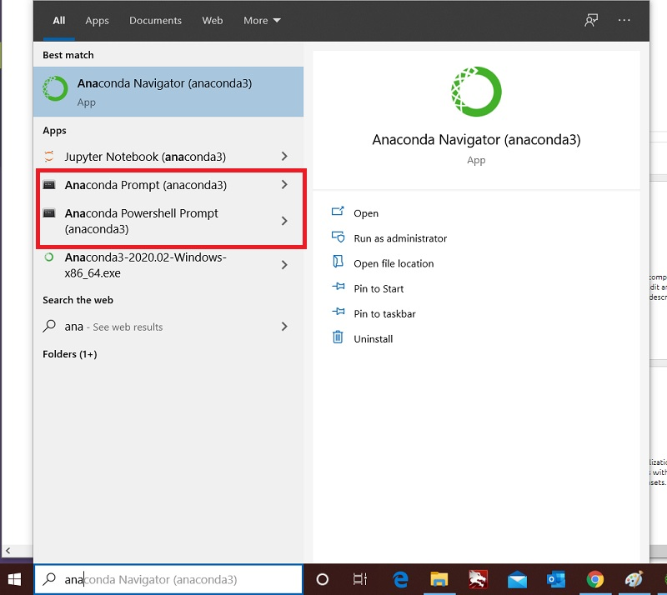
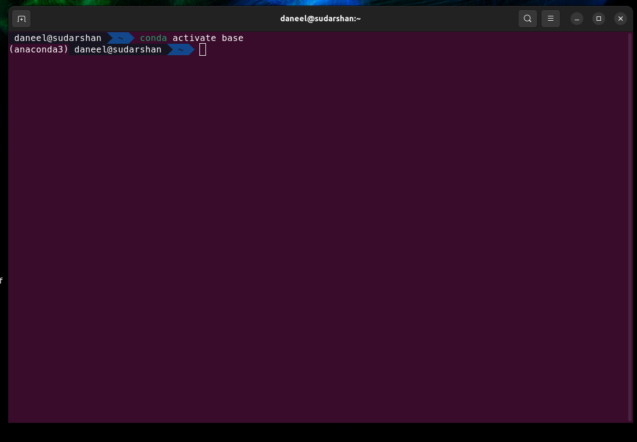
Preliminary Setup and Configuration
Load a ‘conda shell’ with the base environment activated.
Notes:
Fourier methods have revolutionized fields of science and engineering, from
radio astronomy to medical imaging, from seismology to spectroscopy. It is especially useful in improving the quality of visual and audio data. Since a digital photo or a movie frame is just a 2D matrix of intensity values, a 2D FT can help resolve frequencies that correspond to undesirable features, such as noise or distortions. Masking the amplitudes of those frequencies, followed by an inverse transform, restores the original image, but with the undesirable features removed. Similarly, desirable features can be enhanced by increasing the amplitudes of the corresponsing Fourier frequencies. Fourier transforms of audio data can also help identify dominant frequencies, enhancing our understanding of a particular piece of music.

Slide 4
Preliminary Setup and Configuration
Use the conda package manager to add the ‘conda-forge’ repository
After loading the conda shell, create a special conda environment
named ‘exercises’, together with the required packages
Note that:
The conda dependency resolver is a bit slow, so this can take some time to finish.
This environment Is named ‘exercises’, but you can use any name that you want.
This environment runs a more recent version of python (version 3.11) than the anaconda default.
This is suggested because python versions 3.11 and higher perform better than the default version.
Activate this environment whenever you want to use it by loading the conda shell and running
Notes:
Fourier methods have revolutionized fields of science and engineering, from
radio astronomy to medical imaging, from seismology to spectroscopy. It is especially useful in improving the quality of visual and audio data. Since a digital photo or a movie frame is just a 2D matrix of intensity values, a 2D FT can help resolve frequencies that correspond to undesirable features, such as noise or distortions. Masking the amplitudes of those frequencies, followed by an inverse transform, restores the original image, but with the undesirable features removed. Similarly, desirable features can be enhanced by increasing the amplitudes of the corresponsing Fourier frequencies. Fourier transforms of audio data can also help identify dominant frequencies, enhancing our understanding of a particular piece of music.

Slide 5

Preliminary Setup and Configuration
All materials for this workshop session are up on my GitHub Repository.
To view, use a web browser to visit https://github.com/hariseldon99/python_workshop
Notes:
Fourier methods have revolutionized fields of science and engineering, from
radio astronomy to medical imaging, from seismology to spectroscopy. It is especially useful in improving the quality of visual and audio data. Since a digital photo or a movie frame is just a 2D matrix of intensity values, a 2D FT can help resolve frequencies that correspond to undesirable features, such as noise or distortions. Masking the amplitudes of those frequencies, followed by an inverse transform, restores the original image, but with the undesirable features removed. Similarly, desirable features can be enhanced by increasing the amplitudes of the corresponsing Fourier frequencies. Fourier transforms of audio data can also help identify dominant frequencies, enhancing our understanding of a particular piece of music.

Slide 6

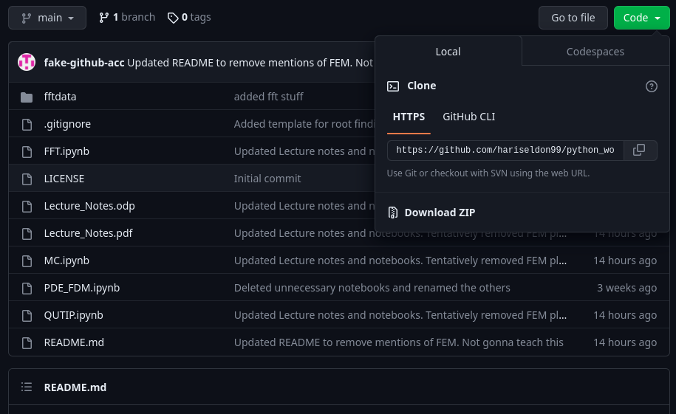
Preliminary Setup and Configuration
All materials for this workshop session are up on my GitHub Repository.
To view, use a web browser to visit https://github.com/hariseldon99/python_workshop
To download this repository on your local machine, click on
above the list of files, then click ‘Download ZIP’ in the dropdown menu
Notes:
Fourier methods have revolutionized fields of science and engineering, from
radio astronomy to medical imaging, from seismology to spectroscopy. It is especially useful in improving the quality of visual and audio data. Since a digital photo or a movie frame is just a 2D matrix of intensity values, a 2D FT can help resolve frequencies that correspond to undesirable features, such as noise or distortions. Masking the amplitudes of those frequencies, followed by an inverse transform, restores the original image, but with the undesirable features removed. Similarly, desirable features can be enhanced by increasing the amplitudes of the corresponsing Fourier frequencies. Fourier transforms of audio data can also help identify dominant frequencies, enhancing our understanding of a particular piece of music.

Slide 7
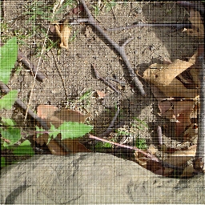



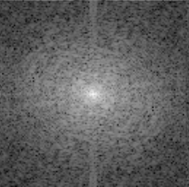


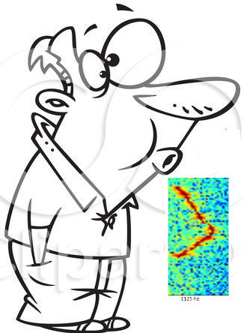
FFT: The Fast Fourier Transform
FFT: The Fast Fourier Transform
C - # 6th octave
1125 Hz
Notes:
Fourier methods have revolutionized fields of science and engineering, from
radio astronomy to medical imaging, from seismology to spectroscopy. It is especially useful in improving the quality of visual and audio data. Since a digital photo or a movie frame is just a 2D matrix of intensity values, a 2D FT can help resolve frequencies that correspond to undesirable features, such as noise or distortions. Masking the amplitudes of those frequencies, followed by an inverse transform, restores the original image, but with the undesirable features removed. Similarly, desirable features can be enhanced by increasing the amplitudes of the corresponsing Fourier frequencies. Fourier transforms of audio data can also help identify dominant frequencies, enhancing our understanding of a particular piece of music.

Slide 8
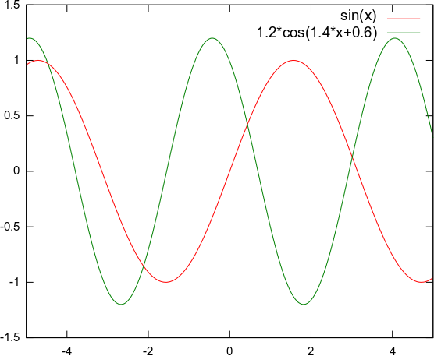
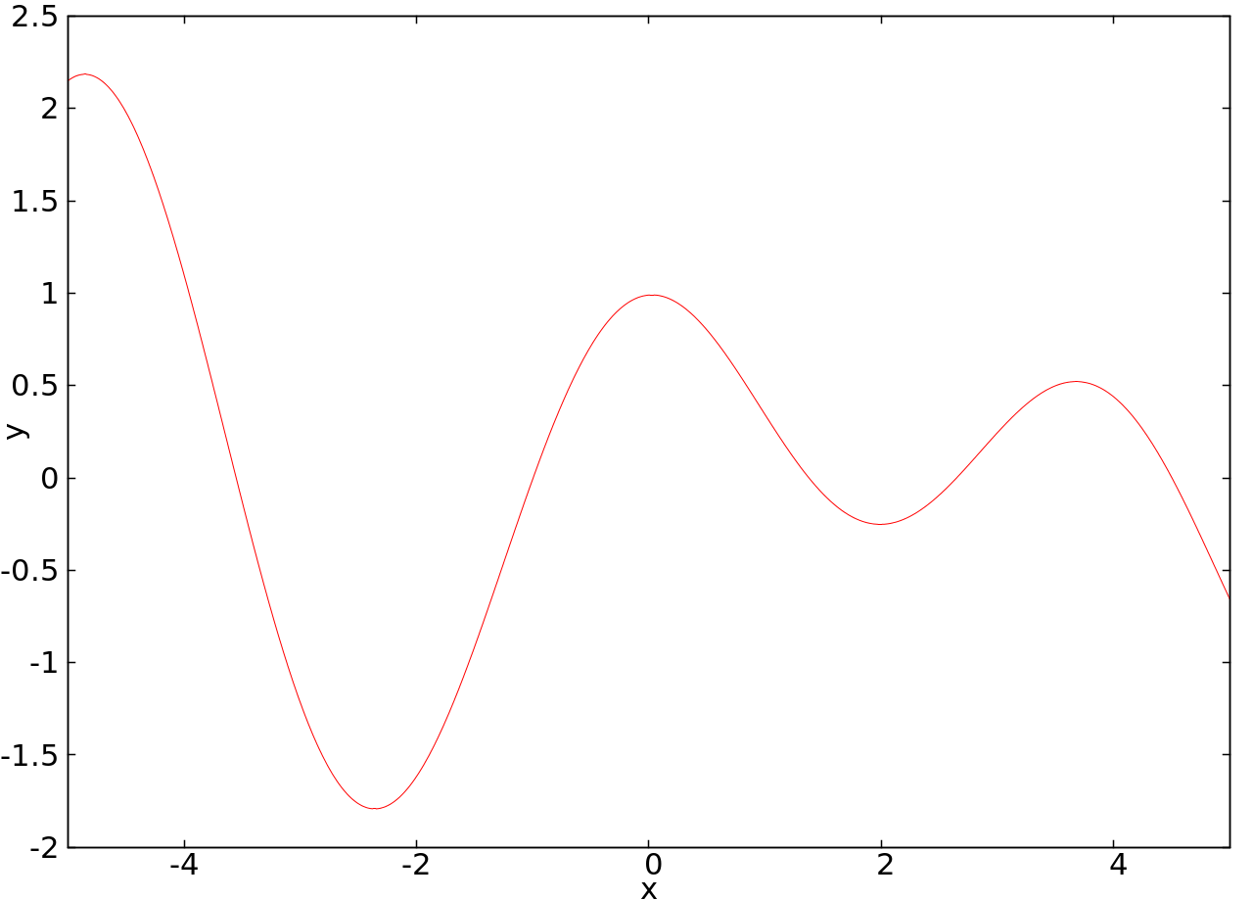
1. Introduction
Intuitive explanation of Fourier Theory
Any signal (Spatially and/or temporally varying data like images, sounds etc.) can be expressed as a sum of series of sinusoids
1 – Dimensional Example (we'll mostly stick to 1D for the rest of this course)
Add the components
Resolve the signal
2
1
0
0.5
-2
Fourier Transform:
Plot of Amplitudes (Phases) as functions of resolved frequencies
-2
-1
0
1
2
0
2
-2
-1
0
1
Notes:
For example, this signal (in 1d now).
A Fourier transform encodes not just a single sinusoid, but a whole series of sinusoids through a range of spatial frequencies from zero (i.e. no modulation, i.e. the average brightness of the whole image) all the way up to the "nyquist frequency", i.e. the highest spatial frequency that can be encoded in the digital image, which is related to the resolution, or size of the pixels. The Fourier transform encodes all of the spatial frequencies present in an image simultaneously as follows. A signal containing only a single spatial frequency of frequency f is plotted as a single peak at point f along the spatial frequency axis, the height of that peak corresponding to the amplitude, or contrast of that sinusoidal signal.
There may also be a "DC term" corresponding to zero frequency, that represents the average intensity across the whole signal. A zero DC term would mean a signal with average intensity of zero, which would mean the sinusoid alternated between positive and negative values in the brightness image, as in our examples so far.

Slide 9
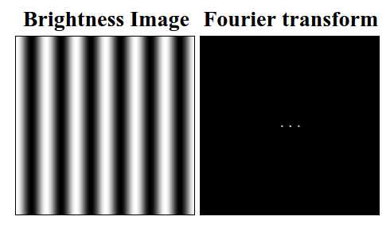
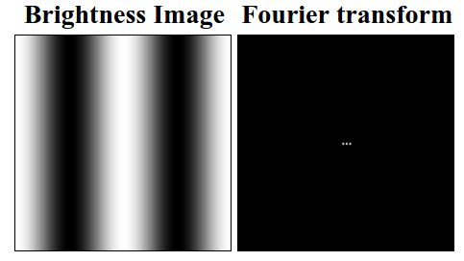
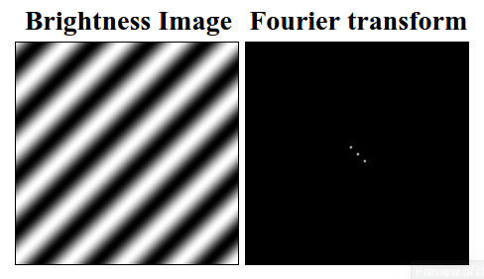
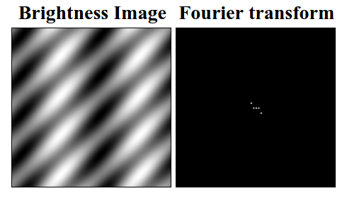
1. Introduction
Intuitive explanation of Fourier Theory
Any signal (Spatially and/or temporally varying data like images, sounds etc.) can be expressed as a sum of series of sinusoids
2 – Dimensional Examples (we'll mostly stick to 1D for the rest of this course)
Notes:
The first image shows a sinusoidal brightness image, and its 2d Fourier transform, presented here also as a brightness image. Every pixel of the Fourier image is a spatial frequency value, the magnitude of that value is encoded by the brightness of the pixel. In this case there is a bright pixel at the very center - this is the DC term, flanked by two bright pixels either side of the center, that encode the sinusoidal pattern. The brighter the peaks in the Fourier image, the higher the contrast in the brightness image. Since there is only one Fourier component in this simple image, all other values in the Fourier image are zero, depicted as black.
2nd image, lower frequency so FT points are closer
3rd image, same frequency magnitudes, but the k vector is “tilted” (rotated by 45 degrees)
Different Fourier coefficients combine additively to produce combination patterns. For example the sinusoidal image shown below is computed as the sum of the tilted sinusoid shown above, and the vertical sinusoid of lower spatial frequency shown above that.

Slide 10
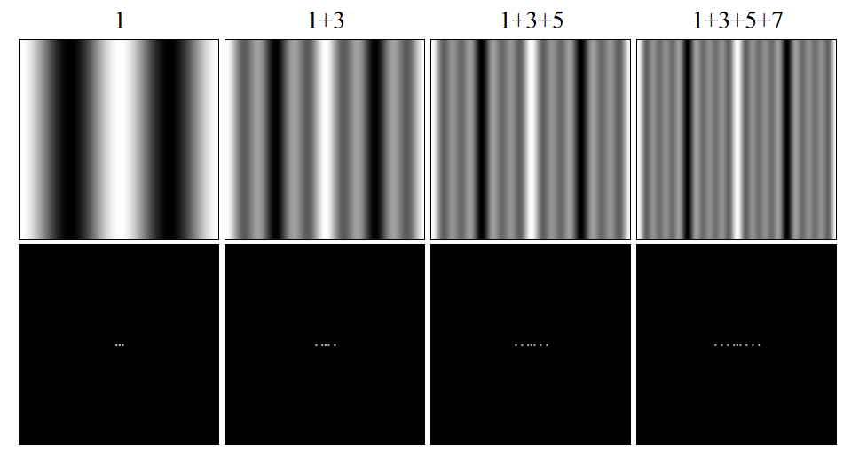
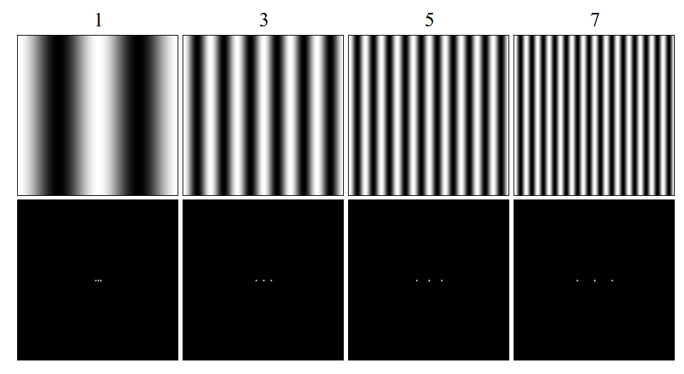
1. Introduction
Intuitive explanation of Fourier Theory
Any signal (Spatially and/or temporally varying data like images, sounds etc.) can be expressed as a sum of series of sinusoids
Higher Harmonics – If signal is “finite” (in extent) or has sharp discontinuities
Notes:
The basis set for the Fourier transform is the smooth sinusoidal function, which is optimized for expressing smooth rounded shapes. But the Fourier transform can actually represent any shape, even harsh rectilinear shapes with sharp boundaries, which are the most difficult to express in the Fourier code, because they need so many higher order terms, or higher harmonics. How these "square wave" functions are expressed as smooth sinusoids will be demonstrated by example.
First fig shows four sinusoidal brightness images of spatial frequency 1, 3, 5, and 7. The first one, of frequency 1, is the fundamental, and the others are higher harmonics on that fundamental, because they are integer multiples of the fundamental frequency. These are in fact the "odd harmonics" on the fundamental, and each one exhibits a bright vertical band through the center of the image. The Fourier transform for each of these patterns is shown below.
Next fig shows the result of progressively adding higher harmonics to the fundamental. Note how the central vertical band gets sharper and stronger with each additional higher harmonic, while the background drops down towards a uniform dark field. Note also how the higher harmonics produce peaks in the Fourier images that spread outward from the fundamental, defining a periodic pattern in frequency space.

Slide 11
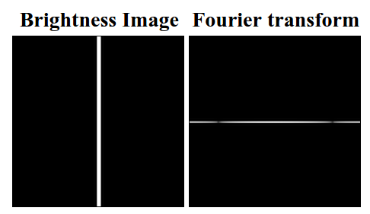
1. Introduction
Intuitive explanation of Fourier Theory
Any signal (Spatially and/or temporally varying data like images, sounds etc.) can be expressed as a sum of series of sinusoids
Higher Harmonics – If signal is “finite” (in extent) or has sharp discontinuities
Notes:
This image shows what would happen if this process were continued all the way out to the Nyquist frequency (I'll explain this term later - The highest possible frequency that can be meaningfully resolved) - it would produce a thin vertical stripe in the brightness image, with sharp boundaries, i.e. a "square wave" in brightness along the x dimension. The Fourier transform of this image exhibits an "infinite" series of harmonics or higher order terms, although these do not actually go out to infinity due to the finite resolution of the original image. This is how the Fourier transform encodes sharp square-wave type features as the sum of a series of smooth sinusoids.

Slide 12
2. Theoretical Section:
Formal Definition of Fourier Transform (FT):
Suppose is absolutely integrable in , then the FT is
Moreover, if the function is square integrable, then the inverse FT (IFT) is

Slide 13
2. Theoretical Section:
Important Properties of Fourier Transform (FT):
  1. Derivative to Coefficient:
  2. Translation Property:
  3. Convolution Property:
  where
  4. Parseval's theorem:
Notes:
Equation [2] should make some intuitive sense.
If the original function g(t) is shifted in time by a constant amount,
it should have the same magnitude of the spectrum, G(f).
That is, a time delay doesn't cause the frequency content of G(f) to
change at all. This should make sense. Since the complex
exponential always has a magnitude of 1, we see the time delay
alters the phase of G(f) but not its magnitude. In eq [3],
A convolution is a sliding, weighted-sum of function f1(\tau), where
the weighting function is f2(-\tau).

Slide 14
3. The Discreet Fourier Transform (DFT)
Given the function, sample it at discrete points and estimate the FT
The value of the function is recorded at regular time intervals and assembled into a vector
Given a discreet vector of data, estimate the FT
The data given might not correspond to a function sampled at regular intervals
So regularize it (estimate the function locally by interpolation and sample it as above)
Sampling Rate
DFT

Slide 15
3. The Discreet Fourier Transform (DFT)
DFT
Choose

Slide 16
3. The Discreet Fourier Transform (DFT)
Periodic in m with period N i.e
Important Properties of DFT:
  1. Convolution Property
  where extended by periodic summation
  2. Parseval's theorem:
Notes:
Extended by periodic summation???

Slide 17
3. The Discreet Fourier Transform (DFT)
Inverse DFT
Sampling Rate
Sampling Interval
DFT
DFT
There is a critical frequency associated with the sampling rate
Nyquist frequency (Nyquist rate)

Slide 18
3. The Discreet Fourier Transform (DFT)
Sampling Rate
Sampling Interval
DFT
DFT
There is a critical frequency associated with the sampling rate
Nyquist frequency (Nyquist rate)
Discretize and build the vector

Slide 19
3. The Discreet Fourier Transform (DFT)
Sampling Rate
Sampling Interval
DFT
DFT
There is a critical frequency associated with the sampling rate
Nyquist frequency (Nyquist rate)
Any frequency in your data that is at Nyquist rate does not get detected !!
Worse, any frequency that is more than the Nyquist rate gives you a false
frequency, a phenomenon called aliasing

Slide 20
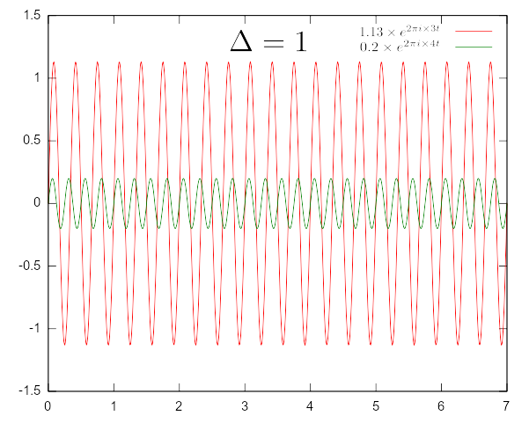
3. The Discreet Fourier Transform (DFT)
Sampling Rate
There is a critical frequency associated with the sampling rate
Sampling Interval
Nyquist frequency (Nyquist rate)
Any frequency in your data that is at Nyquist rate does not get detected !!
Worse, any frequency that is more than the Nyquist rate gives you a false
frequency, a phenomenon called aliasing
The total signal is being sampled at intervals
If the two frequencies differ by a multiple of the sampling rate,
Then they give the same samples!
Sampling rate is just length of the interval
Any frequency outside this interval gets aliased into it
Hence the choice of k to lie between -N/2 and N/2

Slide 21
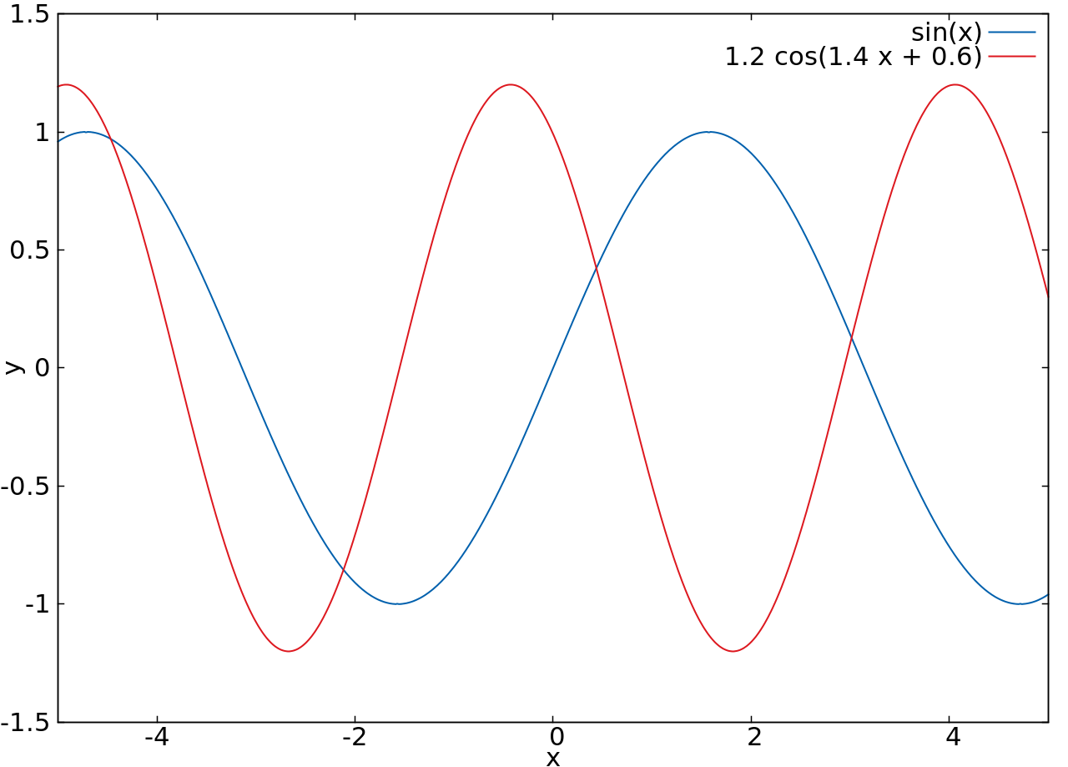
3. The Discreet Fourier Transform (DFT)
How to handle aliasing?
Know the natural bandwidth of the signal
If you already know something about what frequencies are there
Make sure that your Nyquist rate is faster than the largest expected frequency
Add the components
Resolve the signal

Slide 22
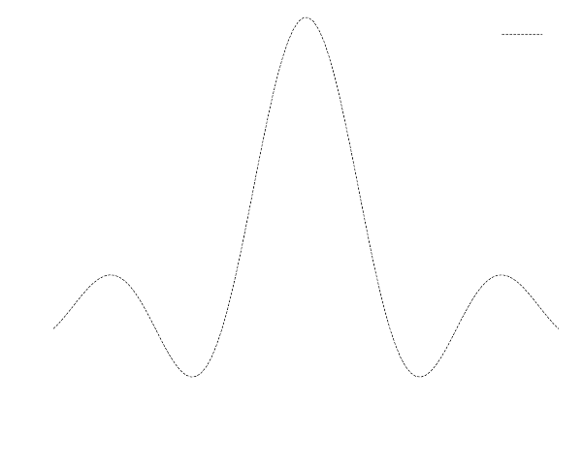
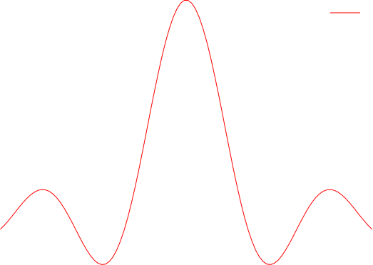
3. The Discreet Fourier Transform (DFT)
How to handle aliasing?
Know the natural bandwidth of the signal
If you already know something about what frequencies are there
Make sure that your Nyquist rate is faster than the largest expected frequency
Choose a Nyquist rate, and sample the data accordingly
If the FFT is too large at the Nyquist edges, then you're aliasing high frequencies
Increase the Nyquist rate and re-sample
Keep doing this until the FFT at the Nyquist edges is small enough to ignore.
Brightness Image Fourier Transform
Infinitely extended signals with (quasi) periodic behavior are not expected to have too many frequencies (here, only 2)
Finite signals, will have many many frequencies (here, a full continuum) - larger frequencies have smaller amplitudes
Choose a sample rate. Sample. Take FFT and re - sample until aliasing falls off

Slide 23
3. The Discreet Fourier Transform (DFT)
Thus, DFT is basically just a Linear Algebra problem!
The numpy and scipy modules already have routines for matrices.
So, are we done? Not quite.
Notes:
So, are we done? Not quite. This has order N^2 operations. Very slow for large N. What if there was an algorithm that could cut down the operations to N logN? That should be much faster than N^2 for large N. That algorithm is the FFT (Fast Fourier Transform), and is coming next.

Slide 24
4. The Fast Fourier Transform (FFT)
Sampling Rate
DFT
FFT
Is there a faster way than to do this brute force matrix-vector operation?
Yes, there is! It's called the FFT algorithm.

Slide 25
4. The Fast Fourier Transform (FFT)
As a special case, consider N=4
16 multiplications and 12 additions!

Slide 26
4. The Fast Fourier Transform (FFT)
As a special case, consider N=4
2 multiplications and 8 additions!
Much faster this way!!!

Slide 27
4. The Fast Fourier Transform (FFT)
As a special case, consider N=4
2 multiplications and 8 additions!
Much faster this way!!!
This observation may reduce the computational effort from into
Much, much faster! Because

Slide 28
4. The Fast Fourier Transform (FFT)
The U matrix above consists only of roots of 1 i.e. 1, -1 &
Thus, all we need to do is group those terms in f that multiply with respectively
Add (or subtract) them as need be, then multiply them with and add/subtract the results

Slide 29
4. The Fast Fourier Transform (FFT)
The U matrix above consists only of 1s and roots of -1 i.e.
Thus, all we need to do is group those terms in f that multiply with respectively
1. Separate the odd and even indices in the sum

Slide 30
4. The Fast Fourier Transform (FFT)
The U matrix above consists only of 1s and roots of -1 i.e.
Thus, all we need to do is group those terms in f that multiply with respectively
2. Rearrange terms in the exponent so N changes to N/2 and a root of -1 comes out

Slide 31
4. The Fast Fourier Transform (FFT)
The U matrix above consists only of 1s and roots of -1 i.e.
Thus, all we need to do is group those terms in f that multiply with respectively
Two smaller DFT's:
Danielson Lanczos lemma (1942!)
Based on earlier works by Runge (1903)
3. Split the FFT to a combination of two smaller FFT's

Slide 32
4. The Fast Fourier Transform (FFT)
ee
e
eee
eeee … e
eeo
eeee … o
eee … oe
eo
eoe
eee … oo
eoo
eee … oee
eee … oeo
BIT REVERSED ORDER OF THE ORIGINAL INDICES!!!
oe
oee
o
oeo
oo
ooe
ooo
ooo … o
4. Repeat recursively until you wind up with only vectors of length 1by rearranging in bit reversed order of index

Slide 33
4. The Fast Fourier Transform (FFT)
ee
eee
= 000 = eee
e
eeo
= 100 = oee
eo
eoe
= 010 or eoe
eoo
= 110 = ooe
oe
oee
= 001 = eeo
o
oeo
= 101 = oeo
oo
ooe
= 011 = eoo
ooo
= 111 = ooo

Slide 34
4. The Fast Fourier Transform (FFT)
Danielson-lanczos lemma (recursive)
What have we done to obtain FFT analytically?
Separate the odd and even indices in the sum
Rearrange terms in the exponent so N changes to N/2 and a root of -1 comes out
Split the FFT to a combo of two smaller FFT's (Danielson – Lanczos lemma)
Repeat recursively until you wind up with only vectors of length 1 by rearranging in bit reversed order of index
How should FFT be done numerically ?
Rearrange the vector in bit reversed order of index
Apply the Danielson - Lanzcos lemma to get the previous combination
Repeat this times until full FFT vector is obtained. Only multiplications!

Slide 35
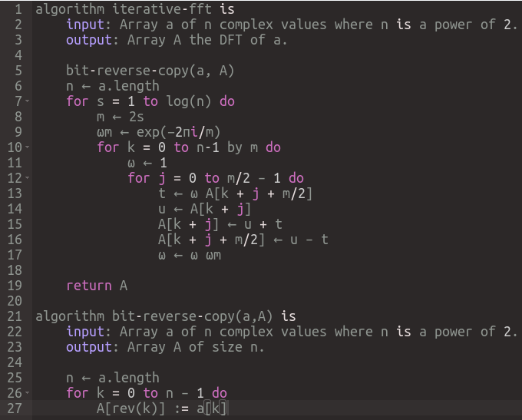
4. The Fast Fourier Transform (FFT)
Danielson-lanczos lemma (recursive)
FFT Algorithm in pseudocode:
The Cooley-Tukey algorithm (1965) uses the bit reversal idea
Gauss had already come up with this in the 19th century (1866), but C&T made it widely known

Slide 36
5. Exercises
1a. FFT in Python:
Choose a sampling rate (say, 1000)
Evaluate the corresponding sample interval
In Python, build a 'time vector' of desired interval size in steps of the sample interval
In Python, generate data of signal as a function of time where the signal is:
  A sine wave of frequency 100
  A superposition of sine waves of different amplitudes (say, 1 and 0.3) and different
  frequencies (say 100 and 70 respectively)
For both sets of data, evaluate the FFT
Pad the signal data to a size of the nearest power of 2 to the original size:
The ‘numpy.fft.fft’ routine has a kwarg of ‘n=padded_size’ for this
To get the padded size, use 'padded_size = 2^nextpow2(original_size)' .
The exponent of the nearest power of 2 to ‘n’ can be obtained as the ceiling of log(n) with base 2
Generate the frequencies where the FFTs were evaluated.
Use the ‘numpy.fft.fftfreq’ routine to do this automatically
Plot the absolute value of the FFTs as functions of the frequencies.
What can you infer from the FFT data?

Slide 37
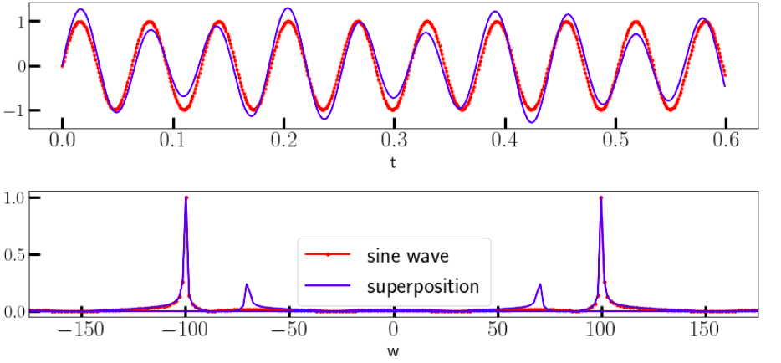
5. Exercises
import numpy as np
import matplotlib.pyplot as plt
plt.rcParams['figure.figsize'] = (12,6)
plt.rcParams['font.size'] = 20
sample_rate = 1000
Delta = 1/sample_rate
sample_size = 4000
t = np.arange(sample_size) * Delta
padded_size = 2**np.ceil(np.log2(sample_size)).astype(int)
s1 = np.sin(100*t)
s2 = s1 + 0.3 * np.sin(70*t)
sp1 = np.fft.fft(s1, n=padded_size)
sp2 = np.fft.fft(s2, n=padded_size)
freq = np.fft.fftfreq(padded_size, d=t[1]-t[0])
f, (ax1, ax2) = plt.subplots(2,1)
ax1.plot(t[0:600], s1[0:600], "r.-", label='sine wave', alpha=0.6)
ax1.plot(t[0:600], s2[0:600], "b", label='superposition')
ax1.set_xlabel('t')
ax2.plot(2*np.pi*freq, np.abs(sp1)/np.amax(np.abs(sp1)), "r.-", label='sine wave')
ax2.plot(2*np.pi*freq, np.abs(sp2)/np.amax(np.abs(sp2)), "b", label='superposition')
ax2.legend()
ax2.set_xlabel('w')
ax2.set_xlim(-175,175)
plt.show()

Slide 38
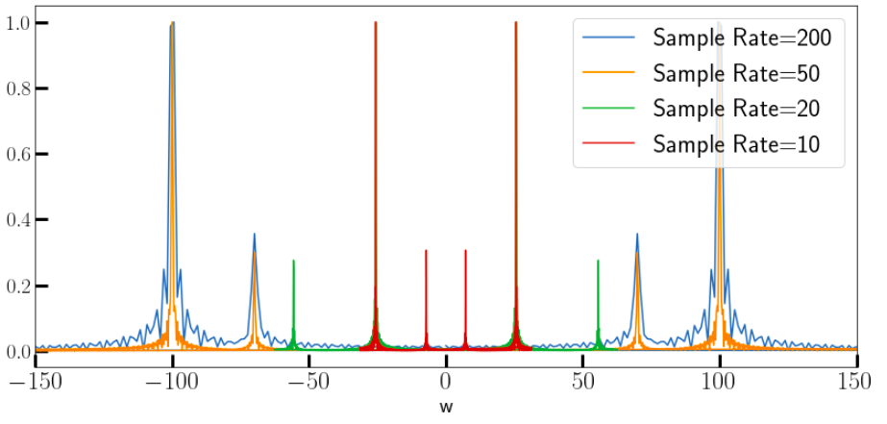
5. Exercises
1b. FFT and Aliasing:
Take the previous signal and plot the FFT for a range of sample rates
Can you see the effects of aliasing if the sample rate is too low? How low?
import numpy as np
import matplotlib.pyplot as plt
plt.rcParams['figure.figsize'] = (12,6)
plt.rcParams['font.size'] = 20
sample_rates = [200, 50, 20, 10]
sample_size = 600
for s in sample_rates:
Delta = 1/s
t = np.arange(sample_size) * Delta
padded_size = 2**np.ceil(np.log2(sample_size)).astype(int)
signal = np.sin(100*t) + 0.3 * np.sin(70*t)
ft = np.fft.fft(signal, n=padded_size)
freq = np.fft.fftfreq(padded_size, d=t[1]-t[0])
plt.plot(2*np.pi*freq, np.abs(ft)/np.amax(np.abs(ft)),\
label=f'Sample Rate = {s}')
plt.xlabel('t')
plt.legend()
plt.xlabel('w')
plt.xlim(-150,150)
plt.show()

Slide 39
5. Exercises
2. Using FFT to filter noisy signals:
Goto the GitHub repository for this course and download the following files:
    ‘fftdata/times.npy’,
    ‘fftdata/signal.npy’,
    ‘fftdata/noisy_signal.npy’
Load these files into numpy arrays
Plot the data from the signal files as a function of the data in the times file
Now, do FFTs of the signal data and plot them as functions of frequency
For now, assume that the time data is regularly spaced, otherwise you’ll have to regularize it by interpolation
Is the FFT data what you expected?
Clean up the FFT data of the noisy signal by removing the ‘noisy frequencies’ .
Visually estimate the noise threshold in the amplitudes and set all data below that to 0.
Finally, take an inverse FFT of the masked data and see if you succeeded in cleaning it up

Slide 40
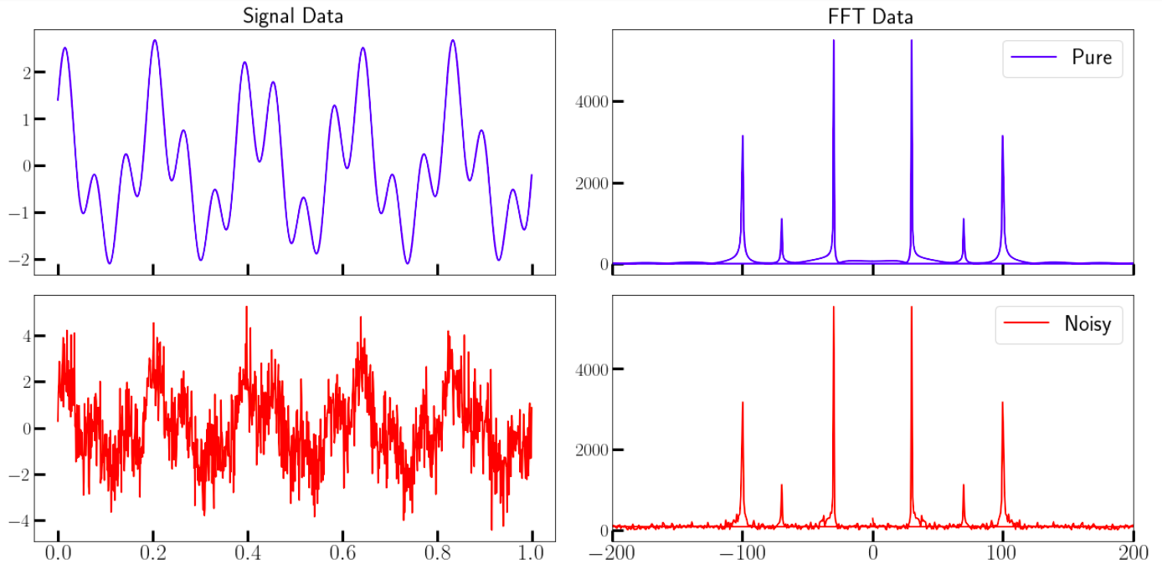
5. Exercises
import numpy as np
import matplotlib.pyplot as plt
plt.rcParams['figure.figsize'] = (18,9)
plt.rcParams['font.size'] = 20
# Load the datasets from files
times = np.load('fftdata/times.npy')
signal = np.load('fftdata/signal.npy')
noisy_signal = np.load('fftdata/noisy_signal.npy')
# Create a 2X2 grid of axes
f, axs = plt.subplots(2,2, sharex='col')
#Plot the raw datasets on the first column axes
axs[0,0].plot(times[0:1000], signal[0:1000], color="blue")
axs[0,0].set_title("Signal Data")
axs[1,0].plot(times[0:1000], noisy_signal[0:1000],color="red")
# Do the FFT of the datasets
sample_size = times.shape[-1]
padded_size = 2**np.ceil(np.log2(sample_size)).astype(int)
ft_sig = np.fft.fft(signal, n=padded_size)
ft_noisy = np.fft.fft(noisy_signal, n=padded_size)
freq = np.fft.fftfreq(padded_size, d=t[1]-t[0])
#Plot the fft datasets on the corresponding rows of the last column
axs[0,1].plot(2*np.pi*freq, np.abs(ft_sig), color='blue', label='Pure')
axs[0,1].set_title("FFT Data")
axs[1,1].plot(2*np.pi*freq, np.abs(ft_noisy), color='red', label='Noisy')
for ax in axs[:,1]:
ax.set_xlim(-200,200)
ax.legend()
plt.legend()
plt.show()

Slide 41
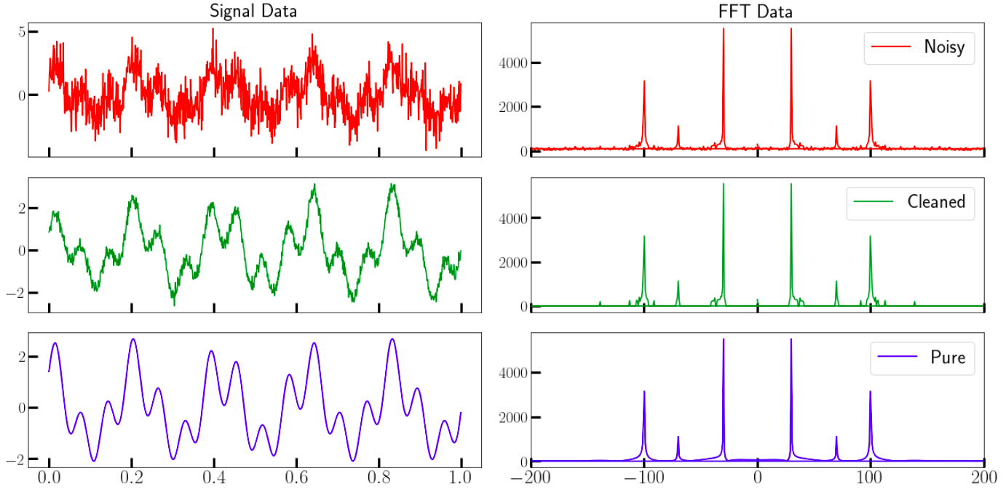
5. Exercises
import numpy as np
import matplotlib.pyplot as plt
threshold = 200
ft_abs = np.abs(ft_noisy)
indices = ft_abs > threshold # filter out those value under 300
ft_clean = indices * ft_noisy # noise frequency will be set to 0
cleaned_signal = np.fft.ifft(ft_clean) # Do inverse FFT
# Create a 2X2 grid of axes
f, axs = plt.subplots(3,2, sharex='col')
#Plot the raw datasets on the first column axes
axs[0,0].plot(times[0:1000], noisy_signal[0:1000], color='red')
axs[0,0].set_title("Signal Data")
axs[1,0].plot(times[0:1000], cleaned_signal[0:1000].real, color='green')
axs[2,0].plot(times[0:1000], signal[0:1000].real, color='blue')
#Plot the fft datasets on the corresponding rows of the last column
axs[0,1].plot(2*np.pi*freq, np.abs(ft_noisy), color='red', label='Noisy')
axs[0,1].set_title("FFT Data")
axs[1,1].plot(2*np.pi*freq, np.abs(ft_clean), color='green', label='Cleaned')
axs[2,1].plot(2*np.pi*freq, np.abs(ft_sig), color='blue', label='Pure')
for ax in axs[:,1]:
ax.set_xlim(-200,200)
ax.legend()
plt.show()
Homework: Use a similar technique to separate the two frequencies in the cleaned data and plot them
Independently.

Slide 42
5. Exercises
3. Compare FFT speed with DFT speed on random arrays of varying sizes.
Write (or find) a Python routine that:
  Takes a numpy array f as its argument.
  Evaluates the DFT vector F using the formula given on the right.
  Evaluates the execution time.
  Returns both of the above.
Generate random column vectors of sizes 16, 32, 64, 128, 256, 512, 1024, 2048, and 4096.
Run the above subroutine and plot the execution time
as a function of data size. Interpret the curve.
Repeat the steps above with the builtin FFT routine.
In both cases, plot the execution time as a function of size and compare, then:
  Plot the execution time for the DFT case as a function of size^2
  Plot the execution time for the FFT case as a function of size*log2(size)
  What can you infer from these graphs?

Slide 43
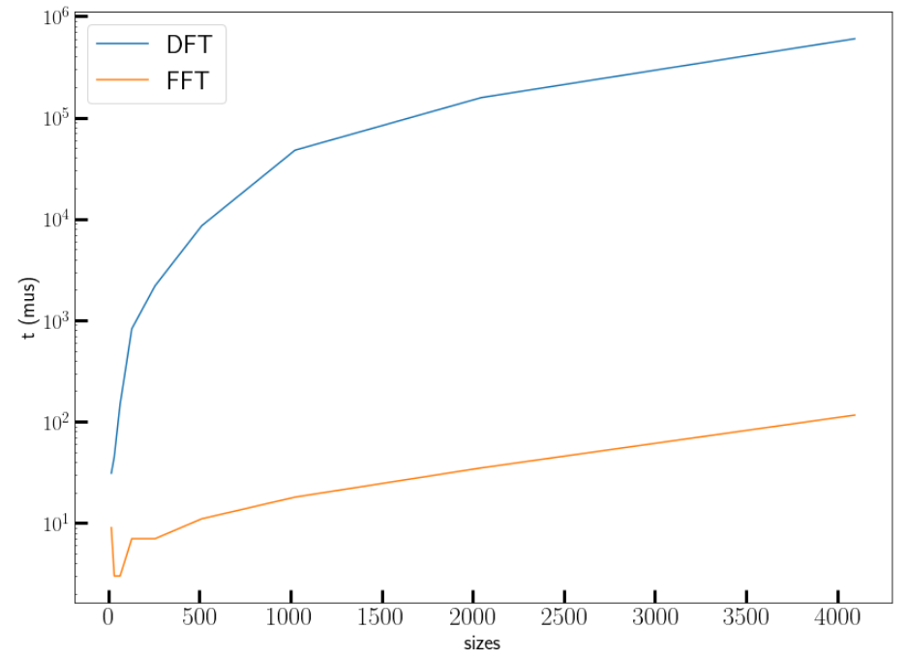
5. Exercises
import numpy as np
def dft(x):
"""
Function to calculate the
discrete Fourier Transform
of a 1D real-valued signal x
"""
N = x.shape[-1]
n = np.arange(N)
k = n.reshape((N, 1))
e = np.exp(-2j * np.pi * k * n / N)
return e @ x
x = np.random.random(100)
print(np.allclose(dft(x), np.fft.fft(x)))
import matplotlib.pyplot as plt
plt.rcParams['figure.figsize'] = (8,6)
plt.rcParams['font.size'] = 20
from timeit import Timer
defnum = 20
mysetup = 'import numpy as np\n'
mysetup += '''def dft(x):
N = x.shape[-1]
n = np.arange(N)
k = n.reshape((N, 1))
e = np.exp(-2j * np.pi * k * n / N)
return e @ x'''
sizes = 2**np.arange(4,13)
times_dft = np.zeros_like(sizes)
times_fft = np.zeros_like(sizes)
for i,s in enumerate(sizes):
dft = Timer(setup=mysetup, stmt="dft(np.random.random(%d))" % (s,))
times_dft[i] = min(dft.repeat(number=defnum)) * 1e6 / defnum
fft = Timer(setup=mysetup, stmt="np.fft.fft(np.random.random(%d))" % (s,))
times_fft[i] = min(fft.repeat(number=defnum)) * 1e6 / defnum
plt.plot(sizes, times_dft,label="DFT")
plt.plot(sizes, times_fft, label="FFT")
plt.xlabel("sizes")
plt.ylabel("t (mus)")
plt.yscale('log')
plt.legend()
plt.show()

Slide 44
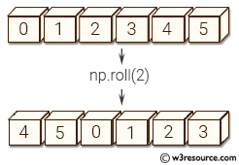
5. Exercises
4. Convolutions via FFT
Generate two vectors ‘f’ and ‘g’ of equal size (choose a large size, preferably a power of 2), consisting of random numbers, and evaluate the convolution vector , where the elements of c are given by
  Imagine that the elements of ‘f’ lie on a ring. Then, the l^{th} component of ‘c
  involves the components of ‘f’ after ‘rolling’ this ring by l places.
  In numpy, there is a function ‘numpy.roll’ that does this. Use that function.
Now, get the FFTs of the two vectors, compute their element-wise product, and do the IFFT of the result. Sum over this.
Is this sum equal to the first result? Why?
  Repeat for a few different sets of two random vectors.
  Recall the convolution theorem
If they are indeed equal as expected, then which method is faster and why?
  Use the %timeit magic in Jupyter to measure runtimes

Slide 45
5. Exercises
4. Convolutions via FFT
import numpy as np
N = 2**15
f = np.random.random(N)
g = np.random.random(N)
print("Normal Convolution:")
%timeit c = np.array([np.sum(np.roll(f,-l-1)[::-1]*g) for l in range(N)])
c = np.array([np.sum(np.roll(f,-l-1)[::-1]*g) for l in range(N)])
print("\nConvolution by FFT:")
%timeit c_fft = np.fft.ifft(np.fft.fft(f) * np.fft.fft(g))
c_fft = np.fft.ifft(np.fft.fft(f) * np.fft.fft(g))
print("\nAre they equal?", np.allclose(c, c_fft))
Normal Convolution:
1.91 s ± 10.7 ms per loop (mean ± std. dev. of 7 runs, 1 loop each)
Convolution by FFT:
1.4 ms ± 23.7 µs per loop (mean ± std. dev. of 7 runs, 1000 loops each)
Are they equal? True

Slide 46
QuTiP: The Quantum Toolbox in Python
QuTiP: The Quantum Toolbox in Python
Framework for computational quantum dynamics
  Efficient and easy to use for quantum physicists
  Thoroughly tested (100+ unit tests)
  Well documented (200+ pages, 50+ examples)
  Quite large number of users (>1000 downloads)
Suitable for
  theoretical modeling and simulations
  modeling experiments
100% open source
Implemented in Python/Cython using SciPy, Numpy, and matplotlib

Slide 47
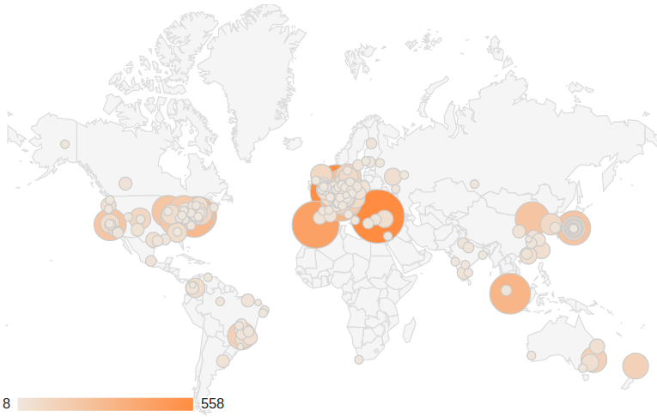
QuTiP: The Quantum Toolbox in Python
Project information
Authors: Paul Nation and Robert Johansson
Web site: http://qutip.org
License: GPLv3
Repository: http://github.com/qutip
Publication: Comp. Phys. Comm. 183, 1760 (2012)
arXiv:1211.6518 (2012)

Slide 48
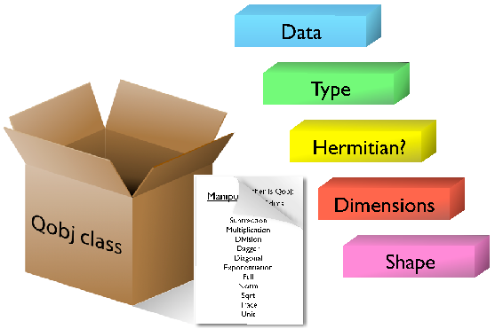
QuTiP: The Quantum Toolbox in Python
Objectives
To provide a powerful framework for quantum mechanics that closely resembles the standard mathematical formulation
  Efficient and easy to use
  General framework, able to handle a wide
  range of different problems
Design and implementation
  Object-oriented design
  Qobj class used to represent quantum objects
    Operators
    State vectors
    Density matrices
  Library of utility functions that operate on Qobj instances
QuTiP core class: Qobj

Slide 49


QuTiP: The Quantum Toolbox in Python
Quantum object class: Qobj
Abstract representation of quantum states and operators
  Matrix representation of the object
  Structure of the underlaying state space, Hermiticity, type, etc.
  Methods for performing all common operations
  on quantum objects:
  eigs(),dag(),norm(),unit(),expm(),sqrt(),tr(), ...
  Operator arithmetic with implementations of: +. -, *, ...
Example: built-in operator
Example: built-in state
>>> sigmax()
Quantum object: dims = [[2], [2]], shape = [2, 2],
type = oper, isHerm = True
Qobj data =
[[ 0. 1.]
[ 1. 0.]]
>>> coherent(5, 0.5)
Quantum object: dims = [[5], [1]], shape = [5, 1], type = ket
Qobj data =
[[ 0.88249693]
[ 0.44124785]
[ 0.15601245]
[ 0.04496584]
[ 0.01173405]]

Slide 50
QuTiP: The Quantum Toolbox in Python
Evolution of quantum systems
The main use of QuTiP is quantum evolution. A number of solvers are available.
Typical simulation workflow:
  Define parameters that characterize the system
  Create Qobj instances for operators and states
  Create Hamiltonian, initial state and
  collapse operators, if any
  Choose a solver and evolve the system
  Post-process, visualize the data, etc.
Available evolution solvers:
  Unitary evolution: Schrödinger and von Neumann equations
  Lindblad master equations
  Monte-Carlo quantum trajectory method
  Bloch-Redfield master equation
  Floquet-Markov master equation
  Propagators

Slide 51

QuTiP: The Quantum Toolbox in Python
Lindblad master equation
Equation of motion for the density matrix for a quantum system that interacts with its environment:
How do we solve this equation numerically?
I. Construct the matrix representation of all operators
II. Evolve the ODEs for the unknown elements in the density matrix
III. For example, calculate expectation values for some selected operators for each

Slide 52
QuTiP: The Quantum Toolbox in Python
Lindblad master equation
Equation of motion for the density matrix for a quantum system that interacts with its environment:
How do we solve this equation numerically in QuTiP?
from qutip import *
psi0 = ... # initial state
H = ... # system Hamiltonian
c_op_list = [...] # collapse operators
e_op_list = [...] # expectation value operators
tlist = linspace(0, 10, 100)
result = mesolve(H, psi0, tlist, c_op_list, e_op_list)

Slide 53
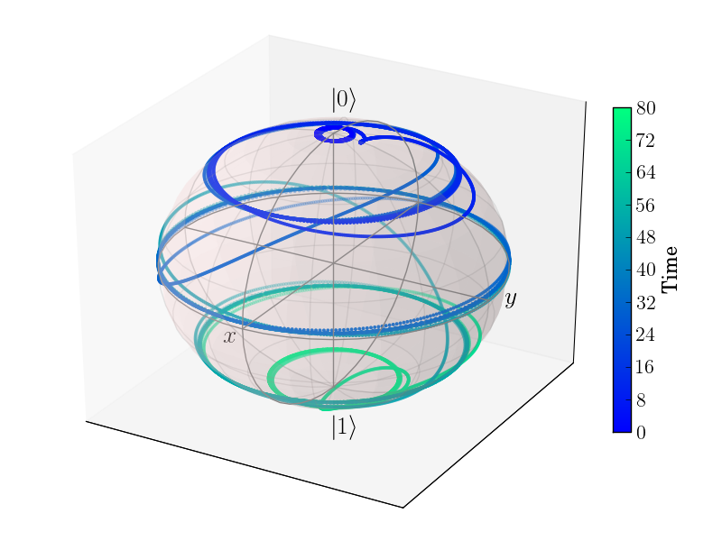
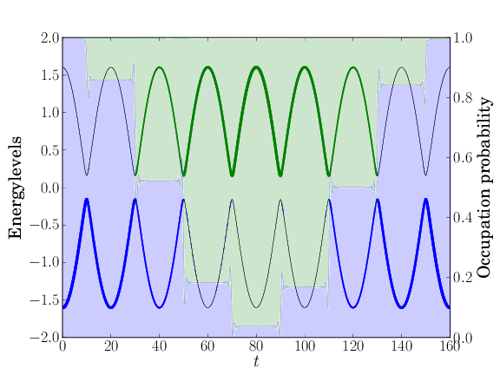
QuTiP: The Quantum Toolbox in Python
Example: time-dependence
Multiple Landau-Zener transitions
from qutip import *
# Parameters
epsilon = 0.0
delta = 1.0
# Initial state: start in ground state
psi0 = basis(2,0)
# Hamiltonian
H0 = - delta * sigmaz() - epsilon * sigmax()
H1 = - sigmaz()
h_t = [H0, [H1, 'A * cos(w*t)']]
args = {'A': 10.017, 'w': 0.025*2*pi}
# No dissipation
c_ops = []
# Expectation values
e_ops = [sigmax(), sigmay(), sigmaz()]
# Evolve the system
tlist = linspace(0, 160, 500)
output = mesolve(h_t, psi0, tlist, c_ops, e_ops, args)
# Process and plot result
# ...

Slide 54
QuTiP: The Quantum Toolbox in Python
QuTiP: Examples
from qutip import *
def evals_multw(w1list, w2, w3, g12, g13):
# Pre-compute operators for the hamiltonian
sz1 = tensor(sigmaz(), qeye(2), qeye(2))
sx1 = tensor(sigmax(), qeye(2), qeye(2))
sz2 = tensor(qeye(2), sigmaz(), qeye(2))
sx2 = tensor(qeye(2), sigmax(), qeye(2))
sz3 = tensor(qeye(2), qeye(2), sigmaz())
sx3 = tensor(qeye(2), qeye(2), sigmax())
evals_mat = np.zeros((len(w1list),2**3))
for idx, w1 in enumerate(w1list):
# evaluate the Hamiltonian
H = w1 * sz1 + w2 * sz2 + w3 * sz3 +\
g12 * sx1 * sx2 + g13 * sx1 * sx3
# find the energy eigenvalues of the composite system
evals = H.eigenenergies()
evals_mat[idx,:] = np.real(evals)
return evals_mat
w1 = 1.0 * 2 * np.pi # atom 1 frequency: sweep this one
w2 = 0.9 * 2 * np.pi # atom 2 frequency
w3 = 1.1 * 2 * np.pi # atom 3 frequency
g12 = 0.05 * 2 * np.pi # atom1-atom2 coupling strength
g13 = 0.05 * 2 * np.pi # atom1-atom3 coupling strength
w1list = np.linspace(0.75, 1.25, 50) * 2 * np.pi # atom 1 frequency range
evals_mat = evals_multw(w1list, w2, w3, g12, g13)
import matplotlib.pyplot as plt
plt.rcParams['font.size'] = 20
fig, ax = plt.subplots(figsize=(12,6))
for n in [1,2,3]:
ax.plot(w1list / (2*np.pi), (evals_mat[:,n]-evals_mat[:,0]) / (2*np.pi), 'b')
ax.set_xlabel('Energy splitting of electron 1')
ax.set_ylabel('Eigenenergies')
ax.set_title('Energy spectrum of three coupled electrons')
plt.show()
See Jupyter Notebook:
‘QUTIP.ipynb’

Slide 55
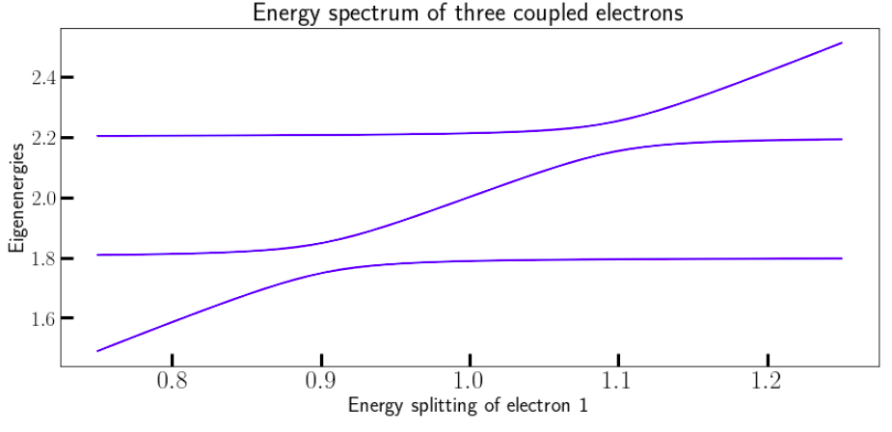
QuTiP: The Quantum Toolbox in Python
QuTiP: Examples
See Jupyter Notebook:
‘QUTIP.ipynb’

Slide 56
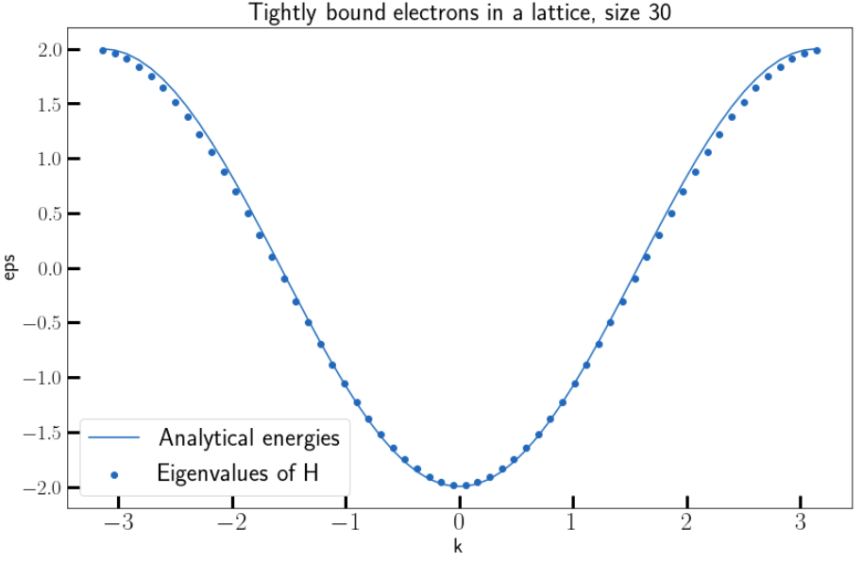
QuTiP: The Quantum Toolbox in Python
QuTiP: Examples
See Jupyter Notebook:
‘QUTIP.ipynb’
#N = 100
N = 30
H = sum([basis(N,i) * basis(N, i + 1).dag() for i in range(N - 1)]) +\
sum([basis(N,i) * basis(N, i - 1).dag() for i in range(1, N)])
evals = H.eigenenergies()
# satisfy periodic boundary conditions we need E(-k) = E(k)
numerical = np.concatenate((np.flip(evals, 0), evals), axis=0)
import numpy as np
import matplotlib.pyplot as plt
plt.rcParams['figure.figsize'] = (12,8)
plt.rcParams['font.size'] = 20
k = np.linspace(-np.pi, np.pi, 2*N)
#plt.scatter(k[::3],numerical[::3].real, label='Eigenvalues of H')
plt.scatter(k,numerical.real, label='Eigenvalues of H')
analytical = -2 * np.cos(k)
plt.title(f"Tightly bound electrons in a lattice, size {N}")
plt.plot(k,analytical, label='Analytical energies')
plt.xlabel("k")
plt.ylabel("eps")
plt.legend()
plt.show()

Slide 57
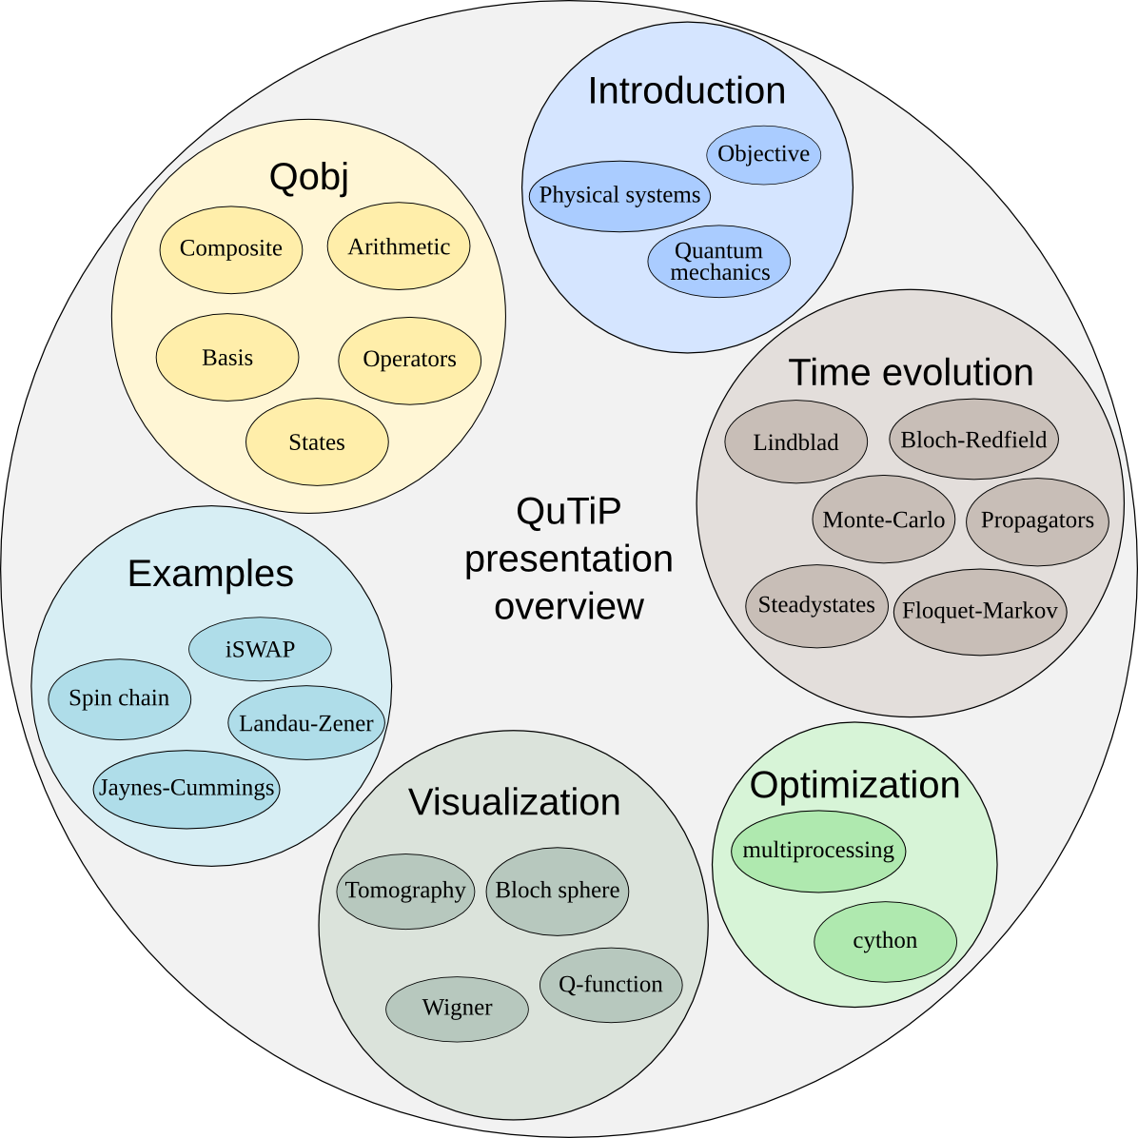
QuTiP: The Quantum Toolbox in Python
More information at: http://qutip.org
QuTiP: framework for numerical simulations of quantum systems
  Generic framework for representing quantum states and operators
  Large number of dynamics solvers
Main strengths:
  Ease of use: complex quantum systems can programmed rapidly and intuitively
  Flexibility: Can be used to solve a wide variety of problems
  Performance: Near C-code performance due to use of Cython for time-critical functions

Slide 58
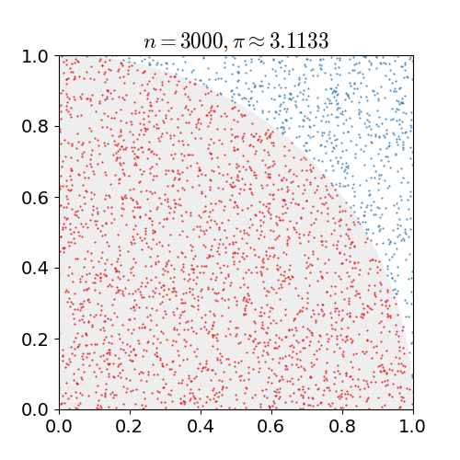

Monte Carlo Methods in Python
Monte Carlo Methods in Python
Many computer calculations employ Monte Carlo methods that include elements of chance to either:
Simulate random physical processes, such as thermal motion or radioactive decay, or
Estimate areas, volumes etc. by numerical integration
Monte Carlo Casino, Monaco, Cote-d-Azur, France

Slide 59
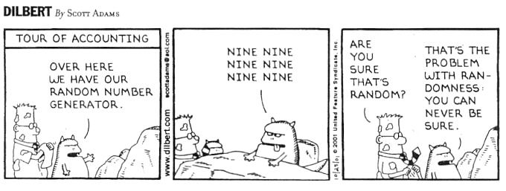
Monte Carlo Methods in Python
Monte Carlo Methods in Python
Randomness in deterministic computers???
Besides, how do even know if anything can be ‘random’??

Slide 60
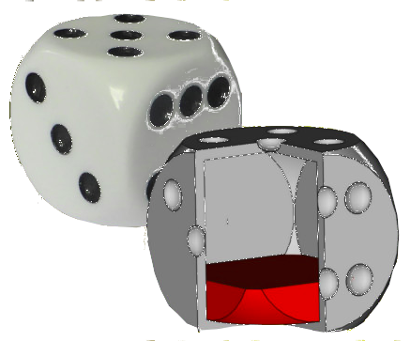
Monte Carlo Methods in Python
Monte Carlo Methods in Python
What is ‘randomness’, or a ‘random variable’?
Basically, it’s a special way of choosing the elements of a set. In our case, it involves choosing a single number from a particular subset of complex numbers , based on a probability of choice.
Uniform randomness: When all numbers in the subset are equally likely to be chosen
Non-uniform Randomness: When the probability of a particular choice depends on the value of the choice.
P(r) dr – Probability of a choice being in [r, r+dr]
Non- Uniform: P(r) depends on r
Uniform: P(r) constant

Slide 61
Monte Carlo Methods in Python
Monte Carlo Methods in Python
What is ‘randomness’, or a ‘random variable’?
Basically, it’s a special way of choosing the elements of a set. In our case, it involves choosing a single number from a particular subset of complex numbers, based on a probability of choice.
Mathematically, “independent randomness” occurs when there are no correlations between any two sets of choices from the same subset

Slide 62
Monte Carlo Methods in Python
Monte Carlo Methods in Python
What is ‘randomness’, or a ‘random variable’?
Basically, it’s a special way of choosing the elements of a set. In our case, it involves choosing a single number from a particular subset of complex numbers, based on a probability of choice.
Mathematically, “independent randomness” occurs when there are no correlations between any two sets of choices from the same subset
Obeys the ‘Central Limit Theorem’
Consider an arbitrarily large (infinite) array of independent random variables, called ‘A’.
By the law of large numbers, their average is a fixed constant and stdev
For a finite (but reasonably large) array of independent random variables from A , the probability that their sample average (times ) is a value ‘x’ (times ) is

Slide 63
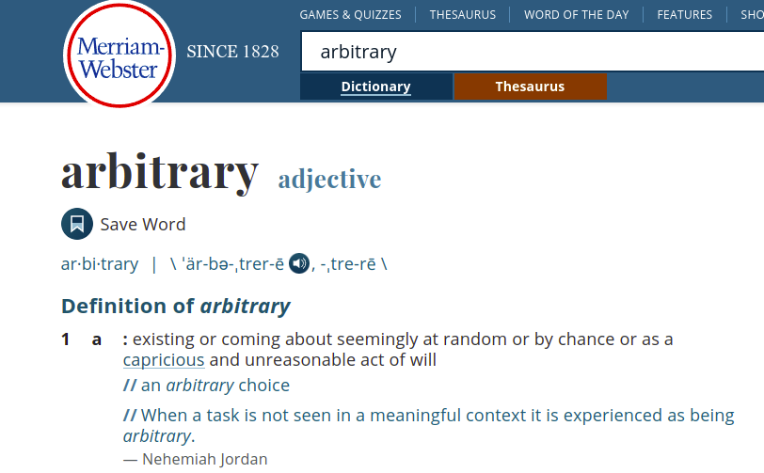
Monte Carlo Methods in Python
Monte Carlo Methods in Python
What is ‘randomness’, or a ‘random variable’?
Basically, it’s a special way of choosing the elements of a set. In our case, it involves choosing a single number from a particular subset of complex numbers, based on a probability of choice.
Note: In science, ‘Random’ and ‘Arbitrary’ are two different things!
Although they are used interchangeably in common parlance
Arbitrary choices have no well-defined probability, whereas random choices do

Slide 64
Monte Carlo Methods in Python
Monte Carlo Methods in Python
What is ‘randomness’, or a ‘random variable’?
Basically, it’s a special way of choosing the elements of a set. In our case, it involves choosing a single number from a particular subset of complex numbers, based on a probability of choice.
Note: In science, ‘Random’ and ‘Arbitrary’ are two different things!
Although they are used interchangeably in common parlance
Arbitrary choices have no well-defined probability, whereas random choices do
However, in some cases, depending on context, we ignore this distinction
In Python: “Prove” that Convolution Theorem works by creating 2 random arrays and using FFT to test the theorem

Slide 65
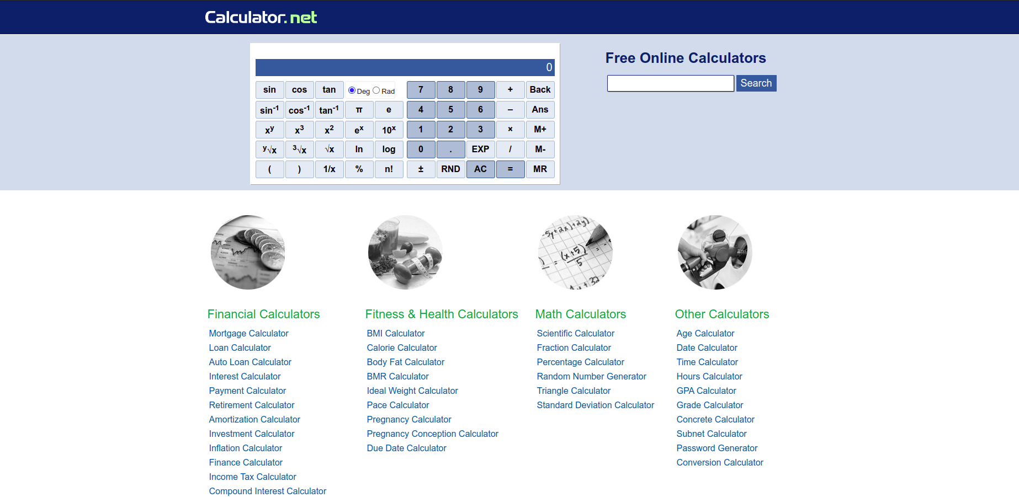
Monte Carlo Methods in Python
Monte Carlo Methods in Python
What is ‘randomness’, or a ‘random variable’?
Basically, it’s a special way of choosing the elements of a set. In our case, it involves choosing a single number from a particular subset of complex numbers, based on a probability of choice.
Standard Classical Computer CPU’s cannot generate random numbers
However, they can generate ‘nearly’ random, or pseudorandom numbers, usually by either
Chaotic maps
Exploiting ‘random’ floating point errors in remainders of divisions

Slide 66
Monte Carlo Methods in Python
Monte Carlo Methods in Python
Random numbers in NumPy: Uniform beteween 0 and 1 by default
Python 3.8.8 (default, Apr 13 2021, 19:58:26)
[GCC 7.3.0] :: Anaconda, Inc. on linux
Type "help", "copyright", "credits" or "license" for more information.
>>> import numpy as np
>>> print(np.random.random())
0.6226775696151192
>>> print(np.random.random())
0.7922634259220305
>>> print(np.random.random())
0.14630228848931848
>>> a = np.random.random((3,2)); print(a)
[[0.69190953 0.36821051]
[0.36047735 0.17258306]
[0.00406954 0.26549197]]

Slide 67
Monte Carlo Methods in Python
Monte Carlo Methods in Python
Random numbers in NumPy: Uniform beteween 0 and 1 by default
How to make the probability of a number r be biased by P(r)?
import numpy as np
def weighted_choice(objects, weights):
""" returns randomly an element from the sequence of 'objects',
the likelihood of the objects is weighted according
to the sequence of 'weights', i.e. percentages."""
weights = np.array(weights, dtype=np.float64)
# Normalize the weights:
weights /= weights.sum()
# “Integrate” the probabilities to find the cumulative probability
weights = weights.cumsum()
r = np.random.random()
for i in range(len(weights)):
if r < weights[i]:
return objects[i]
Cumulative “Weights”
Objects to choose from
Choose r uniform-randomly
If , then
return

Slide 68
Monte Carlo Methods in Python
Monte Carlo Methods in Python
Random numbers in NumPy: Uniform beteween 0 and 1 by default
How to make the probability of a number r be biased by P(r)?
import numpy as np
def weighted_choice(objects, weights):
""" returns randomly an element from the sequence of 'objects',
the likelihood of the objects is weighted according
to the sequence of 'weights', i.e. percentages."""
weights = np.array(weights, dtype=np.float64)
# Normalize the weights:
weights /= weights.sum()
# “Integrate” the probabilities to find the cumulative probability
weights = weights.cumsum()
r = np.random.random()
for i in range(len(weights)):
if r < weights[i]:
return objects[i]
Note that:

Slide 69
Monte Carlo Methods in Python
Monte Carlo Methods in Python
Random numbers in NumPy: Uniform beteween 0 and 1 by default
How to make the probability of a number r be biased by P(r)?
Example problems: See Jupyter Notebook MC.ipynb
Radioactive Decay (exact)
Random Walks
Metropolis Algorithm and the Ising Model (1d and 2d)

Slide 70
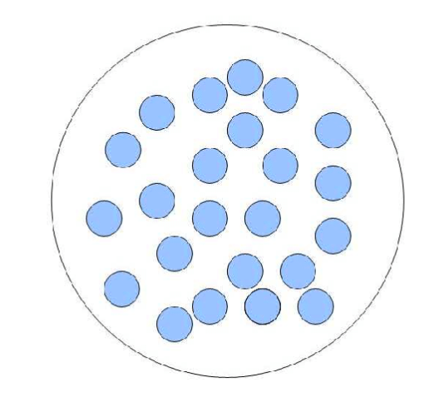
Monte Carlo Methods in Python
Monte Carlo Methods in Python
Example problems: See Jupyter Notebook MC.ipynb
Radioactive Decay:
A sample of N radioactive atoms undergoing spontaneous decay
The probability P of decay within a given time interval is
proportional to the interval
Continuum Approximation

Slide 71
Monte Carlo Methods in Python
Monte Carlo Methods in Python
Example problems: See Jupyter Notebook MC.ipynb
Radioactive Decay:
A sample of N radioactive atoms undergoing spontaneous decay
The probability P of decay within a given time interval is proportional
to the interval
Exact Simulation: At each time, for each atom, choose a random number ‘r’ and decrement N only if

Slide 72
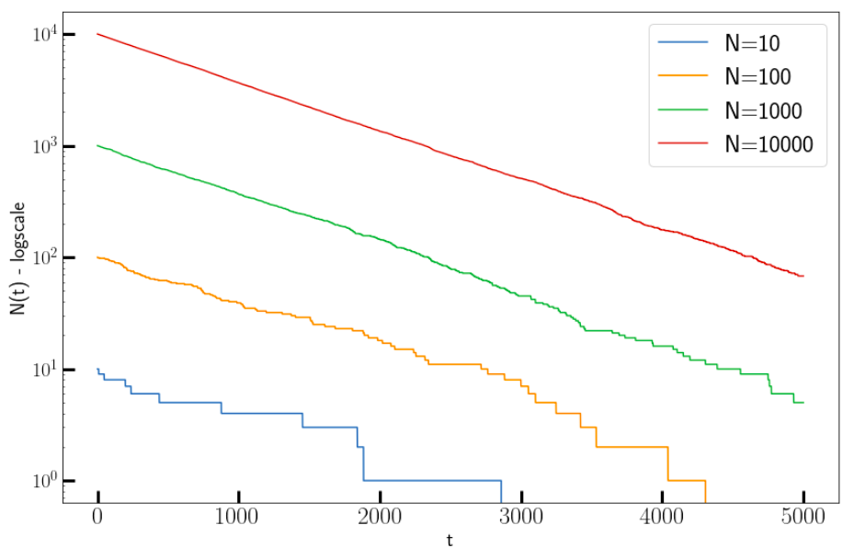
Monte Carlo Methods in Python
Monte Carlo Methods in Python
import numpy as np
import matplotlib.pyplot as plt
plt.rcParams['figure.figsize'] = (12,8)
plt.rcParams['font.size'] = 20
# Decay constant
lambda1 = 1e-3
natoms_arr = [10, 100, 1000, 10000]
maxtime = 5000
timeline = np.arange(0, maxtime + 1)
for natoms in natoms_arr:
natoms_begin = natoms
natoms_time = []
for time in timeline:
decays = np.random.random(natoms)
natoms -= np.count_nonzero(decays < lambda1)
natoms_time.append(natoms)
plt.plot(timeline, natoms_time,label=f'N={natoms_begin}')
plt.ylabel("N(t) - logscale")
plt.xlabel("t")
plt.yscale("log")
plt.legend()
plt.show()

Slide 73
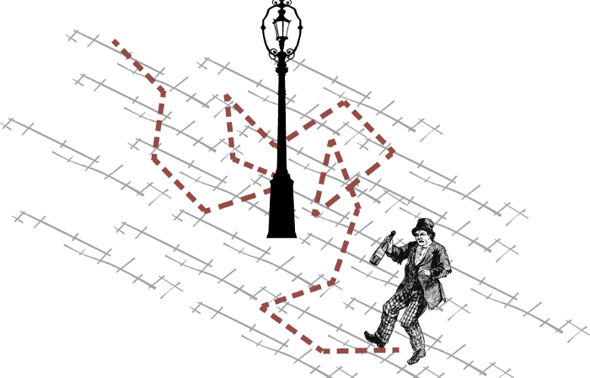
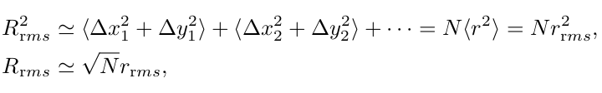
Monte Carlo Methods in Python
Monte Carlo Methods in Python
Example problems: See Jupyter Notebook MC.ipynb
Random Walk Problem:
Monte Carlo-like model of Diffusion, Brownian motion etc.
A digital simulation of a ‘drunk man’, where a point advances along a graph in discrete steps
Each step can be of a random stepsize in a random direction, or fixed stepsize in a random direction.
Average over a large number of trials:

Slide 74
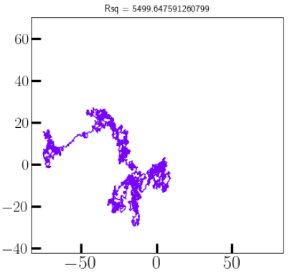
Monte Carlo Methods in Python
Monte Carlo Methods in Python
Example problems: See Jupyter Notebook MC.ipynb
Random Walk Problem: Given the mean free path of air at room temperature (68 nm), how many collisions will it take for a single molecule suspended in air to travel 20 metres?
Molecule = Random Walker
Average over a large number of trials:

Slide 75
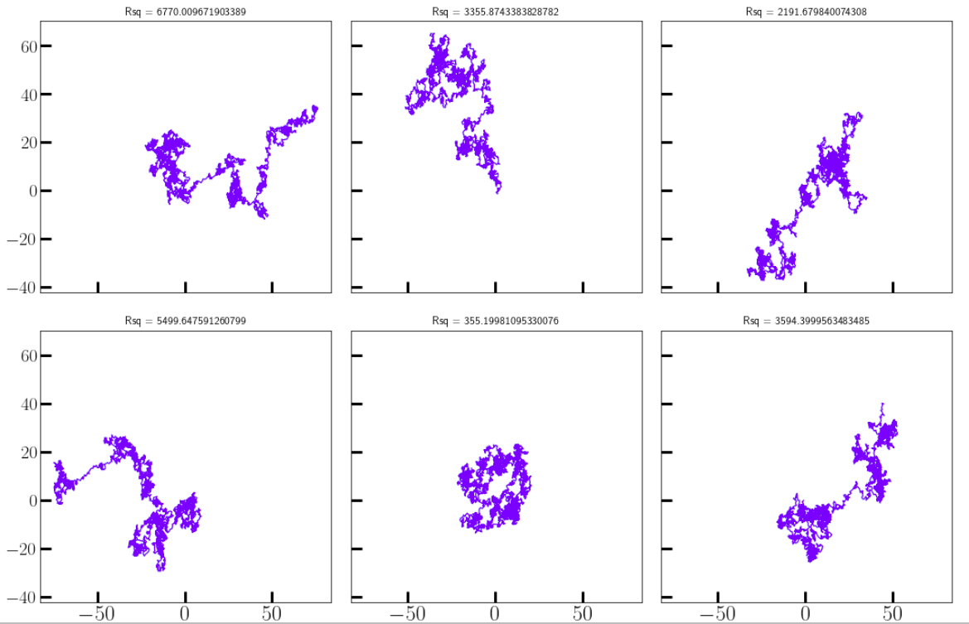
Monte Carlo Methods in Python
Monte Carlo Methods in Python
Example problems: See Jupyter Notebook MC.ipynb
Random Walk Problem: Given the mean free path of air at room temperature (68 nm), how many collisions will it take for a single molecule suspended in air to travel 20 metres?
import numpy as np
plt.rcParams['figure.figsize'] = (15,10)
plt.rcParams['font.size'] = 20
fig, axs = plt.subplots(2,3, sharex=True, sharey=True)
axs = axs.flatten()
jmax = 2500
for ax in axs:
dr_vals = 2.0 * np.random.random((jmax,2)) -1
Lvals = np.sum(dr_vals**2, axis=1)
dr_vals /= np.sqrt(Lvals[:, None])
points = np.cumsum(dr_vals, axis=0)
Rsq = np.linalg.norm(points[-1])**2
ax.set_title(f"Rsq = {Rsq}", fontsize=12)
ax.plot(points[:,0], points[:,1], color='blue', alpha=0.6)
plt.show()

Slide 76
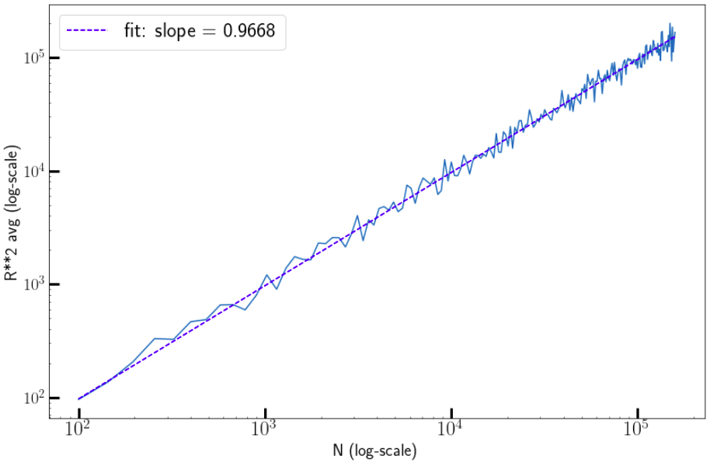
Monte Carlo Methods in Python
Monte Carlo Methods in Python
Example problems: See Jupyter Notebook MC.ipynb
Random Walk Problem: Given the mean free path of air at room temperature (68 nm), how many collisions will it take for a single molecule suspended in air to travel 20 metres?
import matplotlib.pyplot as plt
from scipy.optimize import curve_fit
import numpy as np
plt.rcParams['figure.figsize'] = (12,8)
plt.rcParams['font.size'] = 20
def randwalk2d(nsteps, repeat=6):
points = []
for i in range(repeat):
dr_vals = 2.0 * np.random.random((nsteps,2)) -1
Lvals = np.sum(dr_vals**2, axis=1)
dr_vals /= np.sqrt(Lvals[:, None])
points.append(np.cumsum(dr_vals, axis=0))
return points
nsteps = np.arange(10,400,2)**2
Rsq_avs = []
for nstp in nsteps:
walks = randwalk2d(nstp, repeat=50)
Rsq_avs.append(np.average([np.linalg.norm(w[-1])**2 for w in walks]))
plt.loglog(nsteps, Rsq_avs)
popt, pcov = curve_fit(lambda x,a: a * x, nsteps, Rsq_avs)
plt.loglog(nsteps, popt[0] * nsteps, 'b--', label=f'fit: slope = {popt[0]:2.4f}')
plt.xlabel("N (log-scale)")
plt.ylabel("R**2 avg (log-scale)")
plt.legend(); plt.show()

Slide 77
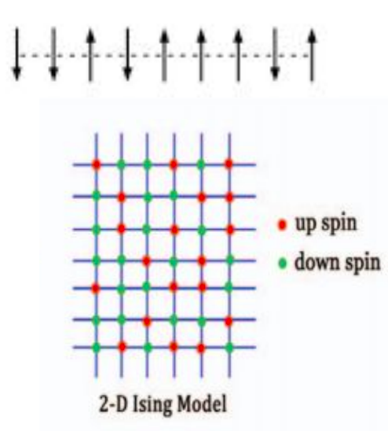
Monte Carlo Methods in Python
Monte Carlo Methods in Python
          Demo: Ising Model and the Metropolis Algorithm
Cannot get the exact partition function numerically
Too many combinations of spins for a large size

Slide 78
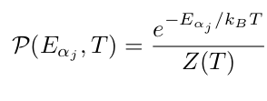
Monte Carlo Methods in Python
Monte Carlo Methods in Python
          Demo: Ising Model and the Metropolis Algorithm
The Metropolis Algorithm is a technique for computing the Monte Carlo calculation
of averages that accurately simulates the fluctuations occurring during thermal equi-
librium.
It changes individual spins randomly, but weights the changes such that on the average
a Boltzmann distribution results (Canonical Ensemble)

Slide 79
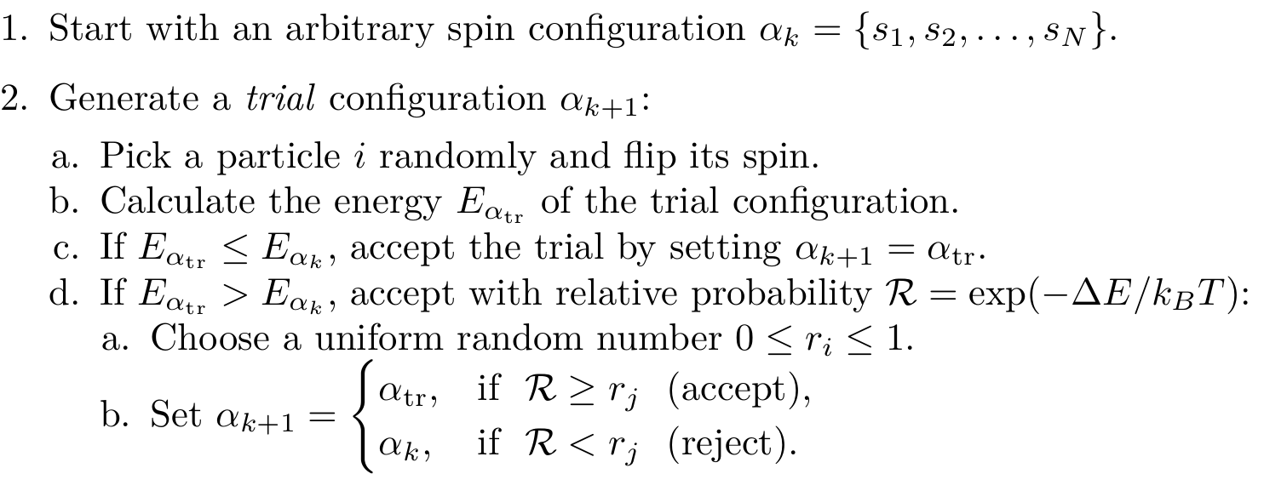
Monte Carlo Methods in Python
Monte Carlo Methods in Python
          Demo: Ising Model and the Metropolis Algorithm

Slide 80
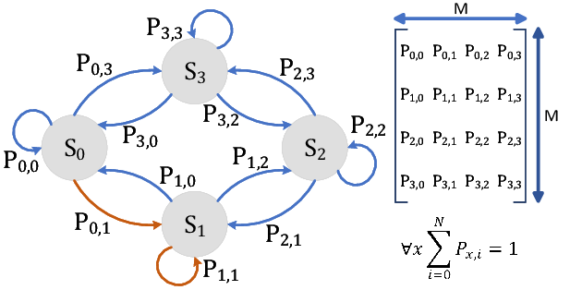
Monte Carlo Methods in Python
Monte Carlo Methods in Python
          Demo: Ising Model and the Metropolis Algorithm
Will this equilibriate into a Canonical Ensemble?
Markov Chain:
Each AB transition depends only on
Detailed Balance:
Happens when all transition probs balance out

Slide 81
Monte Carlo Methods in Python
Monte Carlo Methods in Python
          Demo: Ising Model and the Metropolis Algorithm
Will this equilibriate into a Canonical Ensemble?
Detailed Balance:
Happens when all transition probs balance out

Slide 82
Monte Carlo Methods in Python
Monte Carlo Methods in Python
          Demo: Ising Model and the Metropolis Algorithm
Will this equilibriate into a Canonical Ensemble?
Detailed Balance:
Happens when all transition probs balance out

Slide 83
Monte Carlo Methods in Python
Monte Carlo Methods in Python
          Demo: Ising Model and the Metropolis Algorithm
Will this equilibriate into a Canonical Ensemble?
Detailed Balance:
Happens when all transition probs balance out

Slide 84
Monte Carlo Methods in Python
Monte Carlo Methods in Python
          Demo: Ising Model and the Metropolis Algorithm
Videos: 2D without field

Slide 85
Monte Carlo Methods in Python
Monte Carlo Methods in Python
          Demo: Ising Model and the Metropolis Algorithm
Videos: 2D without field

Slide 86
Partial Differential Equations
Partial Differential Equations
PDE: Imposes relations between the various partial derivatives of a multivariable function.
Solve for u(x,y,z, ...), subject to Boundary Conditions

Slide 87
Partial Differential Equations
Partial Differential Equations
PDE: Imposes relations between the various partial derivatives of a multivariable function.
Types of Linear PDE:
Parabolic:
Hyperbolic:
Elliptic:

Slide 88
Partial Differential Equations
Partial Differential Equations
PDE: Imposes relations between the various partial derivatives of a multivariable function.
Types of Boundary Conditions in PDE’s:
Dirichlet:
Neumann:
Cauchy: Dirichlet + Neumann

Slide 89
Partial Differential Equations
Partial Differential Equations
PDE: Imposes relations between the various partial derivatives of a multivariable function.
Numerical Methods for PDE’s
Finite Difference Methods (FDM):
Approximate the solutions to using finite difference equations to approximate derivatives. Reduce the ODE to a Linear Algebra Equation
Finite Volume Methods
(FVM):
Divide the domain into subdomains and use Gauss/Stoke’s theorem to reduce PDE to integral equations, solved using quadratures in alegebraic form
Finite Element Methods (FEM):
Divide the domain intosubdomains and use Gauss/Stoke’s theorem to reduce PDE to integral equations, weighed by a choice of basis states, discretize them solve as linear eqns.

Slide 90
Partial Differential Equations
Partial Differential Equations
PDE: Imposes relations between the various partial derivatives of a multivariable function.
Numerical Methods for PDE’s: Unline ODE’s there are no general methods
Numerical Solutions to PDEs are more complex than ODEs
Each type of PDE requires its own algorithm
Algorithms are also dependent on the boundary conditions

Slide 91
Partial Differential Equations
Finite Difference Methods: 2D Poisson Equation (Dirichlet)
Divide the 2D Domain into a discrete lattice.
Replace the partial derivatives by finite difference approximations evaluated at the lattice
points
Reduce the PDE to a system of linear algebra equations, with boundary conditions added as extra equations, then solve them (similar to the ‘matrix method’ for ODE’s)
Alternatively, reduce the PDE to a system of iterative equations, then update the domain
values, starting from the boundary values.

Slide 92
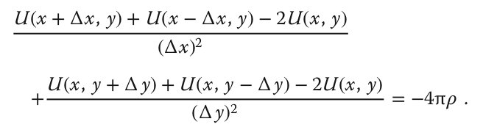


Partial Differential Equations
Finite Difference Methods: 2D Poisson Equation (Dirichlet)
Three point difference formula!
Lattice Point
Boundary Values (given)
Nearest neighbours

Slide 93
Partial Differential Equations
Finite Difference Methods: 2D Poisson Equation (Dirichlet)
Three point difference formula!

Slide 94
Partial Differential Equations
Finite Difference Methods: 2D Poisson Equation (Dirichlet)
Can solve these equations numerically using
linear algebra methods
But, there is a better way (less memory)
Jacobi Update:
A proper solution will be the average of the
nearest neighbors plus a contribution from
the charge density
So, start with an initial guess for the potential
and improve it by striding through the lattice
taking the average over nearest neighbors
Keep doing this until solution converges

Slide 95

Partial Differential Equations
Finite Difference Methods: 2D Poisson Equation (Dirichlet)
Can solve these equations numerically using
linear algebra methods
But, there is a better way (less memory)
Gauss-Seidel Update:
A proper solution will be the average of the
nearest neighbors plus a contribution from
the charge density
So, start with an initial guess for the potential
and improve it by striding through the lattice
taking the average over nearest neighbors in real time.
Keep doing this until solution converges

Slide 96

Partial Differential Equations
Finite Difference Methods: 2D Poisson Equation (Dirichlet)
import numpy as np
import matplotlib.pyplot as plt
plt.rcParams['figure.figsize'] = (12,8)
plt.rcParams['font.size'] = 20
Nmax = 100
V_wire = 100
V = np.zeros((Nmax, Nmax))
V[:,0] = V_wire # Line at V_wire volts
print ("Running the Jacobi Update Solver ...")
def jacobi_update(V, Niter=70):
Nmax = V.shape[0]
for iter in range(Niter):
for i in range(1, Nmax-2):
for j in range(1,Nmax-2):
V[i,j] = 0.25*(V[i+1,j]+V[i-1,j]+V[i,j+1]+V[i,j-1])
return V
V = jacobi_update(V)
x = np.arange(0, Nmax-1, 2); y = np.arange(0, 50, 2)
X, Y = np.meshgrid(x,y)
def functz(V): # V(x, y)
z = V[X,Y]
return z
Z = functz(V)
ax = plt.figure().add_subplot(projection='3d')
ax.plot_wireframe(X, Y, Z, color = 'r') # Red wireframe
ax.set_xlabel('X')
ax.set_ylabel('Y')
ax.set_zlabel('Potential')
ax.view_init(30, 140) #Perspective
plt.show() # Show fig
Wire with fixed voltage
Edges are grounded

Slide 97

Partial Differential Equations
Finite Difference Methods: 2D Poisson Equation (Dirichlet)
import numpy as np
import matplotlib.pyplot as plt
plt.rcParams['figure.figsize'] = (12,8)
plt.rcParams['font.size'] = 20
Nmax = 100
V_wire = 100
V = np.zeros((Nmax, Nmax))
V[:,0] = V_wire # Line at V_wire volts
print ("Running the Jacobi Update Solver ...")
def jacobi_update(V, Niter=70):
Nmax = V.shape[0]
for iter in range(Niter):
for i in range(1, Nmax-2):
for j in range(1,Nmax-2):
V[i,j] = 0.25*(V[i+1,j]+V[i-1,j]+V[i,j+1]+V[i,j-1])
return V
V = jacobi_update(V)
x = np.arange(0, Nmax-1, 2); y = np.arange(0, 50, 2)
X, Y = np.meshgrid(x,y)
def functz(V): # V(x, y)
z = V[X,Y]
return z
Z = functz(V)
ax = plt.figure().add_subplot(projection='3d')
ax.plot_wireframe(X, Y, Z, color = 'r') # Red wireframe
ax.set_xlabel('X')
ax.set_ylabel('Y')
ax.set_zlabel('Potential')
ax.view_init(30, 140) #Perspective
plt.show() # Show fig
See Jupyter notebook: “Special_Topics.ipynb”

Slide 98



Partial Differential Equations
Finite Difference Methods: 1D Wave Equation (Dirichlet)
Plucked String
Time-Stepping (Leapfrog Method):
Divide the space-time domain into a discrete lattice
Replace the partial derivatives by finite difference approximations evaluated at the lattice
points
Reduce the PDE to a system of linear algebra equations, with initial/boundary conditions added as extra equations
Jacobi-update one time-step at a time, updating space-steps from the previous time
Repeat for all times

Slide 99



Partial Differential Equations
Finite Difference Methods: 1D Wave Equation (Dirichlet)
Plucked String
Time-Stepping (Leapfrog Method):
Contains three time values:
j + 1 = the future,
j = the present,
j − 1 = the past
Predict the future solution from the present and past solutions

Slide 100

Partial Differential Equations
Finite Difference Methods: 1D Wave Equation (Dirichlet)
Plucked String
Time-Stepping (Leapfrog Method):

Slide 101

Partial Differential Equations
Finite Difference Methods: 1D Wave Equation (Dirichlet)
Plucked String
Time-Stepping (Leapfrog Method):
Von-Neumann Stability Analysis
Ensures that the eigenfuncs don’t blow up
Courant condition
Solution gets better with smaller time steps
But gets worse for smaller space steps

Slide 102
Partial Differential Equations
Finite Difference Methods: 1D Wave Equation (Dirichlet)
Plucked String
Time-Stepping (Leapfrog Method):
Homework: See if you can change
the code to pluck the string in the
middle
See Jupyter notebook: “Special_Topics.ipynb”

Slide 103

Partial Differential Equations
Finite Difference Methods: 1D Wave Equation (Dirichlet)
Time-Stepping (Leapfrog Method):
Homework: See if you can change
the code to pluck the string in the
middle
See Jupyter notebook: “Special_Topics.ipynb”

Slide 104
Partial Differential Equations
Finite Element Methods: 2D Poisson Equation (Dirichlet)
Reduce the PDE to an integral equation using Gauss/Stoke’s theorem on the boundary
Divide the domain into a discrete mesh
Choose basis functions, usually polynomials, corresponding spatially to each mesh element
Write the RHS as a (known) linear superposition of these basis functions, and the LHS as a superposition with unknown coefficients
Substitute into the Integral equation and reduce it to a system of linear equations
Solve using BLAS or whatever.

Slide 105
Partial Differential Equations
Finite Element Methods: 2D Poisson Equation (Dirichlet)
Reduce the PDE to an integral equation using Gauss/Stoke’s theorem on the boundary
Divide the domain into a discrete mesh
Choose basis functions, usually polynomials, corresponding spatially to each mesh element
Write the RHS as a (known) linear superposition of these basis functions, and the LHS as a superposition with unknown coefficients
Substitute into the Integral equation and reduce it to a system of linear equations
Solve using BLAS or whatever.

Slide 106
Partial Differential Equations
Finite Element Methods: 2D Poisson Equation (Dirichlet)
DO!

