Slide 1

SOFTWARE ENGINEERING PROJECT
Deliverable 4 · Sprint 3 · Final Presentation
Group Members
M Haris Fayyaz
23L-0767
Moeez Ijaz
23L-0750
CineSense
Faiqa Waseem
23L-0633
Intelligent Movie Recommendation System
Section:
BCS-6C
Submitted to:
Ma'am Ansa Liaqat
Date:
May 2026
01

Slide 2
Project Introduction
What is CineSense?
CineSense
Sprint 1
User Management
A full-stack, AI-powered web application that delivers personalized movie recommendations using a Hybrid Machine Learning engine (Content-Based Filtering + Collaborative Filtering).
Users can search the MovieLens dataset, rate movies, build watchlists, and receive ranked suggestions tailored to their taste.
Signup · Login · Profile · Password Reset
Sprint 2
Core Movie Features
Search · Details · Rating · Dashboard · Watchlist
Tech Stack
React.js
Node.js / Express
Python / Flask
Sprint 3
AI/ML Engine
Firebase
MovieLens Dataset
Hybrid Recs · CBF Similar · Feedback Loop · BVA
02

Slide 3
Advantages & Constraints
✔ Advantages
✗ Constraints
Hybrid Recommendations
No Real-Time Streaming
Combines CBF + CF for better accuracy than single-method engines
CineSense recommends movies only — no video playback or streaming integration
Cold-Start Handling
Movies Only
Falls back to trending movies for new users with < 3 ratings
Scope limited to movies; TV shows, music, and podcasts excluded
Real-Time Feedback Loop
Firebase Dependency
User thumbs-up/down continuously re-ranks future recommendations
Full reliance on Firebase for auth and data; outages affect the whole system
Firebase BaaS
Dataset Freshness
Scalable auth, storage, and Firestore — no server infrastructure to manage
MovieLens dataset is static; new movie releases are not automatically included
MovieLens Dataset
Recommendation Latency
Rich historical rating data enables meaningful ML from day one
First-time ML computation can take up to 3 seconds for users with many ratings
03

Slide 4
Non-Functional Requirements
NFR-01 · NFR-02
NFR-01 · Performance
NFR-02 · Security
What:
What:
Authentication & data operations must complete within defined time thresholds.
All user data and API access must be protected through layered security mechanisms.
Requirements:
Requirements:
Signup & Login (Firebase Auth): complete within 3 seconds under normal network conditions
Firestore profile reads: complete within 2 seconds on page load
AI recommendation endpoint (POST /recommend): return results within 3 seconds from cache; first computation within 8 seconds
Lighthouse performance score for dashboard: ≥ 80
Passwords managed exclusively via Firebase Authentication — never stored in plaintext
Firestore security rules must restrict each collection to its owning user (uid-scoped reads/writes)
All backend API routes that modify data (ratings, watchlist, dashboard, feedback) must require a valid Firebase ID token
Unauthenticated users must not access any protected route — enforced both client-side (React Router guards) and server-side (auth middleware)
Rationale: Users abandon slow apps. These thresholds ensure CineSense remains responsive during the two most critical interactions — authentication and recommendation delivery.
Rationale: CineSense stores personal rating history and preferences. Weak security could expose sensitive user behaviour data and allow unauthorised modifications to recommendations.
04

Slide 5
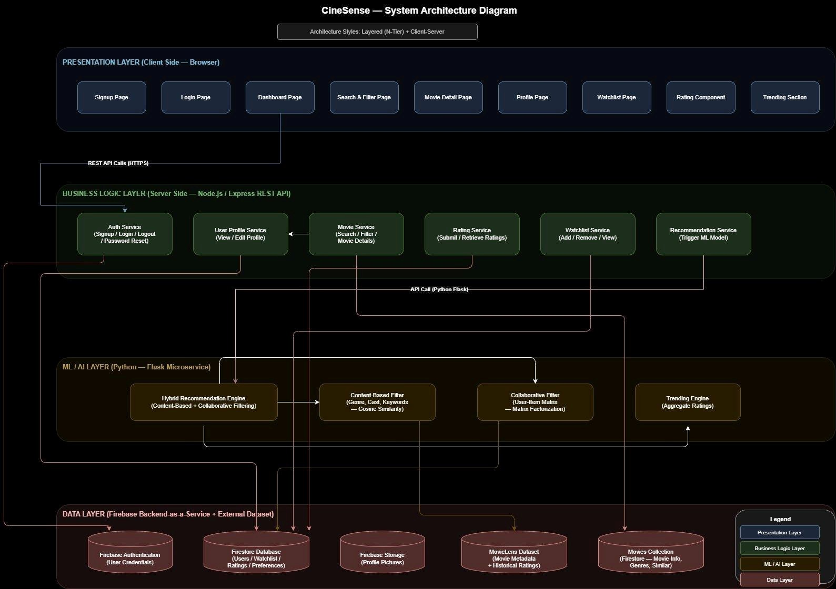
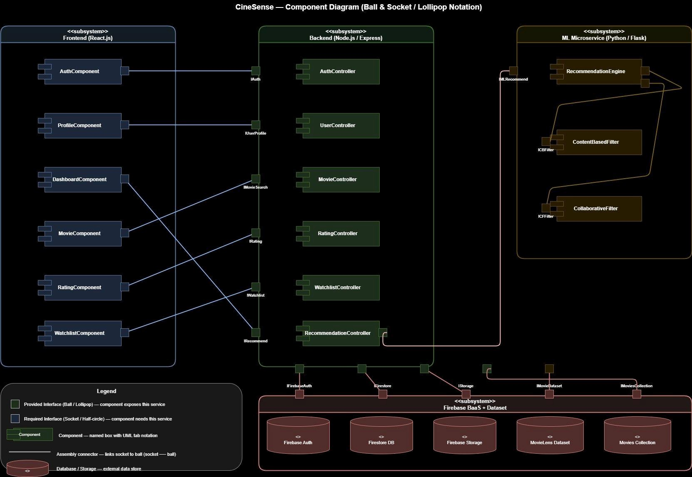
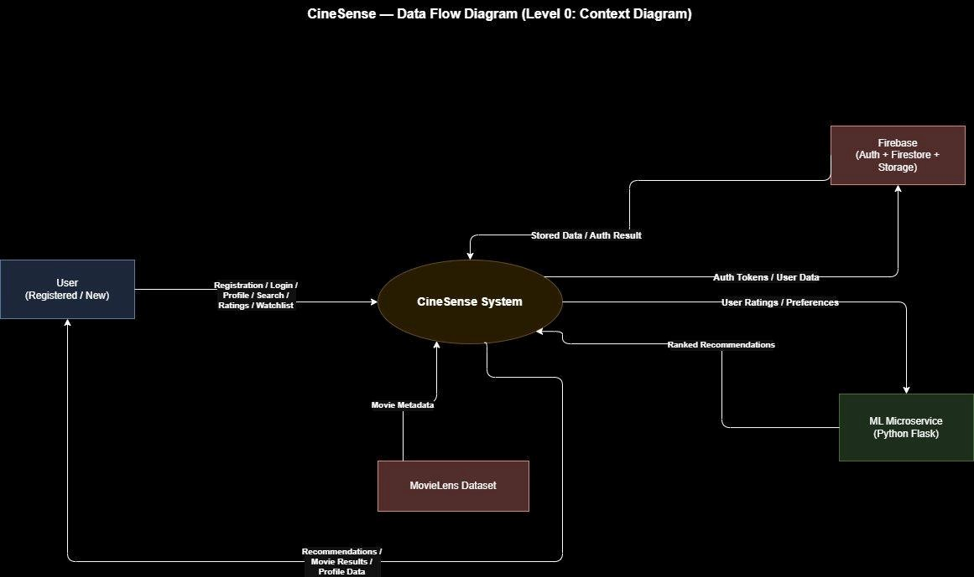
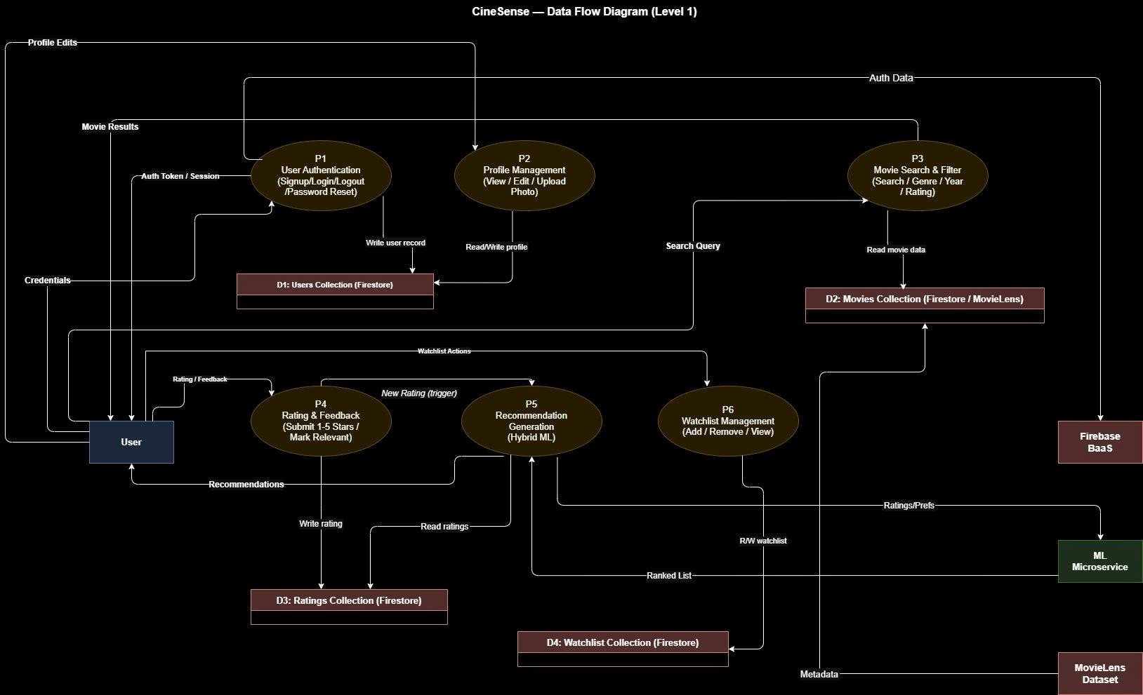
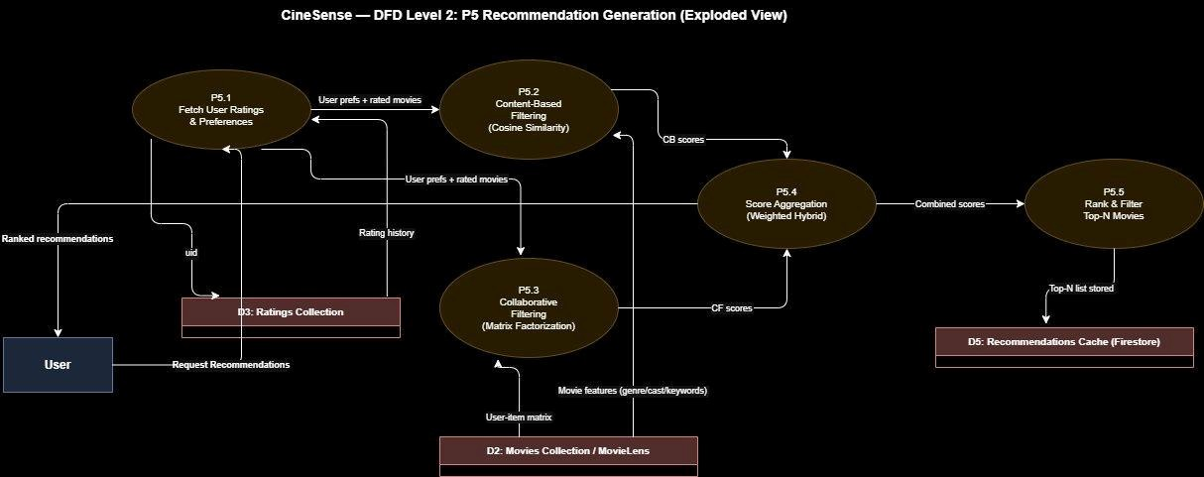
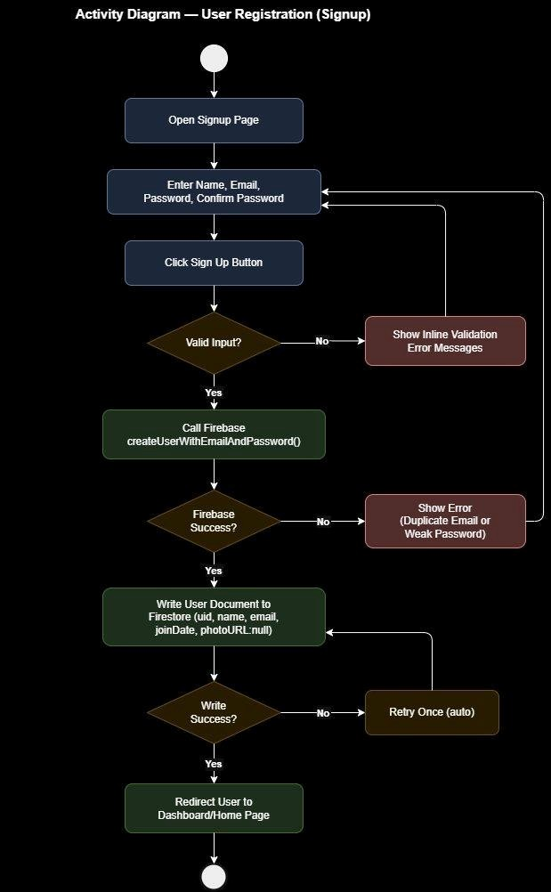
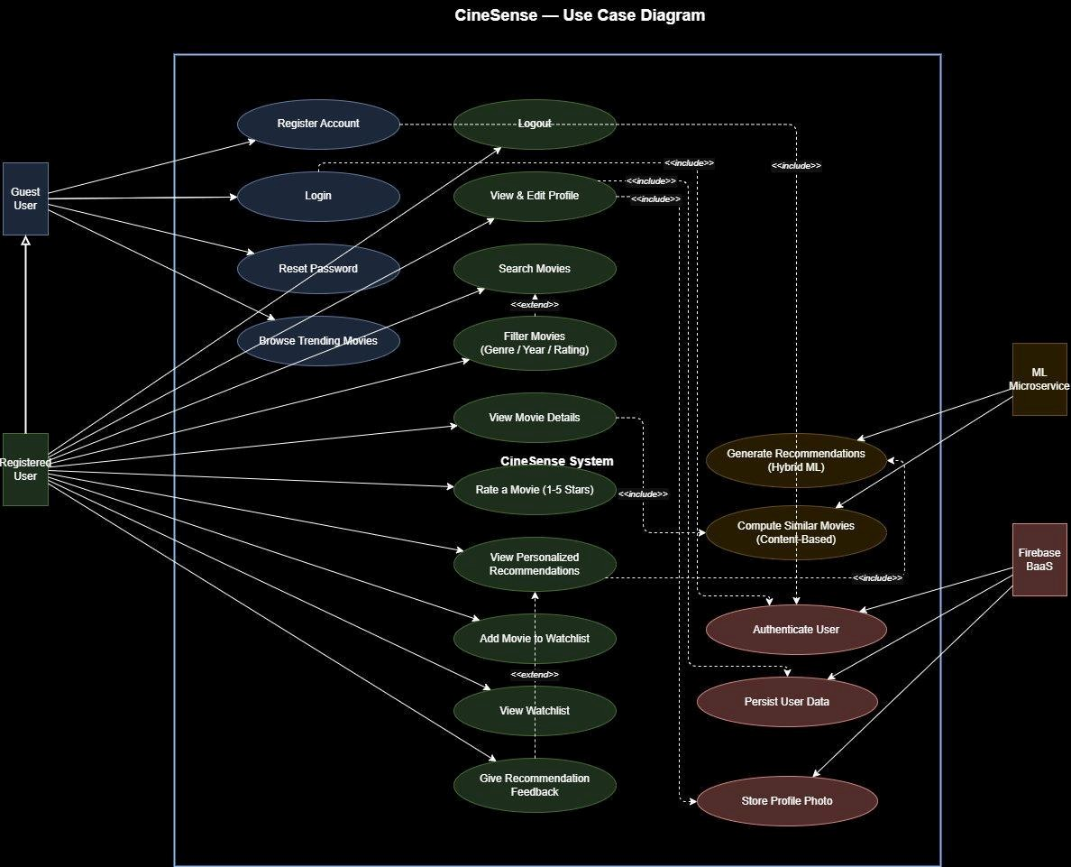
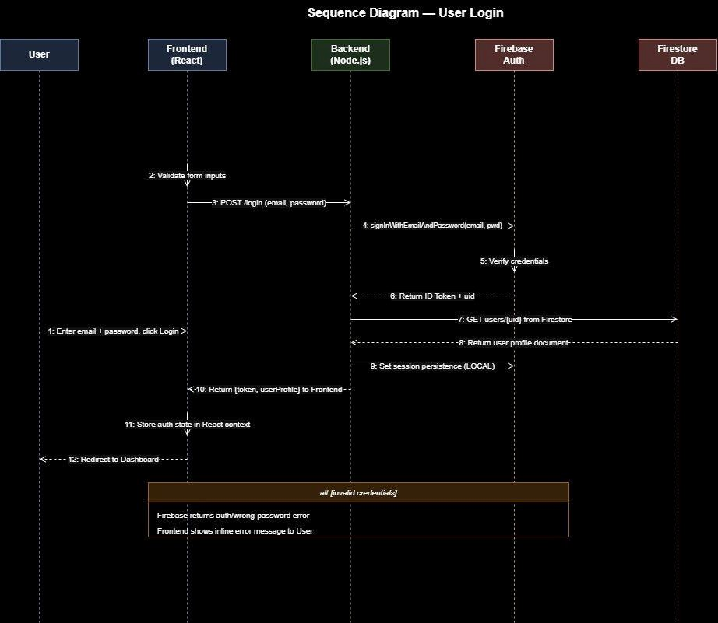
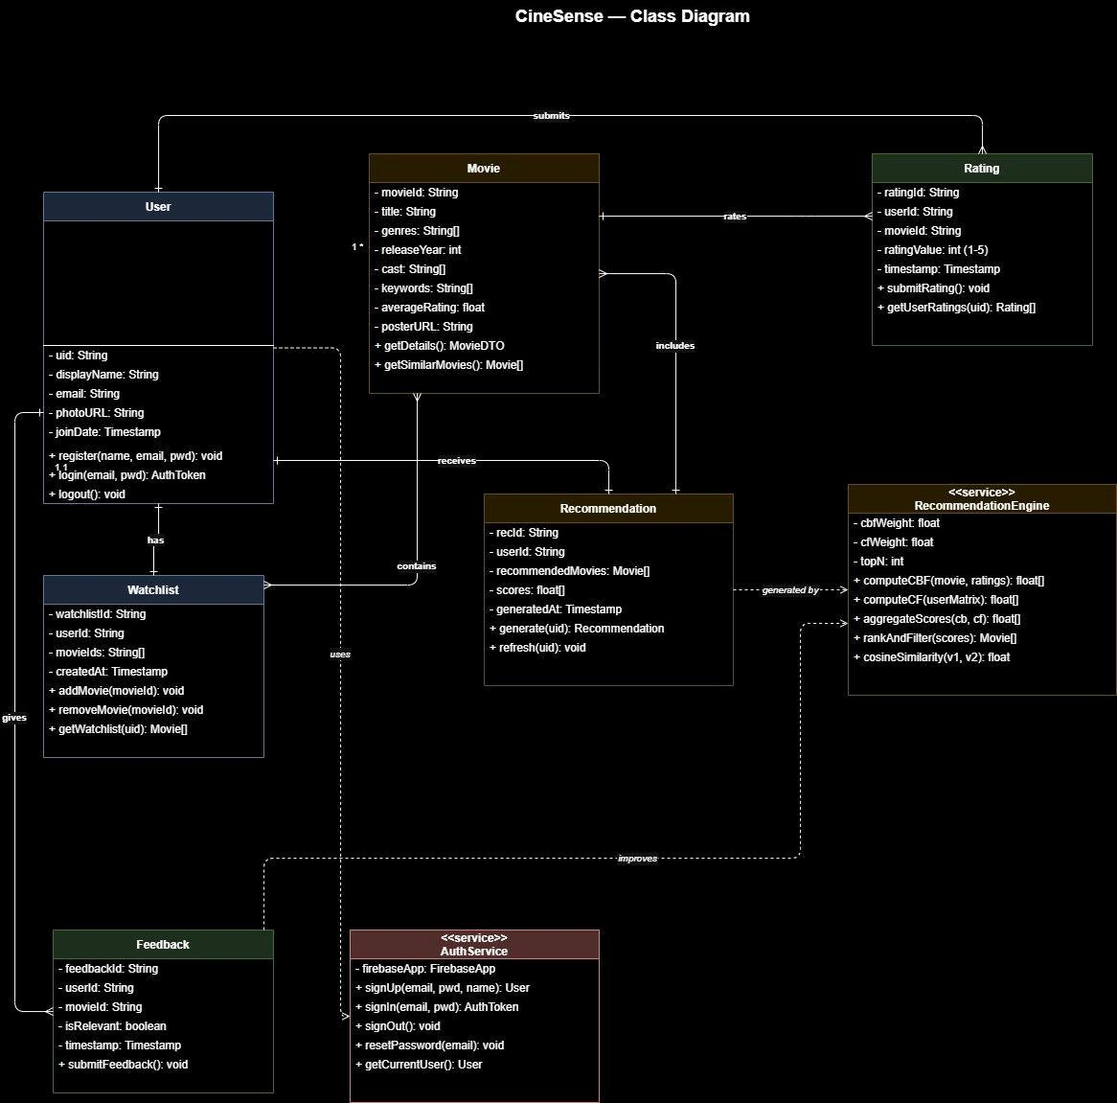
System Design
7 diagram types covering the full CineSense system
Architecture Diagram
Component Diagram
DFD Level 0
Layered N-Tier + Client-Server hybrid
Ball & socket (lollipop) UML notation
Context diagram — 4 external entities
DFD Level 1
DFD Level 2
Activity Diagrams (3)
6 system processes + 4 Firestore stores
P5 Recommendation engine exploded
Signup · Rating trigger · Dashboard load
Use Case Diagram
Sequence Diagrams (3)
Class Diagram
4 actors · <<include>> & <<extend>>
Login · Rate movie · Recommendations
8 classes with full UML relationships
05

Slide 6
Architecture Diagram
Layered N-Tier + Client-Server hybrid · Figure 1 of 13

Slide 7
Component Diagram
Ball & socket (lollipop) UML notation · Figure 2 of 13

Slide 8
DFD Level 0 — Context Diagram
4 external entities: User, Firebase, ML Microservice, MovieLens · Figure 3 of 13

Slide 9
DFD Level 1 — System Processes
6 processes: Auth, Profile, Search, Rating, Recommendations, Watchlist · Figure 4 of 13

Slide 10
DFD Level 2 — Recommendation Engine
P5 exploded: Fetch Ratings → CBF → CF → Score Aggregation → Top-N · Figure 5 of 13

Slide 11
Activity Diagram — User Registration
Signup flow with Firebase Auth · Figure 6 of 13

Slide 12
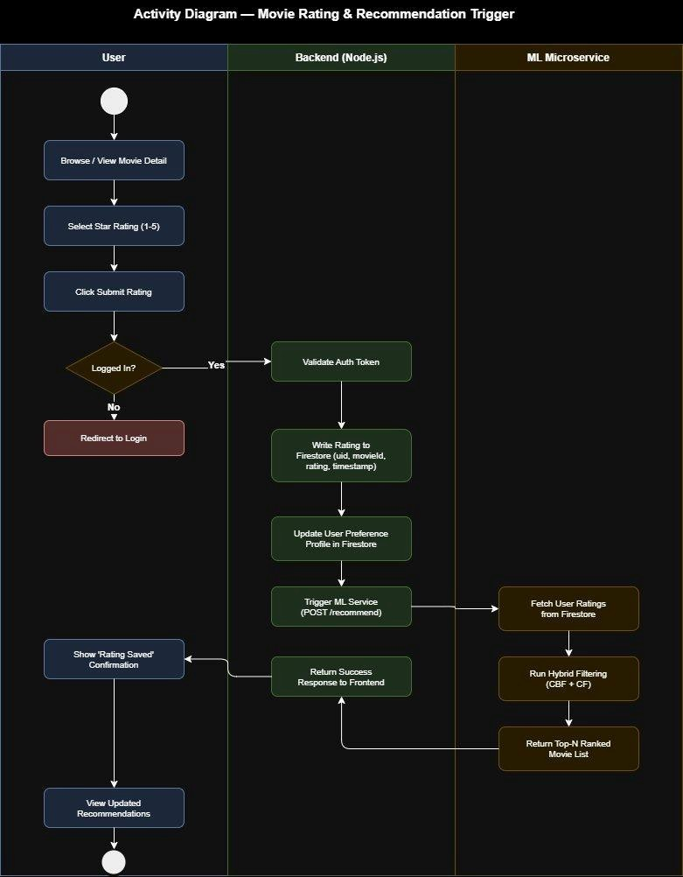
Activity Diagram — Movie Rating & Recommendation Trigger
Swimlane: User → Backend → ML Microservice · Figure 7 of 13

Slide 13
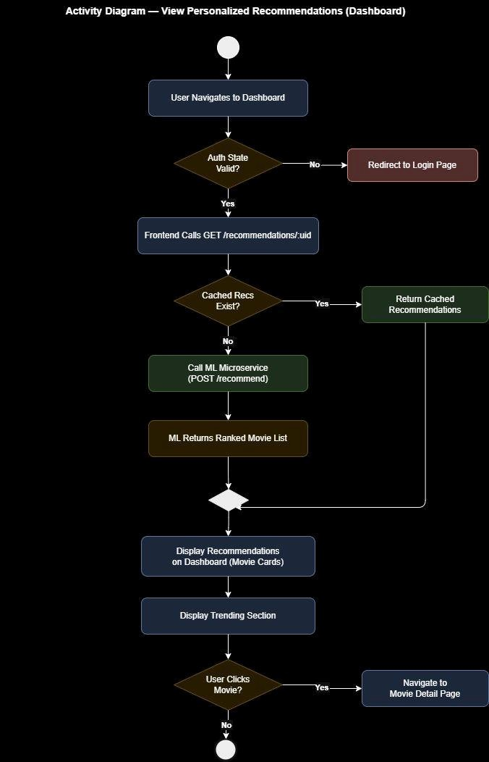
Activity Diagram — View Personalized Recommendations
Dashboard load with cache-first strategy · Figure 8 of 13

Slide 14
Use Case Diagram
4 actors · <<include>> & <<extend>> relationships · Figure 9 of 13

Slide 15
Sequence Diagram — User Login
Firebase Auth flow with session persistence · Figure 10 of 13

Slide 16
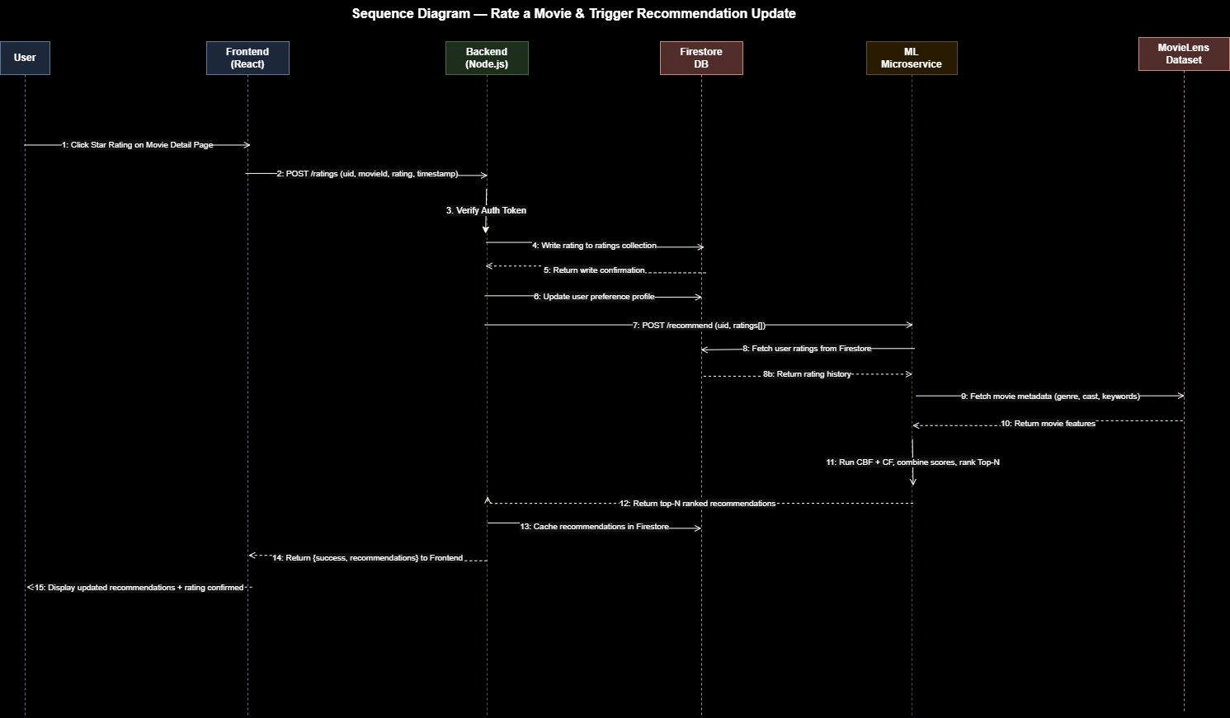
Sequence Diagram — Rate a Movie & Recommendation Update
Rating write → ML trigger → cache update · Figure 11 of 13

Slide 17
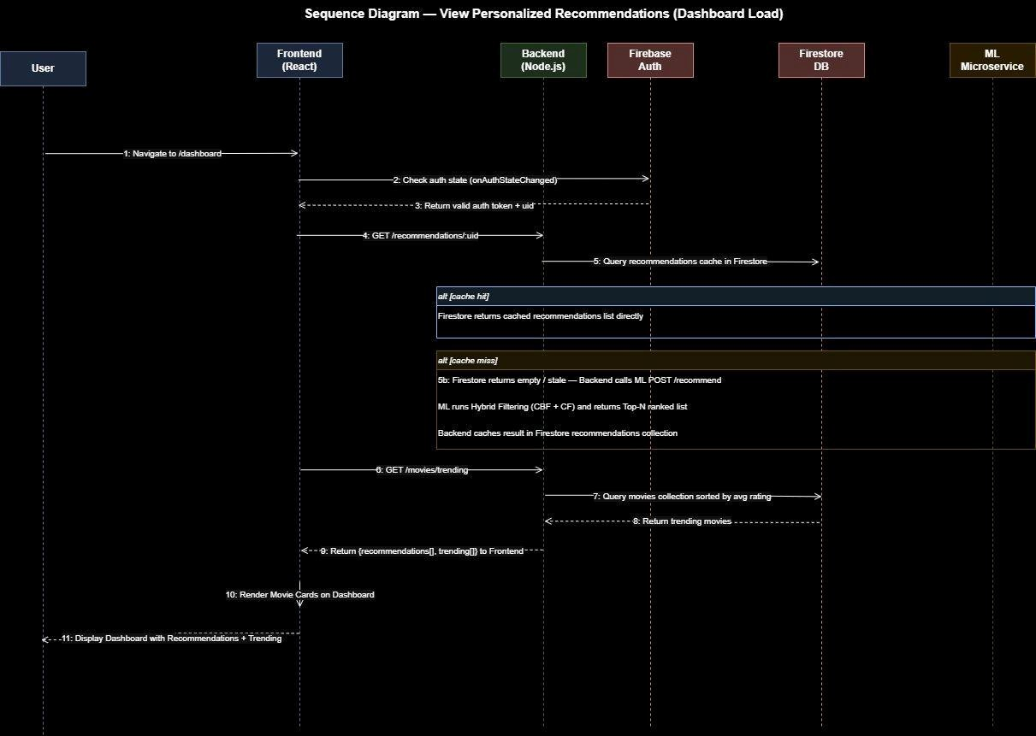
Sequence Diagram — Dashboard Load
Cache-first recommendation retrieval · Figure 12 of 13

Slide 18
Class Diagram
8 classes with full UML relationships · Figure 13 of 13

Slide 19
Architecture
Layered (N-Tier) + Client-Server hybrid
ARCHITECTURE PATTERN
PRESENTATION LAYER
Architecture Styles
React.js SPA
UI components · React Router · React Context · Lazy loading · Responsive design
Layered (N-Tier)
Each layer only communicates with the one directly below — enforces strict separation of concerns
BUSINESS LOGIC LAYER
Node.js / Express REST API
Client-Server
Auth middleware · Request validation · Firestore orchestration · ML trigger
Browser communicates with Node.js backend exclusively via REST APIs over HTTPS
ML / AI LAYER
Rationale
Python / Flask Microservice
Content-Based Filtering (CBF) · Collaborative Filtering (CF) · POST /recommend · Cold-start fallback
The Layered style allows the ML microservice to be developed, tested, and scaled independently from the React frontend.
The Client-Server style defines clean API boundaries, enabling horizontal scaling and easier debugging across all three sprints.
DATA LAYER
Firebase BaaS + MovieLens Dataset
Firebase Auth · Firestore (users, movies, ratings, watchlist, dashboard, feedback, recommendations) · Firebase Storage
06

Slide 20
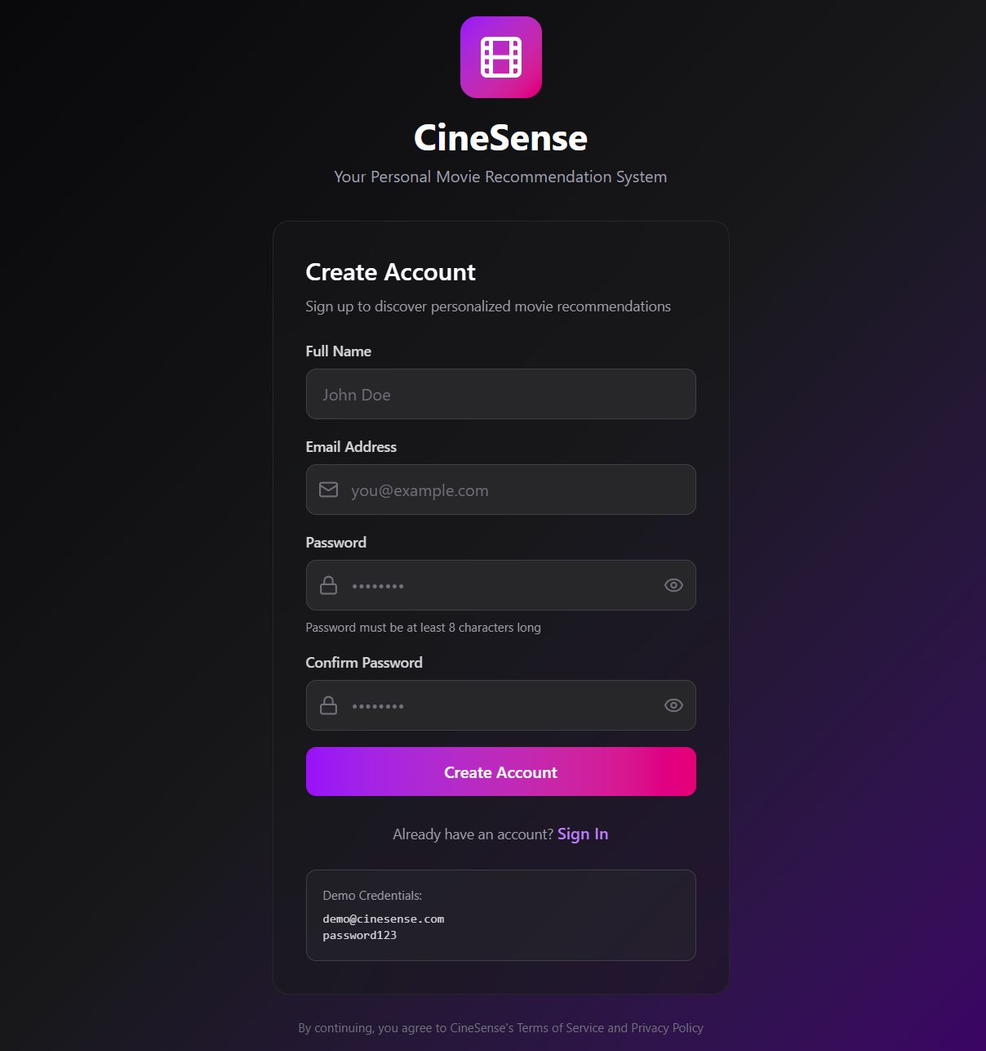
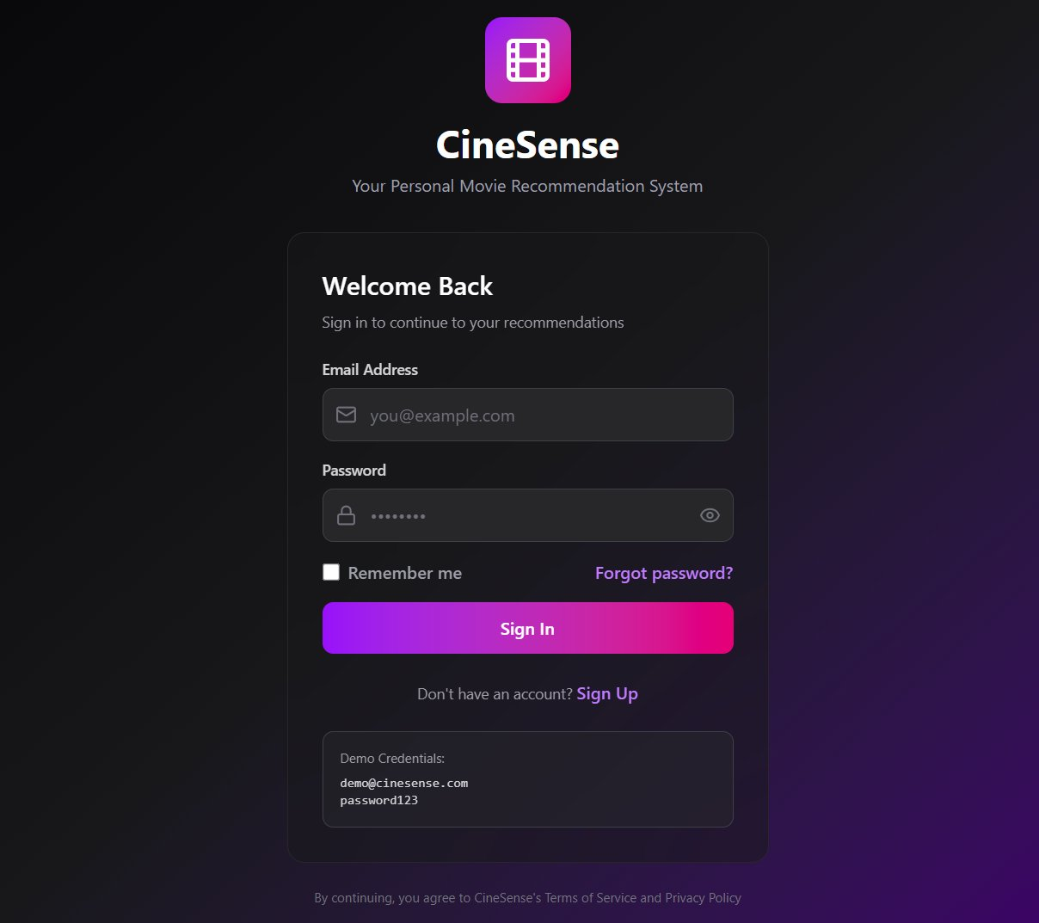
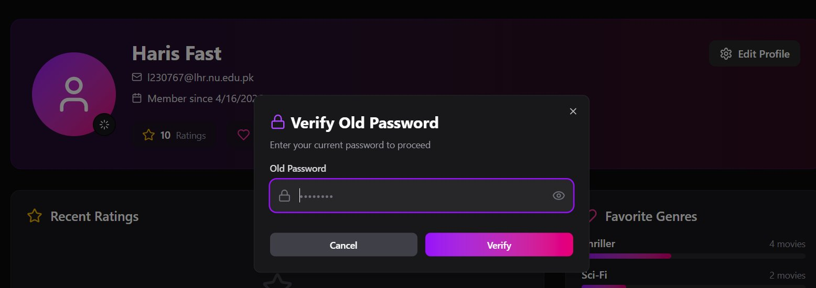
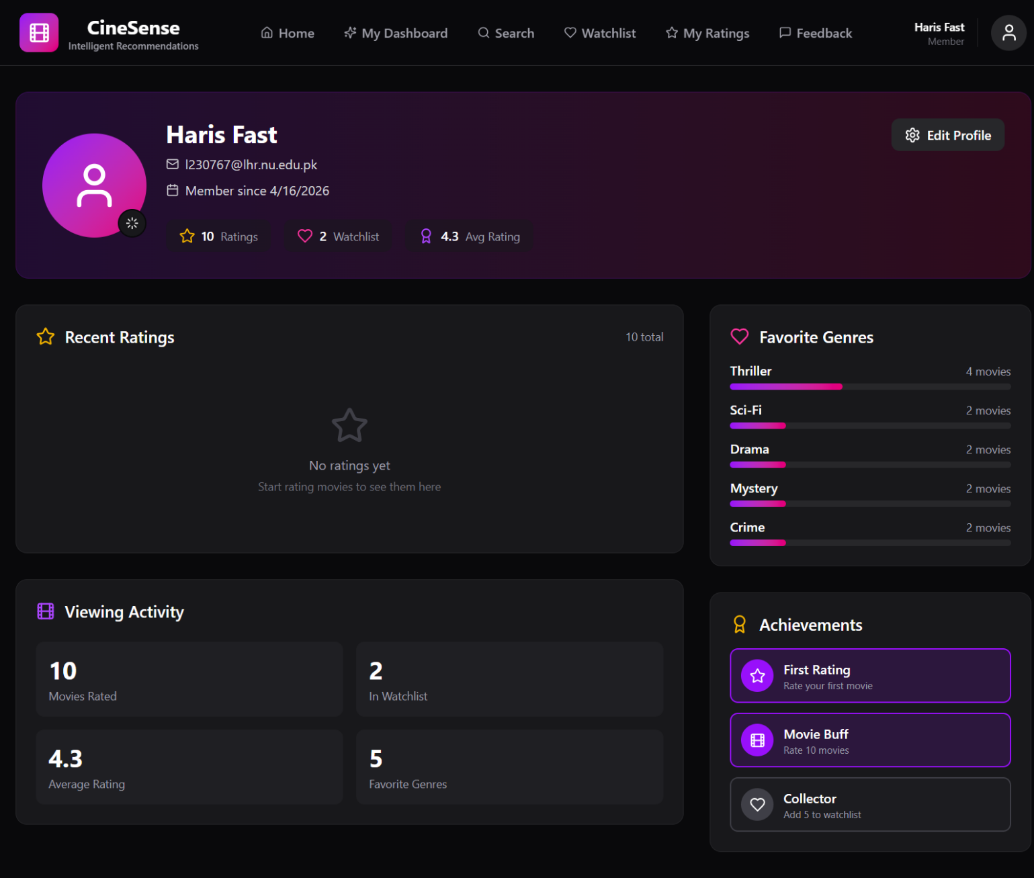
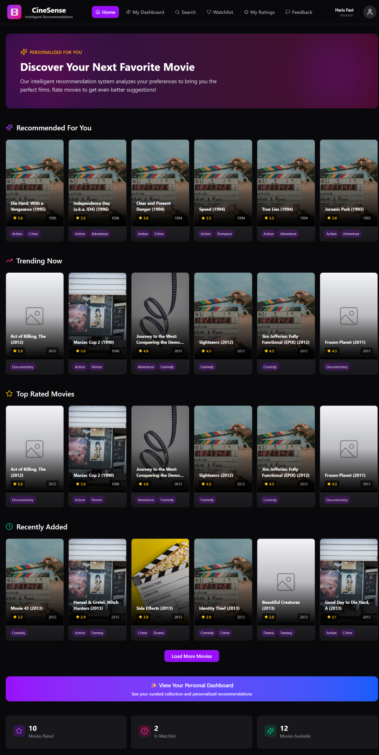
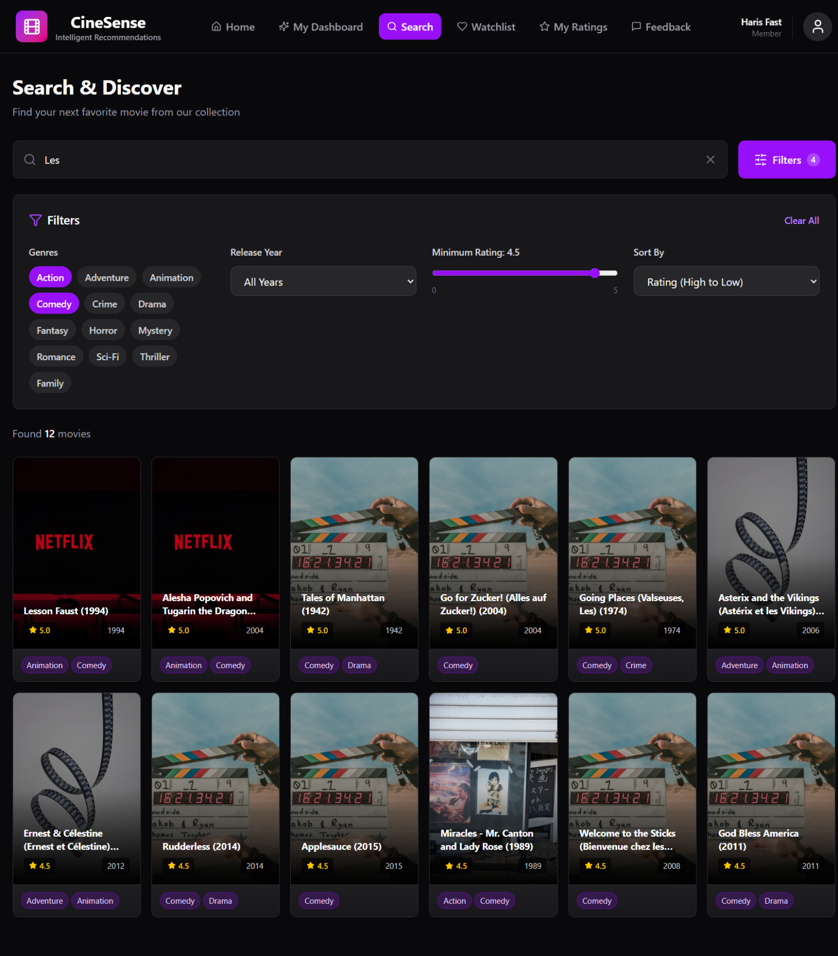
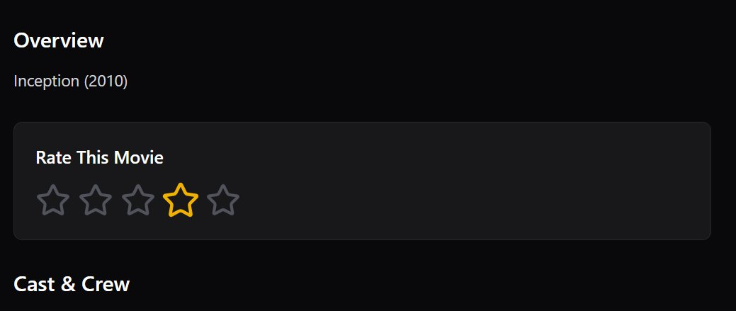
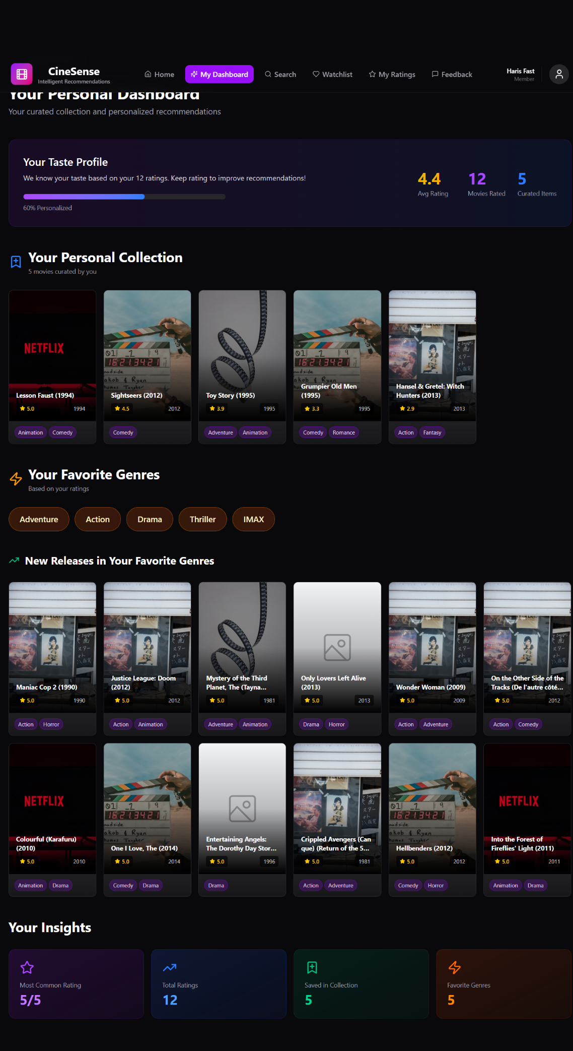
Implementation Screenshots
Sprint 1 & Sprint 2 — Authentication & Core Features
[ Screenshot ]
S1
[ Screenshot ]
S1
[ Screenshot ]
S1
[ Screenshot ]
S2
Signup Page
Login Page
User Profile
Movie Search & Filters
Firebase Auth · Firestore profile write
Persistent session · Forgot Password link
View/Edit name · Profile pic · Reset password
Genre · Year · Rating filters on Firestore
[ Screenshot ]
S2
[ Screenshot ]
S2
[ Screenshot ]
S2
[ Screenshot ]
S2
Movie Details Page
Personal Dashboard
Watchlist Page
Feedback Center
Cast · Overview · Rate · Add to Watchlist
Manually curated movie collection
Add · Remove · Sort movies
Thumbs-up/down stored for ML re-ranking
07

Slide 21
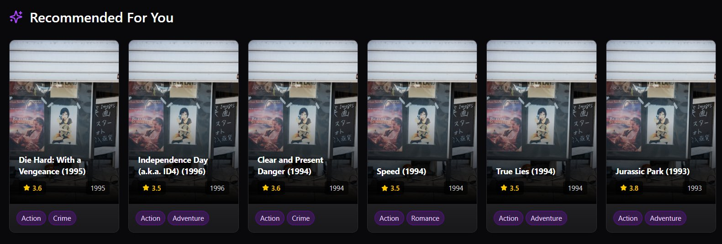
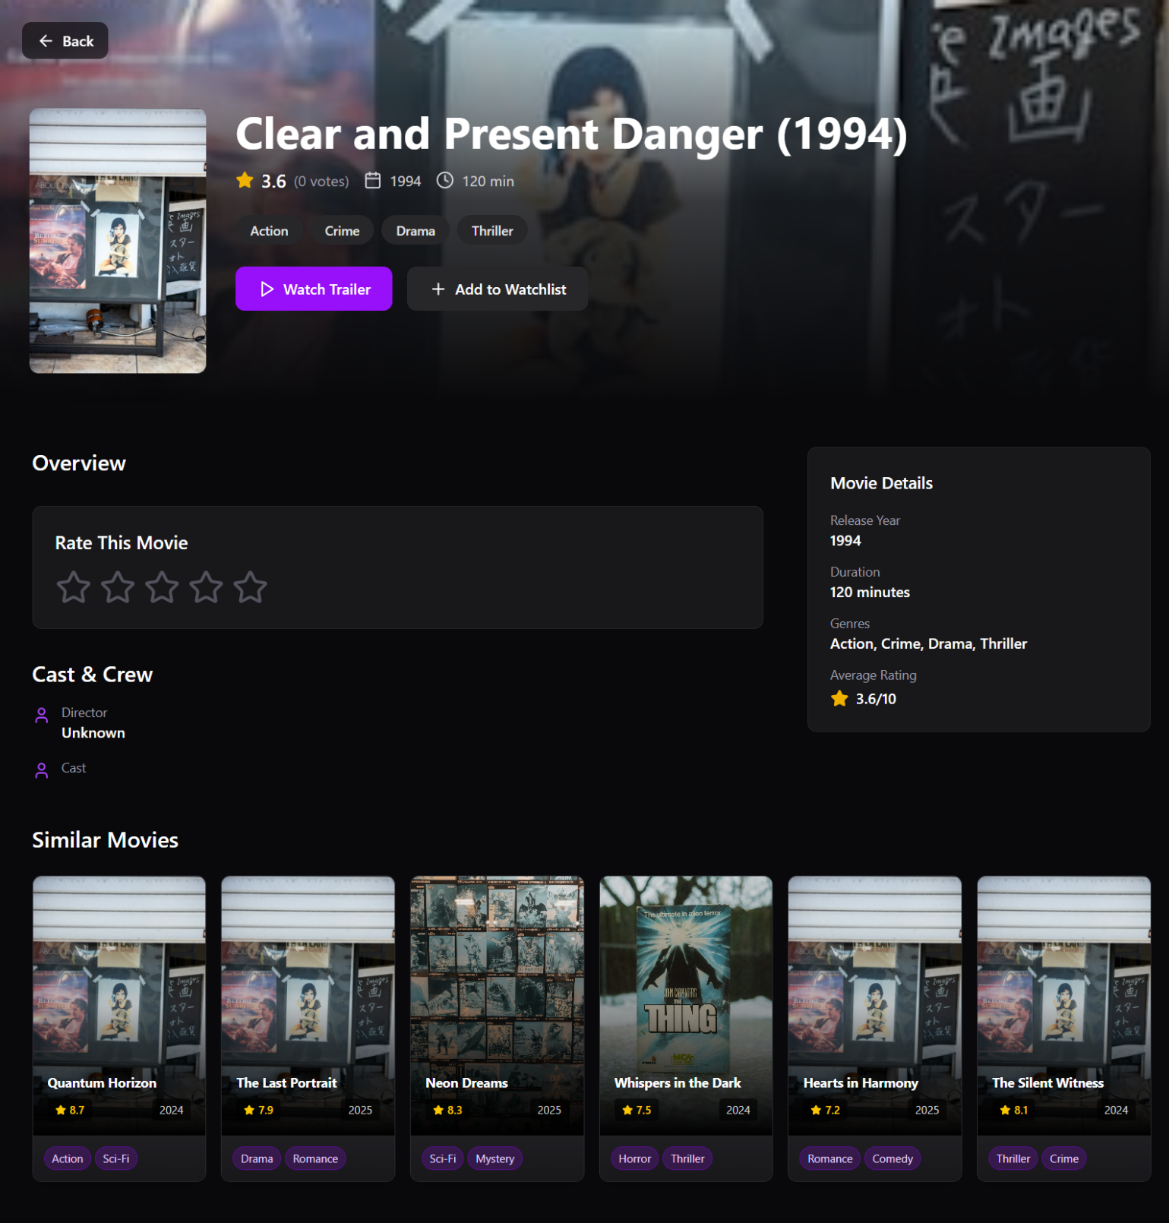
Implementation — AI/ML Features
Sprint 3 · The core deliverable
[ Screenshot: Recommended For You — AI Dashboard ]
[ Screenshot: Similar Movies — Content-Based ]
Sprint 3
Sprint 3
AI Recommendations (US-14)
Similar Movies via CBF (US-10)
Hybrid CBF + CF engine · Top-N ranked · Firestore cache · Cold-start fallback
TF-IDF cosine similarity on genre & keywords · Min 5 results · 2s load target
08

Slide 22
Signup / Registration Page
Sprint 1 · US-01 · Firebase Auth + Firestore profile write

Slide 23
Login Page
Sprint 1 · US-02 · Persistent session + Forgot Password link

Slide 24
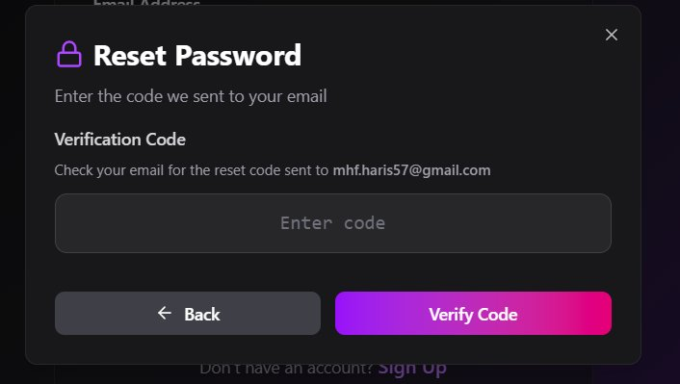
Password Reset
Sprint 1 · US-05 · Email-based reset via Firebase Auth

Slide 25
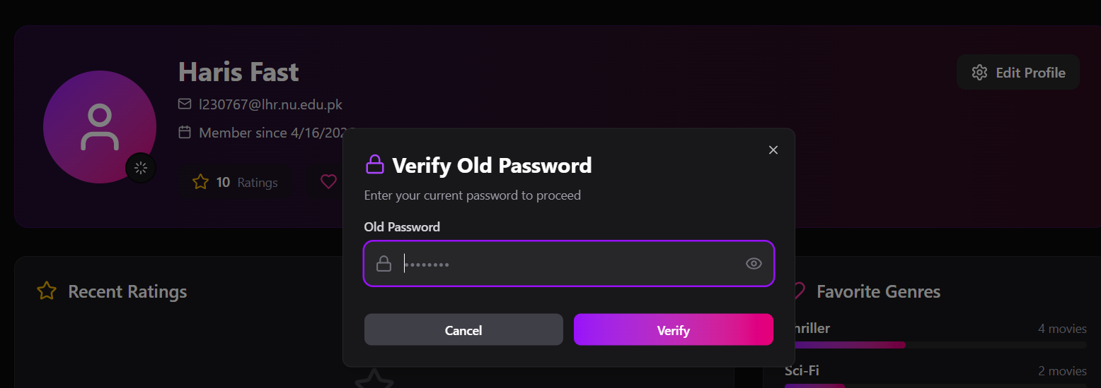

Slide 26
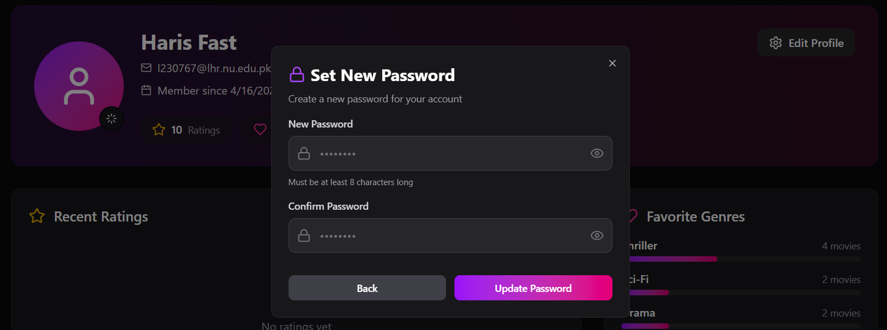

Slide 27

User Profile
Sprint 1 · US-04 · View/Edit name · Profile pic · Reset password

Slide 28

Home Dashboard
Sprint 2 · US-09 · Personalized movie collection view

Slide 29
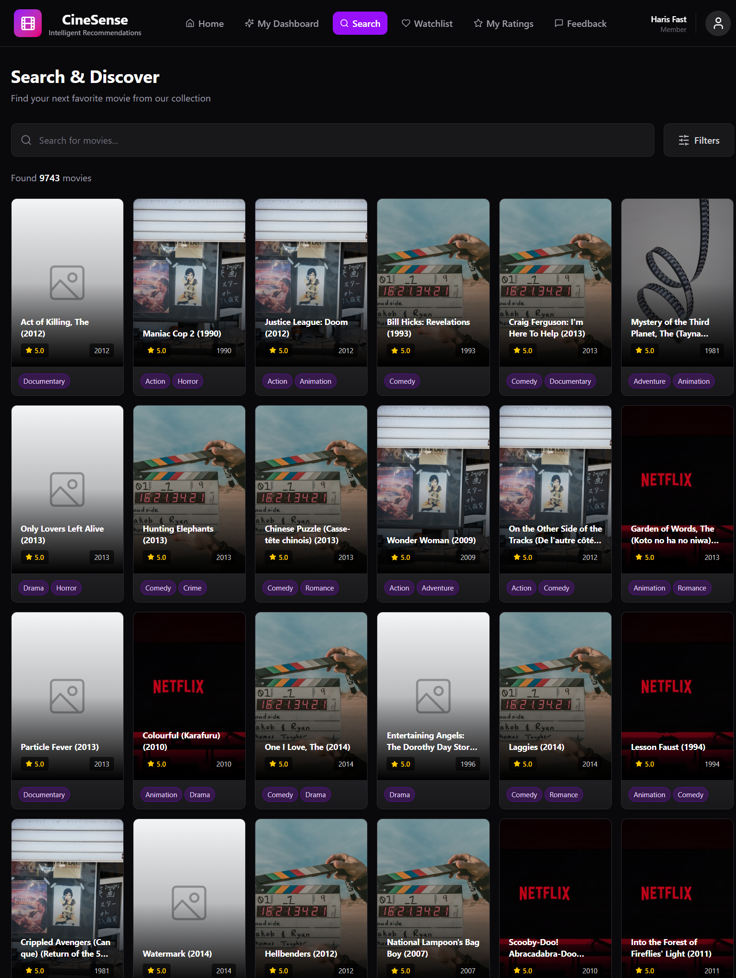
Movie Search & Filtering
Sprint 2 · US-06 · Genre · Year · Rating filters on Firestore

Slide 30
Movie Search & Filtering
Sprint 2 · US-06 · Genre · Year · Rating filters on Firestore

Slide 31
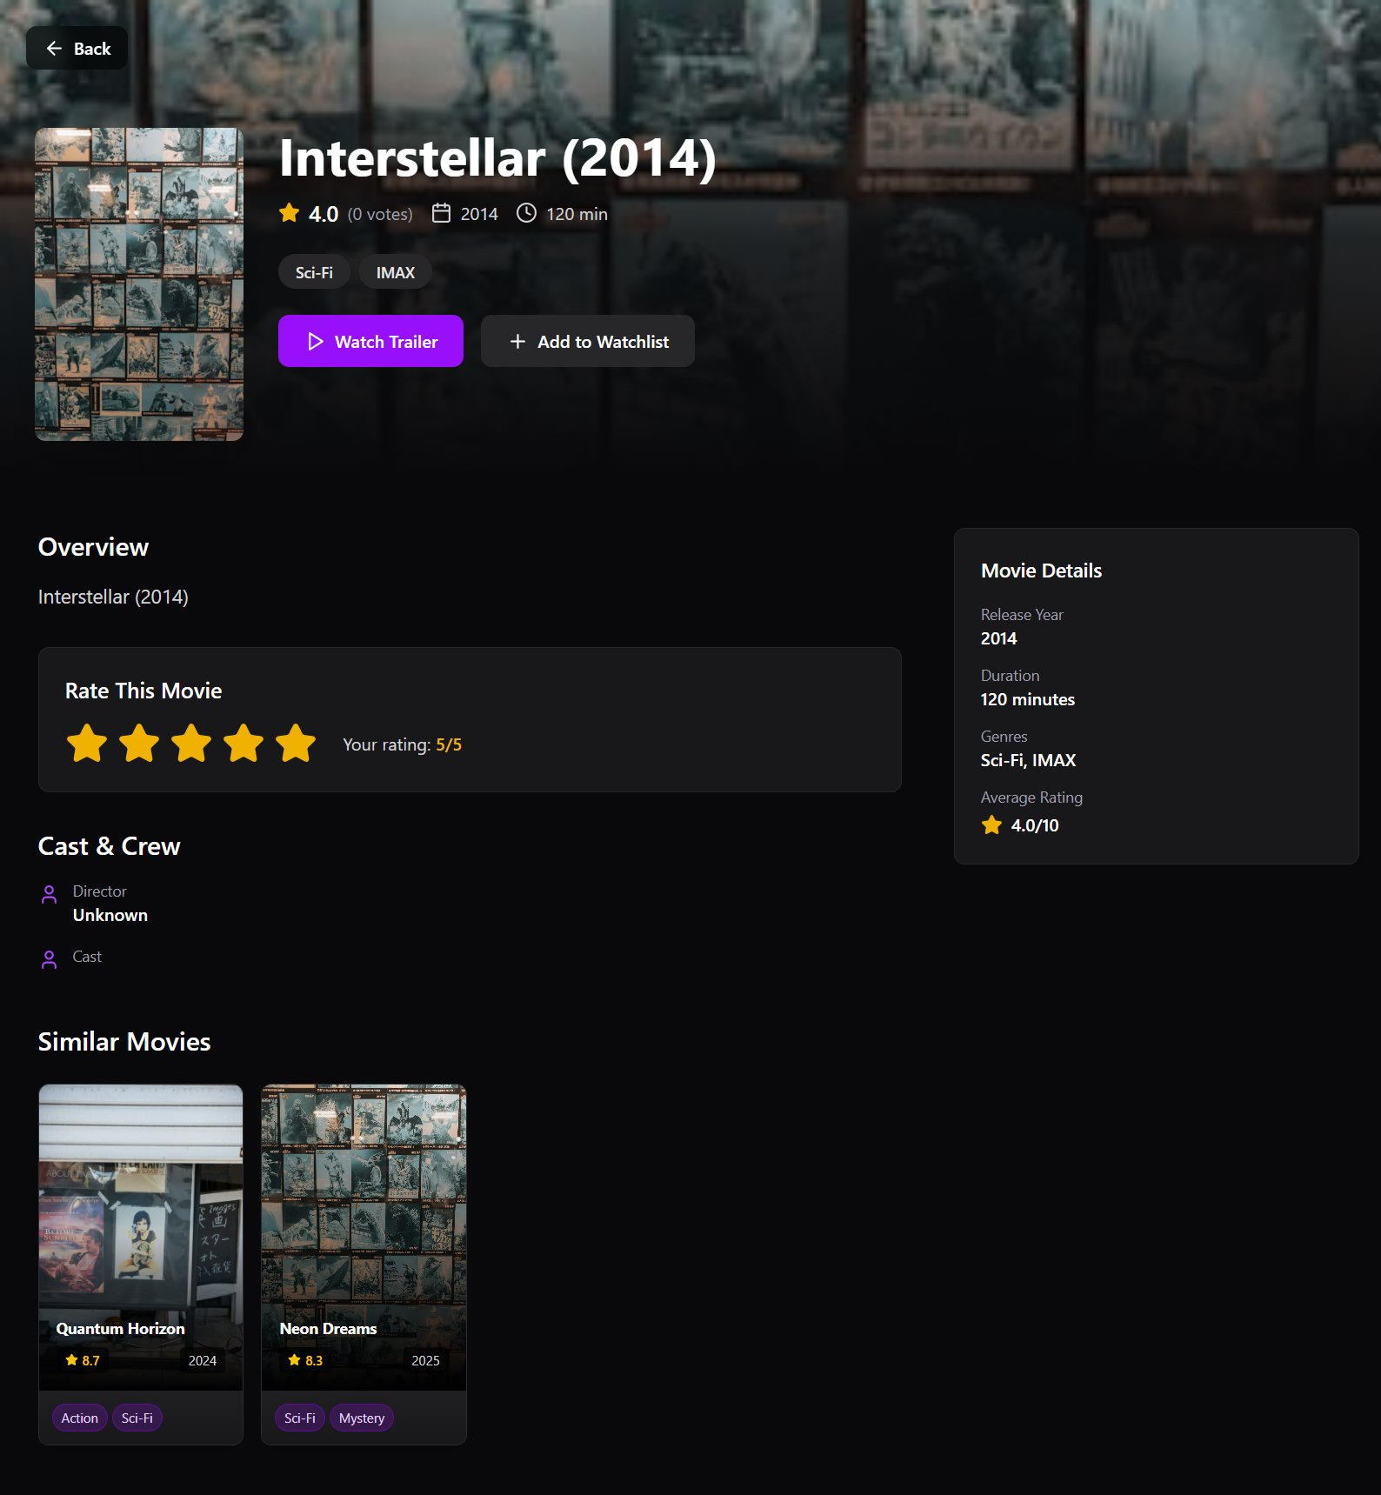
Movie Details Page
Sprint 2 · US-07 · Cast · Overview · Rate · Add to Watchlist

Slide 32
Rate a Movie Widget
Sprint 2 · US-08 · 1–5 star rating · writes to Firestore ratings

Slide 33
Personalized Dashboard (Manual)
Sprint 2 · US-09 · Manually curated movie collection

Slide 34
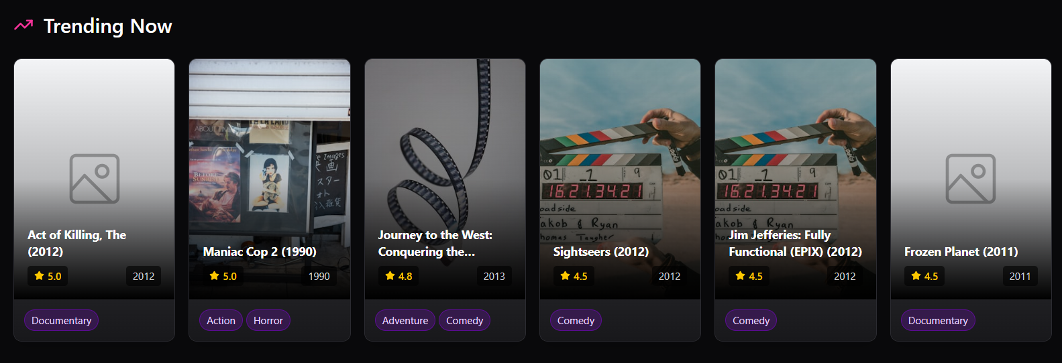
Trending Movies Section
Sprint 2 · US-11 · Top 10 by avg rating · horizontal scroll

Slide 35
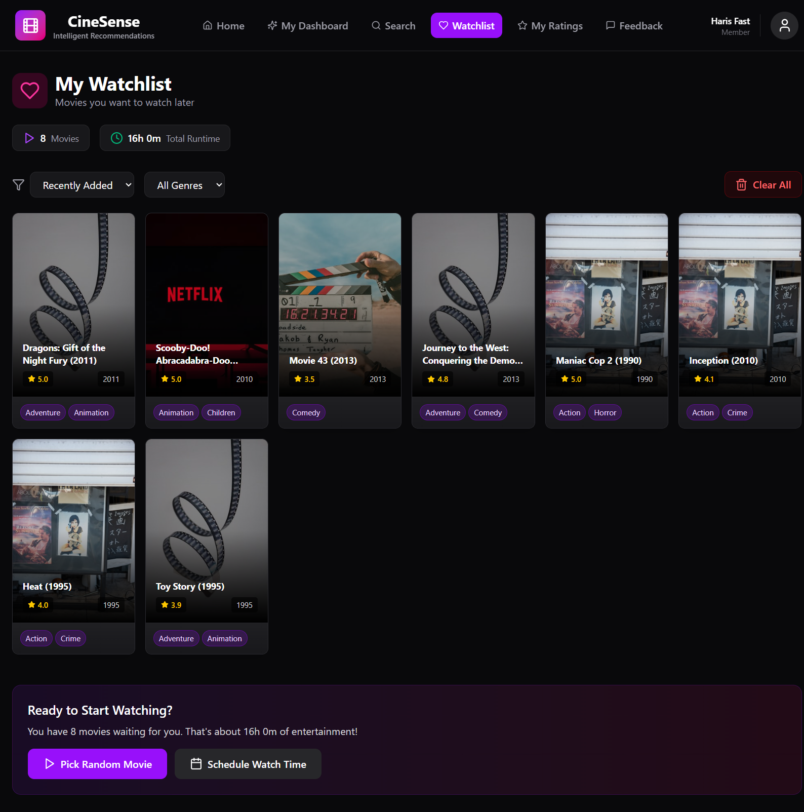
Watchlist Page
Sprint 2 · US-12 · Add · Remove · Sort movies

Slide 36
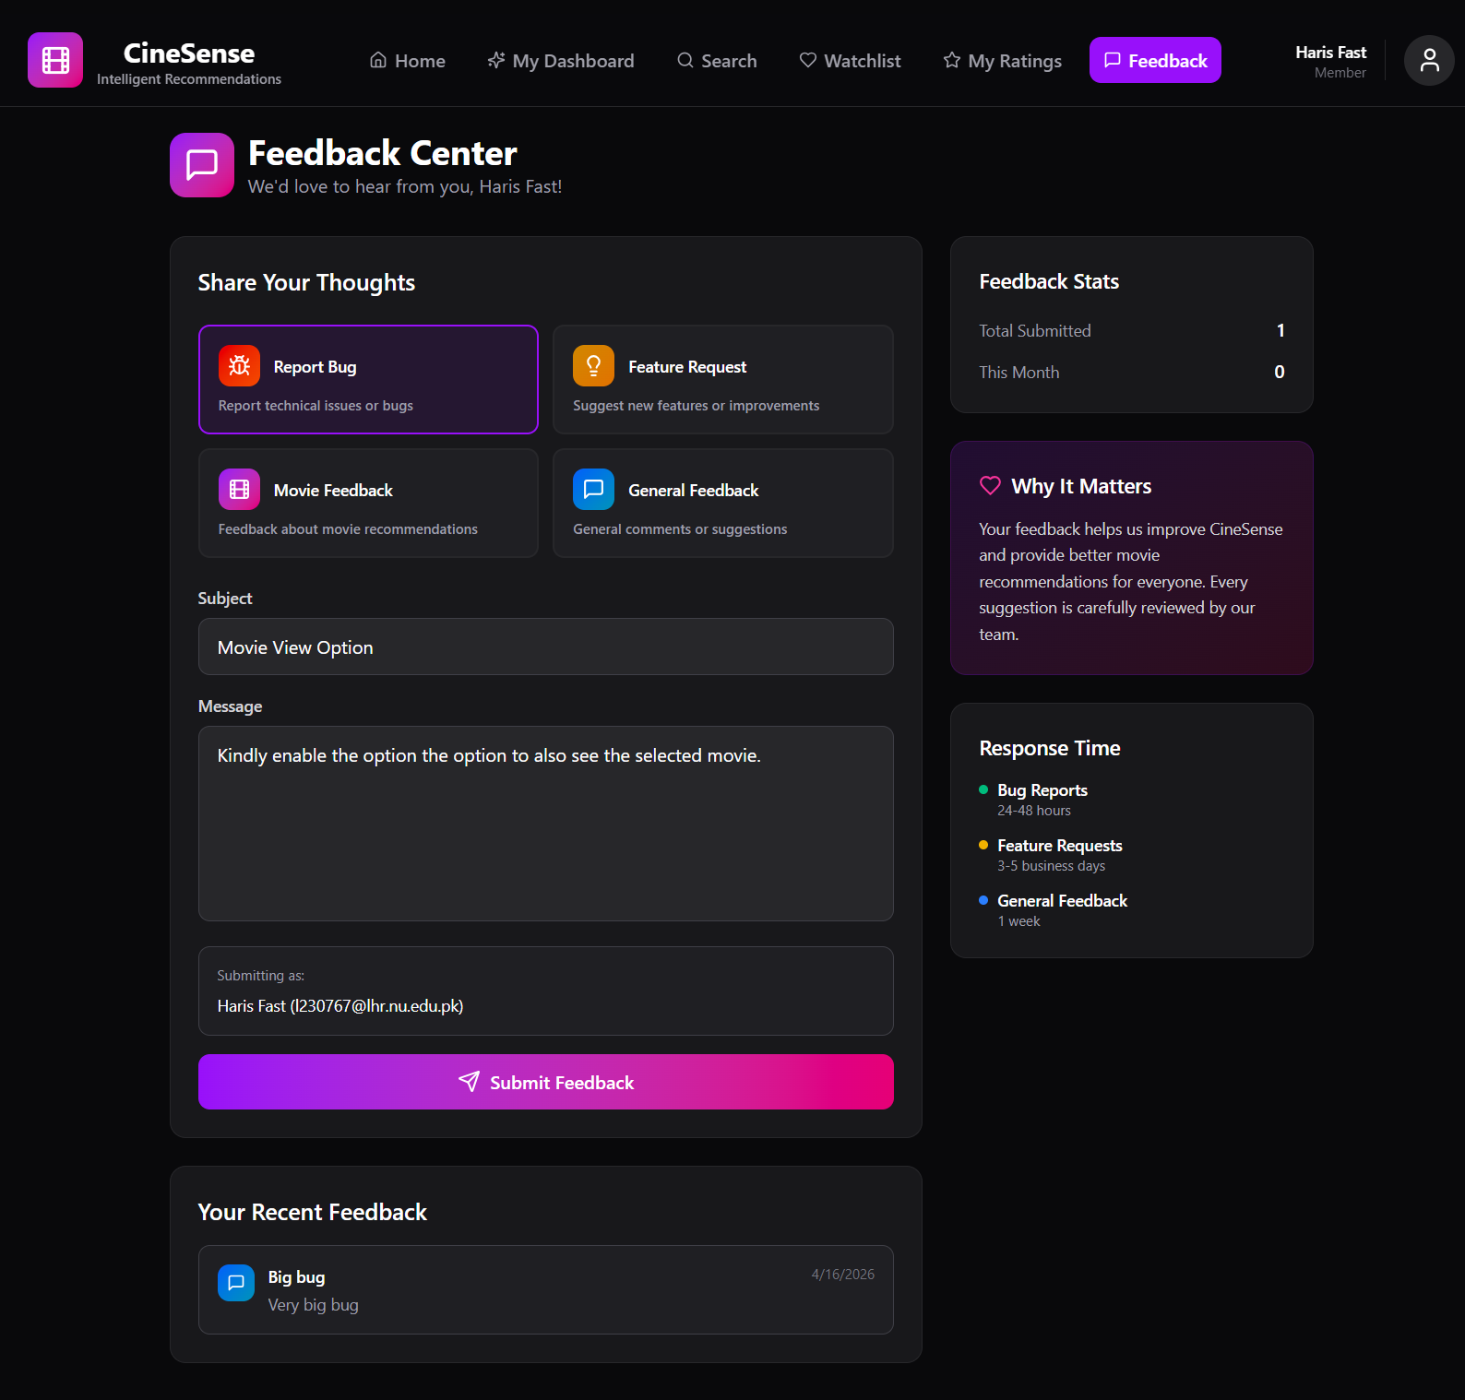
Feedback System
Sprint 2 · US-15 · Thumbs-up/down stored for ML re-ranking

Slide 37
AI Recommendations — Recommended For You
Sprint 3 · US-14 · Hybrid CBF + CF · Top-N ranked · Firestore cache · Cold-start fallback

Slide 38
Similar Movies via Content-Based Filtering
Sprint 3 · US-10 · TF-IDF cosine similarity on genre & keywords · Min 5 results

Slide 39
Work Division
Sprint 3 responsibilities
M Haris Fayyaz
Faiqa Waseem
Moeez Ijaz
23L-0767 · Backend & ML Engineer
23L-0633 · Frontend Developer & Documentation
23L-0750 · Backend API & Project Coordination
ML Microservice (Python/Flask) — hybrid CBF + CF engine
Content-Based Filtering: TF-IDF cosine similarity (US-10)
Collaborative Filtering: matrix factorization (US-14)
POST /recommend endpoint — Top-N ranked movie list
Feedback-to-ML re-ranking loop (US-13)
Cold-start fallback & Firestore cache TTL management
Final integration testing & BVA documentation (US-17)
'Recommended For You' section on Dashboard (US-14)
Similar Movies section on Movie Details Page (US-10)
Lazy loading for all movie posters (US-16)
UI polish — visual consistency across all pages
Pagination / infinite scroll on Search page (US-16)
Sprint 3 user stories, BVA write-up & final report
Node.js route — proxy recommendations from Flask to frontend
Firestore cache reads/writes with TTL check
GET /recommendations/:uid — cache-first endpoint
Integration testing: full user journey signup → recommendations
Trello Sprint 3 board management & sprint coordination
Code review, final merge & submission coordination
09

Slide 40



Lessons Learnt
Technical · Process · Team Collaboration
Technical
Process
Team Collaboration
ML data pipelines take longer than features — allocate dedicated sprint time before development
Firestore security rules must be designed with the data model on Day 1, not retrofitted
Cold-start problem needs a defined fallback strategy from the start — not Sprint 3
Microservice separation (Flask ML from Node.js) was the right call — enabled parallel work
React Context needs memoization discipline to prevent re-renders on the dashboard
Early documentation saves rework — US-09 scope change in Sprint 2 was handled cleanly because user stories were structured
Real-time Trello card moves keep burndown charts honest and reflect true progress
Factor in 20–30% integration overhead — Sprint 1 US-05 leftover proved this
15-minute daily check-ins surface blockers before they become blockers (ML CORS issue caught early)
Clear role separation (frontend / backend / ML) reduces conflicts — but needs API contracts agreed before coding begins
Feature branches + PRs by Sprint 3 eliminated the merge conflicts seen in Sprint 1's direct-to-main pushes
30-minute rule: raise a blocker to the group after 30 minutes rather than continuing solo
10

Slide 41
Thank You
Questions welcome
CineSense
3
17
82
100%
Delivered
Sprints
User Stories
Hours Est.
Delivered
M Haris Fayyaz · Moeez Ijaz · Faiqa Waseem
BCS-6C · Software Engineering · FAST-NUCES
11

