Slide 1
Extractive
Single Document
Based on
Input Size
Based on Summarization Approach
Abstractive
Multi Document
Hybrid
Classification
of Text Summarization
Systems
Monolingual
Supervised
Based on Summary Language
Based on Summarization Algorithm
Multilingual
Unsupervised
Cross-Lingual
Headline
Generic
Based on
Nature of Output Summary
Based on Summary Type
Sentence Level
Domain-Specific
Highlights
Query-Based
Full Summary

Slide 2
Predicate Argument Based
Semantic Graph Based
Semantic Based
Tree Based
Information Item Based
Template Based
Multimodal
Abstractive Text Summarization
Ontology Based
Structure Based
Graph Based
RNN / CNN
Rule Based
Seq2Seq model
Lead & Body Phrase
Attention Based
DL Based
With Reinforcement
Point Generator Network
Transformers
PLM, LLMs

Slide 3
Supervised
Statistical Based
Machine Learning Based
Unsupervised
TF
Semi Supervised
TF-IDF
Topic Based
Lexical Chain
RNN, CNN
Deep Learning Based
Attention,
Topic Word
Concept Based
Extractive
Text Summarization
Transformers, LLM,
Graph Based
Optimization
Swarm Intelligence
Text Rank
Sentence Centrality (Cluster) Based
LexRank
Fuzzy Logic
LSA
Semantic Based
Others
Reinforcement

Slide 4
Automatic Reasoning &
Tools Use (ART)
KB Reasoning & Generation
Zero shot prompting
New Task Without Extensive Training
Few shot prompting
Retrieval Augmented Generation (RAG)
Chain of Thought (CoT)
ReAct Prompting
Auto Chain of Thought
(Auto CoT)
Chain of Verification (CoVe)
Reduce Hallucination
Self Consistency
Chain of Note (CoN)
Prompt Engineering
Reasoning & Logic
Logical CoT
Chain of Knowledge (CoK)
Chain of Symbol (CoS)
Contrastive CoT
Improve Consistency & Coherence
Tree of Thoughts (ToT)
Emotion Prompting
Managing Emotions
& Tone
Graph of Thoughts (GoT)
Scratchpad Prompting
System 2 Attention
Program of Thought (PoT)
Thread of Thought
Code Generation & Execution
Structured CoT (SCoT)
Chain of Table
Chain of Code (CoC)
User Interaction
Active Prompt
Optimization by Prompting
Optimization & Efficiency
Fine Tuning & Optimization
Automatic Prompt Engineer
Rephrase & Respond (RaR)
Understanding User Intent
Metacognition & Self Reflection
Take a step back prompting

Slide 7
Statistical Based
Machine Learning Based
Concept Based
Deep Learning Based
Extractive Text Summarization
Topic Based
Optimization
Sentence Centrality Based
Fuzzy Logic
Graph Based
Semantic Based
Others

Slide 8
Extractive
Single Document
Based on Input Size
Based on Summarization Approach
Abstractive
Multi Document
Hybrid
Generic
Classification
of Text Summarization
Systems
Based on Nature of Output Summary
Query-Based
Monolingual
Based on Summary Language
Multilingual
Supervised
Cross-Lingual
Based on Summarization Algorithm
Unsupervised
Headline
General
Based on Summary Type
Sentence Level
Based on Summarization Domain
Domain-Specific
Highlights
Full Summary

Slide 9
Classification of Text Summarization Systems
Single Document
Extractive
Based on Input Size
Multi Document
Based on Summarization Approach
Abstractive
Generic
Hybrid
Based on Nature of Output Summary
Query-Based
Monolingual
Based on Summary Language
Multilingual
Supervised
Based on Summarization Algorithm
Unsupervised
Cross-Lingual
Indicative
Headline
Based on Summary Content
Informative
Based on Summary Type
Sentence Level
Highlights
General
Based on Summarization Domain
Full Summary
Domain-Specific

Slide 10
Extractive
Single Document
Based on Input Size
Based on Summarization Approach
Abstractive
Multi Document
Hybrid
Generic
Classification
of Text Summarization
Systems
Based on Nature of Output Summary
Query-Based
Monolingual
Based on Summary Language
Multilingual
Supervised
Cross-Lingual
Based on Summarization Algorithm
Unsupervised
Headline
General
Sentence Level
Based on Summarization Domain
Based on Summary Type
Domain-Specific
Highlights
Full Summary

Slide 11
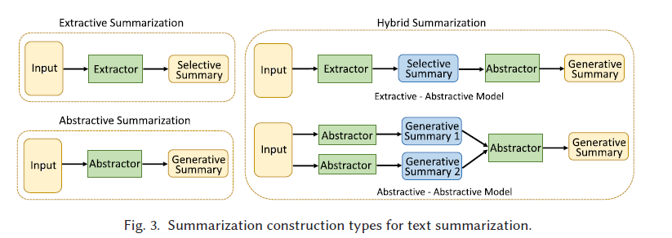

Slide 12
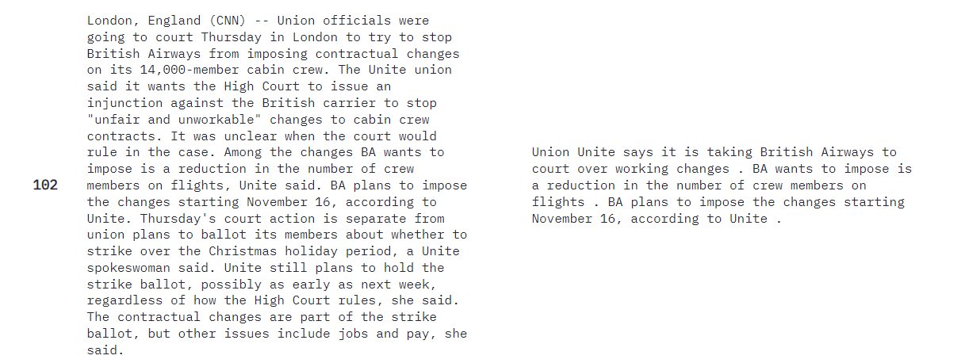
Article
Highlights
ID

