Slide 1

PROJECT PRESENTATION
Unified Public Transport Prediction & Navigation Platform
  Problem Statement Title - Smart Public Transport Intelligence Platform
  Theme - Intelligent Mobility & Smart Transport System
  Problem Statement category - Smart Transport / Software-based Intelligent Mobility Solution
  Team Name - NexRide.
  Sustainable Development Goals 11 — Sustainable Cities and Communities
NexRide promotes sustainable urban mobility by enabling intelligent, accessible and reliable public transport navigation.
www.nexride.co.in

Slide 2
PROBLEM STATEMENT
Many public transport users do not know the exact arrival time of buses because GPS tracking is not available. People wait at bus stops without proper information and often choose private transport instead. New commuters and students also find it difficult to understand routes, platforms, and how to reach their destination easily.
Public transport users face major challenges:
  No reliable bus arrival timing
  Low confidence in government transport
  People choose private buses due to timing uncertainty
  New commuters and students struggle to navigate unfamiliar cities.
www.nexride.co.in

Slide 3
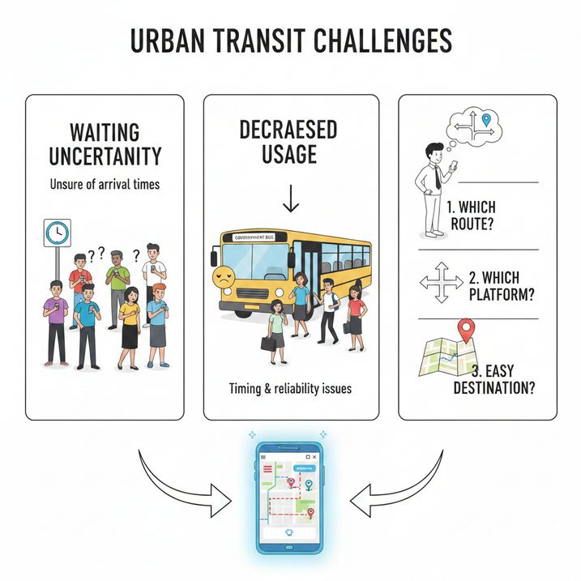
Real-Life Problems / Use Cases
Real-Life Problems Faced by Users:
Many users wait at bus stops without knowing the exact arrival time. Government buses are used less because passengers are unsure about timing and reliability. New commuters and students coming to a new city do not know:
  Which route to take
  Which platform to go
  How to reach their destination easily.
www.nexride.co.in

Slide 4
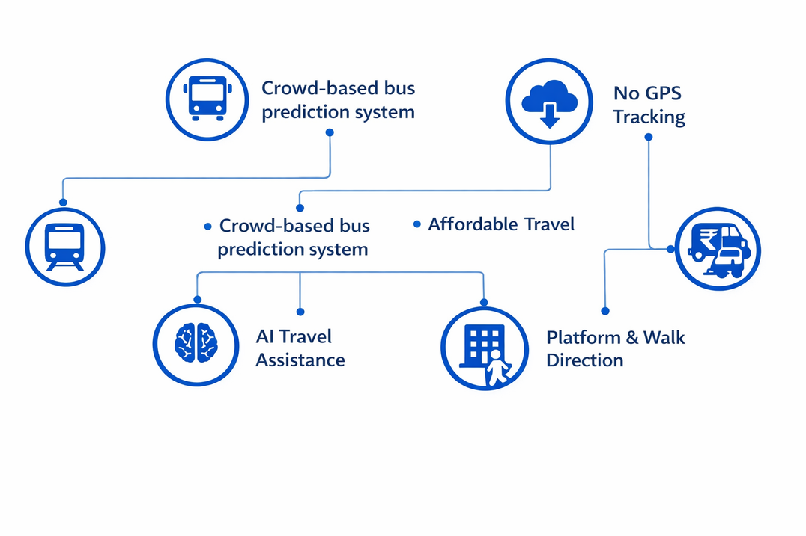
Solution Overview
NexRide is a smart public transport application that helps users plan their journey easily and predict arrival time without GPS tracking.
Key Solutions :
  Predicts public transport arrival without GPS tracking
  Crowd-based bus arrival prediction system
  Smart route search using start and destination input
  Step-by-step navigation guidance
  Platform number and walking direction assistance
  Affordable travel option suggestions (bus, auto, train)
  Offline prediction support for low network areas
  Behaviour-based smart travel assistance.
www.nexride.co.in

Slide 5
Unique Innovation
What Makes NexRide Different:
Works without bus GPS tracking
• Predicts arrival using intelligent data instead of hardware tracking.
Crowd-Based Prediction (StopSense Engine)
• Users contribute real-time signals to improve prediction accuracy.
Offline Prediction System
• Provides travel guidance even with low or no internet.
Behaviour-Based Smart Assistant
• Learns user travel patterns and provides smarter suggestions.
www.nexride.co.in

Slide 6

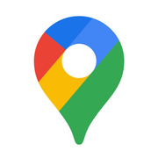


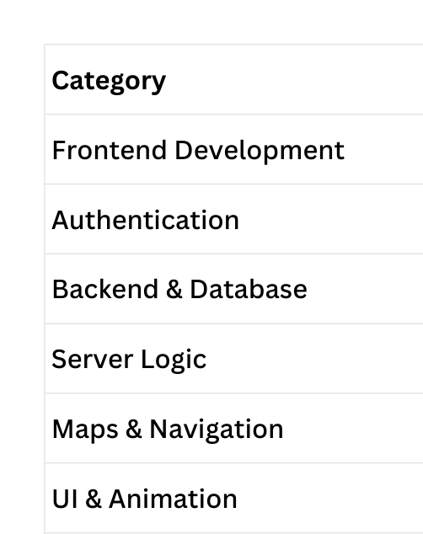
Technology Stack
Technology Stack Used in NexRide:
www.nexride.co.in

Slide 7

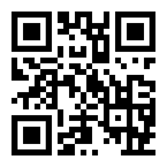
THANK YOU
www.nexride.co.in

