Slide 1
EDITH.ai
Karthikeyan S
Artificial Intelligence – Nano Degree

Slide 2
Problem Statement
How can we help farmers identify and respond to potentialwildlife intrusion near agricultural areas, while improving awareness of animal movement patterns and reducing crop damage without causing harm to wildlife?
Proposed Solution
EDITH.ai
Environmental Digital Intelligence for Threat & Habitat
An AI-powered early-warning system that detects wildlife, evaluates crop-conflict risk, analyzes movement patterns and assists farmers and authorities with non-harmful response.

Slide 3
Existing Systems
Existing approach | Limitation
Manual monitoring | Human-dependent and difficult continuously
CCTV / Camera surveillance | Shows activity but may not understand the threat
Basic alert systems | Often trigger alerts without deeper risk context

Slide 4
Why EDITH.ai
SEE
Camera-based wildlife detection
↓
IDENTIFY
Species classification
↓
ASSESS
Risk + crop vulnerability
↓
UNDERSTAND
Movement & intrusion intelligence
↓
RESPOND
Farmer / authority alert + non-harmful deterrence

Slide 5
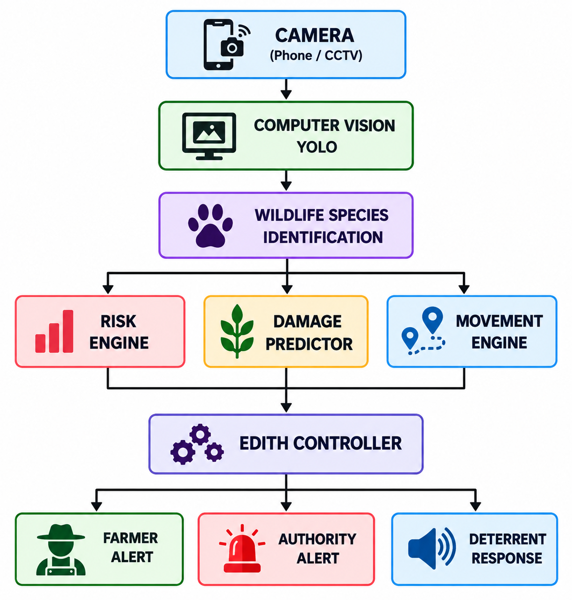
AIML Components
Architecture Flowchart
Computer Vision
YOLO-based object detection
Custom wildlife model
7 wildlife classes
Intelligence Models
Risk Engine
Crop Damage Predictor
Movement Intelligence
Data Inputs
Camera
Crop type
Location
Historical sightings
Environmental factors

Slide 6
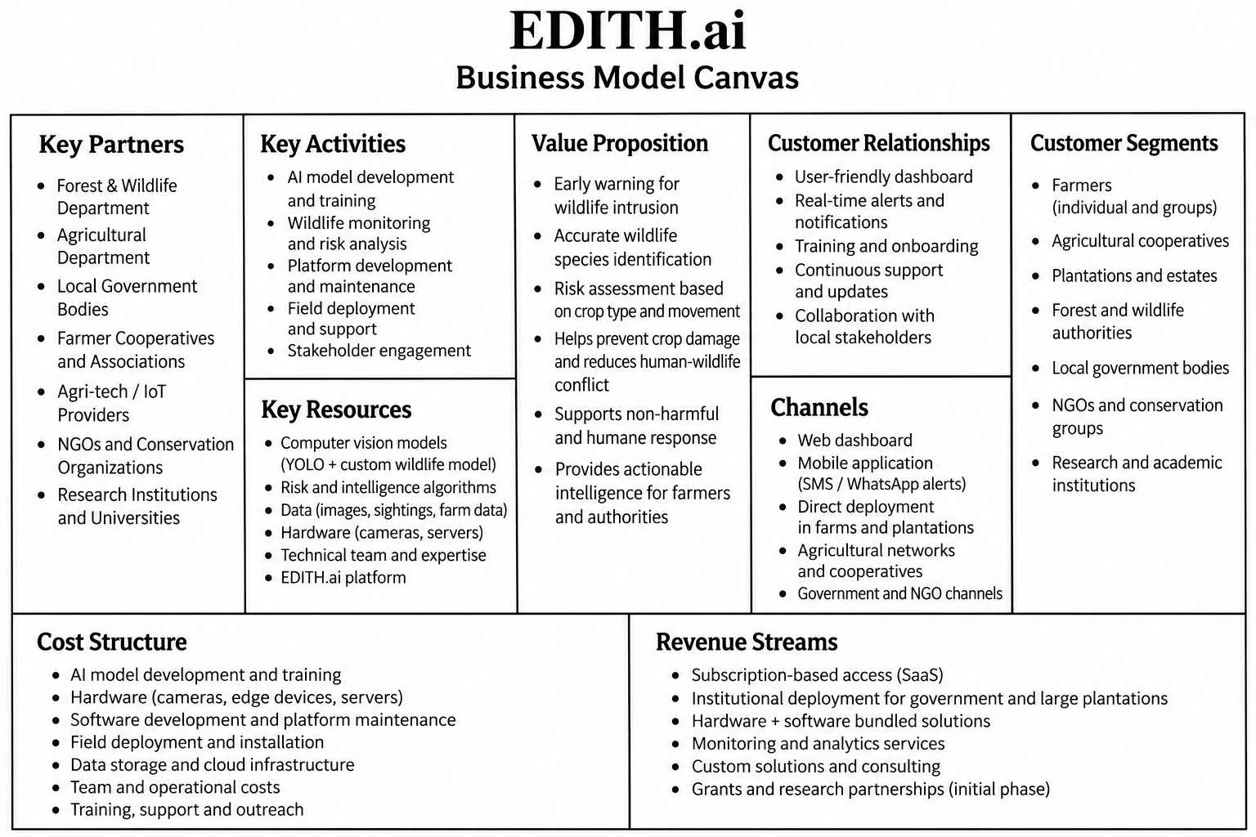
Business Model Canvas

Slide 7
THANK YOU

