Slide 1
Digitization of Tamil Text
- Peratchi Hariharasudhan Kannan – U6366102
- Vinayak Ravi - U6561524

Slide 2
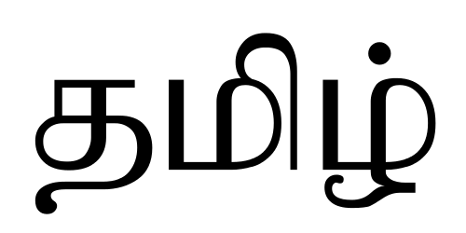
A Brief about Tamil script
Tamil script was said to have existed from 5th century BCE.
Tamil script consists of 31 letters in its independent form and an additional 216 combinant letters, summing to 247 combinations (“uyirmeyyeḻuttu -"soul-body-letters”
about 100 to 120 million people speak Tamil as of 2015 census of India.
https://en.wikipedia.org/wiki/Tamil_script

Slide 3
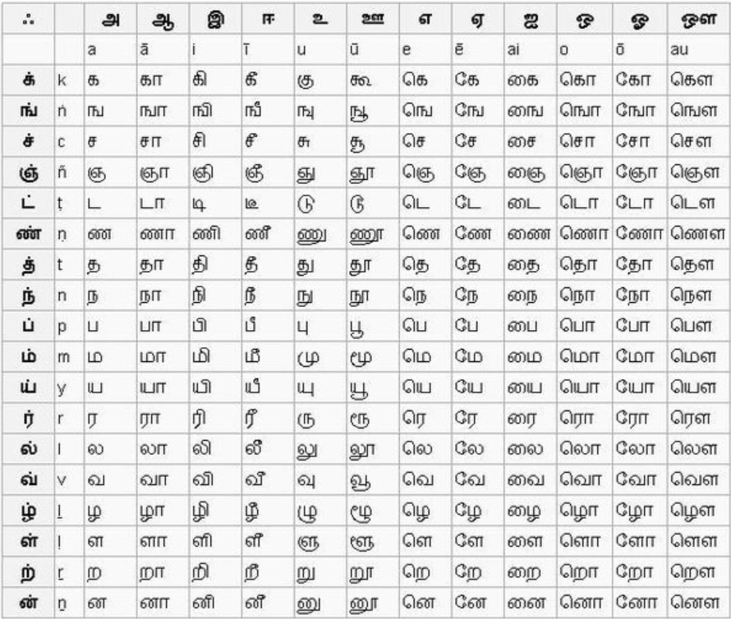
Tamil Script
Quick Fact:
“One of the languages which are spoken from time when humans were hunters”.
https://www.nammakalvi.org/tamil.html

Slide 4
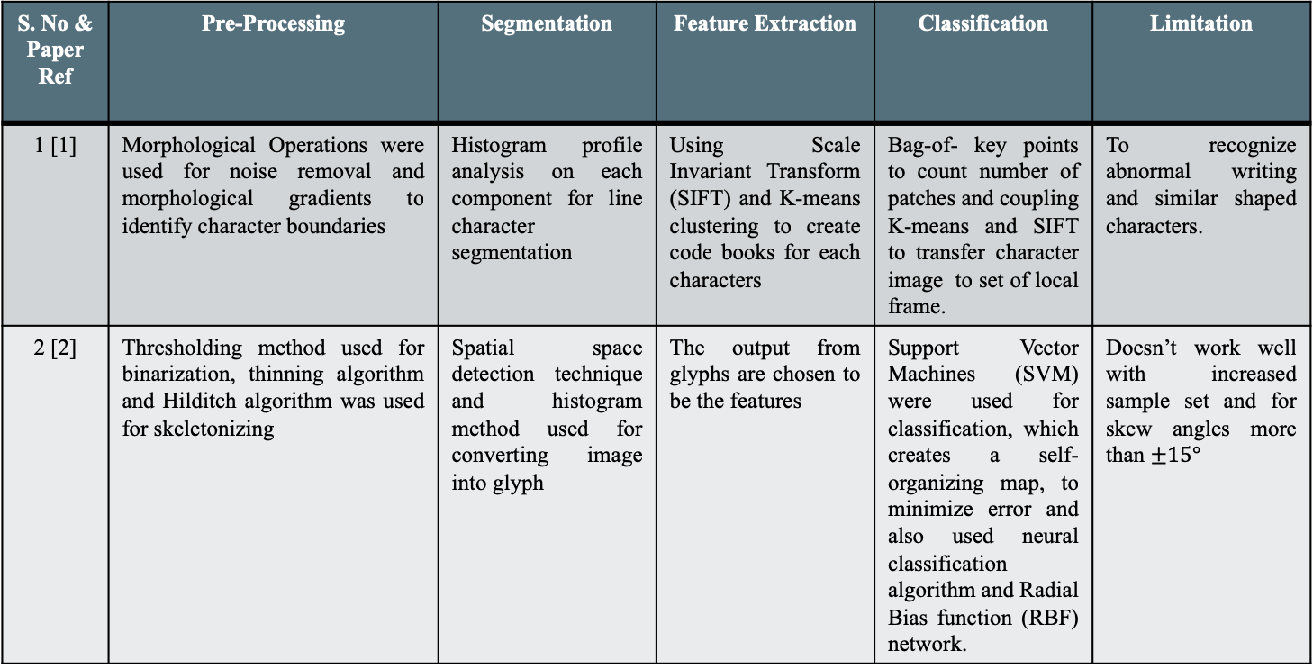
Literature Review for object recognition of Tamil Script
S. No & Paper Ref | Pre-Processing | Segmentation | Feature Extraction | Classification | Limitation
1 [1] | Morphological Operations were used for noise removal and morphological gradients to identify character boundaries | Histogram profile analysis on each component for line character segmentation | Using Scale Invariant Transform (SIFT) and K-means clustering to create code books for each characters | Bag-of- key points to count number of patches and coupling K-means and SIFT to transfer character image to set of local frame. | To recognize abnormal writing and similar shaped characters.
2 [2] | Thresholding method used for binarization, thinning algorithm and Hilditch algorithm was used for skeletonizing | Spatial space detection technique and histogram method used for converting image into glyph | The output from glyphs are chosen to be the features | Support Vector Machines (SVM) were used for classification, which creates a self-organizing map, to minimize error and also used neural classification algorithm and Radial Bias function (RBF) network. | Doesn’t work well with increased sample set and for skew angles more than $±15°$

Slide 5
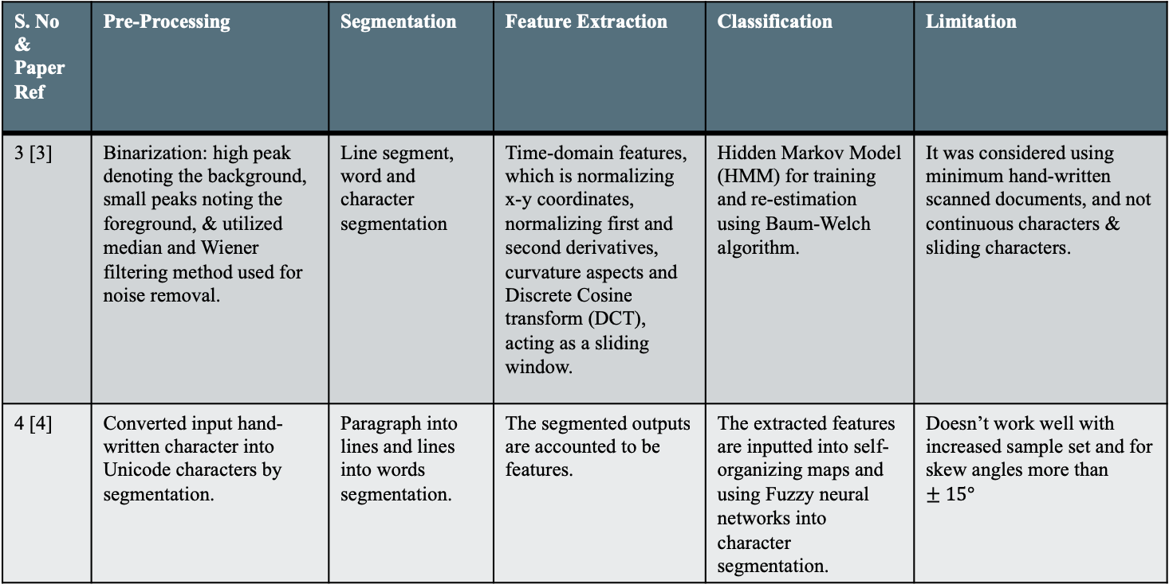
Literature Review for object recognition of Tamil Script (contd.)
S. No & Paper Ref | Pre-Processing | Segmentation | Feature Extraction | Classification | Limitation
3 [3] | Binarization: high peak denoting the background, small peaks noting the foreground, & utilized median and Wiener filtering method used for noise removal. | Line segment, word and character segmentation | Time-domain features, which is normalizing x-y coordinates, normalizing first and second derivatives, curvature aspects and Discrete Cosine transform (DCT), acting as a sliding window. | Hidden Markov Model (HMM) for training and re-estimation using Baum-Welch algorithm. | It was considered using minimum hand-written scanned documents, and not continuous characters & sliding characters.
4 [4] | Converted input hand-written character into Unicode characters by segmentation. | Paragraph into lines and lines into words segmentation. | The segmented outputs are accounted to be features. | The extracted features are inputted into self-organizing maps and using Fuzzy neural networks into character segmentation. | Doesn’t work well with increased sample set and for skew angles more than $±15°$

Slide 6
Troubles faced in classification of Tamil Characters
Curves in Tamil characters
Complex letter structure
Variation in writing styles (causing mis-interpretation when defining the strokes)
Difficulties in viewing angles, definition of amount of skew in the characters

Slide 7
Strategy Proposed
In the literature review [5], Tamil characters were classified using Convolutional Neural Networks from data obtained from HPL database. They utilized various pooling techniques (max, stochastic), activation functions (tanh, ReLu) and classifiers (SVM, Softmax).
CNN has been around for 50 years, with certain advantages for identifying
and classifying images (in our case Tamil characters), they are:
Rugged to intrinsic distortions (changes caused due to skew in camera angle) and
different lighting conditions, different poses and are shift invariant.
Range of parameters choice is high
Models can be generalized with ease (inducing Robustness).
https://ip.cadence.com/uploads/901/TIP_WP_cnn_FINAL-pdf

Slide 8
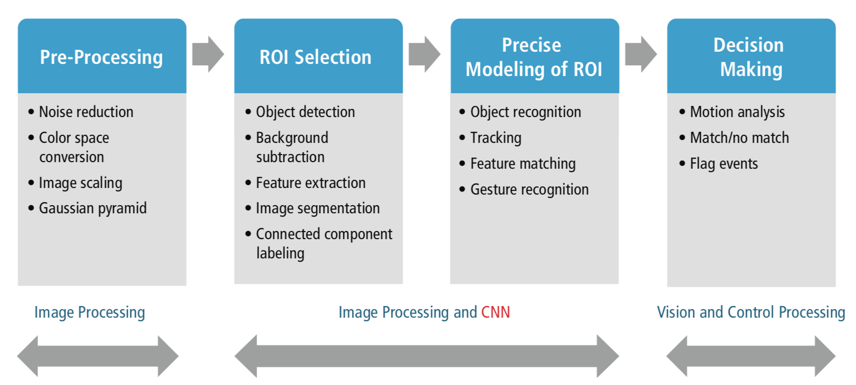
Pipeline for CNN in Image Processing
Pipeline Implemented:
Pre-processing
Image Scaling
Input image
CNN
ROI – Feature extraction and matching
Decision Making
Class
https://ip.cadence.com/applications/cnn

Slide 9
Dataset Pre-processing
HPL Dataset consisting of 50683 with 155 classes [6].
Resizing to size (32 x 32) images.
Label definitions (no 1 to no 155)
Next step, is to input resized images into network

Slide 10
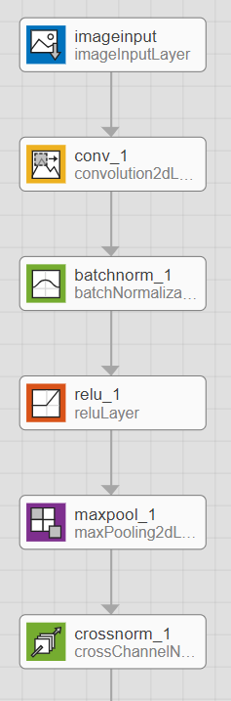
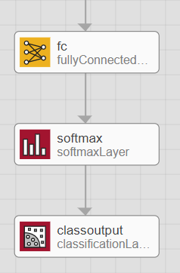
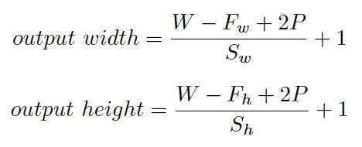

Network architecture
(32 x 32 x 1) size
Feature map sizes (8, 16, 32, 64)
Filter size (5 x 5) , optimizers: ADAM & SGD
Used in identifying features w,r,t. classes.
batch normalization layer would normalize the activation of a particular convolution layer with respect to mini batch mean and standard deviation.
helps in identifying
the features extracted
cross channel normalization, after the convolution layers where it normalizes with respect to channel wise mean than the whole mini batch.

Slide 11
Parameter Combinations
Learning rate
0.001, 0.01 (default), 0.1
Minibatch size
32, 64,128
Optimizer
Adam/ Stochastic Gradient Descent (SGD)

Slide 12
Demo

Slide 13
Troubles faced during Learning
Finding the right data (insufficient data/ Data augmentation)
Finding the right activation function (tanh/ReLU)
Parameters selection (Learning rate/ Optimizer)

Slide 14
Future Recommendations & conclusion
Expansion of dataset
Generalization of dataset, by preprocessing of image input (through thresholding, skeletonizing, segmentation)

Slide 15
References
[1] A. Subashini, N.D. Kodikara, ” A Novel SIFE-based Codebook Generation for Handwritten Tamil character Recognition” , 6th IEEE Int. Conf. on Industrial and Information Systems (ICIIS), Page(s): 261 – 264, 2011
[2] C. Suresh Kumar and T. Ravichandran, “Handwritten Tamil Character Recognition using RCS algorithms”, Int. J. of Computer Applications, (0975 – 8887) Vol. 8– No.8, 2010
[3] R.J. Kumar, R. Prabhakar and R.M. Suresh, “Off-line Cursive Handwritten Tamil Characters Recognition”, International Conference on Security Technology, pp. 159 – 164, 2008
[4] C. Sureshkumar and T. Ravichandran. “Handwritten Tamil character recognition and conversion using neural network”. InIntJComputSciEng 2 (7 2010), pp. 2261–2267.
[5] P. Vijayaraghavan and M. Sra. “Handwritten Tamil Recognition using a Convolutional Neural Network”.
[6] HP Labs India Pvt. Ltd, http://lipitk.sourceforge.net/datasets/tamilchardata.htm .
Github link:
https://github.com/harish-kp/Data-analytics

