Slide 1
Impact Analysis(Cost) on TRAIs New Regulation
Using Python Jupiter Notebook to perform EDA

Slide 2
New Cable Fees Structure under TRAI’s New regulations
The Telecom Regulatory Authority of India (TRAI) recently drafted new regulations and directed various DTH service providers and operators to implement them. These regulations were set up to ensure all operators in the DTH and cable ecosystem get a fair share of earnings.
The new regulations also bought in new changes in the cost structure of the cable fees. The cost of cable fees now have 2 components,
The first one is like a rental charge & is called the Network Capacity Fee (NCF). This is 153.40 (inclusive of 18% GST). This rental includes the carriage of 100 FTA TV channels and is inclusive of 25 mandatory channels.
The second part is the cost that you will have to pay for each paid channels that you chose to watch. This cost is also inclusive of 18% GST and is charged on a monthly basis.
The immediate benefit to consumers is that there is a transparency as you get to know what you are paying for and you also have the freedom of choosing what you want to watch.
The new plan is already in place since February 1, 2019.

Slide 3
Concerns on Cable Fee of under TRAI’s New regulations
Though TRAI’s intent was to provide benefits to the Consumer, Service Providers and Broadcasters, but there has been a growing concern from the consumers around the increased cost of cable fees which they have to pay under the new cost structure.
Key concern : Why do we have to pay more now?
It is estimated that the average cable fees was around 250 Rs where an consumer was able to watch all the channels. But now, consumers are complaining that now they have to more 2 to 4 times more for the same choice.
Is this a fair deal?

Slide 4
Concerns on Cable Fee of under TRAI’s New regulations
TRAIs has responded stating that the issue highlighted around the cost is “incorrect“ as the comparison being done was between apple to oranges.
Consumers need to be aware that since the Cable fees are itemized now and the more they add to the cart the higher their cable cost will be.
TRAI’s recommendation to chose wisely. Their research suggests that around 90% of an average viewer does not watch more than 50 channels. So, if you pick the channels correctly you will not have to “pay more”.
Testing the Hypothesis “If we pick our channels smartly as recommended by TRAI (around 50)”. Can we keep the cost <= 250 Rs(Consumer’s Benchmark)?
Used TatasSky’s Master list which contains all the FTA and paid channels. (Source: TRAI’s website https://main.trai.gov.in/sites/default/files/DPO_TataSky.pdf)
The preliminary data had only Channel Name, Channel Type, Genre, Channel Cost. We added new fields PayType to distinguish if its Free or Paid ,Pay Category and Region (North/South /Other – to see cost distribution between north and south).
We also collected 8 samples from south region to study the patterns around selection of channels across Genre, Language and Pay type. And, finally use rule of averages (channel count and Genre cost) to compute the Average cable fee and see if it lies within the consumers benchmark of 250 Rs.

Slide 5
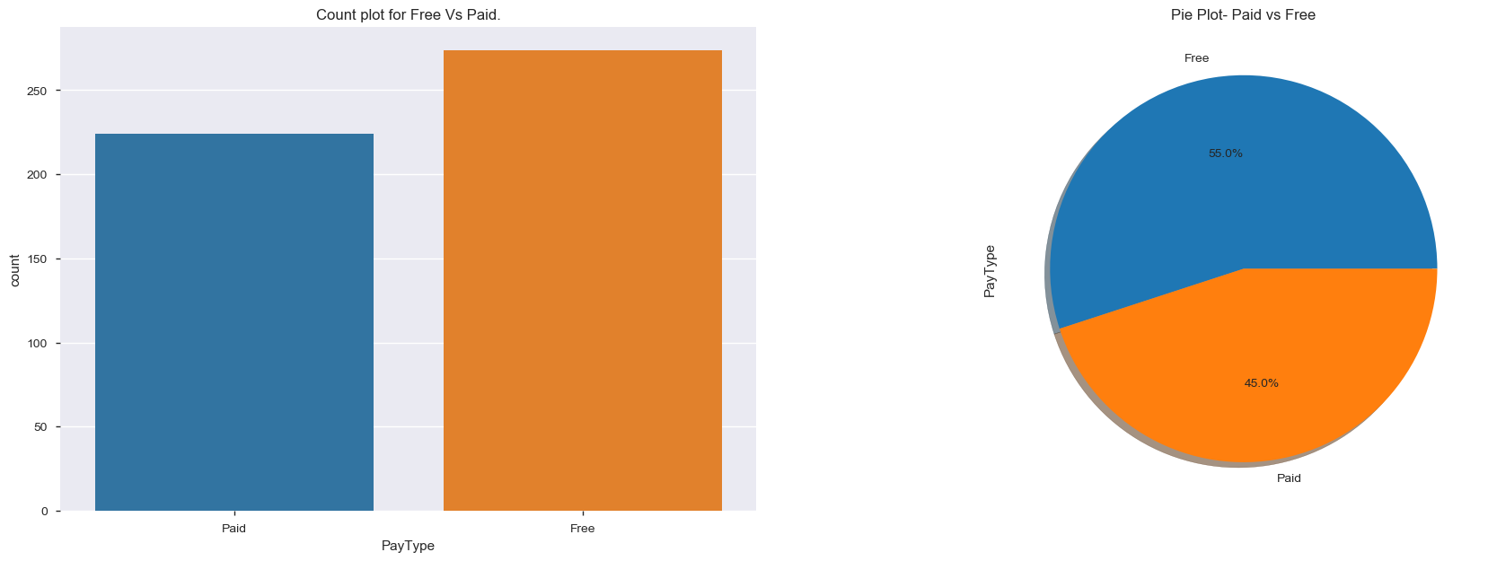
EDA –Analysis on the Master List
Using the Master channels List
Total channels available 589 – 498 are SD and 91 HD channels.
For the analysis purposes only SD data is chosen as those are the majority.
Distribution of Channel count (SD only) under Pay type(Free Vs Paid).
Free 274(55%) vs Paid 224(45%) – In SD Gives an indication there is lot available to chose from Free.

Slide 6
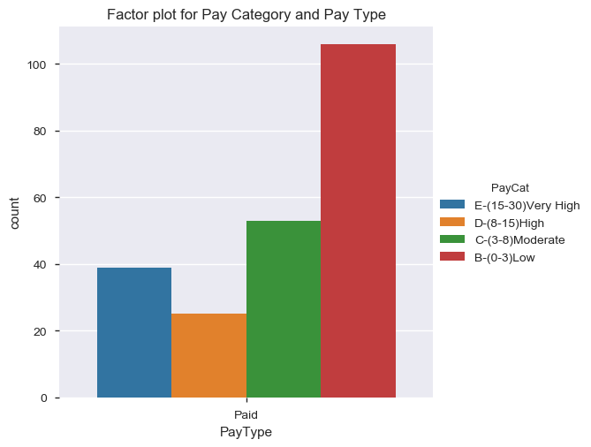
EDA –Analysis on the Master List
Distribution of cost under Paid which are segmented in 4 buckets
Key observations
Majority of them are in 0-3(Low) and 3-8(Moderate) Range(106+53=159).
A good chunk is available in the High (>8-15) range(25) and Very High(>15-30) range (39).

Slide 7
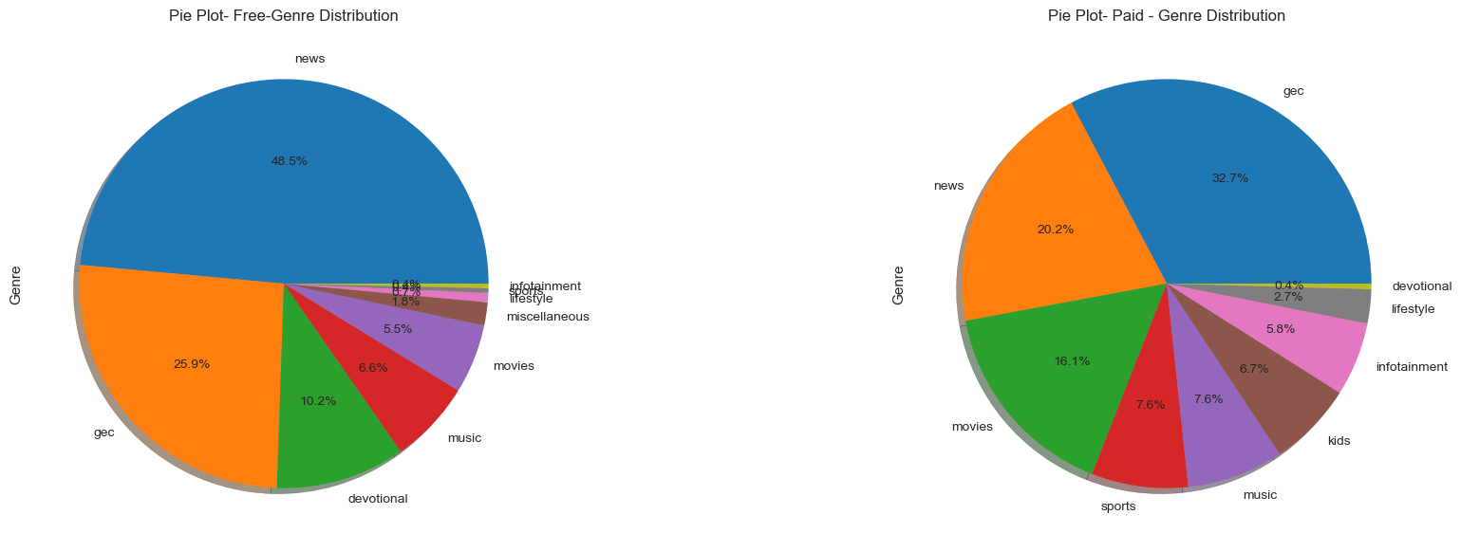
EDA –Analysis on the Master List
Distribution of Genre under Pay type(Free Vs Paid)
Key observations
Top 3 Contributors under Free – News(49%), GEC(26%) & Devotional(10%)
Top 3 Contributors under Paid– GEC(33%), News(20%) & Movies(16%),
Paid had no Devotional and Free had no Kids

Slide 8
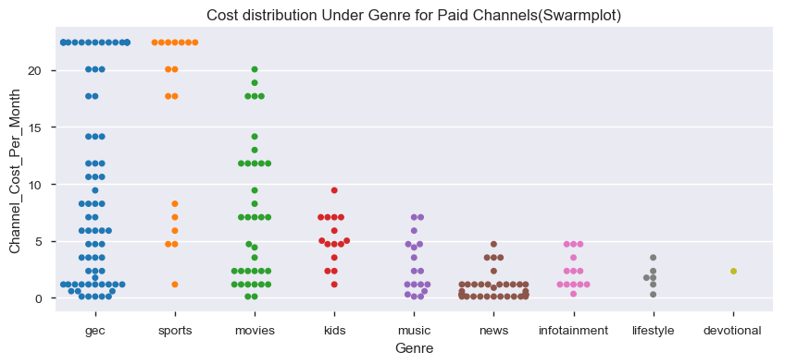
EDA –Analysis on the Master List
Drill down on the Cost distribution under Genre for Pay channel
Key observations
GEC, Sports and Movies are the ones which will be adding to cost burden as they have a major chuck in High(15-18) & Very High bucket (18 – 25).
News, Infotainment, Lifestyle, Devotional, Kids and Music all offer under low(0-3) and moderate(3-8) cost buckets

Slide 9
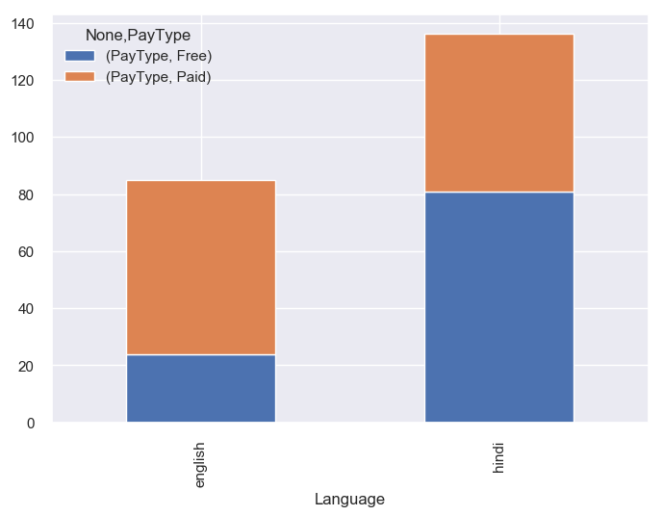
EDA –Analysis on the Master List
Distribution under common language(English and Hindi) under Pay type(Free Vs Paid).
Key observations
Hindi has more Free channels and English more Paid.

Slide 10
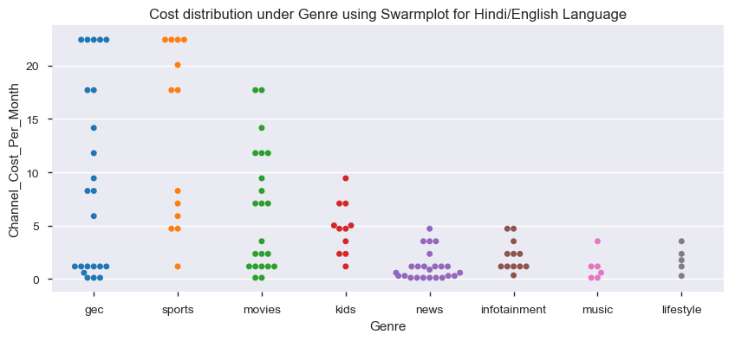
EDA –Analysis on the Master List
Drill down on the Cost distribution under Genre for Hindi and English (Pay Channel)
Key observations
GEC, Sports and Movies will be adding the burden as .
News, Infotainment, Lifestyle, Devotional, Kids and Music all offer under low(0-3) and moderate(3-8) cost buckets

Slide 11
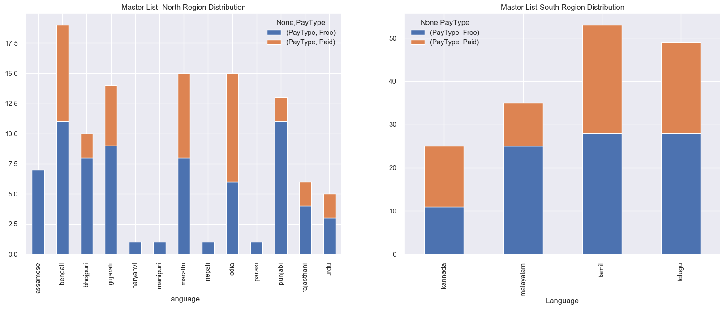
EDA –Analysis on the Master List
Distribution of languages under north and south region.
Key observations
South region - Malayalam offers more free over paid. And in North it is Punjabi, Bhojpuri, Rajasthani and Gujrati.
It is worth noting to see no paid channels under Nepali, Parasi, Manipuri and Harayanvi(and this is due to the fact that all except Nepal 1 are doordarshan channels which are mandatory to air)

Slide 12
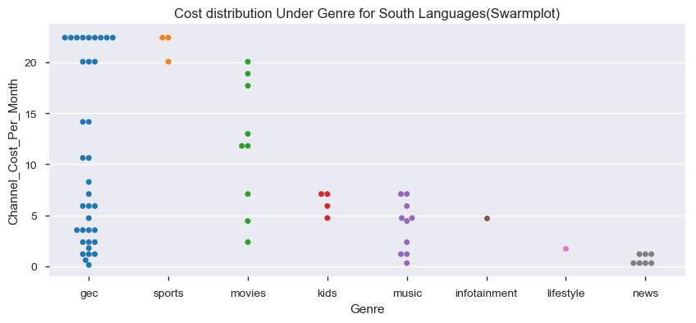
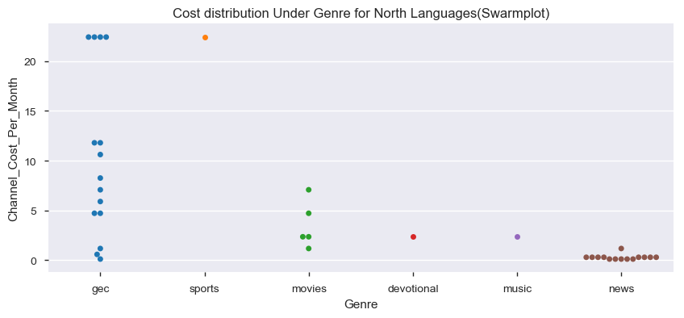
EDA –Analysis on the Master List
Drill down on the Cost distribution under Genre for South/North(Pay Channel)
Key observations
Same trend seen for North and South languages for GEC and Sports. However there are fewer options in North
Watching Sports and movies will be costlier in south language as a majority are in High and Very High cost buckets.
Kids, Music, Infotainment, Lifestyle and News will be a relief as they all fall under Low and Moderate.

Slide 13
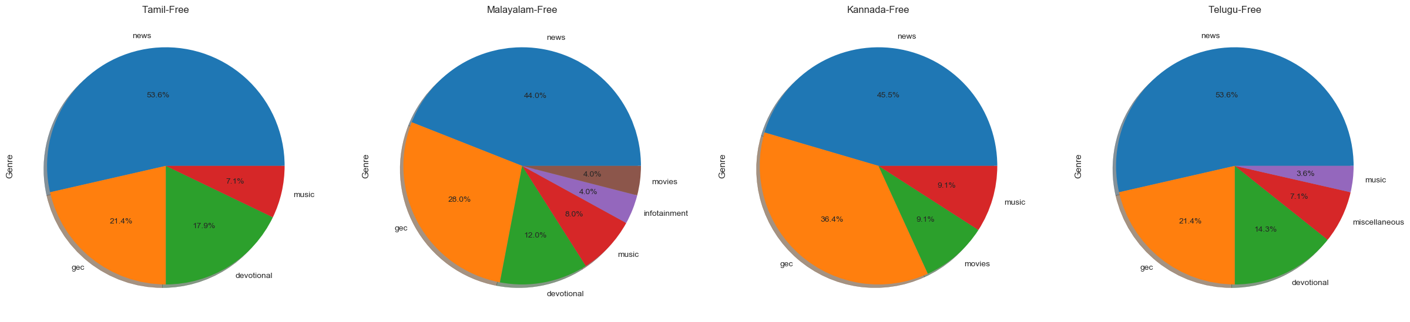
EDA –Analysis on the Master List
Distribution of Genre Under Pay type Free for different languages (South)
Key observations
There are no channels for Kids
It is interesting to note that Malayalam language has most to offer(all except Kids, Sports and Lifestyle) followed by Telugu (all except Kids, Movies, Infotainment, sports and lifestyle).
News, GEC and Devotional were the top 3 categories for Tamil, Malayalam and Telugu language.

Slide 14
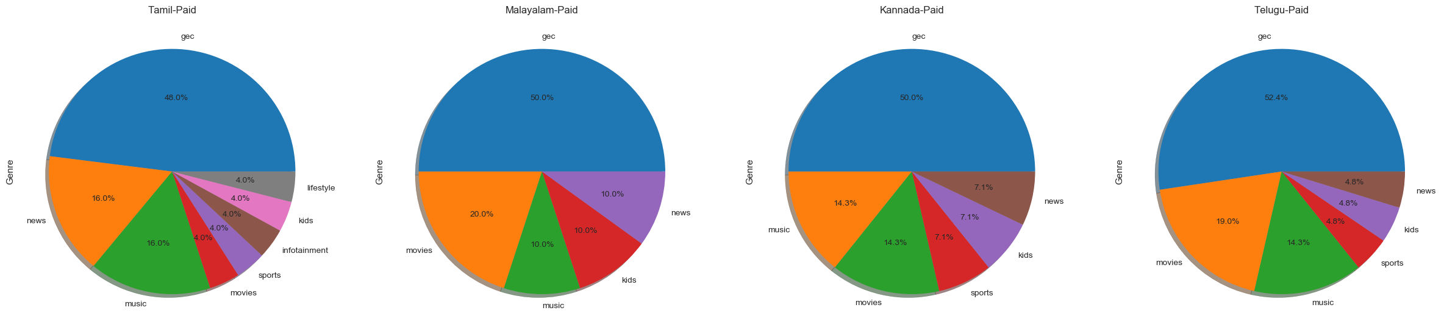
EDA –Analysis on the Master List
Distribution of Genre Under Pay type Paid for different languages (South)
Key observations
There are no channels for Devotional
Tamil language has the most offerings under genre(all except devotional), Next was Telugu and Kannada language(all except infotainment and lifestyle) followed by Malayalam(all except infotainment, sports and lifestyle).
GEC, Music and Movies were the top 3 categories for Malayalam, Kannada and Telugu language.

Slide 15
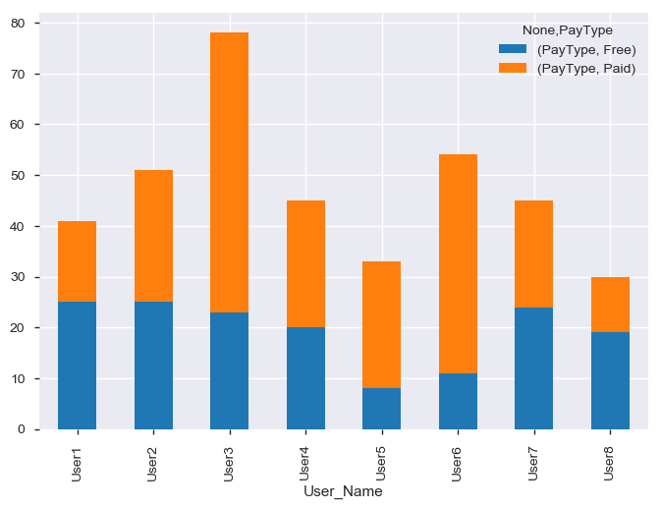
EDA –Analysis on the Sample Users
Distribution of Pay type (Free vs Paid)
5 users have tried to have equal mix of Paid and Free(User1, 2,4,7,8).
However there were outliers(3 users) as well where paid was more(User 3,5,6)

Slide 16
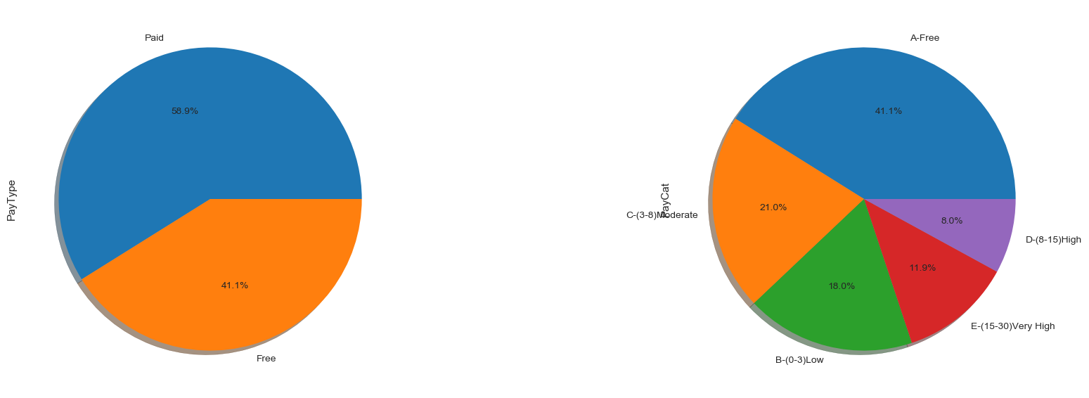
EDA – Analysis on the Sample Users
Overall distribution of Sample under Pay type and Pay category
The distribution under Pay type is 59% Paid Vs 41% Free
The distribution under Pay category –21% (Moderate), 18% (Low), 12% (very High) and 9% in (High).

Slide 17
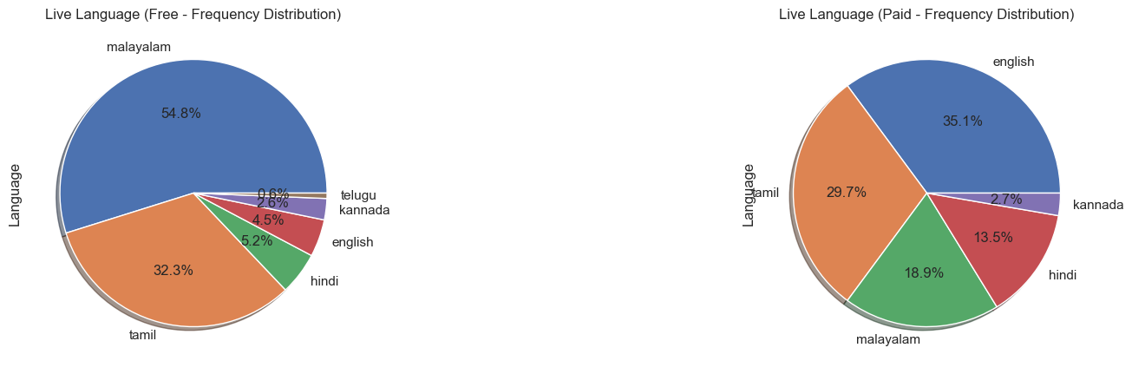
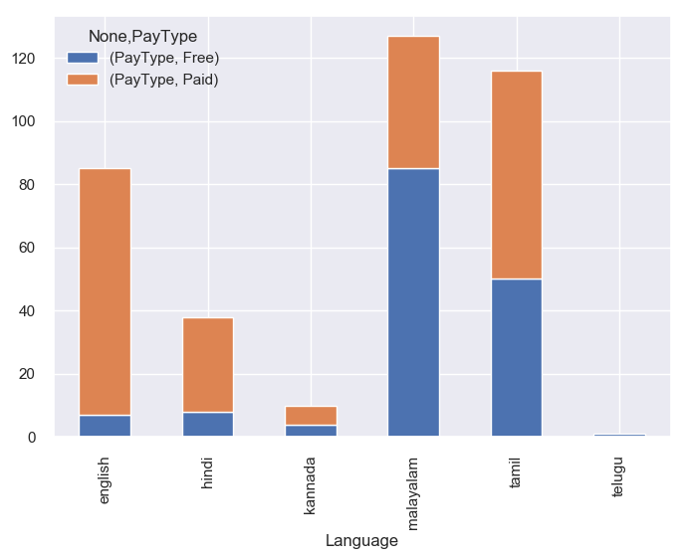
EDA – Analysis on the Sample Users
Overall distribution of Language under Pay type (Free Vs Paid).
The spread is high for English, Tamil and Malayalam in Paid category and in Free category its Malayalam and Tamil.
The distribution low for Hindi, Kannada and English in Free category and this could be due to less choices available in Free.

Slide 18
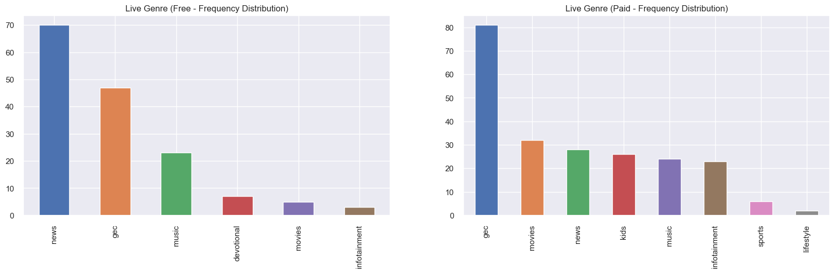
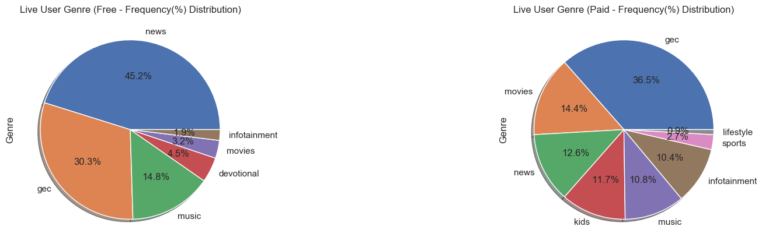
EDA – Analysis on the Sample Users
Overall Distribution of Genre under Pay type(Free Vs Paid)
The top 3 Free – News, GEC and Music.
The top 3 Paid – GEC, Movies and News.
From the pie we see that below is the distribution for Genre under the Paid
GEC (36%) ,Movies (14%) ,News (13%) ,Music (11%) ,Kids (12%) ,Infotainment (10%) ,Sports (3%) ,Lifestyle (1%).

Slide 19
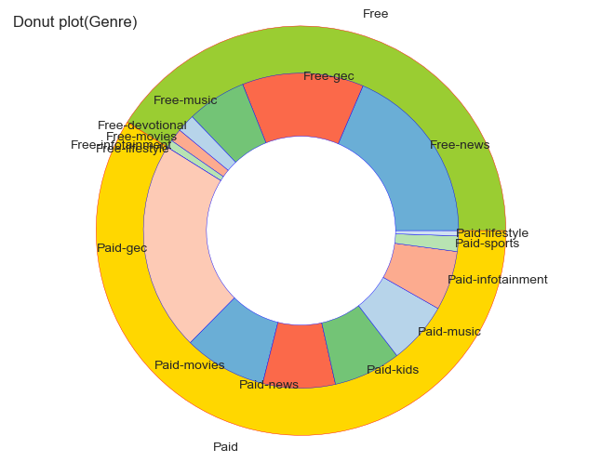
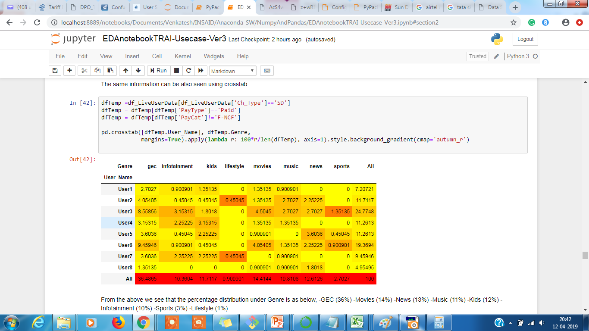
EDA – Analysis on the Sample Users
Overall Distribution of Genre under Pay type(Free Vs Paid)
The same distribution for Genre under the Paid category GEC (36%) ,Movies (14%) , News (13%) ,Music (11%) ,Kids (12%) ,Infotainment (10%) ,Sports (3%) ,Lifestyle (1%) is also seen in donut and crosstab report as well.

Slide 20
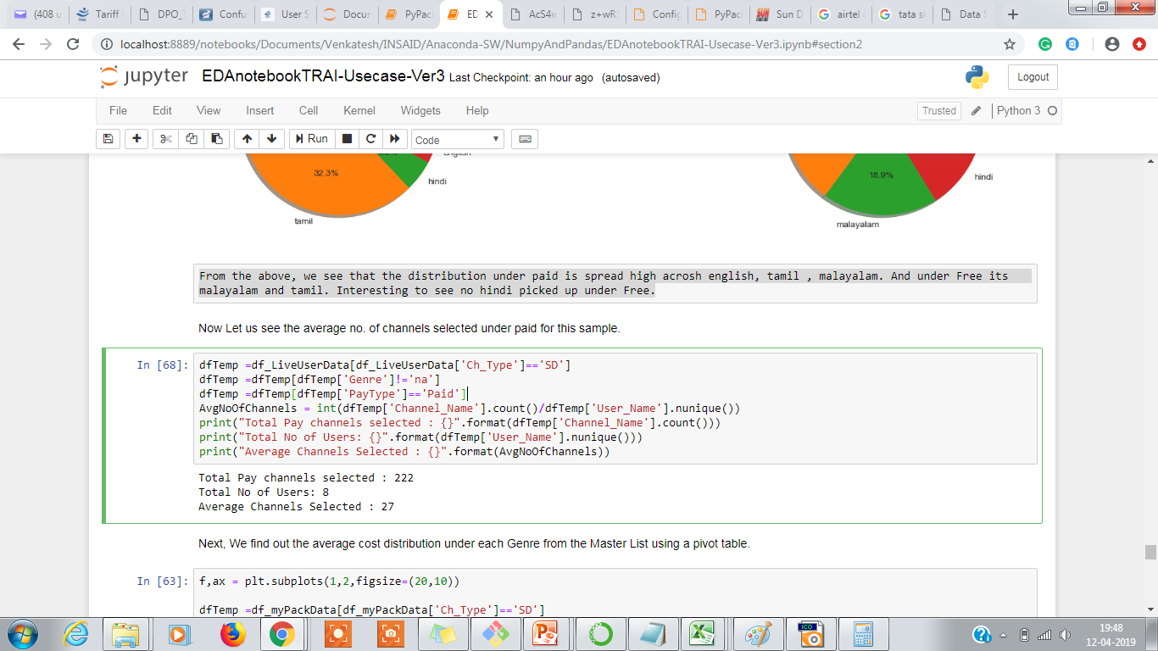
EDA – Analysis on the Sample Users
Now , let us see what is the average no. of channels selected under paid for these sample users.
Average channel selected under paid = 27.

Slide 21
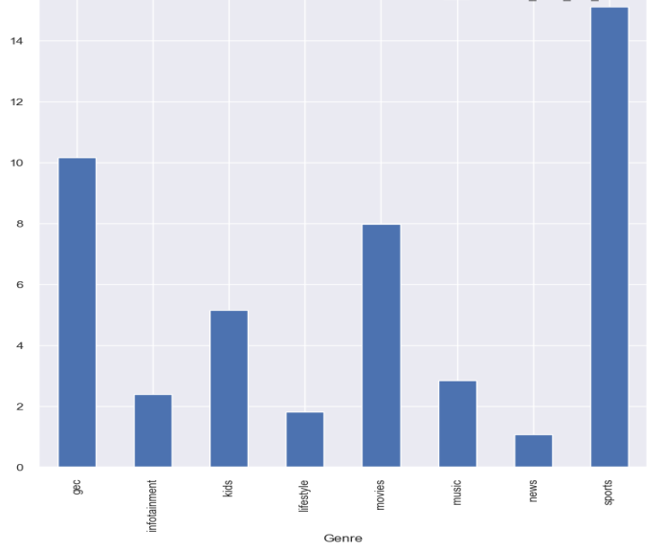
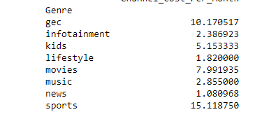
EDA – Computing Avg Cost(Master List)
Next, compute the average cost for each Genre from the Master List using pivot table.
The highest cost is for Sports(15) and GEC(10) and lowest for News(1) and Lifestyle(1.8)

Slide 22
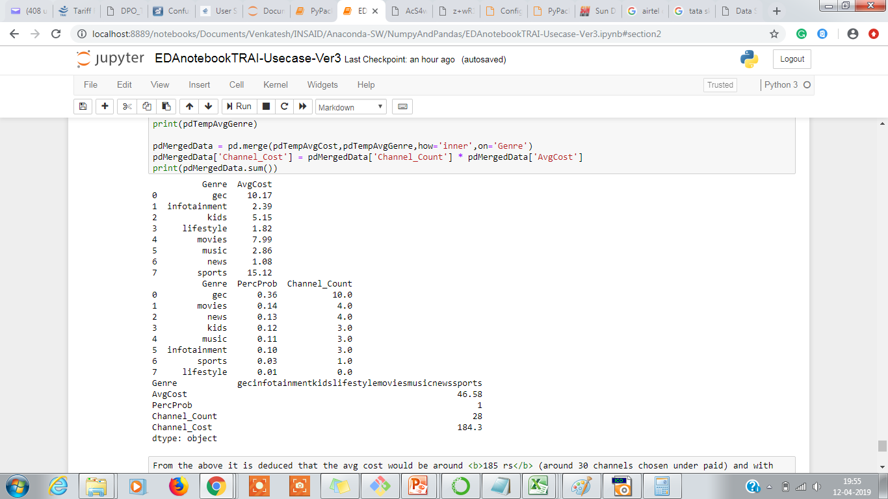
EDA – Computing Avg Cost of Cable Fee
Now, Assuming an average selection of 27 channels under paid we try to compute the average cost by assuming the distribution of Genre as per below,
GEC (36%) ,Movies (14%) ,News (13%) ,Music (11%) ,Kids (12%) ,Infotainment (10%) ,Sports (3%) and Lifestyle (1%)
The average cost computed is 184.3 ~ 185 rs.
We now add the NCF which is 153.40 rs to arrive at the
Average Cable Fee = 185 + 153 ~ 340 Rs

Slide 23
EDA – Conclusion
Total 498 SD channels available, Free 274(55%) vs Paid 224(45%) giving an indication there is lot available to chose from Free.
Majority of them are in 0-3(Low) and 3-8(Moderate) Range(106+53=159).
A good chunk is available in the High (>8-15) range(25) and Very High(>15-30) range (39).
Drilling down on the Cost distribution under Genre for Pay channel
GEC, Sports and Movies are the ones which will be adding to cost burden as they have a major chuck in High(15-18) & Very High bucket (18 – 25).
News, Infotainment, Lifestyle, Devotional, Kids and Music all offer under low(0-3) and moderate(3-8) cost buckets
Arriving at Average Cost,
From the Sample users, the distribution of Genre - GEC (36%) ,Movies (14%) ,News (13%) ,Music (11%) ,Kids (12%) ,Infotainment (10%) ,Sports (3%) ,Lifestyle (1%).
The average paid channels selected = 28.
The average cost using the above 2 information , would be around 340 Rs
Adding a +/- 20% variance to get the range as 301.40 Rs to 370.40 Rs
Below 2 options are suggested to help reduce their costs.
Option 1 : As prescribed by TRAI – try to keep the channel list around 50. Filter out the list channels which are only absolutely needed and discard the ones which we seldom or rarely watch. This if done wisely can reduce the cost by 5-10 %. which means the 185 Rs can be further reduced in the range of 165 Rs(10%) to 175 Rs(5%).
Option 2 : Use the pyPackRecommendation tool to achieve the benefits of using packs which offer lesser cost and try to reduce the cost by 10 to 20% which means the reduction would be in the range of140 Rs (assuming a 20% reduction) to 158 Rs(assuming a 10% reduction)
The above 2 recommendations if implemented correctly would bring down the cost in the range of 295 Rs to 312 Rs. But, this is still an increase of 45 Rs to 60 Rs when compared with consumers benchmark of 250 Rs. Hence the final conclusion is that even after following TRAIs guidelines , the users would see an increase in the cost of cable fees in the range of 50 Rs to 120 Rs when he is comparing it with his benchmark of 250 Rs.
However, the cost will not increase by 2 or 3 times as feared if they follow TRAIs recommendation of choosing the right count of channels(around 50) and use the optimisation tools to further reduce the cost through Pack/Bouquet selections.

Slide 24
Future Considerations
As TRAI faces pressure from consumers on reduction of cost , below are few things that can be considered
Reduce the NCF (which is currently a whopping 153.40 rs and is adds up to 50% of the average cost).
If this can be reduced by half(75 Rs) or even 50 rs will help consumers a lot as he can use this cut in picking up choice from the Paid category.
The broadcasters can reduce the cost of channels and work on increasing revenues through advertisements.
Below are few impacts we see in future.
The consumers will migrate to DTH(Airtel,Tatasky etc ) if they don’t provide transparency and ease of transactions. The worst affected will be the local cable operators as they are currently doing everything manual and this process takes a lot of time. The cable fees is also not transparent as we hear consumers complaining about not implementing the fees as per TRAIs new regulations.
The cost is going to be playing a major role in customers . Once consumers realise the benefits of "Packs/Bouquets" they would naturally want to see more offers. The Broadcasters will now find new competition in this space where the focus would be on providing wide variety Packs which are both attractive and economical at the same time.
New players might emerge( we already are hearing JIO ready to venture in DTH) and will be interesting to see what it has to offers.
Future considerations :
The above study was considered for south region, would like to do the same for north to see if there are major deviations which currently it is assumed to be none.
Use of an ML technique to improve the accuracy of the prediction of Average cost.

Slide 25
Using PyPack Recommendation Tool
User is not sure which pack offer the best savings
Provide the tool your wish list (the channels that your prefer to view). This is captured in MyPack worksheet. The Base Cost is sum of cost of all the paid channels in your wish list.
The tool uses this information and then starts comparing the set of channels against each of the packs offered by the service provider and picks up only those packs which offer the best saving.
Those which could not fit in any pack would be recommended to be added as ALACARTE.
The new cost is computed based on the recommended packs cost + ALACARTE. Also, it will add the Network Capacity Fee (153 Rs).
The savings will be Base Cost – Recommended Cost.
Notes:
Tool offered by TRAI : https://channel.trai.gov.in/channelbouquet.php

Slide 26
Using PyPack Recommendation Tool – Usecase 2
User already has pack but is not sure if that is the best which offers cost savings
Make a list of all the channels that the current pack offers and captured it in MyPack worksheet.
Refine your selection to see if any of these can be replaced by FTA channels or with ones which offer less cost. Remove the channels that you don’t watch. Make sure the new count is around 50 which is the recommended number.
Feed your new wish list to the pyPackRecommendation Tool to see what new packs it offers as savings and compare the cost from what you had in your current pack. If you see any benefits both in terms of cost or channels offered then move to this new plan by discarding the current and adding the new recommended packs.
Notes:
Tool offered by TRAI : https://channel.trai.gov.in/channelbouquet.php

Slide 27
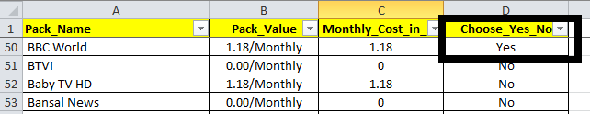

Steps to Follow to Run Recommendation Report
Step 1 : Open the below worksheet
Step 2 : Add all the channels to your wish list by marking the Choose_Yes_No as Yes in the “MyPack” sheet
Step 3 : Add the email id in the “MyEmail” sheet (ID to which you wish to receive the recommendation report). Leave it blank if you don’t want to receive the report.
Step 4: Keep the Recommender Script(PyPackage_Recommender_SR_Ver6.ipynb) , the configuration file(Configurator.py) and the WishList(xlsx file) in the same path and then Run the Python script from Jupiter Notebook to receive the report in your email id.

Slide 28
Thank You

