Slide 1
HR Analytics - Promotion Prediction
By:
Harish Kumar,
GCD, March 2019 Batch

Slide 2
Problem Statement
The goal is to choose a model to best predict the employee who is eligible for promotion.
Target variable is Is_Promoted, is binomial.
The data under prediction contains the Employee information of a MNC Company.
Column Name | Description
employee_id | Unique ID for employee
department | Department of employee
region | Region of employment (unordered)
education | Education Level
gender | Gender of employee
recruitment_channel | Channel of recruitment for employee
no_of_trainings | no of other trainings completed in previous year on soft skills, technical skills etc.
age | Age of employee
previous_year_rating | Employee Rating for the previous year
length_of_service | Length of service in years
KPIs_met >80% | if Percent of KPIs(Key performance Indicators) >80% then 1 else 0
awards_won? | if awards won during previous year then 1 else 0
avg_training_score | Average score in current training evaluations
is_promoted | (Target) Recommended for promotion

Slide 3
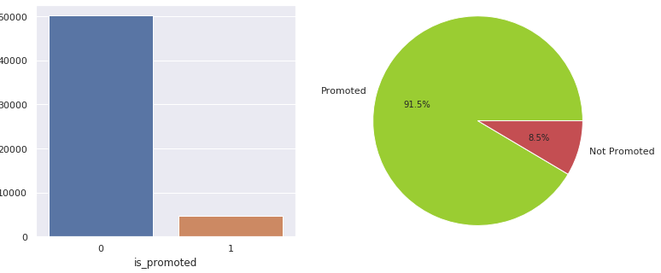
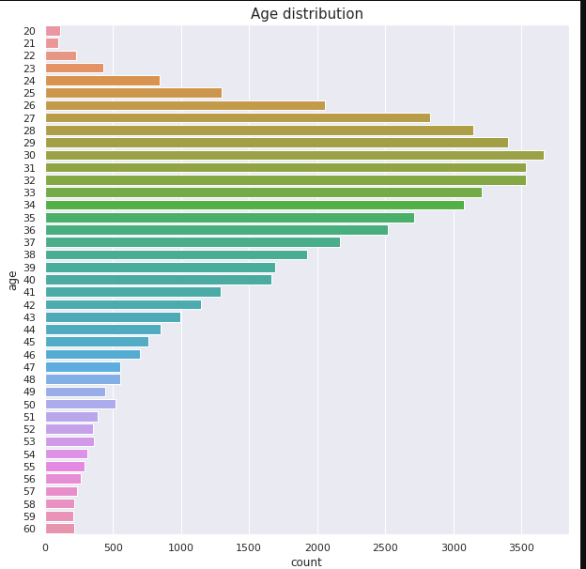
Exploratory Data Analysis
a. Is promoted
It is observed that of the total, only 91.5% tends to get promotion. It shows an imbalanced dataset.
b. Customers by Age
The age distribution is slightly right skewed, the peak is 30 years.
It would be a good idea to map age and create 4 different bins
<=26 , > 27 < 35 , > 35 < 50, > 50

Slide 4
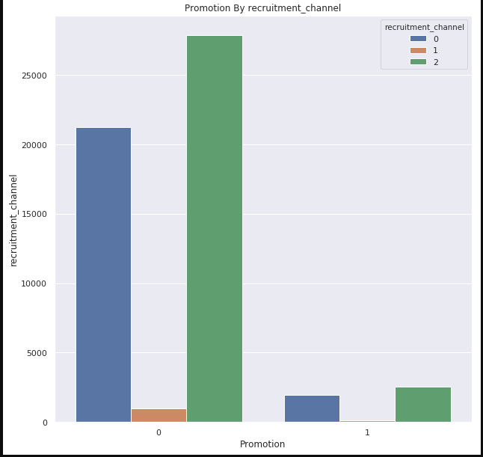
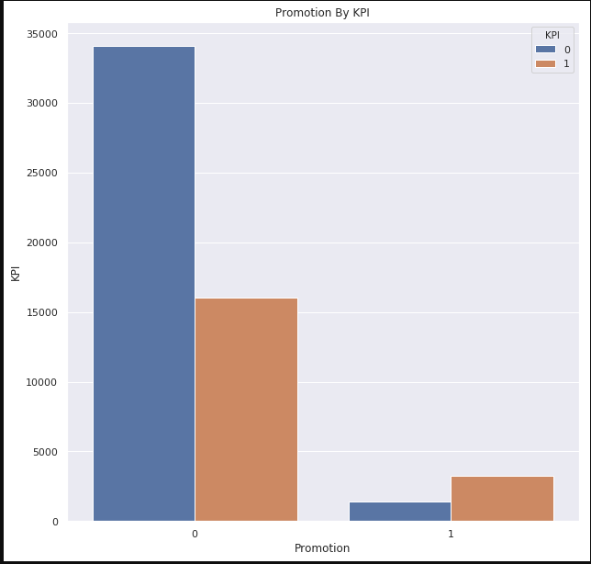
Promotion vs. recruitment channels
Shows promotion is not dependent on recruitment channels whether Sourcing, referred or other
Promotion vs. KPI
Promotion rate is higher for employees who met KPI .

Slide 5
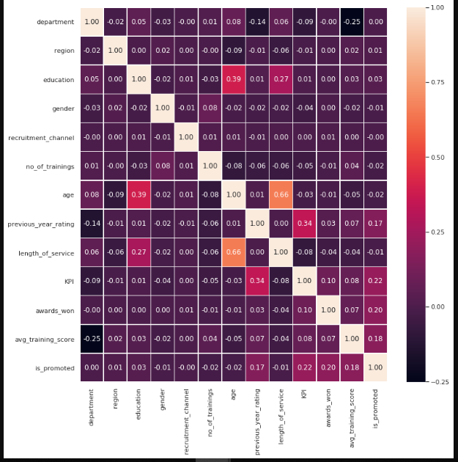
Correlation heat map
We see above almost all the variables are not directly correlated with promotion rate. The variables with the highest correlation (0.22 and 0.20 respectively) is whether the KPI is met and whether an award was won.

Slide 6
Data Preparation
Addressed missing values found in education and previous year rating by filling previous rating with mean of previous ratings and education with mode value of education with group by promotion
Mapped Gender to binary format
Mapped Education categories to numeric categories, Below Secondary=0, Bachelor=1 and Master\'s & above=2
Mapped recruitment_channel to sourcing=0, referred=1, other=2
Created four bin’s for Age <=26 , > 27 < 35 , > 35 < 50, > 50
Transformed the multi-class categorical columns department and region using One Hot Encoding
Scaled data using MinMaxScaler

Slide 7
Model Building
Built Training Models using Logistic Regression, Decision Tree, Random Forest, Gradient Boost, XGBoost, AdaBoost, KNN and SVC.
Tried to optimize Metrics using GridSearchSV and could not achieve better metrics
Since the data set is imbalanced applied, SMOTE. with and without GridSearchSV and achieved little better Metrics
Since the data set is imbalanced applied, Under sampling. with and without GridSearchSV and achieved better Metrics
Contd..

Slide 8
Model Metrics – without hyper parameters
 | Model Name | Accuracy | Precision | Recall | F1 Score | ROC AUC
1 | LogisticRegression | 0.920993 | 0.631579 | 0.07327 | 0.544961 | 0.534739
2 | RandomForest | 0.935257 | 0.739336 | 0.317503 | 0.70493 | 0.653786
3 | DecisionTreeClassifier | 0.90308 | 0.417699 | 0.480326 | 0.696858 | 0.710457
4 | GradientBoostingClassifier | 0.944435 | 0.958904 | 0.332429 | 0.732154 | 0.665582
5 | AdaBoostClassifier | 0.928899 | 0.783133 | 0.176391 | 0.625255 | 0.586028
6 | XGBClassifier | 0.941671 | 0.954447 | 0.298507 | 0.711984 | 0.648622
7 | KNeighborsClassifier | 0.930558 | 0.75 | 0.221845 | 0.652876 | 0.607642
8 | SVC | 0.936363 | 0.928382 | 0.237449 | 0.67232 | 0.617912
The model GradientBoostingClassifier is providing better F1 Score but recall is low among all

Slide 9
Model Metrics – with GridSearchSV
 | Model Name | Accuracy | Precision | Recall | F1 Score | ROC AUC
1 | LogisticRegression | 0.920993 | 0.630058 | 0.0739484 | 0.545487 | 0.535048
2 | RandomForest | 0.933488 | 0.947195 | 0.194708 | 0.644021 | 0.596873
3 | DecisionTreeClassifier | 0.93863 | 0.917431 | 0.27137 | 0.693226 | 0.634602
4 | XGBClassifier | 0.941671 | 0.954447 | 0.298507 | 0.711984 | 0.648622
5 | KNeighborsClassifier | 0.928015 | 0.887387 | 0.13365 | 0.597274 | 0.566073
6 | SVC | 0.918505 | 0 | 0 | 0.478761 | 0.5
The model XGBClassifier provided improved is F1 Score but recall is still low among all

Slide 10
Model Metrics – without hyper parameters & Oversampling - SMOTE
 | Model Name | Accuracy | Precision | Recall | F1 Score | ROC AUC
1 | LogisticRegression | 0.728645 | 0.190742 | 0.718453 | 0.566535 | 0.724001
2 | RandomForest | 0.928623 | 0.62249 | 0.315468 | 0.690354 | 0.649247
3 | DecisionTreeClassifier | 0.902084 | 0.413411 | 0.481004 | 0.695481 | 0.710225
4 | GradientBoostingClassifier | 0.930945 | 0.665685 | 0.306649 | 0.691583 | 0.646492
5 | AdaBoostClassifier | 0.886217 | 0.320418 | 0.35346 | 0.636952 | 0.643473
6 | XGBClassifier | 0.931885 | 0.714539 | 0.273406 | 0.679697 | 0.631857
7 | KNeighborsClassifier | 0.780395 | 0.200623 | 0.567843 | 0.583192 | 0.683548
8 | SVC | 0.839996 | 0.270968 | 0.569878 | 0.637856 | 0.71692
The model SVC is providing better F1 Score and Recall but little low

Slide 11
Model Metrics – with GridSearchSV & Oversampling - SMOTE
 | Model Name | Accuracy | Precision | Recall | F1 Score | ROC AUC
1 | LogisticRegression | 0.728645 | 0.190742 | 0.718453 | 0.566535 | 0.724001
2 | RandomForest | 0.928623 | 0.62249 | 0.315468 | 0.690354 | 0.649247
3 | DecisionTreeClassifier | 0.902084 | 0.413411 | 0.481004 | 0.695481 | 0.710225
4 | XGBClassifier | 0.931885 | 0.714539 | 0.273406 | 0.679697 | 0.631857
5 | KNeighborsClassifier | 0.819649 | 0.245299 | 0.584125 | 0.62046 | 0.712336
6 | SVC | 0.665948 | 0.139064 | 0.597015 | 0.506313 | 0.634539
There is no much improvement with metrics

Slide 12
Model Metrics – without hyper parameters & with Under sampling
 | Model Name | Accuracy | Precision | Recall | F1 Score | ROC AUC
1 | LogisticRegression | 0.724764687 | 0.728978008 | 0.724293059 | 0.724751899 | 0.72476948
2 | RandomForest | 0.782538137 | 0.782886335 | 0.787917738 | 0.782499621 | 0.782483459
3 | DecisionTreeClassifier | 0.774748458 | 0.774522293 | 0.781491003 | 0.774700396 | 0.774679928
4 | GradientBoostingClassifier | 0.829925349 | 0.768191268 | 0.949871465 | 0.827024351 | 0.828706224
5 | AdaBoostClassifier | 0.767932489 | 0.778292522 | 0.755784062 | 0.767927698 | 0.768055965
6 | XGBClassifier | 0.829276209 | 0.767116183 | 0.950514139 | 0.826304437 | 0.828043955
7 | KNeighborsClassifier | 0.677052905 | 0.697118763 | 0.637532134 | 0.676698561 | 0.677454591
8 | SVC | 0.731580656 | 0.734707019 | 0.733290488 | 0.731558485 | 0.731563277
Below is the Test result on non under sampled test data
 | Model Name | Accuracy | Precision | Recall | F1 Score | ROC AUC
1 | GradientBoostingClassifier | 0.727152 | 0.224311 | 0.955224 | 0.59484 | 0.83107
2 | XGBClassifier | 0.723503 | 0.222152 | 0.956581 | 0.592092 | 0.829702
The model GradientBoostingClassifier is providing good Recall Score & F1

Slide 13
Model Metrics – with GridSearch & Under sampling
 | Model Name | Accuracy | Precision | Recall | F1 Score | ROC AUC
1 | LogisticRegression | 0.724764687 | 0.728978008 | 0.724293059 | 0.724751899 | 0.72476948
2 | RandomForest | 0.782538137 | 0.782886335 | 0.787917738 | 0.782499621 | 0.782483459
3 | DecisionTreeClassifier | 0.774748458 | 0.774522293 | 0.781491003 | 0.774700396 | 0.774679928
4 | XGBClassifier | 0.831872769 | 0.776947705 | 0.935732648 | 0.829687453 | 0.830817144
5 | KNeighborsClassifier | 0.731905226 | 0.758498584 | 0.688303342 | 0.73154411 | 0.732348392
6 | SVC | 0.614086336 | 0.637659415 | 0.546272494 | 0.612581812 | 0.614775591
Below is the Test result on non under sampled test data
 | Model Name | Accuracy | Precision | Recall | F1 Score | ROC AUC
1 | GradientBoostingClassifier | 0.727152098 | 0.224310977 | 0.955223881 | 0.594840484 | 0.831070075
2 | XGBClassifier | 0.747553491 | 0.238763096 | 0.958616011 | 0.611832189 | 0.843721417
The metric values reduced with Gridsearchcv , so Under sampling without Gridsearchcv is providing better results

Slide 14
Conclusion
Since data set is imbalanced, we preferred to use F1 score & Recall rather than accuracy to measure the Model
The Model GradientBoostingClassifier with Under sample is providing good F1= 0.83 & Recall Score= 0.93 , but the F1 Score reduced little bit when tested on non under sampled test data set so suggesting below model as well
The Model XGBClassifier SMOTE and GridSearchCV providing better F1 Score=0.748 & Recall Score= 0.72
Either of above two models can be used for promotion prediction depending on business requirement
Top five features are KPI, awards_won, previous_year_rating, department and avg_training_score which contributes for prediction

Slide 15
Thank You !!

