Slide 1











16:198:512 - Introduction to Data Structures and Algorithms
Course Instructor: Antonio Miranda Garcia
Content:
Overview and approach
Algorithm
Step by Step process of Hungarian Approach
Step by Step process of Greedy Approach
Greedy vs Hungarian Approach in Visual output
Greedy vs Hungarian Approach vs Brute force Summary

Slide 2
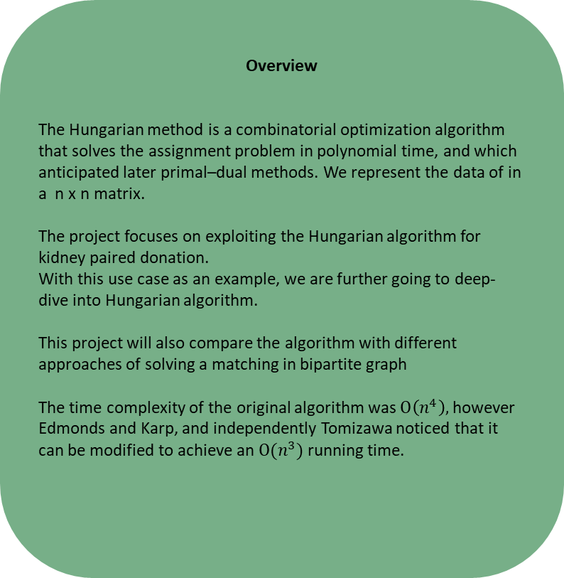
KIDNEY PAIRED DONATION OPTIMAL MATCHINGS IN BIPARTITE GRAPHS USING HUNGARIAN ALGORITHM
Overview
The Hungarian method is a combinatorial optimization algorithm that solves the assignment problem in polynomial time, and which anticipated later primal–dual methods. We represent the data of in a n x n matrix.
The project focuses on exploiting the Hungarian algorithm for kidney paired donation.
With this use case as an example, we are further going to deep-dive into Hungarian algorithm.
This project will also compare the algorithm with different approaches of solving a matching in bipartite graph
The time complexity of the original algorithm was $O\left(n^{4}\right),$however Edmonds and Karp, and independently Tomizawa noticed that it can be modified to achieve an $O(n^{3})$running time.
Approach
We represent a bipartite graph in form of matrix as an input to Hungarian algorithm. Each cell represents a compatibility metric between The Donor and The Patient. By utilizing the Hungarian Algorithm, we find the maximum match between Donors and patients.
In the matrix formulation, we are given a nonnegative n×n matrix, where the element in the i-th row and j-th column represents the match of the j-th patient to the i-th donor. We have to find an assignment of the patient to the donor, such that each patient is assigned to one donor and each donor is assigned one patient, such that the total compatibility of assignment is maximum.
In general, Hungarian algorithm is used to find the minimum cost of the assignments. However, in this case we will maximize the assignment (compatibilities). The maximum is obtained by taking compliment of the given matrix and then minimize the cost/compatibility matrix. The resulting output is a maximization assignment.
Complement Matrix = Matrix.max() – each value in matrix
.

Slide 3
Kidney paired donation optimal matchings in bipartite graphs using Hungarian Algorithm
Algorithm
Step 1: Subtract row minima
For each row, find the lowest element and subtract it from each element in that row.
Step 2: Subtract column minima
Similarly, for each column, find the lowest element and subtract it from each element in that column.
Step 3: Cover all zeros with a minimum number of lines
Cover all zeros in the resulting matrix using a minimum number of horizontal and vertical lines. If n lines are required, an optimal assignment exists among the zeros. The algorithm stops.
If less than n lines are required, continue with Step 4.
Step 4: Create additional zeros
Find the smallest element (call it k) that is not covered by a line in Step 3. Subtract k from all uncovered elements and add k to all elements that are covered twice.
Consider the below is a matrix of Kidney matches (out of 100) between patient and donor.
 | Patient_1 | Patient_2 | Patient_3 | Patient_4
Donor_1 | 82 | 83 | 69 | 92
Donor_2 | 77 | 37 | 49 | 92
Donor_3 | 11 | 69 | 5 | 86
Donor_4 | 8 | 9 | 98 | 23

Slide 4
Step by Step process of Hungarian Approach
Step 1: Subtract row minima
We start with subtracting the row minimum from each row. The smallest element in the first row is, for example, 69. Therefore, we subtract 69 from each element in the first row. The resulting matrix is:
Step 2: Subtract column minima
Similarly, we subtract the column minimum from each column, giving the following matrix:
 | Patient_1 | Patient_2 | Patient_3 | Patient_4
Donor_1 | 13 | 14 | 0 | 23 | (-69)
Donor_2 | 40 | 0 | 12 | 55 | (-37)
Donor_3 | 6 | 64 | 0 | 81 | (-5)
Donor_4 | 0 | 1 | 90 | 15 | (-8)
 | Patient_1 | Patient_2 | Patient_3 | Patient_4
Donor_1 | 13 | 14 | 0 | 8
Donor_2 | 40 | 0 | 12 | 40
Donor_3 | 6 | 64 | 0 | 66
Donor_4 | 0 | 1 | 90 | 0
 |  |  |  | (-15)

Slide 5
Step by Step process of Hungarian Approach
Step 3: Cover all zeros with a minimum number of lines
We will now determine the minimum number of lines (horizontal or vertical) that are required to cover all zeros in the matrix. All zeros can be covered using 3 lines:
Because the number of lines required (3) is lower than the size of the matrix (n=4), we continue with Step 4.
Step 4: Create additional zeros
First, we find that the smallest uncovered number is 6. We subtract this number from all uncovered elements and add it to all elements that are covered twice. This results in the following matrix:
Now we return to Step 3.
 | Patient_1 | Patient_2 | Patient_3 | Patient_4
Donor_1 | 13 | 14 | 0 | 8
Donor_2 | 40 | 0 | 12 | 40 | X
Donor_3 | 6 | 64 | 0 | 66
Donor_4 | 0 | 1 | 90 | 0 | X
 |  |  | x
 | Patient_1 | Patient_2 | Patient_3 | Patient_4
Donor_1 | 7 | 8 | 0 | 2
Donor_2 | 40 | 0 | 18 | 40
Donor_3 | 0 | 58 | 0 | 60
Donor_4 | 0 | 1 | 96 | 0

Slide 6
Step by Step process of Hungarian Approach
Step 3: Cover all zeros with a minimum number of lines
Again, We determine the minimum number of lines required to cover all zeros in the matrix. Now there are 4 lines required:
The optimal assignment
The following zeros cover an optimal assignment:
 | Patient_1 | Patient_2 | Patient_3 | Patient_4
Donor_1 | 7 | 8 | 0 | 2 | X
Donor_2 | 40 | 0 | 18 | 40 | X
Donor_3 | 0 | 58 | 0 | 60 | X
Donor_4 | 0 | 1 | 96 | 0 | X
 | Patient_1 | Patient_2 | Patient_3 | Patient_4
Donor_1 | 7 | 8 | 0 | 2
Donor_2 | 40 | 0 | 18 | 40
Donor_3 | 0 | 58 | 0 | 60
Donor_4 | 0 | 1 | 96 | 0
Because the number of lines required (4) equals the size of the matrix (n=4), an optimal assignment exists among the zeros in the matrix. Therefore, the algorithm stops.

Slide 7
Hungarian Approach
The optimal assignment
This corresponds to the following optimal assignment in the original cost matrix with minimum cost match:
The optimal assignment
Similarly, (Considering the matrix holds compatibility values between donor and patient) the maximum match with optimal assignment with maximum compatibility match are:
 | Patient_1 | Patient_2 | Patient_3 | Patient_4
Donor_1 | 82 | 83 | 69 | 92
Donor_2 | 77 | 37 | 49 | 92
Donor_3 | 11 | 69 | 5 | 86
Donor_4 | 8 | 9 | 98 | 23
 | Patient_1 | Patient_2 | Patient_3 | Patient_4
Donor_1 | 82 | 83 | 69 | 92
Donor_2 | 77 | 37 | 49 | 92
Donor_3 | 11 | 69 | 5 | 86
Donor_4 | 8 | 9 | 98 | 23

Slide 8
Step by Step process of Greedy Approach
For every Donor starting from the first, pick the patient with the highest compatibility and set the compatibility for that patient to - ∞ to remove it from future consideration. Consider the same matrix.
 | Patient_1 | Patient_2 | Patient_3 | Patient_4
Donor_1 | 82 | 83 | 69 | 92
Donor_2 | 77 | 37 | 49 | - ∞
Donor_3 | 11 | 69 | 5 | - ∞
Donor_4 | 8 | 9 | 98 | - ∞
 | Patient_1 | Patient_2 | Patient_3 | Patient_4
Donor_1 | - ∞ | 83 | 69 | 92
Donor_2 | 77 | 37 | 49 | - ∞
Donor_3 | - ∞ | 69 | 5 | - ∞
Donor_4 | - ∞ | 9 | 98 | - ∞
 | Patient_1 | Patient_2 | Patient_3 | Patient_4
Donor_1 | - ∞ | - ∞ | - ∞ | 92
Donor_2 | 77 | - ∞ | - ∞ | - ∞
Donor_3 | - ∞ | 69 | - ∞ | - ∞
Donor_4 | - ∞ | - ∞ | 98 | - ∞
 | Patient_1 | Patient_2 | Patient_3 | Patient_4
Donor_1 | - ∞ | - ∞ | 69 | 92
Donor_2 | 77 | - ∞ | 49 | - ∞
Donor_3 | - ∞ | 69 | 5 | - ∞
Donor_4 | - ∞ | - ∞ | 98 | - ∞

Slide 9
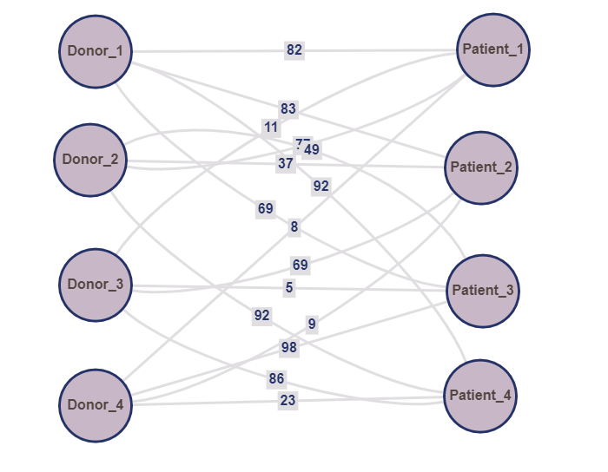
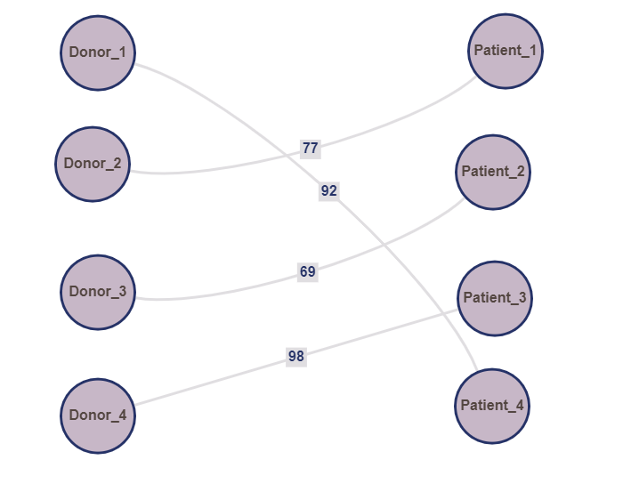
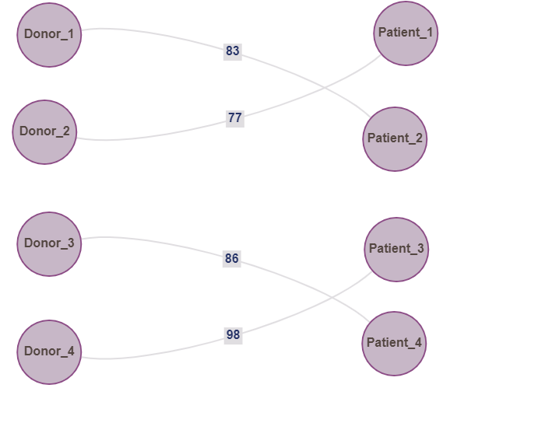
Final Graph with Greedy Algorithm
Visualization of the initial matrix
Visualization of Greedily Maximized Matching
Visualization of Hungarian Maximized Matching
The weight of the matching as maximized by greedy method is 336
Hungarian Algorithm gives us a maximum matching of weight 344

Slide 10
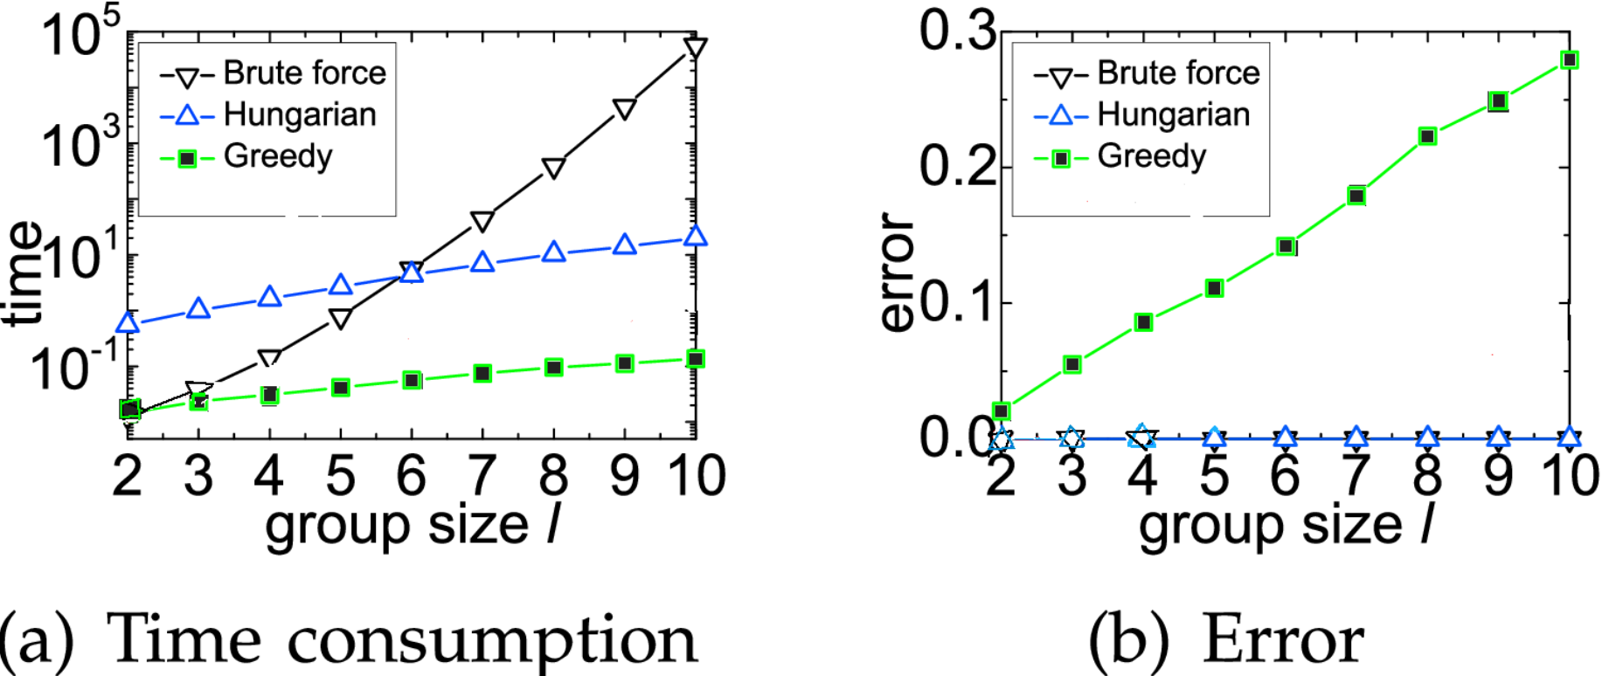

Project Summary
The brute force method or solving an assignment problem gives an optimal solution with maximum matching. However, the complexity of the algorithm is much higher.
Time complexity: $O(n!)$
The greedy approach solves the algorithm quicker; however, it only returns a suboptimal solution. In other words, the greedy approach, might or might not give the maximum matching in a bipartite graph.
Time complexity: ($O(n^{2})$)
The Hungarian algorithm, returns the maximum bipartite matching (optimal solution) with a reasonable time complexity.
$$\text{Time} \text{complexity}\text{:} O(n^{3})$$
Fig: The time consumption and error comparison for each of the approaches are shown above

Slide 11
Team
Course Instructor: Antonio Miranda Garcia
Position: Associate Teaching Professor
Email Address: antonio.miranda@rutgers.edu
Date of Submission of Project: December 17 2021
Topic: Kidney paired donation optimal matchings in bipartite graphs using Hungarian algorithm
Teja Paladgu:
tp577
Swathi Gopal:
sd1322
Harish Udhaya Kumar:
hu33
Yashraj Gangal:
Yg457

