Slide 1
Hungarian Algorithm
1
The Hungarian method is a combinatorial optimization algorithm that solves the assignment problem in polynomial time, and which anticipated later primal–dual methods. It was developed and published in 1955 by Harold Kuhn, who gave the name "Hungarian method" because the algorithm was largely based on the earlier works of two Hungarian mathematicians: Dénes Kőnig and Jenő Egerváry.
2
The time complexity of the original algorithm was {O($n^{4}$)}. However, Edmonds and Karp, and independently Tomizawa noticed that it can be modified to achieve an {O(n^{3})} running time. One of the most popular[citation needed] {O($n^{3}$)}variants is the Jonker–Volgenant algorithm

Slide 2
Hungarian Algorithm
Given below is a matrix of Kidney matches (out of 100) between patient and donor.
 | Patient_1 | Patient_2 | Patient_3 | Patient_4
Donor_1 | 82 | 83 | 69 | 92
Donor_2 | 77 | 37 | 49 | 92
Donor_3 | 11 | 69 | 5 | 86
Donor_4 | 8 | 9 | 98 | 23

Slide 3
Step 1: Subtract row minima
We start with subtracting the row minimum from each row. The smallest element in the first row is, for example, 69. Therefore, we subtract 69 from each element in the first row. The resulting matrix is:
Step 2: Subtract column minima
Similarly, we subtract the column minimum from each column, giving the following matrix:
 | Patient_1 | Patient_2 | Patient_3 | Patient_4
Donor_1 | 13 | 14 | 0 | 23 | (-69)
Donor_2 | 40 | 0 | 12 | 55 | (-37)
Donor_3 | 6 | 64 | 0 | 81 | (-5)
Donor_4 | 0 | 1 | 90 | 15 | (-8)
 | Patient_1 | Patient_2 | Patient_3 | Patient_4
Donor_1 | 13 | 14 | 0 | 8
Donor_2 | 40 | 0 | 12 | 40
Donor_3 | 6 | 64 | 0 | 66
Donor_4 | 0 | 1 | 90 | 0
 |  |  |  | (-15)

Slide 4
Step 3: Cover all zeros with a minimum number of lines
We will now determine the minimum number of lines (horizontal or vertical) that are required to cover all zeros in the matrix. All zeros can be covered using 3 lines:
Because the number of lines required (3) is lower than the size of the matrix (n=4), we continue with Step 4.
Step 4: Create additional zeros
First, we find that the smallest uncovered number is 6. We subtract this number from all uncovered elements and add it to all elements that are covered twice. This results in the following matrix:
Now we return to Step 3.
 | Patient_1 | Patient_2 | Patient_3 | Patient_4
Donor_1 | 13 | 14 | 0 | 8
Donor_2 | 40 | 0 | 12 | 40 | X
Donor_3 | 6 | 64 | 0 | 66
Donor_4 | 0 | 1 | 90 | 0 | X
 |  |  | x
 | Patient_1 | Patient_2 | Patient_3 | Patient_4
Donor_1 | 7 | 8 | 0 | 2
Donor_2 | 40 | 0 | 18 | 40
Donor_3 | 0 | 58 | 0 | 60
Donor_4 | 0 | 1 | 96 | 0

Slide 5
Step 3: Cover all zeros with a minimum number of lines
Again, We determine the minimum number of lines required to cover all zeros in the matrix. Now there are 4 lines required:
The optimal assignment
The following zeros cover an optimal assignment:
 | Patient_1 | Patient_2 | Patient_3 | Patient_4
Donor_1 | 7 | 8 | 0 | 2 | X
Donor_2 | 40 | 0 | 18 | 40 | X
Donor_3 | 0 | 58 | 0 | 60 | X
Donor_4 | 0 | 1 | 96 | 0 | X
 | Patient_1 | Patient_2 | Patient_3 | Patient_4
Donor_1 | 7 | 8 | 0 | 2
Donor_2 | 40 | 0 | 18 | 40
Donor_3 | 0 | 58 | 0 | 60
Donor_4 | 0 | 1 | 96 | 0
Because the number of lines required (4) equals the size of the matrix (n=4), an optimal assignment exists among the zeros in the matrix. Therefore, the algorithm stops.

Slide 6
The optimal assignment
Similarly, (Considering the matrix holds compatibility values between donor and patient) the maximum match with optimal assignment with maximum compatibility match are:
The optimal assignment
This corresponds to the following optimal assignment in the original cost matrix with minimum cost match:
 | Patient_1 | Patient_2 | Patient_3 | Patient_4
Donor_1 | 82 | 83 | 69 | 92
Donor_2 | 77 | 37 | 49 | 92
Donor_3 | 11 | 69 | 5 | 86
Donor_4 | 8 | 9 | 98 | 23
 | Patient_1 | Patient_2 | Patient_3 | Patient_4
Donor_1 | 82 | 83 | 69 | 92
Donor_2 | 77 | 37 | 49 | 92
Donor_3 | 11 | 69 | 5 | 86
Donor_4 | 8 | 9 | 98 | 23

Slide 7
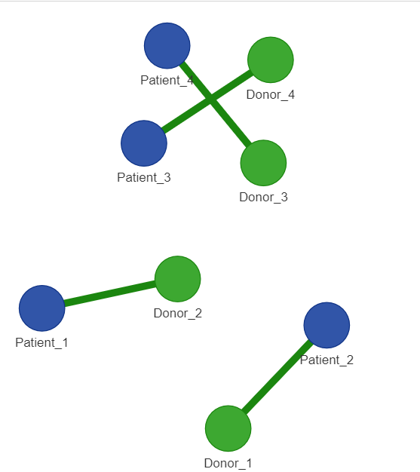
Final Graph for with optimal matching using Hungarian algorithm

Slide 8
Greedy Algorithm
Considering the same sample compatibility matching:
 | Patient_1 | Patient_2 | Patient_3 | Patient_4
Donor_1 | 82 | 83 | 69 | 92
Donor_2 | 77 | 37 | 49 | 92
Donor_3 | 11 | 69 | 5 | 86
Donor_4 | 8 | 9 | 98 | 23

Slide 9
Working
For every Donor starting from the first, pick the patient with the highest compatibility and set the compatibility for that patient to ∞ to remove it from future consideration.
1:
2:
 | Patient_1 | Patient_2 | Patient_3 | Patient_4
Donor_1 | 82 | 83 | 69 | 92
Donor_2 | 77 | 37 | 49 | 92
Donor_3 | 11 | 69 | 5 | 86
Donor_4 | 8 | 9 | 98 | 23
 | Patient_1 | Patient_2 | Patient_3 | Patient_4
Donor_1 | 82 | 83 | 69 | 92
Donor_2 | 77 | 37 | 49 | ∞
Donor_3 | 11 | 69 | 5 | ∞
Donor_4 | 8 | 9 | 98 | ∞
3:
4:
 | Patient_1 | Patient_2 | Patient_3 | Patient_4
Donor_1 | ∞ | 83 | 69 | 92
Donor_2 | 77 | 37 | 49 | ∞
Donor_3 | ∞ | 69 | 5 | ∞
Donor_4 | ∞ | 9 | 98 | ∞
 | Patient_1 | Patient_2 | Patient_3 | Patient_4
Donor_1 | ∞ | ∞ | 69 | 92
Donor_2 | 77 | ∞ | 49 | ∞
Donor_3 | ∞ | 69 | 5 | ∞
Donor_4 | ∞ | ∞ | 98 | ∞

Slide 10
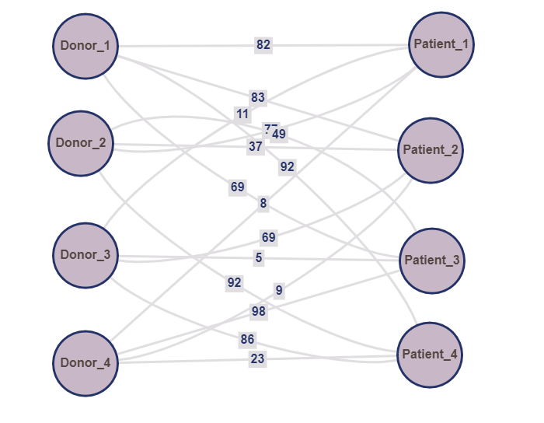
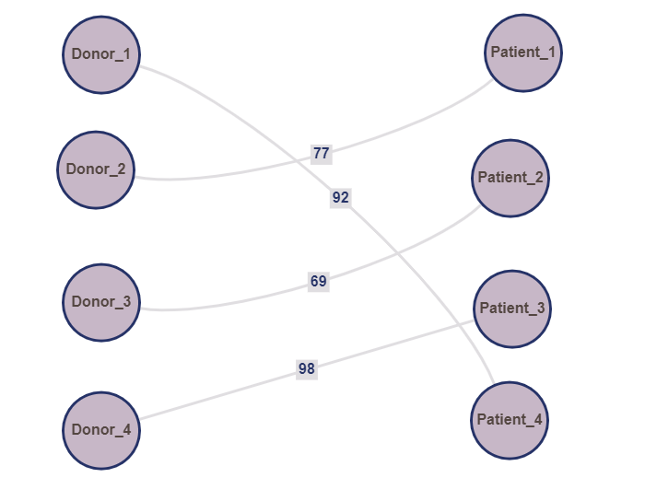
Final Graph with Greedy Algorithm
Compatibility Visualization
Greedily Maximized Matching

Slide 11
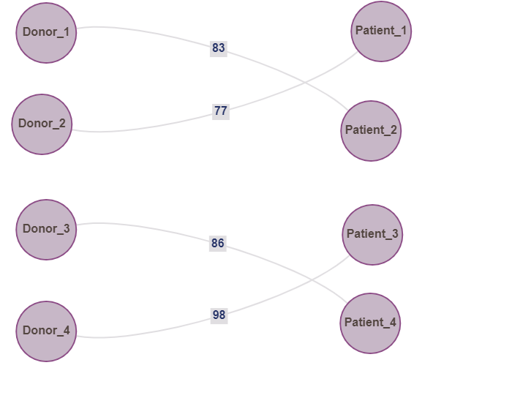
Greedy Algorithm vs Hungarian Algorithm
For the chosen example, the weight of the matching as maximized by greedy method is 336
Hungarian Algorithm gives us a maximum matching of weight 344

