Slide 1

PROJECT TITLE:
DETECTING TARGETED MALICIOUS EMAIL
PROJECT TITLE:
DETECTING TARGETED MALICIOUS EMAIL
FACULTY NAME:PROF.JAGADEESH
TEAM MEMBERS:
M.HARISH MOHAN(12MSE0044)
R.MOHAN(12MSE0267)

Slide 2
INTRODUCTION
Social networks are playing an important role in the internet world. These are used to share the information by SMTP (Simple Mail Transfer Protocol). While transferring the messages some malicious emails are received by the users this causes many problems either at the server side or at the client side. This type of messages may contain viruses, or it could be due to the message being crafted. This project explains how the malicious emails are classified and how these are deleted and know the contents of messages. In order to classify here we are using a Bayesian spam filtering, Email filtering and J48 process which overcomes the This gives the accurate results when compared to the existing one. There are three steps to examine first one is to detect the malicious email second step is apply classifier to classify according to the emails received and send to trash automatically and delete directly.

Slide 3
Existing system:
Previously attackers are entering in network environment. Email attackers are creates the problems in network transmission. Some kinds of attacks are detects with the help of firewall and antivirus techniques. Detection of attacks possible using alert systems and learning systems. These kinds of systems are not working properly. It cannot possible for detect all kinds of attacks.

Slide 4
Proposed System:
Using new detection and filtering techniques starts the detection of phishing and spam emails. Every mail verifies with probability distribution characteristics. Once all the characteristics are satisfied in Meta data structure then to allow in inbox. In inbox all the mails are placed here only trust worthy mails of content. In total number of mails after performing the preprocessing operation then to apply here classification techniques. Classification gives the results like recipient and persistent mails

Slide 5
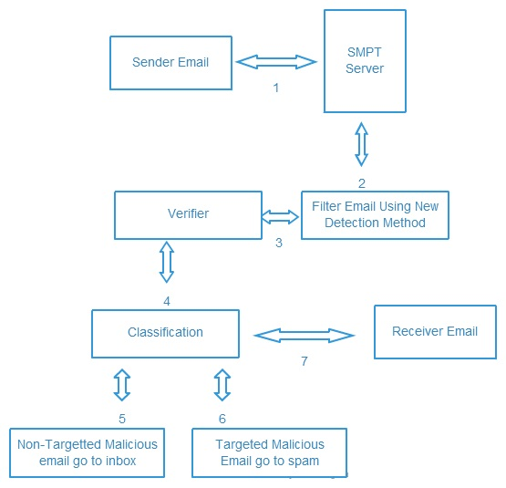
Architecture specifications

Slide 6
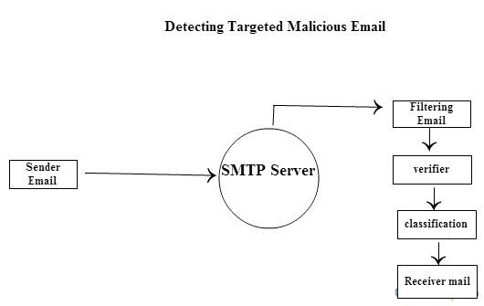
Data flow diagram

Slide 7
Configuration:
The interrelated functional and physical characteristics of a product defined in product configuration information.
The approved product configuration information that establishes the characteristics of a product at a point in time that serves as reference for activities throughout the life cycle of the product.
Configuration baselines:

Slide 8
CONFIGURATION MANAGEMENT RESPONSIBILITY:
The developer should identify and describe responsibilities and authorities related to the implementation and verification of the configuration management process. The following should be considered.
The complexity and nature of the software.
The needs of the different product life cycle stages
The interfaces between activities directly involved in the configuration management process;
The other relevant interested parties that may be involved, within and outside the organization.
The identification of the responsible authority for verifying implementation activities.
The identification of the dispositioning authority.

Slide 9
Interface:
The definition of the interfaces is one of the most important planning elements for ensuring a smoothing operation. Every possible effort should be made to reach the common agreement regarding each organization’s responsibility regarding the interface(s) and then document them in the subsection.

Slide 10
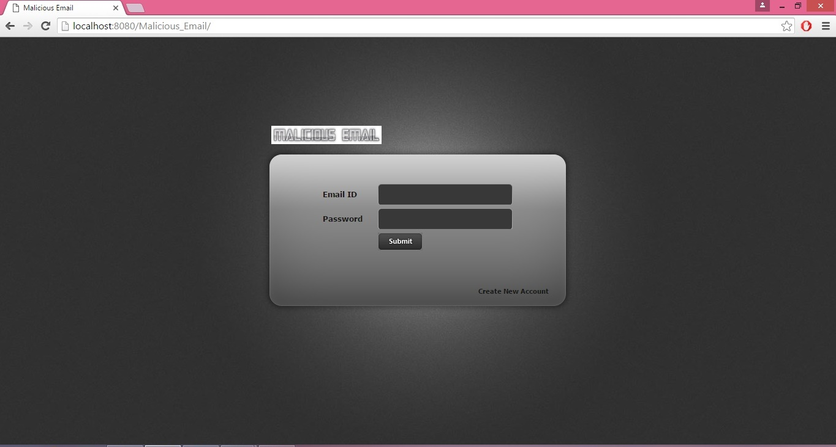

Slide 11
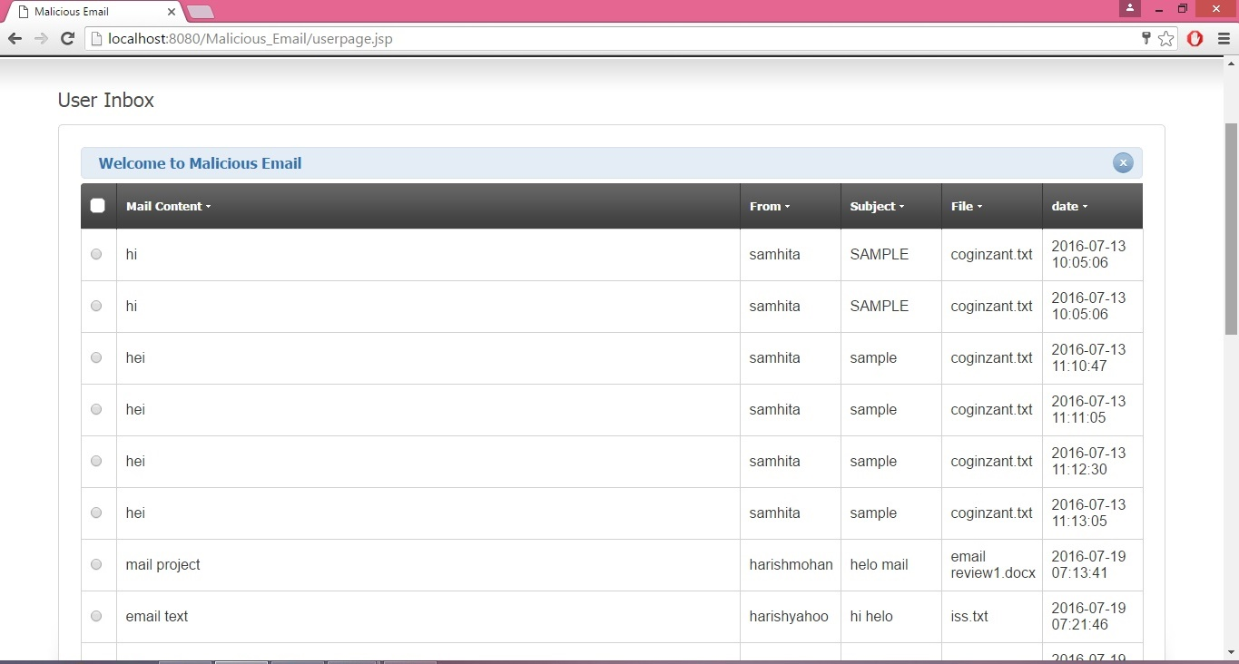

Slide 12
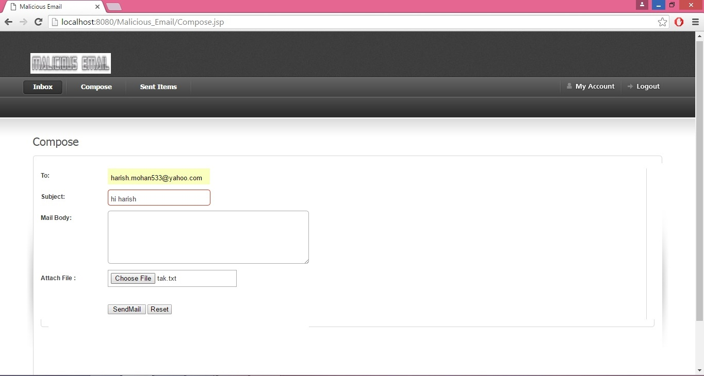

Slide 13
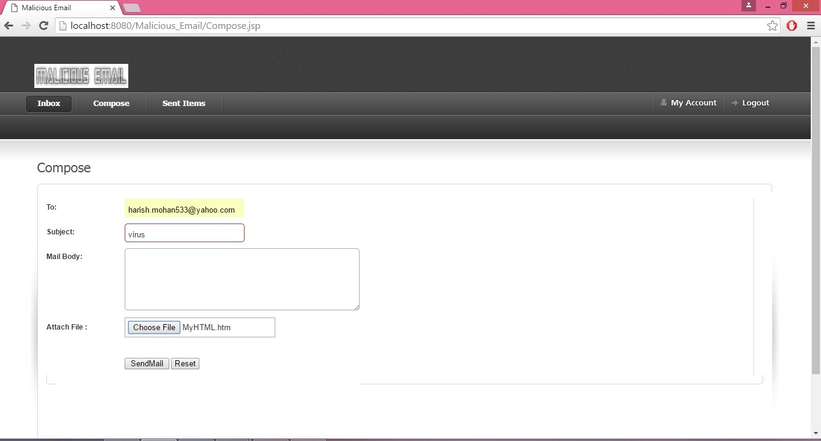

Slide 14
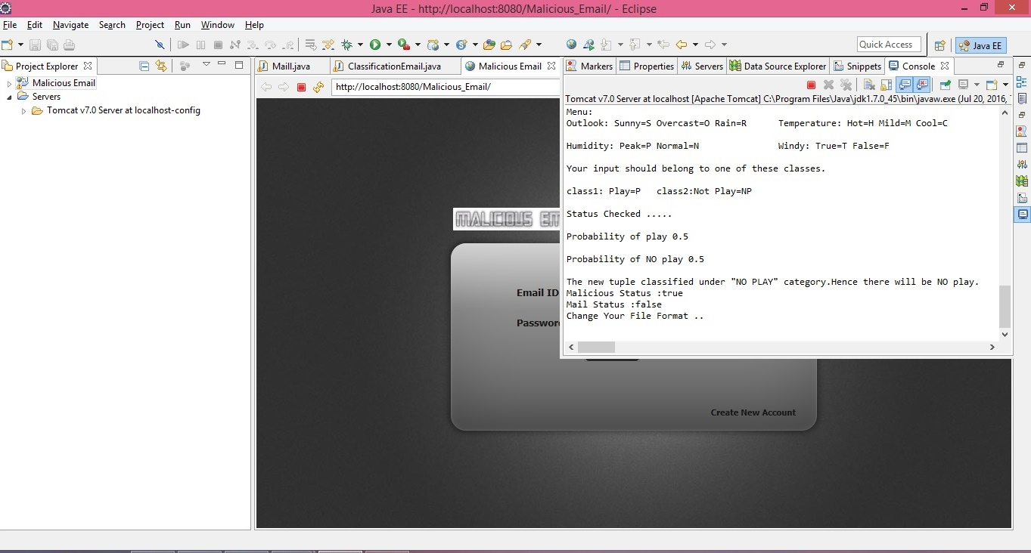

Slide 15
The end

