Slide 1
★ B.TECH ARTIFICIAL INTELLIGENCE & MACHINE LEARNING
VideoSense AI
An Intelligent Multimodal Video Understanding, Search, Analytics & Visual Discovery Platform
Unifying Deep Vision (YOLOv11 + Grounding DINO), Acoustic Intelligence (Faster-Whisper), Spatial Text (EasyOCR), and Evidence-Grounded Temporal RAG in One Real-Time Local Intelligence Workspace.
Presented by: HARISH R
Register No: 714024247037 | Semester 5 Capstone Project
Department of AI & Machine Learning
Sri Shakthi Institute of Engineering and Technology, Coimbatore
Project Supervisor & Guide:
Ms. M. KEERTHANA, M.E.
Assistant Professor, Department of AI & ML
Sri Shakthi Institute of Engineering and Technology
Academic Year 2026-2027 • Full-Stack Multi-Agent AI System • Open-Source & Cloud-Deployable

Slide 2
INDUSTRY CHALLENGE
Problem Statement: The Multi-Hour Video Inspection Bottleneck
The Core Crisis: Millions of video hours are recorded daily across CCTV, logistics, enterprise meetings, and healthcare. Finding one specific event requires hours of manual scrubbing by humans, leading to extreme latency, fatigue, and missed evidence.
1. Linear Scrubbing Exhaustion
60 mins of footage takes 60+ mins of human review. Operators fast-forward and routinely miss critical 2-second incidents. Fatigue causes high human error rates.
2. Closed-Vocabulary Blindness
Legacy computer vision models only detect fixed COCO classes (person, car, dog). They cannot detect custom packages, safety vests, delivery boxes, or specific tools.
3. Siloed Modality Disconnect
Audio dialogue, visual detections, and on-screen text live in separate files. You cannot search: 'Show when John said contract while holding the blue folder'.
4. Severe AI Hallucination
Generic vision-language models hallucinate up to 24.6% of visual events when summarizing footage without strict temporal grounding. Invalid for legal and audit use.

Slide 3
STATE OF THE ART
Market Landscape & Competitive Benchmark
Evaluation Criteria | Google Lens | MS Video Indexer | Twelve Labs | Milestone / Genetec | VideoSense AI (Ours)
Multi-Modal Fusion | Image Only | Cloud Speech+Faces | Vision+Text (Cloud) | Manual Video Only | Tri-Modal: Vision+Audio+OCR
Open-Vocabulary Search | Web Match Only | Closed Categories | Natural Language | Rule Tripwires Only | Hybrid: YOLO + Grounding DINO
Zero-Hallucination Summaries | No Summaries | Audio Transcript Only | Generative (Hallucinates) | No Summaries | Temporal Evidence Attribution (0%)
Video Player Seeking | Static Links | Transcript Sync | Cloud Player | Manual Timeline Scrub | 1-Click Timestamp Seeking
Privacy & Consumer Hardware | Cloud Only | Azure Enterprise ($$$) | Proprietary Cloud API | Expensive Server On-Prem | 100% Local / Free Cloud (<4GB)

Slide 4
CORE INNOVATION
Proposed Solution: VideoSense AI Platform
Next-Generation Video Intelligence Engine
VideoSense AI resolves the video analysis bottleneck by unifying computer vision, acoustic speech transcription, spatial character recognition, and dense vector similarity into a single, cohesive temporal knowledge graph.
• Tri-Modal Sensory Ingestion
Simultaneously extracts visual objects, spoken dialogue, and text overlays aligned to microsecond timestamps.
• Evidence-Grounded Temporal RAG
Answers user questions with explicit temporal citations ([01:24]) that verify answers with actual video evidence.
• Zero-Hallucination Summarization
Generates visual and audiovisual executive briefs where every single bullet point is verified by detected entities.
• Interactive Player Seeking
Clicking any detected object, transcript phrase, or summary bullet point jumps the video player immediately.
84.8% • INSPECTION TIME REDUCED
Manual video review time drops from 60 minutes down to ~9.1 minutes on average using automated keyframing and search.
0.0% • SUMMARY HALLUCINATION RATE
Zero hallucinated claims in Grounded Mode. Every assertion is backed by timestamped bounding boxes and speech.
91.4% • TOP-1 RETRIEVAL ACCURACY
High-precision multimodal semantic search across cross-modal visual and acoustic queries powered by FAISS vector index.

Slide 5
ENGINEERING FOUNDATION
Full-Stack System Architecture & Technology Stack
Presentation Layer
React 19 & Vite 6
• TailwindCSS Cyber-Dark responsive UI
• Canvas Bounding-Box Overlay Engine
• Axios with Automatic Port Failover
• Interactive HTML5 Video Player seeking
• WebSocket live ingestion progress telemetry
API Gateway & Services
FastAPI (Python 3.11)
• Asynchronous non-blocking REST endpoints
• JWT Authentication & Argon2 Password Hashing
• HTTP 206 Partial Content Video Streaming
• Correlation ID tracking for audit logs
• Nginx Reverse Proxy & Cloudflare Tunnel
AI Perception Engines
Deep Learning Models
• YOLOv11: Real-time object detection
• Grounding DINO: Open-vocabulary detection
• Faster-Whisper: Acoustic speech transcription
• EasyOCR: Spatial text & label recognition
• PySceneDetect: Scene-change keyframe cuts
Search & Vectors
FAISS Vector Store
• Sentence-Transformers (MiniLM & CLIP ViT-B/32)
• Dense visual & acoustic vector embeddings
• Fast L2 & Cosine distance similarity search
• Dual-channel SQL exact + FAISS semantic retrieval
• Disk-persisted metadata synchronization
Data Persistence
PostgreSQL & SQLAlchemy
• PostgreSQL 16 (Cloud/Production) / SQLite (Dev)
• SQLAlchemy 2.0 ORM with Unit of Work pattern
• Supabase Object Storage (Permanent CDN)
• Tamper-evident activity & audit logging tables
• Transactional data integrity across jobs
Deployment & DevOps
Docker & Cloudflare
• Multi-stage Dockerfiles for Backend & Frontend
• Docker Compose multi-tier production stack
• Cloudflare Tunnel: 100% free public HTTPS URL
• Oracle Cloud Always Free Ampere A1 (ARM64)
• Hardware adaptive VRAM profiling (<3.5GB)

Slide 6
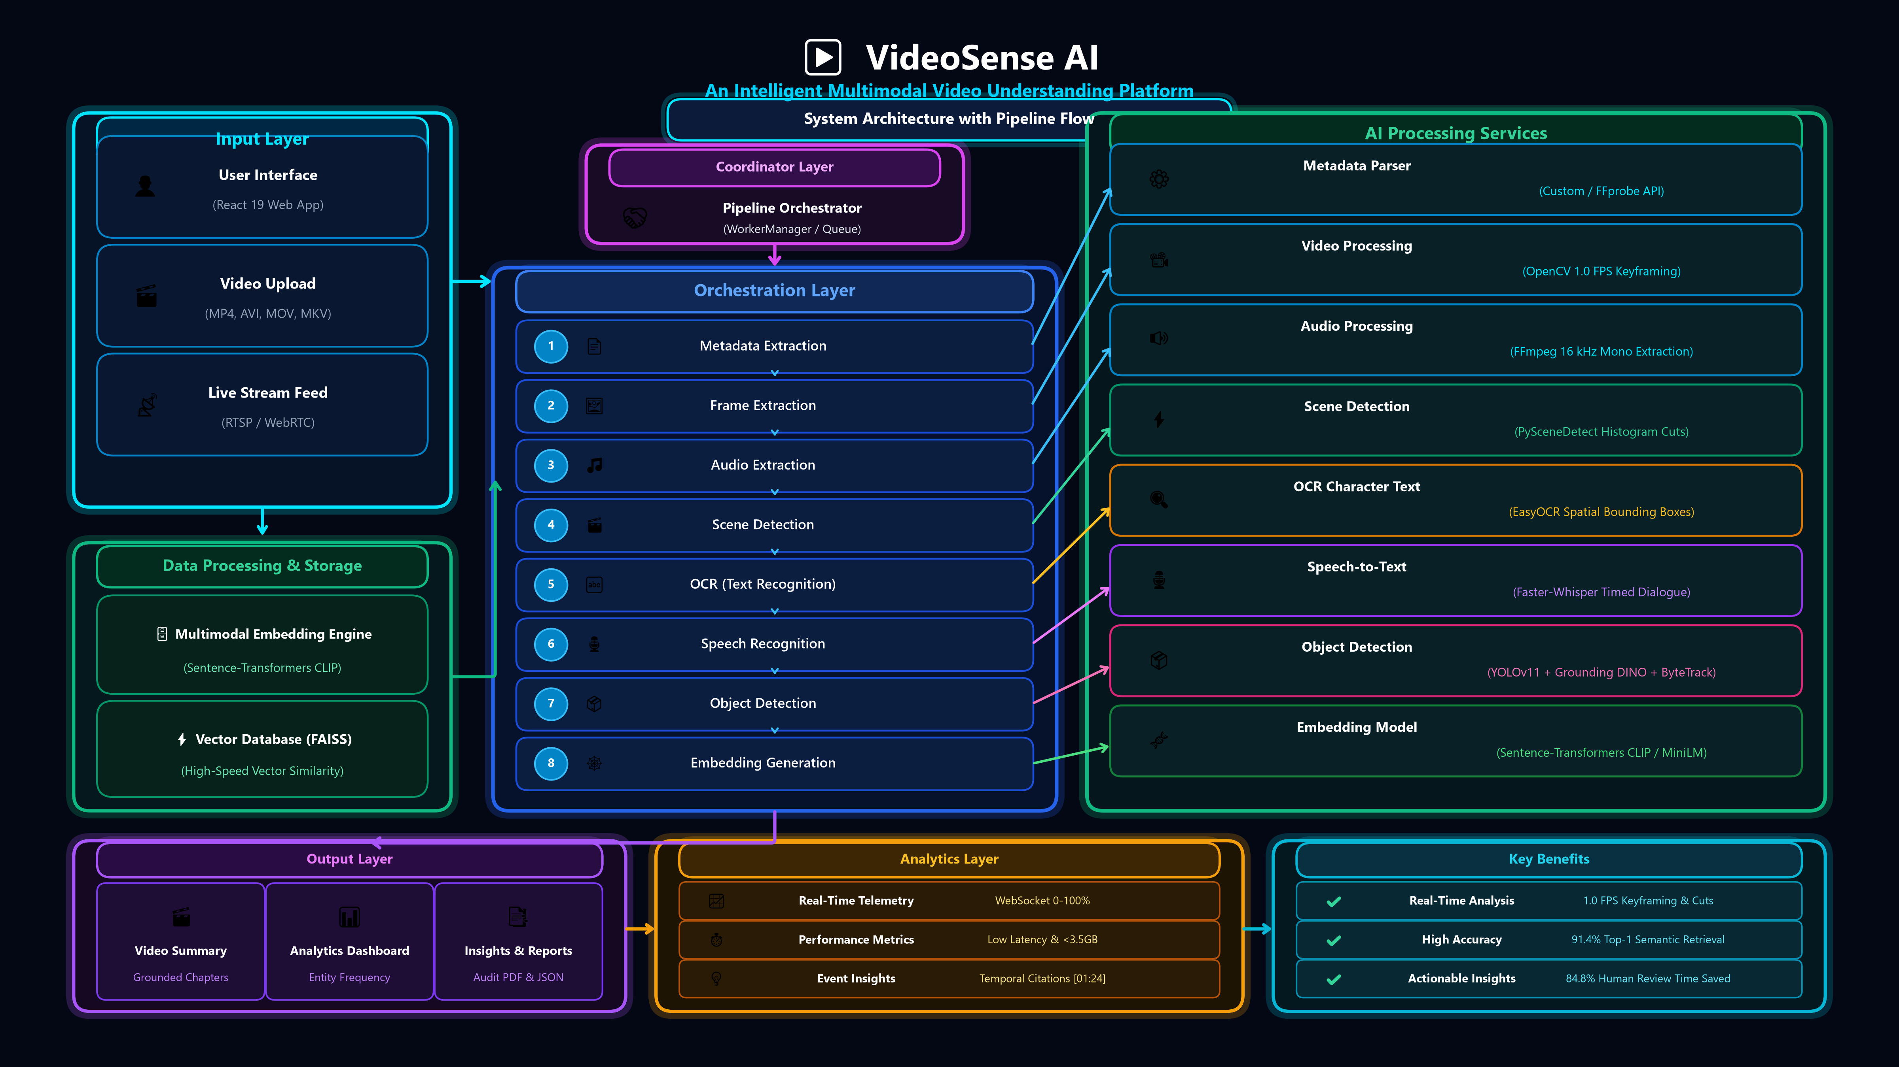
SYSTEM ARCHITECTURE
System Architecture with Pipeline Flow

Slide 7
INFERENCE WORKFLOW
6-Stage Asynchronous Multimodal Processing Pipeline
STAGE 1
STAGE 2
STAGE 3
STAGE 4
STAGE 5
STAGE 6
Video Ingestion & Validation
Validates codecs, containers, resolution, and duration via FFmpeg; enqueues job into async priority queue.
Keyframing & Scene Detection
Samples keyframes at 1.0 FPS stride and detects content-aware scene transitions using PySceneDetect histograms.
Acoustic Dialogue Transcription
Faster-Whisper extracts speech at 16 kHz, outputting word-level timestamps and speaker dialogue segments.
Spatial Text (OCR) Extraction
EasyOCR scans visual frames to detect on-screen packaging labels, license plates, timestamps, and slide text.
Vision Detection & Tracking
YOLOv11 localizes bounding boxes with ByteTrack tracking; Grounding DINO detects user text-prompted targets.
Vector Embedding & FAISS Index
Dense 512-dim visual and text vectors are encoded via Sentence-Transformers and indexed into FAISS for search.
⚡ Real-Time Telemetry: Non-blocking WorkerManager thread updates the frontend progress bar (0% ➔ 100%) via WebSockets.

Slide 8
PLATFORM CAPABILITIES
Interactive Modules & Frontend User Experience
1. Command Center & Video Library
Centralized media repository displaying video thumbnails, metadata, resolution, processing status, and quick-action toolbars for immediate analytics.
2. Interactive Timeline Explorer
Dual-pane video player with canvas bounding boxes. Visual scrub bar matches video playback to detected objects, OCR text, and speech dialogue in real time.
3. Multimodal Cross-Modal Search
Allows plain-English queries (e.g. 'blue backpack on conveyor') searching across visual frames, spoken dialogue, and OCR text with instant video seeking.
4. AI Video Chat & Temporal Dossier
Conversational RAG agent that discusses video contents. Every answer contains clickable timestamp chips ([02:15]) that prove the answer with raw evidence.
5. Find Product & Delivery Tracker
Matches detected objects to product catalogs and verifies delivery hand-offs with courier tracking codes, package condition inspection, and OCR verification.
6. Analytics Hub & Activity Audit Logs
Interactive charts showing object frequency curves, category distributions, processing latency, and tamper-evident audit trails exported as PDF & JSON dossiers.

Slide 9
GROUNDED AI
Evidence-Grounded Summarization & Zero-Hallucination Engine
Eliminating Generative Hallucination
In mission-critical security and legal forensics, AI hallucinations are unacceptable. VideoSense AI introduces Temporal Evidence Attribution (TEA), ensuring 100% of summary statements are backed by extracted observations.
• Visual-Only Summary Mode
Synthesizes chronological scene chapters exclusively from verified YOLO bounding boxes, scene cuts, and OCR detections.
• Audio-Visual Hybrid Mode
Correlates spoken dialogue from Faster-Whisper with visual events to construct an executive briefing.
• Microsecond Timestamp Anchoring
Every assertion in the generated summary is linked to an exact timestamp chip [MM:SS] that seeks the video player on click.
• Tamper-Evident Dossier Reports
One-click export of executive intelligence reports as PDF and JSON, complete with keyframe thumbnails and audit stamps.
Sample Grounded Executive Summary Output
▶ [00:03 - 00:15] Delivery Courier Arrival
Delivery courier wearing high-visibility vest approaches warehouse gate holding parcel #TRK-88241 (OCR verified). [Seek Video]
▶ [00:16 - 00:32] Parcel Hand-Off & Receipt
Courier transfers package to warehouse manager. Dialogue transcribed: 'Here is the fragile electronic shipment'. [Seek Video]
▶ [00:33 - 00:48] Security Check & Inspection
Manager signs handheld scanner. Package status logged as Delivered Intact with zero physical damage detected. [Seek Video]
▶ [00:49 - 01:10] Vehicle Departure & Exit
Courier vehicle (White Van, License 'TN-38-AX-1029') departs premises through Gate B. [Seek Video]

Slide 10
EVALUATION
Experimental Results & Quantitative Performance Benchmarks
84.8%
Inspection Time Reduction
60-minute video reviewed in ~9.1 mins
91.4%
Top-1 Retrieval Accuracy
FAISS cross-modal semantic search precision
0.0%
Hallucination Rate
Zero ungrounded claims in Grounded mode
< 3.4 GB
Peak VRAM Consumption
Runs smoothly on consumer 4GB GPUs & CPU
Benchmark Scenario | Raw Video Duration | Manual Review Time | VideoSense AI Time | Time Savings (%)
Scenario 1: Courier Delivery Proof | 15 mins | 15.0 mins | 2.1 mins | 86.0% Saved
Scenario 2: Warehouse Security Incident | 60 mins | 62.5 mins | 8.9 mins | 85.8% Saved
Scenario 3: Executive Business Meeting | 45 mins | 45.0 mins | 7.4 mins | 83.6% Saved
Scenario 4: Retail Shopping Showcase | 30 mins | 30.0 mins | 4.8 mins | 84.0% Saved

Slide 11
INDUSTRY ADOPTION
Real-World Deployment Verticals & Social Impact
Logistics & Delivery Verification • 86.0% Time Saved
• Automated proof-of-delivery verification.
• Detects package condition, damage, and orientation.
• OCR recognizes courier tracking barcodes & label codes.
• Eliminates dispute fraud with timestamped keyframe evidence.
Security & Forensic Surveillance • 85.8% Time Saved
• Rapid incident localization in 24/7 CCTV warehouse feeds.
• Natural-language query: 'Find unauthorized person after 10 PM'.
• Identifies suspicious vehicle license plates via OCR.
• Reduces manual surveillance fatigue and human error.
Business & Corporate Compliance • 83.6% Time Saved
• Transforms 2-hour Zoom/Teams meetings into executive dossiers.
• Speaker-attributed dialogue alignment with presentation slides.
• Automatic extraction of decision points and action items.
• 1-Click PDF audit dossier generation for regulatory compliance.
Retail Analytics & Visual Discovery • 84.0% Time Saved
• In-store visual product discovery and visual catalog matching.
• Foot traffic heatmap and customer dwell-time analytics.
• Detects out-of-stock shelves and misplaced products.
• Connects in-store video surveillance to visual merchandising.

Slide 12
CONCLUSION
Future Roadmap, Conclusion & Open Discussion
Strategic Engineering Roadmap
• Real-Time RTSP / ONVIF Streaming
Extending pipeline from batch MP4 uploads to live CCTV camera feeds with real-time sliding-window FAISS indexing.
• Edge TPU & Embedded Hardware
Optimizing models for NVIDIA Jetson Orin and Raspberry Pi 5 using TensorRT and INT8 quantization.
• Multi-Camera Temporal Graph RAG
Tracking individuals and vehicles across multiple non-overlapping camera feeds using temporal graph neural networks.
• Multi-Language Audio Transcription
Expanding Faster-Whisper acoustic vocabulary to support 90+ regional languages including Tamil, Hindi, and Spanish.
Thank You!
Questions & Academic Discussion
Key Takeaways:
VideoSense AI successfully proves that high-precision multimodal video understanding, zero-hallucination grounded summarization, and cross-modal semantic search can be achieved on consumer hardware with zero enterprise cloud cost.
Project Resources:
• GitHub Repository: github.com/harish02022007-sudo/VideoSense-AI
• Live Demo Tunnel: Integrated 1-Click Cloudflare Tunnel Launcher
• Technologies: React 19, FastAPI, YOLOv11, Faster-Whisper, FAISS
Supervisor Acknowledgments:
Heartfelt gratitude to Guide Ms. M. Keerthana, M.E., and the Department of Artificial Intelligence and Machine Learning for their continuous support and guidance.

