Slide 1
Data Security in Cloud Computing Based on Homomorphic Encryption – Advanced Secret Sharing-Key Management Scheme
Ashwath.S , Karthik Raj.A , Balasubramaniam.T
Guide : Prabakeran Saravanan

Slide 2
Agenda
Abstract
Introduction
Literature Survey
Proposed Technique
Proposed Architecture
Modules
Conclusion and Result
References

Slide 3
Abstract
Cloud is globally used and has no borders.
It’s features attracts organizations to use cloud storage.
Data security stands as one of it’s major issues.
Use of internet in cloud reduces data control.
The proposed technique provides better security solutions against attacks and failures.

Slide 4
Introduction
Cloud is virtual environment for data processing
Cloud computing provide convenient & on – demand network access to shared resources.
Eg: Yahoo, Gmail, Hotmail etc.
Types of Cloud computing:
Deployment model
Public
Private
Hybrid
Community
Service model
Saas
Paas
Iaas

Slide 5
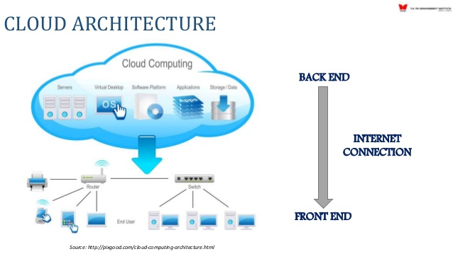
Cloud Computing Architecture
Two Components - Frontend & Backend
Front end- Interface, Browser & so on
Back end- Data storage, Security mechanism, Servers & so on

Slide 6
Security issues and Risk
Issues
Data location
Data segregation
Long term viability
Recovery
Privilege user access
Risk
Security of data in transit.
Security of data at root.
Cloud legal & regulatory issues.
Robust separation between data.
Authentication of user.

