Slide 1

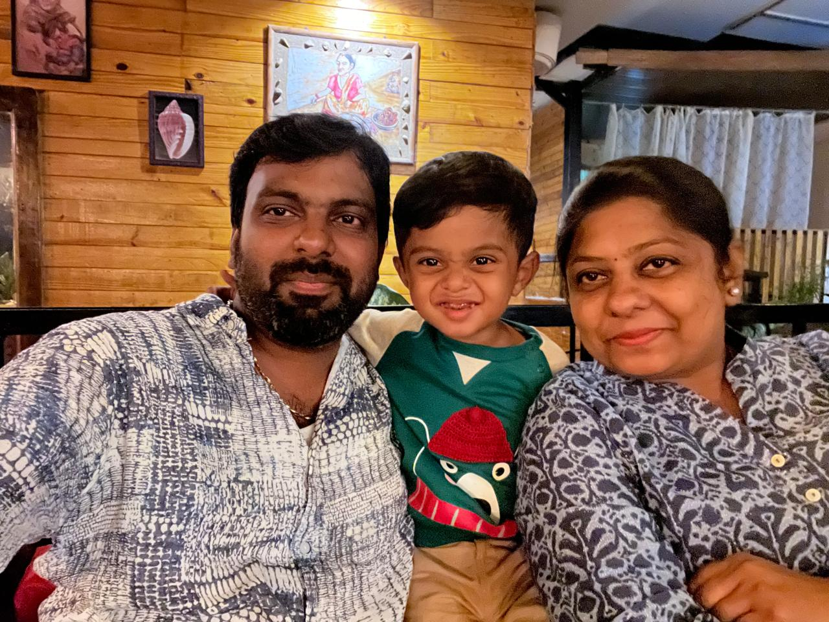



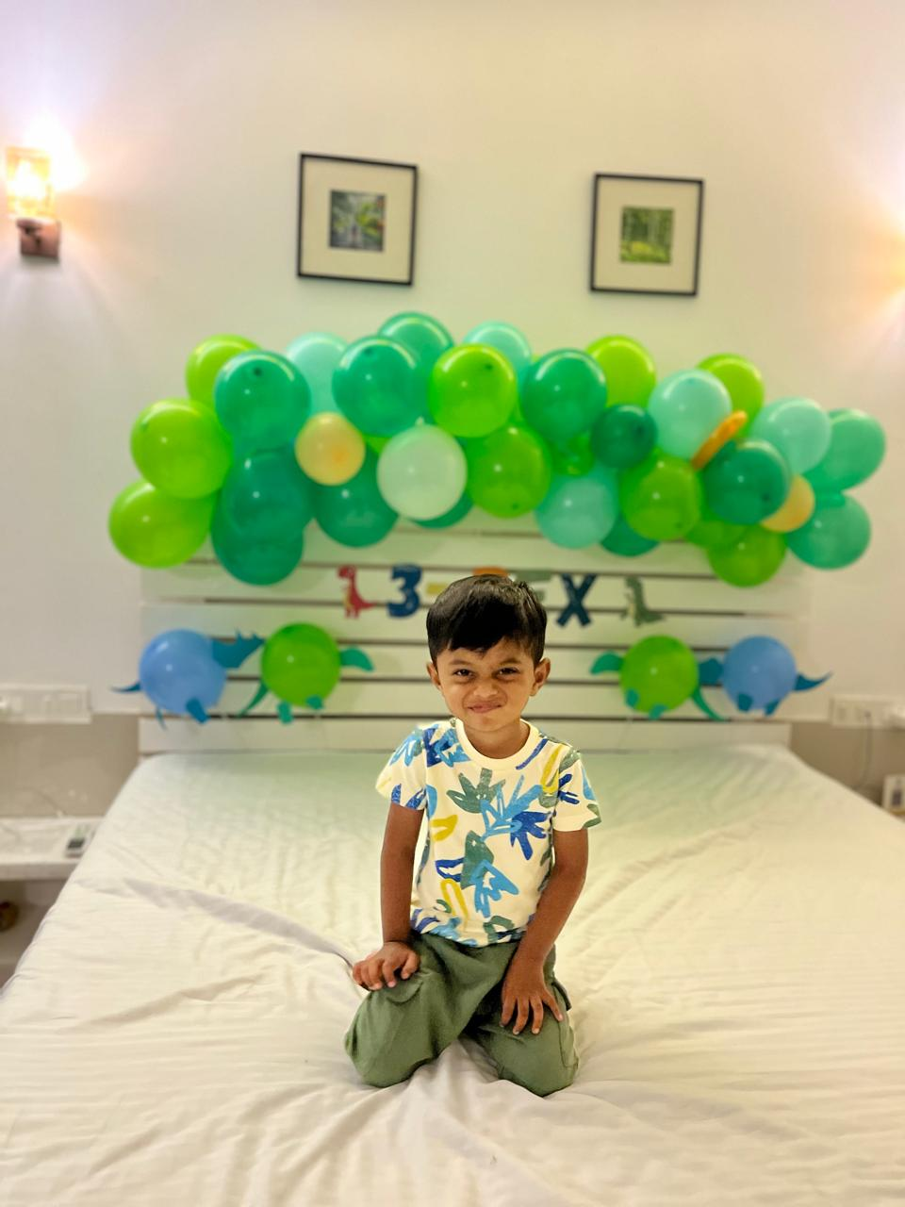
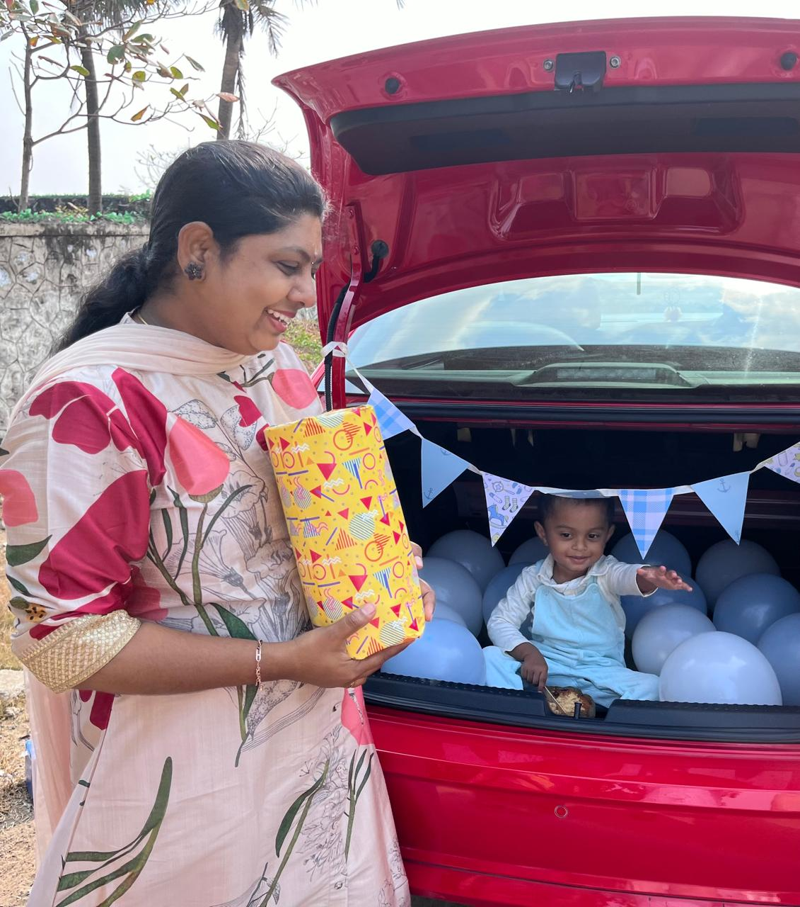
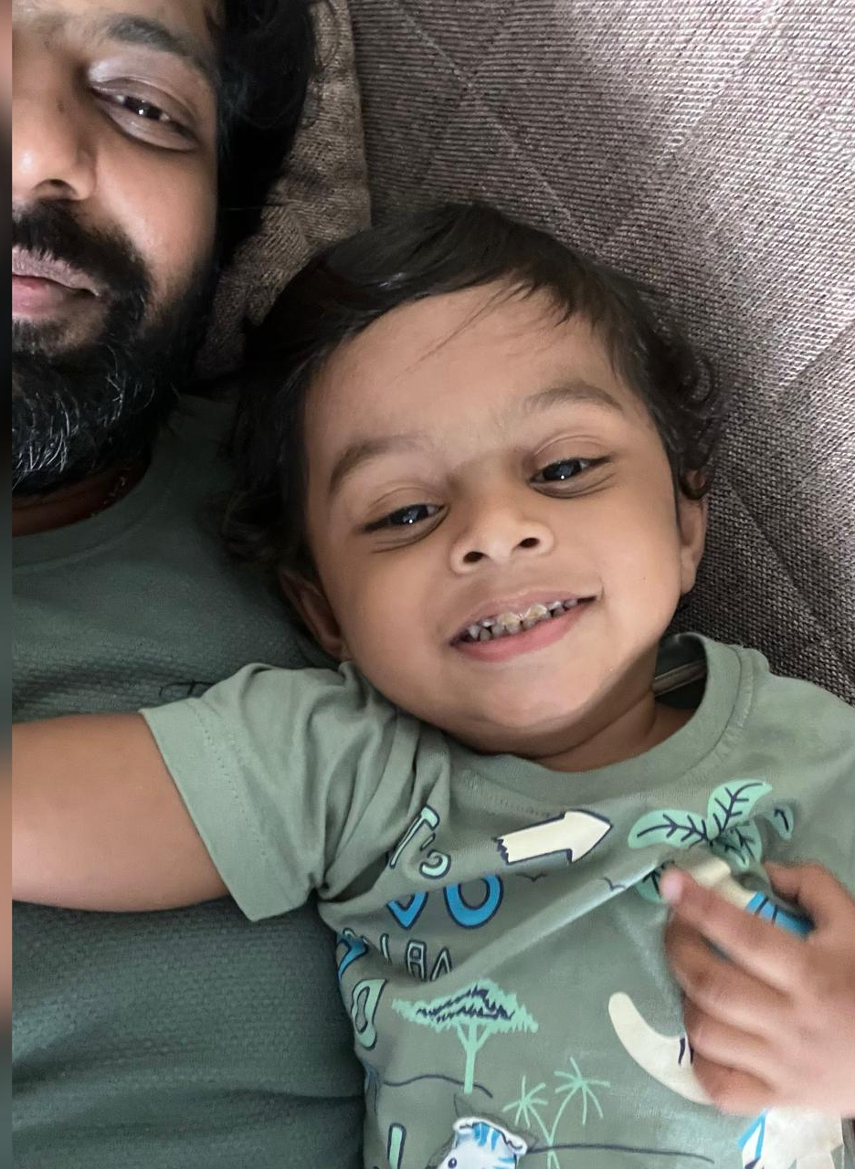
Harish Kumar Raju – Chennai, Tamil Nadu, India
My Professional Journey:
💼 Experience: 15+ years in software development (and counting).
🏢 Current Role: 7+ years growing and thriving with this company.
👨‍💻 Career Path:
Started with .NET Technology Full Stack Develop
Transitioned to React and Vue
home team
Creative
chronicles
Beyond Work:
Passionate about art, craft, and decorating, love sketching, painting, cooking, making gifts, playing with my child, and creating mini masterpieces, cherish smiles, giggles, and finding joy in little things.
Happy Times
Fun Facts About Me:
I’ve gifted so many handmade items that I might start a side business someday.
I have way too many craft supplies because “I might need it someday!
I can turn random things into creative masterpieces (sometimes they even look good!)

