Slide 1
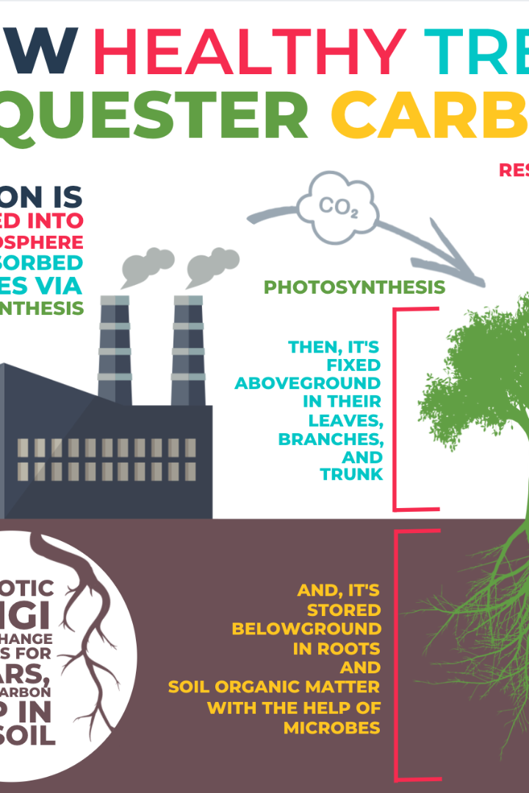
Air Quality Monitoring
We all need clean air to breathe. In this presentation, we'll explore how we're bringing technology to the forefront to measure the air quality parameters that affect us all, and how we plan to display real-time air quality data to the public on the web.

Slide 2

Phase 2: Innovation
1
IoT Device Design
2
Deployment Considerations
We're designing IoT devices - including the popular MQ135 sensor - to measure air quality parameters across various regions.
The devices will be deployed in a way that captures prevailing weather conditions, varying altitudes, and regional air quality.
3
Real-time Air Quality Data
4
Data Transmission Methods
A web-based platform will be deployed to display real-time air quality data to the public. The platform will be accessible across all mobile and desktop devices.
We're researching various protocols including mqtt and http to determine how IoT devices will send data to the data-sharing platform.

Slide 3
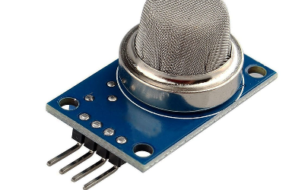
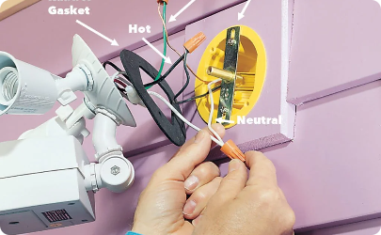
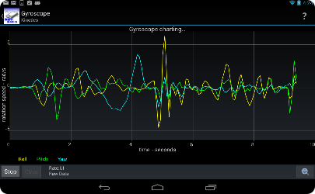
MQ135 Sensor: Measuring Air Quality Parameters
The Science Behind MQ135
Sensor Installation
Sensor Data Visualization
Sensors will be installed in various locations like schools, hospitals and high-traffic areas. Data will be sent to the central platform for real-time analysis.
Visualizing sensor data requires understanding and selecting user-centered visuals and insights. We're researching commonly-used techniques, and are thinking creatively about how we might represent real-time air quality data on a map.
The MQ135 sensor, capable of detecting poisonous gases like ammonia, CO, and NO2, works on the principle of resistance changes when gases interact with sensitive layers.

Slide 4
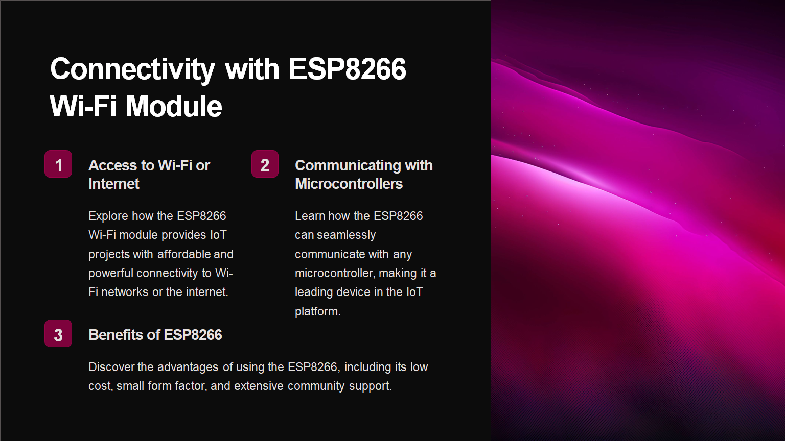

Slide 5
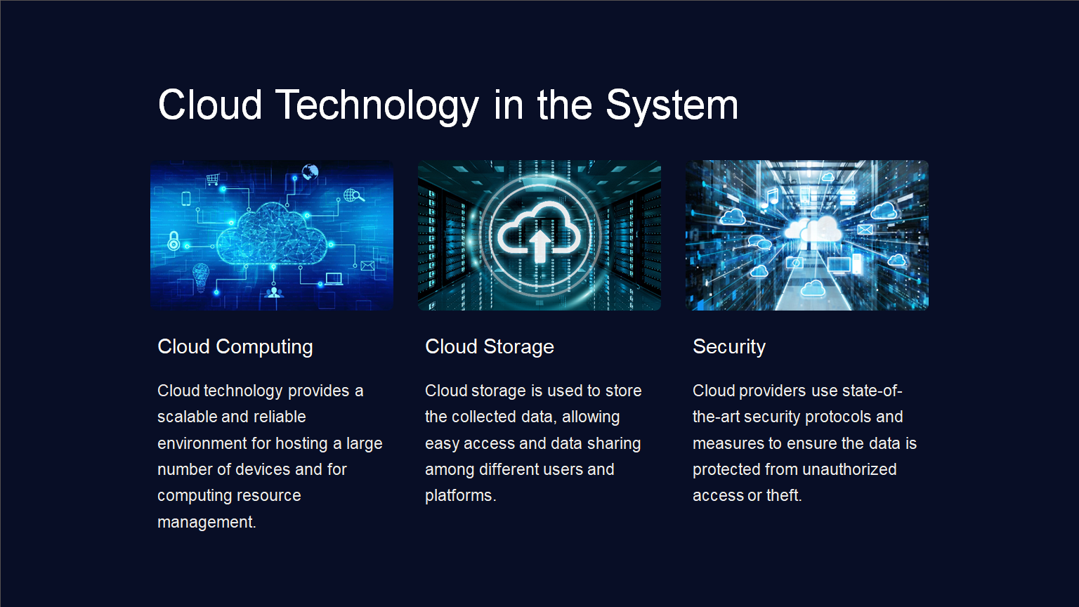

Slide 6
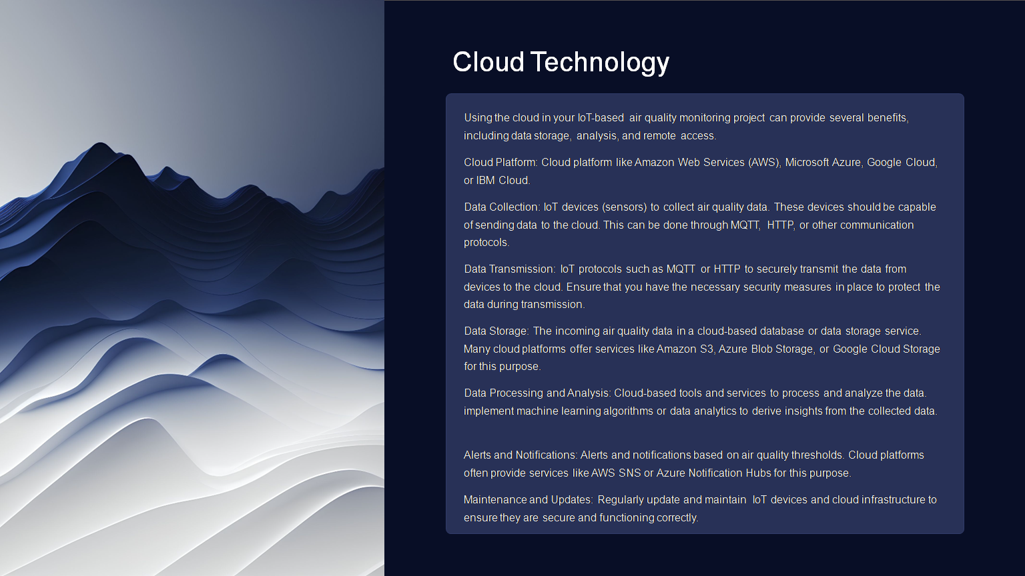

Slide 7
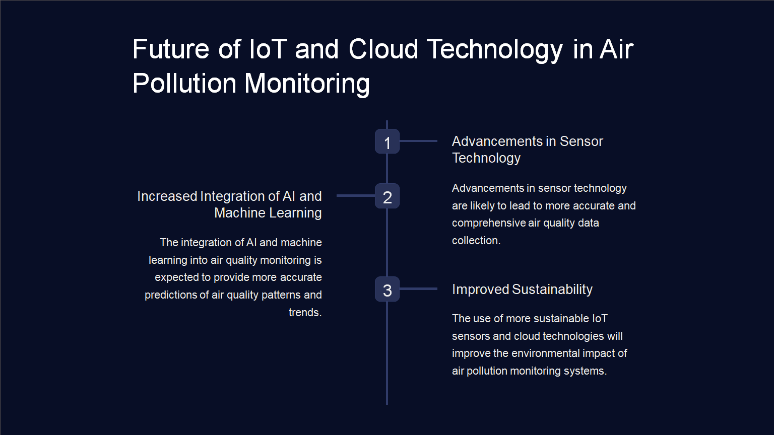

Slide 8
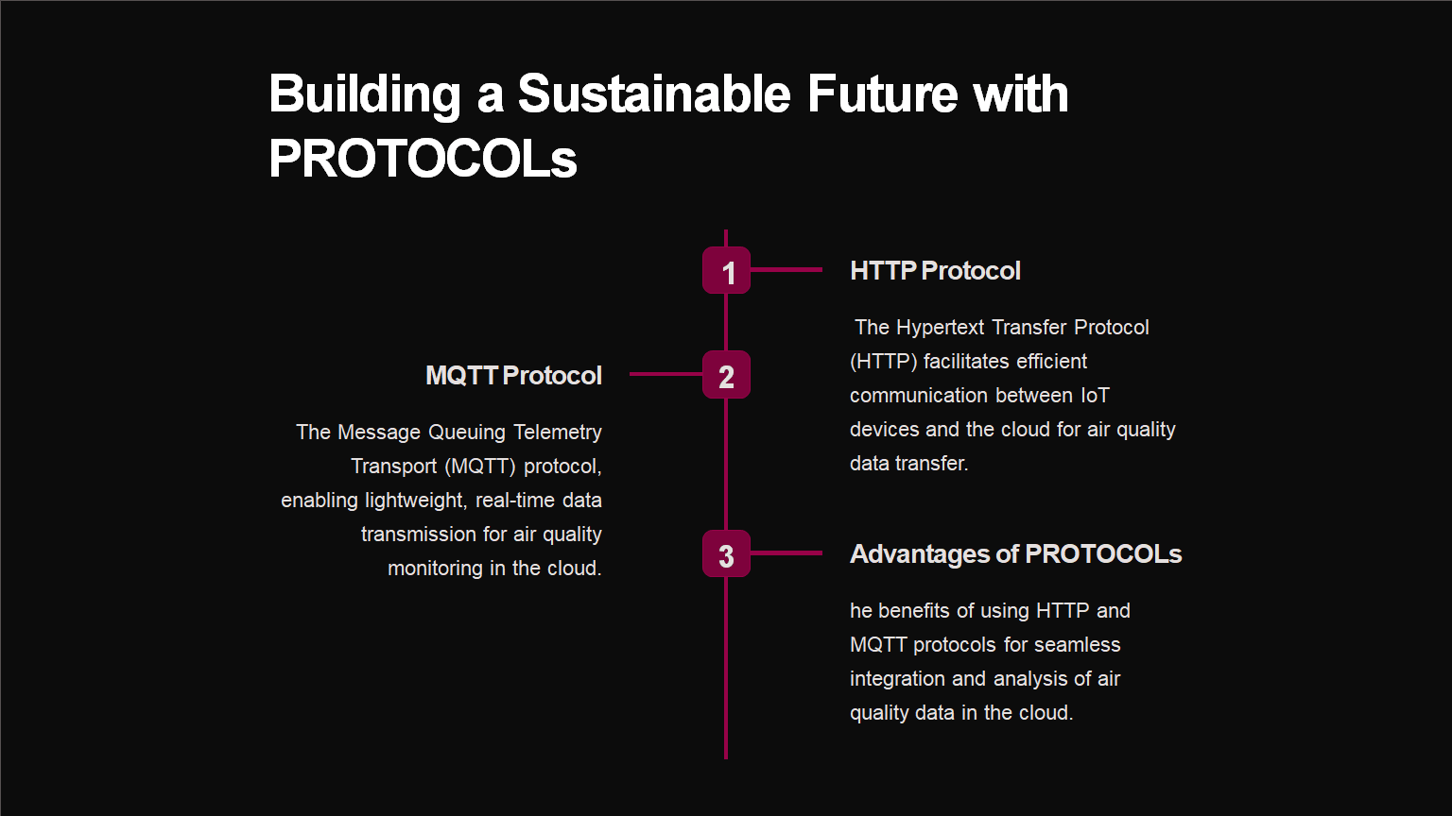

Data Transmission Methods for IoT Devices
1
Wireless Protocols
We're testing various wireless protocols including LoRaWAN, NB-IoT, SigFox and Lte-M to determine the best approach for communicating data from sensors to the data-sharing platform.
Network Security
2
We're ensuring that data sent from the devices is secure throughout its transmission and storage, and working with experts in the field to incorporate strong security measures.
3
Data Compression
We're compressing the data to reduce space requirements and bandwidth usage, which is important when transmitting large amounts of data across networks.

Slide 9
