Slide 1
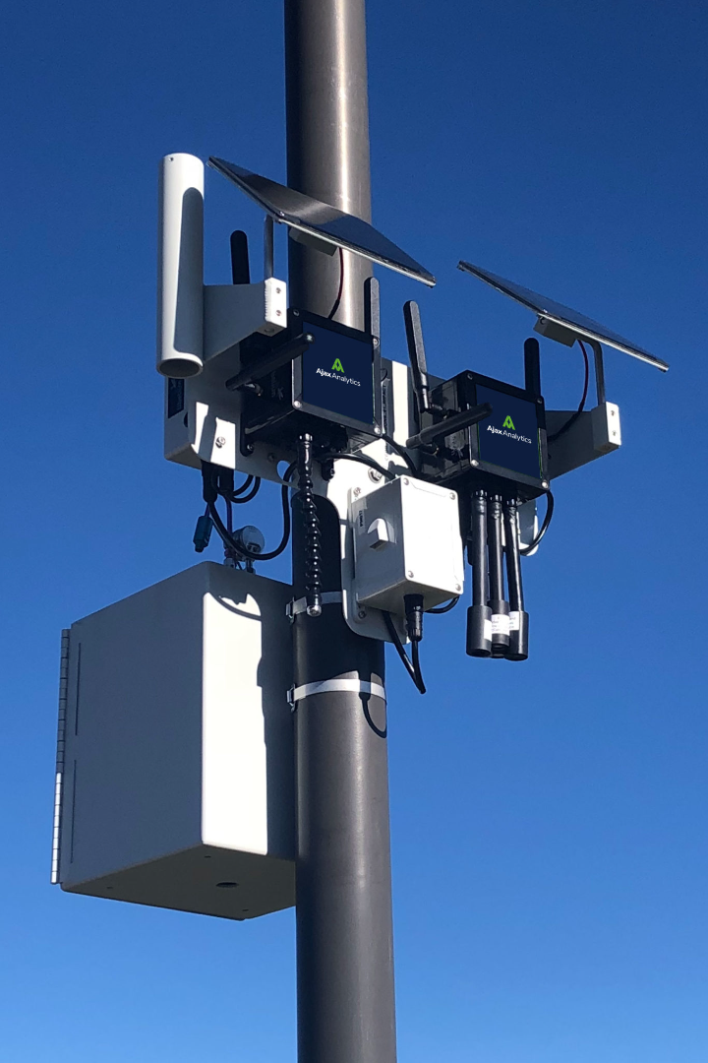
Air Quality Monitoring Project
Our project aims to establish real-time air quality monitoring, promote data sharing, increase public awareness, and assess the health impact of air pollution.

Slide 2

Project Objectives
1
Real-Time Monitoring
2
Data Sharing
Implement sensors to continuously measure key air quality parameters and provide up-to-date information.
Create a user-friendly web-based platform to share air quality data with the public, researchers, and policy-makers.
3
Public Awareness
4
Health Impact Assessment
Educate the community about the importance of air quality and its impact on health, encouraging sustainable practices.
Analyze data collected to assess the long-term health effects of air pollution and inform mitigation strategies.

Slide 3
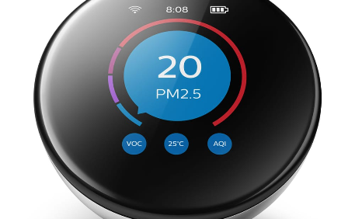
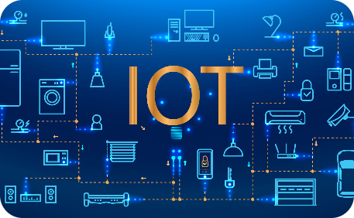
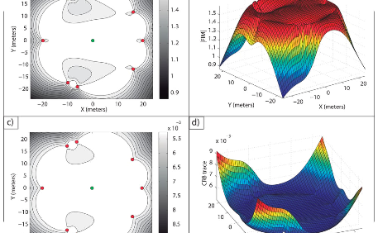
IoT Device Designs
Sensor Deployment
Data Transmission
Optimal Placement
Design and deploy IoT devices equipped with advanced sensors to measure air quality parameters accurately.
Establish a reliable and secure communication system for IoT devices to transmit real-time data to the central server.
Strategically position sensors across the target area to ensure comprehensive coverage and representativeness of air quality data.

Slide 4
Data Sharing Platform
User-Friendly Interface
Data Visualization
Data Analytics
Employ interactive charts, maps, and graphs to present air quality data in a straightforward and understandable manner.
Implement advanced analytics tools that allow users to explore historical data trends and correlations.
Create an intuitive and visually appealing web-based platform to facilitate easy access to real-time air quality data.

Slide 5
Integration Approach
1
Sensor Installation
Select appropriate sensor models, install them at designated sites, and ensure proper calibration for accurate readings.
2
Data Collection
Establish a centralized database to store incoming sensor data, ensuring data integrity and efficient retrieval.
3
Data Transmission
Develop a secure protocol utilizing wireless technologies to transmit data from sensors to the central server in real time.

Slide 6
Conclusion
Improving Air Quality
Policy Recommendations
Community Engagement
By implementing this comprehensive air quality monitoring project, we aim to enhance environmental sustainability and public health.
The insights gained from our data analysis will inform evidence-based policies for mitigating air pollution and protecting communities.
We encourage active participation and collaboration with stakeholders to ensure the success and long-term sustainability of the project.

