Slide 1
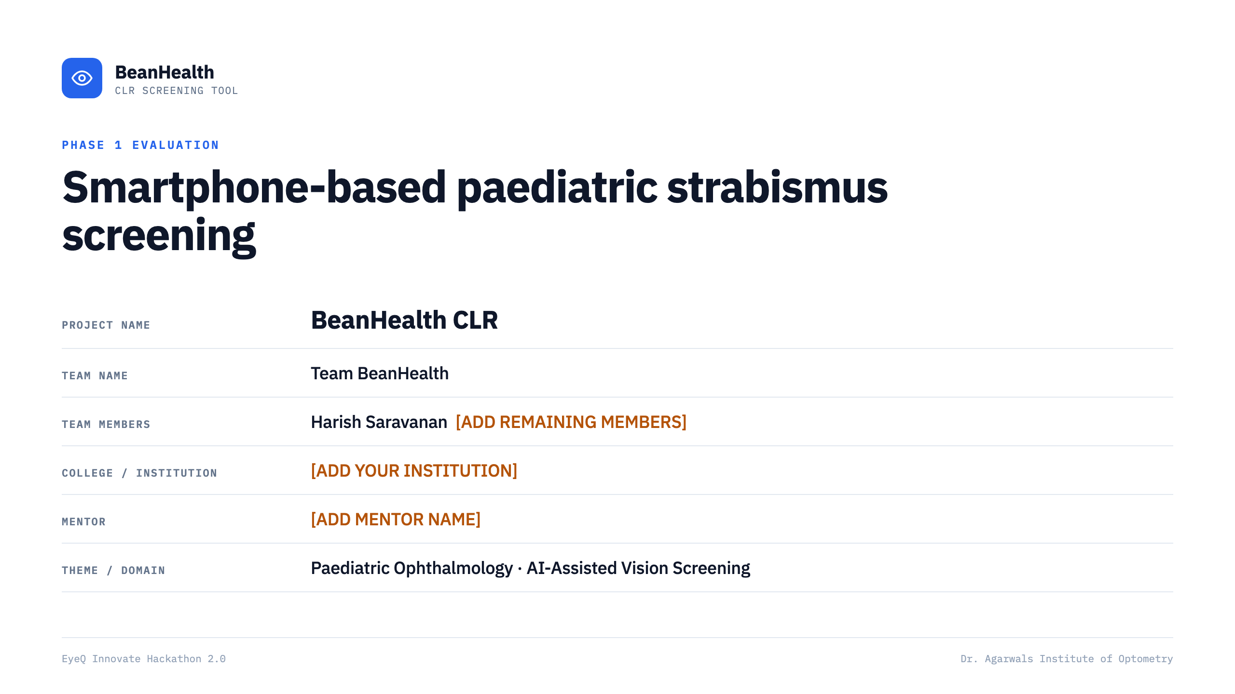
Notes:
TO COMPLETE: add your institution, mentor name and remaining team members.

Slide 2
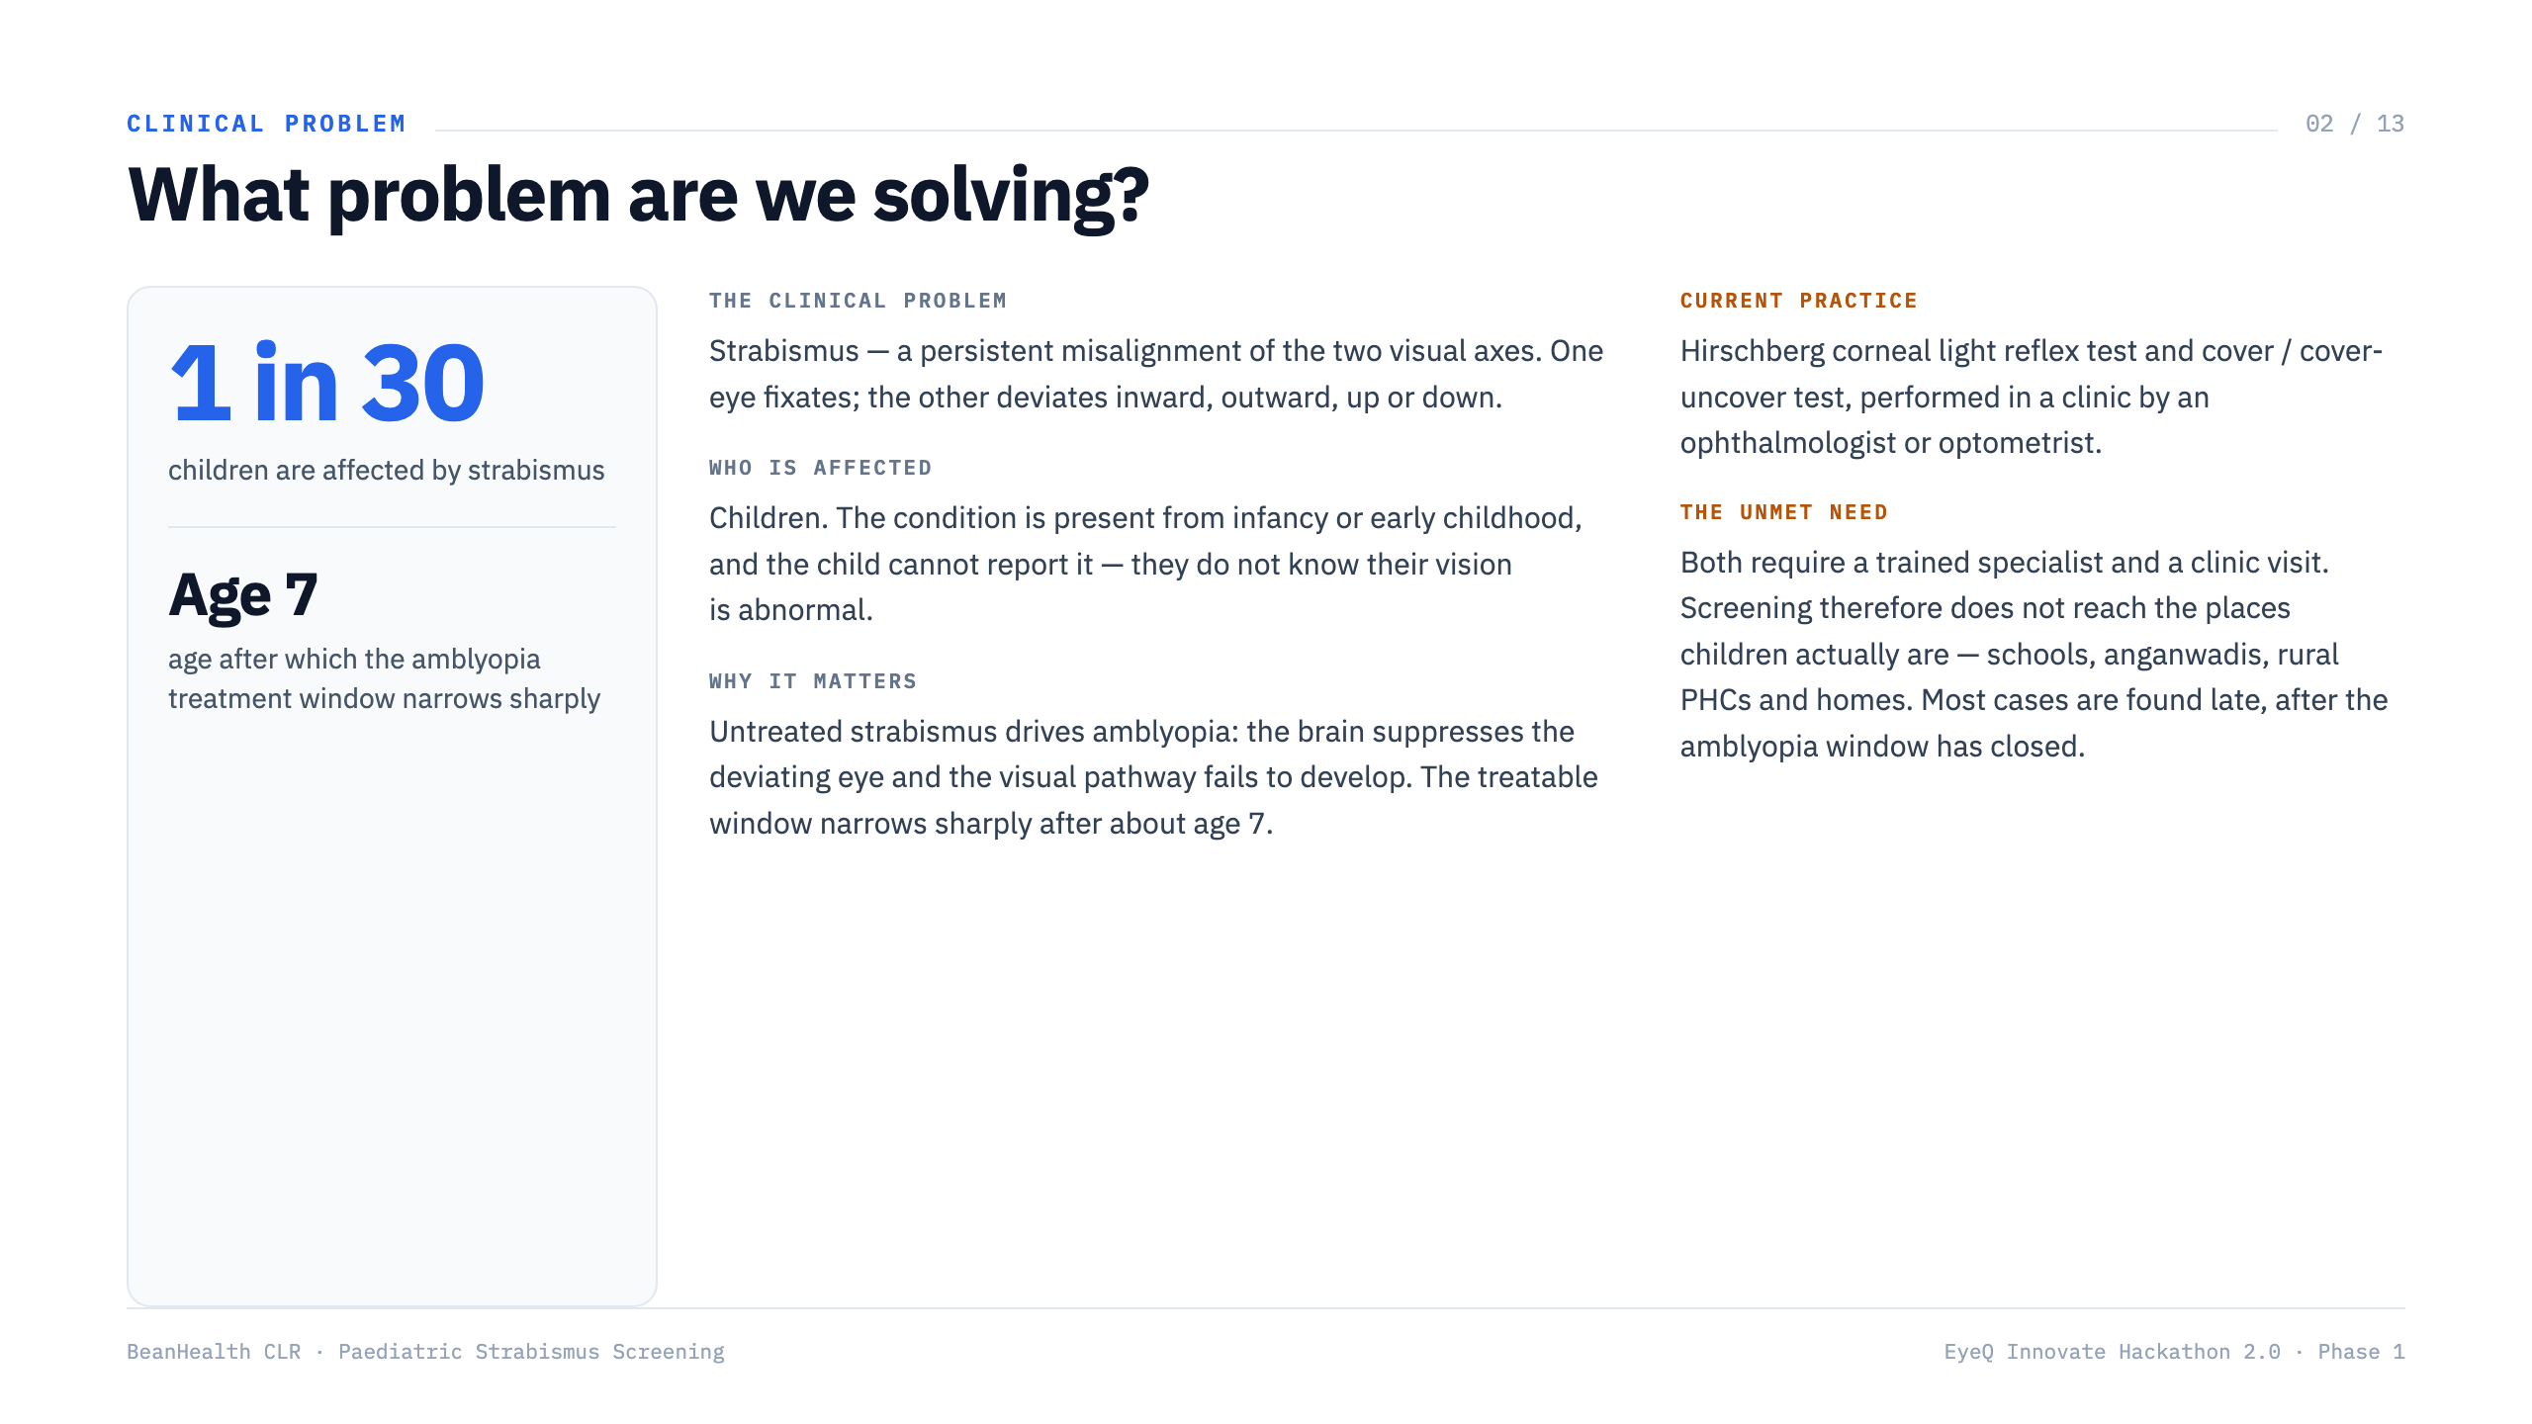

Slide 3
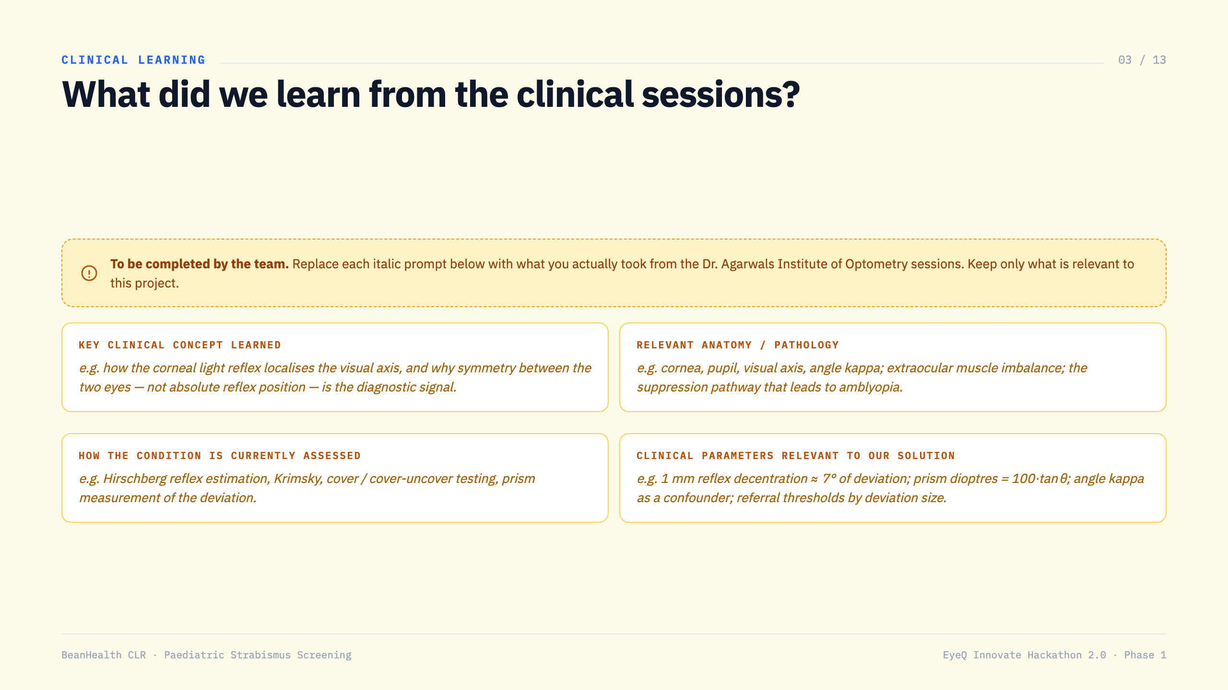
Notes:
TO COMPLETE: replace the italic prompts with what you actually learned from the Dr. Agarwals Institute of Optometry clinical sessions. Keep only what is relevant to this project.

Slide 4
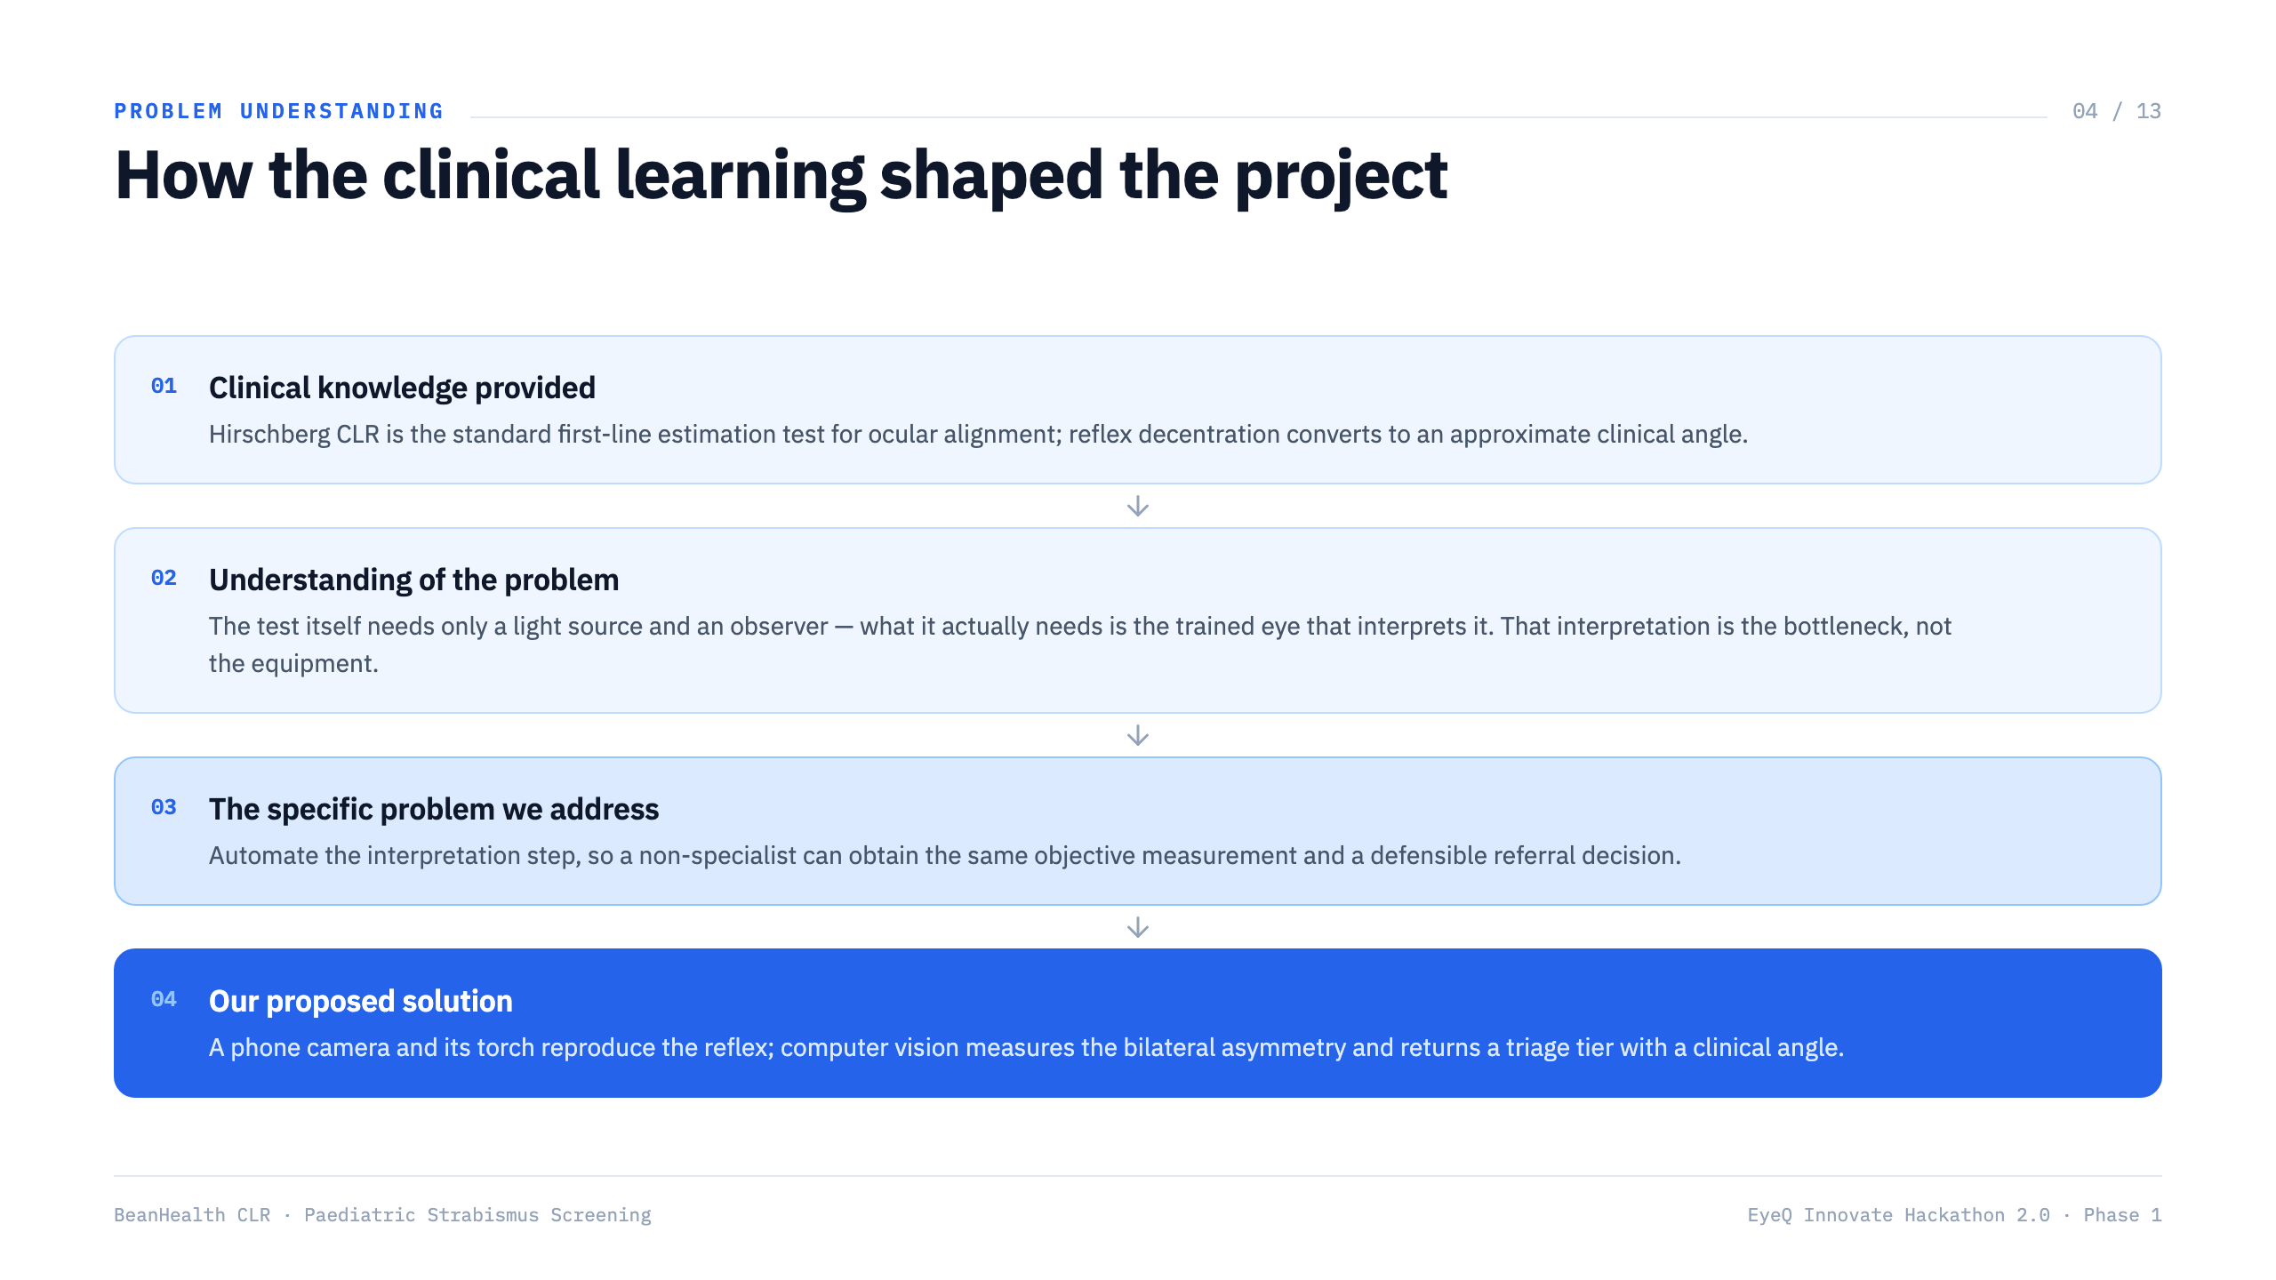

Slide 5
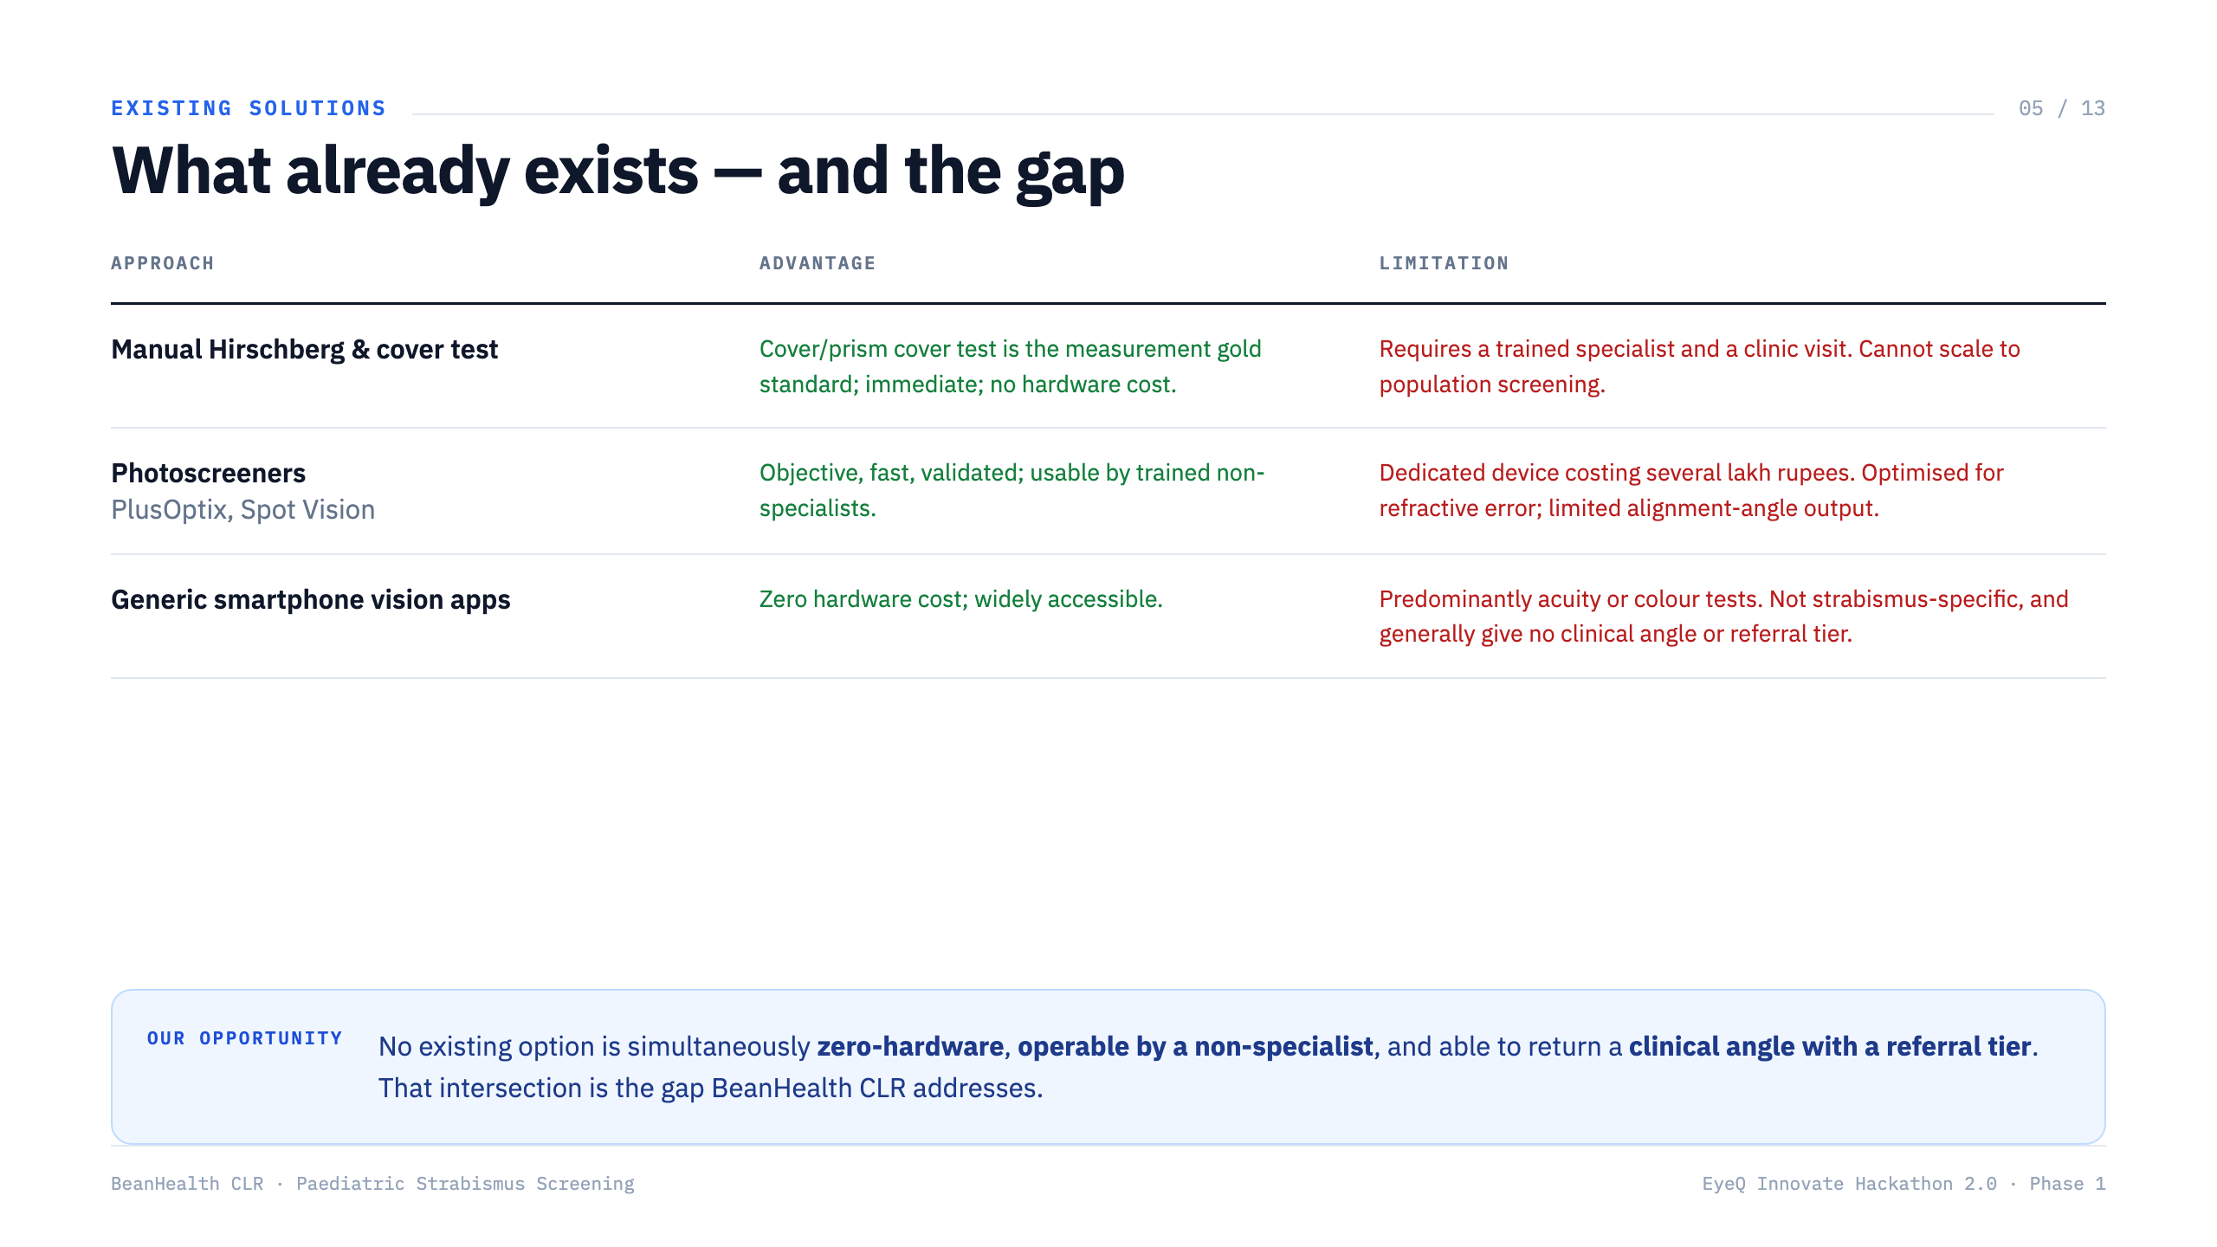

Slide 6
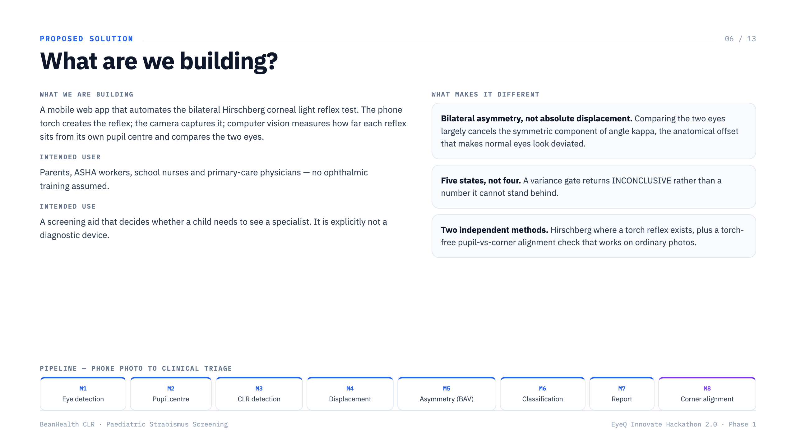

Slide 7
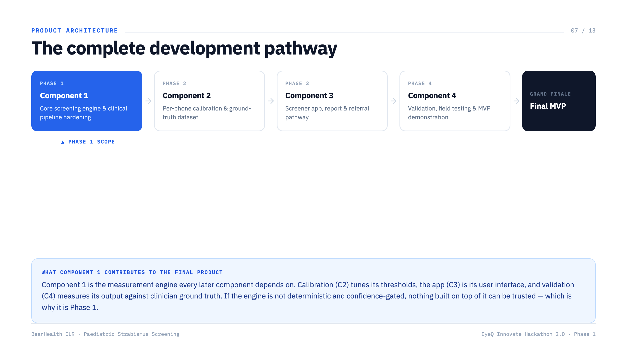

Slide 8
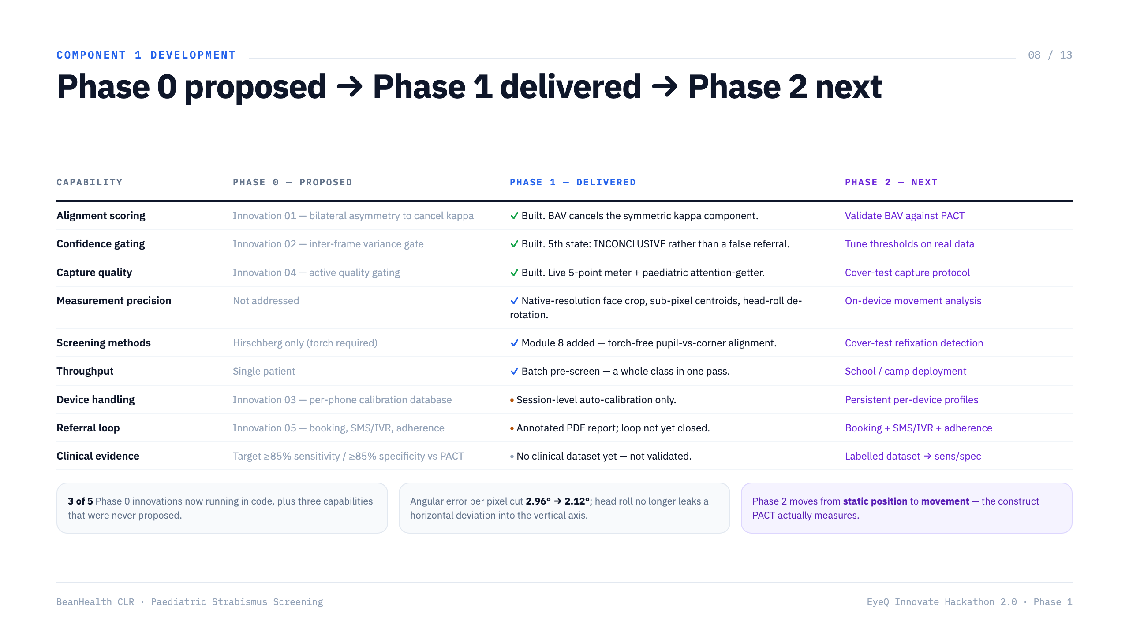
Notes:
Key slide: this is the Phase 0 to Phase 1 delta - the answer to 'what progress did you actually make?'

Slide 9
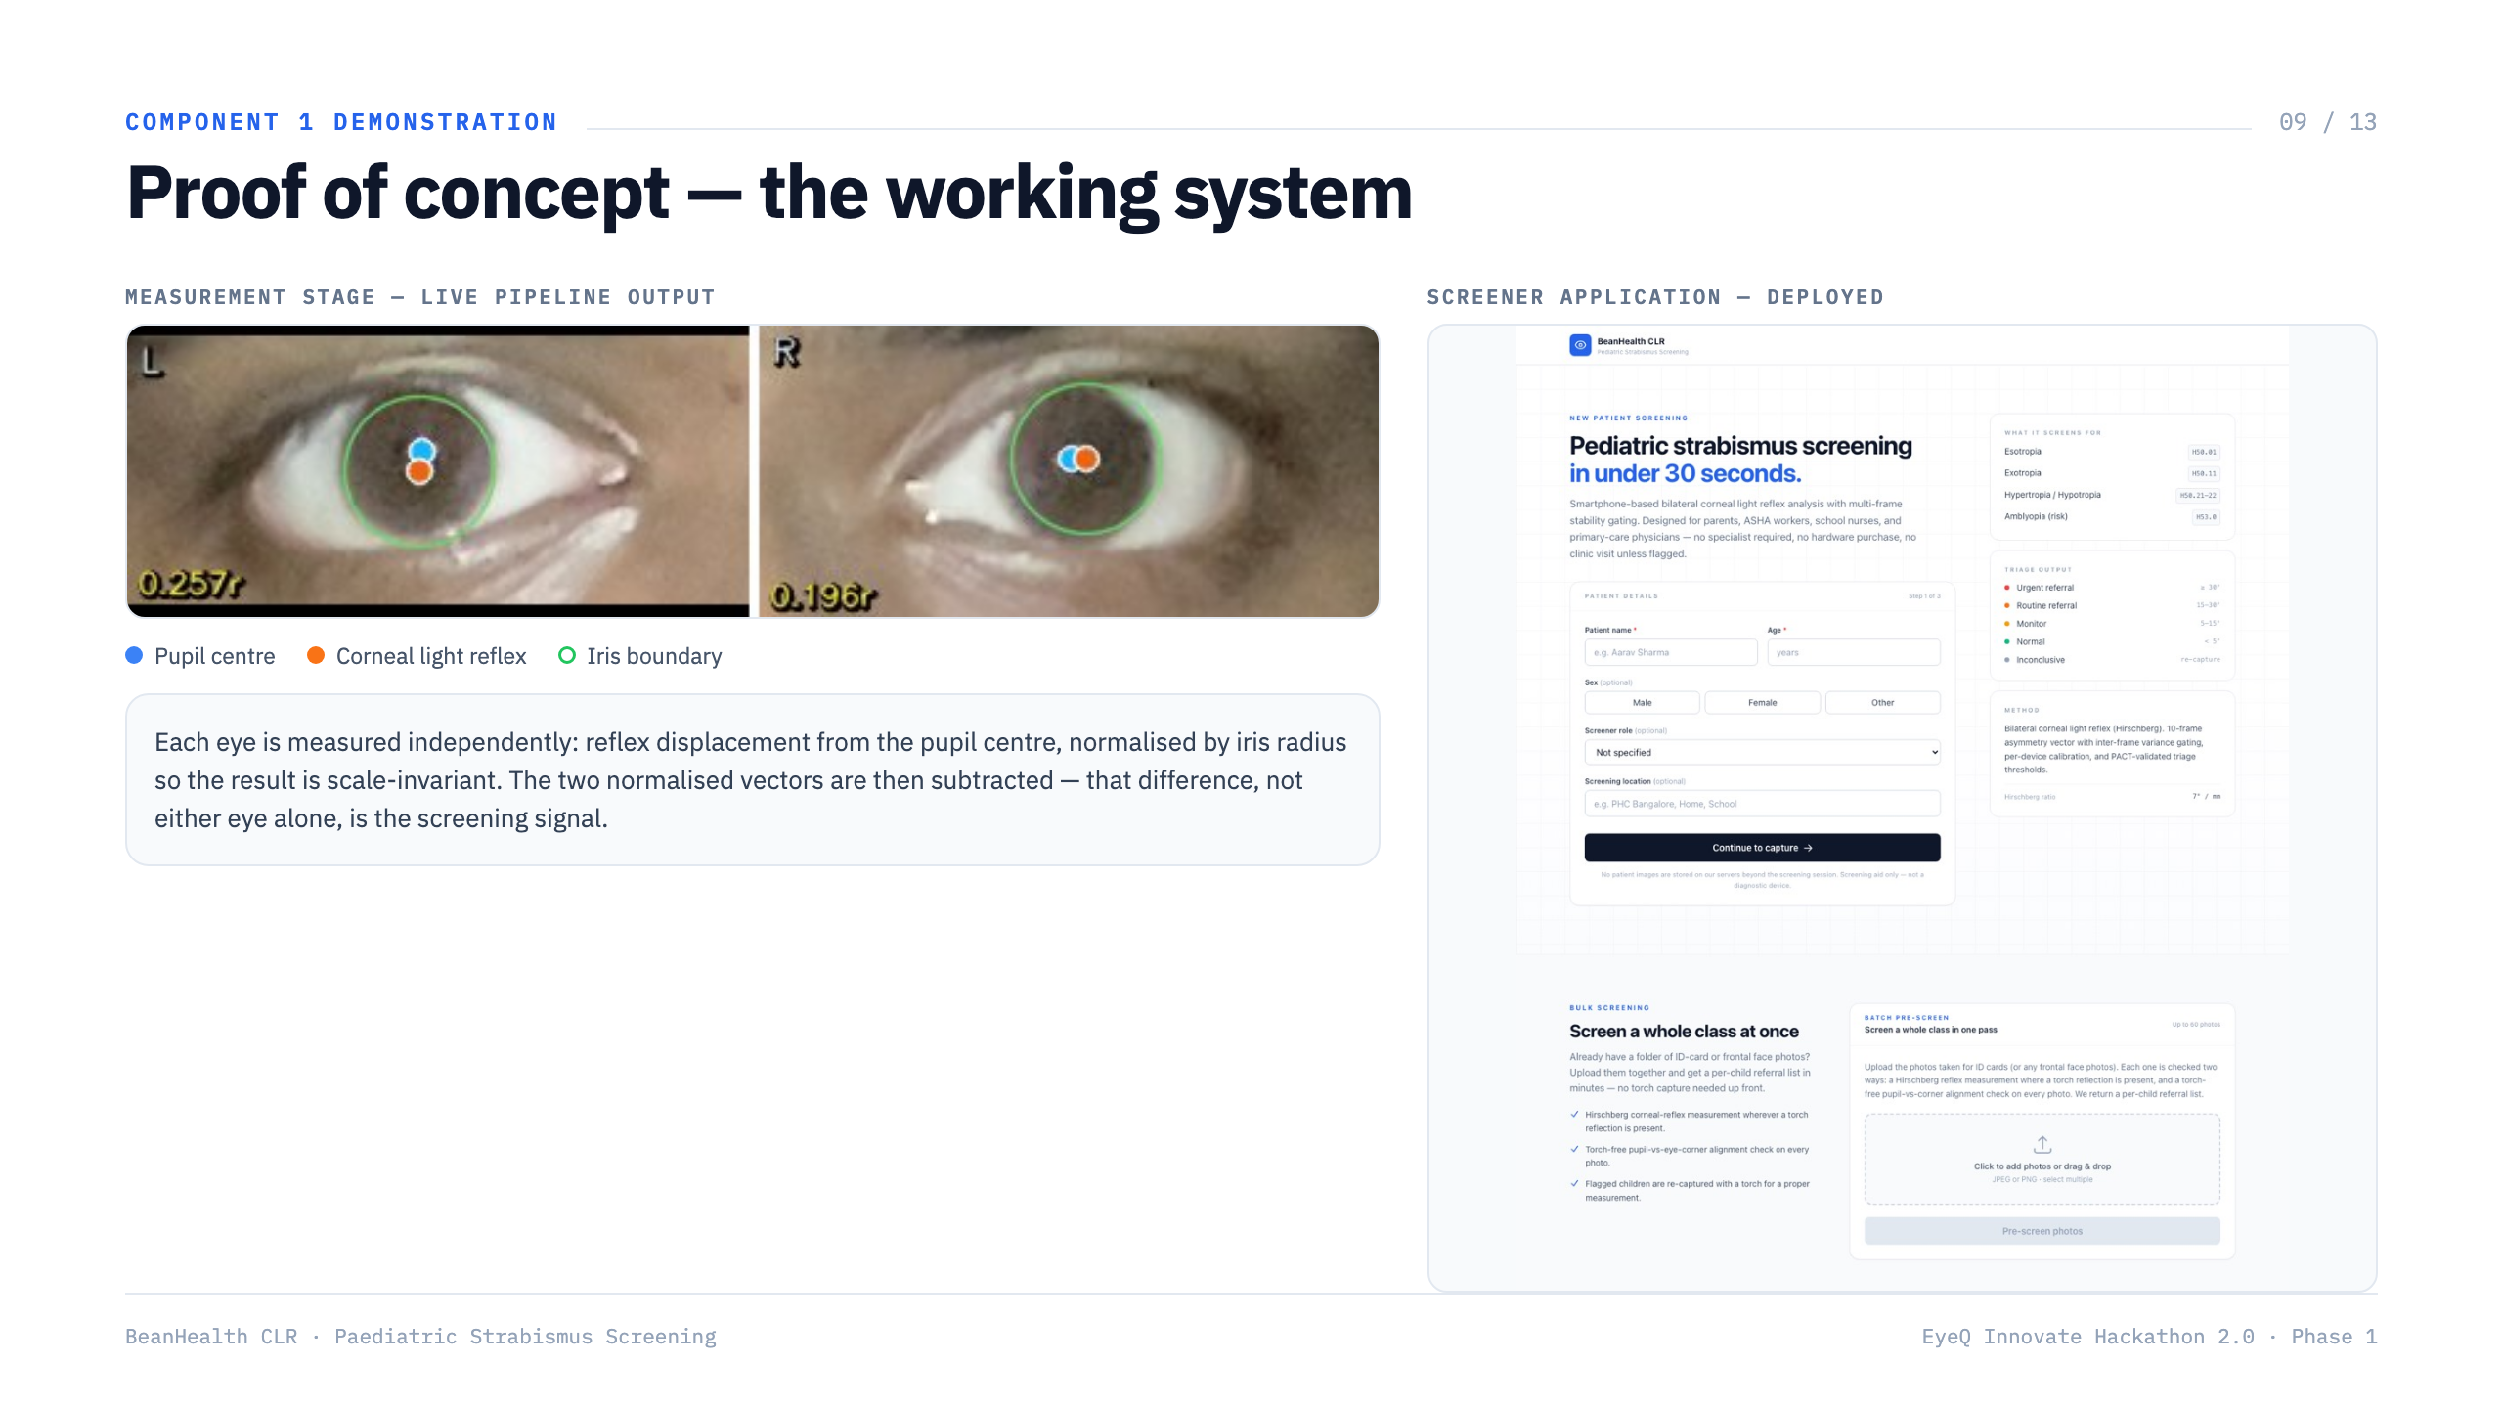
Notes:
The measurement image is genuine pipeline output. Present it as the measurement stage working, not as a validated clinical result.

Slide 10
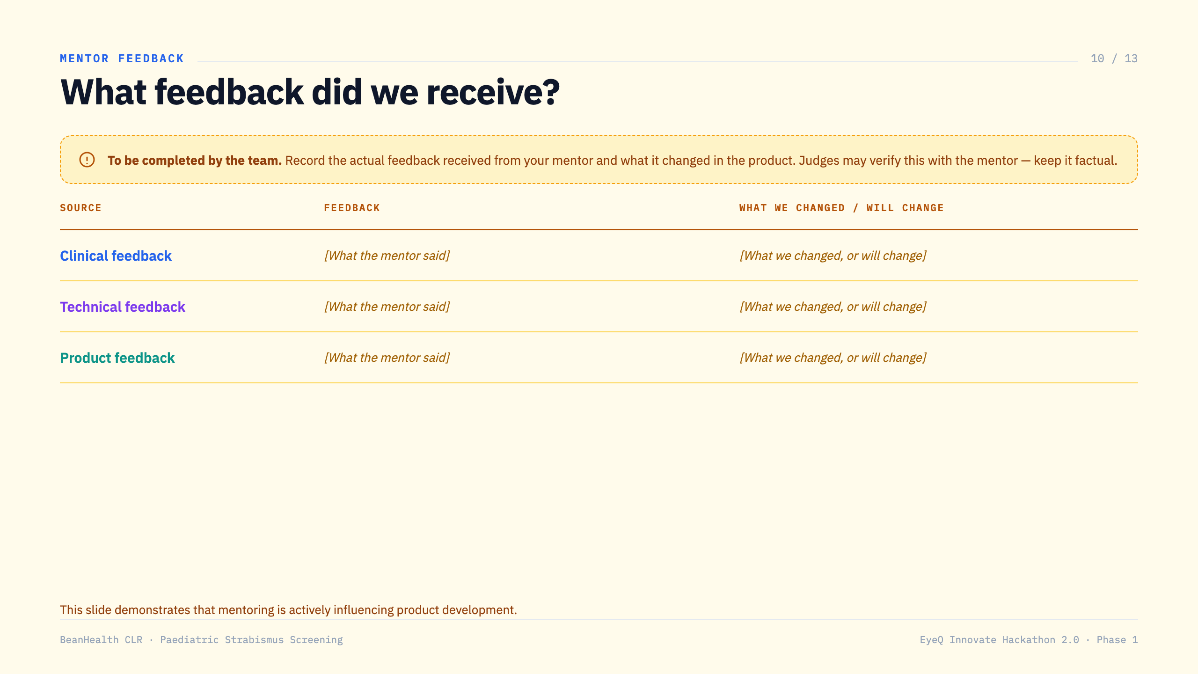
Notes:
TO COMPLETE: record the actual mentor feedback and what it changed in the product. Judges may verify this with your mentor - keep it factual.

Slide 11
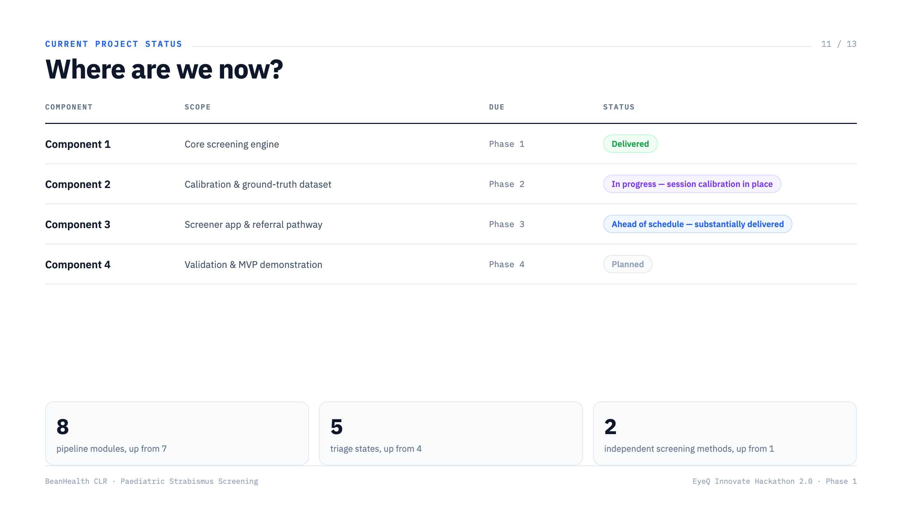

Slide 12
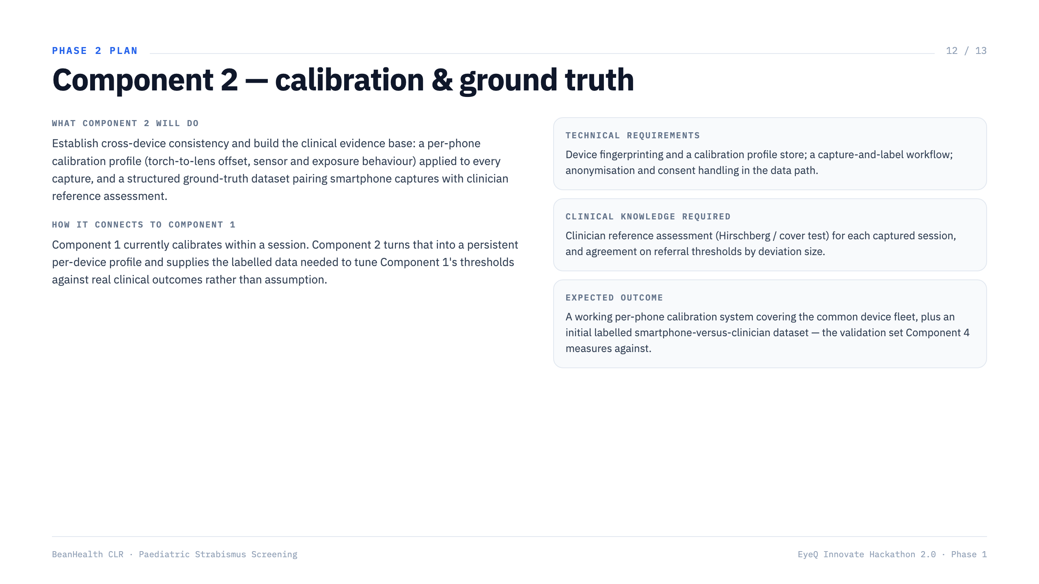

Slide 13
