Slide 1
Smart Cold-Chain Monitoring System
Harish Karunanithi 24235423

Slide 2
Problem
Perishable goods need constant monitoring
Delay in cloud-only systems
Late alerts can cause spoilage

Slide 3
Solution
• Use Fog + Cloud architecture
• Process data near source (Fog)
• Cloud used for storage and dashboard

Slide 4
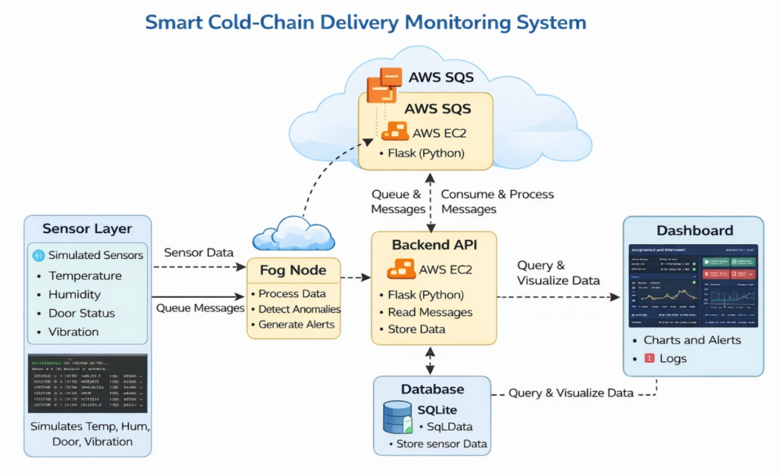
Architecture
Sensors → Fog Node → Backend API → AWS SQS→ Database → Dashboard

Slide 5
Data Flow
1. Sensors generate data
2. Fog node processes data
3. Alerts generated locally
4. Data sent to AWS SQS
5. Backend stores data
6. Dashboard displays results

Slide 6
Technologies
• Python
• Flask (Backend API)
• AWS SQS
• SQLite Database
• Streamlit Dashboard

Slide 7
Highlights & Challenges
Highlights:
• Real-time alert generation using Fog
• Reduced latency
• Reliable communication using SQS
Challenges:
• Connecting all components
• Debugging data flow
• Delay in dashboard updates

Slide 8
Conclusion
Results:
• System works continuously
• Alerts generated correctly
• Data displayed successfully
Conclusion:
• Efficient real-time monitoring system
• Combines Fog + Cloud advantages
• Suitable for real-world applications

