Slide 1
AIET Project
Team Number: 2
Team Name: Bernard Marr
Project Mentor: Ms. Nazil Perveen

Slide 2
Agenda
Team members
Problem statement
Related work
Datasets
Methods and model
Experiments and results
Future work
Conclusion

Slide 3
Team:
Joel Monteiro
Harish Vadlamani
Jayesh Vasudeva
Abhishek chopra

Slide 4

Problem Statement: Kinship Detection
An automatic kinship classifier has been in the works at Northeastern’s SMILE lab since 2010.
Many hidden factors affect familial facial relationships, so a more discriminant model is needed than the computer vision algorithms used most often for higher-level categorizations.
We plan to build a model using state of the art VGG Face model to predict if two people are related based solely on images of their faces.

Slide 5
Dataset:
The data is a subset of the Families In the Wild (FIW), the largest and most comprehensive image database for automatic kinship recognition developed for the Kaggle project.
Our data set contained the following files:
train-faces.zip - the training set is divided in Families (FXXXX), then individuals (MIDX). Images in the same MIDX folder belong to the same person. Images in the same FXXXX folder belong to the same family.
train.csv - training labels. Remember, not every individual in a family shares a kinship relationship. For example, a mother and father are kin to their children, but not to each other.
test-faces.zip - the test set contains face images of unknown individuals
Our dataset has images of 471 families, with 2320 distinct people having a total of 12348 pictures.
Our goal is to predict if each pair of images in test-faces are related (one) or not (zero).

Slide 6
Real-world Applications for Kinship detection
VISUAL kinship recognition has an abundance of practical uses, such as issues of human trafficking and in missing children detection, problems really valuable in today’s refugee crises around the world, and social media platforms.
Use cases exist for the academic world as well, whether for machine vision (e.g., reducing the search space in large-scale face retrieval) or a different field entirely (e.g. historical & genealogical lineage studies).

Slide 7
Data preparation:
Approaches considered
Naive Approach
Adjacency matrix
Random-Combinatorial

Slide 8
Naive Approach:
Considering only the related images which is given for the problem and not considering the unrelated images.
Basically considering the problem as a one class problem, calculating a similarity measure and defining a threshold based on the entire related dataset to form a threshold to differentiate the two classes.
This method would consider only partial dataset (3598 images) to build a model as compared to the total 12348 images, which if used in total can produce a better model.

Slide 9
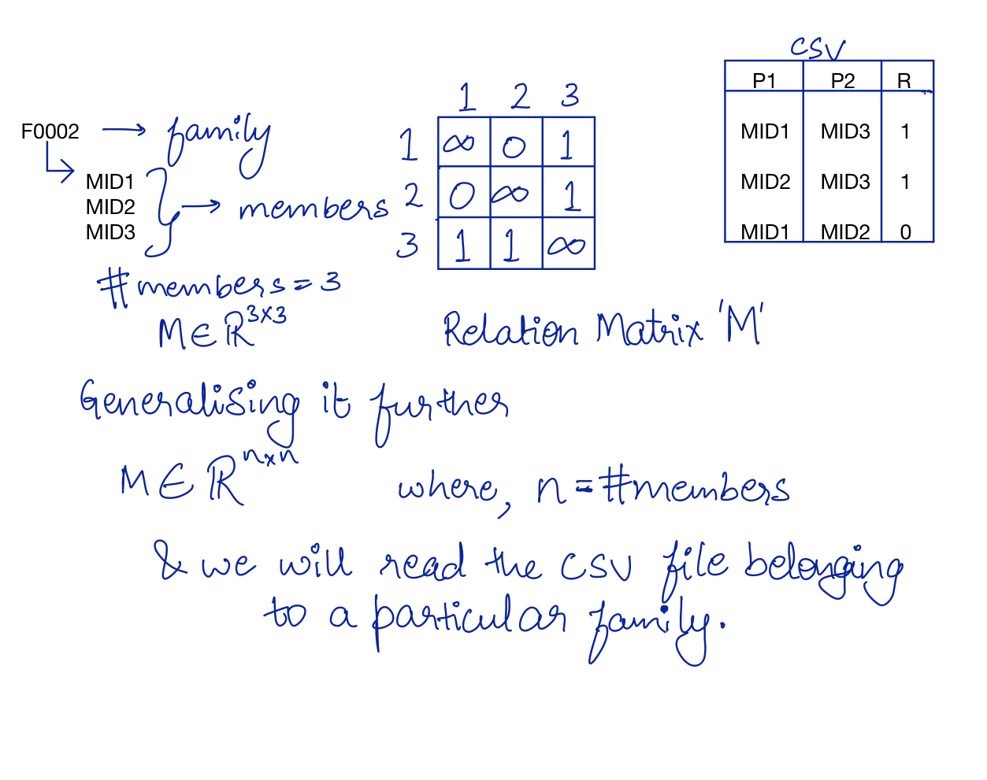
Adjacency Matrix Approach:

Slide 10
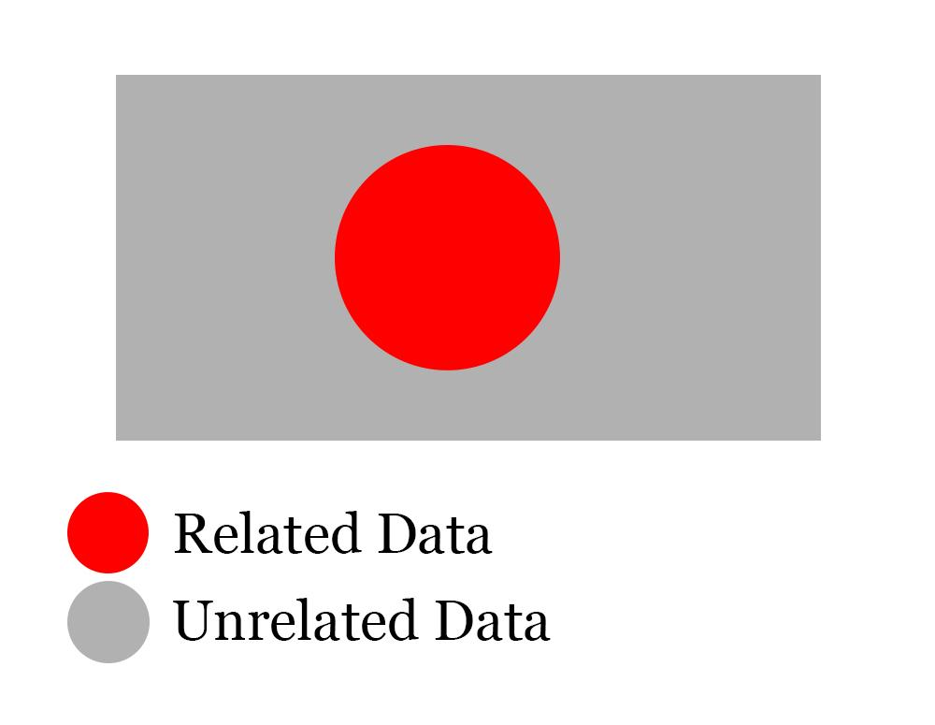
Random-Combinatorial Approach:
We have a csv file for related people,but we also need data that captures unrelated ones.
We make combinations of all possible pair of people in our dataset.
We remove the pair of people that are related from that combination set
This gives us the unrelated images set.

Slide 11
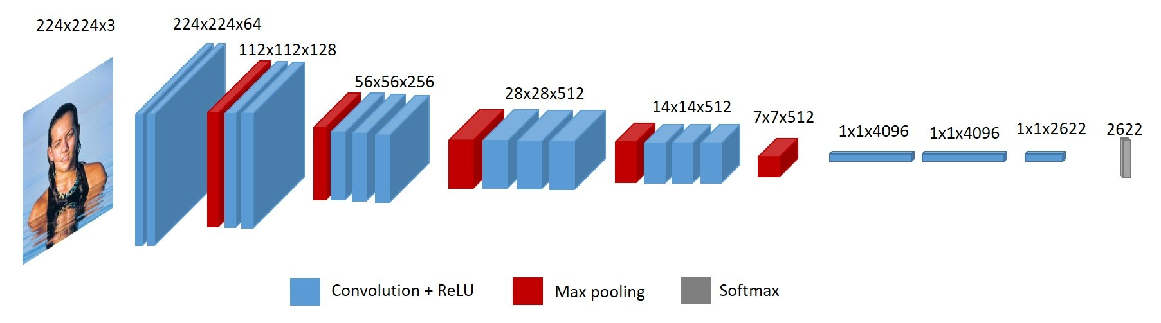
Feature Extraction Model: (VGG- Face)
It's an implementation of CNN’S VGG16 called VGGface, that extracts facial features in the form of a vector.
We get the feature vector for all images and then we concatenate the feature vector of designated images of a pair to form a combined feature vector for the pair,we do this for each pair
We then use different similarity measures and define a threshold line for our class segregation

Slide 12
VGG-Face Person Differentiator Model:
Implemented a transfer learning approach by downloading the pre-trained weights of the VGG-Face model to differentiate images of people.
The facial features are extracted by utilizing the previous layer of the output layer as the feature representation the image.
The input images are preprocessed by normalizing the RGB image in a scale of [-1. +1]
Finally the images are compared by calculating a similarity measure(cosine similarity and euclidean distance).
Due to this similarity measure image segregation,this is an one shot learning approach

Slide 13
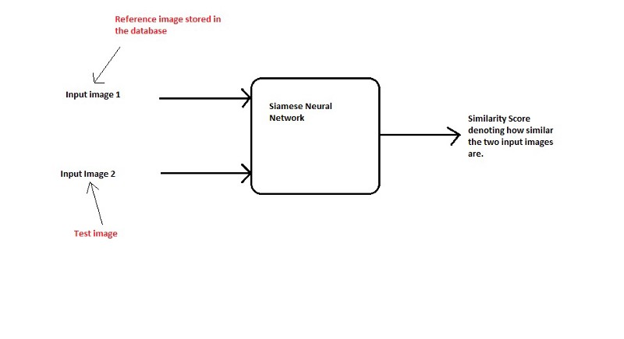
Model 1: One-Shot learning Approach:
This approach will not classify an image directly to any of the output classes.
Rather, it is learning a similarity function, which takes two images as input and expresses how similar they are.

Slide 14
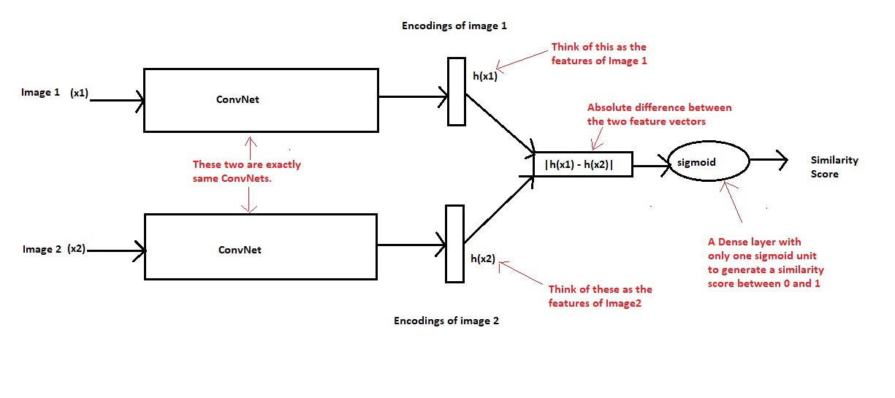
Model 2: Siamese Network Approach
The term Siamese means twins. The two Convolutional Neural Networks shown above are not different networks but are two copies of the same network, hence the name Siamese Networks. Basically, they share the same parameters across different input inputs.

Slide 15
Our Model:
Our model is based on the principles of Siamese networks.
The idea is input images according to labels generated from our generated labelled dataset(related and unrelated) to extract facial feature predictors using the VGG-Face model.
These features are then concatenated to produce a single feature vector of the same length which is then fed into a CNN Network to classify this combined data using the labels of our dataset.
The model produced a 80% accuracy on our validation set and when submitted to kaggle produced an AUC score of 0.738 which was their evaluation criteria.
Our current rank in the competition is 170 which is top 40%.

Slide 16
Future Improvements
Instead of passing our images through two VGG16 networks in pairs, we can instead pass all images through one VGG16 network and store the feature vectors.
Now that we have feature vectors of all images and a csv file containing relationship between those images, we can map pairs of images together and concatenate their feature vectors.
Then we pass our new set of feature vectors along with their class label through a neural network to learn the features of the class labels and then use it on the test set.

Slide 17
Conclusion
Our model produced a 75% accuracy on our validation set and when submitted to kaggle produced an AUC score of 0.738 which was their evaluation criteria.
This is just a first cut solution and many of the hyper parameters can be tuned to improve the model better. In addition we can take in 3rd party dataset to make the training more variable since the current model is trained on a certain demographic.
Our current rank in the competition is 170 which is top 40%. We have around 1 month remaining before the competition ends. So fingers crossed!

Slide 18
References
Kaggle Recognizing Faces In The Wild Competition: https://www.kaggle.com/c/recognizing-faces-in-the-wild/submit
VGG Face: https://sefiks.com/2018/08/06/deep-face-recognition-with-keras/
One Shot Learning and Siamese Network: https://machinelearningmastery.com/one-shot-learning-with-siamese-networks-contrastive-and-triplet-loss-for-face-recognition/
VGG Face vs other state of the art models:
http://www.robots.ox.ac.uk/~vgg/publications/2015/Parkhi15/poster.pdf

Slide 19
Thank you!

