Slide 1
Character Level Convolutional Networks for Text Classification
Harish Umasankar
Ruhul Ameen
Bodgam Rohan Reddy
Akash Vallamsetty

Slide 2
Goal
Use character convolution networks to classify text
Compare the accuracy of classification using the proposed model (using character level CNN) vs traditional method
Analysis on Impact of Various features on the Accuracy

Slide 3
Why do we need Character Level CNN
Traditional Method
Proposed Method
Quantizing by words to obtain features
Issue: Number of words is very large
Total number of characters is limited
Quantizing by character

Slide 4
Dataset: Tweets from Twitter
Tweets are pulled from twitter. Number of tweets = 1.6 M
Tweets are tagged as positive and negative
Our goal use the proposed model in the paper to train the model to classify the tweets.
Link to the dataset

Slide 5
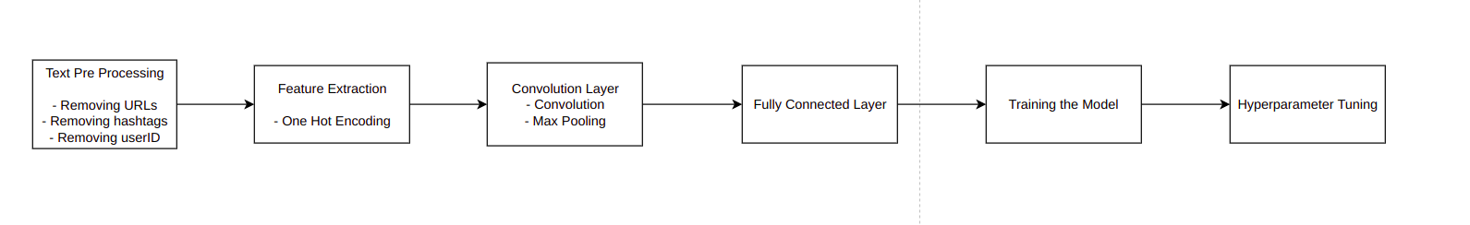
Pipeline for Text Classification using Character Level CNN

Slide 6

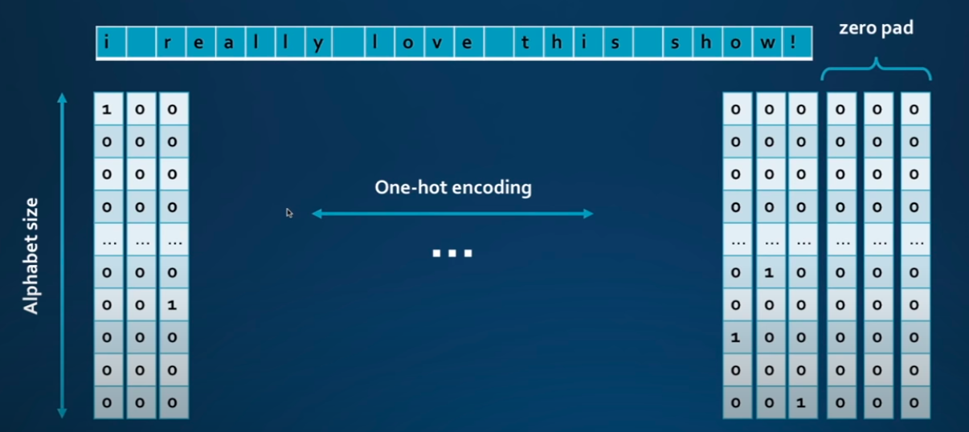
One Hot Encoding

Slide 7
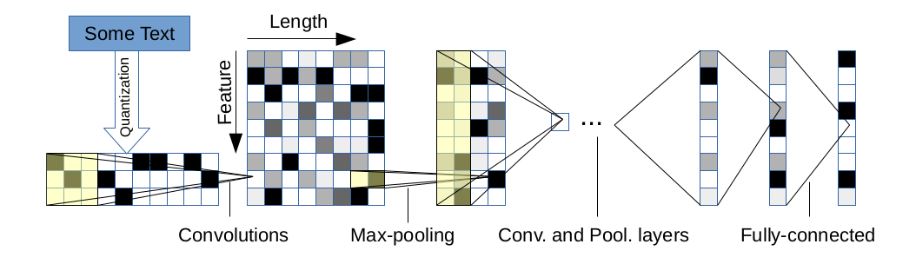
Architecture

Slide 8
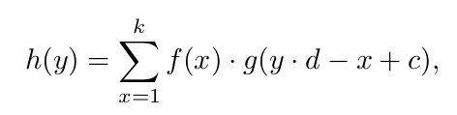

Character level CNN Logistics
Quantize the string using one hot encoding
Model consists of
6 Convolution Networks
3 Fully Connected Layers
Convolutional Network
Strided Convolution
Max-pooling function
Fully Connected Layer

Slide 9
Activation Function
Used for classification based on the linear equation we will get after summing with weighted features
Vanishing Gradient Problem in Sigmoid and Tan h Functions
Why ReLu ?

Slide 10
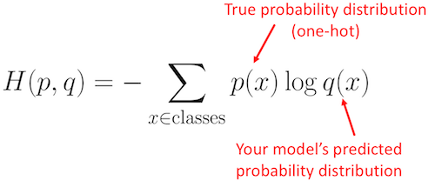
Loss Function
Used Sparse Categorical Cross Entropy Loss/Log Loss Function
Sparse Representation
In sparse categorical cross-entropy , truth labels are integer encoded, for example, [1], [2] and [3] for 3-class problem.

Slide 11
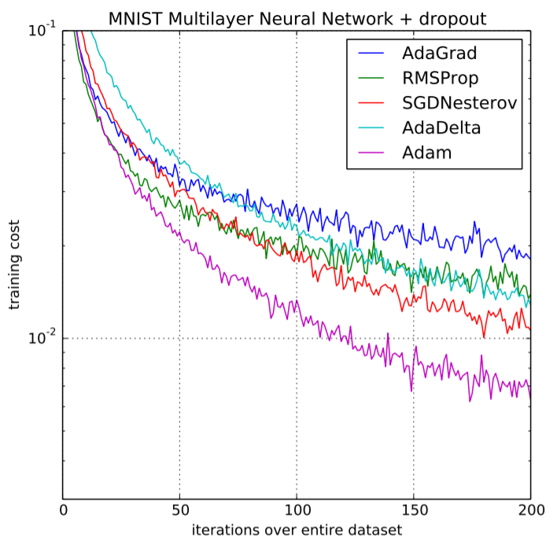
Optimizer
Used Adam Optimizer
Computes individual adaptive learning rates for different parameters

Slide 12
Result
Dataset : 30 percent of whole split into 80-20 train-test data.
Accuracy = 84%
Model | Precision | Recall | F1-measure | Accuracy
CNN(positive) | 0.84 | 0.82 | 0.84 | 0.84
CNN(negative) | 0.83 | 0.85 | 0.83

Slide 13
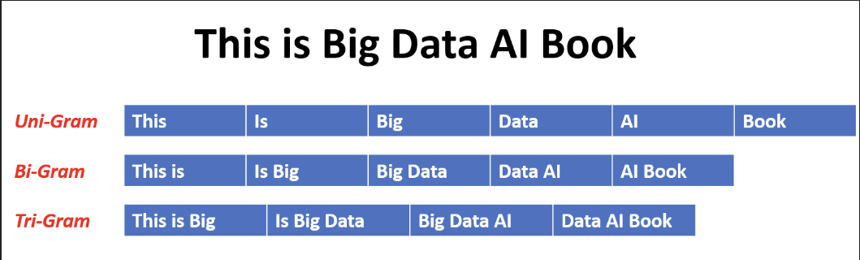
Model 2: n Grams - TFIDF with Multinomial Logistic Regression
Models constructed from selection of most frequent n-grams.
N-gram : A sequence of n items from a given sample.
TFIDF is the method used to convert the n-gram words into feature vectors
Multinomial Logistic Regression applied to the model to classify the test dataset and find accuracy.

Slide 14
Result
Dataset : 30 percent of whole split into 80-20 train-test data.
Model​ | Precision​ | Recall​ | F1​-measure | Accuracy​
CNN (positive)​ | 0.84​ | 0.82​ | 0.84​ | ​ ​ 0.84​
CNN (negative)​ | 0.83​ | 0.85​ | 0.83​
N-gram TFIDF (positive) | 0.76 | 0.80 | 0.78 | 0.78
N-gram TFIDF (negative) | 0.79 | 0.75 | 0.77

Slide 15
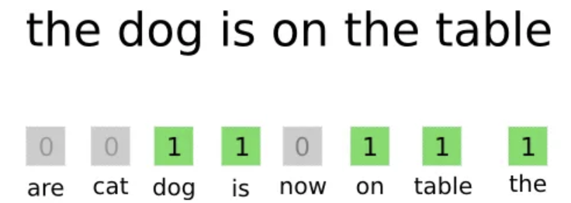
Model 3: Bag of Words TFIDF with Multinomial Logistic Regression
Bag of words model collects/samples the most frequent words in the dataset.
The frequencies of the words are converted into feature vectors using TFIDF.
Multinomial Logistic Regression applied to the model to classify the test dataset and find accuracy.

Slide 16
Result
Dataset : 30 percent of whole split into 80-20 train-test data.
Model​​ | Precision​​ | Recall​​ | F1​​-measure | Accuracy​​
CNN (positive)​​ | 0.84​​ | 0.82​​ | 0.84​​ | ​​ 0.84​​
CNN (negative)​​ | 0.83​​ | 0.85​​ | 0.83​​
N-gram TFIDF (positive)​ | 0.76​ | 0.80​ | 0.78​ | ​ ​ 0.78​
N-gram TFIDF (negative)​ | 0.79​ | 0.75​ | 0.77​
Bag of words TFIDF (positive) | 0.76 | 0.79 | 0.77 | 0.77
Bag of words TFIDF (negative) | 0.78 | 0.75 | 0.76

Slide 17
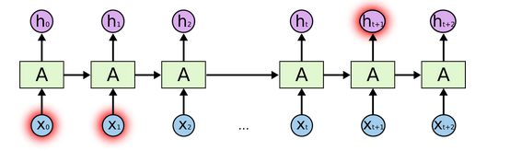
Model 4: LSTM
LSTM is a special kind of Recurrent Neural Network(RNN)
Normal RNN is not able to learn to connect information from a larger gap which is relevant
Eg. I grew up in France... So I speak fluent French . In this predicting French largely depends on the word 'France' which the RNN might not pick up.

Slide 18
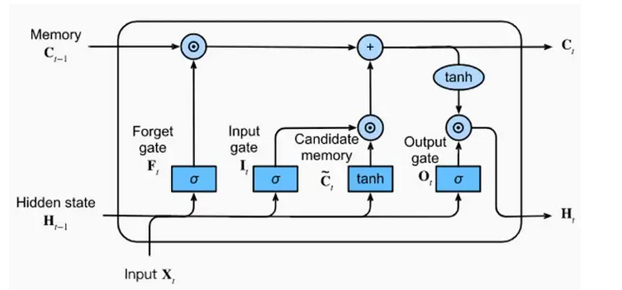
Model 4:LSTM
LSTM consists of two separate streams of memory – short term, long term
It consists of three gates – Forget gate (decides how much long term memory to retain, input gate (updates long term memory), output gate (gives the output which is also next short term memory)
The model is developed by introducing a LSTM layer in the deep neural network structure which gives the output as mean of all the LSTM cells present. The means are used as feature vectors and a classifier is developed using multinomial logistic regression.

Slide 19
Result
Dataset : 30 percent of whole split into 80-20 train-test data.
Model​​ | Precision​​ | Recall​​ | F1​​-measure | Accuracy​​
CNN (positive)​​ | 0.85 | 0.81​​ | 0.83​​ | ​​ 0.84​​
CNN (negative)​​ | 0.8​2 | 0.86 | 0.84
N-gram TFIDF (positive)​ | 0.78 | 0.81 | 0.79​ | ​ ​ 0.79
N-gram TFIDF (negative)​ | 0.80 | 0.77 | 0.78
Bag of words TFIDF (positive) | 0.77 | 0.80 | 0.78 | 0.78
Bag of words TFIDF (negative) | 0.79 | 0.75 | 0.77
LSTM (positive) | 0.75 | 0.79 | 0.77 | 0.77
LSTM (negative) | 0.78 | 0.74 | 0.76

Slide 20
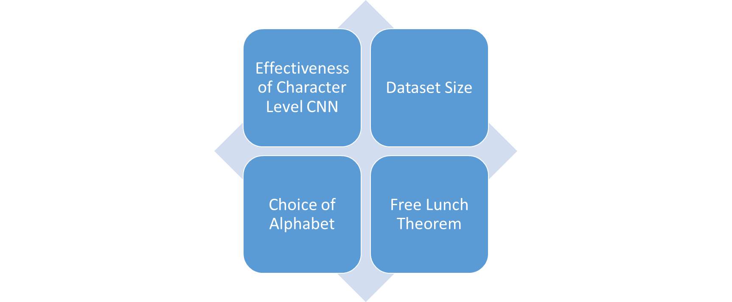
Analysis

Slide 21
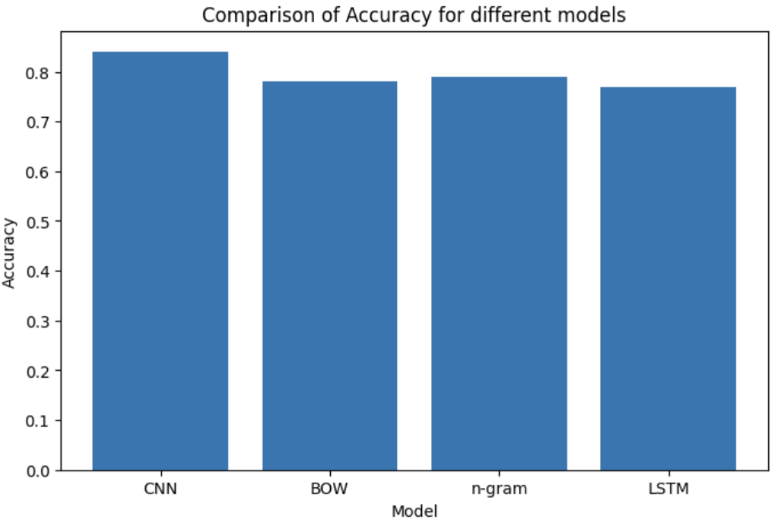
Effectiveness of Character Level CNN
Perform text classification without need for words
Text classification has more accuracy than other models

Slide 22
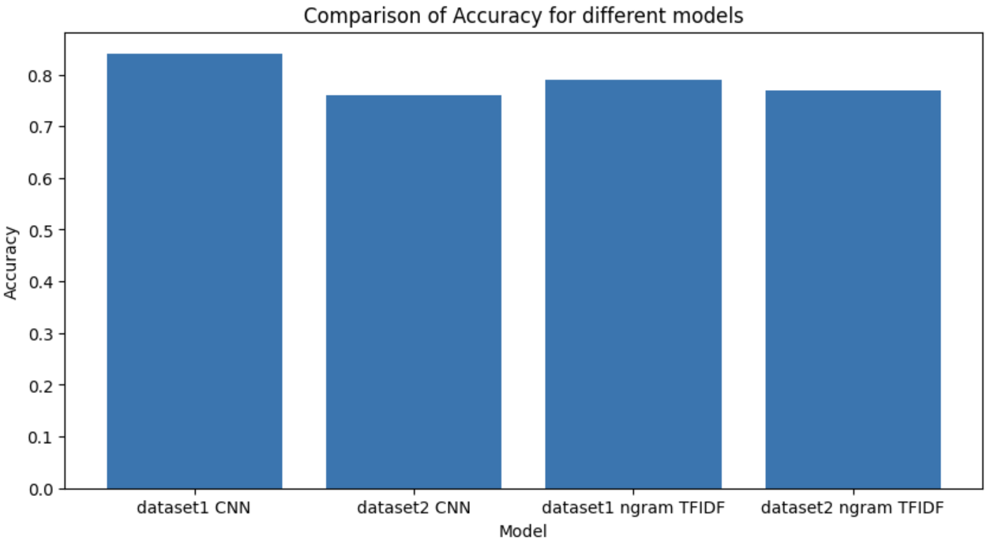
Dataset Size
Convolution Networks work better on larger data sets
Traditional Methods work better on smaller data sets

Slide 23
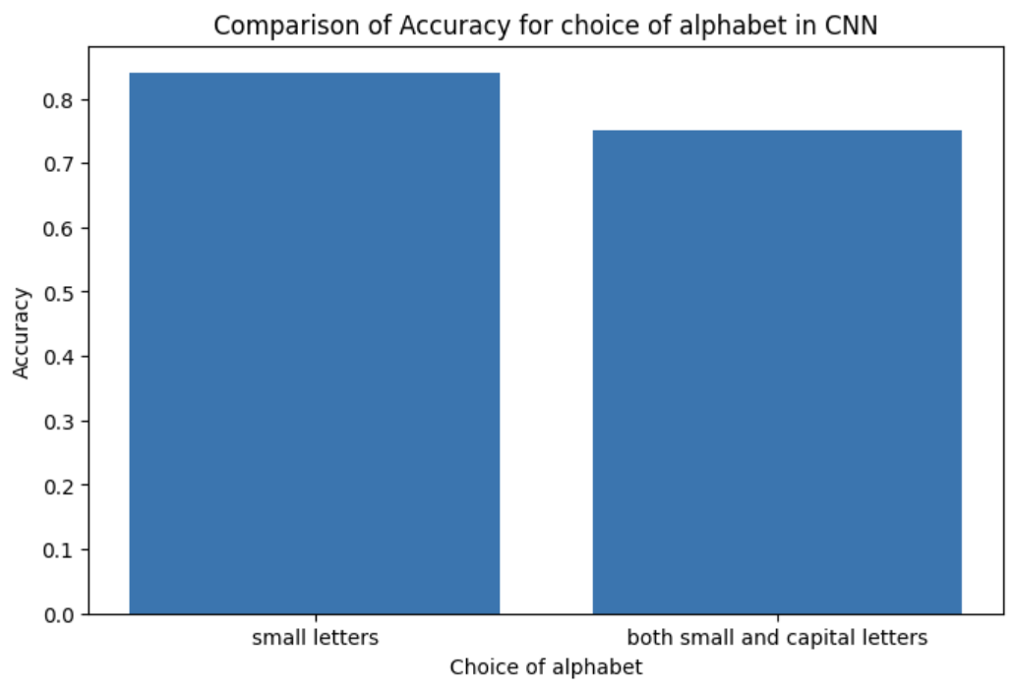
Choice of Alphabet
Only using small letters, accuracy = 0.84
Using both capital and small letters, accuracy = 0.75
Making distinction between lower case and upper-case alphabets does not improve accuracy of model

Slide 24
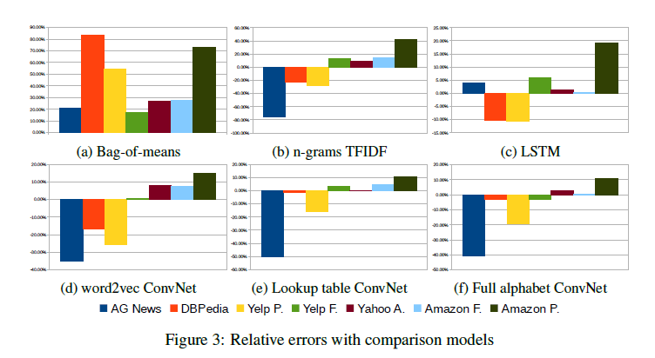
Free Lunch Theorem
These experiments on Character Level CNN and Traditional Methods suggest that there no one single model that will work for all data sets

Slide 25
THANK YOU

