Slide 1
Character Level Convolutional Networks for Text Classification
Harish Umasankar
Ruhul Ameen
Bodgam Rohan Reddy
Akash Vallamsetty

Slide 2
Goal
Use character convolution networks to classify text
Compare the accuracy of classification using the proposed model (using character level CNN) vs traditional method

Slide 3
Why do we need Character Level CNN
Traditional Method
Proposed Method
  Quantizing by words to obtain features
  Issue: Number of words is very large
  Total number of characters is limited
  Quantizing by character

Slide 4

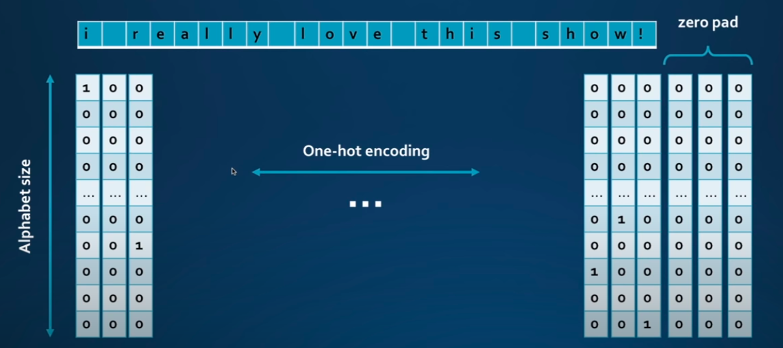
One Hot Encoding

Slide 5
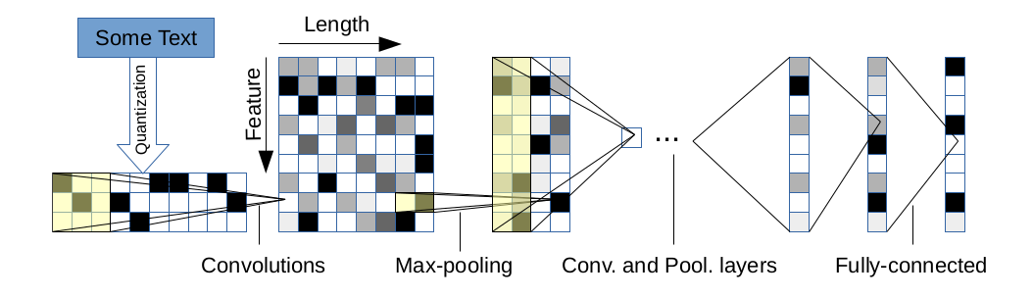
Architecture

Slide 6
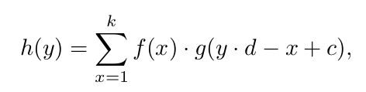

Character level CNN Model
Quantize the string using one hot encoding
Model consists of
  6 Convolution Networks
  3 Fully Connected Layers
Convolutional Network
  Strided Convolution
  Max-pooling function
Fully Connected Layer

Slide 7
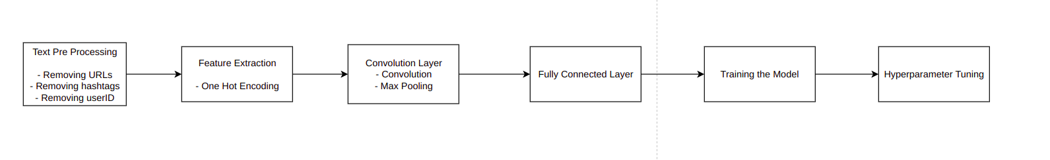
Pipeline for Text Classification

Slide 8
Dataset: Coronavirus Tweets
Tweets are pulled twitter that around the topic of Coronavirus
Tweets are tagged as positive, negative, extremely positive and extremely negative and neutral
Our goal use the proposed model in the paper to train the model to classify the tweets.
Link to the dataset

Slide 9
Deliverables
Code
  Code for the Traditional Model – Bag of Words, TFIDF + Logistic Regression
  Code for the Proposed Model – One Hot Encoding + Character Level CNN
Report
  Report will include the following
  - Details of the experiment
  - Results

Slide 10
THANK YOU

