Slide 1
Sheet Music Reader
Team: P2 & Co.
Tanmay Bhatt (2020112017) (ECD)
Pranav Manu (2020112019) (ECD)
Harish Umasankar (2020102067) (ECE)
Ruhul Ameen (2020102031) (ECE)
Mentor TA: B.V.K
GitHub Repo Link: Link

Slide 2
PROBLEM DEFINITION
Scanning the notes
Detect Music notes
This step will involve scanning and performing pre-processing like thresholding and denoising the image.
Connected component detection algorithms like two pass would be used to identify where a single note is present, and then it would identify the specific note.
Note Mapping
AUDIO SYNTHESIS
This step involves mapping the notes detected using connected components to corresponding frequency values.
Using an audio synthesizer to play the notes based on the note-frequency mapping

Slide 3
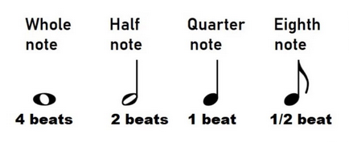
MUSIC THEORY
NOTES DURATION

Slide 4
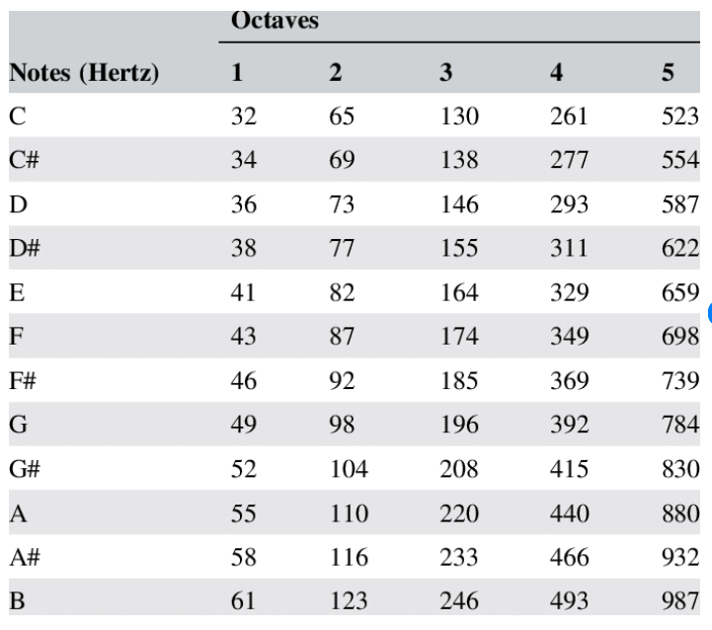
NOTES TO FREQUENCY MAP

Slide 5
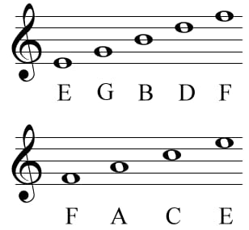
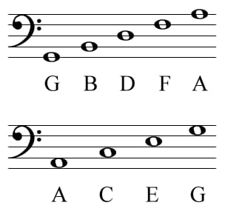
SYMBOL CHARACTER MAP
FOR CLEF
FOR BASE

Slide 6
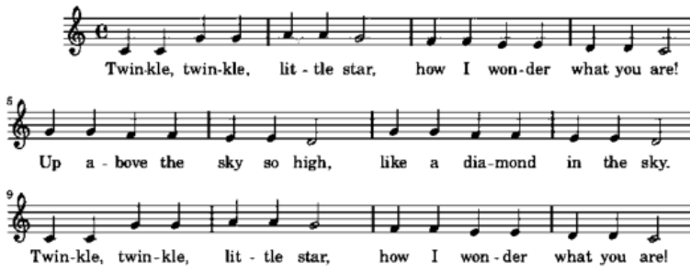
Thresholding
To convert the sheet music image to binary image, Otsu's thresholding method is used.
This removes the imperfections in the image and helps us to apply morphological operations efficiently
We also use Hough Transform to correct the image Skew after performing thresholding

Slide 7
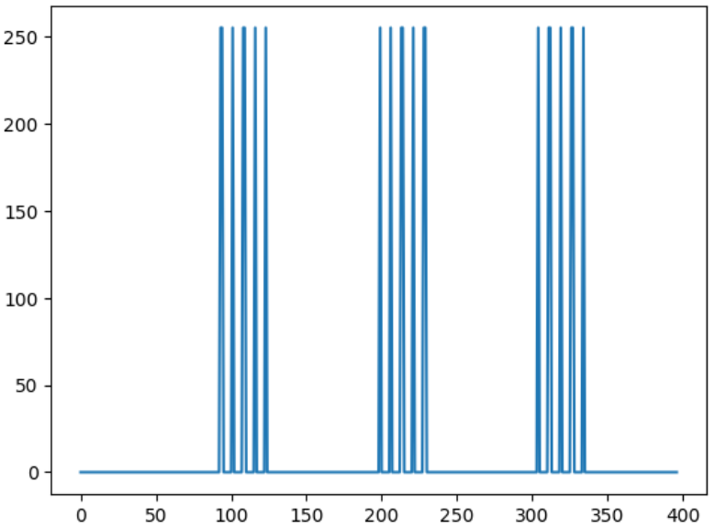
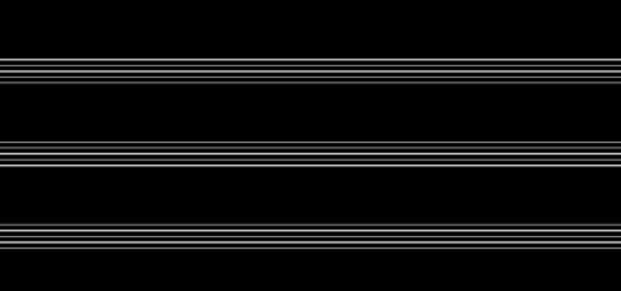
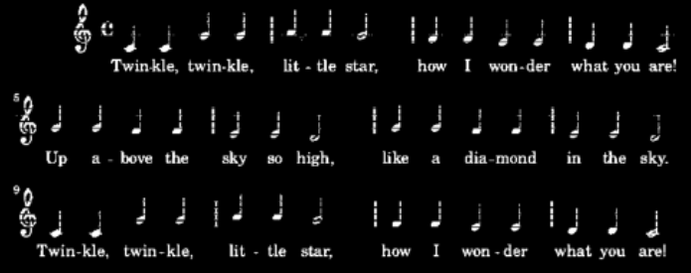
STAFF LINE DETECTION and removal
Staff lines are five horizontal lines in which the musical notes are present.
To detect staff lines, we find the column sum of the image and threshold it to get the row position of the staff lines.
Then remove these staff lines from the image to get image with only musical notes.

Slide 8
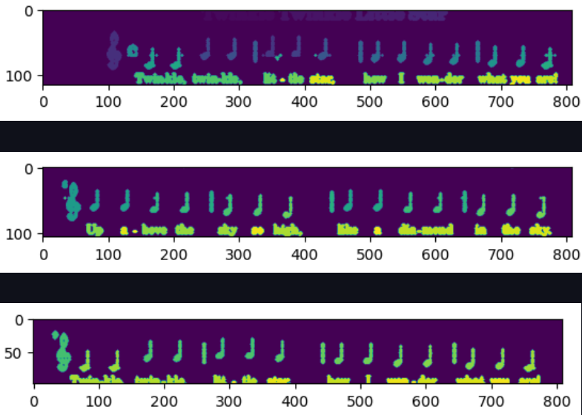
LINE SEGMENTATION
The sheet music will contain several lines with musical notes.
These lines are separated by using the staff line width and staff line location.
Also, each connected component has been assigned a label to identify the musical notes.

Slide 9
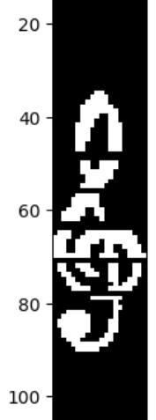
CLEF DETECTION
Clef is always the first object present at the left side of the staff
So, The left edge of the Clef is found at the first major peak while summing the vertical columns.
The end of the clef is found at the first transition below median in the vertical sums

Slide 10
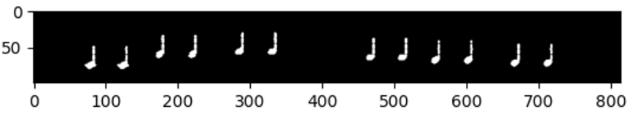
Eighth and Quarter note detection
Quarter and eighth notes are detected as a group as they both have solid circles.
These notes will be detected by eroding and dilating with a disk-shaped structuring element that was normalized to the space between staff lines.
It is then thresholded by eccentricity and area.
The remaining connected components whose area fall below 1.75 standard deviations from the median area gets removed.

Slide 11
HALF AND FULL NOTE DETECTION
Half and Full notes are detected together as they contain hollow circles in them.
To detect we first dilate the image with a structuring element proportional to the width of the staff lines.
Then all the closed regions are filled up using watershed algorithm.
We subtract this result from the original to get the image with non-filled notes present

Slide 12
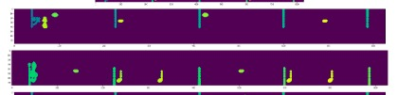

REST NOTE DETECTION
Rest notes are rectangular elements present in the image.
We remove the horizontal and vertical lines from the image to get only musical notes without separating vertical lines.
Then we sum the pixels in the vertical axis of each connected component.
The components where the variance around mode of the component is nearly zero are detected as rest notes.

Slide 13

Mapping of notes to character
The detected notes are mapped to a particular structure using a mapping table.
This structure will consist of the note duration, frequency, etc.
Create a dictionary that maps every note {'A', 'B', . . . 'G'} to corresponding frequency
This structure is used to generate audio from the notes.

Slide 14
Generating audio
Audio is generated from the character string which was generated by mapping of the notes.
This is done by generating sinusoid with frequency corresponding to the music note.
Link To Generated Audio for Twinkle Twinkle Little Star

Slide 15
DIVISION OF WORK
PRANAV
TANMAY
Segmentation
Quarter, half, eighth note detection
Clef detection
Key Signature Detection
Note to character mapping
HARISH
RUHUL
Note to character mapping
Audio synthesis
Rest detection
Audio synthesis

Slide 16
THANK YOU

