Slide 1
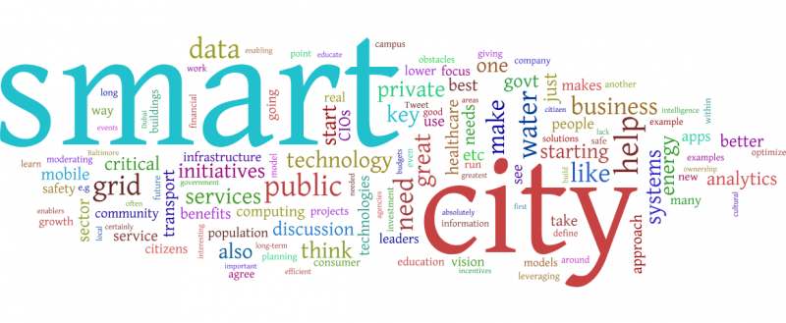
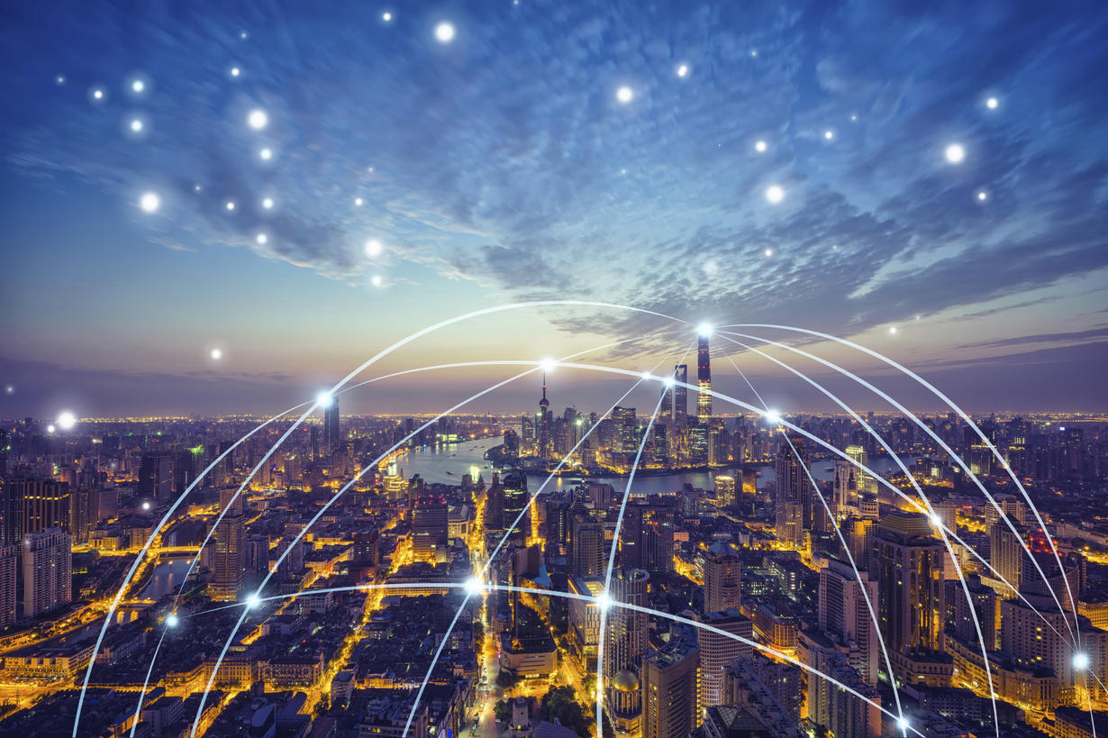
Smart Solutions for Smart cities….
Using Data Analysis

Slide 2
What Does a smart city mean…?
A smart economy
A smart mobility
A smart environment
Smart people
Smart living
Smart Governance

Slide 3
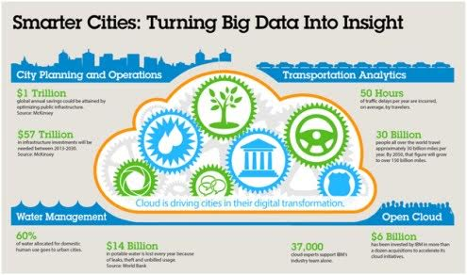
How can big data potentially contribute to smart cities?

Slide 4
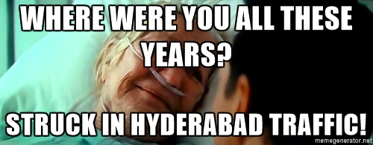

Slide 5

Transport---one of the dreadful problem everyone faces daily
Can we have a smart (and an intelligent) solution…?

Slide 6
YES, an intelligent and a feasible solution is possible by developing intelligent systems using data analysis and machine learning.

Slide 7
IILUSTRATION
Imagine you started at JNTU to reach college through Pragathi nagar.
You are expected to reach in 15 minutes at maximum.
But suddenly traffic grew so much in pragathi nagar.Imagine if you had been told about this well in advance and also a path which makes your journey easier.It’s amazing right.
Our intelligent system does this.

Slide 8
The idea is to use data analytics tools to use large amount of data collected from traffic management systems and produce patterns that can be used to formulate a full-proof and more efficient traffic policy that can reduce or eliminate vehicle congestion.
To save valuable resources and time.
Here we can use traffic data like videos,no: of vehicles, type of vehicles…etc. to infer patterns of traffic congestion.

Slide 9
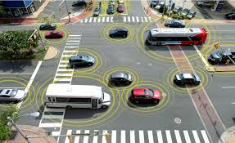
Big data integrated with Machine Learning provides one of the best solutions…
BIG DATA IS A TOOL TO BUILD SMART CITY.
The traffic can be measured and regulated with the help of RFID tags on the vehicle.
The RFID tags will send the geo location data to a central monitoring unit that will identify the congested areas.

Slide 10
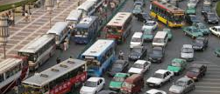
Analysis of RFID information
Traffic detection based on info collected from same the Geo location

Slide 11
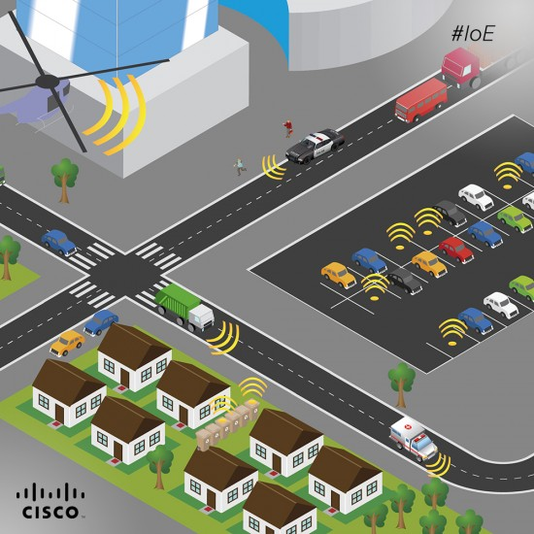
Predicting congestion well in advance
“Machine learning” This is where our today’s world is changing into heaven with unbelievable innovations.
By using advanced algorithms of machine learning like SVM,neural networks and logistic regression, we can predict congestion well in advance and ease the movement.

Slide 12
How the algorithm works
SVM and neural networks are advanced version of classifiers.
Each area can be considered as nodes.
These nodes by using previous available data can be divided into congested and less congested nodes.
This is done continuously by the algorithm without human intervention THUS MAKING IT INTELLIGENT AND SELF DEPEDANT SYSTEM.
This keeps continuing and updating.

Slide 13
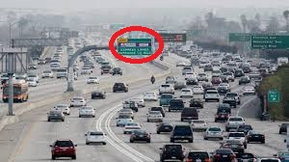
INTELLIGENT TRAFFIC INDICATORS
This can be displayed in LED indicators similar to our map and distance indicators like this

Slide 14
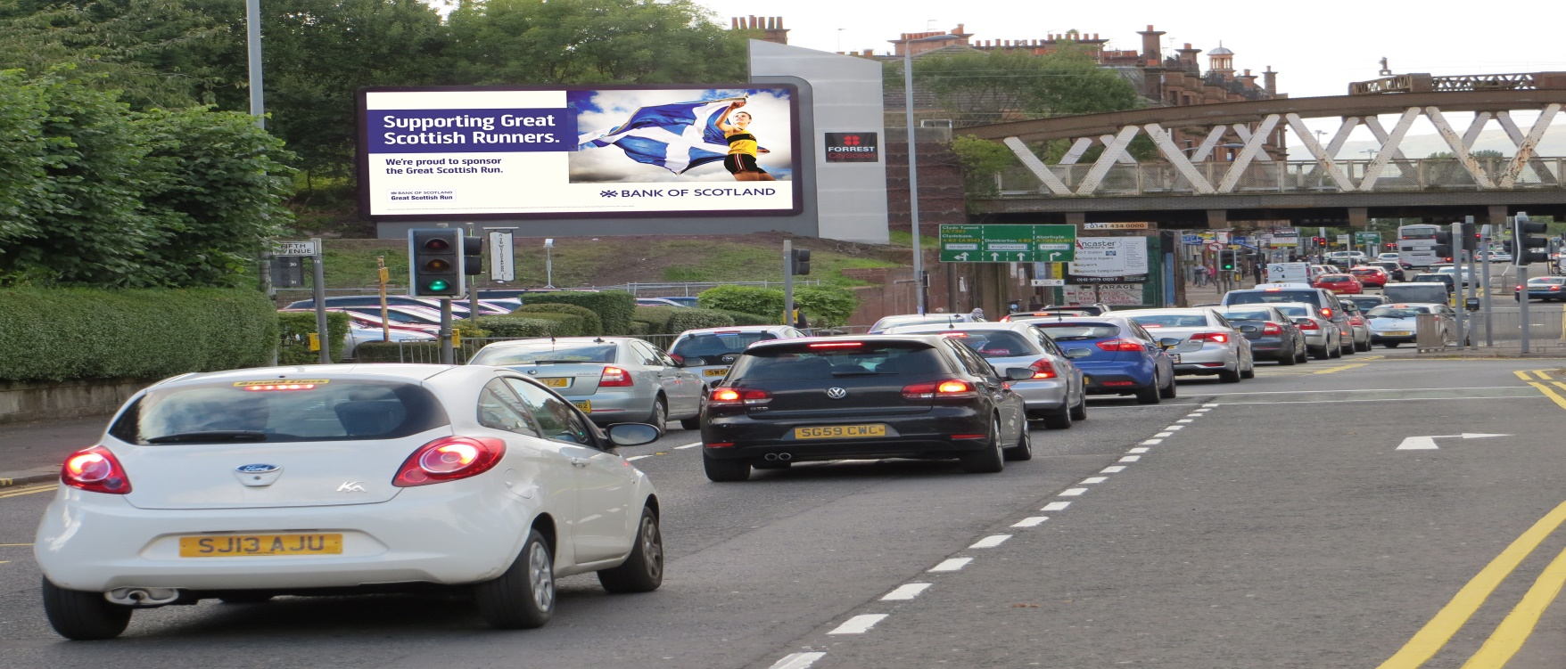
Conveying message to the citizen
Sending exact status of traffic to their mobile.
Digital advertising for important destinations in the city.
Informing to the corresponding police authority to handle traffic immediately.

Slide 15
Advantages of this solution
Traffic problem can be greatly solved.
Parking problems can be better managed.
May look similar to google maps but has additional advantages using RFIDs like communication between RFIDs is possible which could solve some other problems….
Attractive and smart change to the city.

Slide 16
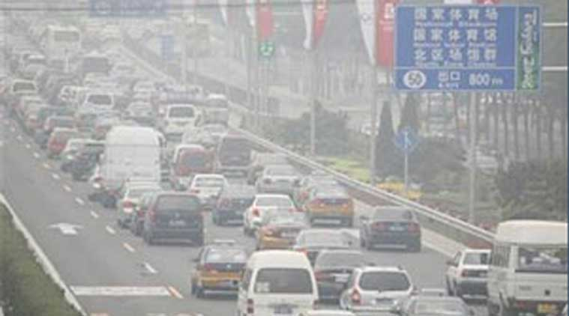
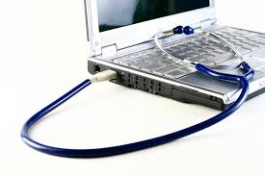
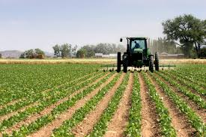
WITH BIG DATA : Not only transport but also…..
Pollution control by sensing its parameters like SO2,CO and taking immediate action like increasing greenery there or traffic shaping as discussed.
Smart health facilities like predicting particular disease , medicine or doctor based on the symptoms given by the patient.
Improving yield of agriculture by analyzing the crop with various parameters like rainfall , temperature, underground water,.. and improving crop condition by making corresponding changes.

Slide 17
THANK YOU…..

