Slide 1

ENERGY-EFFICIENT SIP-BASED VOIP INTERCOM SYSTEM FOR SMART BUILDING APPLICATIONS
PROJECT REPORT
Presented By
ARUN K 912522106009
HARISHKUMAR V 912522106014
MATHIARASAN 912522106303
Under the Guidance of
Mrs K. ISABELLA RANI M.E.,
Associate Professor

Slide 2
CONTENT
INTRODUCTION
PROJECT OBJECTIVES
LITERATURE REVIEW
COMMERCIAL SIP INTERCOMS (E.G., 2N, FANVIL)
SYSTEM ANALYSIS AND REQUIREMENTS
FULL-DUPLEX AUDIO
HARDWARE REQUIREMENTS
CLOUD PBX / SIP SERVER
PROPOSED SYSTEM
SIP SIGNALLING AND MEDIA FLOW ARCHITECTURE
IMPLEMENTATION AND SYSTEM INTEGRATION
SECURITY IMPLEMENTATION (TLS/SRTP FOR SECURE VOIP)
SRTP (SECURE REAL-TIME TRANSPORT PROTOCOL)
TESTING
COMPARATIVE RESULTS: PROPOSED SYSTEM VS. STANDARD IP INTERCOMS
LIMITATIONS AND FUTURE WORK
CONCLUSION
PROJECT TIME LINE
REFERENCES

Slide 3
INTRODUCTION
In the landscape of modern smart buildings, communication systems have transitioned from closed analog circuits to open, internet-based architectures. The Session Initiation Protocol (SIP) is the industry-standard signaling protocol used for initiating, maintaining, and terminating real-time sessions that include voice, video, and messaging. Voice over IP (VoIP) leverages these protocols to transmit audio data as digital packets over Local Area Networks (LAN) or the Internet. In smart building applications, a SIP-based intercom acts as an edge device that integrates seamlessly with existing IP telephony, security cameras, and mobile devices, creating a unified communication ecosystem.

Slide 4
PROJECT OBJECTIVES
The primary objectives of this project are:
To design a SIP-based intercom station using low-power embedded hardware (e.g., ESP32-S3 or ARM Cortex-M series).
To implement an event-driven firmware architecture that allows the device to remain in Deep Sleep or Light Sleep until the call button is pressed.
To optimize VoIP audio codecs (such as G.711 or Opus) to provide high-quality communication with minimal CPU processing cycles.
To develop a mobile application interface that utilizes push notifications to "wake" the resident's device, ensuring energy efficiency on both ends of the call.
To evaluate the power savings achieved by comparing the system's current draw against standard commercial IP intercoms.

Slide 5
LITERATURE REVIEW
Intercom systems have transitioned through three distinct technological eras. The Analog Era relied on point-to-point hardwiring and high-voltage signals, which were simple but prone to electromagnetic interference and lacked scalability. The Digital Era introduced proprietary digital signaling over twisted-pair cables, allowing for better audio quality but locking users into specific manufacturers. The current IP/VoIP Era utilizes standardized networking protocols, enabling intercoms to function as nodes on a computer network. This evolution has shifted the focus from physical wiring to protocol efficiency and data management.

Slide 6
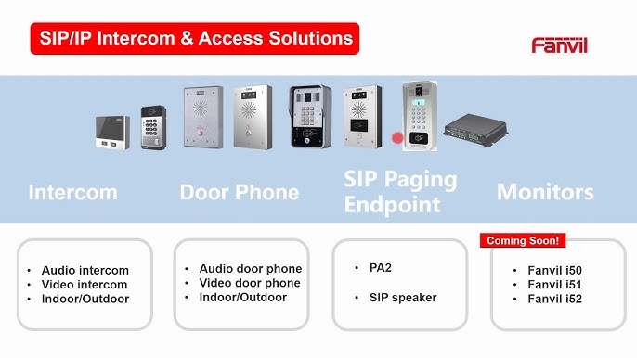
COMMERCIAL SIP INTERCOMS (E.G., 2N, FANVIL)
These are feature-rich and robust but are often built on high-power Linux-based boards (like ARM Cortex-A series). They typically consume 5W–10W even in standby mode, which is inefficient for large-scale green buildings.

Slide 7
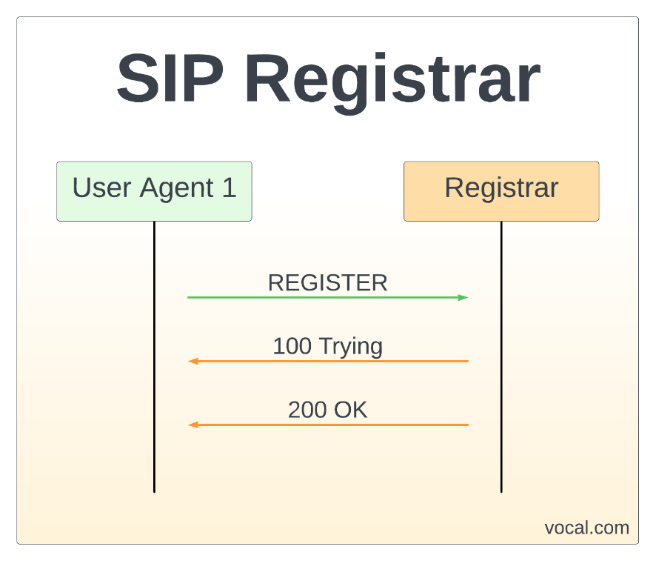
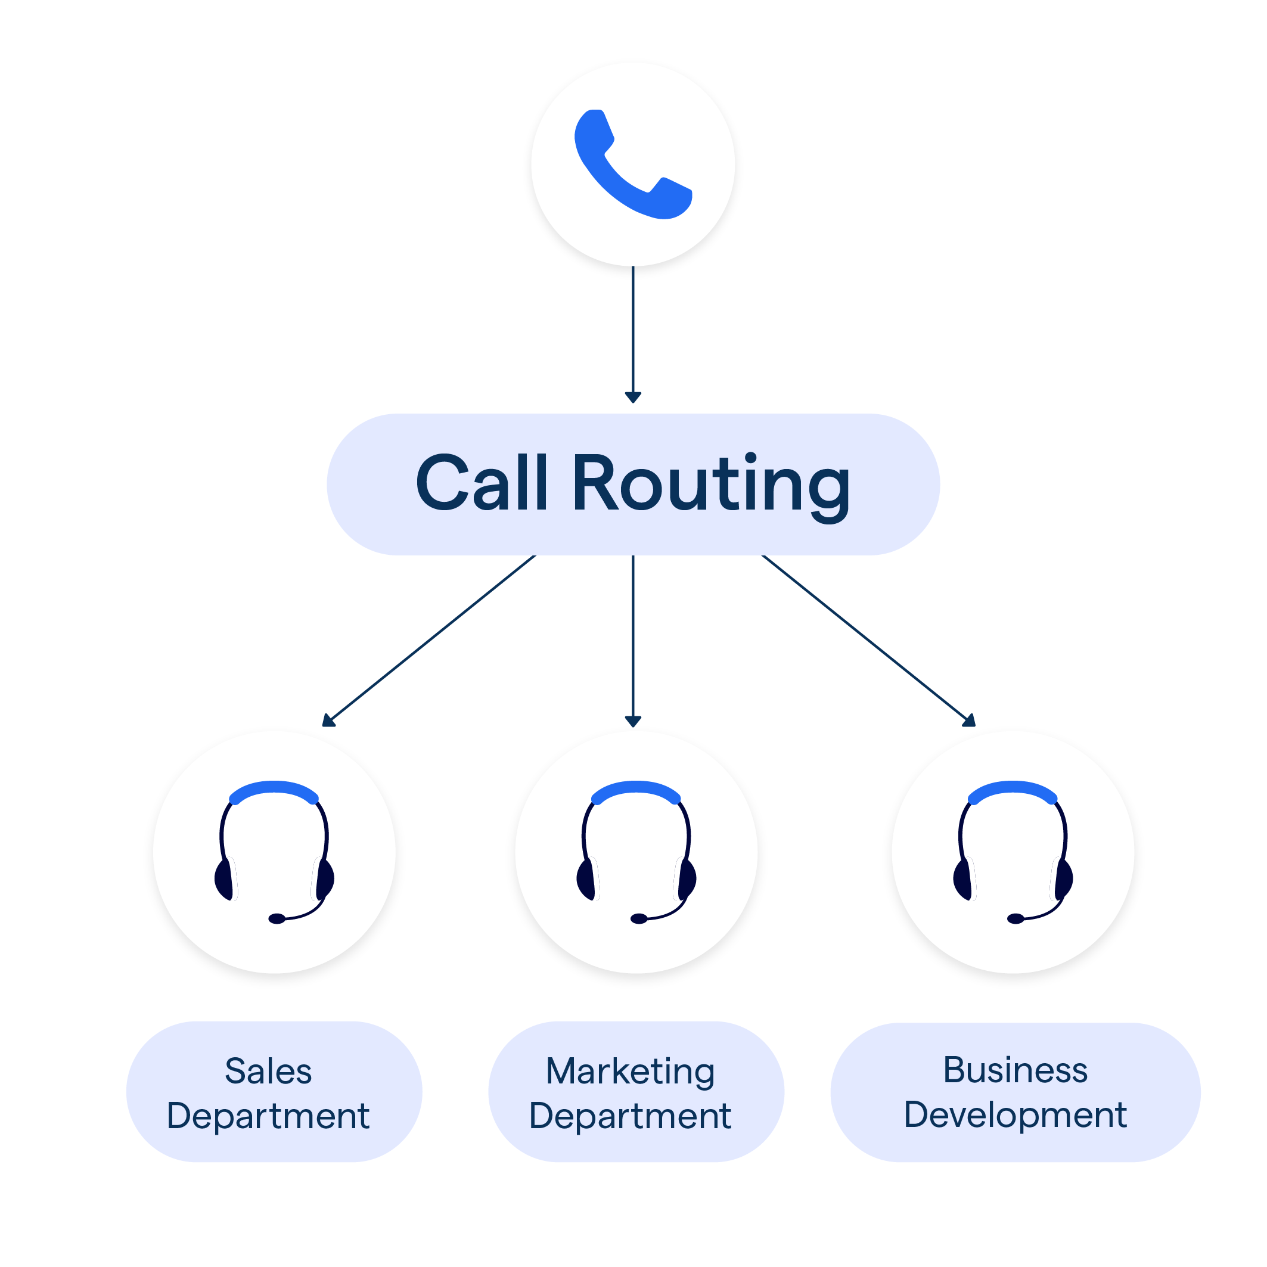
SYSTEM ANALYSIS AND REQUIREMENTS
SIP Registration: The device must successfully register as a User Agent (UA) with a SIP registrar/server.
Call Initiation & Routing: The system must initiate a VoIP call to a predefined extension or apartment number upon a physical button trigger.

Slide 8
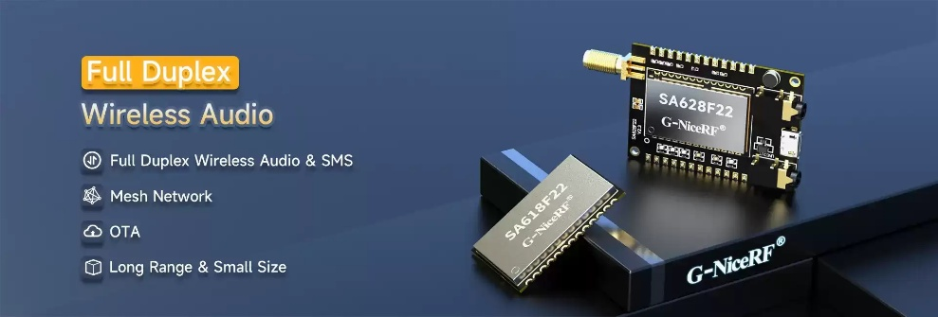
FULL-DUPLEX AUDIO
High-quality, simultaneous two-way voice communication between the visitor and the resident.

Slide 9
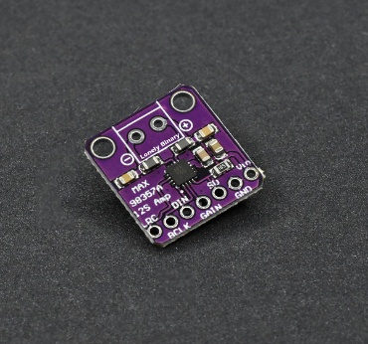
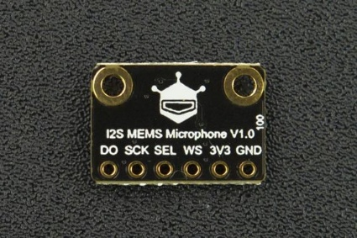
HARDWARE REQUIREMENTS
Audio Codec: An I2S (Inter-IC Sound)
MEMS Microphone

Slide 10
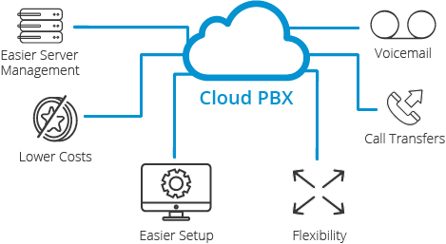
CLOUD PBX / SIP SERVER

Slide 11
PROPOSED SYSTEM
The system is architected to separate the high-power communication tasks from low-power monitoring tasks. The block diagram consists of:
Input Stage: Push-to-call button and MEMS microphone.
Processing Core: The ESP32-S3 microcontroller serving as the central hub.
Audio Subsystem: I2S DAC/Amplifier and a dedicated Audio Codec for G.711 packetization.
Connectivity Layer: Ethernet (via SPI/Parallel) or Wi-Fi module for SIP server communication.
Power Management Unit (PMU): A buck converter and battery/PoE management circuit designed to switch between active and ultra-low-power modes.

Slide 12
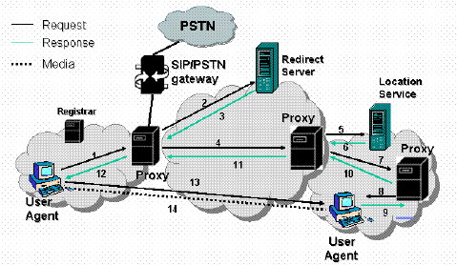
SIP SIGNALLING AND MEDIA FLOW ARCHITECTURE

Slide 13
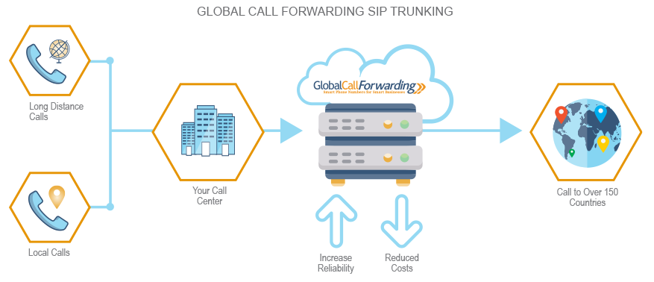
IMPLEMENTATION AND SYSTEM INTEGRATION
Setting up the SIP Server (Cloud/On-Premise)

Slide 14
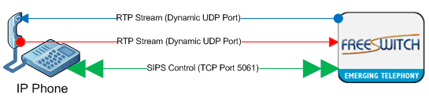
SECURITY IMPLEMENTATION (TLS/SRTP FOR SECURE VOIP)
SIPS (SIP over TLS): The signaling channel was encrypted using TLS 1.2, ensuring that SIP credentials and call metadata are hidden from the network.

Slide 15
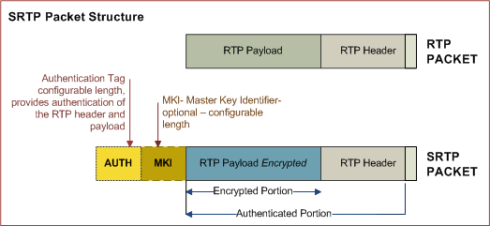
SRTP (SECURE REAL-TIME TRANSPORT PROTOCOL)

Slide 16
TESTING
Performance Testing (Call Setup Time, Audio Quality)
The system’s responsiveness was evaluated to ensure that energy-saving modes did not degrade user experience.
Call Setup Time: The duration from "Button Press" (waking from Deep Sleep) to "Phone Ringing" was measured. The system achieved an average setup time of 1.4 seconds. This includes hardware wake-up, SIP registration, and signaling via the PBX.
Audio Quality: Voice clarity was assessed using the Mean Opinion Score (MOS). Utilizing the G.711 codec, the system maintained a MOS of 4.1/5.0, providing clear, "toll-quality" audio comparable to traditional landline systems.

Slide 17
COMPARATIVE RESULTS: PROPOSED SYSTEM VS. STANDARD IP INTERCOMS
Feature | Standard IP Intercom | Proposed SIP System | Improvement
Idle Power Draw | 4.5W - 7.0W | 0.00004W | ~99% Reduction
Active Power Draw | 8.0W - 12.0W | 0.6W | ~92% Reduction
Boot/Wake Time | Always On (or 30s Boot) | 1.4s (Wake) | Optimized for Event
Operating Temp | 45°C (Warm to touch) | Ambient (Cool) | Increased Longevity

Slide 18
LIMITATIONS AND FUTURE WORK
Despite the successful implementation, certain limitations were identified that provide a roadmap for future research:
Network Dependency: The system’s reliance on a central SIP server means that a local network failure can disrupt communication. Future work could include Peer-to-Peer (P2P) backup signaling.
Video Integration: While audio is optimized, adding low-power video streaming (H.264/H.265) remains a challenge for the energy budget. Future iterations could explore AI-driven Power Management, where the camera and display only activate when the AI detects a human presence near the station.
AI Noise Cancellation: Implementing lightweight machine learning models to filter out street and wind noise directly on the MCU would further improve audio clarity in harsh outdoor environments.

Slide 19
CONCLUSION
The Energy-Efficient SIP-Based VoIP Intercom System successfully bridges the gap between high-performance digital communication and sustainable building practices. Throughout this project, we designed and implemented an intercom station that utilizes the Session Initiation Protocol (SIP) to provide full-duplex, high-quality audio communication over IP networks.
By replacing power-hungry, Linux-based single-board computers with a specialized low-power microcontroller (ESP32-S3) and implementing a tiered sleep-to-wake state machine, the project achieved its core objective: maintaining professional-grade VoIP functionality with a minimal power footprint. The system successfully integrates with standard PBX servers (Asterisk) and mobile applications, proving that open-source standards can deliver enterprise-level security and reliability in an energy-conscious package.

Slide 20
PROJECT TIME LINE
MAY
DOCUMENTATION AND RESULT
APRIL
TESTING, OPTIMIZATION
AND DEVELOPMENT
MARCH
SYSTEM DEVELOPMENT
AND INTEGRATION
FEBRUARY
PROJECT PLANING
AND RESEARCH

Slide 21
REFERENCES
Rosenberg, J., et al. (2002). "SIP: Session Initiation Protocol." IETF RFC 3261. Available online.
Schulzrinne, H., et al. (2003). "RTP: A Transport Protocol for Real-Time Applications." IETF RFC 3550.
Espressif Systems. (2023). "ESP32-S3 Series Datasheet v1.6." Available online.
PJSIP Project. (2023). "PJSIP Documentation: Open Source SIP, Media, and NAT Traversal Library." Available online.
Ito, K., & Nakajima, T. (2012). "Power Management for VoIP over Wireless LANs." International Journal of Computer Science and Network Security.
Asterisk Project. (2023). "The Definitive Guide to Asterisk Architecture." Available online.
ITU-T Recommendation G.711. (1988). "Pulse Code Modulation (PCM) of Voice Frequencies." International Telecommunication Union.
Valenti, S., et al. (2018). "Energy-Efficient IoT Communication via VoIP Protocols." IEEE Internet of Things Journal.

