Slide 1


Hadoop Developer Training
Venkat Krishnan
Technology Evangelist

Slide 2
Venkat Krishnan
If you can read this, thank a Teacher
Training is not filling a bucket, but lighting a fire
26 years into Specialized IT Training and Consulting
Have trained / mentored more than 10,000 participants on domains of Java, Spring-Hibernate, Android, and Big Data and always looking forward to share my knowledge in the IT domain
Mentoring the teams on the design, infrastructure, integration and production level aspects.

Slide 3
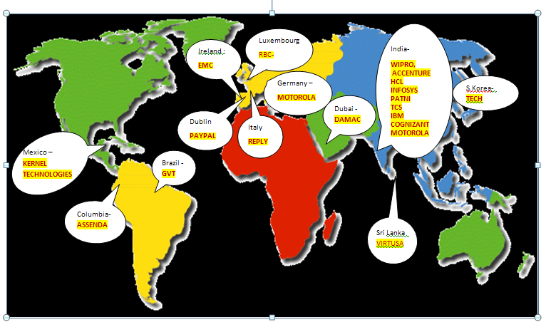
Training Clients – World Wide

Slide 4
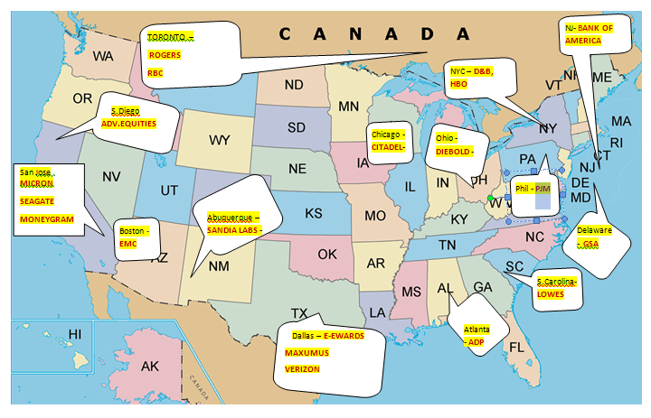
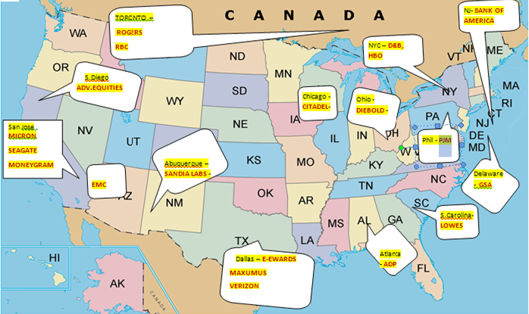
Training Clients - USA

Slide 5
Course Topics
Hadoop Distributed File System (HDFS) and Ecosystem – 4 Hours
Map Reduce – 2 Hours
YARN – 2 Hours
Hive – 8 Hours
Serialization and Deserialization in Hadoop – 2 Hours
Impala – 2 Hours
Scoop – 2 Hours
Spark Architecture and Core RDD – 2 Hours
Spark SQL – 4 Hours
Flume – 1 Hour
Cloudera Manager – 1 Hour

Slide 6
Defining Big Data
IBM’s definition – Big Data Characteristics
http://www-01.ibm.com/software/data/bigdata/
Sensor data, audio, video, click streams, log files and more
Scrutinizes 5 million trade events created each day to identify potential fraud
12 Terabytes of Tweets created each day
Volume
Velocity
Variety

Slide 7
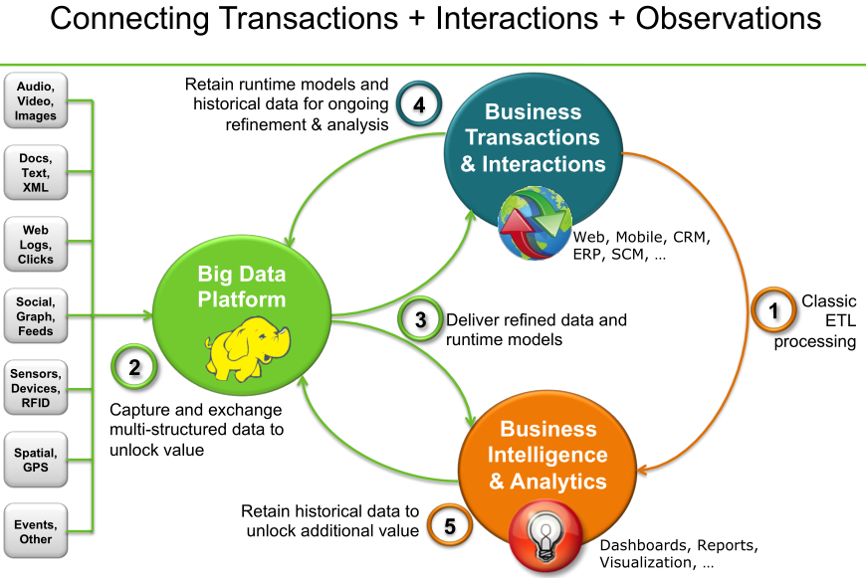

Slide 8
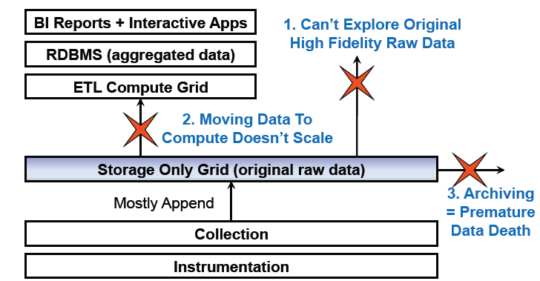
Limitations of existing Data Analytics Architecture

Slide 9
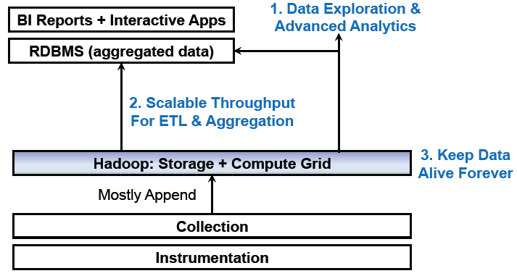
Solution: A Combined Storage Computer Layer

Slide 10
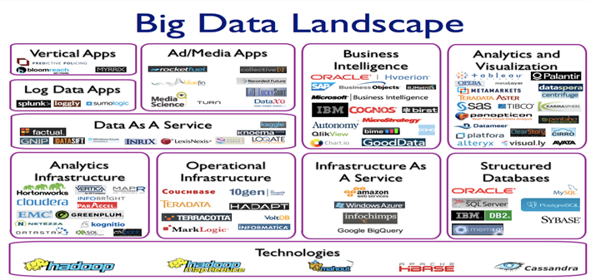

Slide 11
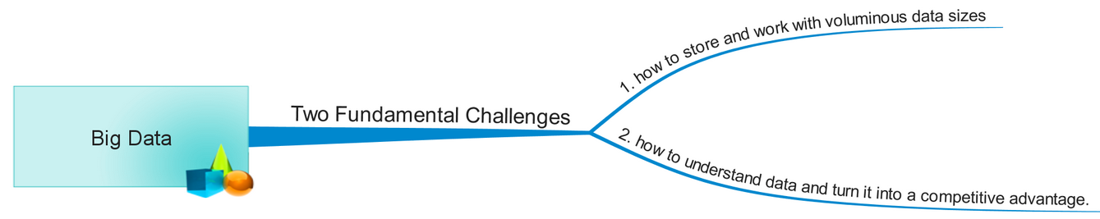
Challenges

Slide 12
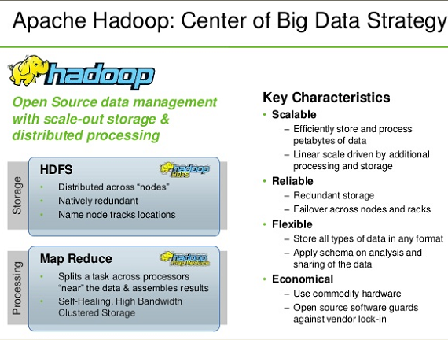

Slide 13
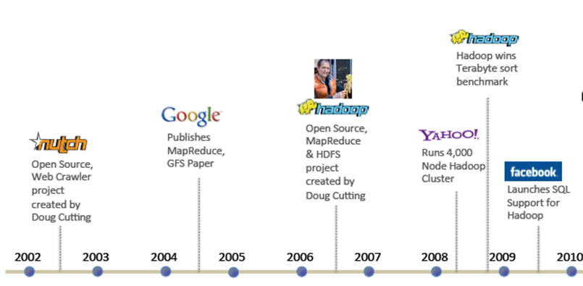
Hadoop History

Slide 14



Hadoop Distributions
Cloudera
Hortonworks
Pivotal
IBM InfoSphere BigInsights
Microsoft HDInsight

Slide 15


Why DFS?
Read 1 TB Data
1 Machine
10 Machines
4 I/O Channels
Each Channel – 100 MB/s
4 I/O Channels
Each Channel – 100 MB/s

Slide 16
Why DFS?
Read 1 TB Data
1 Machine
10 Machines
4 I/O Channels
Each Channel – 100 MB/s
4 I/O Channels
Each Channel – 100 MB/s
43 Minutes

Slide 17
Why DFS?
Read 1 TB Data
1 Machine
10 Machines
4 I/O Channels
Each Channel – 100 MB/s
4 I/O Channels
Each Channel – 100 MB/s
43 Minutes
4.3 Minutes

Slide 18
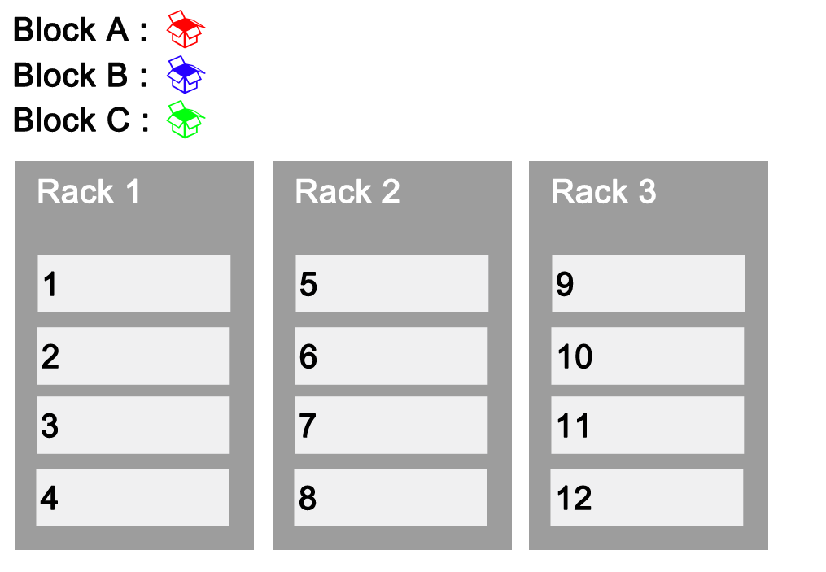



Rack Awareness

Slide 19
Clarifications
Q & A..?

