Slide 1
STUDENT PLACEMENT MANAGEMENT SYSTEM (ISRO)
PIP4004 Capstone Project
Review
Batch Number: CDV-14
ROLL NUMBER | NAMES
20211CDV0018 | RAGHAVENDRA RAKESH
20211CDV0053 | HARISH BHASKARAN
20211CDV0065 | KAVANA S K
20211CDV0068 | RUTHWICK S S
20221LDV0002 | HEMALATHA G
Under the Supervision of,
Mr. Rajan Thangamani,
Assistant Professor,
School of Computer Science and Engineering,
Presidency University, Bengaluru.

Slide 2

Contents
Introduction
Literature Review
Existing method drawbacks
Proposed Method
Objectives
Methodolgy / Modules
Tools & Technologies
Timeline of Project
Expected Outcomes
Conclusion
References

Slide 3
Introduction
Student placement is a crucial process in educational institutions, requiring secure handling of student data and effective decision-making for placements.
This project aims to develop a secure, efficient, and scalable system to manage student placement activities with MFA-based authentication, RBAC, and encrypted data storage.
It ensures that students, faculty, and placement coordinators have separate access rights and functionalities.

Slide 4
Literature Review
Sl. No. | Paper Title | Paper Author | Techniques Used | Merits | Demerits
1 | Training and Placement Cell Application | Swathi J., PriyaTharsini K., Janani S.S., Chakkaravarthy G.V. Published - May 30, 2023 | Mobile application development for placement activities | Provides mobility and ease of access; real-time notifications and updates | Platform dependency; security concerns with mobile data
2 | A Development of Web Based Placement Management System for Campus Recruitment | Sachin Shukla, and team Published - 2024 | Web-based platform integrating advanced data analytics | Streamlines campus placement procedures; enhances communication and decision-making; offers real-time tracking and personalized job recommendations. | Implementation challenges and user adoption factors are not extensively covered.

Slide 5
Literature Review
3 | Student Placement Prediction System using Machine Learning | Varsha Kailas Harihar, D.G. Bhalke Published - Nov 30, 2020 | Machine learning algorithms: MLP, LMT, SMO, Simple Logistic, Logistic classifiers | Predicts student placement performance; aids in identifying areas for student improvement | Accuracy depends on data quality; may require substantial computational resources
4 | Smart System for Student Placement Prediction | Kavya G., Pranitha Y., Sanjana A., Sirisha D.G., Mamatha A. Published - 13 July, 2021 | Machine learning models: Logistic Regression, Random Forest, SVM | Automates prediction of student placement chances; assists in candidate screening | Model performance varies; potential biases in predictions

Slide 6
Literature Review
5 | E-Training and Placement Management System | S. Padwal, S. Ghorpade, S. Patil, M. Patil, S. Biraje, S. Salunkhe Published - 2022 | Integration of training modules with placement management | Combines training and placement; provides a comprehensive platform for student development | Complexity in integrating training content; potential user adaptability issues
6 | A Concise Study on Placement Management System | A. Banu, S.K. D.M Published – 2022 | Analytical study of existing placement systems | Identifies strengths and weaknesses of current systems; provides recommendations for improvement | Lacks implementation details; theoretical focus without practical application

Slide 7
Existing method Drawback
Manual Effort and Inefficiency
Lack of Predictive Analytics
Scalability Issues
Security and Privacy Concerns
Poor Integration with Training Modules
Lack of Real-Time Notifications and Updates

Slide 8
Proposed Method
To enhance Student Placement Management System, consider the following proposed methods:
AI-Powered Shortlisting & Decision Support
Multi-Factor Authentication
Role Based Access Control
Enhanced Security and Privacy Measures
Real-Time Notifications and Alerts
Mobile Accessibility & Multi-Platform Support

Slide 9

Objectives
Multi-Factor Authentication
Role-Based Access Control (RBAC)
User-friendly interface
Store data in MySQL, PostgreSQL, or MongoDB.
High-level data security
Decision Support System (DSS)
Dashboard for placement coordinators

Slide 10

Methodology/Modules
Here’s a proposed methodology for enhancing Student Placement Management System:
Requirements Analysis
System Design
Development and Integration
Testing and Validation
User Training and Feedback
Deployment and Monitoring
Continuous Improvement

Slide 11

Tools & Technologies
Authentication - OAuth, JWT Authentication
Encryption - AES Encryption
Database - MySQL, PostgreSQL, MongoDB
Frontend - HTML, CSS, ReactJS, Javascript
Backend - Node.js, Python (Django/Flask)

Slide 12
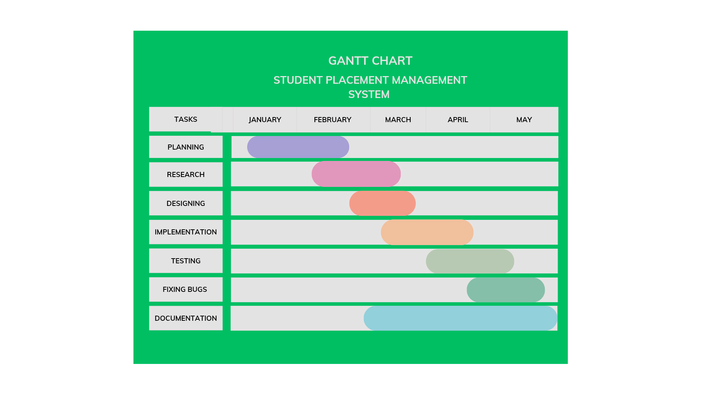
Timeline of Project

Slide 13
Expected Outcomes
A secure, scalable, and efficient Student Placement Management System.
Improved decision-making for placement coordinators via DSS.
High data security with encryption and Role based access control.
Enhanced user experience through a ReactJS-based interface.

Slide 14
Conclusion
The Secure Data Management and Decision Support System will serve as a secure and intelligent platform for student placement management.
By integrating MFA, RBAC, encryption, and a DSS, the system will provide a highly secure and effective way to manage placements, ensuring that student data remains protected while optimizing placement processes.

Slide 15

Github Link
Student Placement Management System

Slide 16
References
[1]Swathi, J., Tharsini, K. P., Janani, S. S., & Chakkaravarthy, G. V. (2018). Training and Placement Cell Application. International Research Journal of Engineering and Technology, 5(3), 316-319.
[2]Shukla, S., Shinde, S. K., Jiwatode, K., & Somvanshi, U. (2024). A Development of Web Based Placement Management System for Campus Recruitment. Journal of Advanced Database Management & Systems, 11(3).
[3]Harihar, V. K., & Bhalke, D. G. (2020). Student Placement Prediction System using Machine Learning. SAMRIDDHI: A Journal of Physical Sciences, Engineering and Technology, 12(2), 72-76
[4]Kavya, G., Pranitha, Y., Sanjana, A., Sirisha, D. G., & Mamatha, A. (2021). Smart System for Student Placement Prediction. International Journal of Advance Research, Ideas and Innovations in Technology, 7(4).
[5]Padwal, S., Ghorpade, S., Patil, P. R., Patil, M., Biraje, S., & Salunkhe, S. (2022). E-Training and Placement Management System. International Research Journal of Modernization in Engineering Technology and Science, 4(6).
[6]Banu, A., & D. M., S. K. (2022). A Concise Study on Placement Management System. International Journal of Computer Techniques, 9(2), 178-181.

Slide 17

Project work mapping with SDG

Slide 18
Thank You

